Slide 1
Food prices and trends

Slide 2
Food prices
Food prices can and do change throughout the year and over time. This may be due to a variety of reasons, including:
climate and weather patterns;
crop failure;
crop disease;
seasonality;
consumer demand;
agricultural costs increase;
fuel prices go up;
increased use of bio fuels.
What can cause food prices to change?
Discuss your thoughts with the person next to you.

Slide 3

What factors can cause food prices to change?
There are several factors which can cause food prices to change.
Climate and weather patterns
Climate change has led to more frequent extreme weather events, such as heat waves, drought and floods. These extreme weather events can destroy or damage crops, affect soil quality, deplete grazing areas and cause the loss of livestock.
This can damage stock levels and stop countries exporting to other countries, causing food prices to increase.

Slide 4

What factors can cause food prices to change?
Crop failure
Crop failure can have a significant impact on farmers, the consumer and the economy. It can affect the farmer’s income, reduce the amount of food available and potentially, negatively affect the economy of a country. Crop failure can be caused by a number of factors:
adverse climatic conditions;
unpredictable weather conditions;
pests and disease;
poor farming practices.

Slide 5

What factors can cause food prices to change?
Seasonality
Buying and eating food that is in season means that it:
is fresh;
has the best flavour, texture and colour;
has optimum nutritional value.
Seasonal food is readily available which usually means it is cheaper to buy.
If the food has been grown or reared locally, travelling and storage costs are reduced.

Slide 6


What factors can cause food prices to change?
Consumer demand
Prices can fluctuate depending on demand for a food, ingredient or piece of equipment. Seasonality and special occasions, such as summer BBQs and Mother’s Day, can influence the price of goods. For example, sausages and burgers are often cheaper in the summer to encourage consumers to buy them for BBQs but flowers are more expensive leading up to Mother’s Day.
TV programmes and social media can also influence consumer demand for ingredients, and also specialist cooking equipment, leading to reduced availability and potentially higher prices. This is now known as ‘The Delia Effect’. Delia Smith’s use of cranberries in a recipe caused a national cranberry shortage in 1995 and more recently the sales of cinnamon sticks and Marsala wine increased by 200% and 300% respectively.
The Delia Effect - Collins Dictionary

Slide 7
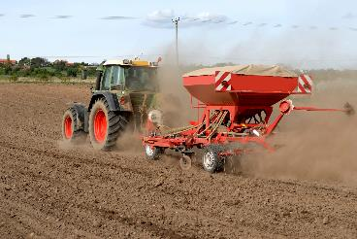
What factors can cause food prices to change?
Agricultural costs
The cost of producing the food and drink that we consume can also influence the costs of the goods at the point of purchase. Agricultural costs depend on the type and size of the farm, but often include:
farm machinery, e.g. purchase, maintenance and fuel;
farm workers, e.g. salaries, accommodation, food;
fertiliser and sprays;
livestock feed;
livestock sheds/housing;
seeds;
vets expenses.

Slide 8
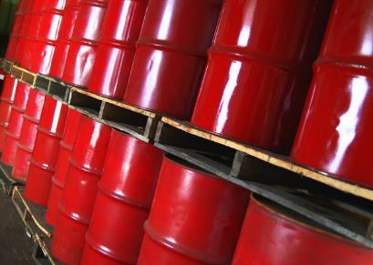
What factors can cause food prices to change?
Increases in oil and energy prices
Increases in oil and energy prices increase the production and transportation costs for agricultural commodities and food, which may lead to an increase in food costs.

Slide 9

What factors can cause food prices to change?
Biofuels
Biofuels are any kind of fuel made from living organisms, or from the waste they produce. The increased use of food such as coarse grains and vegetable oil in the biofuel industry can result in food prices rising.

Slide 10

What is the impact of changing food prices?
There are many possible consequences if food prices rise.
If people cannot afford the increased price of food, they may eat less food or switch to lower quality, cheaper foods.
Family Food 2016/17 expenditure

Slide 11

Changing food prices in the UK
More recently there has been a fall in average food and non-alcoholic beverage prices in the UK.
However, food remains the largest item of household expenditure for some households.
Family Food 2016/17 expenditure
Food Statistics Pocketbook

Slide 12
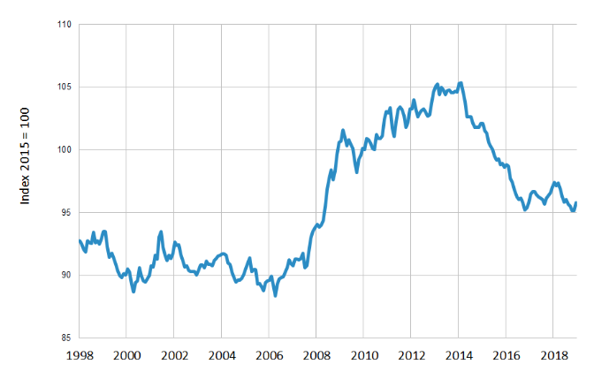
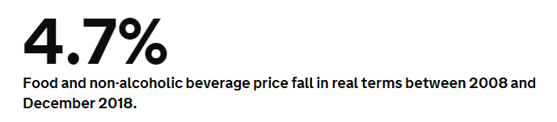
UK trend in food and non-alcoholic beverage prices in real terms
Changes in food price over time
The graph shows the changes in food price over time ‘in real terms’. When ‘in real terms’ is used, it means that the figure is adjusted for inflation - an increase in the cost of living.
Food Statistics Pocketbook

Slide 13
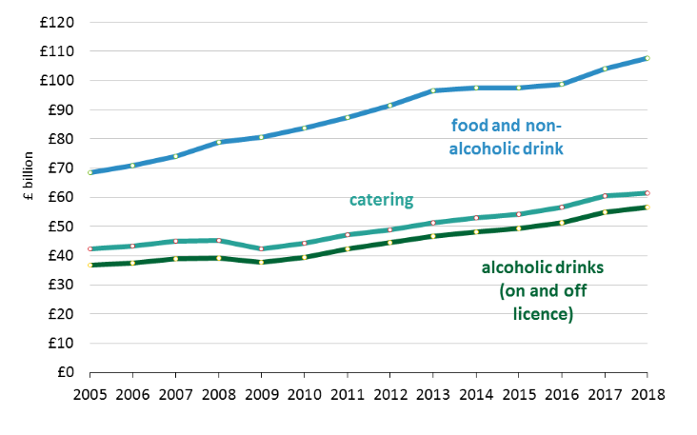
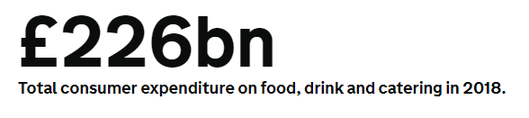
UK consumer expenditure on food, drink and catering
Mean money spent by UK consumers over time
Despite the fall in average food and non-alcoholic beverage prices, there has, however, been an increase in total consumer expenditure on food, drink and catering.
The chart shows the amount of money spent by UK consumers on food and non-alcoholic drinks, catering and alcoholic drinks per year.
Food Statistics Pocketbook

Slide 14
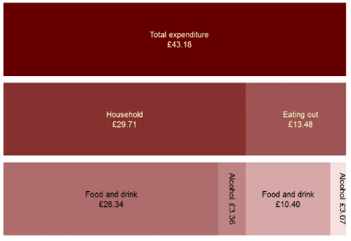
UK average weekly expenditure on food and drink
The percentage of spend on food continues to be highest for households with the lowest 20 per cent of income.
The average household spent 0.3 per cent more on food in 2016/17 than in 2014, when prices were at their highest during the last 10 years.
As shown in the chart, average UK expenditure on food and drink was £43.18 per person per week, with the majority spent on household food.
Family Food survey, 2016/17
Family Food expenditure 2016/17

Slide 15
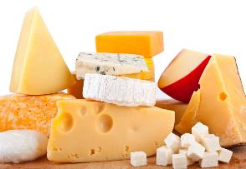

Quantities of household purchases of food and drink in the UK over the last 10 years
Dairy products
Milk purchases have generally declined (68% of milk purchases are semi-skimmed milk).
Household purchases of cheese have shown no clear trend.
Meat
Purchases of chicken have increased.
Lamb has shown a clear downward trend, whilst pork and beef have been relatively stable.
Family Food survey, 2016/17

Slide 16
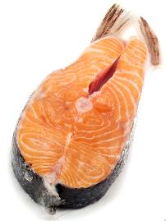
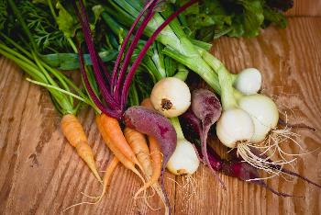
Quantities of household purchases of food and drink in the UK over the last 10 years
Fish
Household purchases of fish and fish products have fallen steadily however, purchases of salmon have shown an upward trend in recent years. Ready meals account for over one third of fish purchases.
Fruit and vegetables
Household purchases of fresh and processed vegetables (excluding potatoes) have shown no clear trend in the last 5 years, following a sharp fall.
Potato purchases continued their long term downward trend.
Family Food survey, 2016/17

Slide 17

Quantities of household purchases of food and drink in the UK over the last 10 years
Bread
Purchases of bread are on a long term downward trend, with white bread in particular falling by 35 per cent over the last 10 years.
Family Food survey, 2016/17
Family spending in the UK 2018

Slide 18
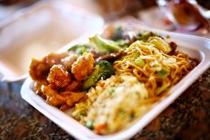
Quantities of household purchases of food and drink in the UK over the last 10 years
Takeaway food
Expenditure on takeaway foods was £2.17 per person per week in 2016/17, 23 per cent higher than in 2013.
Restaurant and café meals
The average expenditure on restaurant and café meals was £18.60 per household per week in 2018.
Family Food survey, 2016/17
Family spending in the UK 2018

Slide 19

Food prices – class activity
In groups, consider the impact of price fluctuations on a weekly food and non-alcoholic drink shop.
What changes could be put in place to reduce the impact of these changes and remain within the family budget for food and drink?

Slide 20
Strategies to reduce the impact of food price changes
The following strategies could be used to reduce the impact of food price changes:
replace branded items with cheaper, non branded (e.g. supermarket own, economy) items;
shop at different places (e.g. discount supermarkets, markets);
compare prices and shop around to find the cheapest items;
try different cooking methods that work well with cheaper cuts of meat, e.g. stewing or casseroling;
grow own food (e.g. growing vegetables in the garden);
buy items from reduced food aisles (e.g. wait until end of day when food is marked down, buy foods which are at/almost at their use by date);
purchase different types of food (e.g. canned vegetables or pulses).

Slide 21
Food price and trends
For further information, go to:
www.foodafactoflife.org.uk

