Slide 1
Types of bread

Slide 2
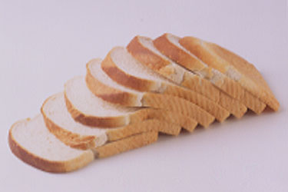
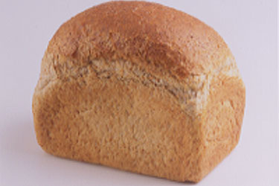
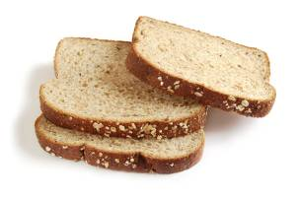
Bread types
White bread is made from flour that contains only the endosperm of the wheat grain (about 75% of the whole grain).
Wholemeal bread is made from the whole of the wheat grain with nothing taken away. Wholewheat is another name for wholemeal.
Brown bread is made from flour from which some bran and wheatgerm is removed (it uses about 85% of the whole grain).

Slide 3
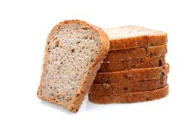
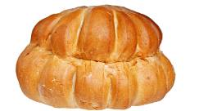
Bread types
Soft grain bread is made from white flour with extra grains of softened rye and wheat to increase the fibre content by 30% compared with standard white bread.
Sandwich loaves can be white or brown bread. They are baked in tins and have a flat top, giving even and rectangular slices.
A cottage loaf has two round sections, one on top of the other. It is believed to date back to Roman times when it was invented to make the most of the height of the oven.

Slide 4
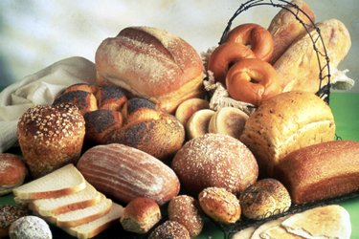
Bread types
There are a huge range of speciality breads available, originating from different cultures, e.g. pitta, naan, chapatti, ciabatta, bagels, baguettes, soda bread

Slide 5
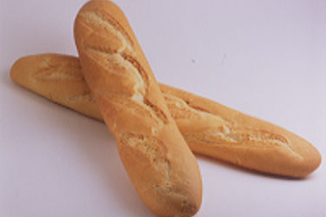
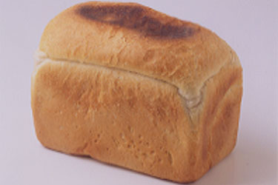
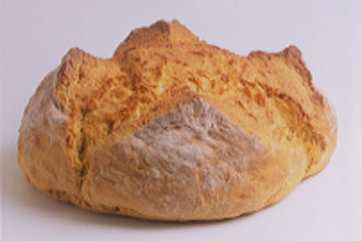
Name the bread type
Baguettes
Wholemeal tin
Split tin
Plain soda bread

Slide 6
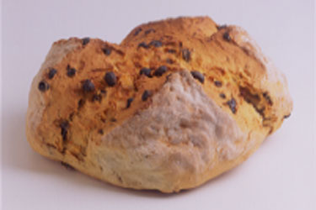
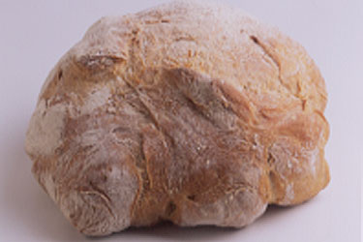
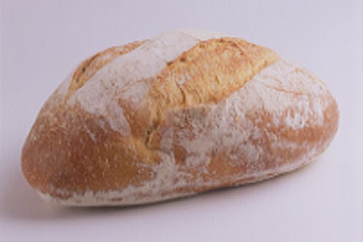
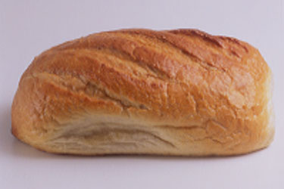
Name the bread type
Fruit soda bread
Campaillou
Sourdough
White bloomer

Slide 7
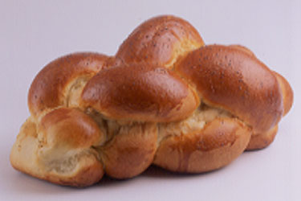
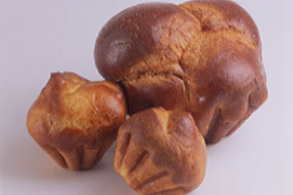
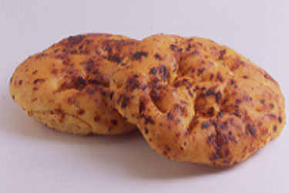
Name the bread type
Focaccia, sundried
tomatoes
Sliced bread
Chollah
Brioche

Slide 8
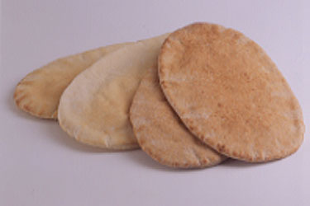
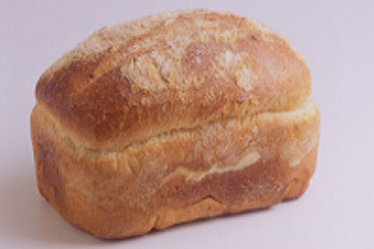
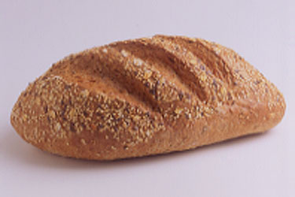
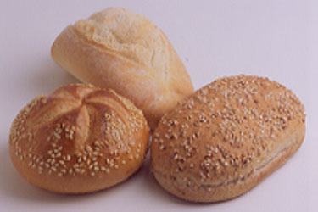
Name the bread type
Pitta bread
Batch loaf
Seed bread
Bread rolls

Slide 9
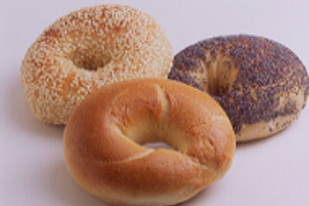
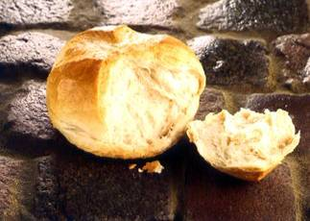
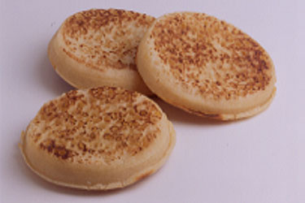
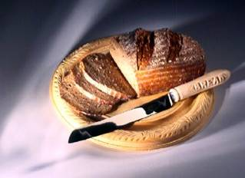
Name the bread type
Bagels
Coburg
Crumpets
Rye

Slide 10
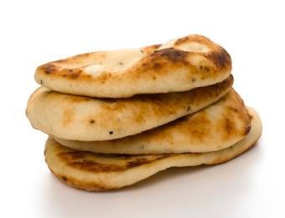
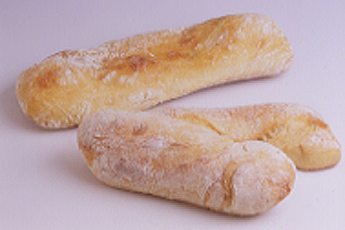
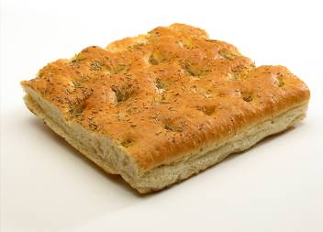
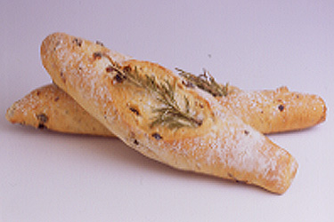
Name the bread type
Ciabatta
Focaccia
Rosemary stick
Naan bread

Slide 11
Types of bread
For further information, go to:
www.foodafactoflife.org.uk

