Slide 1
Wheat and grains

Slide 2
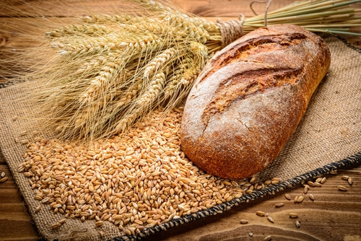
Wheat
Wheat is grown internationally, including the UK. The grain from wheat is milled to make flour.
Flour is used to make lots of different food products, such as bread, pasta, biscuits and cakes.

Slide 3
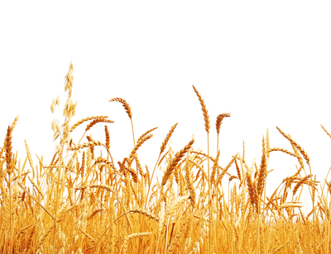
Wheat
Wheat grains are at the top of the plant. They are closely packed together in clusters - called ears.
Each ear of wheat is made up of 45-50 grains, however, this can vary depending on the type of wheat.

Slide 4
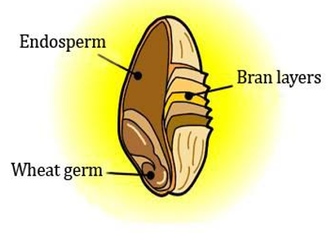
A grain of wheat
Each grain of wheat has three distinct parts.
Bran layers – the coarse outer.
Wheat germ – a new plant would grow from this part.
Endosperm (the starchy store of food which the germ feeds on while it grows)

Slide 5
Bran layers
The bran layers of the wheat grain consist of four separate layers: the pericarp; testa; nucellar layers and aleurone cells.
Bran provides protein and is used in the production of brown and wholemeal flours.

Slide 6
Wheat germ
Wheat germ contains elements of the young wheat plant, providing vitamins, protein and oil.
It is often used in health foods, for the fortification of bread and wholemeal flour.

Slide 7
Endosperm
The endosperm is the potential white flour. When milled, the endosperm fractures along the cell walls, and separates from the bran layers.
The ease of separating the endosperm is determined by the type of wheat. Hard wheats (used for breadmaking) allow easy separation, while the soft wheats (used for biscuit flours) do not separate as cleanly.

Slide 8
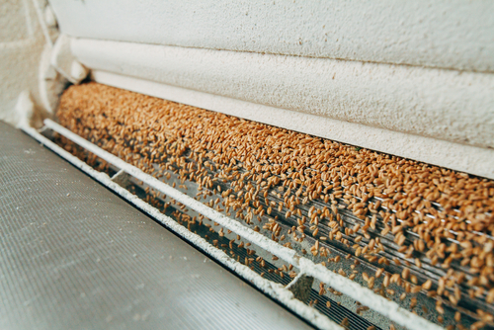
Flour types
The bran, wheatgerm and endosperm have all been separated out. They can now be blended to make different types of flour.
Wholemeal flour uses all parts of the grain.
Brown flour contains about 85% of the original grain, but with some bran and germ removed.
White flour is made from the endosperm only.

Slide 9
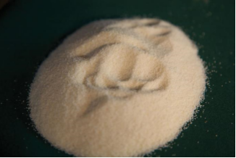
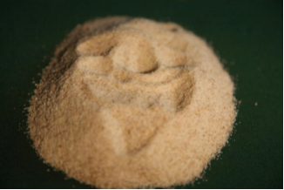
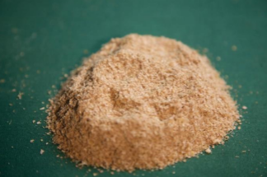
Different flours
White
Brown
Wholemeal

Slide 10
Wheat and grains
For further information, go to:
www.foodafactoflife.org.uk

