Slide 1
Dry heat

Slide 2
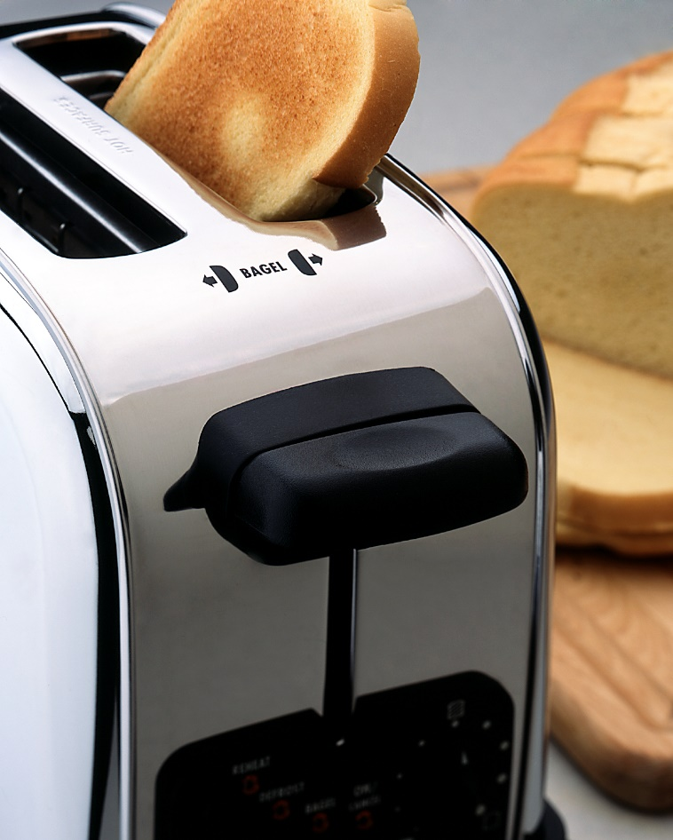
What happens when bread is toasted?

Slide 3
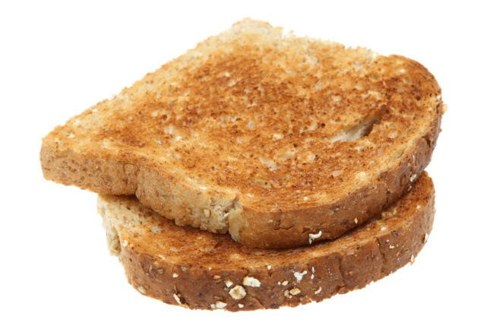
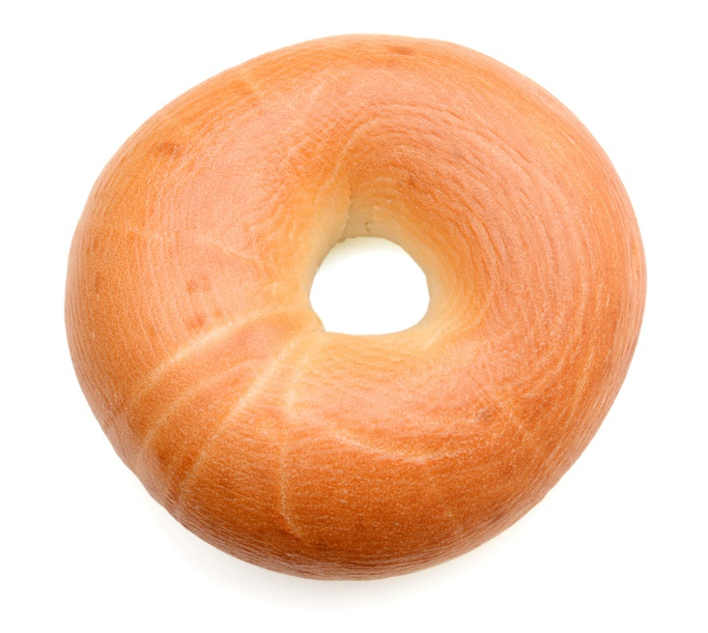
Foods which are baked, grilled or roasted undergo colour, aroma and flavour changes.
This is a result of different reactions, including dextrinisation and the Maillard reaction.

Slide 4
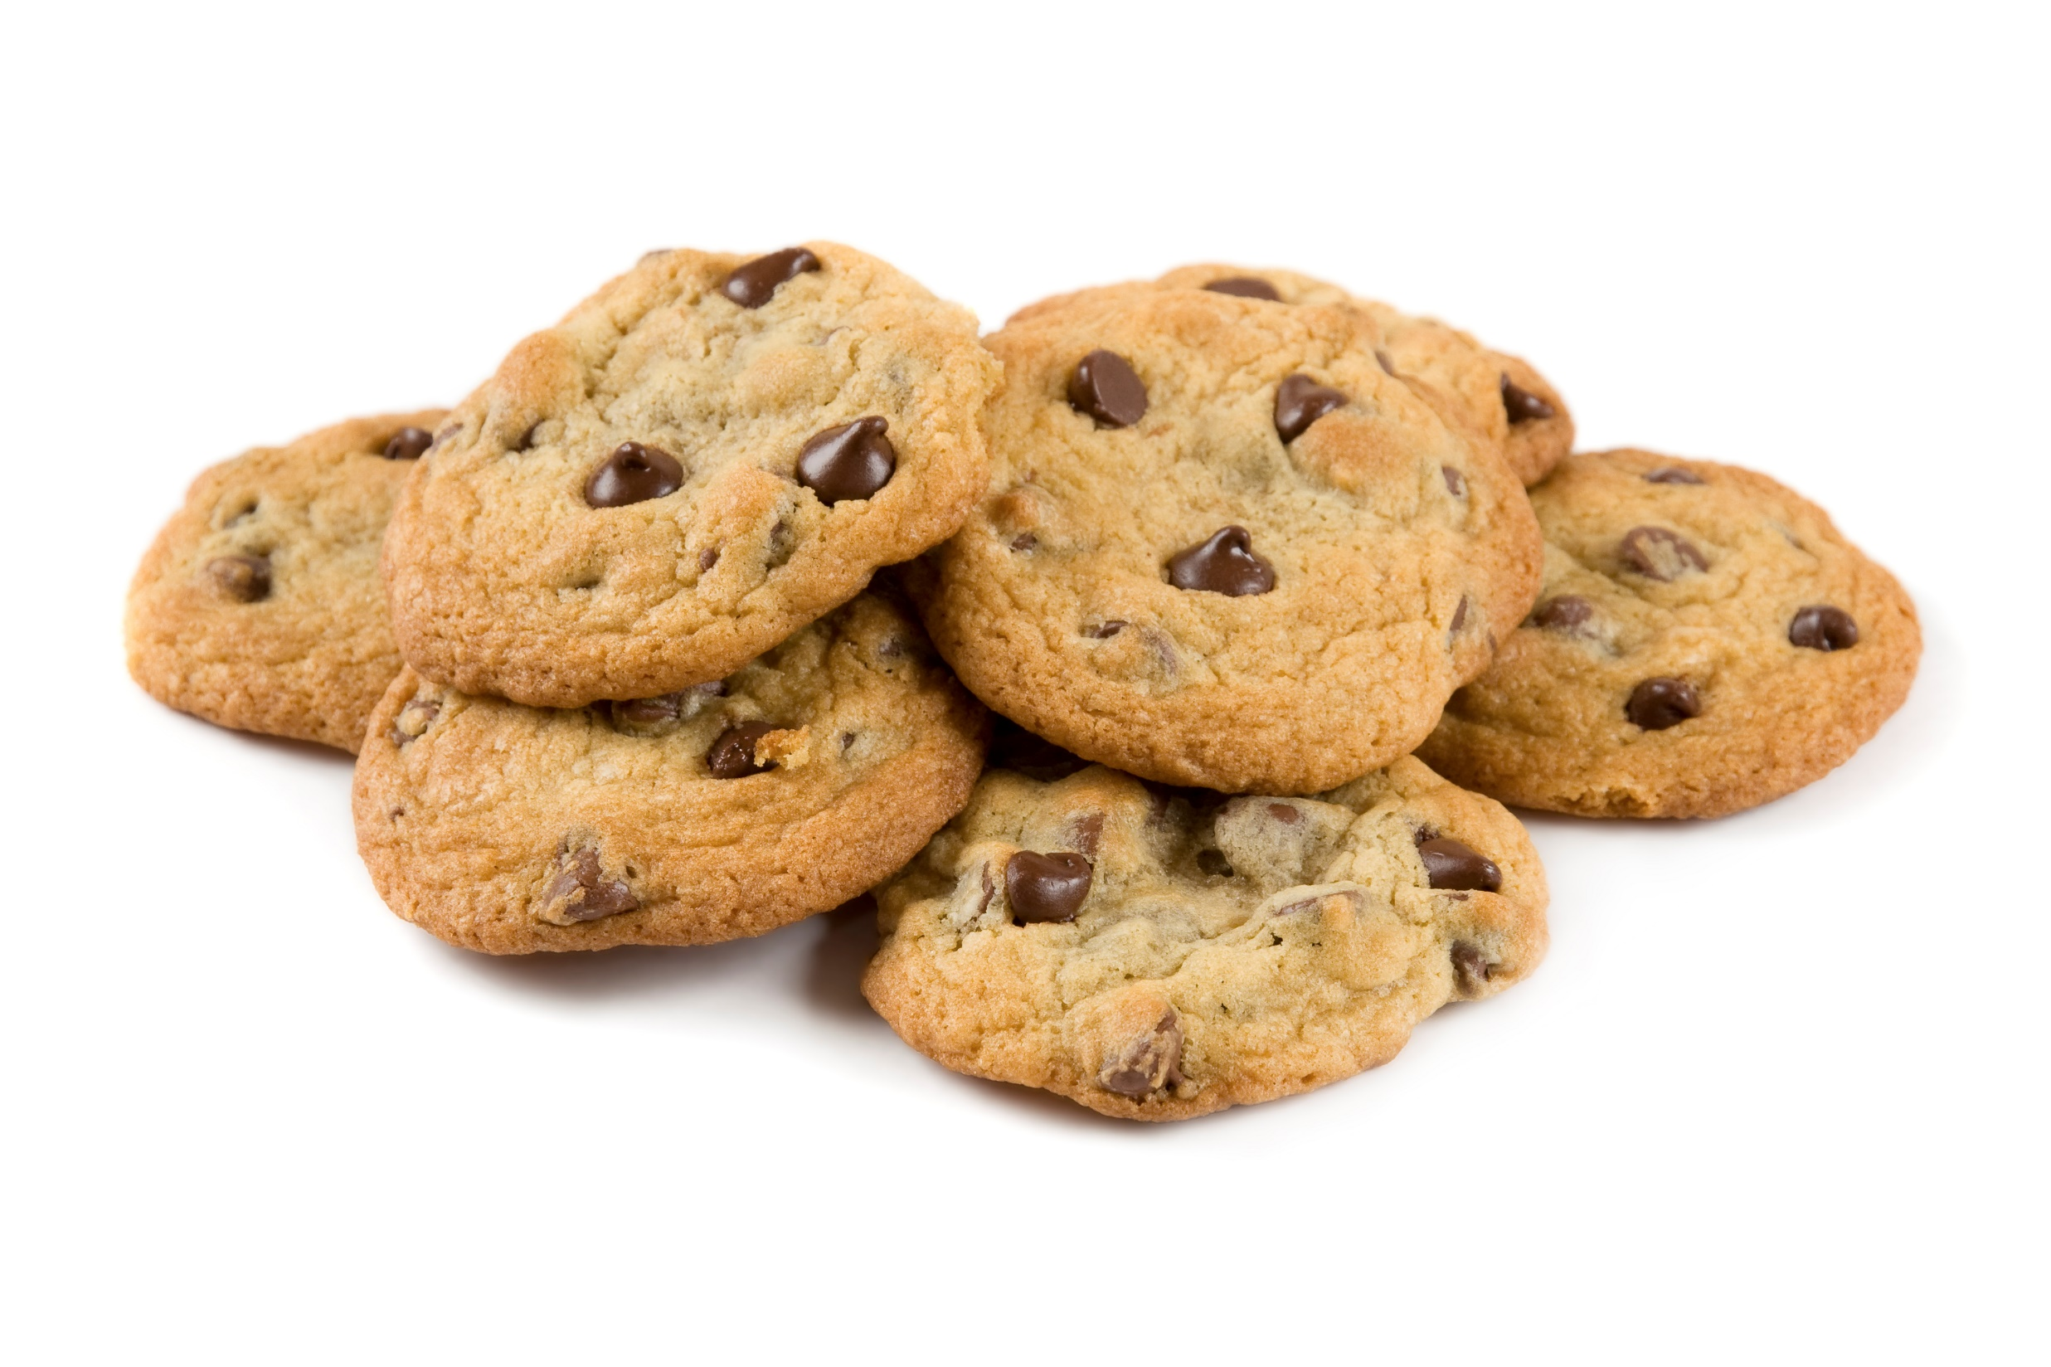
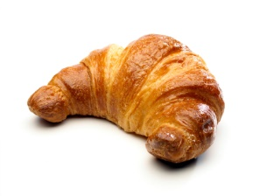
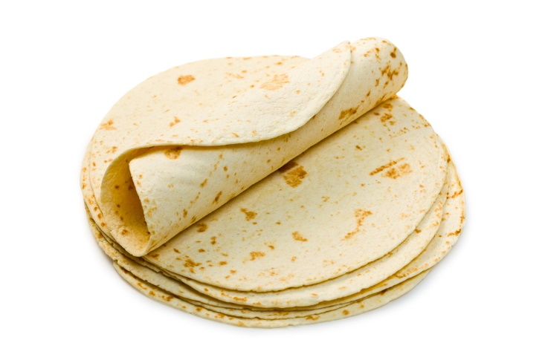
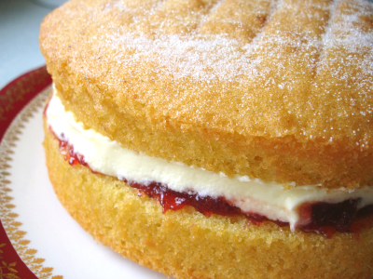
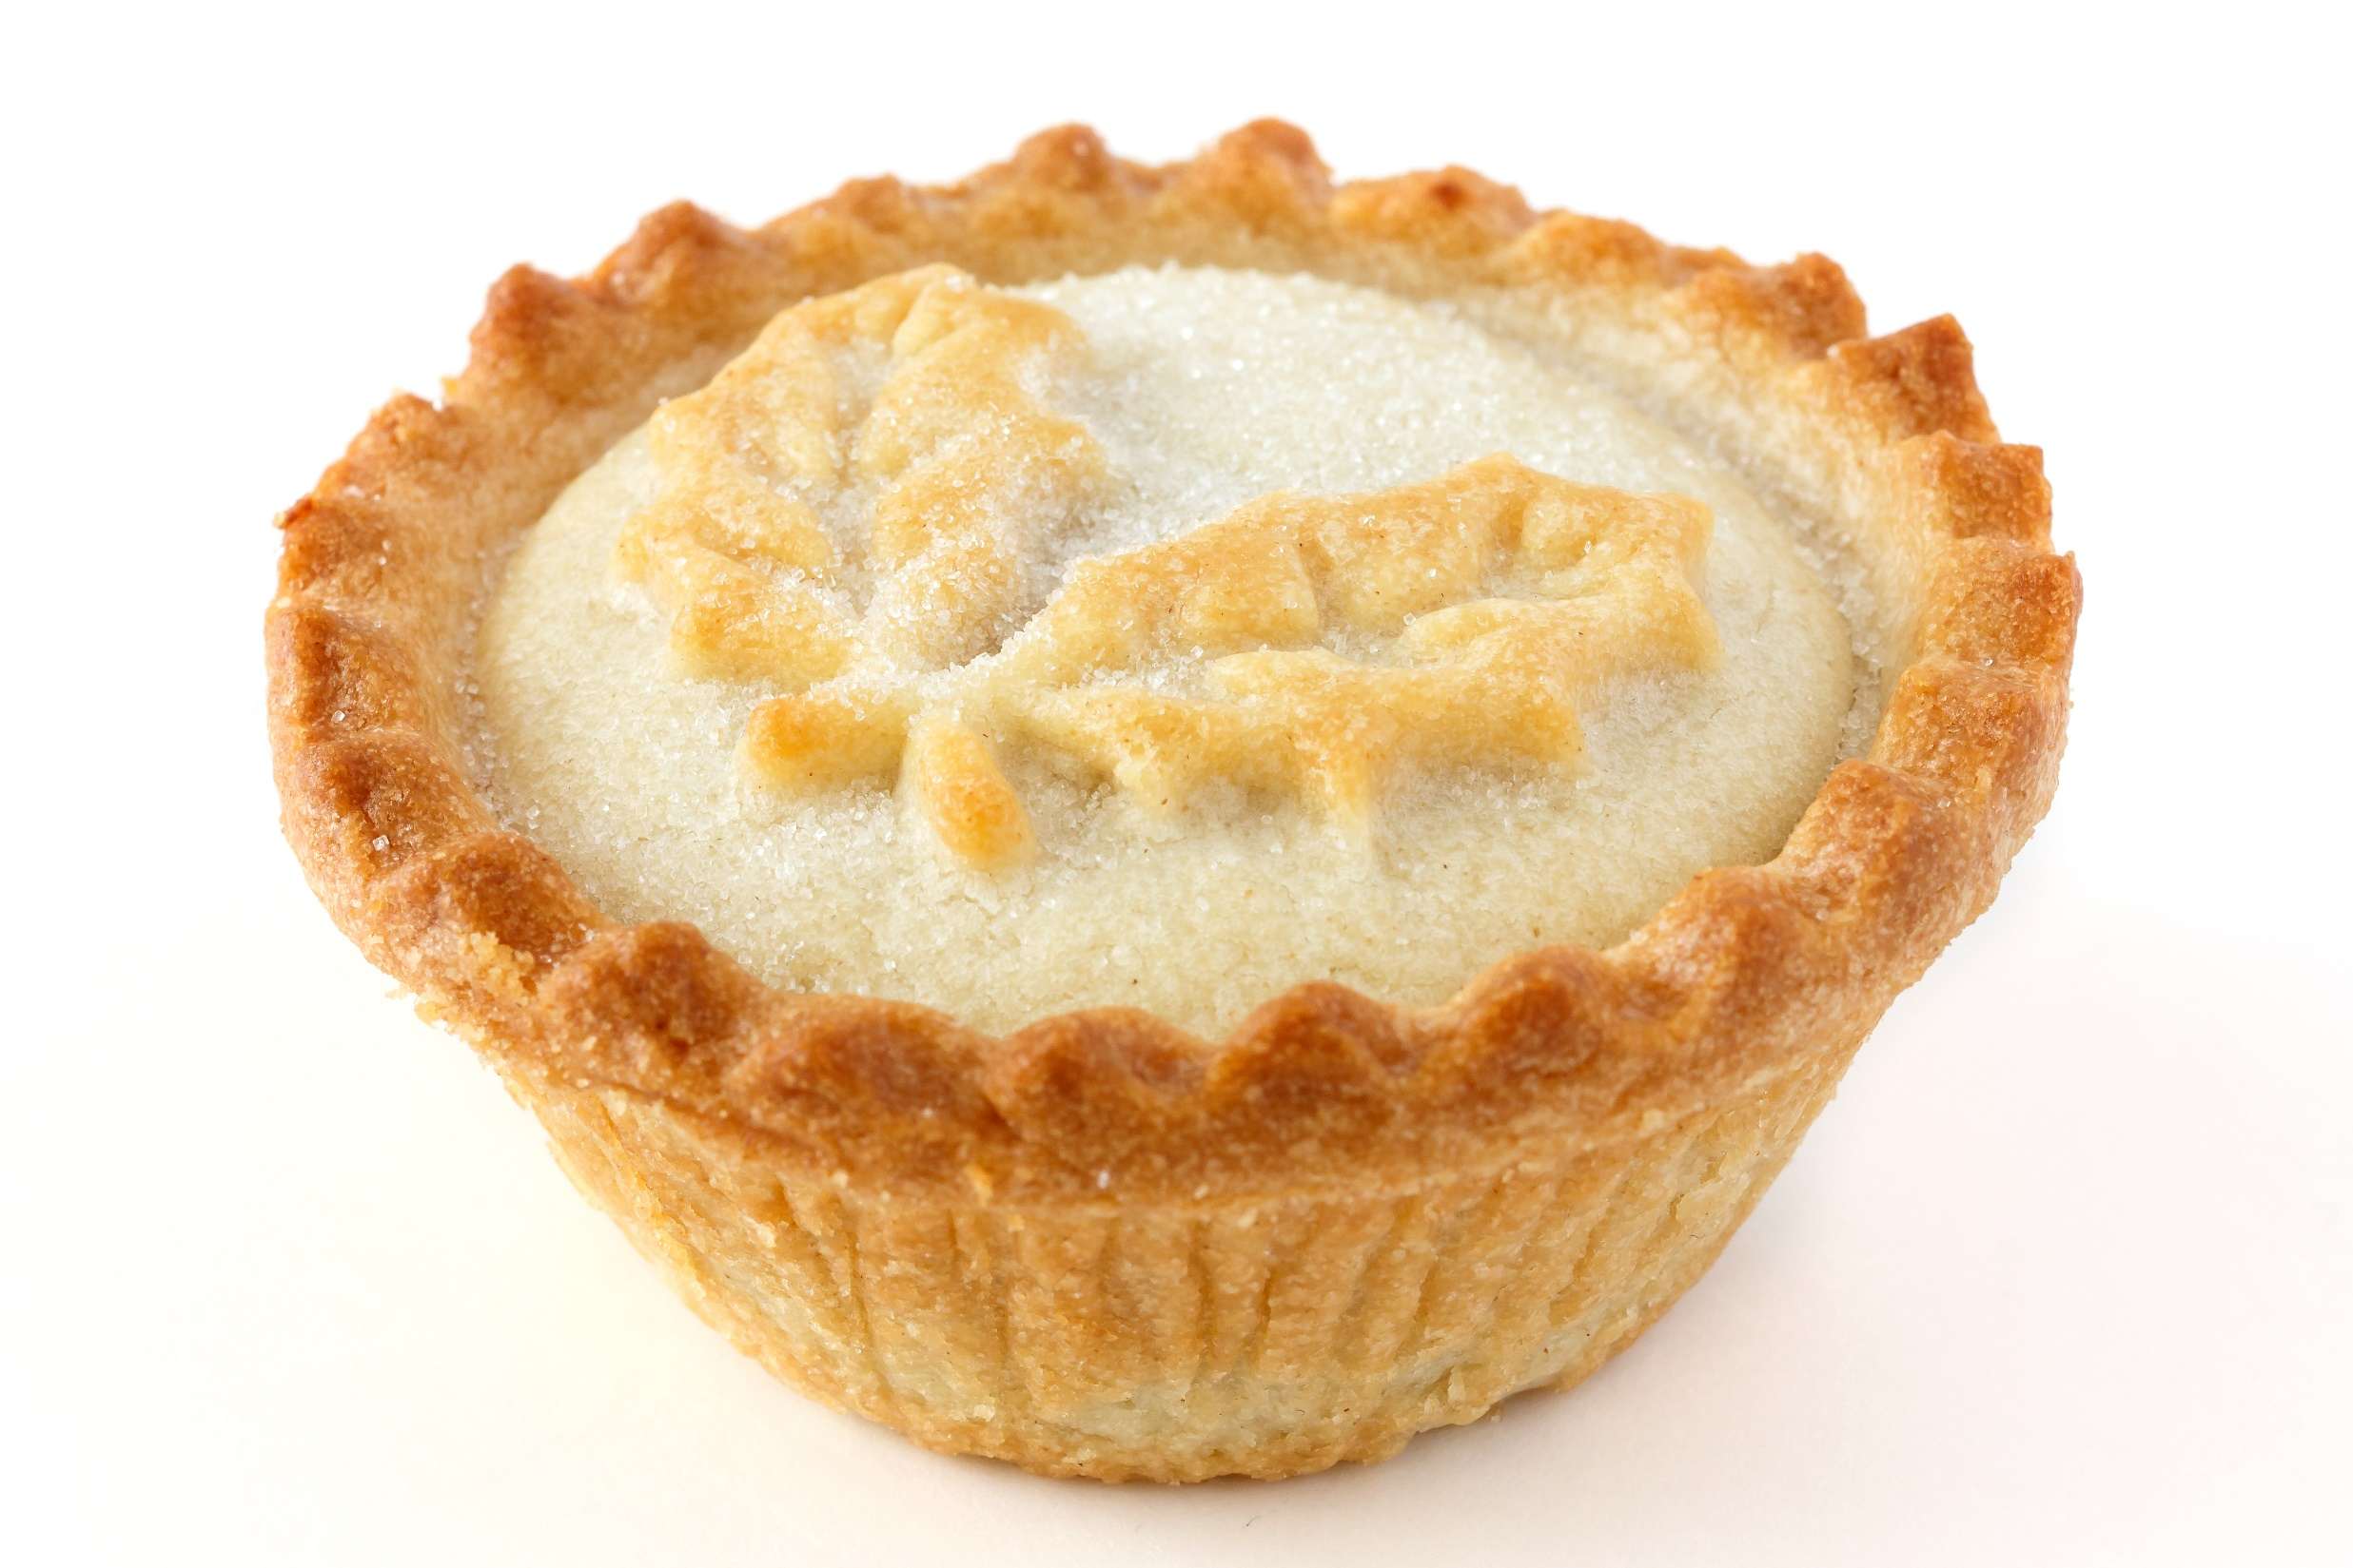
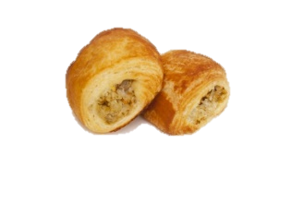
What other dishes change colour this way?
What is the connection between this food?

Slide 5
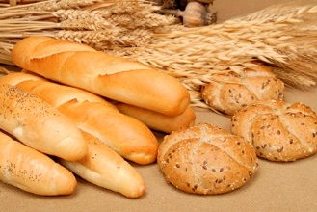
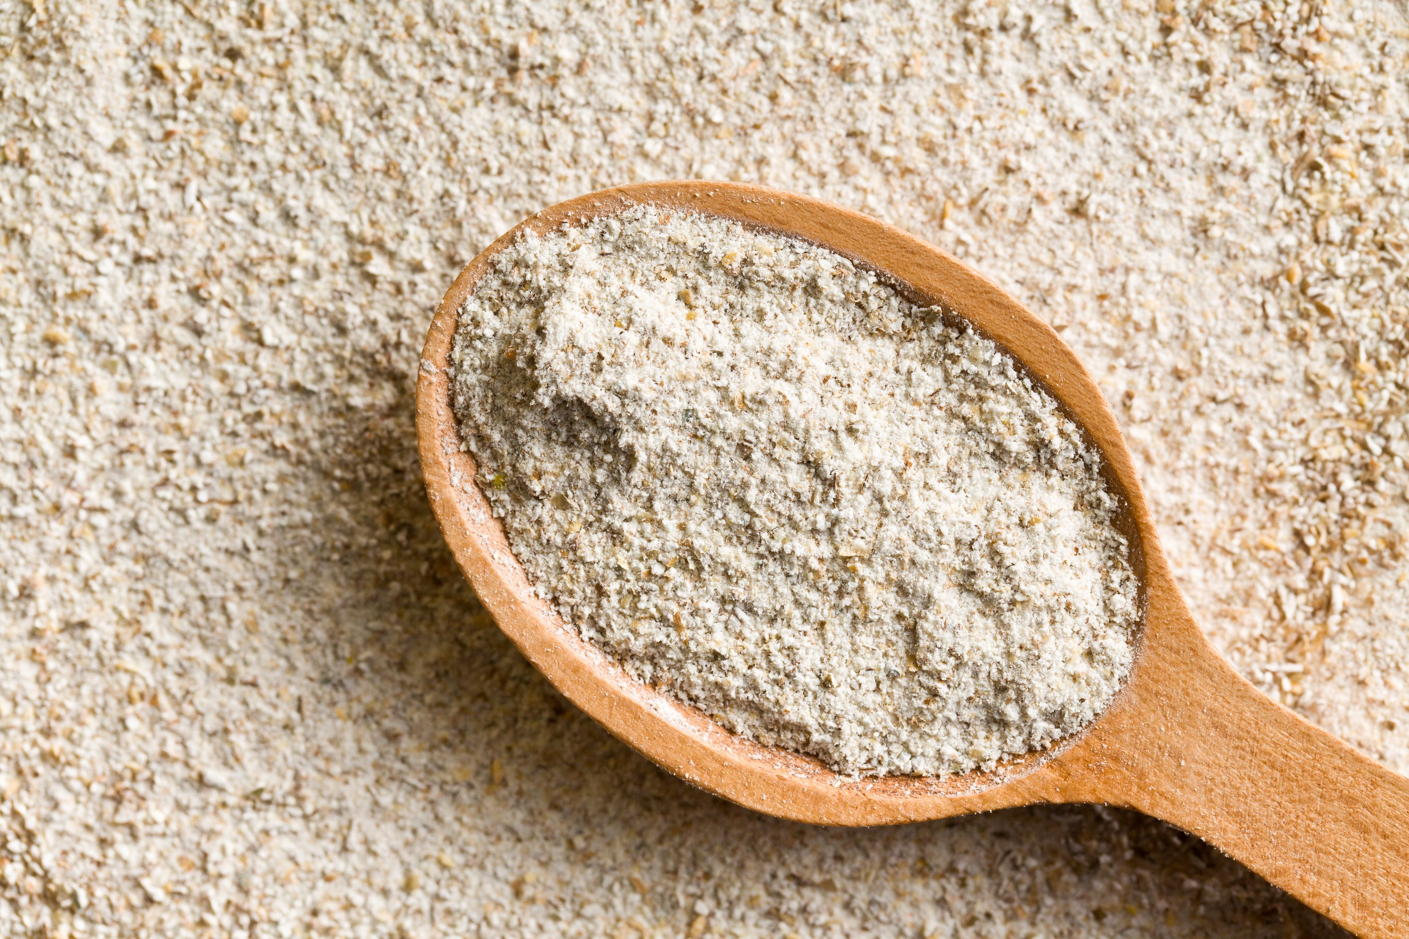
All of them are cooked through dry heat (rather than the transfer of heat through liquid).
All of them are made with starchy foods, e.g. flour

Slide 6
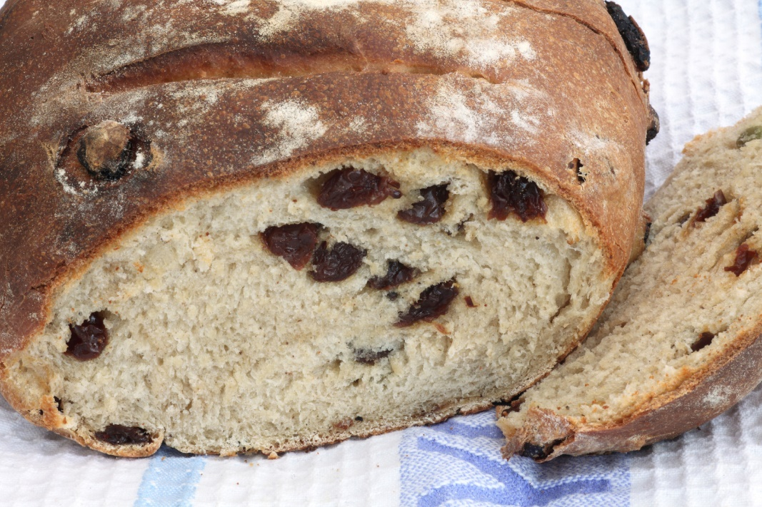
Foods which are baked, grilled or roasted undergo colour, odour and flavour changes.
This is primarily due to a group of reactions involving amino acids (from protein) and reducing sugars.
These compounds contribute to the colour and flavour of many foods such as toast, bread and croissants.

Slide 7
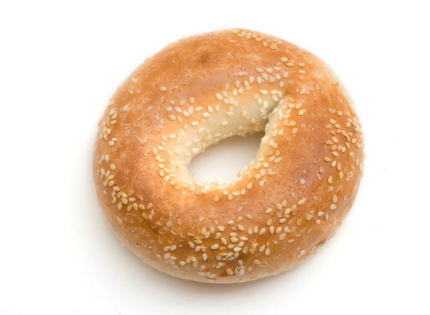
Dextrinisation also contributes to the browning of foods containing starch (when subjected to dry heat).
On dry heating, the starch in the food is broken down by heat into smaller molecules known as dextrins.
Dextrinisation contributes to the colour, aroma and flavour of many foods such as toast, bread and croissants, alongside the Maillard reaction and sometimes also caramelisation.

Slide 8
Dry heat
For further information, go to:
www.foodafactoflife.org.uk

