Slide 1
Food science of marinades

Slide 2
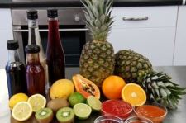
Food science of marinades
What is a marinade?
A marinade is a liquid solution in which you soak foods, particularly meat or fish, before cooking.
A marinade tenderises and adds flavour.
What is the food science?
Marinade ingredients will be acidic, such as vinegar, wine, or fruit juice, or have enzymatic components such as bromelain in pineapple, papain in papaya or zingipain in root ginger.
This allows fluids and seasonings to enter the flesh to tenderise and maintain its juiciness.

Slide 3
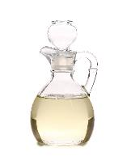
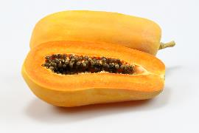
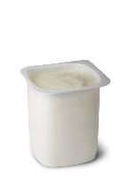
Food science of marinades
Marinades contain ingredients with functionality:
acidic ingredients contain free hydrogen ions that make them active;
enzymatic ingredients provide active enzymes;
friendly bacteria promote bacterial activity in yogurt based marinades.

Slide 4

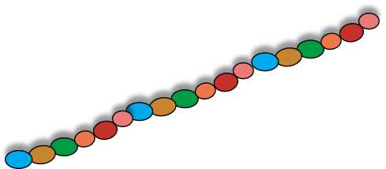
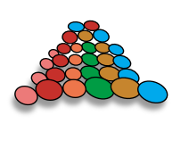
How does a protease work?
Protein enzymes are called ‘proteases’.
Protease ready for action in a marinade.
Proteases are made up from amino acids in a set sequence.
Proteases form specific shapes.

Slide 5
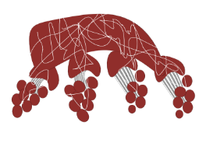
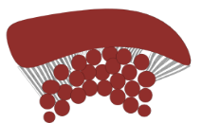
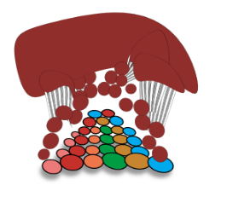

How an enzyme works in a meat marinade
Enzyme reacts with meat cube.
Enzymes change the texture of protein in meat. Meat becomes more tender and absorbs some of the marinade giving flavour and colour.
Enzyme in marinade.
1
2
3

Slide 6
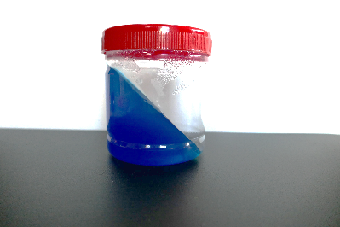

Simple experiment to show enzymic activity
Gelatin is a protein that sets liquids.
Here is a jar of liquid ‘set’ using water and gelatin.
Set

Slide 7
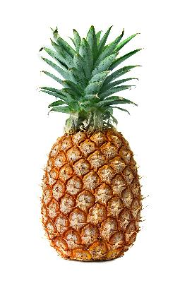
Simple experiment to show enzymic activity
Bromelain (found in fresh pineapple) prevents protein from forming a gel by disrupting the amino acids chains that proteins are made from.
Bromelain enzyme splits the peptide bonds that link amino acids thus altering their functional property and preventing gelling or setting.

Slide 8
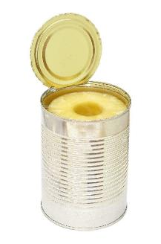
Simple experiment to show enzymic activity
Enzymic activity needs control:
by timing the immersion in the enzymic marinade mixture – length of time meat is marinated for;
by cooking to a temperature high enough to render the enzymes inactive, e.g. high temperatures used in the canning process (canned pineapple does not prevent protein forming a gel in the same way as fresh).

Slide 9
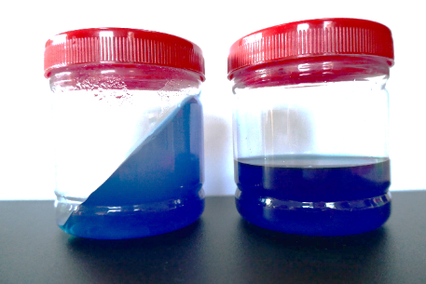

Simple experiment to show enzymic activity
Compare jar I using water to jar 2 with added 1 tablespoon fresh pineapple juice
No set
Set
Jar 1 – water and gelatin
Jar 2 – fresh pineapple juice added

Slide 10
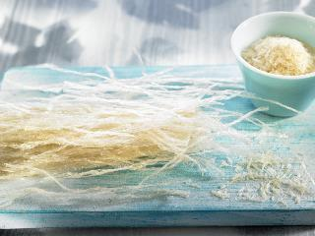
Simple experiment to show enzymic activity
What about using vegetarian gelatin?
Vegetarian gelatin is usually made from agar-agar which is derived from seaweed and not animal protein. Therefore, the enzyme bromelain in the fresh pineapple doesn’t react in the same way and the gel can still be formed.

Slide 11
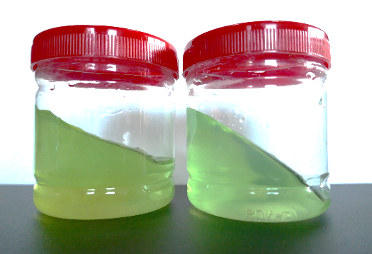
Simple experiment to show enzymic activity
Vegetarian gelatin made with tap water only.
Water and
vegetarian gelatin with 1 tablespoon added fresh pineapple juice.
Set
Set

Slide 12
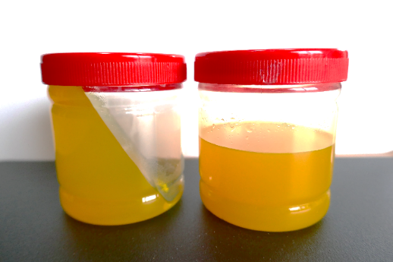
Why not try this yourself?
Equipment:
range of jars;
gelatin leaves;
agar agar powder
or flakes;
food colours;
water;
Juicer;
sieve;
tablespoon.
Selection from:
root ginger;
Canned pineapple;
fresh pineapple;
fresh orange;
papaya;
lemon.

Slide 13
Food science of marinades
With thanks to Barbara Monks, thecookeryteacher.com
For further information, go to:
www.foodafactoflife.org.uk

