Slide 1
Meat storage, preparation and cooking

Slide 2
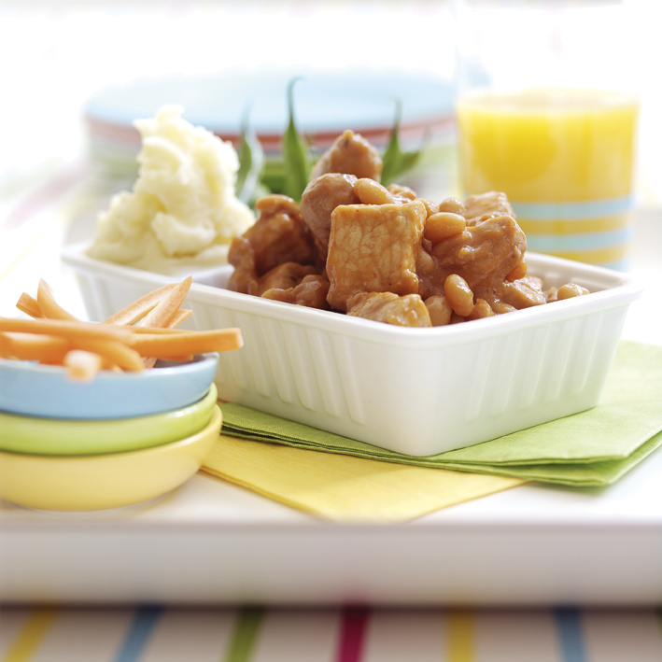
Introduction
All food needs to be stored and prepared safely. New developments in preservation and packaging of meat have led to a greater variety and range of fresh meat and meat products.
Preservation and packaging can help to prevent food deterioration and food poisoning. For wise consumers, this is economical and reduces food wastage.
A sound knowledge of different preparation and cooking techniques for meat will also improve the quality and flavour of products and meals.

Slide 3
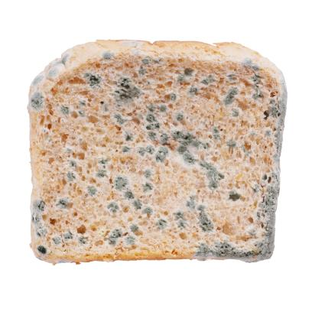
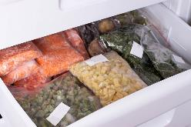
Food spoilage
Food becomes spoiled when it loses water and dries out or bacteria that have an unpleasant flavour or smell grow and multiply. All food contains a quantity of water - the longer the food is exposed to air the more water it will lose due to evaporation.
Covering and packaging foods with suitable materials slows down water loss.
Preservation methods such as vacuum sealing or deep-freezing also prevents water loss.

Slide 4
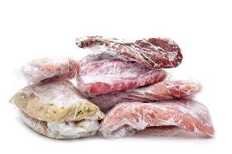
Preventing food spoilage
If raw food is cooked for a sufficient length of time, enzymes and most micro-organisms are destroyed.
However, if cooked food is stored for any length of time, it can become re-contaminated by micro-organisms which will then start to cause deterioration.
To prevent this, all raw and cooked food needs to be handled hygienically and must be properly packaged. It must then be stored at the correct temperature to prevent the action and multiplication of micro-organisms. Raw and cooked meats should be stored in the refrigerator between 0-3°C. This should be covered and stored away from other fresh foods in the refrigerator. For extended shelf life meat needs to be frozen.

Slide 5
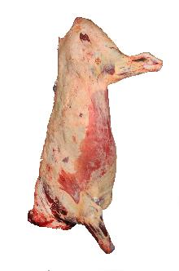
Shelf life of meat
If the carcase is hygienically prepared, the following minimum carcase storage life can be expected:
beef and veal up to 21 days;
lamb up to 15 days;
pigs up to 14 days;
offal up to 7 days.
For retail refrigerated display options, the shelf life of 1-2 days is normal.
overwrapped – shelf life 1-2 days.
Modified Atmosphere packs – shelf life 7-10 days.
vacuum packed – shelf life of up to 10 days.

Slide 6
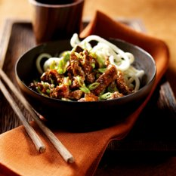
The shelf life of food
The length of time that a food will maintain its quality and be safe to eat is called its ‘shelf life’.
The shelf life of foods depends on:
● water;
● acidity;
● hygienic handling;
● methods of preservation.

Slide 7
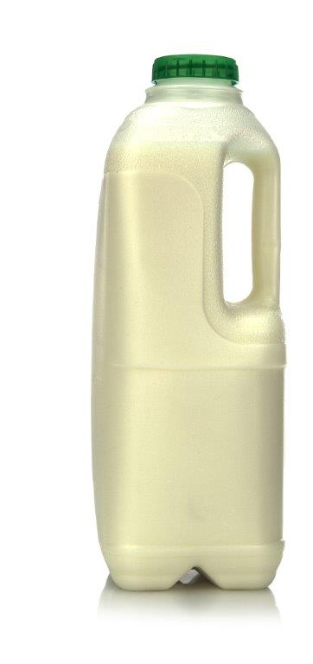
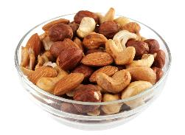
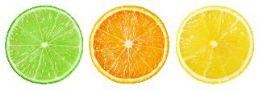
The shelf life of food
Water
Food which contains a lot of water often has a shorter shelf life, e.g. milk. Food containing little water tend to have a longer shelf life, e.g. nuts.
Acidity
Food which is acidic (or have a low pH) tend to keep for longer, e.g. citrus fruit.

Slide 8
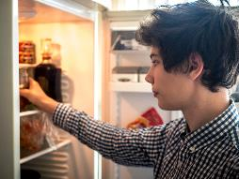
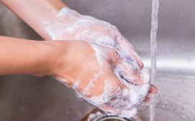
The shelf life of food
Storage conditions
Food which is correctly wrapped and kept at low temperatures will keep for longer.
Hygienic handling
Unhygienic food handling will reduce the shelf life of food. Food can be contaminated by micro-organisms in several ways: through contact with unhygienic equipment, surfaces, or transport, and through human contact.
It is important for food handlers to wash their hands before, in between and after handling raw meat. The use of colour coded chopping boards and clean knives will help reduce the spread of bacteria.

Slide 9
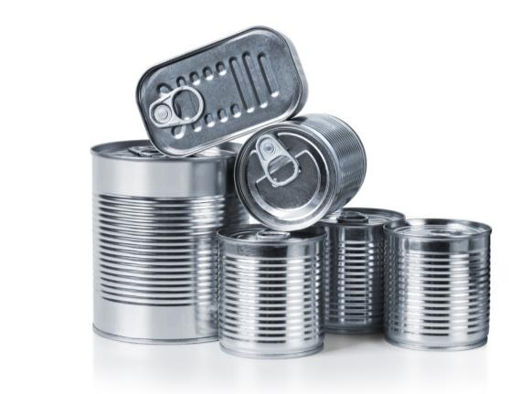
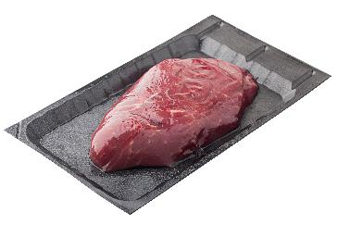
Methods of preservation
Foods can be preserved in several ways:
the removal of oxygen or water;
cooking to high temperatures;
airtight sealing and freezing at low temperatures.
Foods which have been preserved have a longer or extended shelf-life. This includes canning, e.g. meat pies and hot dogs and salting or curing, e.g. bacon and ham.

Slide 10
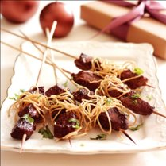
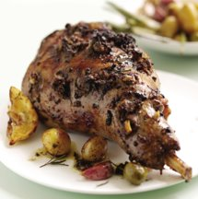
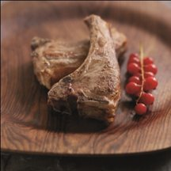
Cooking meat
There are three main methods of heat transfer normally used for cooking meat . These are:
convection;
conduction;
radiation.
Which cooking methods are used for the meals shown?

Slide 11
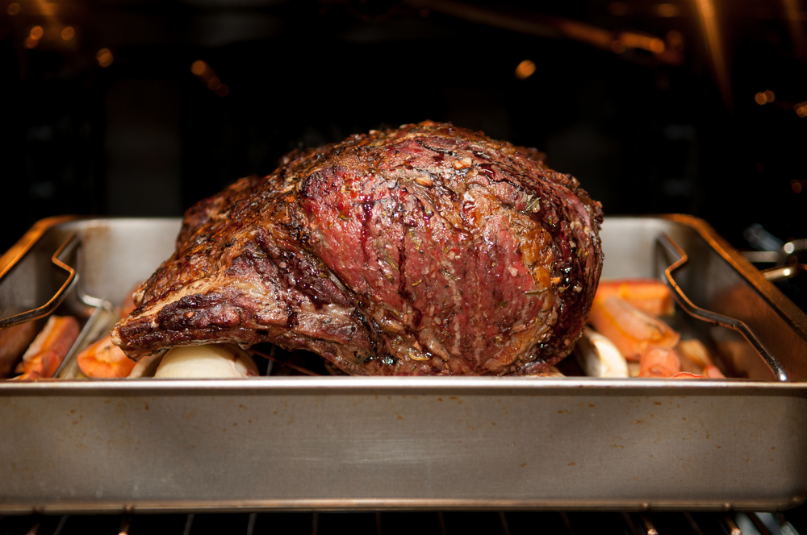
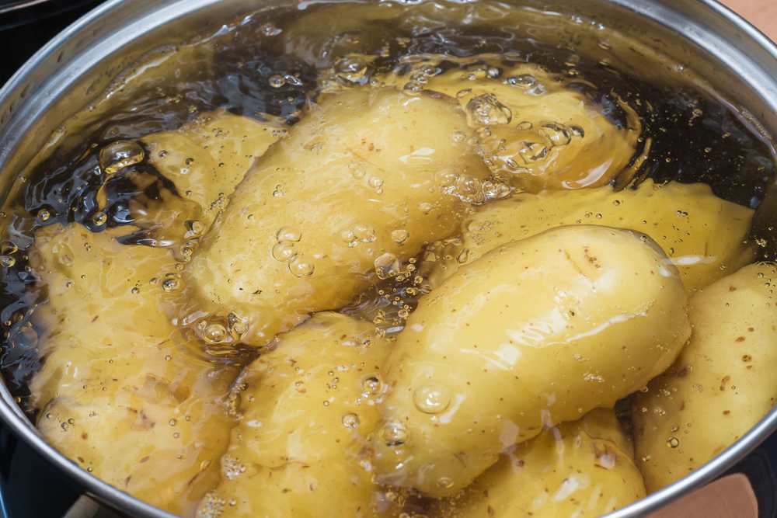
Convection
In this method of cooking, currents of hot air or hot liquid transfer the heat energy to the food.
When gases (such as air) or liquids (such as water) are heated the molecules expand, become lighter in weight and so rise up.
Cooler and heavier molecules in the gas or liquid fall to take their place – until they also become heated and rise up.

Slide 12
Convection
Because the molecules of gas or liquid are constantly being heated and keep moving, circular convection currents are created.
Food which is placed in such a liquid or gas in an enclosed space becomes cooked. This happens because the heat from the convection currents is transferred from the air or liquid, firstly to the outside part of the food then gradually through to the centre.
For efficient and quicker cooking, convection currents in air need to be kept in an enclosed space such as an oven. As hot air rises, cooler air falls – so the hottest part in an oven is at the top. Some ovens are fan assisted so that the hot air is driven around the oven to keep the temperature even from the bottom to the top.
One example of convection in meat cookery is roasting.

Slide 13
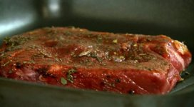
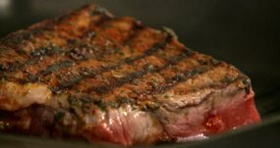
Conduction
In this method of cooking, heat is transferred through solid objects by the vibration of heated molecules.
Those molecules nearest to the heat source first become heated and vibrate.
Molecules next to those already vibrating also start to vibrate – so that a chain reaction is set up.

Slide 14
Conduction
In this way the heat is transferred throughout the food until it becomes hot. Heat is transferred by conduction in cooking methods using hot fat, hot water or steam.
The heat is firstly conducted from the fuel source to the cooking container (usually made of metal – a good conductor of heat). The container in turn heats the cooking medium (fat, water or steam) and finally the food.
Cooking by conduction depends on good contact between the:
source of heat;
cooking equipment;
food to be cooked.
Examples of conduction in meat cookery include stir frying and shallow frying.

Slide 15
Radiation
In this method of cooking, heat is transferred from a heat source in the form of rays which travel quickly in straight lines.
Food placed in the path of the rays quickly absorbs heat.
The surface of the food nearest to the rays becomes quickly browned – and regular turning of the food is needed to ensure even cooking.

Slide 16
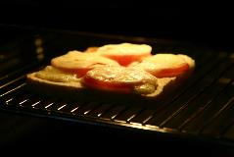
Radiation – heat rays
Heat rays from gas or electric grills travel down onto the food below. The further away the food, the further the heat rays have to travel – so foods cook more slowly.
The grill can be controlled by turning down the heat source(s) so that food cooks more slowly.
The grill pan or the metal grid can also be lowered to move the food further away from the heat rays. Heat rays from a charcoal grill or barbeque travel upwards to cook the food placed above on a grill or spit.

Slide 17
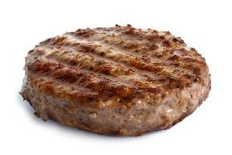
Radiation
Radiant heat is fierce, and food can be come dry and overcooked. So the heat must be carefully controlled, and the food regularly turned.
Without careful control of radiant heat thicker pieces of food can burn on the outside before the inside is cooked.
This method is most suitable for thinner, flatter, tender meat cuts.
Examples of radiant heat in meat cookery include barbequing and grilling.

Slide 18
Preparing and cooking meat to improve tenderness
The tenderness of meat depends on the:
structure of the meat muscle;
age of the animal before slaughter;
part of the animal meat muscle comes from;
the method of preparation and choice of cooking method.

Slide 19
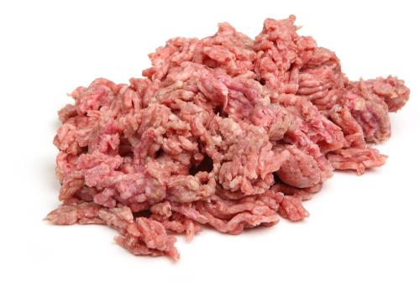
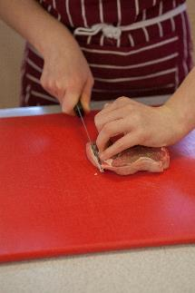
Tenderising meat with physical force
It is possible to increase the tenderness of meat by using special food preparation techniques before and during cooking.
The muscle fibres can be physically broken down by mincing and chopping.
The muscle fibres can be physically separated by using a meat hammer with a spiked edge. Butchers use this method to prepare quick-frying steaks.

Slide 20
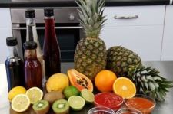
Tenderising meat with enzymes
Certain enzymes contained in plants can be used to tenderise tougher cuts of meat. These enzymes work by partly breaking down protein and connective tissue.
Natural plant sources of enzymes can be used as tenderisers:
bromelin in fresh pineapple;
papin in paw-paw;
ficin in fresh figs.
Commercially prepared tenderisers are usually in the form of powders for easy sprinkling.

Slide 21
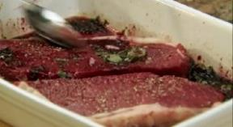
Tenderising meat with a marinade
Tougher cuts of meat can be placed in a marinade, covered and stored in a refrigerator for several hours, or overnight.
This helps to hydrate (keep water in) the muscle fibres and to convert collagen to gelatine.
Marinades usually contain an acid such as lemon juice, tomato, vinegar or wine.

Slide 22
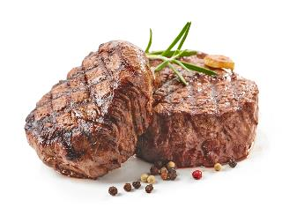
Tenderness during cooking
One important reason for cooking meat is to make the muscle fibres more tender.
The method by which meat is cooked will affect its tenderness and texture.
During cooking muscle fibres coagulate (shrink and harden). When this happens water is squeezed out and the meat shrinks in size.

Slide 23
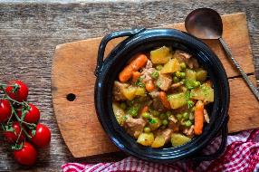
Cooking meat in liquid
To prevent toughening and the loss of liquid from meat, it can be cooked slowly in liquid.
When meat is cooked with liquid, known as a moist cooking method (such as stewing, braising and casseroling) the shrinkage and toughening of meat muscle happens more slowly.
Long, slow methods of cooking using liquids converts collagen in connective tissue to gelatine, making the meat tender. Moist cooking methods are especially suitable for less tender meat which contains more connective tissue.

Slide 24
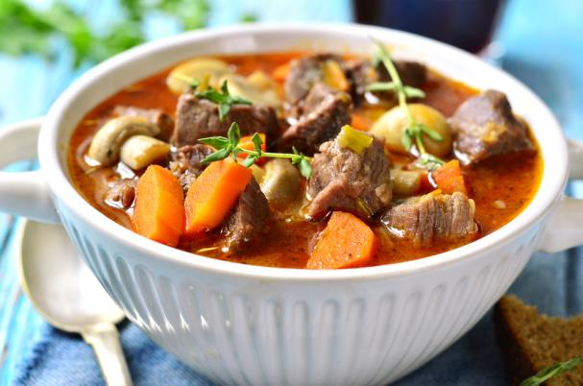
What happens during cooking?
Long cooking – on a low heat, in a liquid - will help make tougher meats tender. At temperatures of 80ºC and above the collagen is softened and converted to gelatine (which is soluble).
Muscle fibres cooked in this way fall apart easily and are easier to chew.
Acid ingredients (such as wine, lemon juice and tomatoes) added to the liquid during cooking aid the conversion of collagen to gelatine and add flavour.

Slide 25
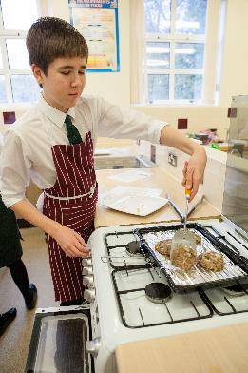
Reducing the fat content of meat dishes
During cooking the fat present in meat starts to melt. For healthy meat meals a grill or trivet used in dry cooking methods helps the fat to drip away into the cooking container. The melted fat also helps to stop the surface of the meat from getting too dry.
In moist methods of cookery, the fat melts into the cooking liquid and eventually rises to the top. For healthy meat dishes this fat can be skimmed off with a spoon.

Slide 26
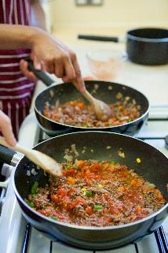
Preparing dishes with improved flavour
Cooking meat increases the flavour through the Maillard reaction and melting the fat. In dry methods of cooking the products of the Maillard reaction are greater and cling to the meat surface. In moist methods of cooking they are absorbed into the cooking liquid.
Extractives contain soluble flavour compounds, which are stronger in meat muscle from older animals and from muscle areas used the most. This can provide a depth of flavour to the dish or meal.

Slide 27
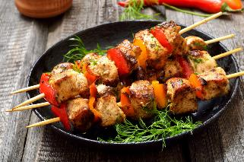
Preparing dishes with improved flavour
Fat contains flavouring compounds which release characteristic smells associated with lamb, beef and pork during cooking. The melted fat also helps to crisp the surface of cooked meat which increases the flavour.
Apart from the development of natural meat flavours, cooking helps the absorption of any flavourings such as herbs and spices added during cooking.

Slide 28
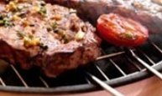
Colour changes during preparation
When meat is cooked the colour changes from red to brown.
Meat muscle contains a protein called myoglobin (similar to haemoglobin) which gives meat its red colour. Immediately after cutting, meat is a purple colour, which turns to bright red after about thirty minutes as myoglobin takes on oxygen to form oxymyoglobin.
After several days of exposure to air the surface of meat turns a brownish colour as the myoglobin oxidises to become metmyoglobin.
During cooking all these pigments are denatured and the meat will take on a brownish colour throughout.

Slide 29
Summary
Food preservation is important to increase the shelf life of products.
Shelf life depends on: water; acidity; hygienic handling; methods of preservation.
Convection is where currents of hot air or hot liquid transfer the heat energy to the food.
Conduction is where heat is transferred through solid objects by the vibration of heated molecules.
Radiation is where heat is transferred from a heat source in the form of rays which travel quickly in straight lines.
Meat can be tenderised by physical action, enzymes or marinades containing an acid.
Meat changes colour during food preparation when the pigment myoglobin changes.

Slide 30
Meat storage, preparation and cooking
For further information, go to:
www.foodafactoflife.org.uk

