Slide 1
How much meat is that?

Slide 2
How much meat is that?
Meat is a good source of protein, vitamins and minerals. However, the Department of Health recommends that adults who eat over 90g (cooked weight) of red and processed meat a day should reduce their intake to 70g, which is the average daily UK consumption.
Do you know what 70g looks like?
Nutrient | Lean beef fillet steak, grilled (100g) | Lean lamb loin chop, grilled (100g) | Lean pork loin chop, grilled (100g)
Energy (kcal) | 188 | 213 | 184
Protein (g) | 29.1 | 28.3 | 31.6
Fat (g) | 8.0 | 10.7 | 6.4
Saturates (g) | 3.6 | 4.9 | 2.2
Monosaturates (g) | 3.2 | 4.0 | 2.6
Polyunsaturates (g) | 0.5 | 0.6 | 1.0
Carbohydrate (g) | Nil | Nil | Nil
Vitamin B12 (µg) | 2.0 | 3.0 | 1.0
Iron (mg) | 2.3 | 2.1 | 0.7
Zinc (mg) | 5.2 | 3.6 | 2.4
Composition of foods integrated dataset (CoFID)
https://www.nhs.uk/live-well

Slide 3
70g cooked sirloin steak

Slide 4
70g sirloin steak meal

Slide 5
70g roast beef meal

Slide 6
70g roast lamb meal

Slide 7
70g cooked beef burger

Slide 8
70g cooked beef burger

Slide 9
70g cooked beef mince

Slide 10
Spaghetti bolognaise (70g cooked weight beef mince)

Slide 11
Stir fry (70g cooked weight pork)

Slide 12
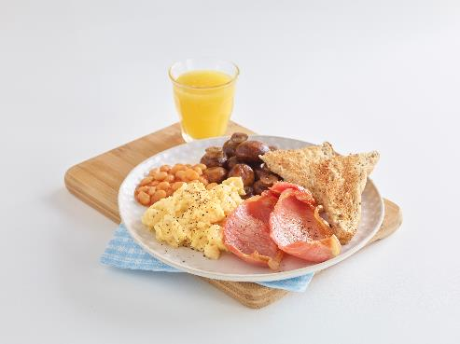
Cooked breakfast (70g cooked weight bacon)

Slide 13
How much meat is that?
For further information, go to:
www.foodafactoflife.org.uk

