Slide 1
Red meat manufacture

Slide 2
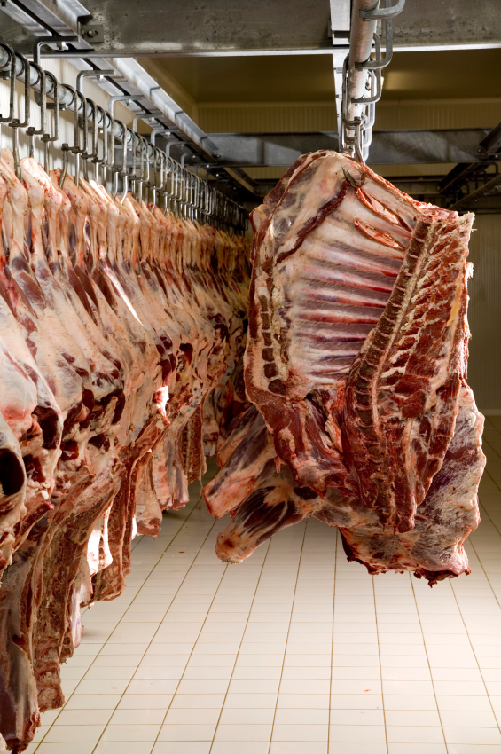
Background information - primary processing
Red meat is edible raw, yet it is normally processed and cooked prior to consumption. Primary processing is the first step which involves preparing raw ingredients.
The first stage is to drain the blood from the carcase.
Red meat can be stored at above its freezing point (–1.5 °C) between two - three weeks without spoilage.

Slide 3
Background information - primary processing
When an animal is killed, the circulation of blood ceases, but within the muscles glucose continues to be broken down (in the production of ATP (Adenosine triphosphate) under anaerobic glycolysis. This is due to a lack of oxygen and results in the production of lactic acid. Lactic acid reduces the pH of the muscle and inhibits the growth of microorganisms, thereby slowing food spoilage and increasing the shelf-life of the meat.
The chemical reactions within the muscles gradually slow down. As a result actin and myosin combine and the muscle contracts, but is no longer able to relax leading to rigor mortis, the point at which the muscles become firm and inextensible.

Slide 4
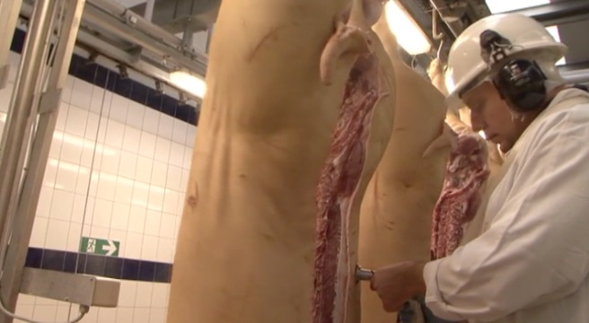
Background information - primary processing
Following rigour mortis, muscle fibres release so the meat becomes tender again. Red meat can be hung or ‘aged’ to allow the muscle fibres to breakdown, otherwise it will not be tender. Proteolytic enzymes (these breakdown the protein chains into smaller peptides and amino acids) help to tenderise the meat while it is aged.
As the carcases are hygienically prepared, the following storage life can be expected:
beef and veal up to 21 days
lamb up to 15 days
pigs up to 14 days
offal up to 7 days

Slide 5
What does primary processing include?
Once hung, the carcase is divided. A butcher will begin to trim the carcase into joints and cuts in line with modern demand from consumers.
Every carcase consists of consumable and non-consumable parts, e.g. bone, lean meat, fat and waste. Approximately 70% of any carcase can be butchered and sold. Some primary processes undertaken by the butchers include:
boning;
slicing;
mincing.
A variety of by-products can be produced from the remaining carcase, e.g. pet food manufacture, edible fats, gelatine and collagen production and sheep and cow hide processing.

Slide 6
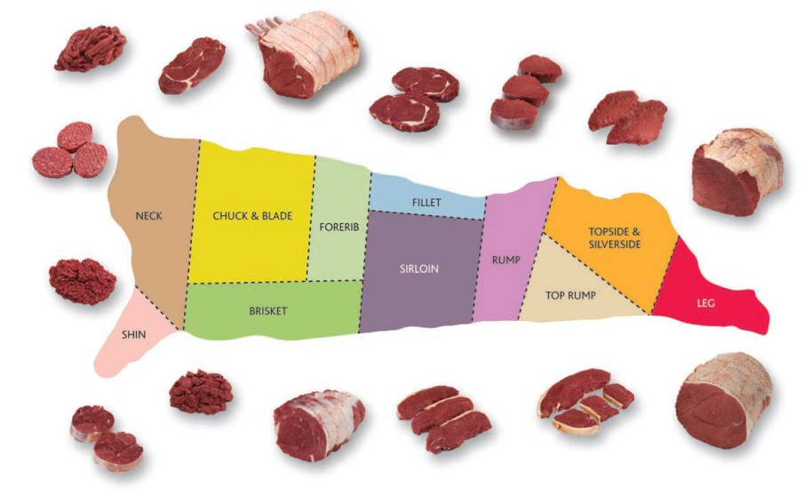
Beef – examples of cuts produced by a butcher
Stir-fry strips
Rib-eye Steaks
Topside Steaks
Chuck Steak
Forerib
Fillet Steaks
Shank
Topside Joint
Shank
Diced Chuck
Silverside Joint
Rump Steaks
Shin Rings
Rolled Brisket
Sirloin Steaks

Slide 7
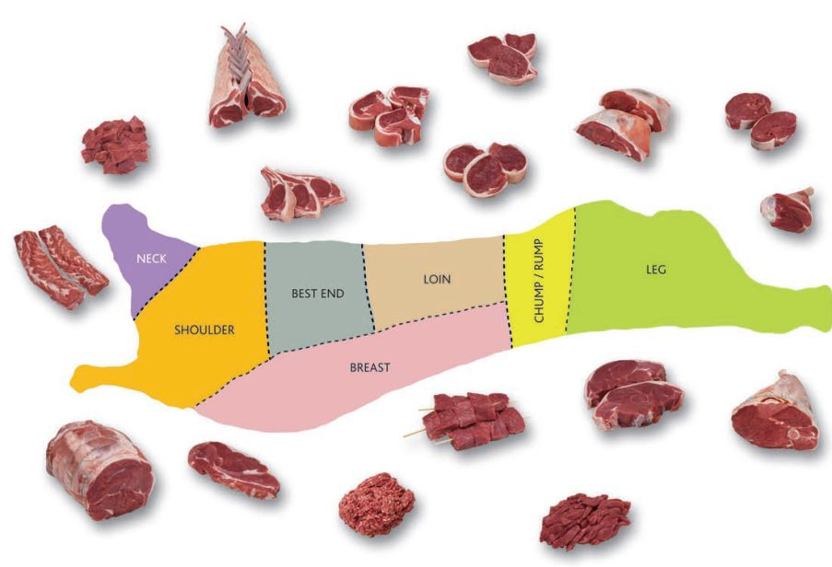
Lamb – examples of cuts produced by a butcher
Valentine Steaks
Racks
Loin Chops
Boneless Leg Steaks
Diced
Boneless Rump
Cutlets
Noisettes
Neck Fillets
Shank
Rump Steak
Kebabs
Half Leg
Shoulder steak
Rolled Shoulder
Stir-fry Strips
Mince

Slide 8
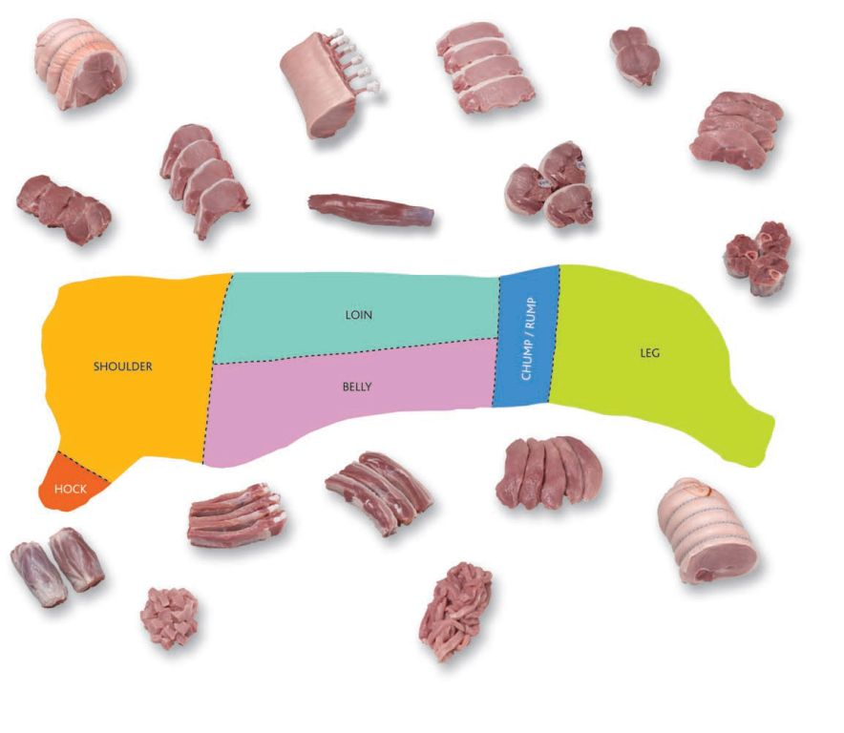
Pork – examples of cuts produced by a butcher
Rack Roast
Valentine steaks
Rolled Shoulder Joint
Rolled Shoulder Joint
Rump steaks
T-Bone Chops
Rib chops
Tender Loin
Osso Busso
Belly strips
Leg steaks
Spare ribs
Hock
Boneless Leg
Diced
Stir-fry Strips

Slide 9
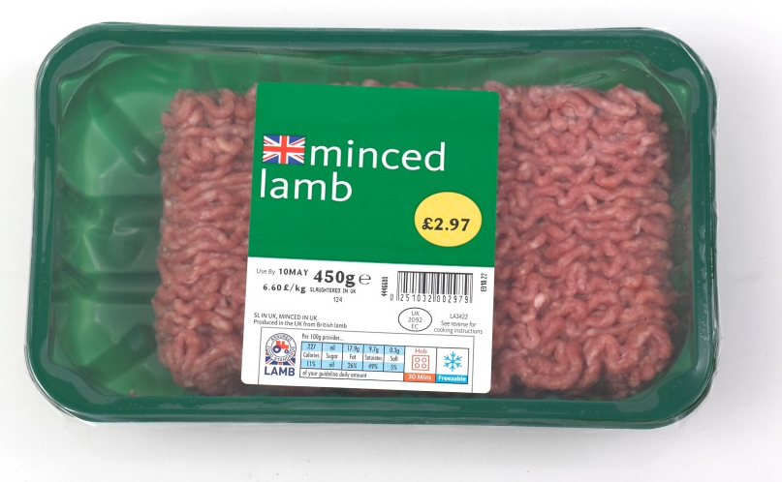
Mince
Mince is 100% meat (typically containing 5-20% fat) with no added water, additives, fillers or any other ingredients.
Different grades of mince can be produced by the butcher. Standard mince contains on average 20% fat. Any mince identified as lean will contain no more than 10%. Extra lean mince is also available which can be up to 95% lean (so 5% fat).
Organic minced meat is available for a premium price. The animals used for this type of mince will have been reared according to organic standards. Mince provides consumers with a versatile ingredient base for many dishes, e.g. koftas, meatballs or curries.

Slide 10
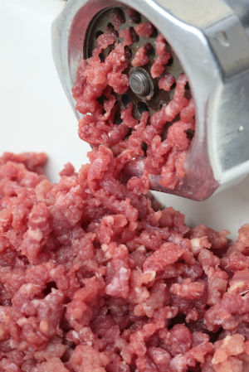
Mincing
The process of mincing involves:
trimming the meat to be minced;
placing the raw pieces of meat into the hopper of a mincing machine;
the feeding ‘worm’ rotates, drawing the meat along a cylindrical barrel;
star shaped blades rotate within the worm forcing the meat through holes in perforated plates or grinding disks;
heat may be applied or removed, depending on the product;
the mince is extruded through the perforated plate into a meat tray.

Slide 11
Mincing
When mincing frozen meat or meat with a lot of connective tissue, plates with larger perforations are used to produce a coarse mince. The mixture is then drawn through plates with smaller perforations for a finer texture. A variety of plates can be used on one machine – the size of the final perforations will determine the final size of the piece of minced meat.
Hopper
Heating elements (optional)
Blade
Drive unit and gear box
Feeding worm
Plate

Slide 12
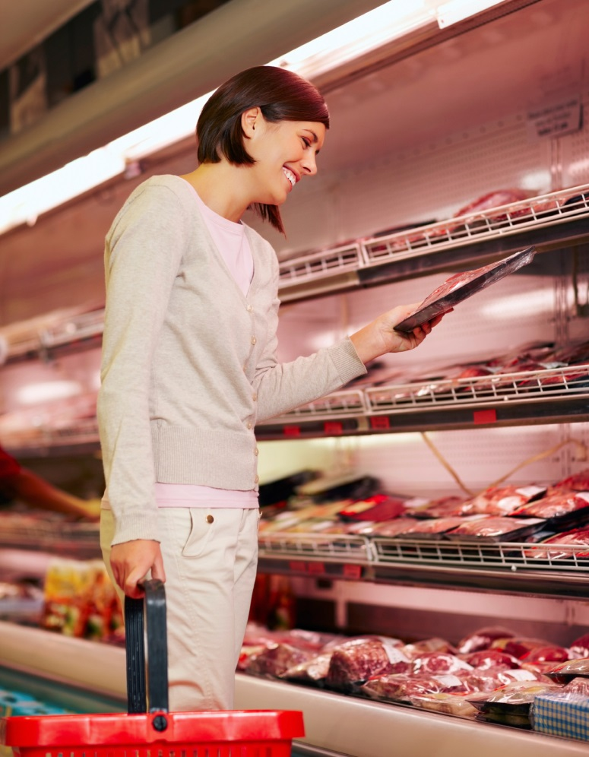
The colour of red meat
When meat is cut it loses water from the cut surface and becomes darker in colour. The protein myoglobin is purple in colour because it contains iron and haem. When meat is cut and exposed to air, the myoglobin is converted to oxymyoglobin, which is bright red.
Consumers associate the red colour in meat with freshness. Some packaging maintains a red colour by having high oxygen levels in the pack, which keeps myoglobin in the oxymyoglobin form to meet consumer expectations. If the supply of oxygen is inadequate, the pigment is oxidised to metmyoglobin, which is brown.

Slide 13
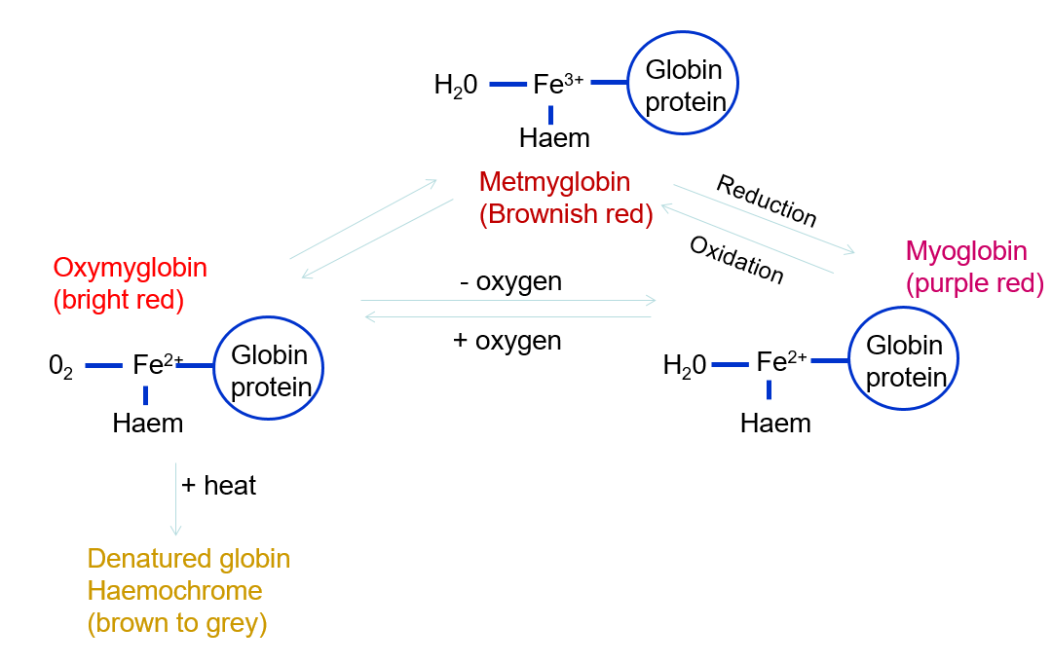
The colour of red meat
When meat is packaged it gradually uses up the oxygen present and at low levels of oxygen the pigment turns brown through oxidation. Using high oxygen packs enables the high levels of oxygen to be maintained longer in meat, keeping the red appearance for longer.

Slide 14
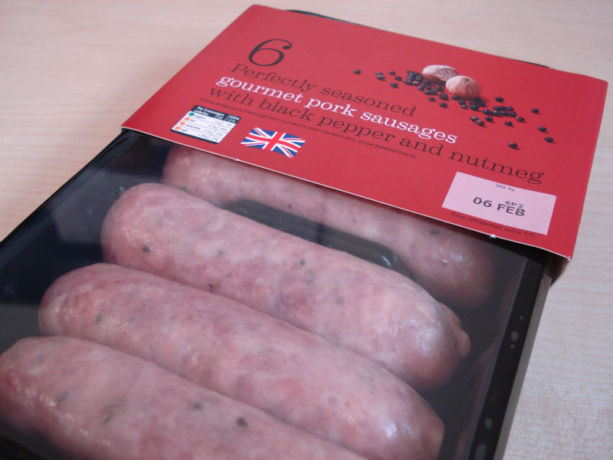
Background information – secondary processing
Secondary processing is the conversion of meat cuts from primary processing to food products. This could include a large number of products, such as:
sausages;
cold meats;
cured meats;
pies and pasties;
burgers;
pâtés;
ready or frozen meals.
Throughout the manufacture of each food product, safety and hygiene remain vitally important.

Slide 15
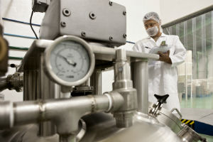
Hazard and Critical Control Points
HACCP (Hazard Analysis and Critical Control Point) is a pro-active system, where all potential hazards to food product safety at each stage of the production chain are identified.
A Critical Control Point (CCP) is a point, step or procedure where control must be applied to prevent, eliminate or reduce a food hazard to an acceptable level. To assure food safety, each CCP is monitored to check that it is within critical limits.
If limits are in danger of being broken, corrective action must be taken. This systematic approach,
if properly implemented, should ensure the safe production of food.

Slide 16
7 principles of a HACCP system
Conduct a hazard analysis and develop production flow charts.
Identify the CCP’s.
Establish critical limits i.e. set target levels which must be met to ensure the CCP is under control.
Establish a system to monitor control of the CCP.
Establish corrective actions to be taken when monitoring indicates that a CCP is not under control.
Establish procedures for verification to confirm that the HACCP system is working correctly.
Establish documentation/records for all procedures.

Slide 17
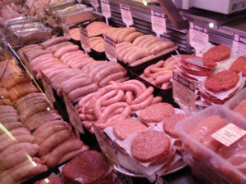
Sausage manufacture
Sausage manufacture involves combining a variety of ingredients, in the right proportions, to produce the desired quality of sausage. Cost is also a key consideration.
In the United Kingdom (UK) fresh sausages are made from fresh meat which are neither cured, smoked, fermented or cooked. Fresh sausages must be kept under refrigeration prior to cooking and consumption.

Slide 18
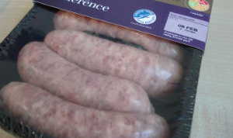
Raw material procurement and intake
Sausage manufacturers carefully identify ingredient providers (who are audited ) and careful records are kept for each delivery. Ingredients are thoroughly inspected before they are received and stored at the factory. This ensures full traceability.
The basic ingredients to produce sausages include:
pork;
rusk;
seasoning;
casings.
Some sausages will also include additional ingredients such as fruit or vegetables and cheese.

Slide 19
Raw material storage and preparation
Temperature control is vital in order to limit the growth of micro-organisms. Correct storage, in terms of temperature and location of the ingredients and separation of potential allergens, is a key Critical Control Point (CCP).
Production environment
The factory working environment is set at 10°C in order to reduce the growth of microorganisms in the product during production.
Refrigeration
Perishable ingredients are stored in a refrigerated room.
The refrigerator temperature is held between 1-4°C.
Ambient temperature
Other non-perishable ingredients and packaging materials are stored at ambient temperature (20-25°C) in a separate area.
Allergens
Certain ingredients which can cause an allergic reaction, such as gluten, are stored in a separate location (refrigerated or in ambient temperature) in order to reduce the risk of contamination.

Slide 20
Mincing the pork meat
The pork meat will be inspected and weighed. An accurate amount of pork is placed inside a hopper of the large mincer. A certain amount of pork fat is also added and is essential to help improve the flavour and succulence of the sausages.
Rotating blades will cut the meat into fine pieces. The size reduction of the meat and fat takes place as the sharpened blades rotate at about 100 revolutions per minute (rpm).
Blade
Hopper
Rotating blades
Feeding worm
Drive box and gear unit
Plate

Slide 21
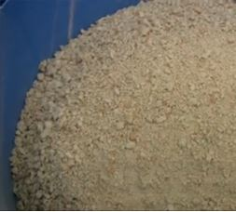
Additional ingredients
Once the pork has been minced, other ingredients are added, such as rusk (usually made from wheat flour, salt and a raising agent), seasoning and water. Different varieties of rusk, such as fine or coarse, may be used to change the texture of the sausage filling.
Rusk absorbs moisture from the meat and water. It is known to have a high water absorbency capacity of about 3-4 times its weight and helps to bind the mixture together. The required amount of rusk, seasoning and water are measured and added to the hopper.

Slide 22
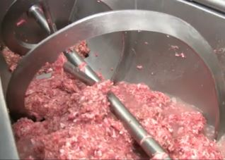
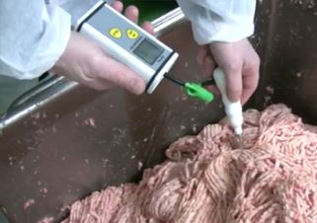
Additional ingredients
The accurate addition of ingredients is a Critical Control Point (CCP) in the sausage making process. It is vital the correct amount of ingredients are added to ensure a consistent product each cycle.
The sausage filling is mixed with the rotating blades and then drawn along a feeding worm. The feeding worm rotates and draws the filling along a cylindrical barrel towards star shaped blades which rotate. The worm presses the meat through holes in perforated plates or grinding disks.
The sausage filling is returned to the cold store to reduce the temperature of the mixture, which has risen due to the mechanical action of the mincer.

Slide 23
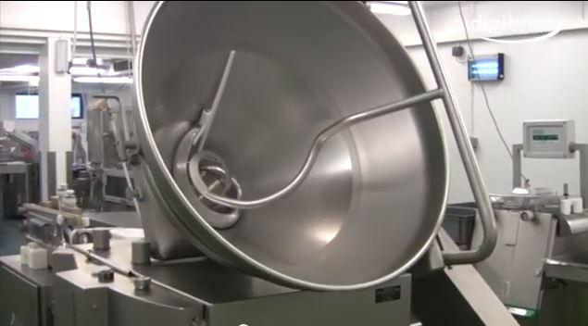
Filling the sausages
It is important that sausages are identical in length, diameter and weight, to create a uniform product each cycle. This ensures that the weight and nutrition content of the sausages matches the information displayed on the packaging.
When the temperature of the sausage filling has reduced, it is either manually or automatically transferred into the hopper of the vacuum filler or sausage filling machine.
This machine will determine how many grams of mixture will be extruded into each sausage casing. The set amount of filling for the recipe is programmed into the machine.

Slide 24
Filling the sausages
The feeding worm attached to the hopper draws a specific amount of the filling under vacuum conditions into the nozzle to be extruded into casings.
The casings will automatically or manually be placed onto the linking nozzle. A specific amount of sausage filling will be extruded into a section of the casing.
The machine ensures optimum portioning accuracy, precise distribution of the filling and produces compact, firm sausages.
Feeding worm
Hopper
Linking nozzle
Chilled sausage filling
Filling table
Computer controls

Slide 25
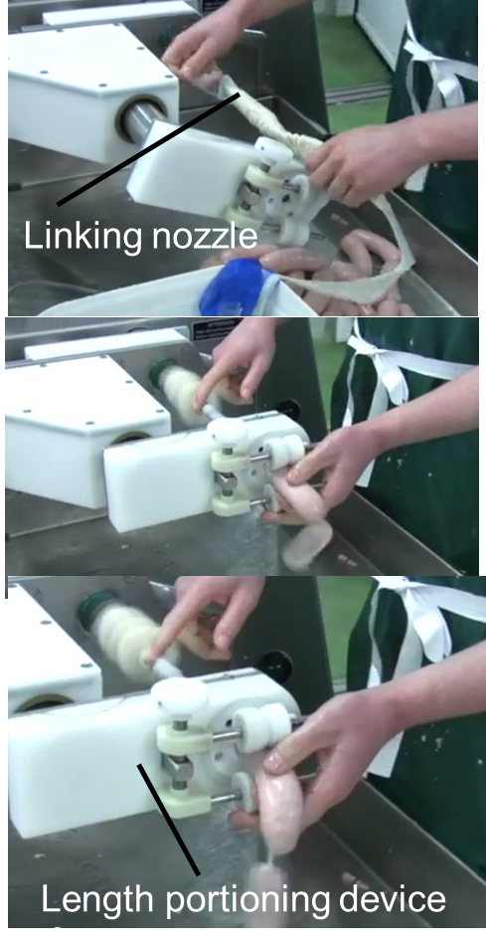
Filling the sausages
A length portioning device, attached at the end of the nozzle, accurately portions a consistent weight of sausage filling and therefore creates a consistent length of sausage.
The sausage mixture passes through the calibrating horn of the length portioning device into the casing and onto the filling table.

Slide 26
Casings
Casings, known as sausage skins, play a significant role in the portioning of sausage meat.
Casings also improve the shelf life by providing moisture and oxygen resistant properties. They also contribute to minimising weight loss of the sausage during cooking.
Casings can be reformed or natural. Natural casings are produced from the small intestines of pigs or sheep, the intestines are flushed, scraped and cleaned. Alternatively, reformed casings are manufactured with collagen.

Slide 27
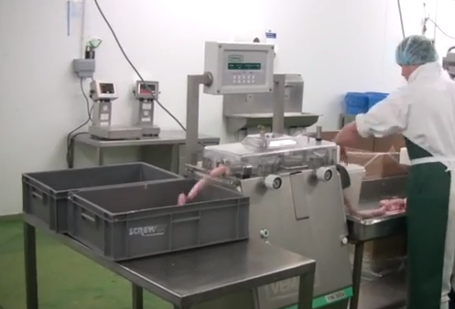
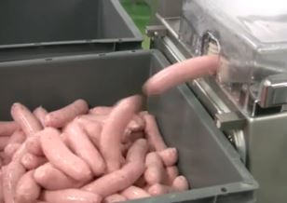
Trimmed sausages
The connected sausages automatically or manually fed into an automatic link cutting machine. This machine snips and separates the sausages with great accuracy and precision reducing damage to the sausages.
The machine also mechanically stretches the casing in order to eliminate any residual air and separates the sausage from the chain.
If any air were to remain inside the sausage, it would result in the sausage bursting during cooking.

Slide 28
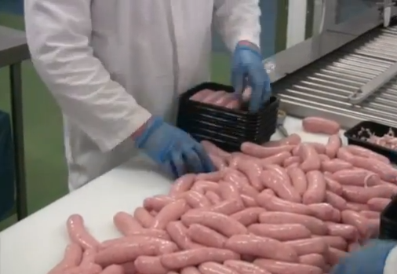
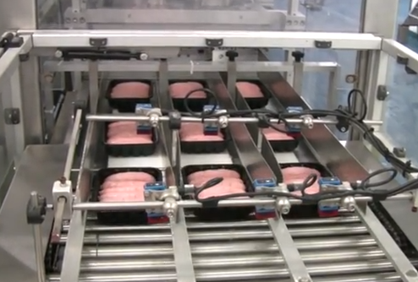
Inspection and Modified Atmosphere Packing (MAP)
The sausages are individually inspected by food technicians before they are packed into plastic trays. Irregular shaped or burst sausages will be removed from the production line.
The filled trays are placed on a conveyor belt to the packing machine for Modified Atmosphere Packaging (MAP).
The main advantage MAP is the increase in the shelf life of food products, such as sausages, without the addition of chemical preservatives which may alter the taste, colour, flavour or consistency of the product.

Slide 29
Modified Atmosphere Packing
The 3 main gases used for MAP are nitrogen (N2), Oxygen (O2) and carbon dioxide (CO2). The composition of the gas mixture is specific to the type of products being packaged. It works by surrounding the food with gases that prevent or reduce the growth of bacteria, yeasts and moulds that spoil food. The shelf-life of food products is increased by days, or weeks.
The packaging of the sausages is done by a vacuum chamber machines which evacuates the normal atmosphere out of the package and replaces it with a corresponding gas mixture (modifying the atmosphere) before the packet is covered with film and heat sealed.
Sealing time, pressure and temperature are all monitored and controlled, ensuring high-quality sealed packages every time.

Slide 30
Materials used for packaging
A range of synthetic materials suitable for meat packaging can be chosen. Packaging films have many requirements, some of these include:
flexibility;
mechanical strength;
light weight;
odourless;
hygienic (clean and toxicologically harmless);
recycled materials;
easy to recycle;
resistance to hot and cold temperatures;
resistance to oil and fats;
good barrier properties against gases;
low-cost or economical.

Slide 31
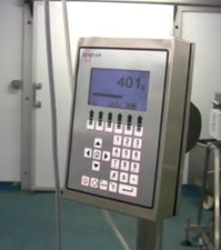
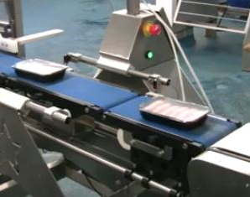
Check weighed and cardboard sleeve label
Sausage packages are check weighed to ensure each packet is within the estimated weight range. Sausage packages which are either too light or heavy will be removed from the production line and inspected by a member of the Quality Assurance team.
The packages proceed via conveyor belt for the addition of an overwrapping cardboard sleeve. An automatic arm opens the cardboard sleeves and the sausage packet in transit moves through the sleeve and on towards the metal detector.
Ensuring the correct label is applied is a CCP in the sausage making process, for example, gluten-free sausages must not contain gluten.

Slide 32
Metal detection
The metal detection unit is sensitive to metallic objects and another CCP within the sausage making process. All sausage packages must be passed through the metal detectors at the end of production, where no further possible contamination could take place.
Any packages failing the test must be removed from the production line and undergo an approved re-checking procedure. All packs failing metal detection must be broken down by the Quality Assurance department to determine the reason for failure.
Search head
From packaging
To boxing & palletisation
Control unit
Conveyor belt

Slide 33
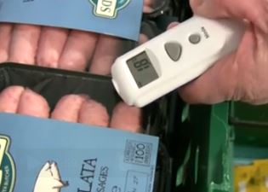
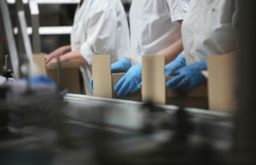
Packaging, palletisation and distribution
A final visual check is conducted before the sausage are packed into boxes, these boxes are closed and scanned to ensure traceability before being palletised.
The finished products are stored in a cool room prior to distribution.
A infra-red thermometer is used to monitor the temperature of the final goods. This allows the temperature to be checked without damaging the food products.

Slide 34
Cold chain
A quality assurance system, referred to as the cold chain, is in place to measure, control and document the temperature of the sausages between their journey from manufacture, to storage and to the retailer. This ensures the quality and integrity of the food product.
The cold chain ensures that the temperature of the sausages remains within a safe range during the storage and distribution system to help extend and ensure the shelf-life of food products.
Refrigerated and insulated transport vehicles are involved when moving the food product from the cold store of the manufacturer to storage and/or the retailer.
Sausage factory
Retail outlet
Supplier
Warehouse
Refrigerator transport

Slide 35
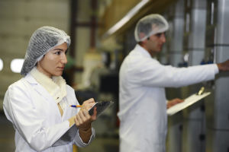
Burger production – ingredient intake
A transit document is checked when fresh or frozen beef is delivered. Each delivery is inspected to ensure it complies with certain specifications.
Checks, including temperature checks, are carried out before the goods are accepted. These checks are recorded and maintained to ensure quality and traceability of the products. A database is used to record details of each delivery.
The First In First Out (FIFO) inventory method is used for stock rotation to ensure ingredients are not wasted. This means the meat which is delivered first to the factory, will be used first in burger production.

Slide 36
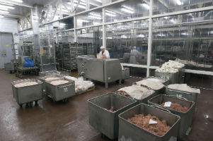
Burger production – ingredient intake
To ensure traceability, legislation states that beef sourced from different countries cannot be mixed. The factory stores UK and Irish beef separately to ensure the meats are not mixed.
Random checks are carried out by trained meat inspectors. Particles such as bone or gristle are removed and reported. This aims to help improve the quality of the ingredients used.

Slide 37
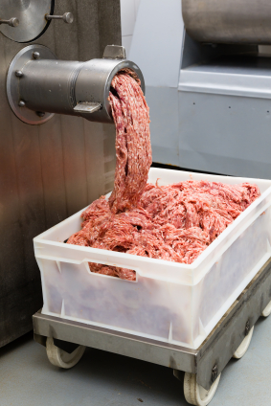
Burger blending
At the beginning of the burger making process, the chilled and frozen meat are transferred from the stores to the manufacture floor and placed into large hoppers. The process of batch formulation is computer controlled to ensure a consistent amount of meat is added.
A combination of 70% chilled and 30% frozen meat is used. The meat will increase in temperature due to the mechanical action of the grinder.
The addition of frozen meat helps to maintain a low temperature. The frozen meat also helps to ensure the mixture is stiff enough to form burgers in the forming machine without sticking to the machinery and causing problems and delays.

Slide 38
Burger blending
The initial mincing takes place and the meat is mixed in the pre-blenders.
Two separate mincers are used for the forequarter and flank meat.
The final mincing mixes a combination of both the flank and forequarter meat to ensure a consistent burger is produced. Samples are taken to be analysed to ensure consistency.
Pre-blenders
Forequarter mincing
Flank mincing
Final mincing

Slide 39
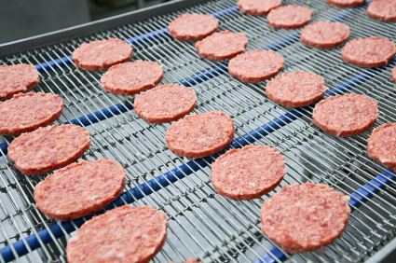
Burger forming and checking
Once the mince mixture has been tested and approved, minced beef is transferred to the burger forming machines. These machines use pressures of 45-70kg (100-150 pounds) per square inch to press the mixture into the mould plate.
Once filled, the meat inside the mould plate is punched out onto a conveyor belt to produce ‘patties’.

Slide 40
Burger forming and checking
Thicker burgers will pass through an additional knife scoring stage to assist heat penetration during cooking.
All patties are spayed with a fine water mist to replace water content and to minimise the effect of dehydration.
The main aim of the forming stage is to ensure that the products are of a uniform shape, size and weight each production cycle.

Slide 41
Removal of water
The water activity of a food describes the amount of available water in a food. It is calculated by:
Water activity = water vapour pressure above the food at a certain temperature
water vapour pressure above pure water at the same temperature
The water activity of a food must be reduced to 0.6 to prevent the growth of microorganisms. A number of techniques are used during the manufacture of food to reduce the water content of food to this level.

Slide 42
Removal of water
During burger production a freezer tunnel is used to:
1) dramatically reduce the temperature to inhibit growth of micro-organisms and limit enzyme and chemical activity.
2) form ice crystals within the patties, reducing water activity to prevent the growth of micro-organisms.

Slide 43
Burger freezing
The patties then enter the freezing tunnel on a conveyor belt while liquid nitrogen (boils at -196°C) is blown against the flow of burgers.
The flow of gas and speed of the conveyor belt is controlled to ensure the patties emerging at the end of the freezing tunnel are fully frozen (approximately -20°C). The burgers will remain frozen until cooked by consumers.
Liquid nitrogen
Unfrozen
Frozen
Conveyor belt

Slide 44
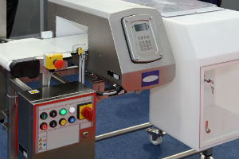
Burger packing and storage
Each pattie then passes through a metal detector which is sensitive to metal fragments. If metal is detected the pattie will automatically be removed and sent to a separate area to prevent it continuing in the supply chain.
Throughout production quality assurance checks of the burger pattie dimensions and temperature are made to confirm the patties are within specification.

Slide 45
Burger quality
The frozen burgers are packed into cardboard cartons lined with polythene liners. Although the cartons are automatically formed and lined, the frozen burgers are manually packed by food technicians into each carton. Once filled, every carton has a production code and ‘Best before’ date printed on it. The production code ensures the pack can be traced back to the time and date of production at the particular plant.
All cartons are check weighed, the flaps are automatically closed and the cartons sealed.
Bar code scanners identify and record the boxes before stacking these onto a pallet. The pallet is then stretch wrapped to secure the load to the pallet during transportation. The pallets are then transferred to the cold store and held at or below -18°C before dispatch. The burgers are dispatched on the FIFO system and in strict rotation.

Slide 46

Quality assurance
The Quality Assurance team will pan-fry and test burgers from the production line before the batches are dispatched to retail outlets.
Ideally, consumers should cook the burgers until internal temperatures of 80°C are reached in order to destroy food poisoning agents potentially present in the raw meat mixes (such as Listeria, Salmonella or E. coli).
Food safety and quality checks are carried out throughout the burger making process to meet EU standards and protect consumers.

Slide 47
Red meat manufacture
For further information, go to:
www.foodafactoflife.org.uk

