Slide 1
The Eatwell Guide – an in-depth look at healthy eating and nutrition

Slide 2
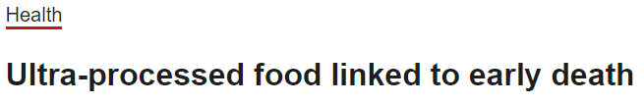
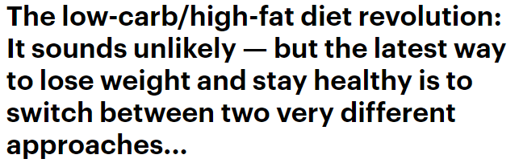
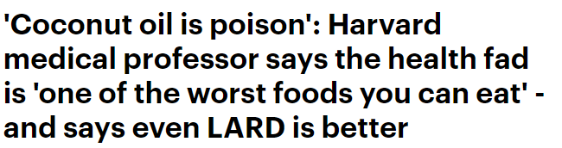



Nutrition in the news

Slide 3


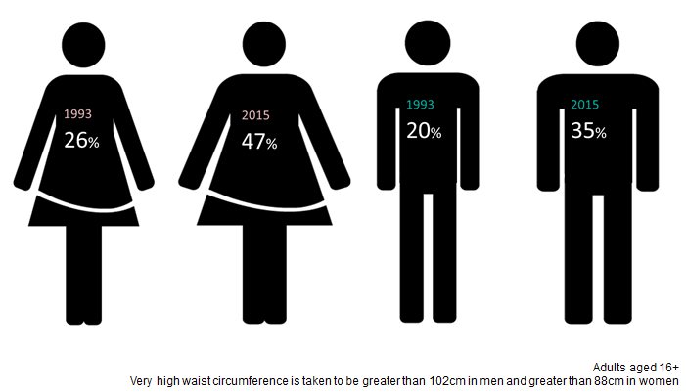
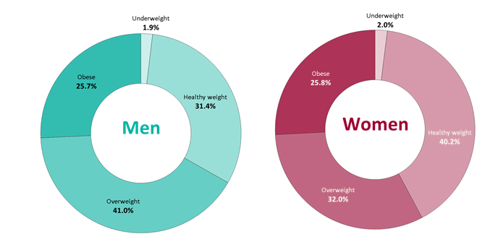

High levels of overweight and obesity
1 in 5 children starts school overweight or obese.
By the time children leave primary school, 1 in 3 are overweight or obese.
NDNS 2018,
Health Survey England 2017

Slide 4
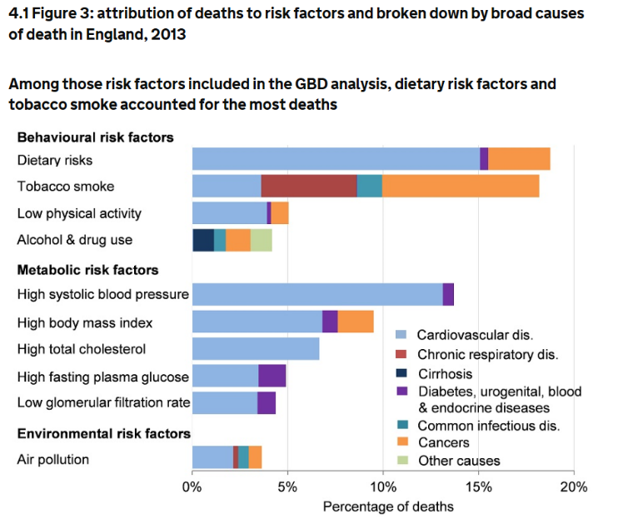
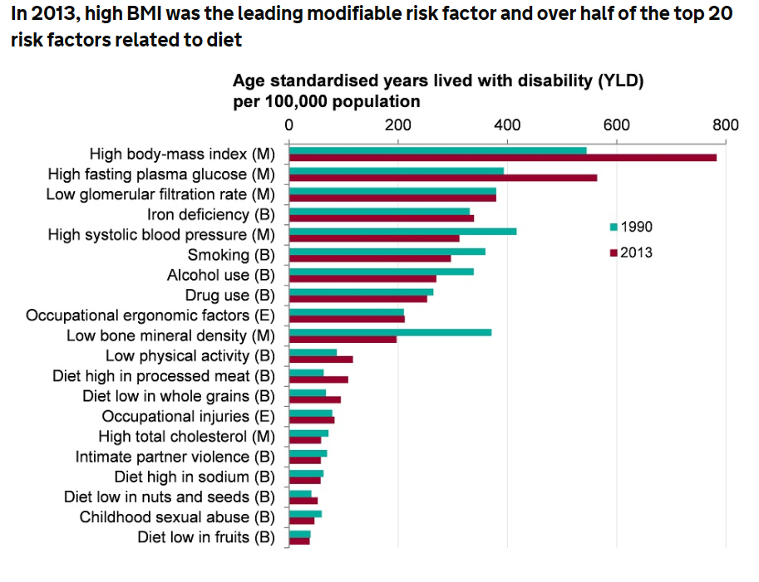
Diet impacts our health
1 in 16 people have Type 1 or Type 2 diabetes. Obesity accounts for 80-85% of overall risk of developing Type 2 diabetes. Diagnoses doubled since 2006.
Source: PHE (2017) Health profile for England

Slide 5
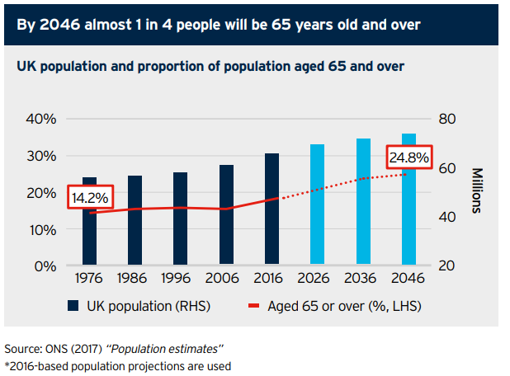
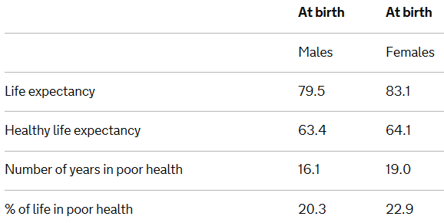
An ageing population

Slide 6




Opportunities for improved diets
Excess consumption of free sugars, salt, saturated fat and energy.
Low intake of fibre and wholegrains.
31% adults & 8% teens meet 5 A DAY.
Low intakes of some vitamins and minerals.
NDNS 2018

Slide 7
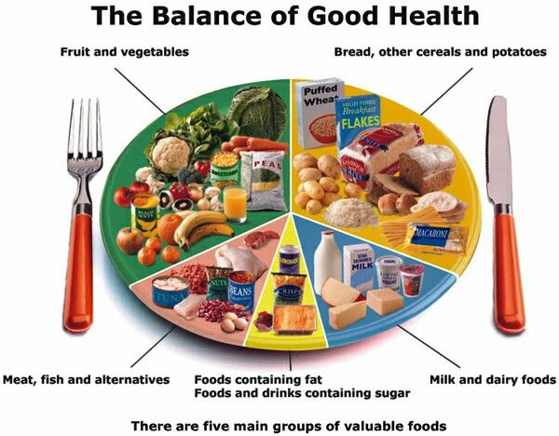
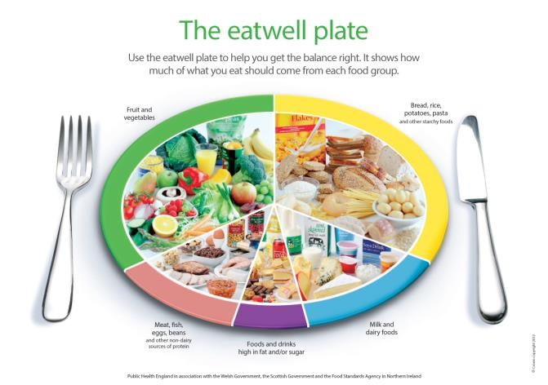
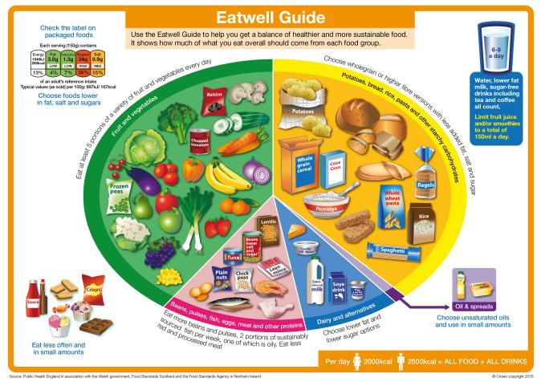
The progression of food based models
1994
2007
2016

Slide 8

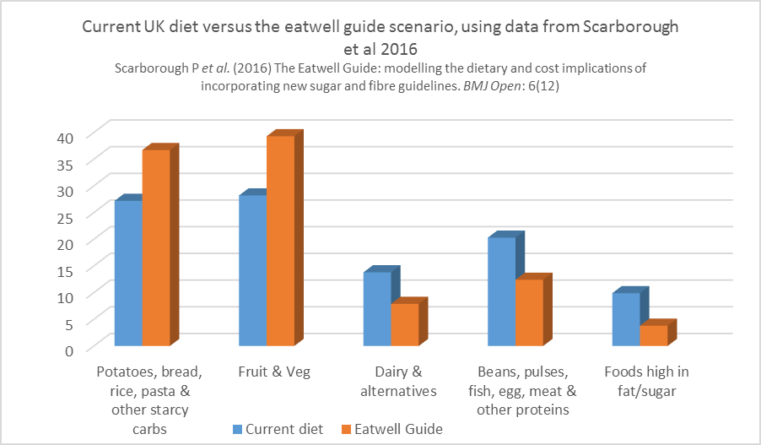
The Eatwell Guide
The Eatwell Guide

Slide 9


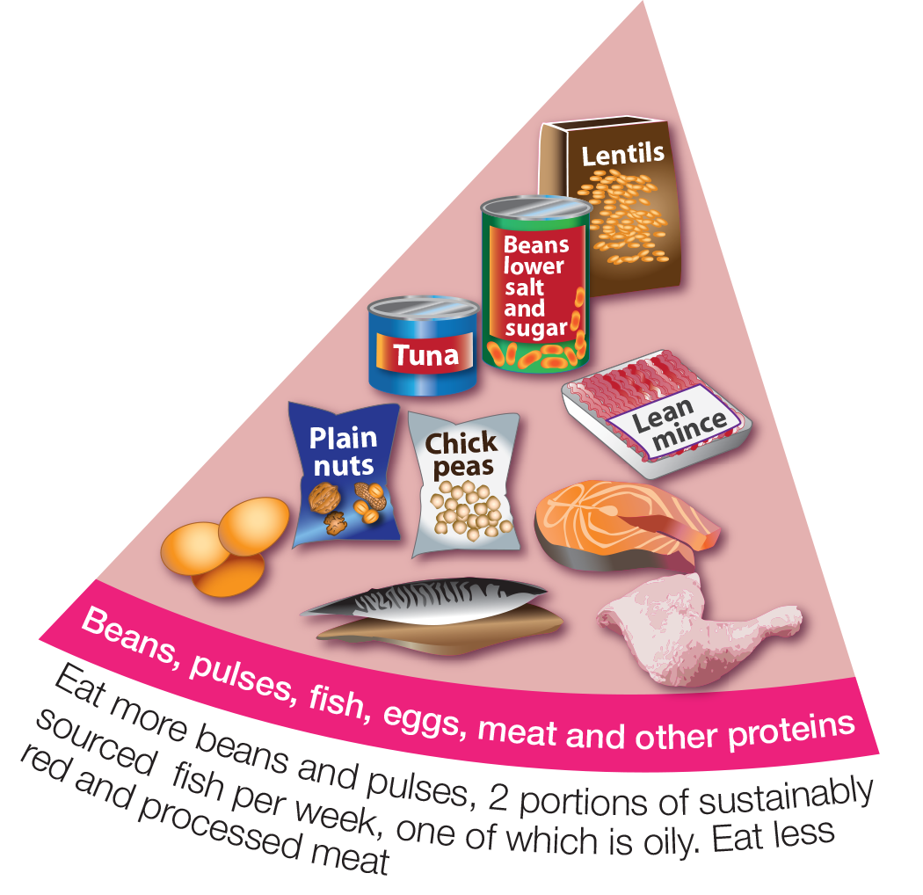

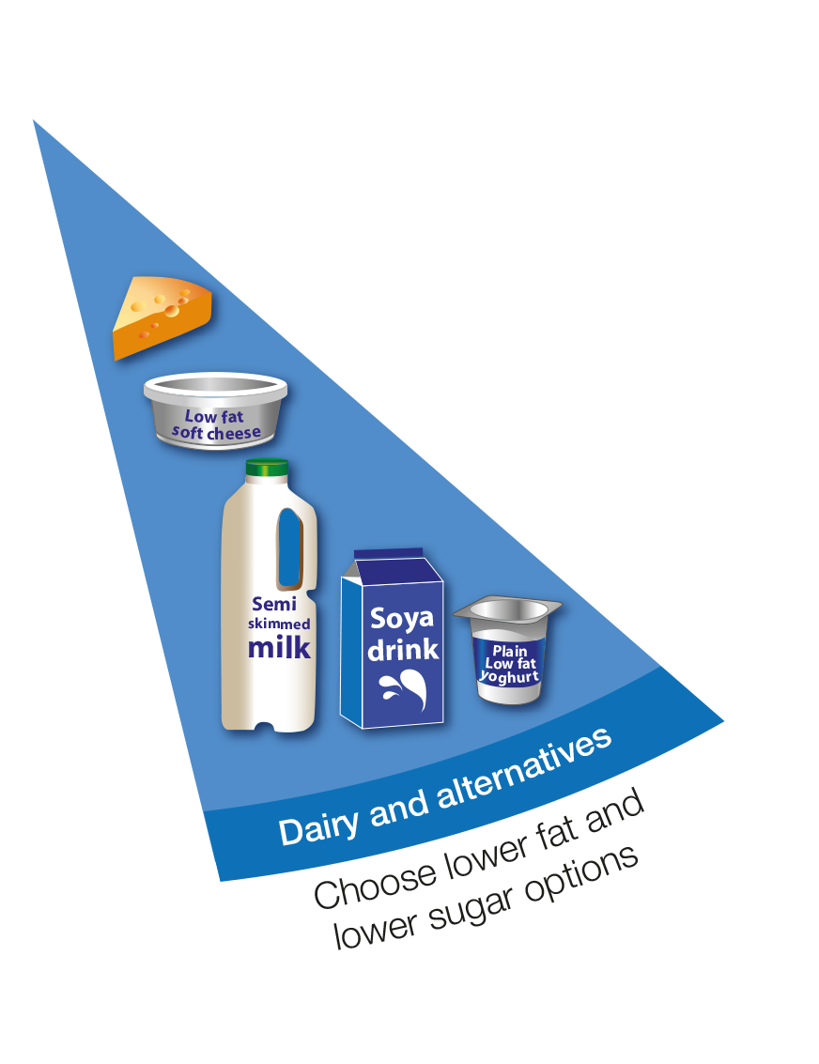




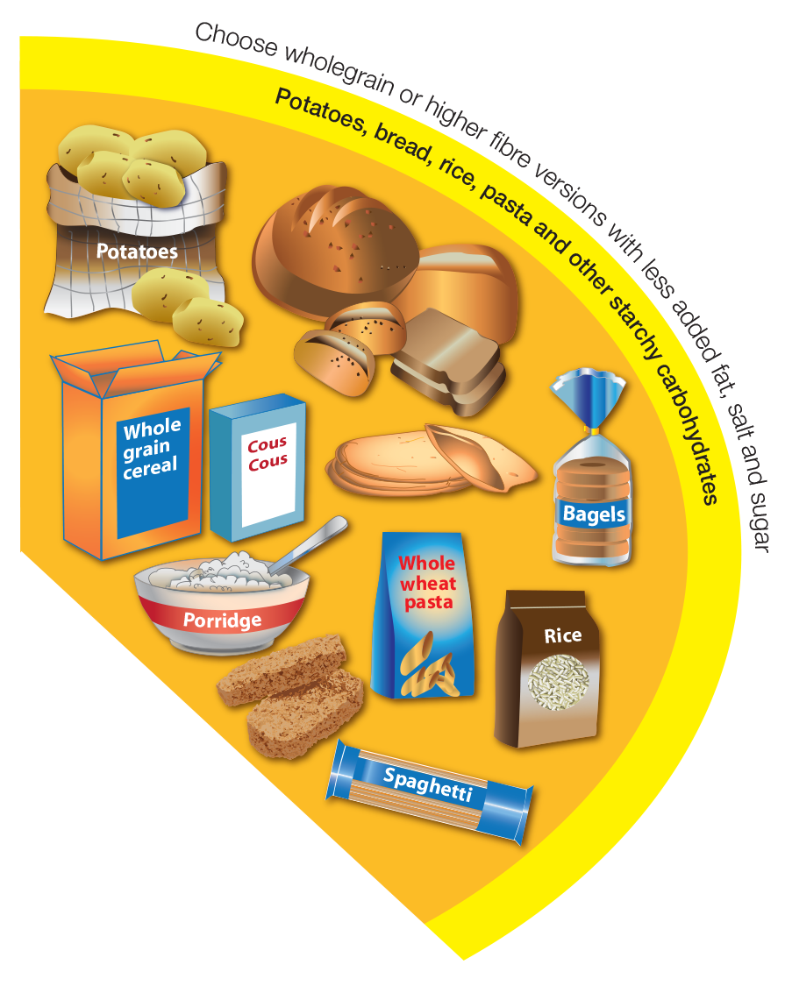

Fat

Slide 10
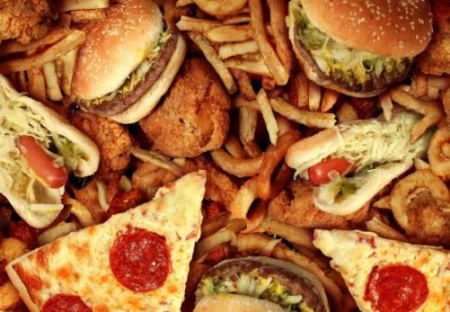


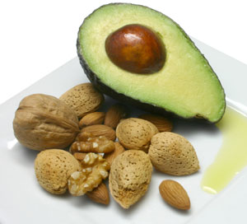

Saturated and unsaturated fats
Change 4 life

Slide 11
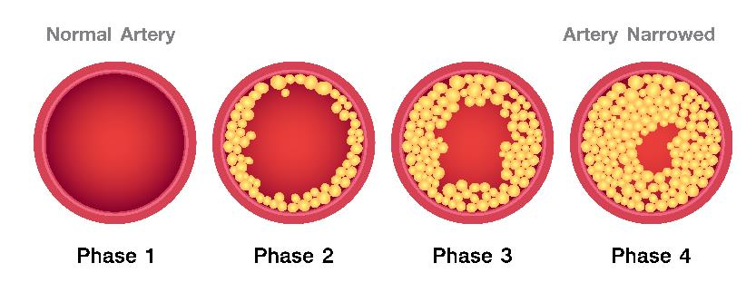
Saturated fats and health
Examples of food high in saturated fat include: Fatty cuts of meat and processed meat products, cheese, butter, coconut oil and palm oil, cakes, biscuits and pastries and chocolate.
High intakes of saturated fat in the diet increases blood cholesterol.
Having high blood cholesterol raises your risk of heart disease.
Reducing intake of saturated fat and replacing with unsaturated fat reduces total cholesterol and LDL (bad) cholesterol.
Current recommendation - swapping foods with a high proportion of saturated fats for those rich in unsaturated fats.
Saturated fats and health: SACN report

Slide 12
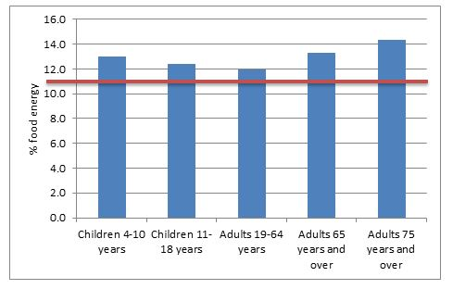
Saturated fats and health
Current recommendation - saturated fatty acids should make up no more than 11% of food energy.
Top contributors to saturated fat intake (adults 19-64 years)
Meat products | 24%
Cereal products | 21%
Milk products | 21%
Fat spreads | 9%
Vegetables and potatoes | 6%
National Diet and Nutrition Survey, years 7 and 8

Slide 13

Coconut oil
Fats and oils provide the same number of calories (9kcal/g) regardless of where they come from. This means that too much of any type of fat can encourage weight gain.
There is very little scientific evidence to support health benefits from eating coconut oil.
Coconut oil is very high in saturated fat (around 90%).
Just two tablespoons of coconut oil contains more than our reference intake of around 20g saturated fat.
There is some evidence that consuming coconut oil in place of unsaturated oils raises blood cholesterol.
Coconut oil talk
Coconut oil FAQ

Slide 14
Fatty acid composition of edible oils
Source: McCance and Widdowson’s Composition of Foods

Slide 15
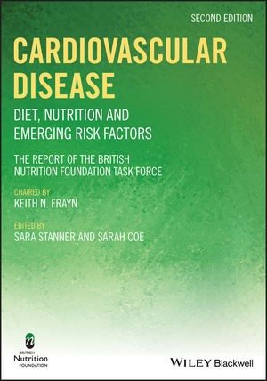
Cardiovascular Disease (CVD): Diet, Nutrition and Emerging Risk Factors
CVD risk is not just about single nutrients, like saturated fat, or individual foods.
Healthier dietary patterns and lifestyle habits are key to CVD prevention.
Healthier dietary patterns have higher intakes of vegetables, fruit, pulses, wholegrains, low-fat dairy, seafood, nuts and seeds and lower intakes of fatty/processed meat, refined grains, sugars-sweetened foods and drinks, salt and saturates.
Increasing physical activity and reducing time sitting (sedentary behaviour) is also important as is not smoking and maintaining a healthy weight.

Slide 16
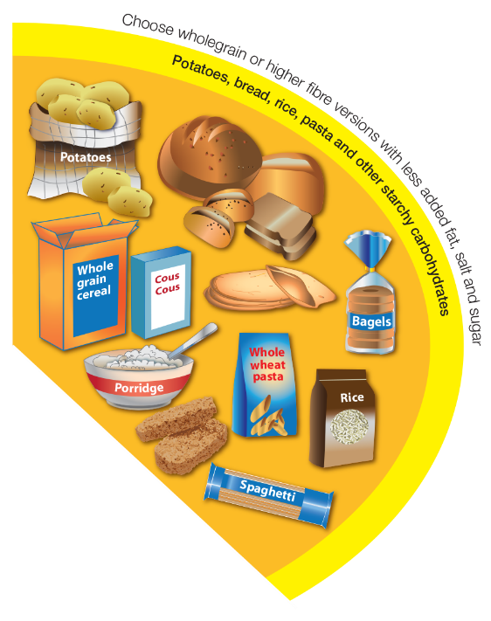
Carbohydrate

Slide 17



Free sugars
What are free sugars?
All sugars added to foods by the manufacturer, cook or consumer, plus sugars naturally present in honey, syrups and unsweetened fruit juice.
Free sugars are the type of sugars we need to be reducing in our diets.
What sugars do not count as free sugar?
Lactose (the sugar in milk) when naturally present in milk and milk products and the sugars contained within the cellular structure of foods (e.g. in fruit and vegetables).

Slide 18
Free sugars
Higher consumption of sugars and sugar containing food is associated with a greater risk of tooth decay.
Increasing total energy (calorie) intake from sugars leads to an increase in energy intake.
Consumption of sugars-sweetened drinks results in greater weight gain and increases in BMI in children and adolescents.
Greater consumption of sugars-sweetened drinks is associated with increased risk of type 2 diabetes.
Current recommendation – free sugars should make up no more than 5% of total energy.
SACN Carbohydrates and Health Report
National Diet and Nutrition Survey, years 7 and 8

Slide 19
Fibre
Age group (years) | Dietary recommendation (g/day) | Mean intake (g/day)
1.5-3 | 15 | 10.3▼
4-10 | 20 | 14.0▼
11-18 | 25 | 15.3▼
19-64 | 30 | 19.0▼
65+ | 30 | 17.5▼
75+ | 30 | 16.5▼
Adults are recommended to eat 30g of fibre per day.
Current adult intake is around 19g per day on average.
Diets high in fibre are associated with a reduced risk of heart disease, type 2 diabetes and colorectal cancer.
It is also important for digestive health and may increase fullness.
We can consume more fibre by increasing our consumption of wholegrains, choosing a high fibre breakfast cereal and including plenty of fruit and vegetables and pulses, nuts and seeds within our diet.
18% adults & 15% children
have no wholegrain consumption
NDNS
31% adults & 8% teens meet 5 A DAY

Slide 20
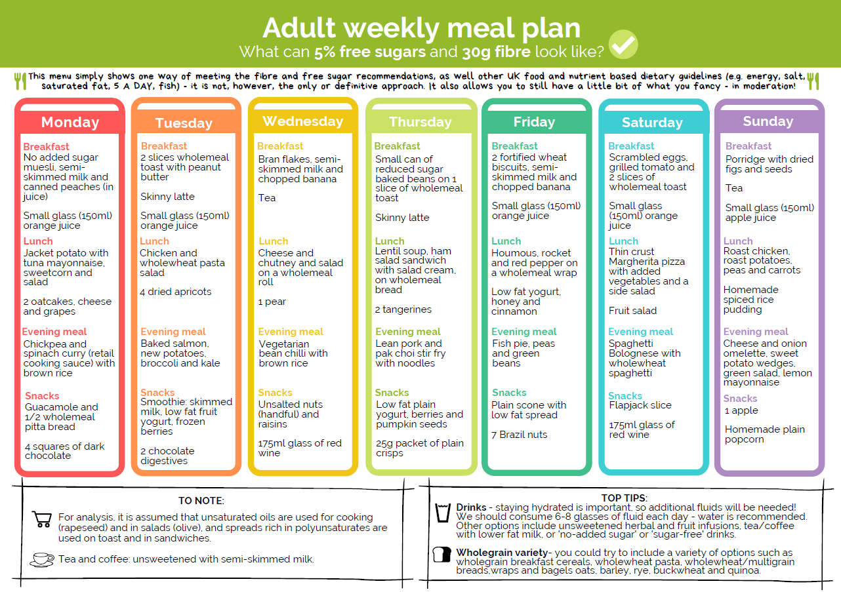
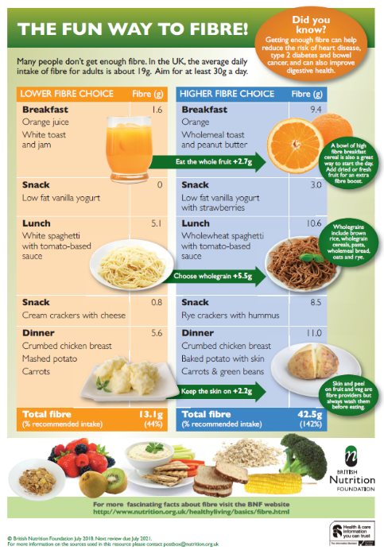
BNF's 7-day meal plan
The fun way to fibre!

Slide 21
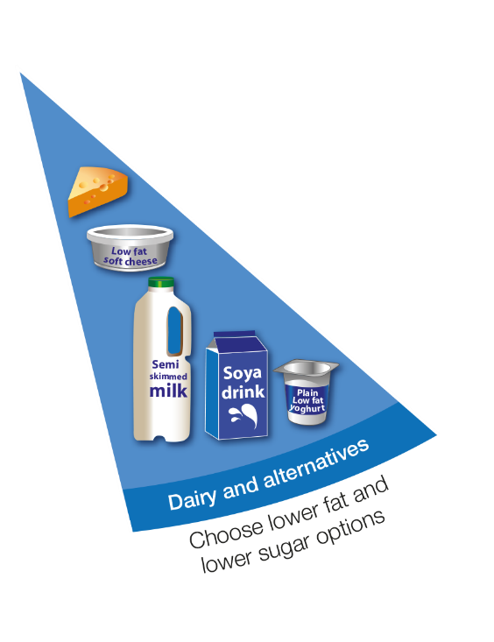
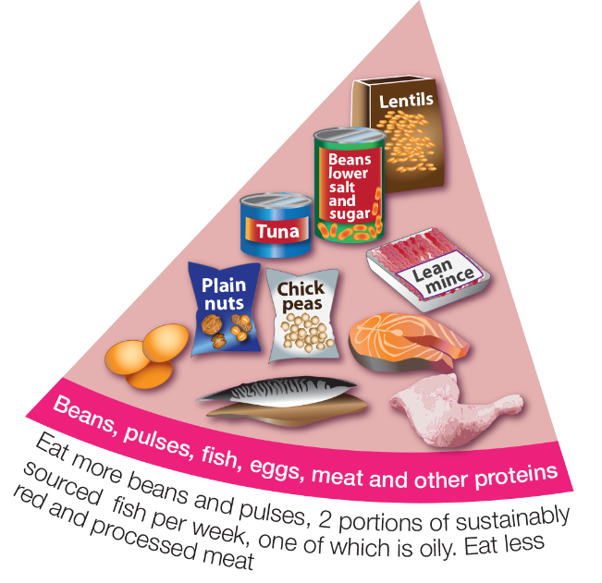
Plant-based diets

Slide 22
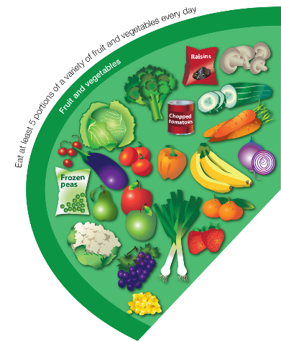





The rise of plant-based diets
In recent years, there has been an increase in the number of people following vegan, vegetarian and flexitarian diets.
Plant-based diets more generally are dietary patterns that have a greater emphasis on foods derived from plants (such as fruits and vegetables, wholegrains, pulses, nuts, seeds and oils) but plant-based diets do not have to exclude animal derived foods completely.
This rise has been influenced by health, animal welfare, ethical and environmental concerns.

Slide 23

Health benefits of plant-based diets
High intakes of red and processed meat are associated with increased risk of colorectal cancer.
People who follow vegetarian, vegan or Mediterranean-style diets appear to be at lower risk of heart disease, stroke and type 2 diabetes when compared with those following less healthy dietary patterns.
Diets that emphasise foods derived from plants tend to be higher in fruit and vegetables, wholegrains, nuts, seeds and pulses, and tend to provide higher amounts of dietary fibre, and lower amounts of saturated fat and free sugars.

Slide 24




Not all plant-based diets are equal
A plant-based diet can still contain high amounts of food high in saturated fat, salt and free sugars.
This can include savoury snacks, deep fried foods, cakes, biscuits, confectionary and sweet spreads.
A very restrictive plant-based diet that lacks variety may also not provide all the nutrients needed for health.

Slide 25


What about meat, fish and dairy?
Animal food sources, such as meat and dairy, make an important contribution to some nutrients in the UK diet.
Vitamin B12 and vitamin D are naturally absent from most plant foods.
Long chain omega-3 fatty acids are found in highest amounts in oily fish.
Iodine is found in highest amounts in seafood, dairy foods and eggs.
Iron and zinc are more easily absorbed from animal than plant foods.

Slide 26

Healthy, varied and balanced diet
A healthy, varied and balanced diet includes:
eating plenty of fruit and vegetables and wholegrains;
trying to cut back on foods high in free sugars and salt;
swapping foods with a high proportion of saturated fats for those rich in unsaturated fats;
following the basic healthy eating principles as depicted in the Eatwell Guide.

Slide 27
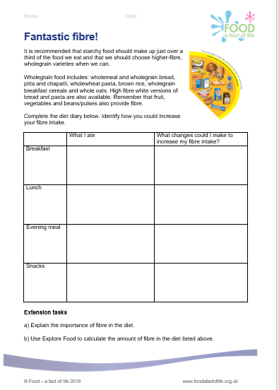
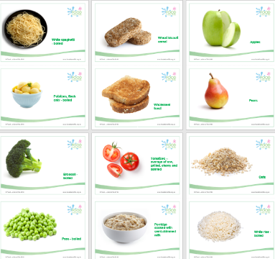
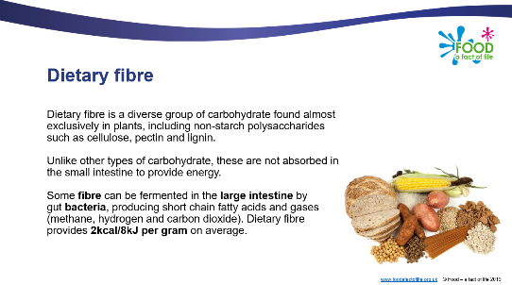
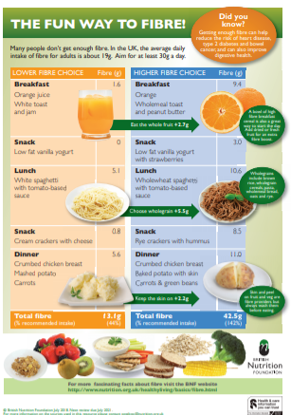
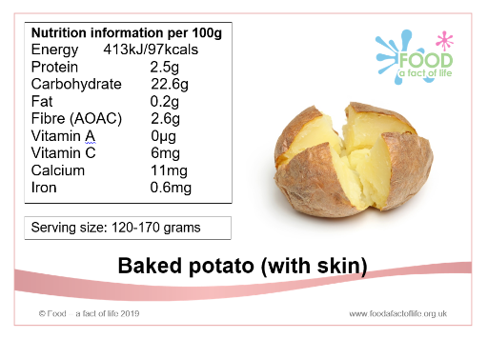
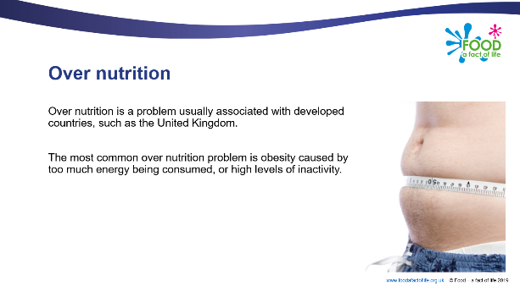
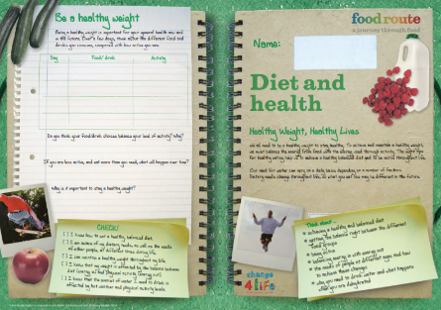

Food – a fact of life resources

Slide 28
The Eatwell Guide – an in-depth look at healthy eating and nutrition
For further information, go to:
www.foodafactoflife.org.uk

