Slide 1
Meals with mince

Slide 2
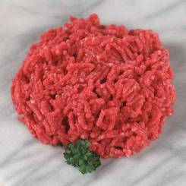
Meals with mince
Beef, lamb and pork mince are popular and versatile​ ingredients. In addition, they are relatively economical​ and can be used in a variety of dishes.

Slide 3
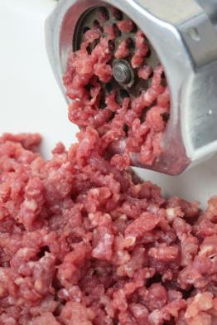
Introduction
Mince is made up of selected beef, pork or lamb cuts which are passed through a mincing machine. ​​
This involves meat being pushed onto rotating blades which force the meat through holes in a cutting plate. The size of the holes determines how fine or coarse the mince will be.​
The process cuts the muscle fibres into smaller pieces – making it more suitable for quicker cooking methods, e.g. dry-frying or​ combining with other ingredients.​

Slide 4
Making mince
Mince is made up of selected beef, pork or lamb cuts which are passed through a mincing machine.
Hopper
Blade
Drive unit and gear box
Feeding worm
Plate

Slide 5
Different grades of mince
Supermarket beef mince is available with a fat content of 5%, 10%, 12% and 20%.
Organic minced meat is also available for a premium price. The animals used for this type of mince will have been reared according to organic standards.

Slide 6
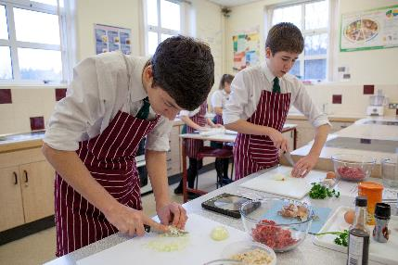
Recipe creation challenge
Develop and make an original main meal recipe using beef, pork or lamb mince for teenagers to enjoy. ​
​
It should be served with suitable accompaniments.

Slide 7
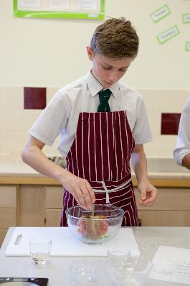
Your recipe must:
Include 200g of beef, pork or lamb mince.​
Show consideration of the 8 tips for healthy eating​.
Include a full ingredient list (with quantities).​
Include a detailed recipe method.​
Include a 60 minute (maximum) time plan. ​
Include a the cost of the recipe. ​
Include an equipment list.

Slide 8
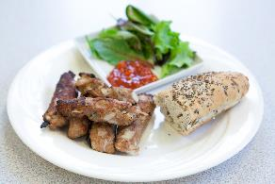
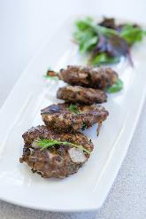
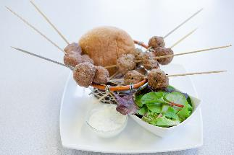
Development of idea
You have 10 minutes to create three recipe concepts considering the brief and target market.
Provide feedback on the three ideas.

Slide 9
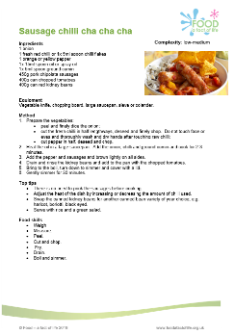
How to write a recipe
Name of the recipe using words which accurately describe the dish.​
Create a catchy short description explaining the history of the dish or its potential use.​
Note the cooking time and number of servings the recipe produces.​
List the ingredients in order of use and include measurements.​
List the equipment required, in order of use.​
List the method in logical stages, including ingredient preparation directions.​
Add any top tips, e.g. ingredient substitutions or serving suggestions.

Slide 10
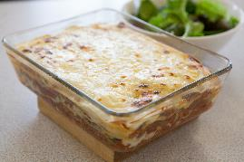
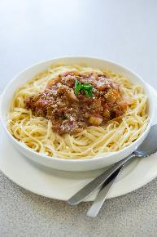
Evaluation criteria
You will be asked to answer these questions following the challenge.​
What were my original aims?​
How does the finished recipe meet the aims?​
Describe any difficulties when making the recipe.​
What did I like best about this recipe?​
Did I finish on time?​
Does the recipe taste good and look inviting?​
What do other people think about my recipe?​
Can I improve this recipe in any way?

Slide 11
Meals with mince
For further information, go to:
www.foodafactoflife.org.uk

