Slide 1
Breakfast

Slide 2

Have breakfast
Breakfast helps get the day off to a good start by providing some of the energy and nutrients your child needs for good health, e.g. starchy carbohydrates, fibre, B vitamins, calcium and iron.
Some studies suggest that having a healthy breakfast can help to improve cognitive function and academic performance in children and young people.

Slide 3

Don’t skip breakfast!
Don’t skip breakfast is one of the Government’s eight tips for healthy eating.
Make time for breakfast – just waking up 10 minutes earlier for your child to have time for something to eat and drink can make a big difference to the day.

Slide 4
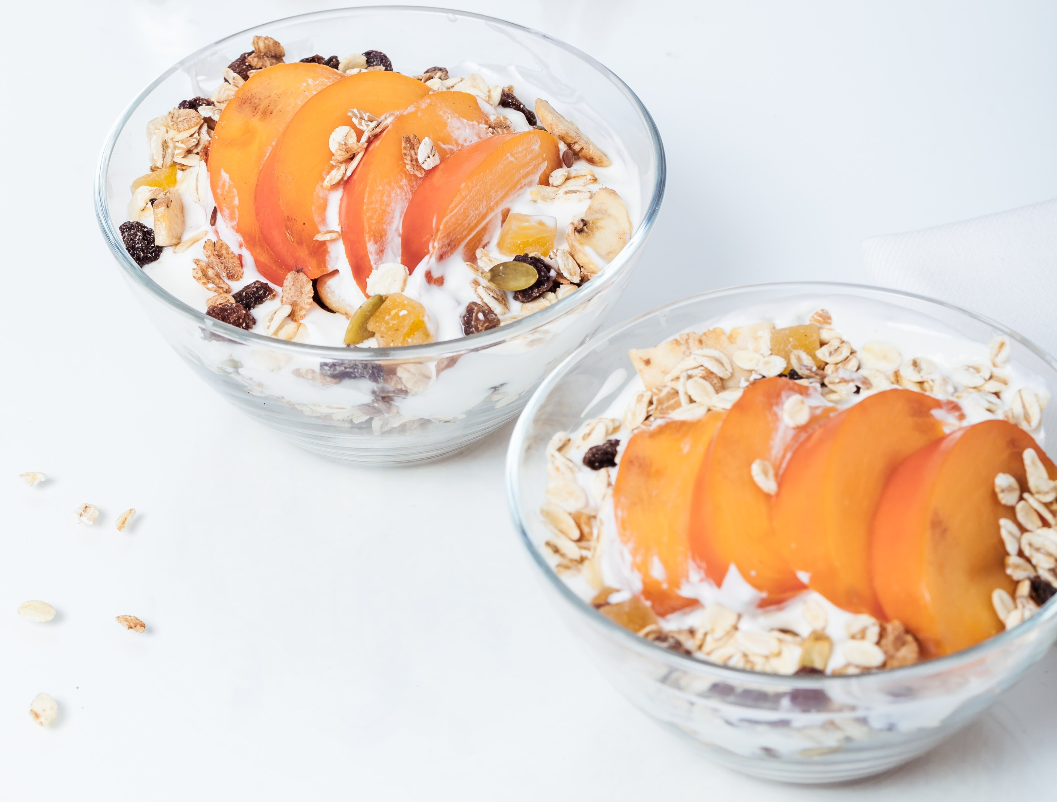
Starchy carbohydrates
Starchy carbohydrates are the best source of energy for your growing child. Choose a variety of wholegrains and high fibre versions such as wholegrain breakfast cereals with no added sugar, wholemeal bread and oats. These foods provide fibre which is important for a healthy digestive system.
Look for breakfast cereals that are lower in salt, sugars and saturated fat. Check the labels!

Slide 5
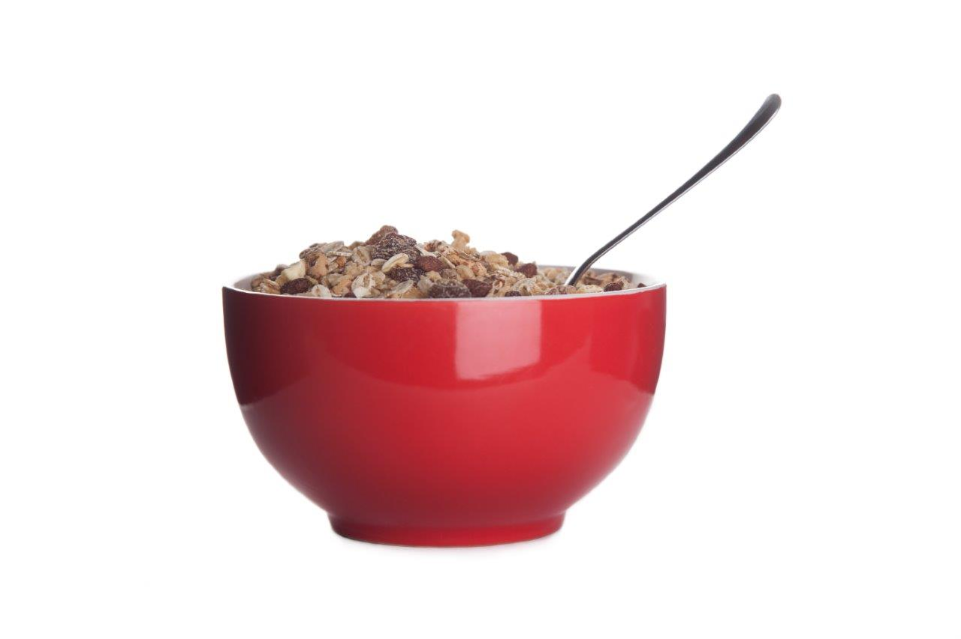
Starchy carbohydrates
Healthy breakfast ideas:
Wheat biscuits with semi-skimmed milk, a banana and a glass of water.
Overnight oats or bircher museli with berries, chopped nuts and a glass of semi-skimmed milk or calcium-fortified dairy alternative.
Porridge with sultanas and a 150 ml glass of orange juice.
Wholegrain toast with peanut butter.

Slide 6
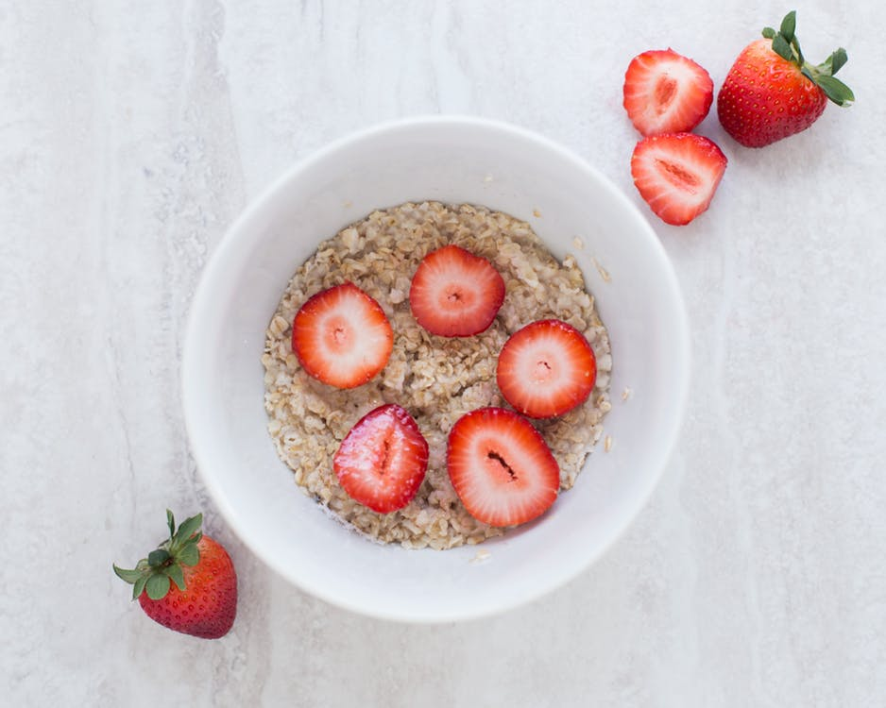
Fruit and vegetables
Breakfast is a great opportunity to offer your child fruit and vegetables!
Include at least one portion of the recommended 5 A DAY, e.g. chopped banana, a handful of berries, an apple or a pear, grilled tomatoes or mushrooms.

Slide 7
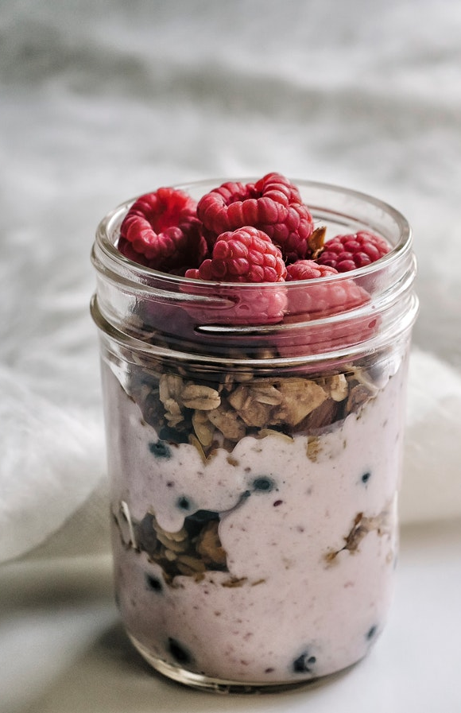
Fruit and vegetables
Healthy breakfast ideas:
Cheese and mushroom omelette, wholemeal toast, an apple and a glass of water.
Porridge with grated apple, raisins and 150 ml fresh orange juice.
Bran flakes with semi-skimmed milk, blueberries, and a glass of water.

Slide 8

A source of protein
Having breakfast, particularly one which includes protein, may help to keep your child feeling full and less likely to snack on less healthy food. Protein also helps support growth and repair of muscles. Therefore, you may choose to include a source of protein such as eggs or beans with breakfast.
If your child is having a cooked breakfast, healthier options include scrambled eggs or poached eggs, beans, tomatoes and mushrooms. Beans and eggs are lower in saturated fat than bacon and sausages.

Slide 9
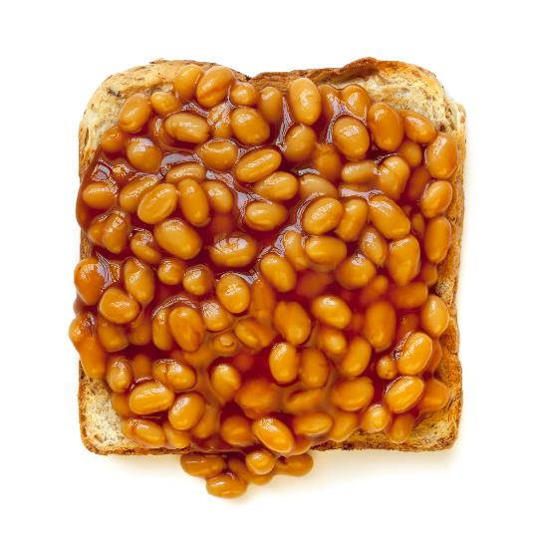
A source of protein
Healthy breakfast ideas:
Baked beans (no added sugar) on wholemeal toast and a glass of semi-skimmed milk.
Toasted crumpets with peanut butter, a pear, and a glass of semi-skimmed milk.
Cheese and mushroom omelette, an apple and a glass of water.

Slide 10
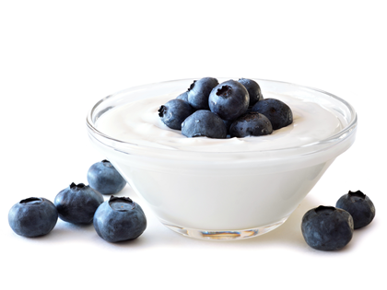
Dairy and dairy alternatives
It’s a good idea to include dairy foods such as milk, yogurt, cheese or calcium-fortified dairy alternatives such as soya drinks and soya yogurt. Choose lower fat and unsweetened options. Milk and dairy foods are sources of calcium, which is needed to develop and help maintain strong bones and teeth.

Slide 11
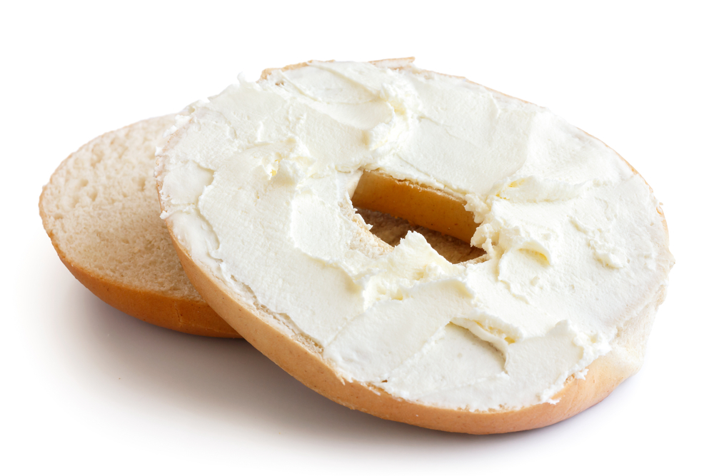
Dairy and dairy alternatives
Healthy breakfast ideas:
Plain, Greek-style yogurt and oats with berries, a banana and a glass of water.
Wheat biscuits with semi-skimmed milk, strawberries and a glass of water.
Bagel with lower fat soft cheese, smoked salmon and a glass of water.

Slide 12

Start the day hydrated
Always include a drink with breakfast. Water and lower fat milks are good choices.
100% fruit juices and smoothies count towards one of the recommended 5 A DAY but should be limited to a combined maximum of 150ml per day.

Slide 13

Food high in sugar, salt and fat
Try not to give your child food such as pastries, sweet muffins and croissants too often as they tend to be high in energy (calories), sugar and saturated fat.

Slide 14
Have a think
What do you usually give your child for breakfast?
What three features do you think a healthy breakfast should include?

Slide 15

A healthy breakfast
A healthy breakfast will give your child a good start to the day. A healthy breakfast should include:
starchy foods, preferable wholegrains and other higher fibre versions;
at least one portion of the recommended 5 A DAY;
an unsweetened drink to help start the day hydrated.
You may also choose to offer a source of protein and a dairy food or dairy alterative.
Will you make any changes to the breakfasts you give your child based on this information?

Slide 16
Make the healthier choice
The following activities are aimed to summarise learning about breakfast within the context of the Eatwell Guide.

Slide 17
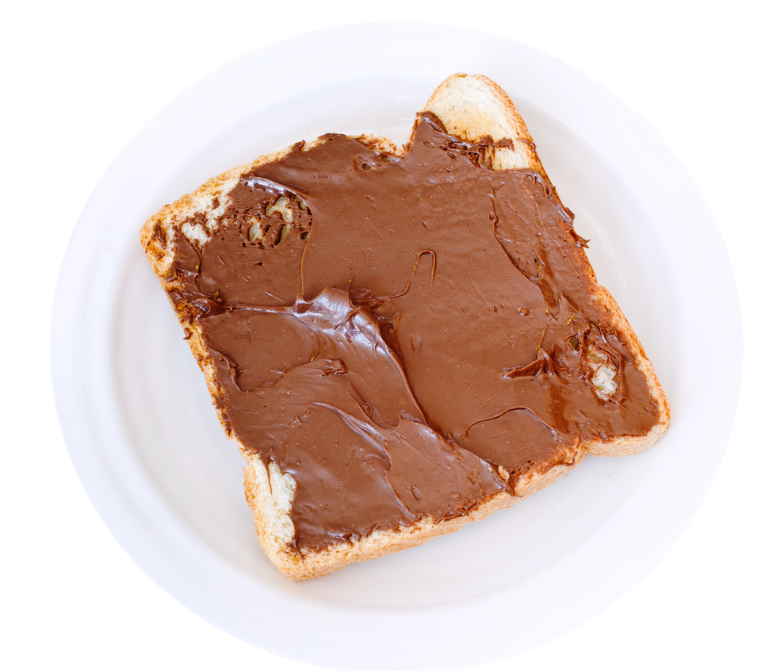
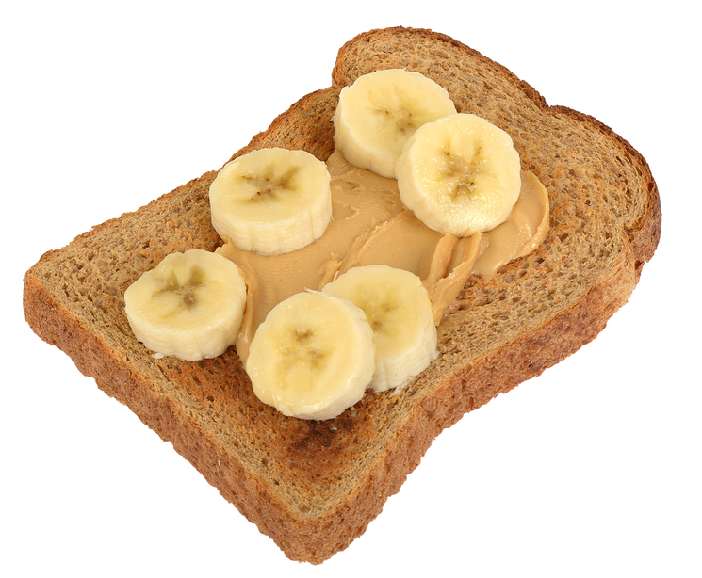
Which one?
Which breakfast is the healthier option for your child? Give three reasons why your choice is the healthier option.
Wholemeal bread
✔
1 of the 5 A DAY!
Peanut butter: a source of protein

Slide 18
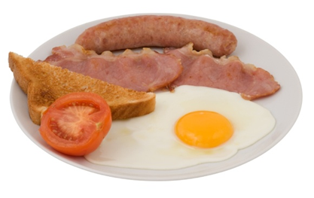
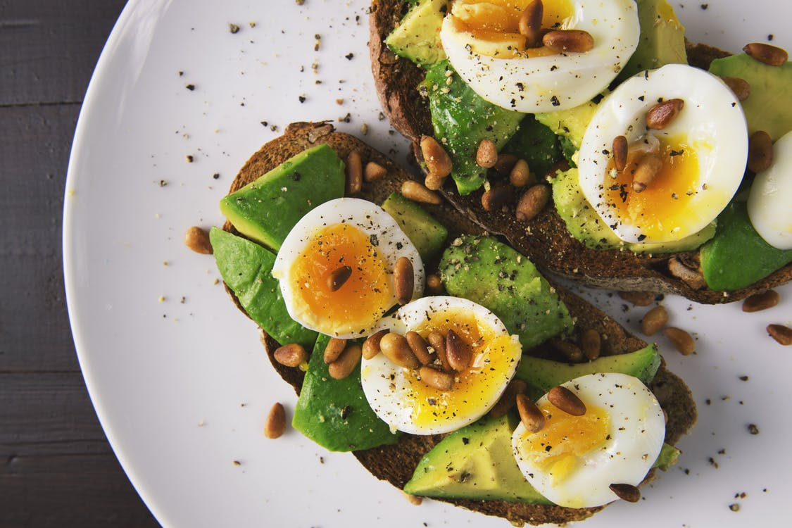
Which one?
Which breakfast is the healthier option for your child and why? Give three reasons why your choice is the healthier option.
½ an avocado: 1 of the 5 A DAY!
✔
Lower in saturated fat
Wholegrain toast: source of fibre
Boiled eggs with ½ an avocado on wholegrain toast,
Fried egg with tomato, toast bread (white), fried bacon and sausage

Slide 19
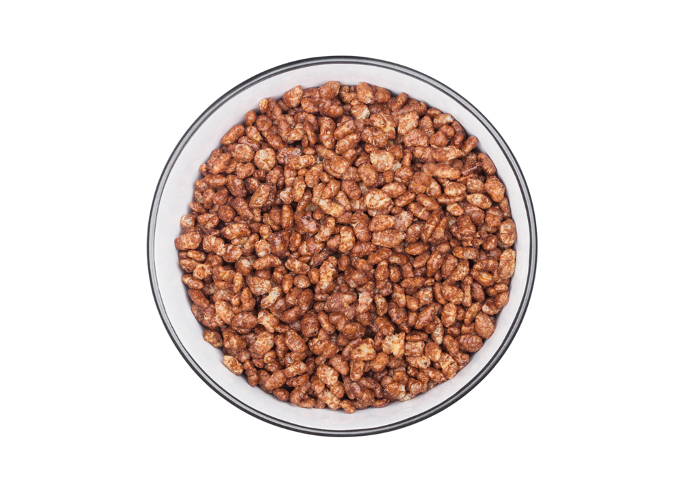
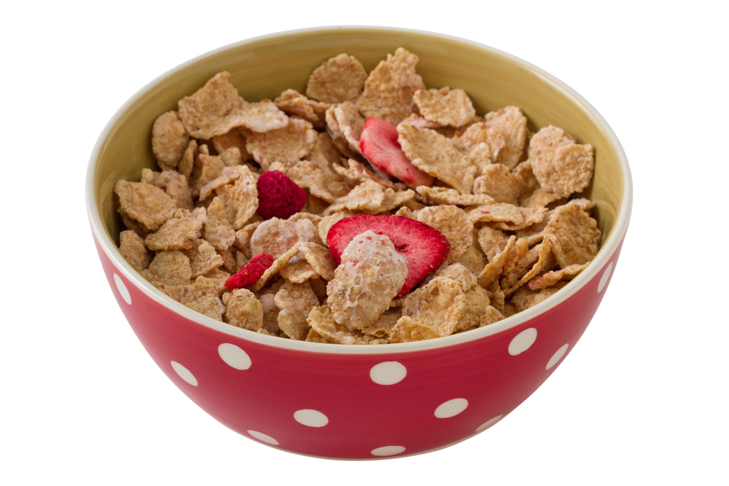
Which one?
Which breakfast is the healthier option for your child and why? Give three reasons why your choice is the healthier option.
Source of fibre
✔
Counts towards 5 A DAY
Lower in sugar
Wholegrain cereal with fruit
Chocolate cereal

Slide 20
Have breakfast
For further information, go to:
www.nutrition.org.uk

