Slide 1
Eat well

Slide 2

Eat well
A healthy, balanced and varied diet is important for your child’s health. Because they are growing and developing, children have higher energy (calorie) and nutrient requirements for their body size compared to adults.

Slide 3
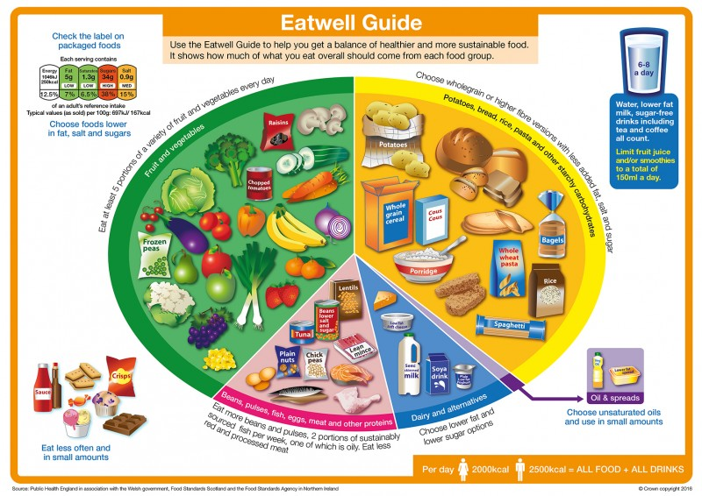
The Eatwell Guide
In the UK, the healthy eating model is known as the Eatwell Guide.
The Eatwell Guide shows the proportions in which different food groups are needed to make up a healthy, balanced diet.
The proportions shown are representative of food eaten over a day or more, not necessarily at each meal time.
Children’s diets from the age of 5 should be based on the principles of the Eatwell Guide.

Slide 4
Food groups
The five main groups of the Eatwell Guide are:
Fruit and vegetables
Potatoes, bread, rice, pasta and other starchy carbohydrates
Beans, pulses, fish, eggs, meat and other proteins
Dairy and alternatives
Oils and spreads
It is important to choose a variety of different food from each food group to help your child get the wide range of nutrients their body needs to stay healthy.

Slide 5
Key messages
Eat at least 5 portions of a variety of fruit and vegetables every day.
Base meals on potatoes, bread, rice, pasta or other starchy carbohydrates; choose wholegrain versions where possible.
Eat some beans, pulses, fish, eggs, meat and other proteins (including 2 portions of fish every week, one of which should be oily).
Have some dairy or dairy alternatives (such as soya drinks); choose lower fat and lower sugar options.
Choose unsaturated oils and spreads and eat in small amounts.
Have 6-8 unsweetened drinks every day.

Slide 6
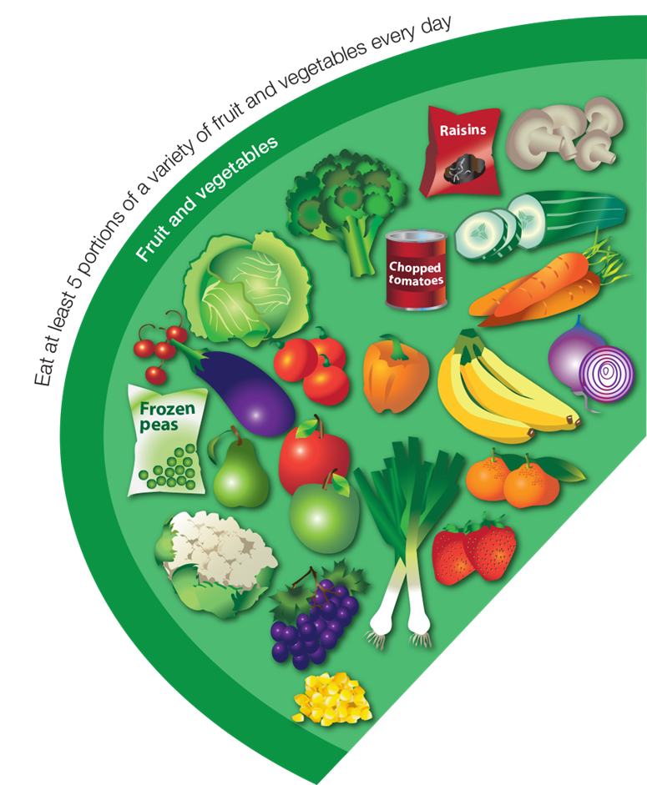
Fruit and vegetables
Children should eat at least 5 portions of fruit and vegetables every day.
Fruit and vegetables provide a range of different vitamins and minerals needed for health. They also provide fibre which is important a healthy digestive system.

Slide 7











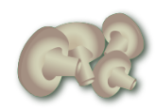


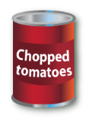







Fruit and vegetables
What counts?
Fresh, frozen, canned or dried – all count!
Portion sizes for children and young people will vary depending on their size and age. As a guidance, a portion is what fits into the palm of the individual’s hand.
150ml of unsweetened 100% fruit/vegetable juice or smoothie counts towards the 5 A DAY – but only one portion.
Encourage your child to eat a variety of fruit and vegetables everyday, as each type provides different amounts and combinations of nutrients. Dried fruit and dried fruit products can stick to teeth so should be eaten at mealtimes, not as a between-meal snack, to reduce impact on teeth.

Slide 8
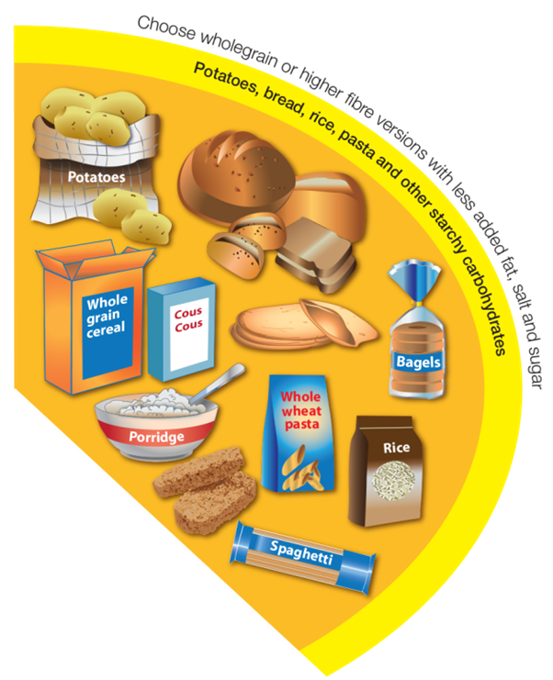
Potatoes, bread, rice, pasta and other starchy carbohydrates
Base your child’s meals on this food group – include food from this group with every main meal.
Starchy carbohydrates are the best source of energy for your growing child. They also contain fibre which is important for a healthy digestive system.

Slide 9
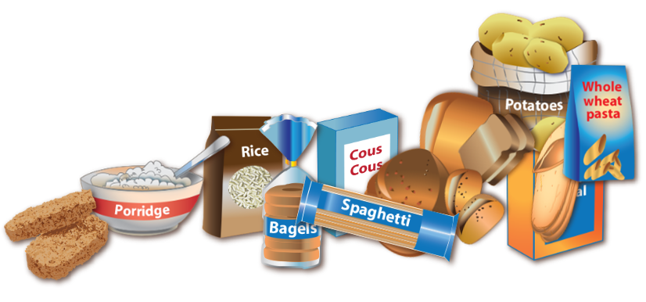
Potatoes, bread, rice, pasta and other starchy carbohydrates
Offer a variety of different starchy food – choose high fibre and wholegrain varieties as much as possible as they usually contain more fibre, vitamins and minerals.
Food examples include: bread and bread products, potatoes, breakfast cereals, pasta, rice, oats, couscous and other grains (quinoa, bulgur wheat, barley).

Slide 10
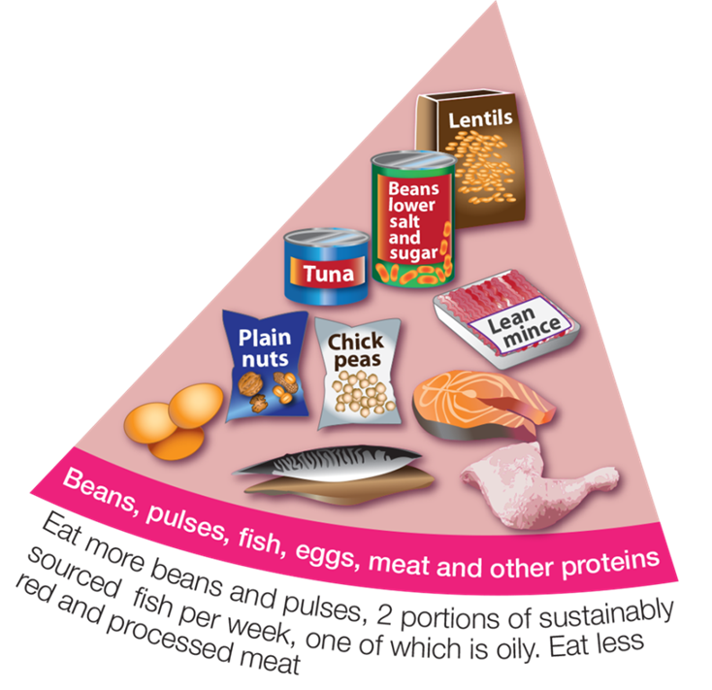
Beans, pulses, fish, eggs, meat and other proteins
This food group provides protein, which children need to grow and develop as well as other important nutrients like iron and zinc.
Food examples include beans, lentils, peas, fish (white and oily), soya products, eggs, lean meat and dairy products.

Slide 11









Beans, pulses, fish, eggs, meat and other proteins
Try to include more plant sources of protein such as beans, pulses, nuts and seeds. They are inexpensive, high in fibre and naturally lower in fat than animal sources of protein. One portion per day also counts towards the 5 A DAY recommendation.
We’re all recommended to eat at least two portions of fish a week (2 x 140g), one of which should be oily fish. Examples of oily fish include salmon, mackerel, trout or sardines.
It’s also a good idea not to have too much red and processed meat. The term processed meat includes sausages, bacon, cured meats and reformed meat products.

Slide 12
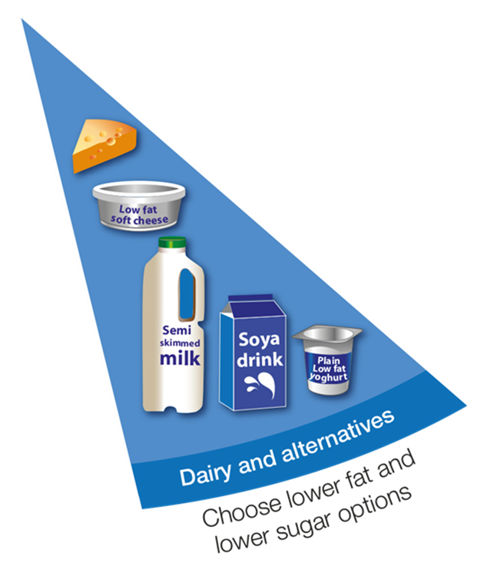
Dairy and alternatives
Food from this group provides protein, calcium, iodine and B vitamins.
Dairy and dairy alternative products are an important source of calcium which is needed for the development and maintenance of strong bones and teeth.
Food examples include milk, cheese, yogurt, fromage frais, and calcium fortified dairy alternatives.

Slide 13





Dairy and alternatives
Some dairy food can be high in fat and saturated fat – choose lower fat and lower sugar options.
For example, try:
1% fat milk which contains about half the fat of semi-skimmed milk without a noticeable change in taste or texture (note that 1% milk isn’t suitable for under 5s);
reduced fat cheese, which is also widely available;
having a smaller amount of the full-fat varieties less often;
going for unsweetened, calcium-fortified versions when buying dairy alternatives.

Slide 14
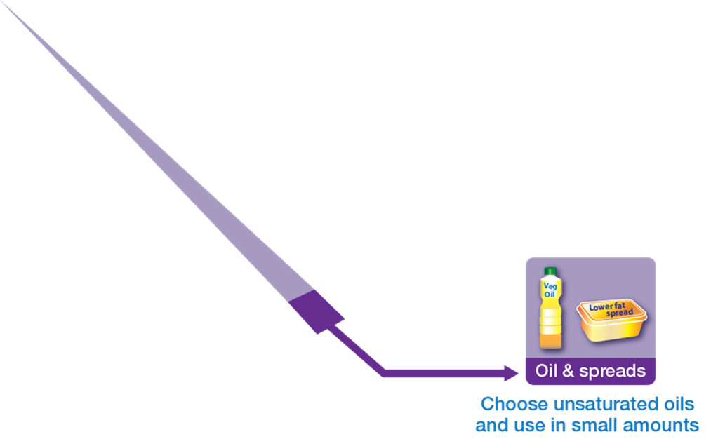
Oils and spreads
Some fat is needed in the diet but it needs to be the right type of fat and in the right amount. Choose unsaturated oils and spreads made from unsaturated oils and use in small amounts.
Generally we are eating too much saturated fat and should be reducing this and choosing unsaturated fats.
Sources of unsaturated fat include olive, rapeseed, sunflower and corn oils, oily fish, nuts and seeds.
Sources of saturated fat include animal products such as fatty meats, butter, lard, ghee, and dairy products and foods made with these such as cakes, biscuits and pastries.

Slide 15

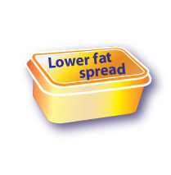
Oils and spreads
Too much saturated fat can increase the risk of your child developing serious health conditions later in life such as heart disease. Replace saturated fats in your child’s diet with unsaturated fats wherever possible.
Remember that all types of fat are high in energy (calories) and should be limited in the diet.

Slide 16
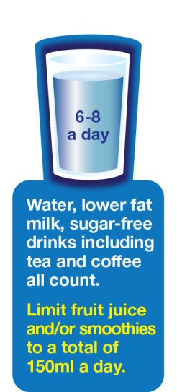
Hydration
Encouraging children to drink fluids regularly is important as children may not remember to have a drink by themselves.
The amount of fluid a child needs depends on many factors including their age, their size, the weather and how much physical activity they do but generally they should aim to have at least 6-8 unsweetened drinks every day.
You can find the BNF hydration guide on healthy drink choices for children at www.nutrition.org.uk/healthyliving/hydration

Slide 17

Hydration
What counts?
Water is a good choice throughout the day because it hydrates without providing extra energy (calories) or harming teeth. Children should aim to drink water regularly!
Milk is a useful source of nutrients, especially protein, B vitamins, iodine and calcium. Go for 1% or semi-skimmed. Unsweetened, calcium-fortified dairy alternatives can also be included (note that skimmed or 1% milks are not suitable for under 5s).
Fruit juice and smoothies also count, although they are a source of free sugars and so they should be limited to no more than a combined total of 150ml per day.

Slide 18
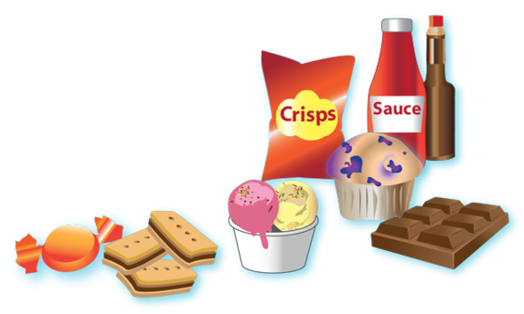
Foods to eat less often and in small amounts
Food that is high in salt, saturated fat and sugar are not needed as part of a healthy, balanced diet. If it is consumed it should be infrequently and in small amounts.
Examples are products such as chocolate, cakes, biscuits, full-sugar soft drinks, butter and ice-cream.
Check the label and avoid giving your child food that is high in fat, salt and sugar.

Slide 19
Key messages - summary
Eat at least 5 portions of a variety of fruit and vegetables every day.
Base meals on potatoes, bread, rice, pasta or other starchy carbohydrates; choose wholegrain versions where possible.
Eat some beans, pulses, fish, eggs, meat and other proteins (including 2 portions of fish every week, one of which should be oily).
Have some dairy or dairy alternatives (such as soya drinks); choose lower fat and lower sugar options.
Choose unsaturated oils and spreads and eat in small amounts.
Have 6-8 unsweetened drinks every day.
If consuming food and drinks high in fat, salt or sugar have these less often and in small amounts.

Slide 20
Eat well
The following activity is intended to summarise learning about a healthy, balanced diet within the context of the Eatwell Guide.

Slide 21
Making healthier choices with the Eatwell Guide
How does this diet compare to the Eatwell Guide?
What types of starchy carbohydrate were included?
How many portions of fruit and vegetables were included?
What is good about this diet?
What could be improved?
Breakfast: toast (white) with raspberry jam.
Lunch: jacket potato with tuna mayonnaise sweetcorn and carrot sticks.
Evening meal: spaghetti Bolognese (white spaghetti).
Snacks: Cream crackers and peanut butter
Drinks: 6 glasses of water, 300ml orange juice, 1 glass of whole milk.

Slide 22
Making healthier choices with the Eatwell Guide
Potatoes, bread, rice, pasta or other starchy carbohydrates
The three main meals, breakfast, lunch and evening meal were all based on starchy carbohydrates.
High fibre varieties were only included for lunch (jacket potato). The Eatwell Guide recommends basing meals on starchy carbohydrates, choosing wholegrain versions where possible. To include more wholegrains and high fibre varieties, swap white toast for wholemeal, spaghetti for whole-wheat spaghetti and cream crackers for oatcakes.
Breakfast: wholemeal toast with raspberry jam.
Lunch: jacket potato with tuna mayonnaise sweetcorn and carrot sticks.
Evening meal: spaghetti Bolognese with wholewheat spaghetti.
Snacks: oatcakes and peanut butter; 2 chocolate biscuits
Drinks: 6 glasses of water, 300ml orange juice, 1 glass of whole milk.

Slide 23
Making healthier choices with the Eatwell Guide
Fruit and vegetables
This diet included three portions of the recommended 5 A DAY, i.e. sweetcorn, carrot sticks, orange juice.
The Eatwell Guide recommends eating at least 5 portions of a variety of fruit and vegetables every day.
To include more fruit and vegetables, add some fruit for breakfast, at main meals and as a snack.
Fruit juice and smoothies do count, although they are a source of free sugars and so they should be limited to no more than a combined total of 150ml per day. Replace 300ml to 150ml orange juice.
Breakfast: wholemeal toast with raspberry jam and a banana.
Lunch: jacket potato with tuna mayonnaise sweetcorn and carrot sticks.
Evening meal: spaghetti Bolognese with mixed salad and wholewheat spaghetti.
Snacks: Oatcakes and peanut butter and an apple; 2 chocolate biscuits
Drinks: 6 glasses of water, 150ml orange juice, 1 glass of whole milk.

Slide 24
Making healthier choices with the Eatwell Guide
Beans, pulses, fish, eggs, meat and other proteins
The diet included tuna and also included nuts which are a good source of protein. Milk is also a good source of protein.
Breakfast: wholemeal toast with raspberry jam and a banana.
Lunch: jacket potato with tuna mayonnaise sweetcorn and carrot sticks.
Evening meal: spaghetti Bolognese with mixed salad and wholewheat spaghetti.
Snacks: Oatcakes and peanut butter and an apple; 2 chocolate biscuits
Drinks: 6 glasses of water, 150ml orange juice, 1 glass of whole milk.

Slide 25
Making healthier choices with the Eatwell Guide
Dairy or dairy alternatives
The diet included a glass of whole milk.
If your child is over 2 years old and eating well you can swap whole milk for semi-skimmed milk.
Breakfast: wholemeal toast with raspberry jam and a banana.
Lunch: jacket potato with tuna mayonnaise sweetcorn and carrot sticks.
Evening meal: spaghetti Bolognese with mixed salad and wholewheat spaghetti.
Snacks: Oatcakes and peanut butter and an apple; 2 chocolate biscuits
Drinks: 6 glasses of water, 150ml orange juice, 1 glass of semi-skimmed milk.

Slide 26
Making healthier choices with the Eatwell Guide
Oil and spreads
The Eatwell guide recommends choosing unsaturated oils and spreads and using them in small amounts.
Mayonnaise can be high in fat and saturated fat. Swap general mayonnaise in the tuna mayonnaise for lower mayonnaise or an alternative such as lower fat cottage cheese.
When preparing the spaghetti Bolognese, use a small amount of unsaturated oil such as olive oil and vegetable oil.
Breakfast: wholemeal toast with raspberry jam and a banana.
Lunch: jacket potato with tuna mayonnaise (lower fat), sweetcorn and carrot sticks.
Evening meal: spaghetti Bolognese with mixed salad and wholewheat spaghetti.
Snacks: Oatcakes and peanut butter and an apple; 2 chocolate biscuits
Drinks: 6 glasses of water, 150ml orange juice, 1 glass of semi-skimmed milk.

Slide 27
Making healthier choices with the Eatwell Guide
Drinks
The Eatwell Guide recommends having 6-8 drinks every day.
This diet included 8 drinks in total.
Breakfast: wholemeal toast with raspberry jam and a banana.
Lunch: jacket potato with tuna mayonnaise (lower fat), sweetcorn and carrot sticks.
Evening meal: spaghetti Bolognese with mixed salad and wholewheat spaghetti.
Snacks: Oatcakes and peanut butter and an apple; 2 chocolate biscuits
Drinks: 6 glasses of water, 150ml orange juice, 1 glass of semi-skimmed milk.

Slide 28
Making healthier choices with the Eatwell Guide
Foods high in sugar, salt and saturated fat
These foods are not needed in the diet. If they are included, they should be consumed infrequently and in small amounts.
Chocolate biscuits are high in fat and sugar – swap to a slice of malt loaf
Raspberry jam is also high in free sugars so you could go for something less sugary like peanut butter or lower fat soft cheese.
Breakfast: wholemeal toast with lower fat soft cheese and a banana.
Lunch: jacket potato with tuna mayonnaise (lower fat), sweetcorn and carrot sticks.
Dinner: spaghetti Bolognese with mixed salad and wholewheat spaghetti.
Snacks: Oatcakes and peanut butter and an apple; a slice of malt loaf
Drinks: 6 glasses of water, 150ml orange juice, 1 glass of semi-skimmed milk.

Slide 29
Making healthier choices with the Eatwell Guide
Take a look at the diet now!
How does this diet compare to the Eatwell Guide?
What types of starchy carbohydrate were included?
Wholegrains and other high fibre varieties
How many portions of fruit and vegetables were included?
Six!
What is good about this diet?
It is based on the principles of the Eatwell Guide.
You can make healthier choices by following the principles of the Eatwell Guide. For more information go to https://bit.ly/2BjWO99
My healthy, balanced diet:
Breakfast: wholemeal toast with lower fat soft cheese and a banana.
Lunch: jacket potato with tuna mayonnaise (lower fat), sweetcorn and carrot sticks.
Evening meal: spaghetti Bolognese with mixed salad and wholewheat spaghetti.
Snacks: Oatcakes and peanut butter and an apple; slice of malt loaf.
Drinks: 6 glasses of water, 150ml orange juice, 1 glass of semi-skimmed milk.

Slide 30
Eat well
For further information, go to:
www.nutrition.org.uk

