Slide 1
Healthy Lunchbox

Slide 2

Healthy lunchbox
This presentation is for parent/carers who are interested in knowing about how to build a healthy lunchbox for children!
Before we start – could your child have a school meal? Meals served in the UK (with the exception of some academies in England) have to comply with regulatory standards for the food provided and it is often easier to get the essential nutrients children need in a cooked meal than in a packed lunch.

Slide 3
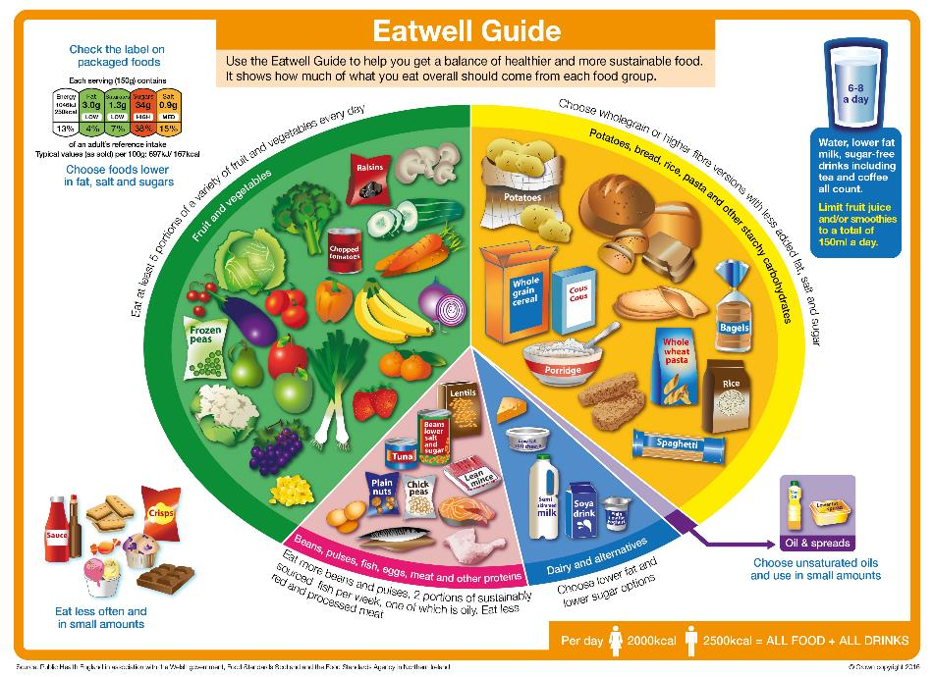
The Eatwell guide
A healthy, balanced lunchbox should be based on the principles of the Eatwell Guide, the UK’s healthy eating model. The Guide shows the proportions in which different types of foods are need to have a well-balanced and healthy diet.
The Eatwell Guide applies to all children from the age of five.
Children aged between two and five should gradually begin to eat the same foods as the rest of the family, in the proportions shown in the Eatwell Guide.

Slide 4

What should a healthy lunchbox look like?
A healthy, balanced lunchbox should be based on the principles of the Eatwell Guide and should include:
Starchy carbohydrates, e.g. potatoes, bread, rice and pasta - choose wholegrain or higher fibre versions when possible!
Plenty of fruit and vegetables – aim for a variety!
A portion of beans, pulses, fish, eggs, meat and other proteins.
A dairy food or calcium fortified dairy alternative.
A drink, e.g. water semi-skimmed milk or 1% milk.
A small amount of unsaturated oils and spreads (if included).
✔
✔
✔
✔
✔
✔

Slide 5
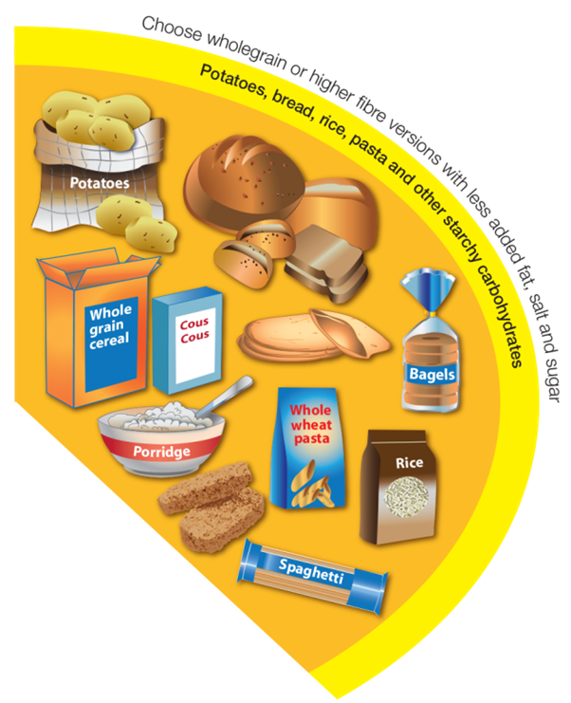
Potatoes, bread, rice, pasta and other starchy carbohydrates
A healthy, balanced lunchbox should be based on starchy carbohydrates.
Choose wholegrain or other high fibre varieties where possible, with less added fat, salt and sugar, e.g. wholemeal bread and potatoes with their skins on.
Wholegrains provide fibre which is important for the digestive system and can help reduce the risk of certain diseases in adulthood.

Slide 6
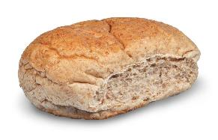
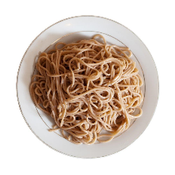
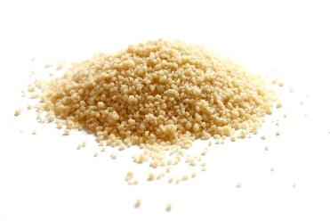



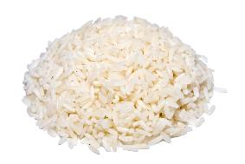

Potatoes, bread, rice, pasta and other starchy carbohydrates
Examples of starchy carbohydrates that can be included in the lunchbox:
wholemeal bread
pasta
couscous
pitta
baked potato with skin
tortilla wrap
chapatti
rice

Slide 7
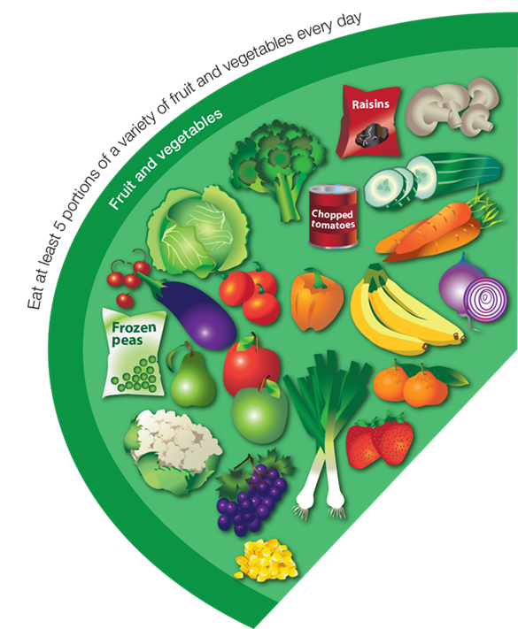
Fruit and vegetables
Include plenty of vegetables and fruit in the lunchbox – at least 1-2 portions!
Aim for a variety of colours - each type of fruit and vegetable provides different amounts and combinations of nutrients.
Fresh, frozen, canned and dried – all count!

Slide 8


Fruit and vegetables
You could add sliced vegetables into a sandwich, rice or pasta dish.
You could include vegetables for dipping with a small pot of reduced fat hummus.
Supermarkets often have packs of chopped fresh fruit or vegetables. You could keep some of these in the fridge or prepare your own in advance for those days when you don’t have much time!
Dried fruit counts towards your 5 A DAY, but can stick to teeth so should only be eaten at mealtimes to reduce the impact on teeth.

Slide 9
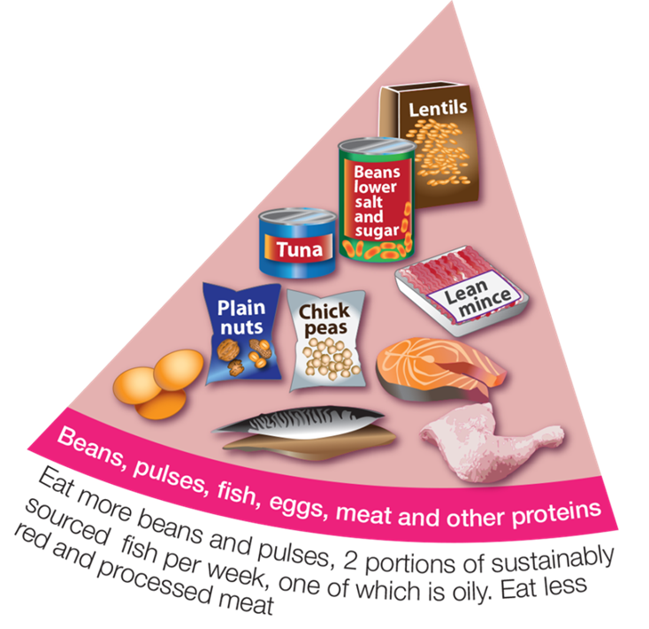
Beans, pulses, fish, eggs, meat and other proteins
Include a portion of beans, pulses, fish, eggs, meat, a dairy food and/or a non-dairy source of protein. These foods are good sources of protein, vitamins and minerals.
Beans and pulses are inexpensive, high in fibre and naturally lower in fat than animal sources of protein, and one portion per day can also count as one of your 5 A DAY!

Slide 10

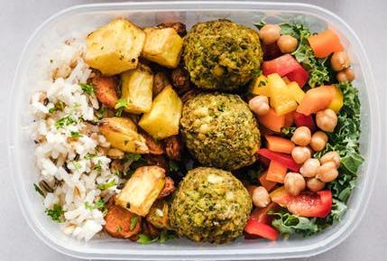
Beans, pulses, fish, eggs, meat and other proteins
Use beans, pulses, fish, eggs, meat and other sources of protein as sandwich fillings or in a pasta or rice salad.

Slide 11
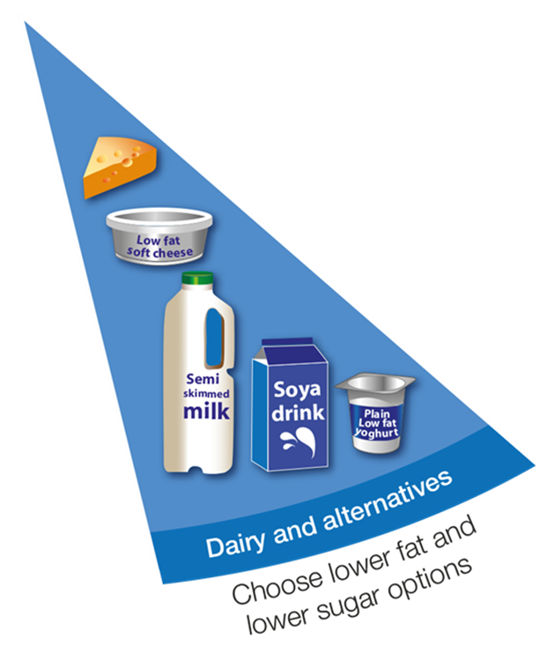
Dairy and alternatives
Add a dairy food or dairy alternative to the lunchbox – choose lower fat and lower sugar options.
These foods are an important source of calcium, protein and iodine.

Slide 12



Dairy and alternatives
If you’re not including a dairy food in the main lunch item (e.g. in a salad or sandwich), add a yogurt or a portion of cheese such as a stick of Cheddar cheese or cheese triangle to the lunchbox.
If you’re including a dairy alternative, e.g. soya yogurt or milk, choose varieties which are unsweetened and fortified with calcium.

Slide 13

Drinks
A packed lunch should include a drink.
Healthy options include water, semi-skimmed or 1% milk.
You could also give your child fruit juice or smoothie – but remember, fruit juice and smoothies should be limited to a combined total of 150ml a day.

Slide 14


Breaktime snacks
Avoid giving your children dried fruit as a breaktime snack as they are high in sugar and can be harmful to their teeth, instead only offer at meal times to reduce impact on teeth.
Ideas for healthier breaktime snacks:
whole or sliced fruit;
vegetable sticks, e.g. celery, carrot, pepper, cucumber. Some vegetables are naturally baton shaped which can save preparation time for example, sugar snap peas and baby corn;
bag of plain popcorn;
bread sticks;
unsalted nuts (check your child’s schools policy on nuts first as some schools do not allow nuts to be brought in);
rice or corn cakes.

Slide 15

Healthier treat alternatives
A healthy lunchbox can include other food. You may like to consider same of the following ideas from time to time. Remember to check your child’s school food policy first.
Here are some ideas that your child may like:
malt loaf or teacake;
fruit jelly;
plain, fruit or cheese and chive scones;
rice pudding.
You could even get children involved in making these yourselves.

Slide 16
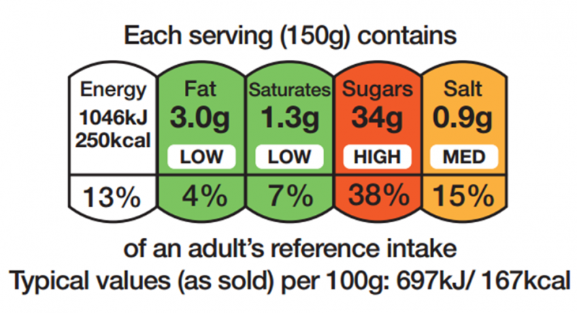
Reading the labels
To help find healthier options to add to your child’s lunchbox, look at nutrition labels on the front of packs. Nutrition labels can help you choose products that fit into a healthy balanced diet. Try to opt for products that have green and amber traffic lights for fat, sugar, salt and saturated fat.
Top tip! You don’t have to use food produced specifically for lunchboxes. Some foods such as meat and pasta can be eaten cold. Why not cook extra for dinner, then use any leftovers as part of your child's lunchbox for school. Some ideas include chicken sandwich or pasta salad.

Slide 17

Lunchbox safety
Most schools will not have a fridge space available for children’s lunchboxes to keep the food cool. Use an insulated lunchbox and include an ice pack or frozen drink which will melt in time for lunch.
If preparing the lunchbox the night before, remember to store it in the fridge!

Slide 18
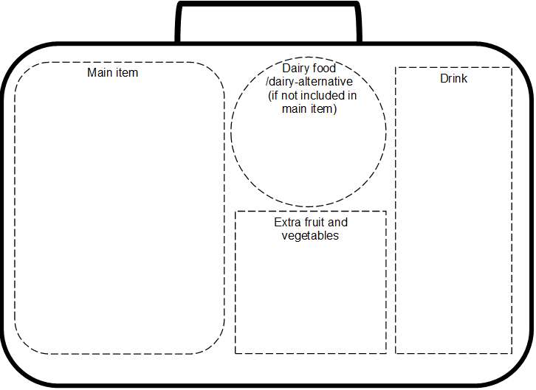
Summary
A healthy, balanced lunchbox should include:
Starchy carbohydrates, e.g. potatoes, bread, rice and pasta - choose wholegrain or higher fibre versions when possible!
Plenty of fruit and vegetables – aim for a variety!
A portion of beans, pulses, fish, eggs, meat and other proteins.
A dairy food or calcium fortified dairy alternative.
A drink, e.g. water semi-skimmed milk or 1% milk.
A small amount of unsaturated oils and spreads (if included).
✔
✔
✔
✔
✔
✔

Slide 19
Healthy lunchbox activity
The following activities are intended to summarise learning about healthy lunchboxes within the context of the Eatwell Guide.

Slide 20

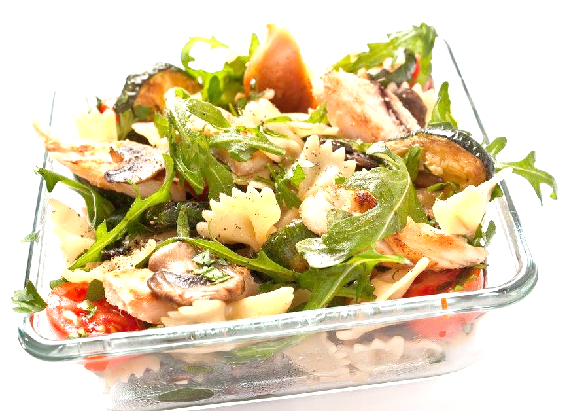

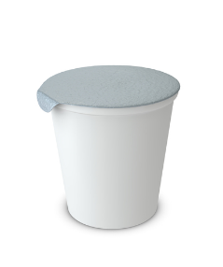
Have a change
Lunchbox checklist
Base meal on starchy food, e.g. potatoes, bread, rice, pasta and other starchy carbohydrates. Choose wholegrain or higher fibre versions when possible!
Include plenty of fruit and vegetables – aim for a variety!
Add a portion of beans, pulses, fish, eggs, meat and other proteins.
Add a dairy food or calcium fortified dairy alternative.
Include a drink, e.g. water semi-skimmed milk or 1% milk.
What changes can you make to make this lunchbox healthier?
Pasta salad with chicken, tomato, rocket and courgette, a bottle of water, plain yogurt and a blueberry muffin.

Slide 21

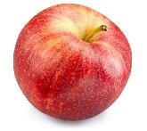
Have a change
Lunchbox checklist
Base meal on starchy food, e.g. potatoes, bread, rice, pasta and other starchy carbohydrates. Choose wholegrain or higher fibre versions when possible!
Include plenty of fruit and vegetables – aim for a variety!
Add a portion of beans, pulses, fish, eggs, meat and other proteins.
Add a dairy food or calcium fortified dairy alternative.
Include a drink, e.g. water semi-skimmed milk or 1% milk.
✔
What changes can you make to make this lunchbox healthier?
Pasta salad with chicken, tomato, rocket and courgette, a bottle of water, plain yogurt and an apple.
✔
✔
✔
✔

Slide 22




Have a change
Lunchbox checklist
Base meal on starchy food, e.g. potatoes, bread, rice, pasta and other starchy carbohydrates. Choose wholegrain or higher fibre versions when possible!
Include plenty of fruit and vegetables – aim for a variety!
Add a portion of beans, pulses, fish, eggs, meat and other proteins.
Add a dairy food or calcium fortified dairy alternative.
Include a drink, e.g. water semi-skimmed milk or 1% milk.
What changes can you make to make this lunchbox healthier?
Egg and salad sandwich with white bread, cheese triangle, orange juice and crisps.

Slide 23
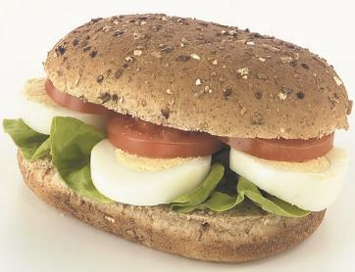

Have a change
Lunchbox checklist
Base meal on starchy food, e.g. potatoes, bread, rice, pasta and other starchy carbohydrates. Choose wholegrain or higher fibre versions when possible!
Include plenty of fruit and vegetables – aim for a variety!
Add a portion of beans, pulses, fish, eggs, meat and other proteins.
Add a dairy food or calcium fortified dairy alternative.
Include a drink, e.g. water semi-skimmed milk or 1% milk.
✔
What changes can you make to make this lunchbox healthier?
Egg and salad sandwich with wholemeal bread, cheese triangle, 150ml orange juice and sliced peppers.
✔
✔
✔
✔
150 ml
wholemeal bread

Slide 24


Missing items
Lunchbox checklist
Base meal on starchy food, e.g. potatoes, bread, rice, pasta and other starchy carbohydrates. Choose wholegrain or higher fibre versions when possible!
Include plenty of fruit and vegetables – aim for a variety!
Add a portion of beans, pulses, fish, eggs, meat and other proteins.
Add a dairy food or calcium fortified dairy alternative.
Include a drink, e.g. water semi-skimmed milk or 1% milk.
✔
What is missing from this lunchbox?
Egg sandwich with wholemeal bread, plain yogurt, and carton of milk.
✔
✔
✔

Slide 25

Missing items
Lunchbox checklist
Base meal on starchy food, e.g. potatoes, bread, rice, pasta and other starchy carbohydrates. Choose wholegrain or higher fibre versions when possible!
Include plenty of fruit and vegetables – aim for a variety!
Add a portion of beans, pulses, fish, eggs, meat and other proteins.
Add a dairy food or calcium fortified dairy alternative.
Include a drink, e.g. water semi-skimmed milk or 1% milk.
✔
What is missing from this lunchbox?
Egg sandwich with wholemeal bread, plain yogurt, carton of milk and carrot sticks.
✔
✔
✔
✔

Slide 26

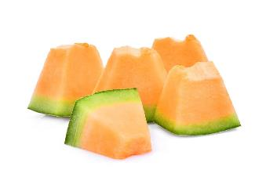
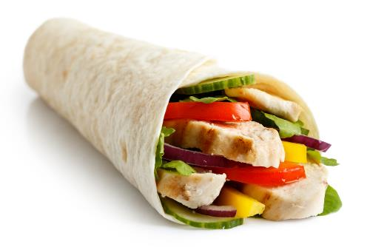

Missing items
Lunchbox checklist
Base meal on starchy food, e.g. potatoes, bread, rice, pasta and other starchy carbohydrates. Choose wholegrain or higher fibre versions when possible!
Include plenty of fruit and vegetables – aim for a variety!
Add a portion of beans, pulses, fish, eggs, meat and other proteins.
Add a dairy food or calcium fortified dairy alternative.
Include a drink, e.g. water semi-skimmed milk or 1% milk.
✔
What is missing from this lunchbox?
Tortilla wrap with chicken and vegetables, celery sticks with hummus, cheese triangle and melon.
✔
✔
✔

Slide 27
Missing items
Lunchbox checklist
Base meal on starchy food, e.g. potatoes, bread, rice, pasta and other starchy carbohydrates. Choose wholegrain or higher fibre versions when possible!
Include plenty of fruit and vegetables – aim for a variety!
Add a portion of beans, pulses, fish, eggs, meat and other proteins.
Add a dairy food or calcium fortified dairy alternative.
Include a drink, e.g. water semi-skimmed milk or 1% milk.
✔
What is missing from this lunchbox?
Tortilla wrap with chicken and vegetables, celery sticks with hummus, cheese triangle, melon and a bottle of water.
✔
✔
✔
✔

Slide 28
Healthy lunchbox
For further information, go to:
www.nutrition.org.uk

