Slide 1
Physical activity

Slide 2
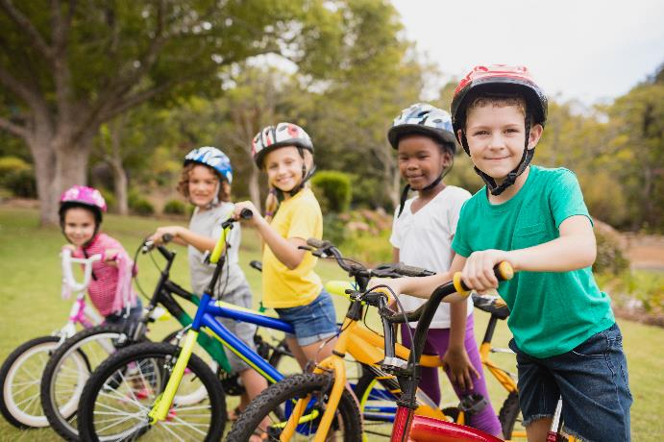
Physical activity
An active lifestyle is essential for physical health as well as mental health and wellbeing.
Encourage your child to move more, sit less and be active every day!

Slide 3
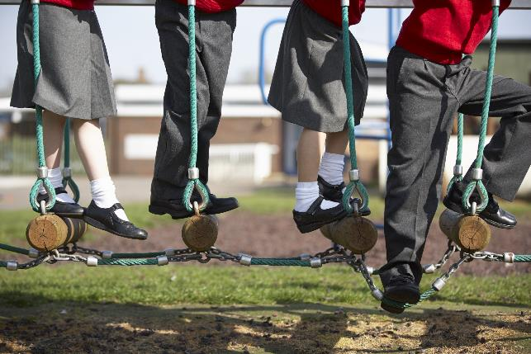
Why is it important to get active?
Physical activity is beneficial as it can:
improve sleep;
help maintain a healthy weight;
lift mood and relieve stress;
improve heart health and strengthen muscles and bones.

Slide 4
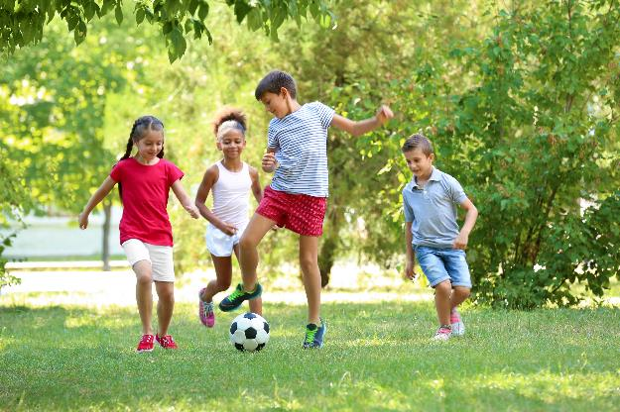
What counts?
Children and young people (aged 5-18 years) should do 60 minutes of physical activity every day, ranging from moderate to vigorous intensity.
On three days of the week this should include exercises to strengthen muscles and bones, such as gymnastics, dancing, swinging on playground equipment, playing tennis, sit-ups, press ups and football.

Slide 5
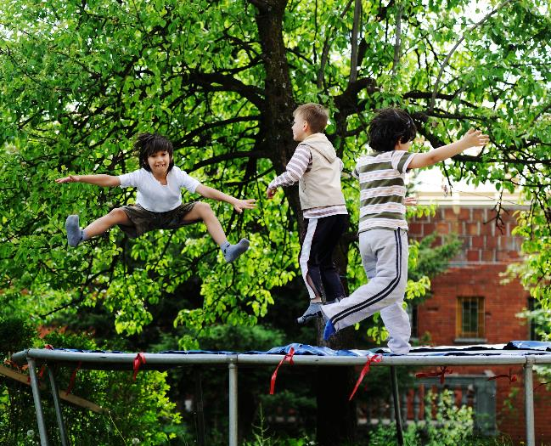
Do children meet physical activity guidelines?
Only 23% of boys and 20% of girls met the physical activity guidelines in 2015.
Statistics on Obesity, Physical Activity and Diet

Slide 6
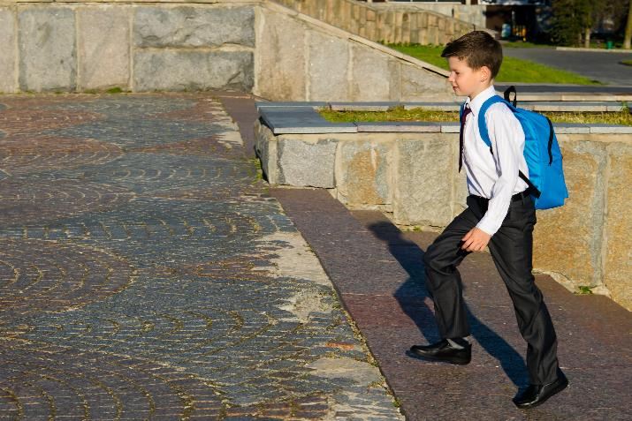
Moderate intensity activity
Moderate intensity physical activity will increase body temperature, increase the rate of breathing and make the heart beat faster.
When exercising at a moderate level, it should be possible to talk but hard to sing a song.

Slide 7
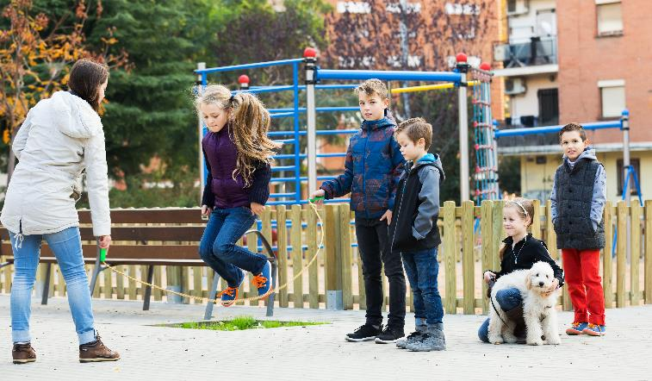
Moderate intensity activity
Examples of moderate intensity activities:
brisk walking to school;
playing in the playground;
riding a scooter;
skateboarding;
rollerblading/skating;
cycling on level ground or ground with a few hills.

Slide 8
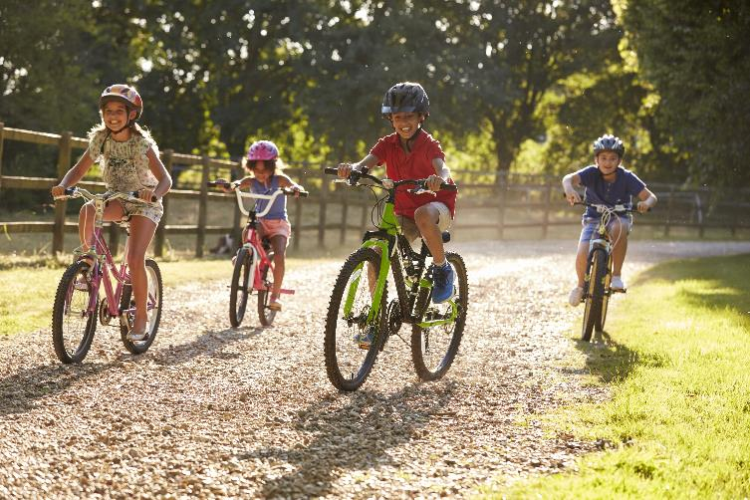
Vigorous intensity activity
Vigorous intensity physical activity will increase body temperature, make breathing even faster and heavier and make the heart beat rapidly.
When exercising at this level, it is hard to say more than a few words without pausing from breath.

Slide 9
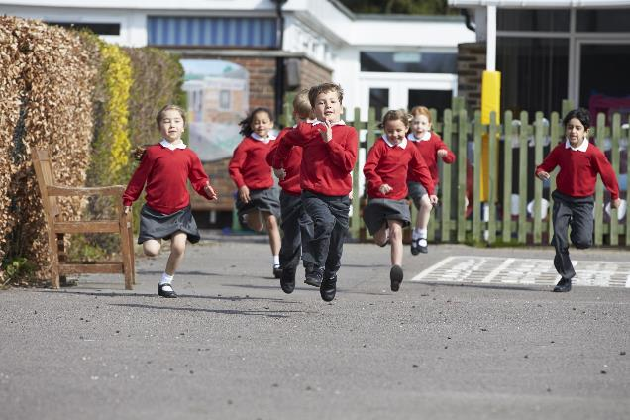
Vigorous intensity activity
Examples of vigorous intensity activities:
playing chase;
swimming;
running;
gymnastics and dancing;
cycling fast or on a hilly ground;
martial arts like karate;
organised sports such as football, rugby, netball, tennis and badminton.

Slide 10

Being physically active for life
Being active at every age increases quality of life and everyone’s chances of remaining healthy. Being physically active can help lead to a healthier happier life.
Every child will enjoy a different type of physical activity so try to encourage them to find out what they prefer as they are more likely to participate in activities they feel more comfortable taking part in.

Slide 11
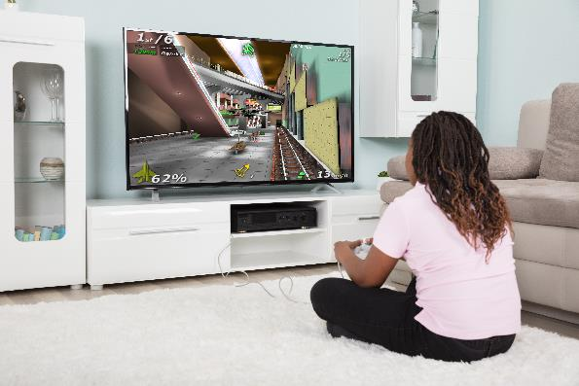
Sedentary behavior
As well as being physically active it is important that children and young people sit less, e.g. watching TV, playing computer games, travelling by car when they could walk or cycle.
This is because sedentary behaviour is bad for health.
Overtime it can increase risk of weight gain and obesity which can then increase the risk of developing serious diseases in adulthood such as heart disease, stroke, and type 2 diabetes.

Slide 12
Summary
To stay healthy or to improve health, children need to do 3 types of physical activity each week:
aerobic exercise;
exercises to strengthen their bones;
exercises to strengthen their muscles.
This is because physical activity can:
improve sleep;
help maintain a healthy weight;
lift mood and relieve stress;
improve heart health and strengthen muscles and bones.

Slide 13
Have a think
Consider some of the ways that your child is physically active.
Are they meeting the physical activity recommendations?
Could you increase the amount of physical activity they are doing?
Discuss your ideas and explain how your child would benefit from these activities.

Slide 14
Physical activity
For further information, go to:
www.nutrition.org.uk

