Slide 1
Sleep

Slide 2

Sleep
Encourage your child to get the sleep they need - every night!

Slide 3


The importance of sleep
A healthy lifestyle includes getting enough quality sleep. In the short-term, lack of sleep can make you feel irritable and moody and can affect memory and creative thinking.
Regular lack of sleep can affect health, and is linked to serious health conditions such as obesity in children and young people, and heart disease and type 2 diabetes in adults.

Slide 4

Sleep recommendations for children
Children and young people need good quality sleep to function at their best. The amount of hours that are needed vary, depending on age.
Children aged 5-11 years need around 9 ½ – 11 hours.
Children aged 11-16 years need around 9 – 9 ½ hours.
How much sleep do adults need?
Most adults need between 7-9 hours of good quality sleep a night to function at their best!
https://sleepcouncil.org.uk/

Slide 5

Sleep and bodyweight
Not getting enough quality sleep has been linked to a higher intake of energy (calories), eating more snacks and snacking on less healthy food.
Being sleep deprived can also make us feel hungrier.
Tiredness and fatigue may increase sedentary behaviour and reduce physical activity.
These factors may increase the chance of weight gain which could, overtime, lead to weight gain and obesity.

Slide 6

Practical tips for sleeping well
Good sleep is important for your child’s physical and mental wellbeing.
A relaxing bedtime routine is one important way to help your child get a good night’s sleep.
Create a ‘sleep friendly’ bedroom – a dark, quiet, cool environment
Once they're in bed, encourage your child to read quietly or listen to some relaxing music, or read a story together.
Avoid giving your child large meals just before bedtime.
Encourage physical activity during the day.

Slide 7

Encourage less screen time
Tablets, smartphones, TVs and other electronic gadgets can affect how easily children get to sleep.
Turn these off at least 1 hour before bedtime and keep them out of the bedroom.

Slide 8
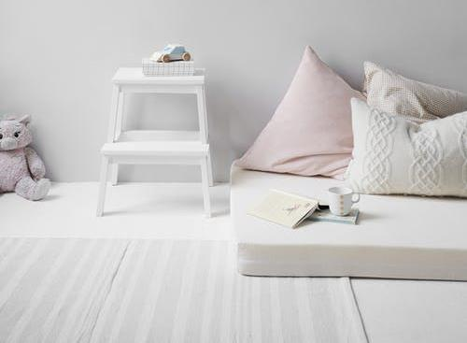
A ‘sleep friendly’ bedroom
Create a ‘sleep friendly’ and relaxing bedroom for your child. Evidence suggests a link in people’s minds between sleep and the bedroom.
Try to keep your child’s bedroom:
a dark, quiet and tidy environment;
cool – a temperature of about 18 to 24 °C;
a screen-free zone – get them to leave their devices outside the bedroom.

Slide 9

Good quality sleep
Sleeping well isn’t just about the duration of sleep, but also about sleep quality.
Signs of good quality sleep include:
falling asleep quickly;
not waking up too many times in the night;
falling back to sleep quickly after waking up during the night;
waking up feeling refreshed.

Slide 10
Have a think
How many hours of sleep does your child usually get?
What might be some reasons your child slept well or didn’t sleep well during the night?
How does your child usually feel when they wake up in the morning?
What are some of your bedtime routines?

Slide 11
Sleep
For further information, go to:
www.nutrition.org.uk

