Slide 1
Sheep farming

Slide 2
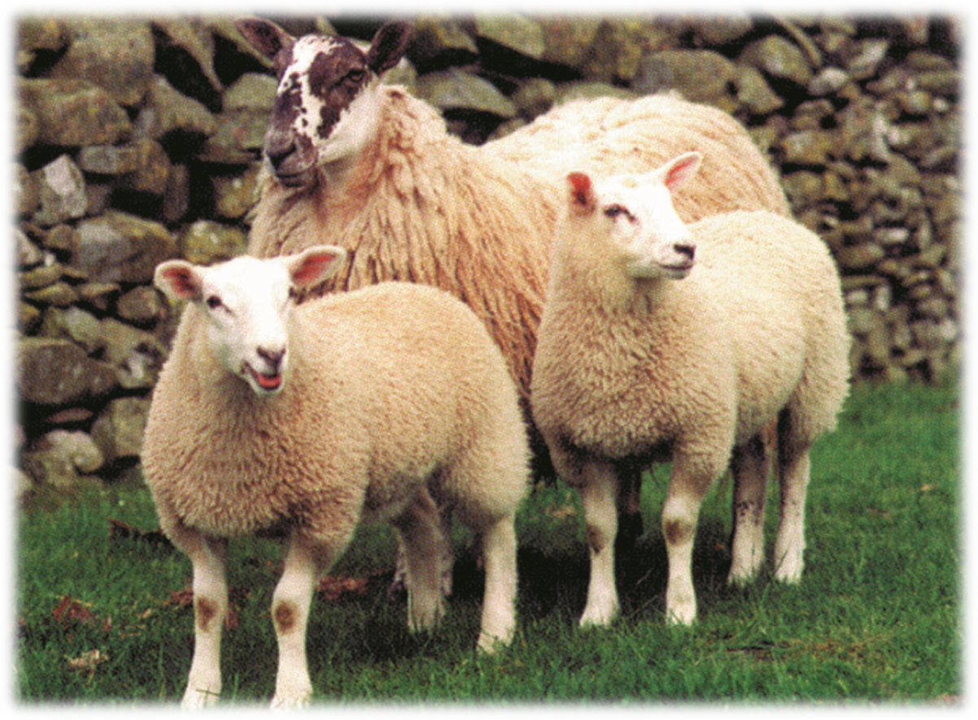
Agriculture in the UK
Livestock farming for meat production has been an established industry in the UK for centuries.
Diverse range of commodities are produced – beef, lamb, pork, dairy, chicken, potatoes, fruit and vegetables.
Significant contributor to the UK economy - £8.5 billion.
We consume just under 50% of the unprocessed food which is produced in the UK.
Agriculture provides 475,000 jobs directly, and an extra 30,000 through goods and services.

Slide 3
Glossary
Ewe - female sheep
Ram or Tup - male sheep
In-lamb - pregnant sheep
Replacements - sheep bred or bought-in to replace the old breeding sheep in the flock
Weaning - the lambs no longer require milk and can live without their mothers
Finished lamb - a lamb which is ready to be sold for meat
Flock - a group of sheep

Slide 4
Introduction
There are 23 million sheep and lambs in the UK.
The UK exported 65,422 tonnes of lamb and mutton to countries in and outside of Europe in 2018.
We also import a similar amount of lamb from Europe, and other countries such as New Zealand and Australia .
UK farm assurance standards for sheep are different to those in Europe and other countries.
Sheep can graze steep hills and poor quality land such as moorland which is unsuitable for growing any other food sources.

Slide 5
Sheep breeding systems
Farmers may keep purebred sheep or crossbred sheep, or a mixture of both.
This decision depends on:
land type such as moorland or high quality grass;
location such as in the north of the country where the weather is colder;
market- whether the farmer is producing lambs for breeding or for meat.
Crossbreeding can be used to get the best attributes of different breeds to improve animal performance such as fertility and lamb survival.

Slide 6
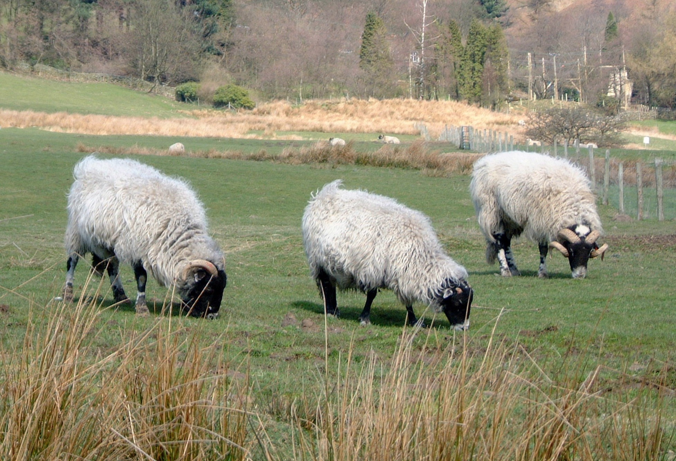
Breeds of sheep
There are over 60 different breeds of sheep farmed in the UK, suited to different parts of the country.
This is known as a stratified system. It utilises the different characteristics of different breeds which are suited to different parts of the country.
Native breeds include:
Swaledale;
Herdwick;
Cheviot;
Bluefaced Leicester;
Suffolk.

Slide 7
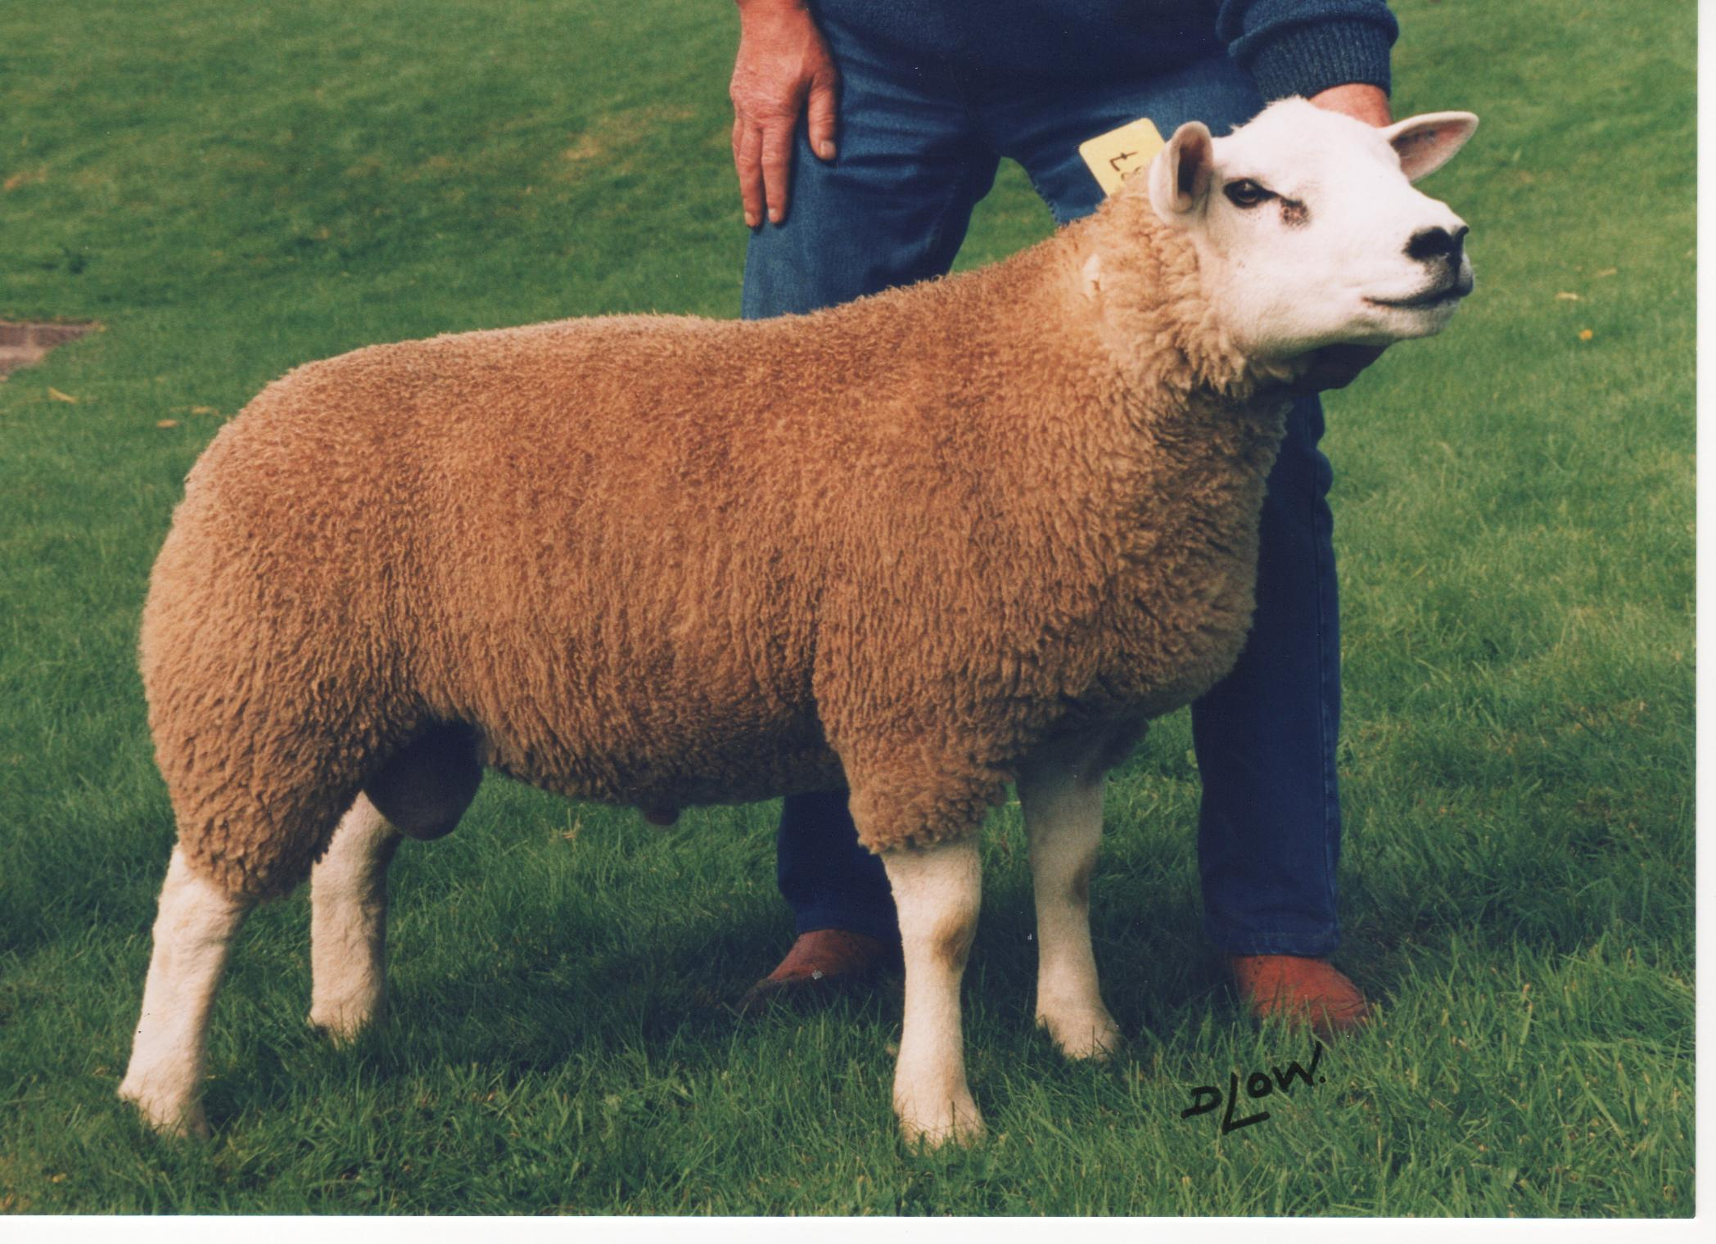
Breeds of sheep
There are also breeds in the UK which originate from outside of the UK, these are known as continental:
Charollais;
Texel;
Beltex.
Continental breeds are fast growing and well muscled animals which maximise meat production.
Continental breeds and native breeds are used together in crossbreeding systems.

Slide 8
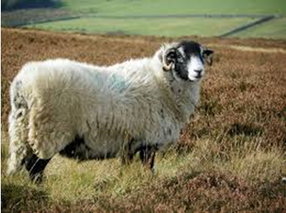
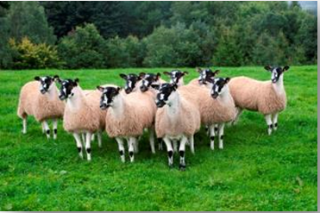
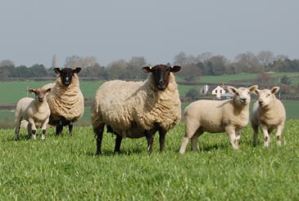
Stratified sheep system
Hill breeds - these are hardy sheep which can cope with rugged terrain and moorland grazing. Usually lamb outside.
Upland breeds - these are quite hardy but usually have faster growth rates than hill breeds. May be lambed indoors or outdoors. Include crossbred sheep, usually using a hill breed.
Lowland - these are well muscled animals with fast growth rates that require good quality grazing. Usually lambed indoors.

Slide 9
The lifecycle of sheep
Sheep give birth to lambs once a year. They must be healthy and in good physical condition to have lambs every year.
A sheep gets in lamb (pregnant) by a ram.
Gestation, or the pregnancy, will last for 145 days
The sheep prepares for pregnancy throughout this time, known as the ‘dry period’

Slide 10
The lifecycle of sheep
Milk is the main source of nutrition for young lambs. The sheep produces colostrum first then milk. Colostrum is thicker than normal milk and is rich in antibodies.
After birth (lambing) the lambs will stay with their mothers for 3–4 months
Sheep are shorn when the weather is warm and dry. Shearing does not hurt the sheep
The lambs no longer require milk and can live without their mothers. This is called weaning

Slide 11
The lifecycle of sheep
Depending on the breed and feed available, most farms will have sold all of their lambs before they start lambing again.
The weaned lambs are sold for meat in groups once they are heavy enough (normally 38–40 kg)
Some females are kept for breeding or sold at market in breeding sales
Their mothers will have rested and are pregnant again

Slide 12
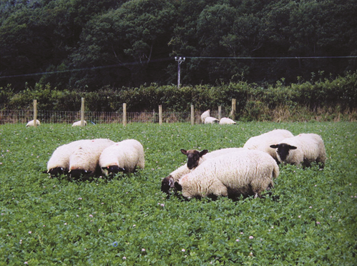
Diet of sheep
Sheep graze grass throughout the year. Some sheep are housed in winter and fed silage and hay just like cattle.
Most sheep are pregnancy scanned so feeding can be planned.
Sheep carrying twins and triplets require a high protein and high energy diet.
Silage or hay will be provided to sheep in winter when grass quality is poor.
Just like cattle, sheep can utilise others feeds such as turnips, clover, kale, straw and grains.

Slide 13
Silage and hay making
When the grass stops growing in winter, sheep and cattle are fed silage or hay. This is preserved grass.
Silage is fermented to maintain the nutrients (sugar and protein). Hay is drier than silage and doesn’t need to be wrapped if it is stored in a weather proof barn.
Grass is cut in spring and summer
The grass is left in the field to wilt (can take up to 5 days for hay)
Silage is baled and wrapped to preserve it

Slide 14
Sheep farming
For further information, go to:
www.foodafactoflife.org.uk

