Slide 1
Resources and training Claire Theobald British Nutrition Foundation

Slide 2
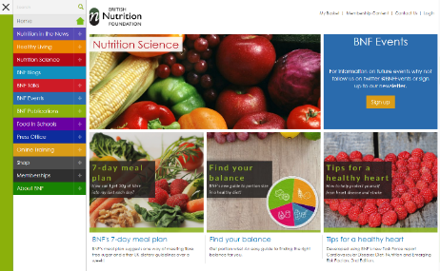
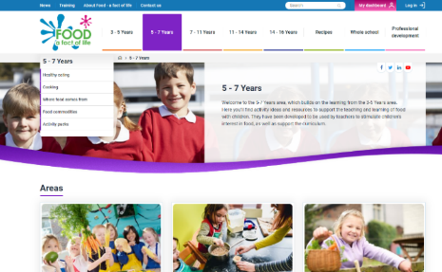
Websites
British Nutrition Foundation - translating evidence-based nutrition science in engaging and actionable ways
www.nutrition.org.uk
www.foodafactoflife.org.uk
@Foodafactoflife

Slide 3
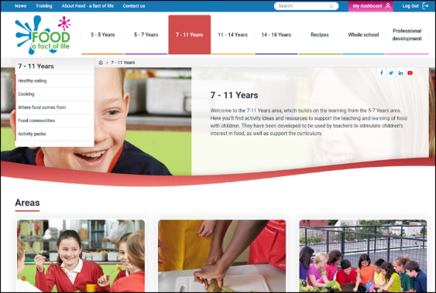
Food - a fact of life
What is Food – a fact of life?
A comprehensive, progressive education programme which communicates up-to-date, evidence-based, consistent and accurate messages around ‘food’ to all those involved in education.
Managed by the British Nutrition Foundation (BNF), in partnership with the Agriculture & Horticulture Development Board (AHDB).

Slide 4

Food - a fact of life
What is Food – a fact of life?
Teaching resources for pupils aged 3-16 years
Organised into areas - healthy eating, cooking, where food comes from, commodities
Progressive and curriculum compliant

Slide 5

Food - a fact of life
What is on the site?
Lesson ideas and supporting resources
Recipe bank
Whole school area – government advice, food provision in school
Professional development area

Slide 6
What do we have to teach about food in primary school?

Slide 7

Curriculum for excellence
Where does food education feature?
Food and health (First and Second)
Nutrition & Safe and hygienic practices
Enjoy a variety of food
How food contributes to a healthy diet
Apply healthy eating advice
Nutritional needs change through life/some people avoiding certain food
Prepare healthy food and drinks
Hygiene and safety

Slide 8

Curriculum for excellence
Where does food education feature?
Food and health continued… (First and Second)
Food and the consumer
Food practices and preferences
Influences - finance, culture, religion, media
Food journeys - source to consumer
Seasonality and local availability, sustainability
Food labelling

Slide 9

Curriculum for excellence
Where does food education feature?
Biological systems (First and Second)
Body systems and cells
Skeleton and organs – keeping them healthy
Make informed decisions to maintain health and wellbeing

Slide 10

Curriculum for excellence
Where does food education feature?
Technologies (First and Second)
Food and textiles
Work with food
Use a range of food skills
Use a range of equipment
Develop creativity and confidence

Slide 11
What resources are available on Food – a fact of life?

Slide 12
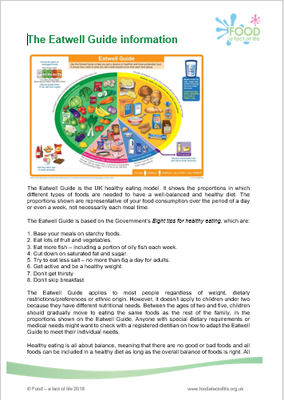
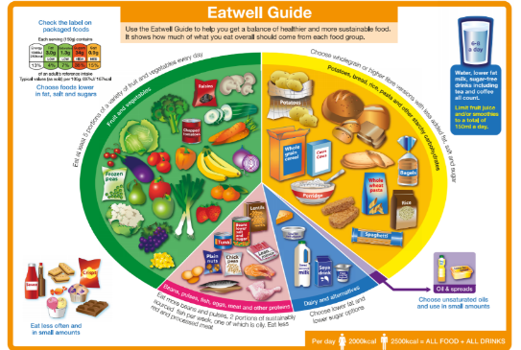
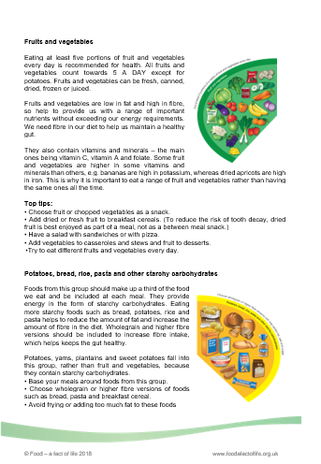
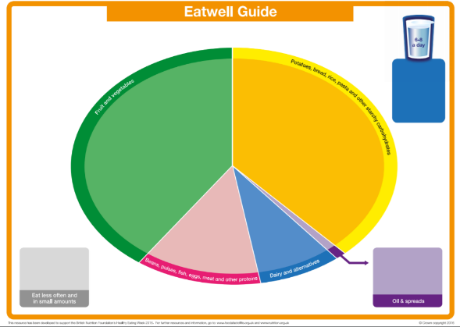
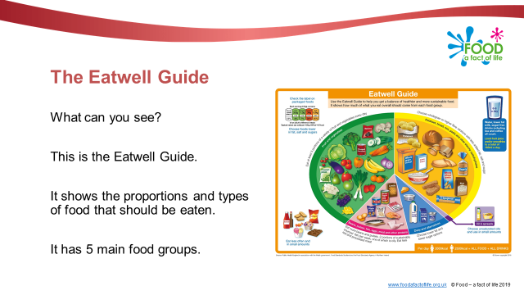
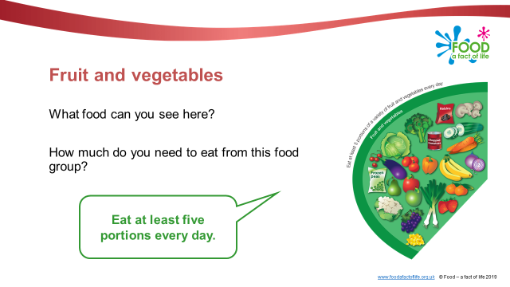






Healthy eating resources
Range of food, healthy diet, application, nutritional needs, informed choice
Guides, e.g. The Eatwell Guide
Presentations
Posters
Cards, e.g. food images
Activity sheets, e.g. planning a day’s menu
Games

Slide 13
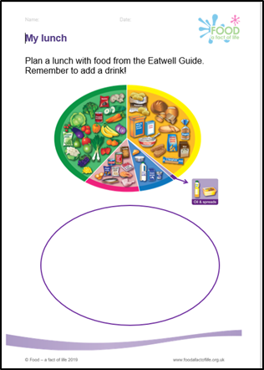
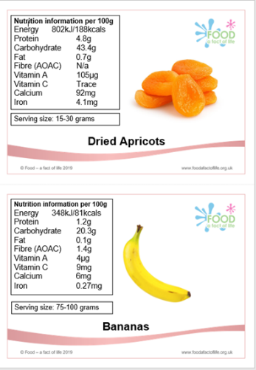
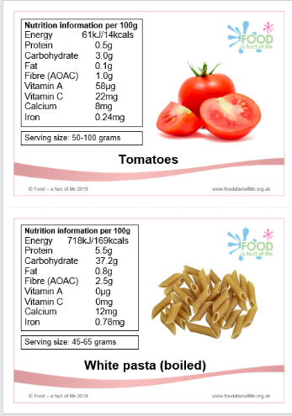
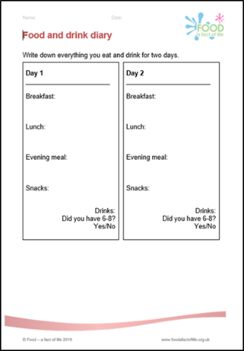
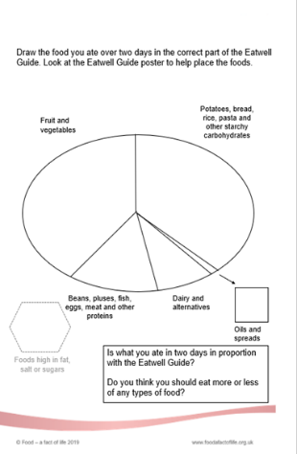
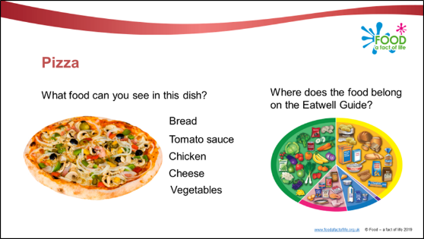
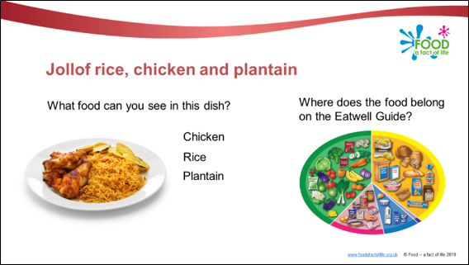
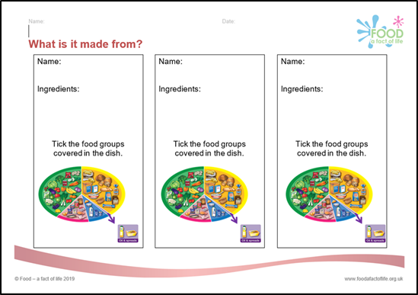
Healthy eating resources
Range of food, healthy diet, application, nutritional needs, informed choice
Guides, e.g. The Eatwell Guide
Presentations
Posters
Cards, e.g. food images
Activity sheets, e.g. planning a day’s menu
Games

Slide 14
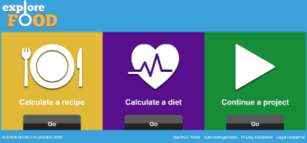
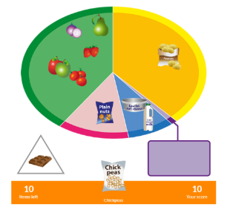

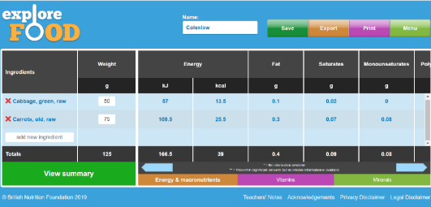
Interactive healthy eating resources
The Eatwell Challenge (game)
Explore food (nutritional analysis tool)

Slide 15
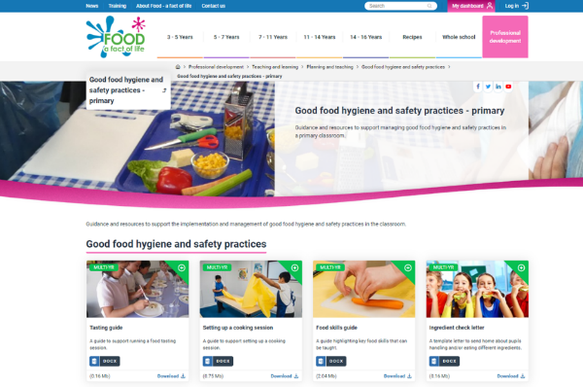
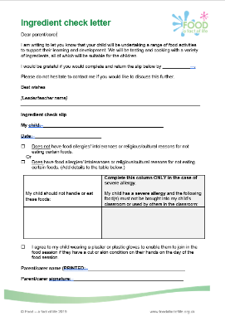
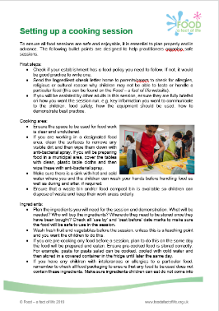
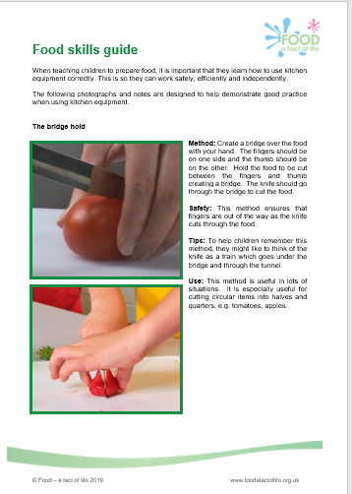
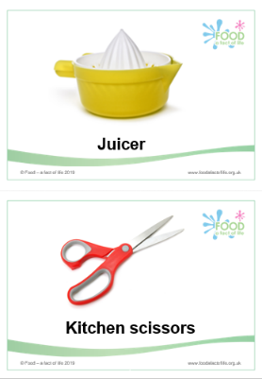
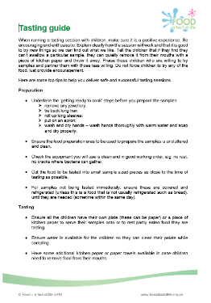
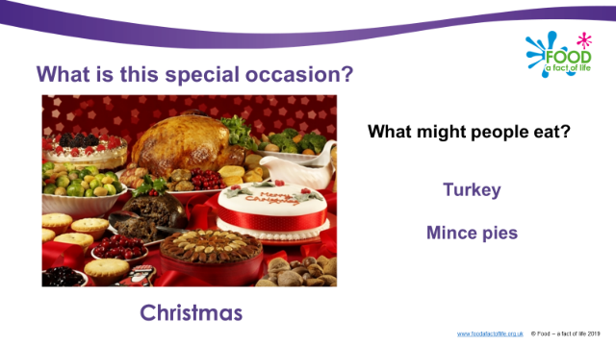


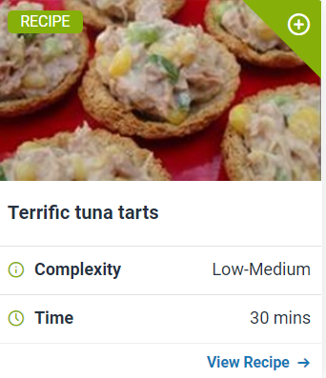
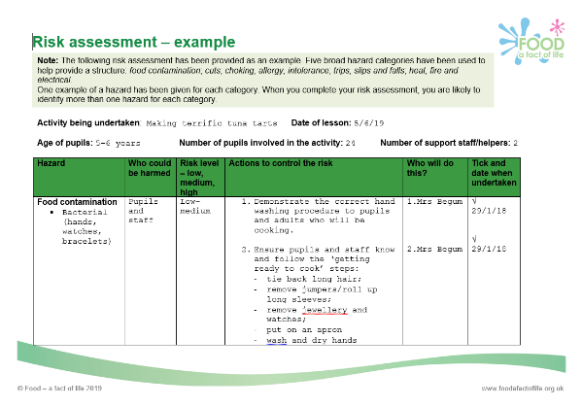
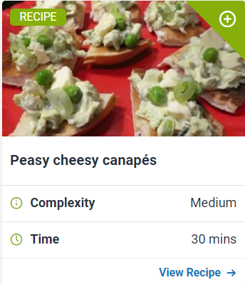
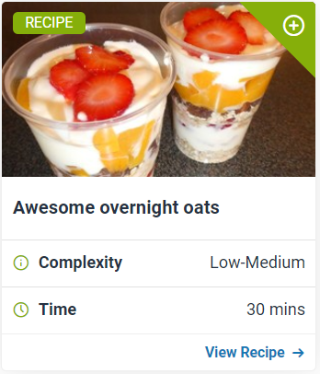
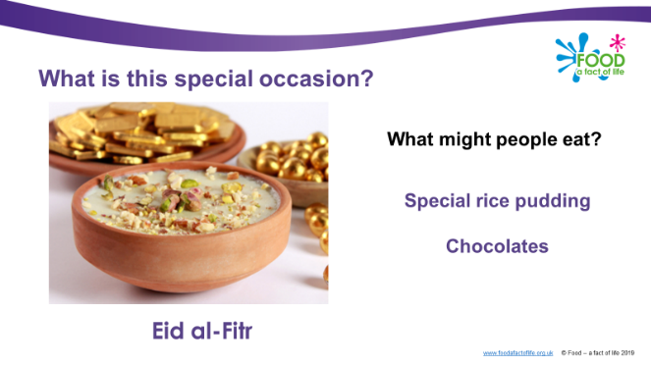

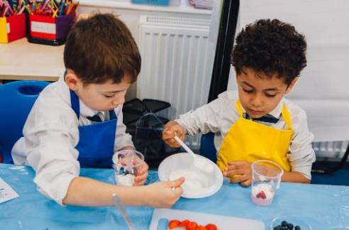
Cooking resources
Enjoy food, taste, preference, food skills, equipment, hygiene and safety, creativity
Guides, e.g. food skills, classroom set up
Template letters, e.g. Ingredient check letter
Risk assessments
Recipes
Recipe videos

Slide 16
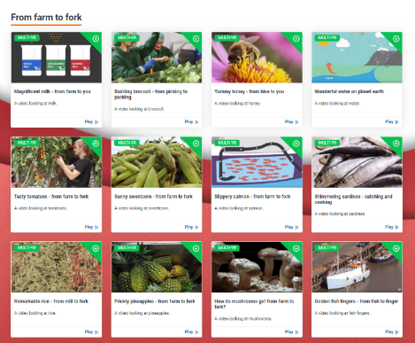
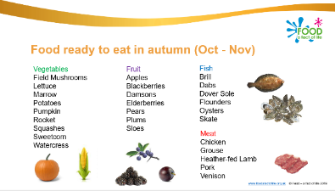
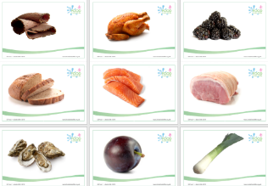

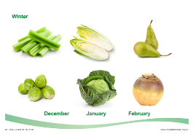
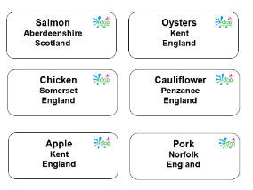
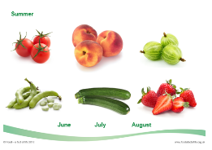



Where food comes from resources
Seasonality, food journey – source to consumer
Farming videos
Seasonality activities
World produce – images, labels, origins

Slide 17
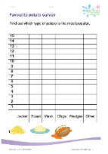
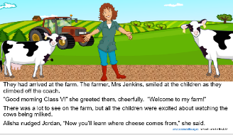
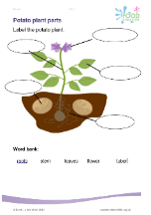
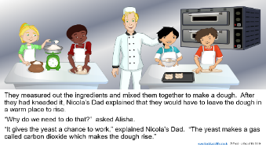
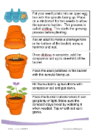
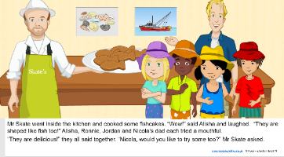
Where food comes from resources
Learn with stories
Stories that combine messages about healthy eating, cooking and where food comes from and with supporting activity sheets.
The colourful present
The bucket garden
The farm visit
The amazing lunchbox
The bread stories
The seaside adventure
The exciting guests

Slide 18
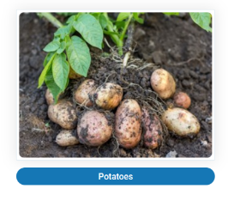
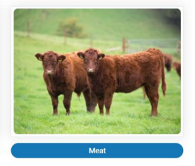
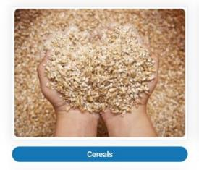
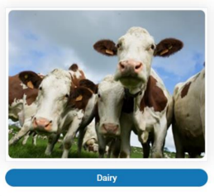
Food commodity resources
Resources focused on specific commodities

Slide 19
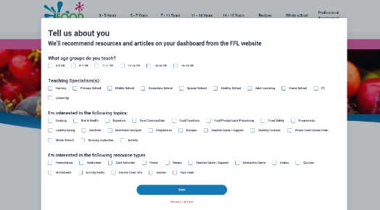



Dashboard
Register - provide brief details and indicate areas of interest
What is the dashboard?
Register/log-in
Organise and store your resources!
Create a ‘collection’, e.g. Monday - HWB – P3
Find resources and use the top, right + button to add resources to your collections

Slide 20



Professional development
What training is available?
Conferences
Webinars
Online courses
Training information: Food – a fact of life > Professional development > FFL training

Slide 21




Training – online courses
Teaching food in primary – the why, what and how (Scotland)
FREE, eight module course:
Food in schools
Food origins
Healthy eating
Nutrition
Applied nutrition
Food safety
Cooking
Teaching
Find it here: Food – a fact of life > Professional development > FFL training

Slide 22

BNF Healthy Eating Week
509 registrations from Scotland!
What is it all about?
Established in 2013
To provide a dedicated week in the year for a simultaneous focus on promoting health
Open to nurseries, schools and workplaces
4,770 registrations from schools and nurseries in 2019 (representing over 2 million young people)
Free to register www.foodafactoflife.org.uk

Slide 23










BNF Healthy Eating Week
How do you get involved?
Register and receive email updates to support planning for the Week
Five health challenge provide structure
Challenge resources:
- guides
- ideas sheets
- trackers
- certificates

Slide 24




BNF Healthy Eating Week
What resources are available?
Posters
Webinars
Cook-a-longs
Quizzes
Bunting!

Slide 25







BNF Healthy Eating Week
What happened in schools?

Slide 26


Keep up to date
Education News
Monthly email update
Register at www.foodafactoflife.org.uk

Slide 27

Thanks for listening!

Slide 28
Resources and training
For further information, go to:
www.foodafactoflife.org.uk

