Slide 1


Slide 2


British Nutrition Foundation – National conference
Jeanette.smart@educationscotland.gsi.gov.uk
For Scotland's learners, with Scotland's educators

Slide 3
Food for Thought Education Fund
The Food for Thought Education Fund gives financial support to develop Food and Health as a context for learning. The fund aims to improve practitioner confidence in providing progressive, high quality, skills based learning experiences which help to embed food education into the ethos of the establishment. It also provides an opportunity to plan and implement learning experiences which build sustainability and capacity for future development.

Slide 4

Number of bids received
Total value of all bids
Number of bids awarded
Total amount awarded
Total number of schools impacted
Number of learners
Phase 1
118
Information not available
61
£358,618.61
232
28,392
Phase 2
171
£984,181.00
173
£649,006.40
411
18,769
Phase 4
241
£850,155.40
124
£297,138.18
136
13,003
Phase 5
402
£1020,945.14
102
£300,000.00
132
14,729
Phase 6
219
£619,172.76
119
£300,000,00
135
11,305
TOTAL
1,384
£4,316,531.29
678
£2,201,601.37
1,220
100,847
Phase 3
233
£842,076.99
99
£296,838.18
174
14,649

Slide 5
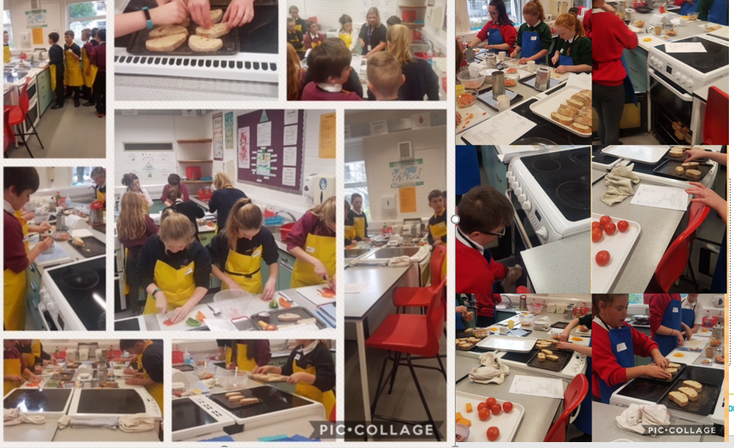

Slide 6
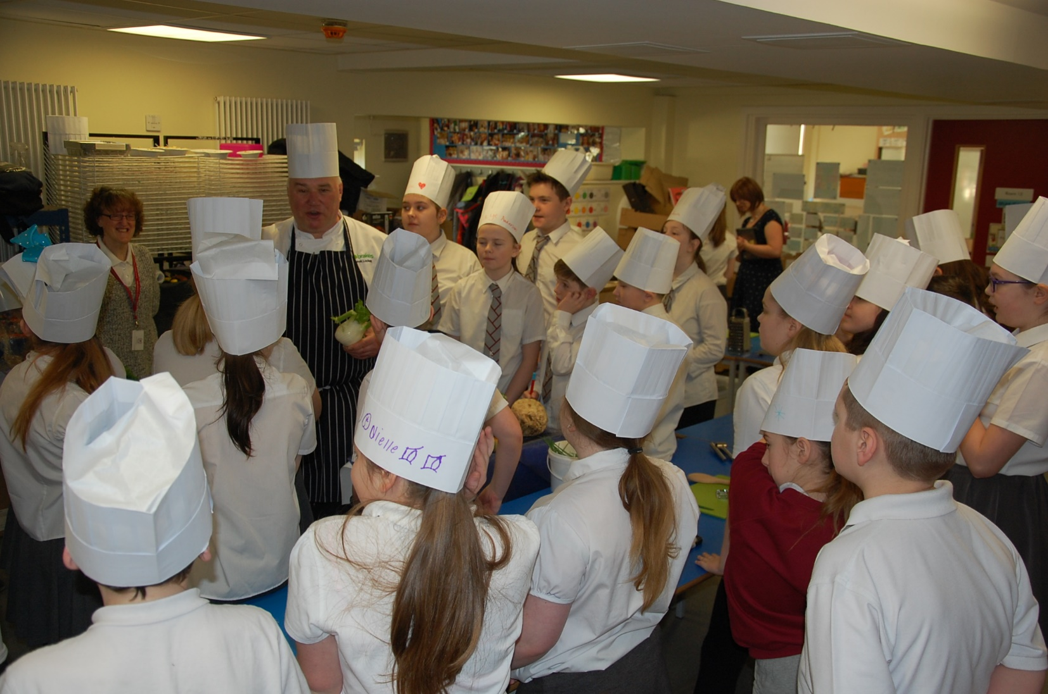

Slide 7
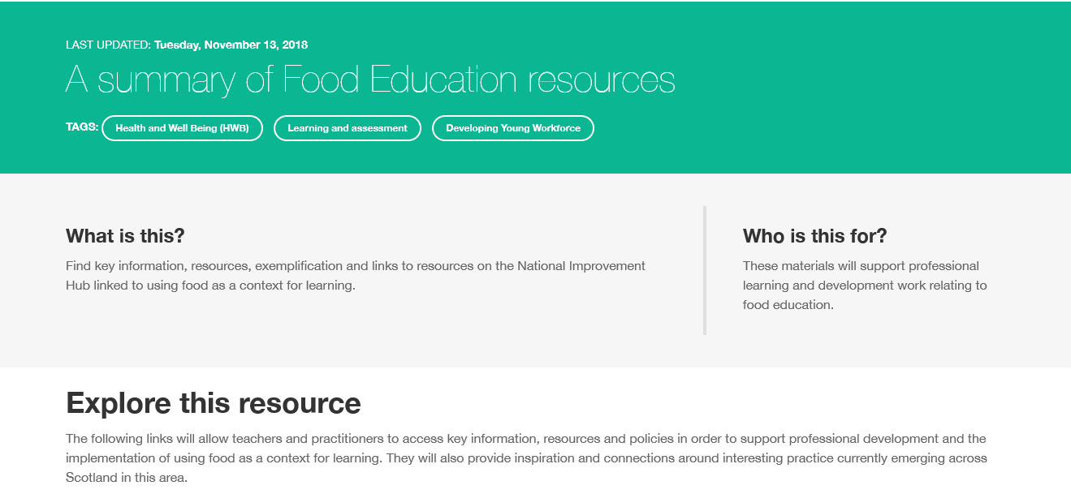

Slide 8
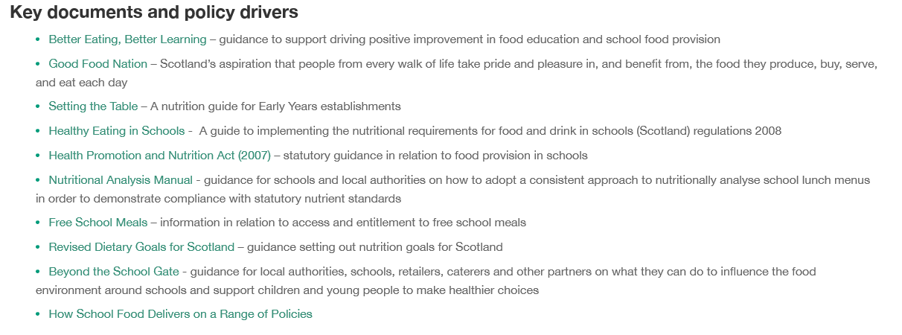

Slide 9
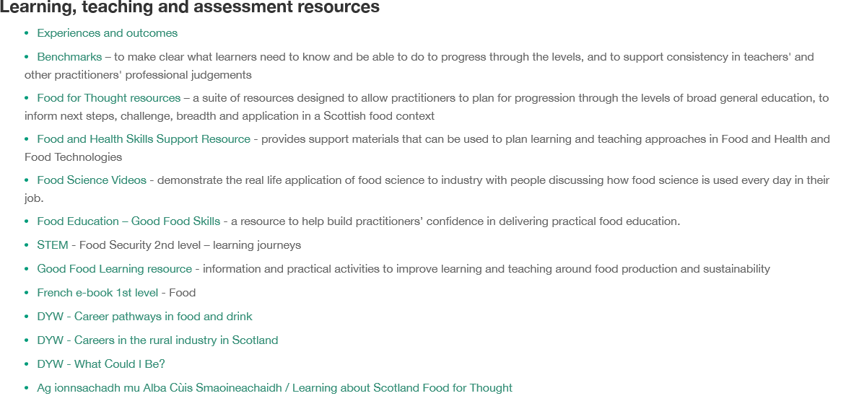

Slide 10
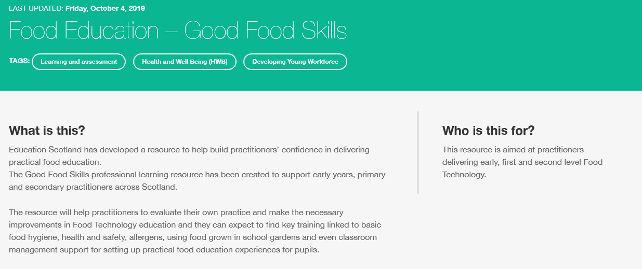

Slide 11
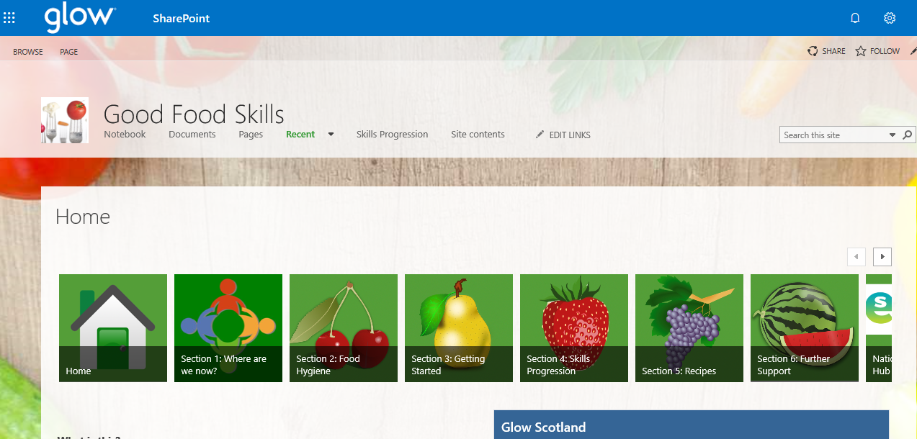

Slide 12
Education Scotland
Denholm House
Almondvale Business Park
Almondvale Way
Livingston EH54 6GA
T +44 (0)131 244 5000
E enquiries@educationscotland.gsi.gov.uk
For Scotland's learners, with Scotland's educators

