Slide 1
Healthy Eating: bringing the Eatwell Guide to life
Alex White British Nutrition Foundation

Slide 2



Context
Excess consumption of free sugars, salt, saturated fat and energy.
Low intakes of some vitamins and minerals in some groups.
Low intake of fibre and wholegrains
31% adults & 8% teens meet 5 A DAY.
NDNS 2018

Slide 3
Primary overweight and obesity in Scotland
Growing up in Scotland: overweight and obesity at age 10 (November 2018)
https://www.gov.scot/publications/growing-up-scotland-overweight-obesity-age-10/pages/3/

Slide 4
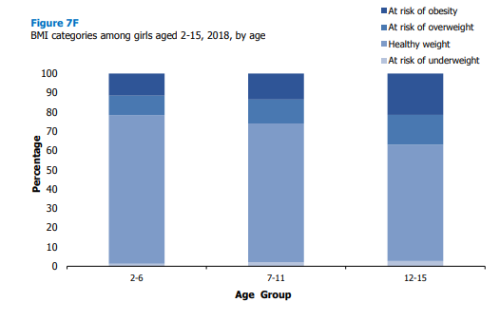
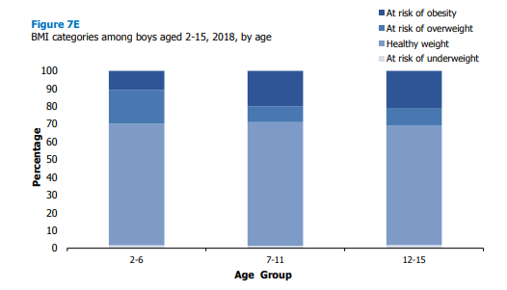
Child overweight and obesity in Scotland
Boys
Girls
Growing up in Scotland: overweight and obesity at age 10 (November 2018)
https://www.gov.scot/publications/growing-up-scotland-overweight-obesity-age-10/pages/3/

Slide 5
Obesity increases in the most deprived areas
Growing up in Scotland: overweight and obesity at age 10 (November 2018)
https://www.gov.scot/publications/growing-up-scotland-overweight-obesity-age-10/pages/3/

Slide 6
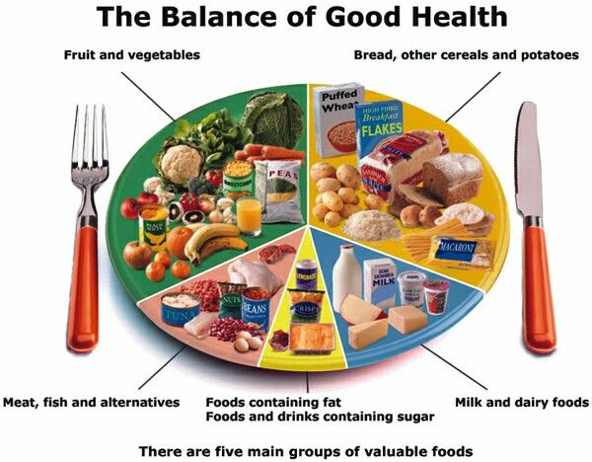
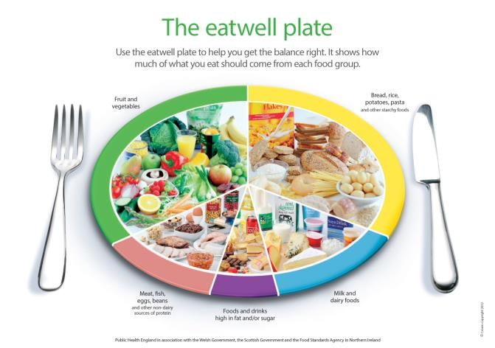
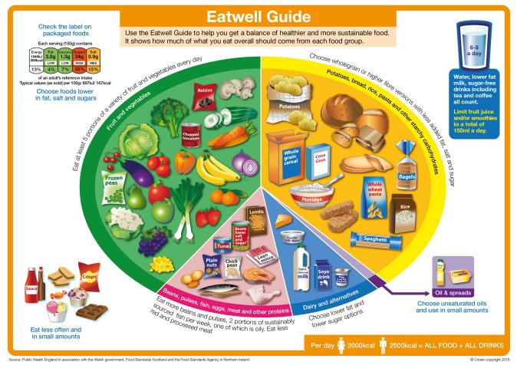
The progression of UK food based models
1994
2007
2016

Slide 7
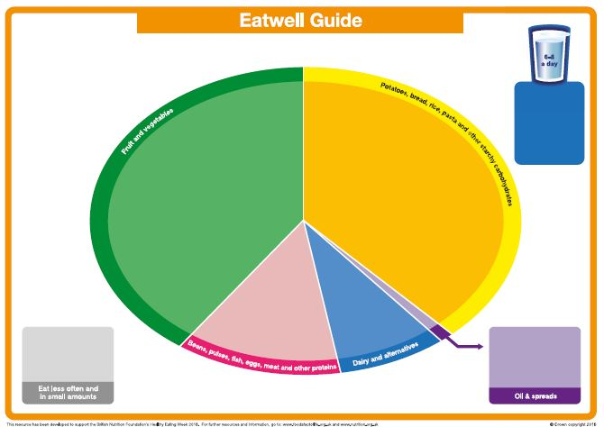
The blank Eatwell Guide

Slide 8

The Eatwell Guide

Slide 9

Who does the Eatwell Guide apply to?

Slide 10
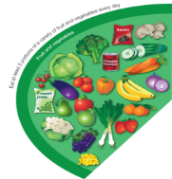
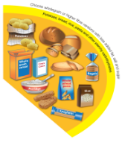
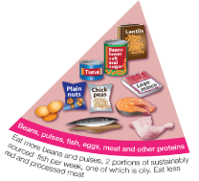
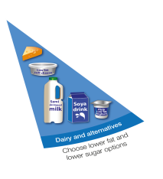

The Eatwell Guide – main groups
Fruit and vegetables
Potatoes, bread, rice, pasta and other starchy carbohydrates
Beans, pulses, fish, eggs, meat and other proteins
Dairy and alternatives
Oil and spreads

Slide 11
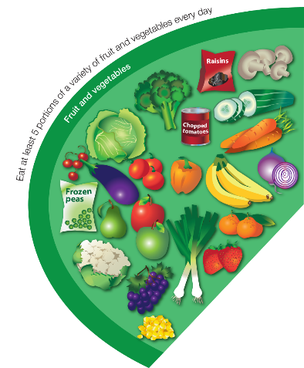
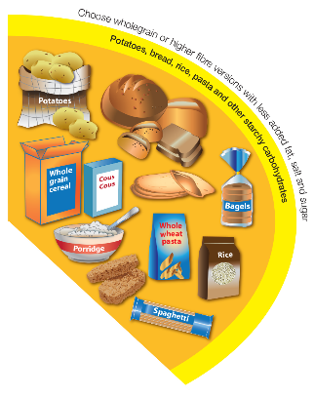
The Eatwell Guide – main groups
Fruit and vegetables
Potatoes, bread, rice, pasta and other starchy carbohydrates
Base meals on potatoes, bread, rice, pasta or other starchy carbohydrates; choosing wholegrain versions where possible
Eat at least 5 portions of a variety of fruit and vegetables every day

Slide 12
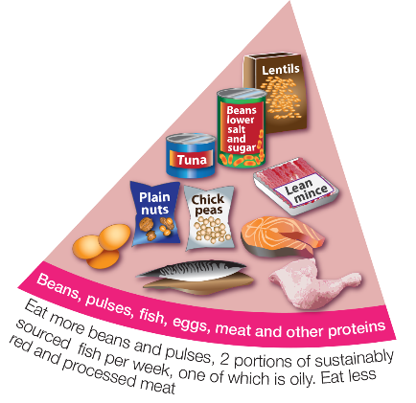
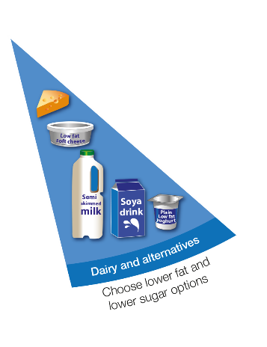
The Eatwell Guide – main groups
Beans, pulses, fish, eggs, meat and other proteins
Dairy and alternatives
Eat some beans, pulses, fish, eggs, meat and other proteins (including 2 portions of fish every week, one of which should be oily)
Have some dairy or dairy alternatives (such as soya drinks); choosing lower fat and lower sugar options.

Slide 13
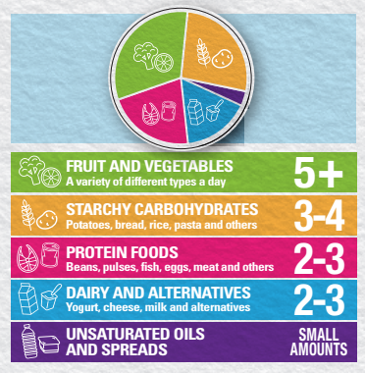
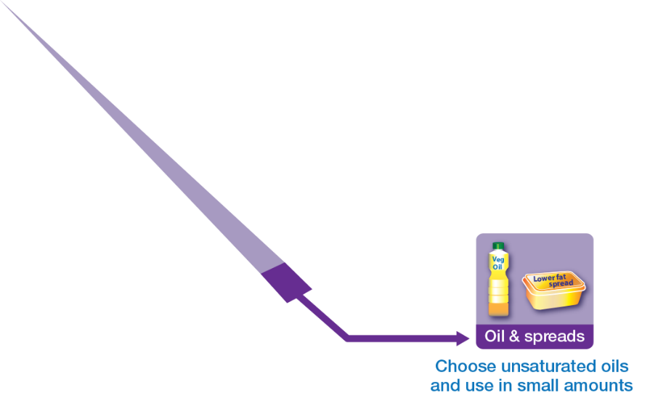
The Eatwell Guide – main groups
Oils and spreads
Choose unsaturated oils and spreads and eat in small amounts.
Find your balance - get portion wise!

Slide 14
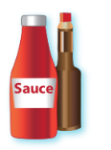









Foods high in fat, salt and sugars
Throughout the UK we consume excess amounts of:
Saturated fat;
Salt;
and Free Sugars.
If consuming foods and drinks high in fat, salt or sugar have these less often and in small amounts.

Slide 15
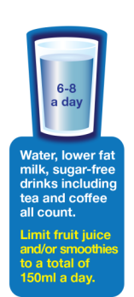


Drink 6-8 cups/glasses of fluid a day

Slide 16
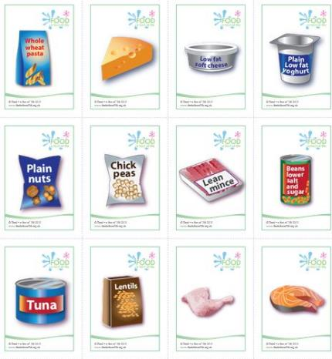

The Eatwell race

Slide 17
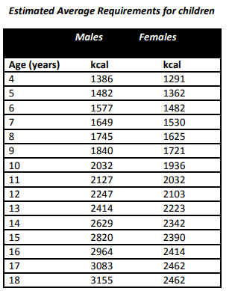
Energy

Slide 18
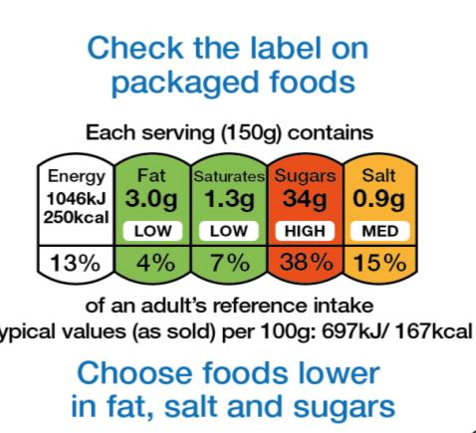

Labelling

Slide 19
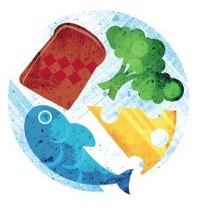
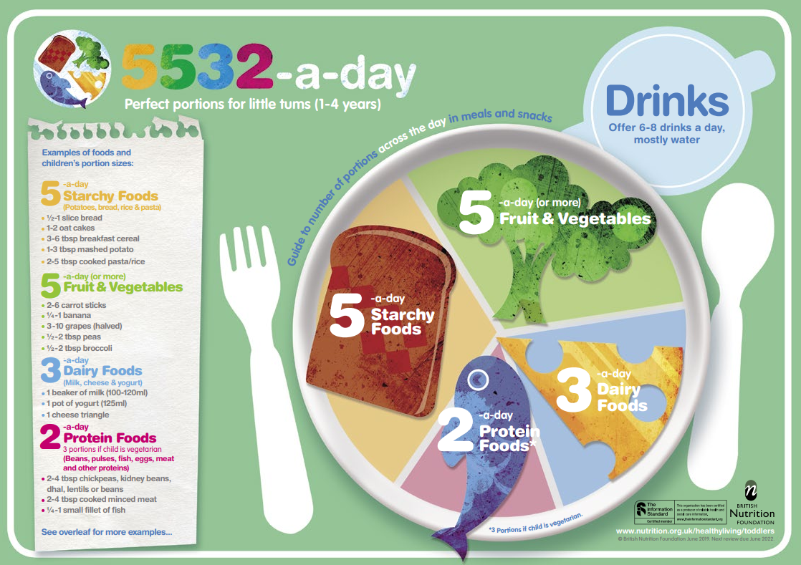
What about for children 1-3 years?
Starchy foods x 5-a-day
Fruit & vegetables x 5-a-day
Dairy foods x 3-a-day
Protein foods x 2-a-day*
=5532-a-day!
*3 portions if child is vegetarian.
5532

Slide 20
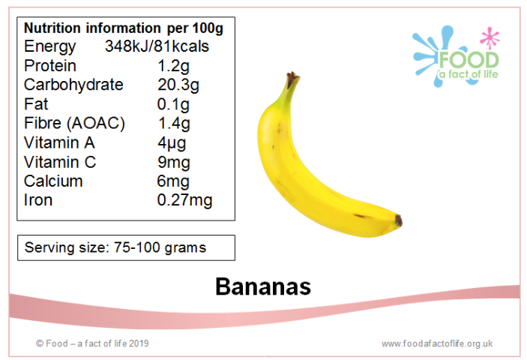
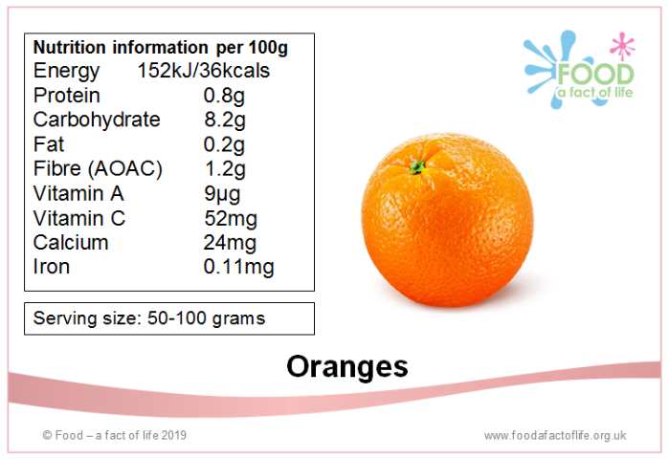
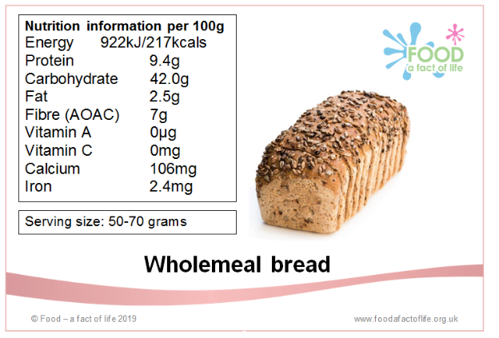
Nutrient line up!

Slide 21
Further information
Reading
Food Standards Scotland (FSS)
FSS education resources
British Nutrition Foundation (BNF)
Scientific Advisory Committee on Nutrition (SACN)
Resources
The Eatwell Challenge
Eatwell Guide videos
Eatwell Guide Kahoot quizzes
Eatwell Guide presentation and worksheets
Eatwell Guide posters

Slide 22
Healthy Eating: bringing the Eatwell Guide to life
For further information, go to:
www.foodafactoflife.org.uk

