Slide 1
Focus on cooking – a practical session
Claire Theobald
British Nutrition Foundation

Slide 2
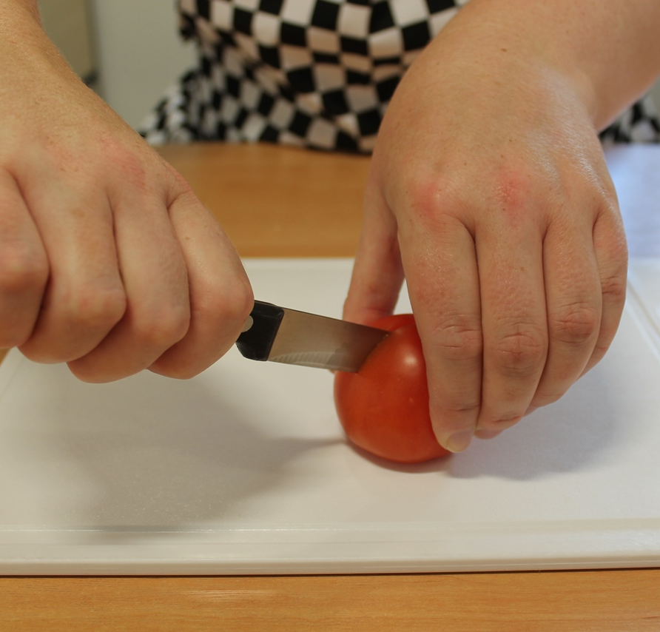
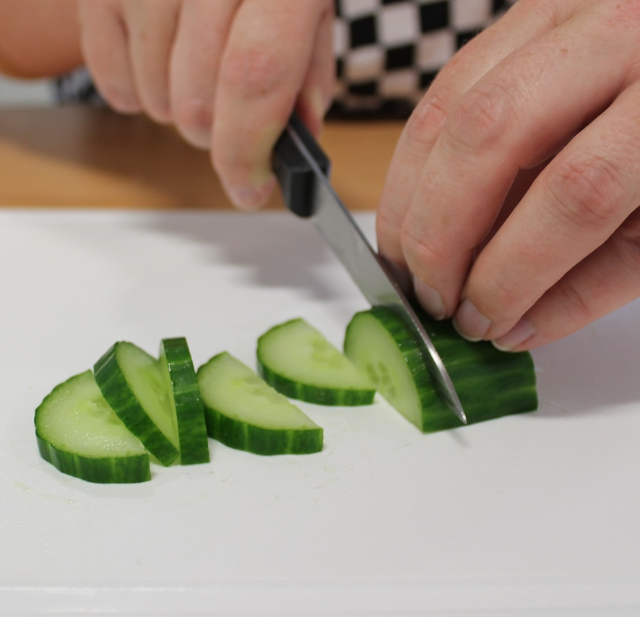
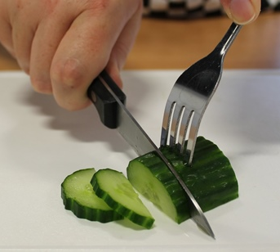
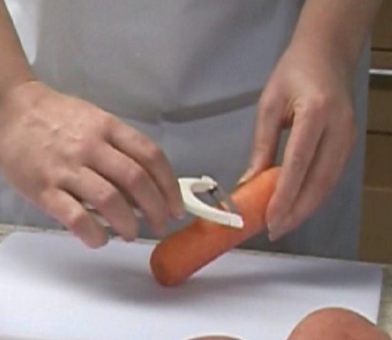
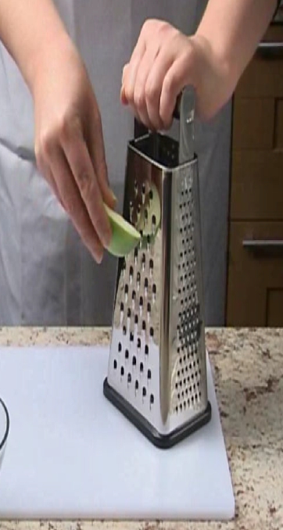
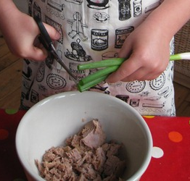
Food skills
Bridge
Claw
Fork secure
Peel
Grate
Snip

Slide 3
Your task!
Dish | Bridge | Claw | Fork secure | Scissors | Peel and Grate
Stripy salad pot layer ingredients Makes 2 pots | 8 x red grapes (halved) | 1 x celery stick (small pieces) | ½ yellow pepper (small pieces) | 2 x lettuce leaves (strips) | Carrot
Salad on a stick thread ingredients Makes 4 kebab sticks | 4 x cherry tomatoes (halved) | Cheese (cubes) | Cucumber (cubes) | ½ orange pepper (2p size pieces)
Crunchy potato salad - combine ingredients Makes 1 pot | 8 x small potatoes (halved) | 1 x celery stick & 1 x spring onion (small pieces) | ¼ red pepper (small pieces) | Herbs
20ml x reduced fat mayonnaise

Slide 4
Reflections
Would you do this with your class?
Would you/how could you adapt it?
Could it be used in a broader curriculum context?
Have you learnt anything new?

Slide 5
Focus on cooking – a practical session
For further information, go to:
www.foodafactoflife.org.uk

Slide 6
Stripy salad pot

Slide 7
Salad on a stick

Slide 8
Crunchy potato salad

