Slide 1

FutureChef Seeking young culinary talent 2019-20
Amanda McDade
Scotland Careers & Education Manager
amandam@springboarduk.org.uk
www.futurechef.uk.net

Slide 2
What is FutureChef?
4 Stage school based Culinary Competition for 12-16 year olds
Fosters a passion for cooking
Engages professional Chefs from industry partners to enhance teaching and learning throughout
Supports the school curriculum
Spotlights Home Economics/ Hospitality Department

Slide 3
Achievements 2018-19:
14,352 12-16 year old participants
590 secondary schools
570 industry chefs
Proven talent pipeline

Slide 4
Registrations are open www.futurechef.uk.net
School Heats Aug- Nov
Local Finals Nov- Dec
Regional Final 4th Feb 2019
National Final of 16th March 2019

Slide 5
FutureChef Programme
Look and Learn demonstrations.
Careers Presentations
Work Experience opportunities
Online Teachers portal https://lms.futurechef.uk.net/

Slide 6
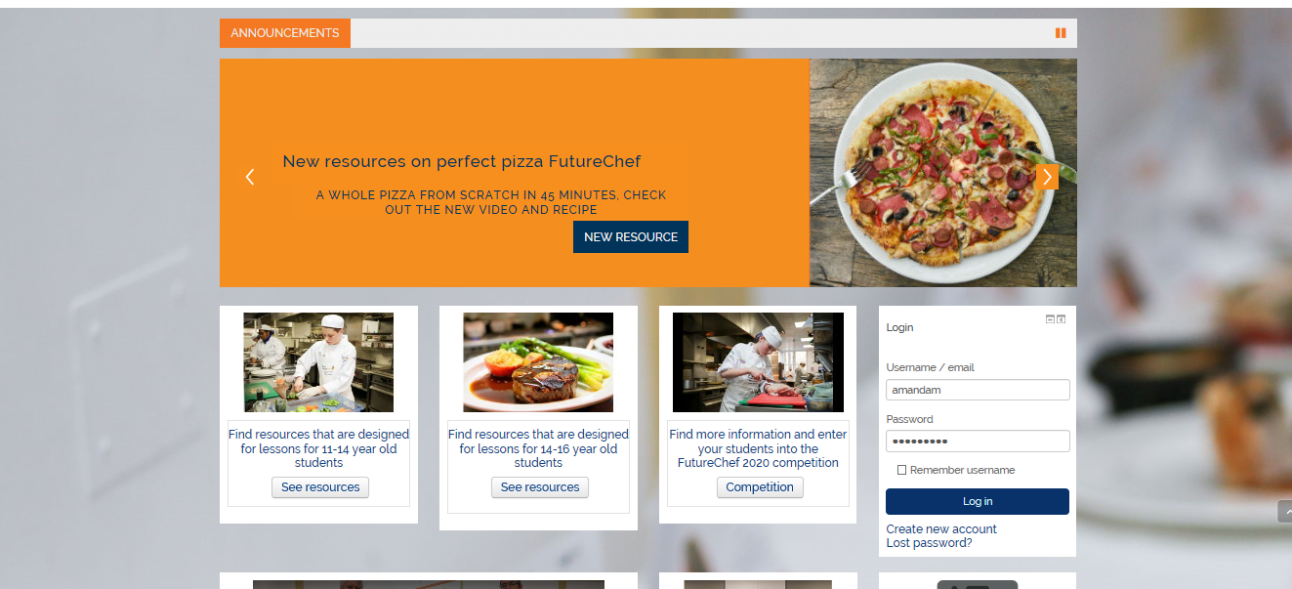

Slide 7


Slide 8
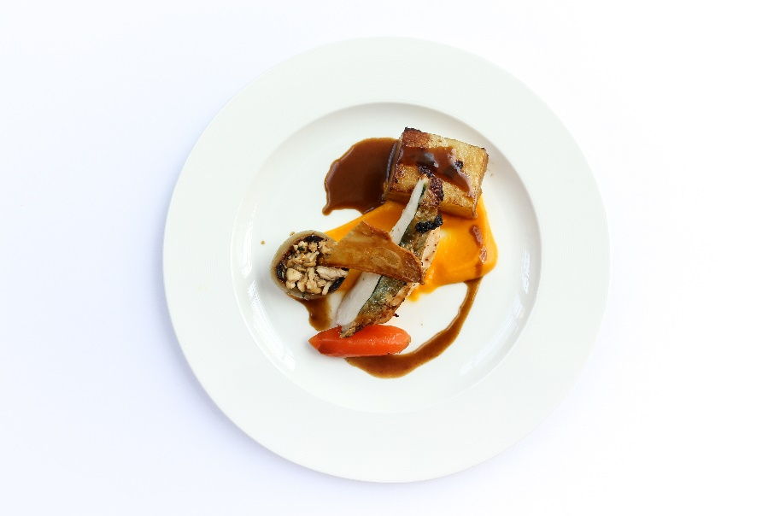
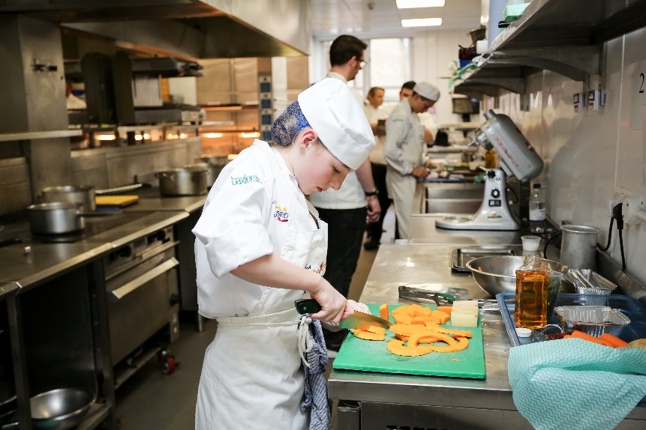
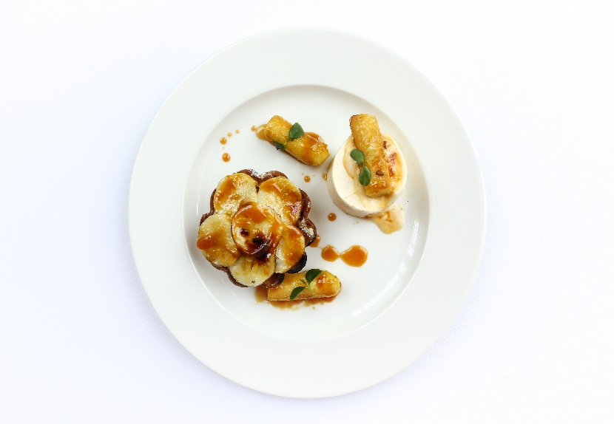
JESSICA MITCHELL FUTURECHEF WINNER 2019

Slide 9


