Slide 1
Get portion wise!
Roy Ballam
November 2019

Slide 2
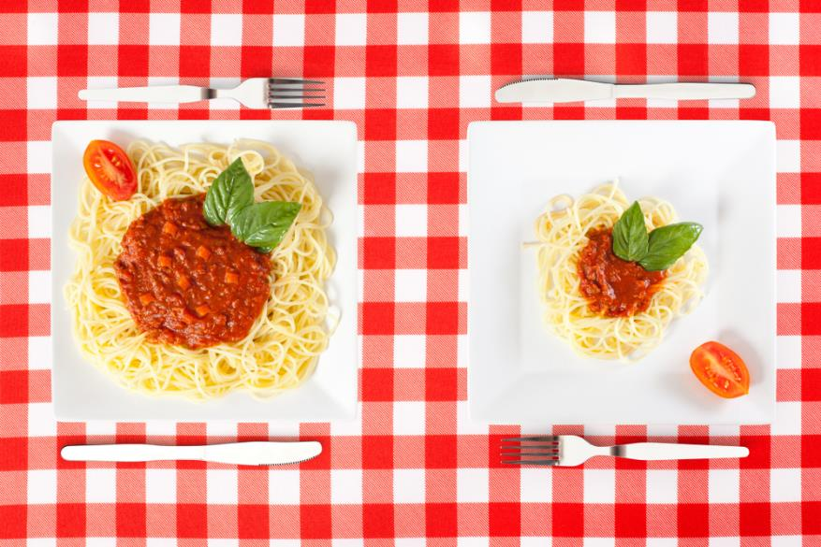
Overview
Why worry about portion size?
Existing portion size guidance
BNF project on portion size
Developing the guidance
Consumer research
Resources

Slide 3
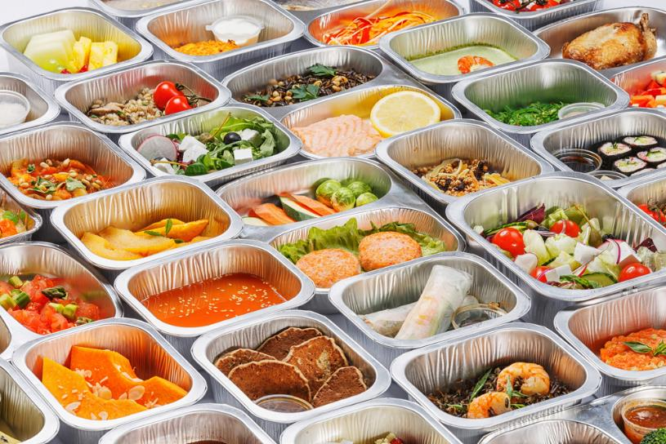
Why portion size?
64% UK adults overweight or obese
On average, adults overconsume by 200-300kcal per day
Consistent evidence that larger portions encourage people to eat more
Portion size one (of many) important targets in tackling obesity

Slide 4
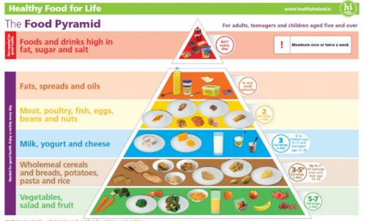
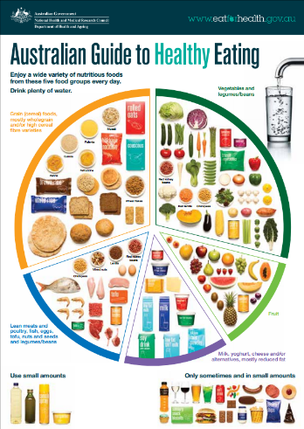
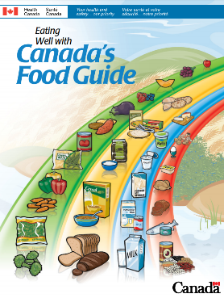
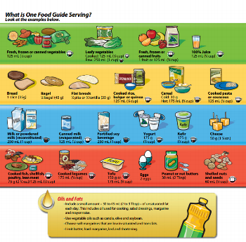
Guidance in other countries

Slide 5
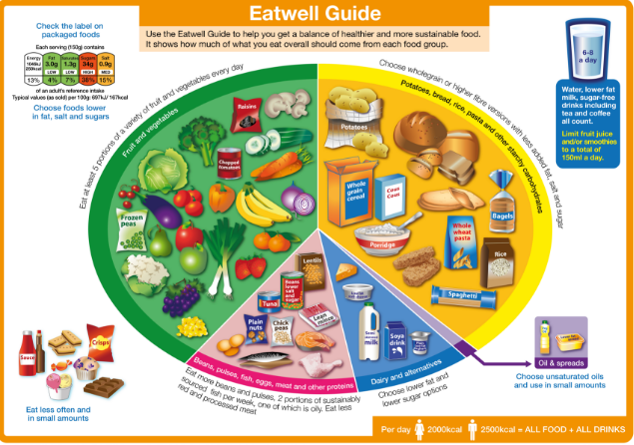
Existing UK guidance
The Eatwell Guide
80g portion for 5 A DAY
140g portion (cooked weight) for fish (x2/week)
Those eating more than 90g red and processed meat a day advised to cut down

Slide 6
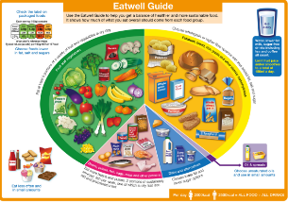
BNF project on portion size
For healthy adults
Provision of practical portion sizes for a range of food
Suggestions for frequency of consumption by food group
Aiming to complement the UK Government’s Eatwell Guide
GUIDANCE, NOT RECOMMENDATIONS!

Slide 7

Roles and responsibilities
BNF – leading on the project – taking final decision on all aspects of the work
Working group – funding, comment on approach, provide data where possible
Expert panel – advice on methods and resources

Slide 8
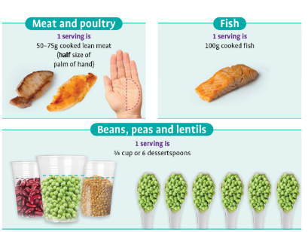
Reviewing other guidance
Guidance from Australia, Canada, Ireland, Germany and the US.
Publications on methodology
Portion sizes and food group frequencies used

Slide 9
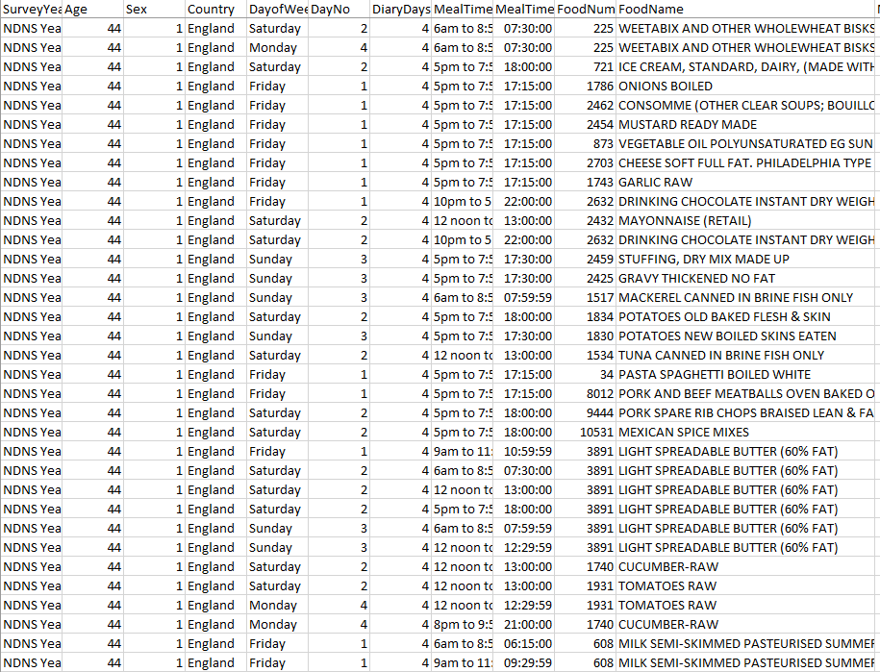
Portion size in the UK National Diet and Nutrition Survey
Raw food diary data from sample of approx. 1,200 adults (data from 19-64 year olds)
Data on portion size for a range of food types selected
Basic statistics collated to look at average portion sizes and the ranges consumed

Slide 10
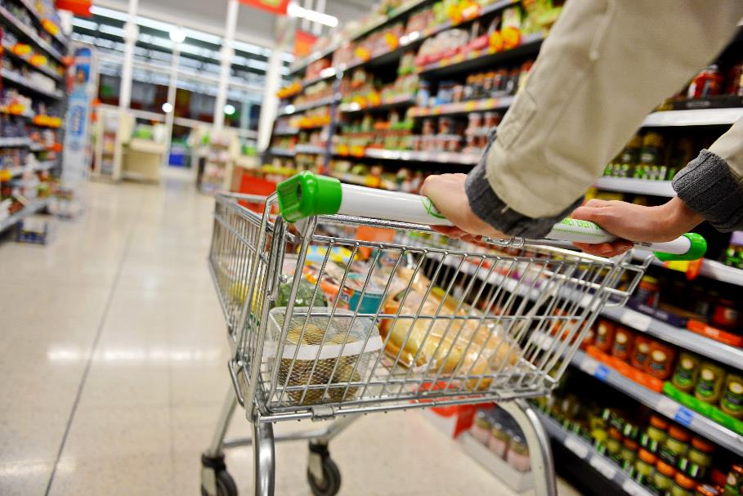
Retail portion sizes
Review of portion sizes available in the 4 biggest retailers

Slide 11
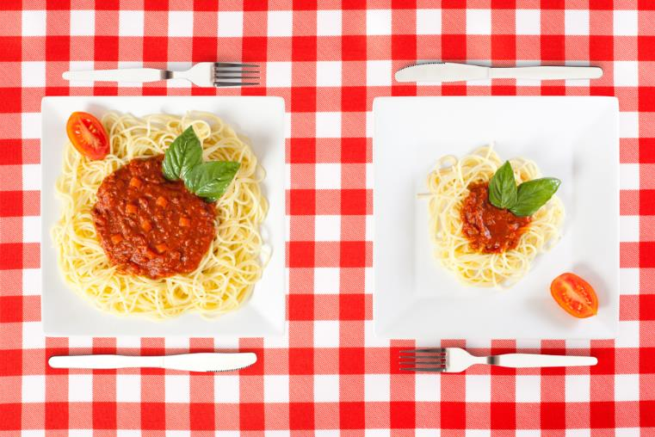
Test diets
7-day diets, different dietary patterns
Meet nutrient and food-based recommendations
Aiming to see how portion sizes work in practice
Developed draft frequencies for each food group and reviewed likely calorie intakes
Reviewed variation within the food groups – foods eaten in different amounts and in different ways, e.g. main meals vs snacks

Slide 12
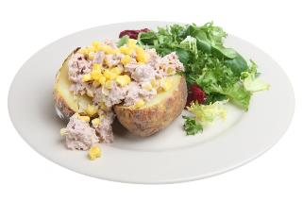
How often for each food group?
Starchy carbohydrates: 3-4 portions per day
Beans, pulses, fish, eggs, meat and other proteins: 2-3 portions per day
Dairy and alternatives: 2-3 portions per day
Fruit and vegetables: 5+ portions a day
Unsaturated oils and spreads: small amounts

Slide 13
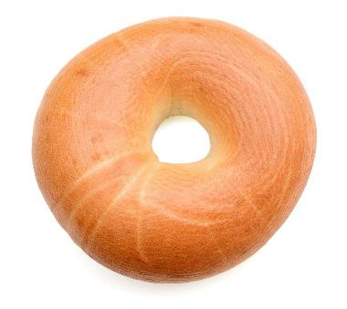

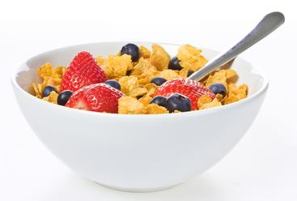
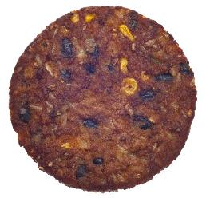
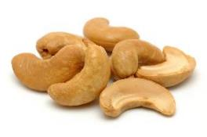
The portion sizes
Developed on a case-by-case basis – for example:
Bagels – based on retail average
Breakfast cereals – based on NDNS data
Chicken breast – based on NDNS data
Veggie burgers – range given based on retail data
Nuts – based on NDNS data

Slide 14
Portion size categories
Wide variation within food groups – so, portion size categories developed to reflect this.
Starchy carbohydrates and protein foods:
Less than 200kcal – lighter meals and breakfasts
More than 200kcal – mostly for main meals
Snacks – less than 150kcal
Dairy and alternatives
Lower fat (low or medium for fat on food labels)
Higher fat (high for fat on food labels)
Individuals can choose within these categories depending on their needs

Slide 15

Consumer research
Focus groups looking at:
Views on portion size
How portion size approached for different foods
How guidance on portion size could be used
How portion sizes could be measured
Visual ways to communicate portion size in a healthy diet

Slide 16


Consumer research outcomes
Portion size message alone often viewed as restrictive
Information on ‘a balanced diet’ welcomed
Both hands and spoons seen as practical ways to measure portion sizes
Recognising individual variation important

Slide 17
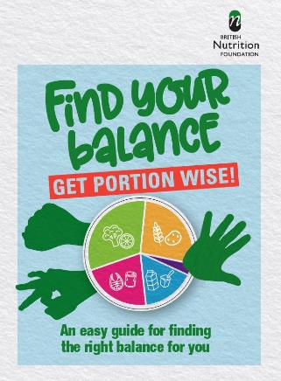
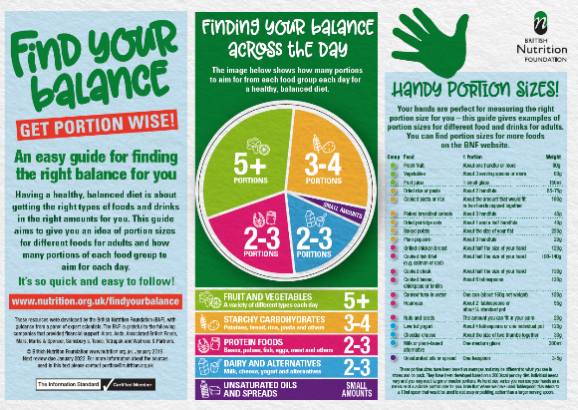
Find your balance
Set of 3 resources
A4 poster
Short booklet
Full portion size list
All available at www.nutrition.org.uk/findyourbalance

Slide 18
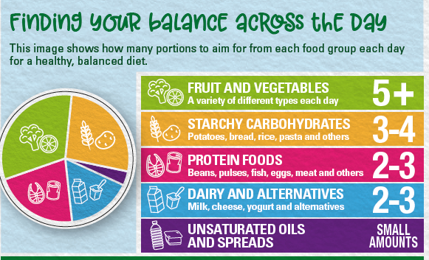
Anchored on balancing the diet as a whole

Slide 19
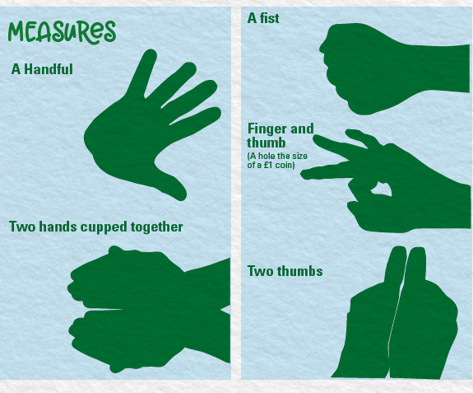
Hand measures for portion sizes

Slide 20
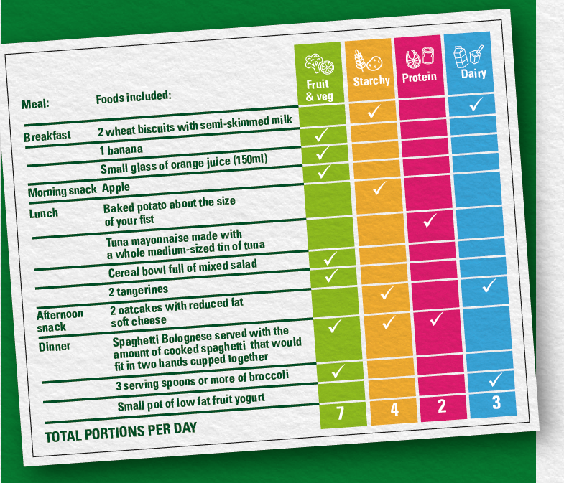
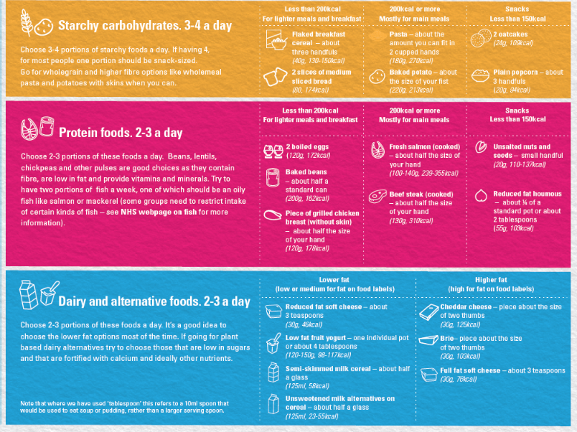

Slide 21
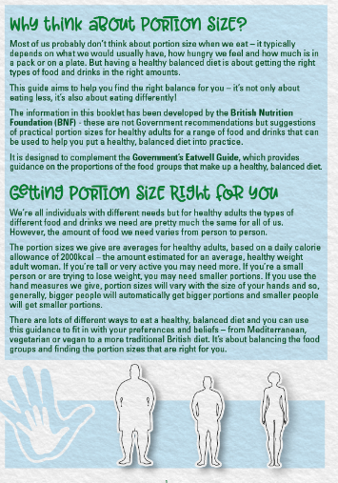
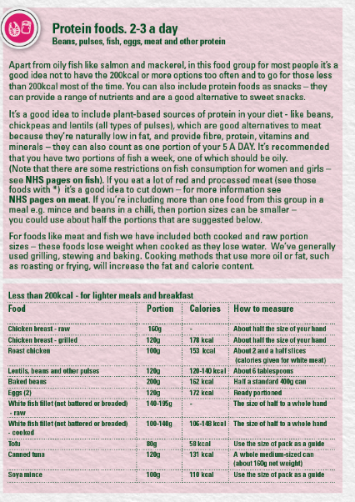
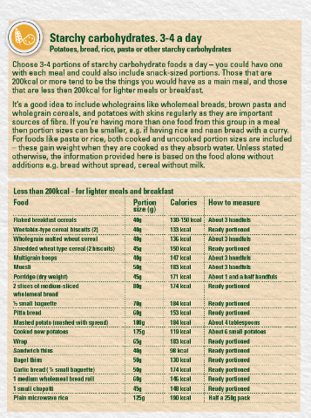
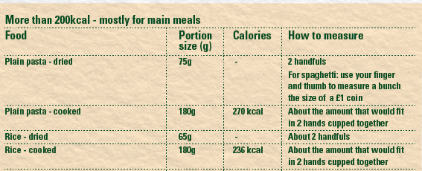
More detailed info

Slide 22
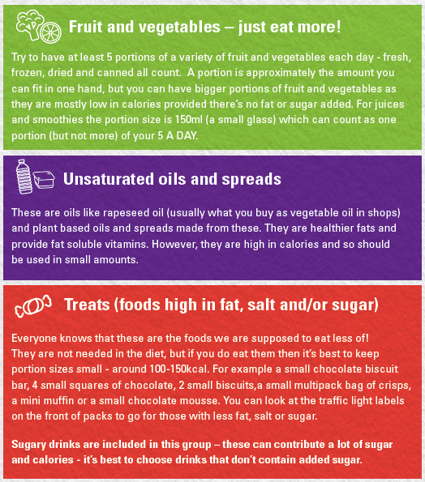
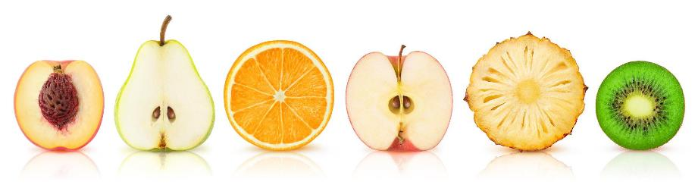
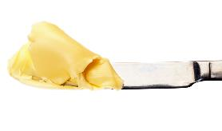

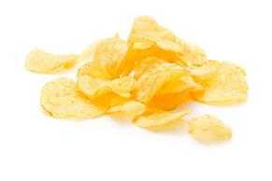

Guidance on other food groups

Slide 23
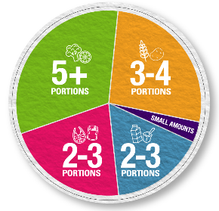
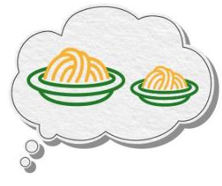
Activities – 6 ideas
Review a diet and compare to the ‘number of portions’ of each food group (spot gaps, suggest changes …)
Weigh typical portion sizes, e.g. breakfast cereals (look at differences in weight, nutrition implications …)
Calculate the cost of different portion sizes
Portion size and nutrient intake – using front-of-pack and back-of-back labels
Nutritional analysis of recipes/dishes, investigating portion size changes
Consider food waste and portion size
https://www.foodafactoflife.org.uk/resources/?q=portion

Slide 24
Thanks for listening
For further information, go to: www.nutrition.org.uk and www.foodafactoflife.org.uk

