Slide 1
Resources and training
Frances Meek
British Nutrition Foundation

Slide 2
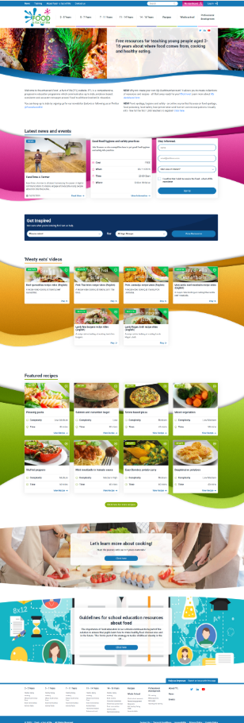
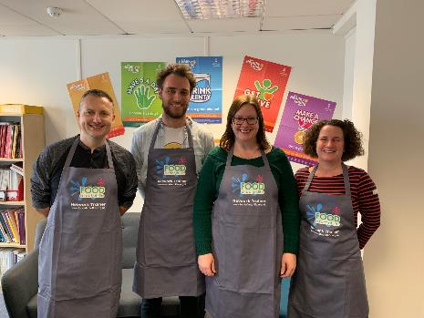
How can we help?
Food – fact of life website.
Resources for 3 – 16 years.
Progressive approach.
Supporting teaching about healthy eating, cooking, where food comes from.
Curriculum compliant.
Personal and professional development (PPD) for teachers.
www.foodafactoflife.org.uk

Slide 3
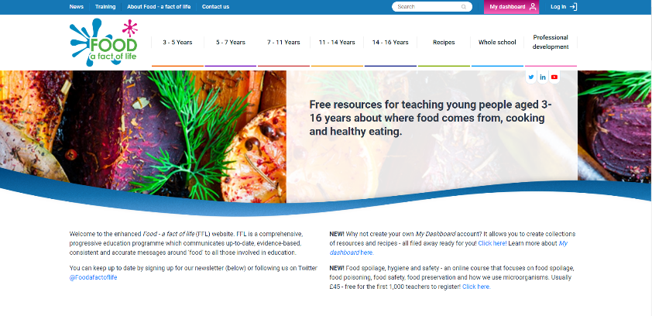
New Food – a fact of life website!
All resources for teaching pupils aged 3-16 reviewed and updated.
New resources created.
Resources from Grain Chain, Meat and Education and Cook your own potatoes reviewed and updated.
Areas of key learning identified and activities developed for each area with supporting resources (11-14 years).
www.foodafactoflife.org.uk

Slide 4
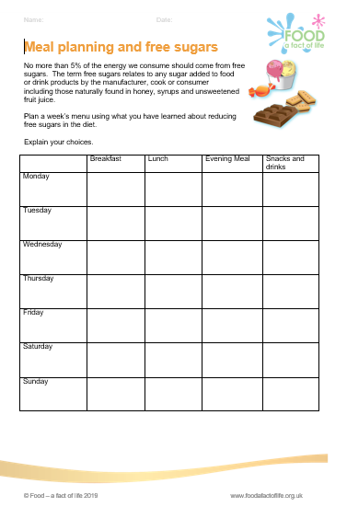
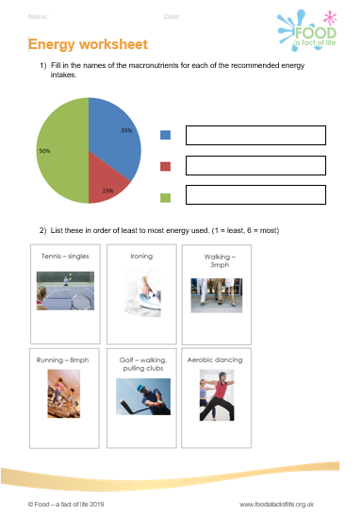
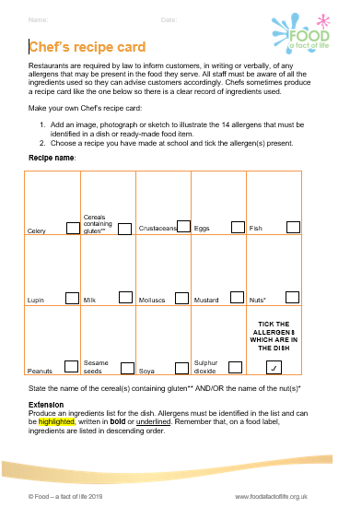
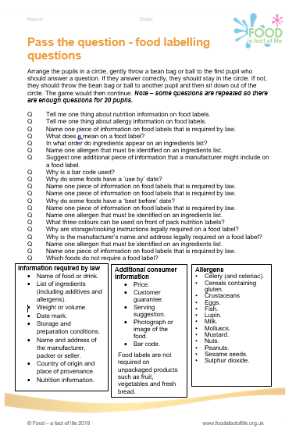
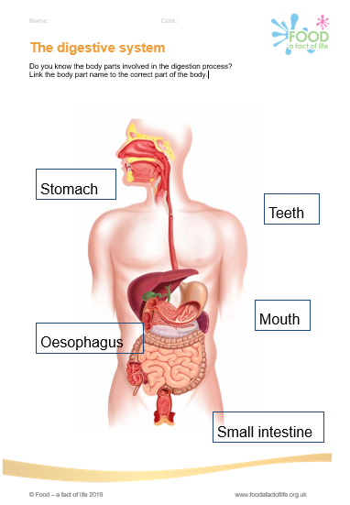

Areas of key learning – Healthy eating
Eat well
Energy and nutrients
Diet and health
Nutrition labels
Digestion
Activity

Slide 5
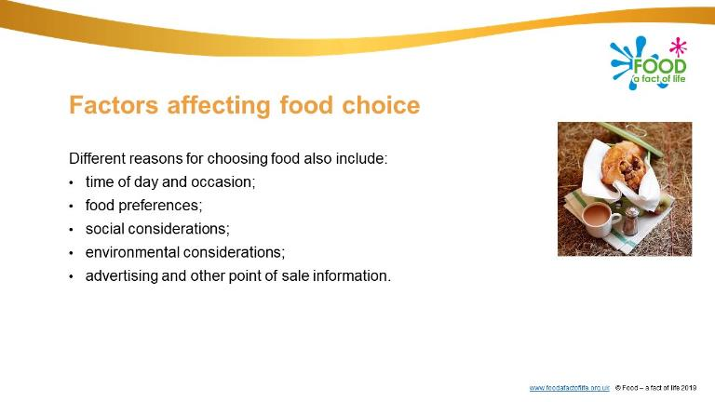

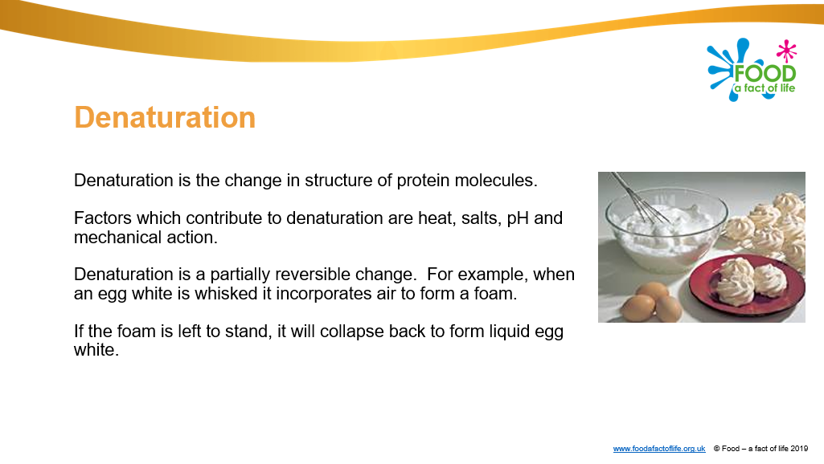
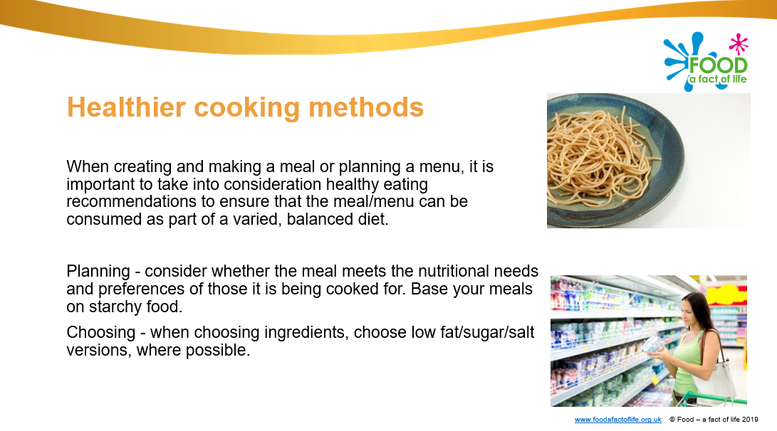
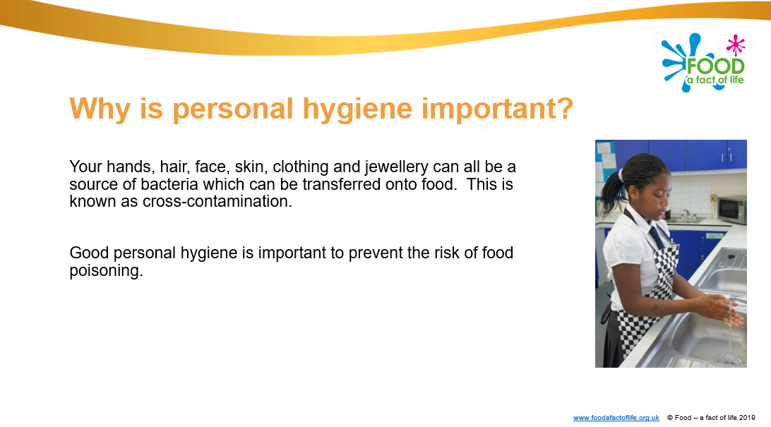
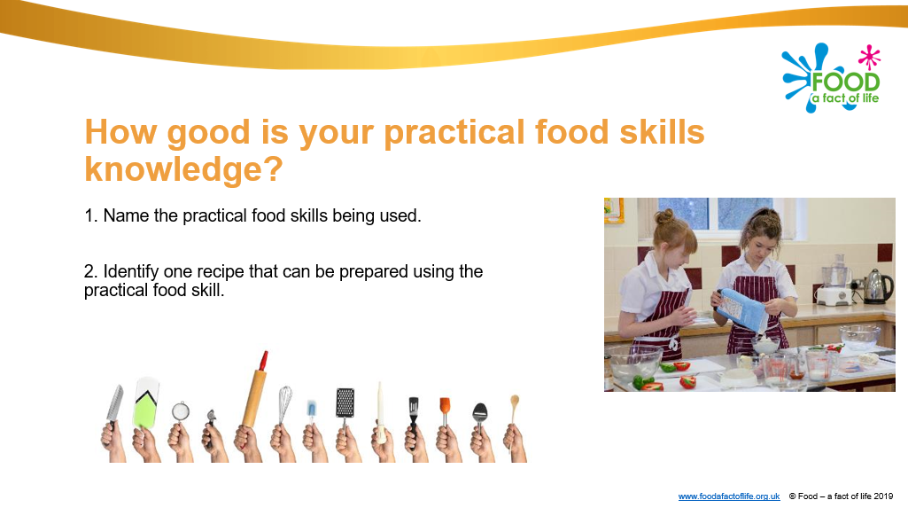
Areas of key learning – Cooking
Planning what to cook
Ingredients
Cooking for health
Hygiene and safety
Cooking

Slide 6
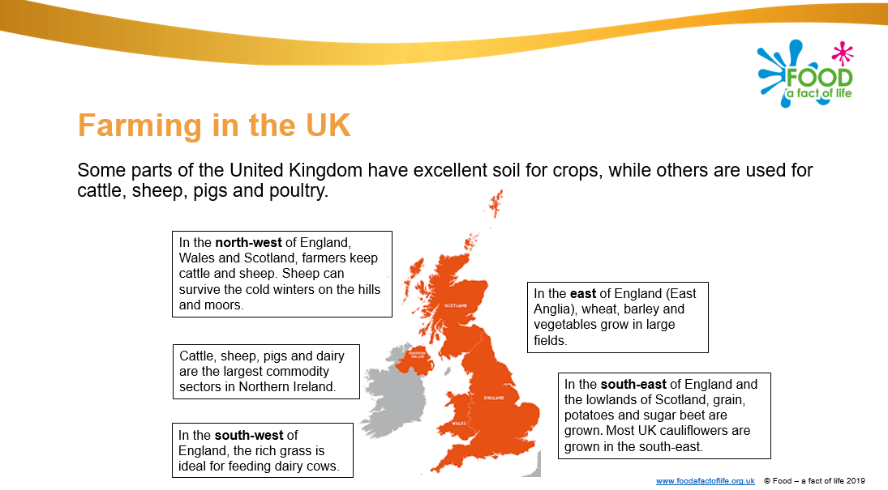
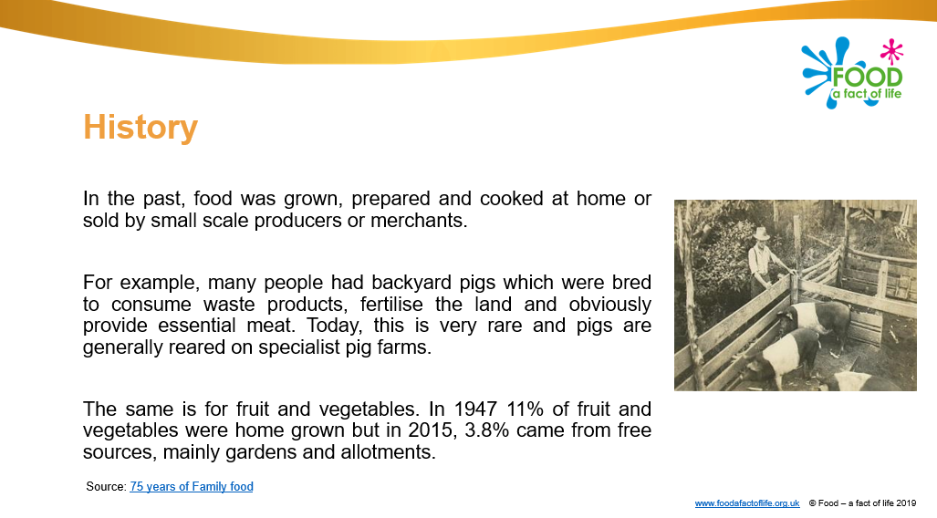
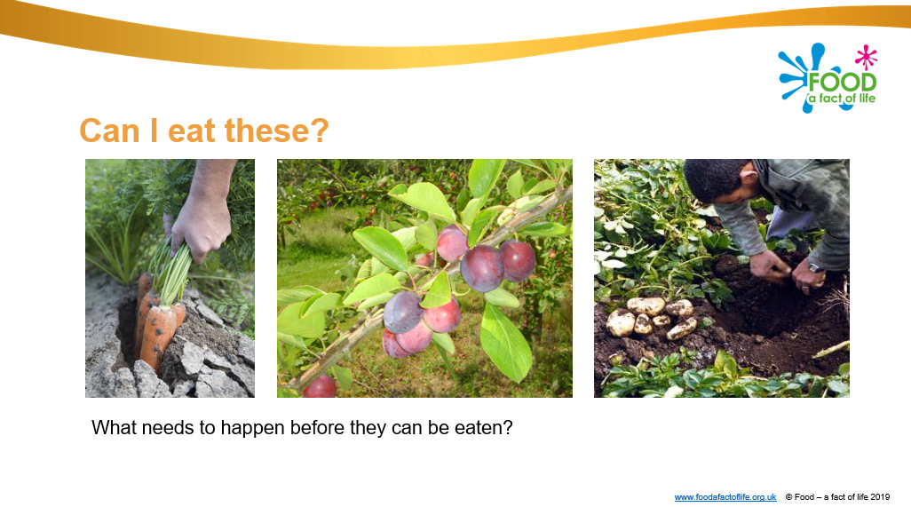
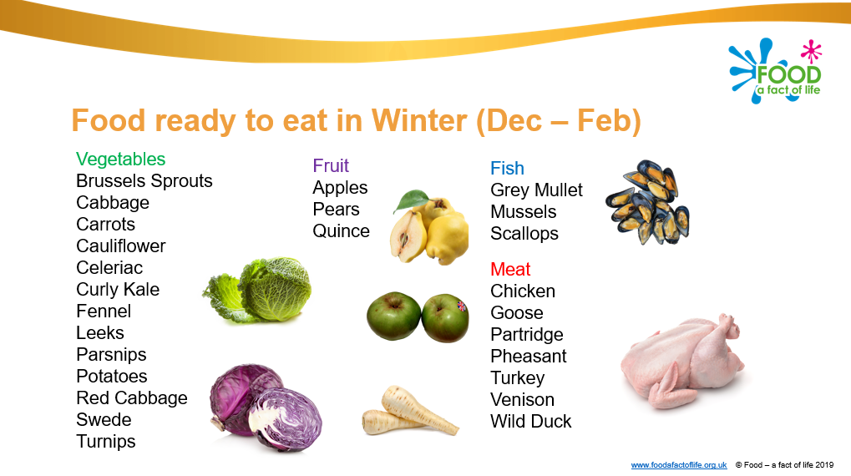
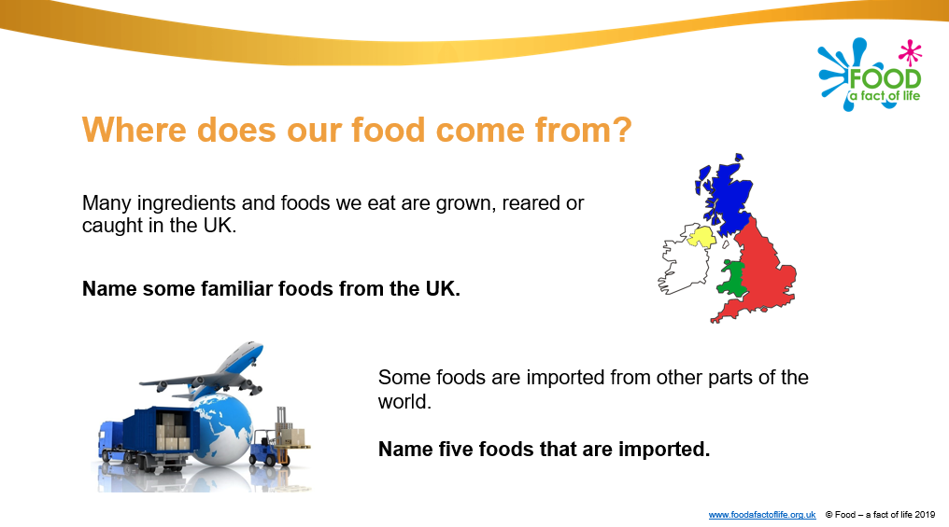
Areas of key learning – Where food comes from
Food origins
Farming and processing
Food availability
Plus videos

Slide 7
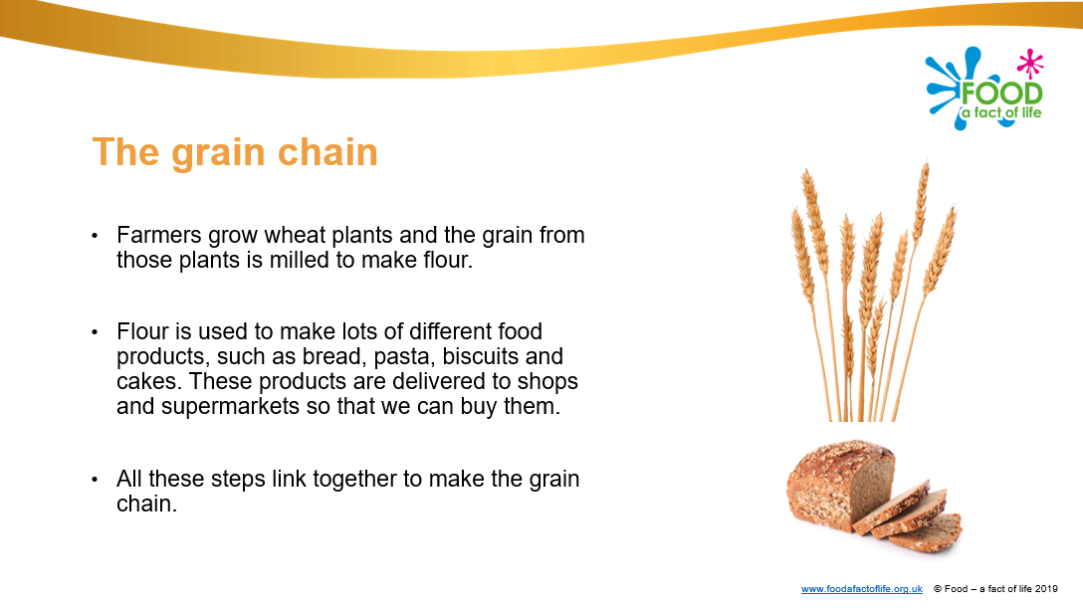
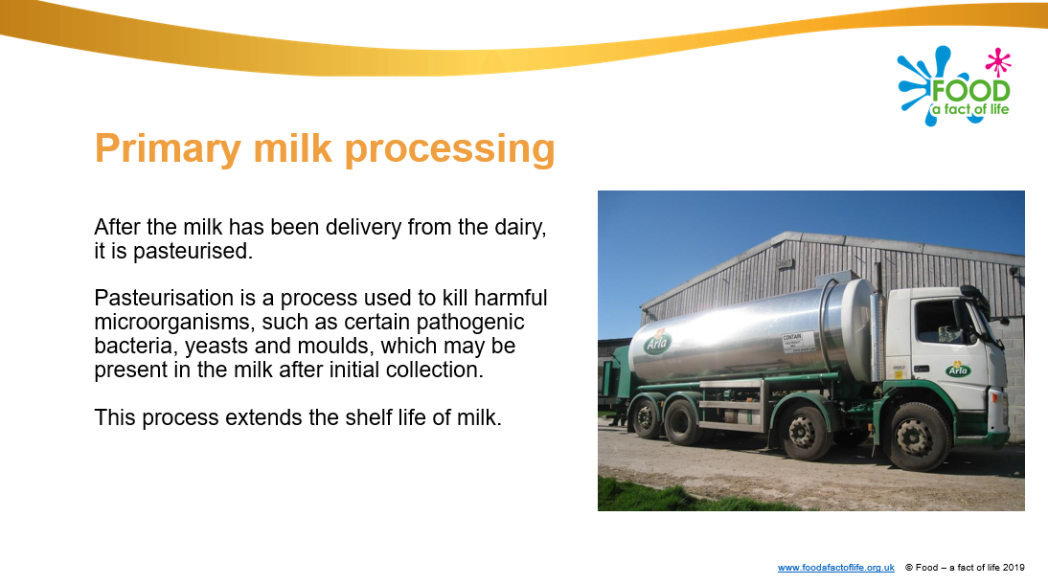
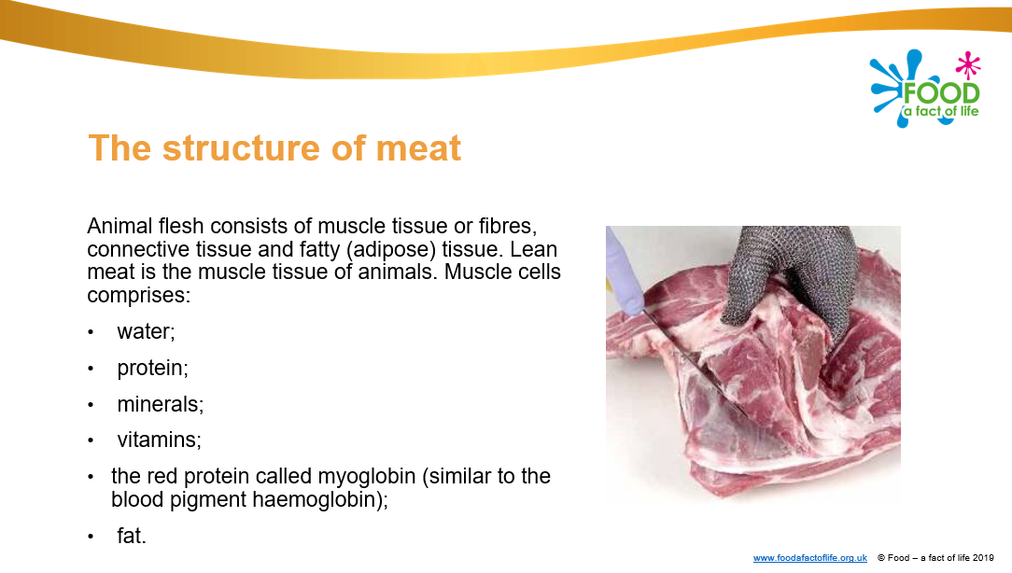
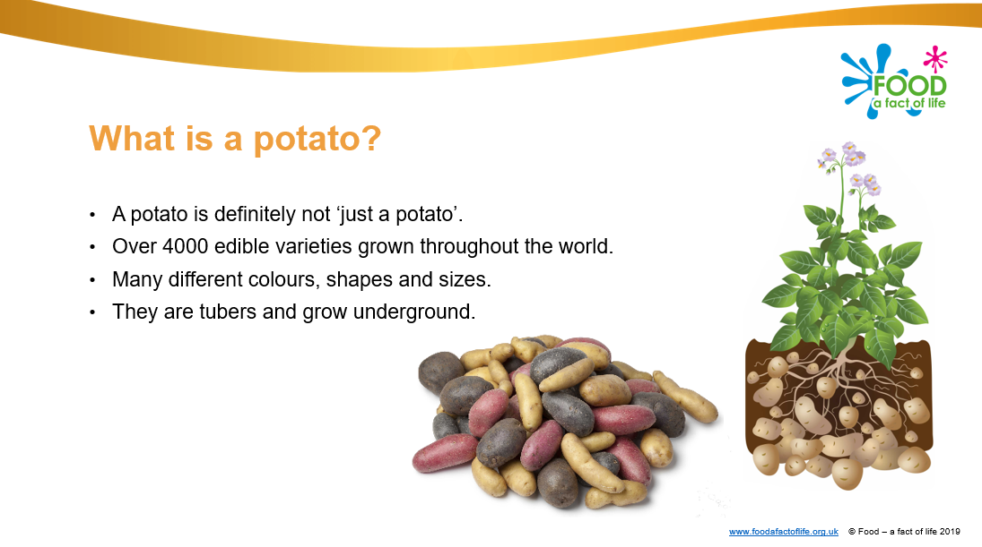
Areas of key learning – Commodities
Cereals
Dairy
Meat
Potatoes
More to come!

Slide 8
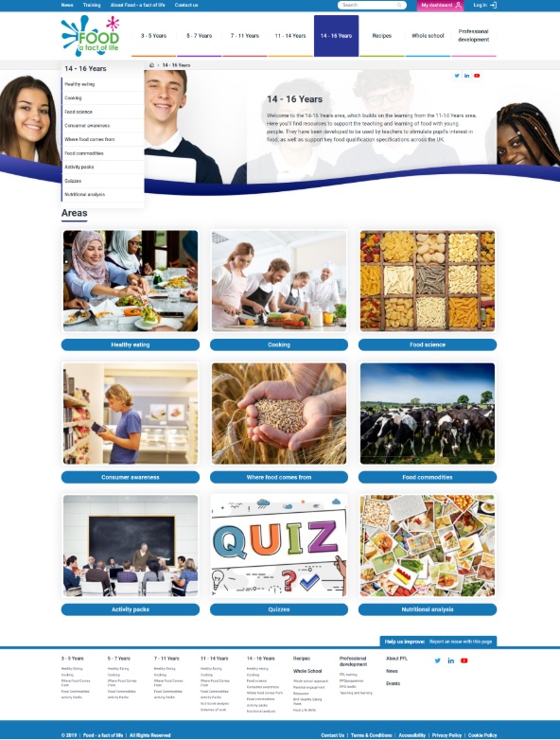
14-16 years
Areas
Healthy eating
Cooking
Food science and sensory science
Consumer awareness
Where food comes from
Food commodities
Activity packs (Food route and BNF HEW)
Quizzes
Nutritional analysis for schools

Slide 9

Personal and professional development
New area on the FFL website
FFL Training – book a range of training delivered via webinars, online courses, practical workshops and conferences.
Personal and professional development toolkit – support for planning, implementing and monitoring your own professional development.
Teaching and learning – advice and support around planning, managing and teaching food, as well as the knowledge and skills required.

Slide 10

FFL training - webinars
ICT, literacy and numeracy in food and nutrition lessons - Tuesday 3 December 2019
Functional properties of food – carbohydrates - Thursday 16 January 2020
For more details and to book, go to: www.foodafactoflife.org.uk
FFL training has real impact!
Post –event evaluation shows that 71% teachers shared or used the training received with other colleagues at school (12% plan to) as a result of attending one of our webinars.
Webinar recordings available online:
www.foodafactoflife.org.uk

Slide 11
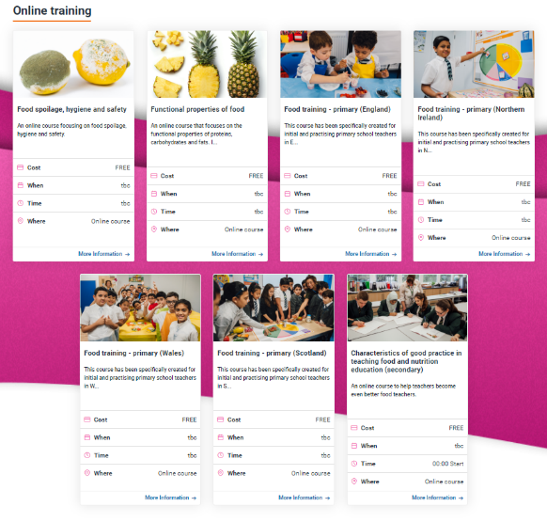
FFL training – online courses
Functional properties of food
Spoilage, hygiene and safety
Sensory science – coming soon!
Characteristics of good practice in teaching food and nutrition education (secondary)
Food teaching in primary schools (Scotland), Gaelic version coming soon
Free access to these courses for a limited number of teachers – register now to secure your place! www.foodafactoflife.org.uk

Slide 12
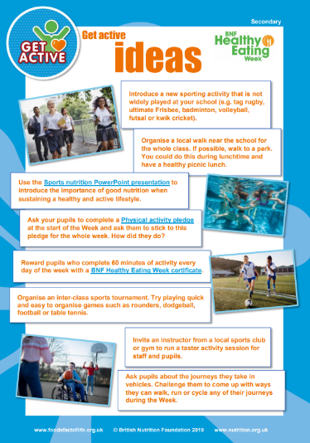

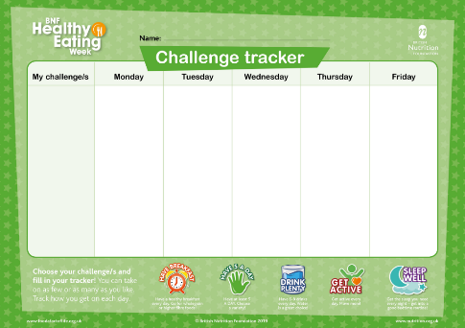
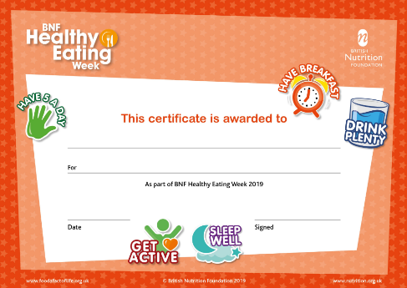
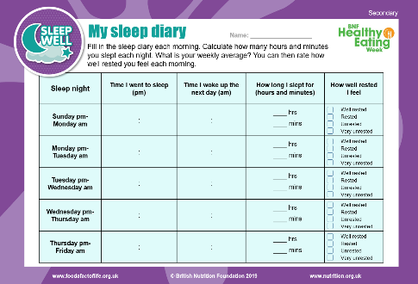
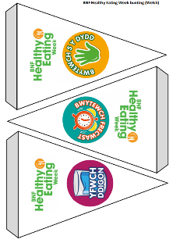
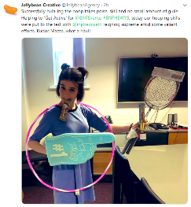
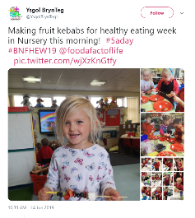
BNF Healthy Eating Week 2020
8 – 14 June 2020
Free downloadable resources and printed posters to support your week.
Challenges every day – including the weekend!
Ideal to support HWB in your school!
Register at: www.foodafactoflife.org.uk

Slide 13
Resources and training
For further information, go to:
www.foodafactoflife.org.uk

