Slide 1
SQA update
November 2019

Slide 2
Statistics 2018/19
Subject | Entries 2018 | Entries 2019 | Pass rate % 2018 | Pass rate % 2019
N3 Fashion | 45 | 8
N4 Fashion | 179 | 201
N5 Fashion | 444 | 382 | 65 | 60
H Fashion | 370 | 213 | 83 | 74

Slide 3
Statistics 2018/19
Subject | Entries 2018 | Entries 2019 | Pass rate % 2018 | Pass rate % 2019
N3 Health | 55 | 54
N4 Health | 599 | 519
N5 Health | 1472 | 1447 | 67 | 73
H Health | 1375 | 1174 | 64 | 60
AH Health | 44 | 21 | 77 | 81

Slide 4
Statistics 2018/19
Subject | Entries 2018 | Entries 2019 | Pass rate % 2018 | Pass rate % 2019
N5 Cake | 1394 | 1239 | 62 | 62
N3 Cookery | 590 | 628
N4 Cookery | 3699 | 3781
N5 Cookery | 5036 | 4826 | 66 | 85

Slide 5
Course and verification reports
These reports are produced by the Principal Assessor and Principal Verifier.
They contain information on candidates performance, promote better understanding and give advice that can help inform your teaching.
The reports can be found on each subject/level homepage.

Slide 6
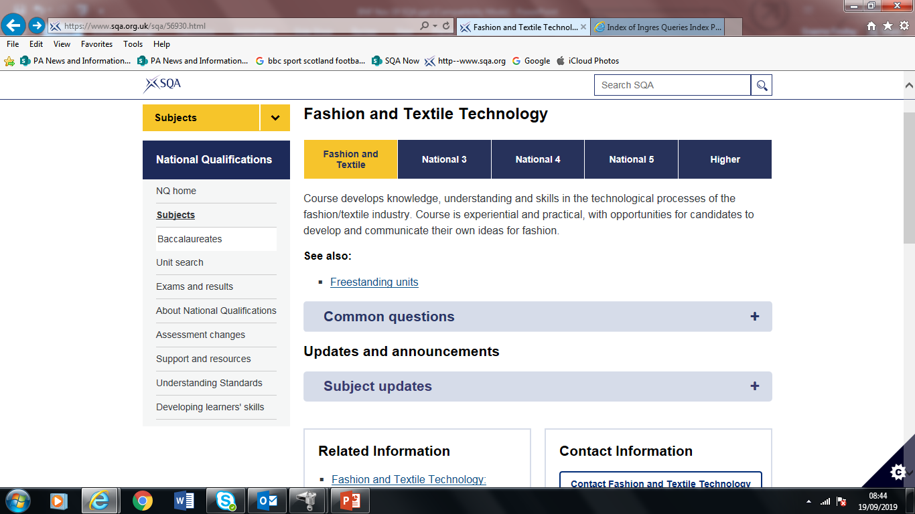
Dark background slide
Use me when presenting to a large group.
Dark backgrounds and white text are easier to read and gentler on the eye.
Don’t mix and match dark and light slides — choose one style and stick to it for consistency in your presentation.

Slide 7
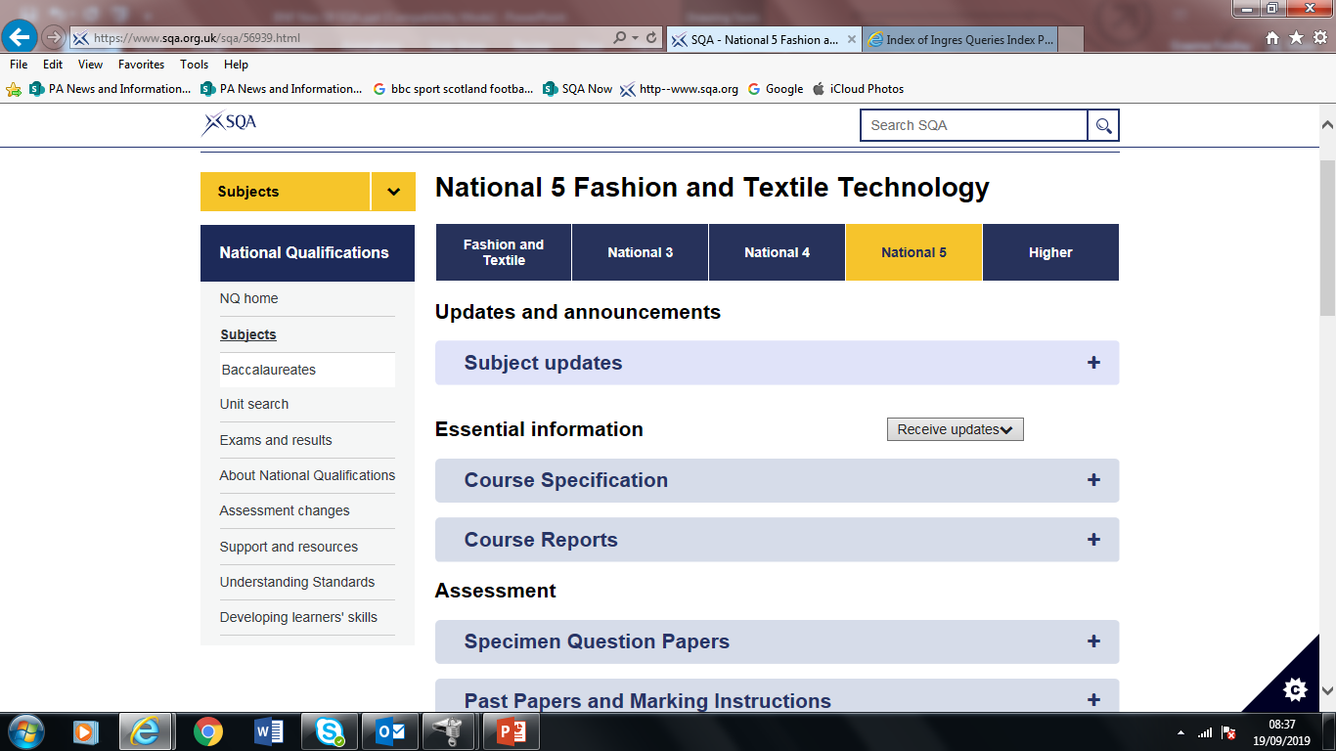
Title with text box and bullets
Keep titles and bullet points short and relevant.
Try to limit the amount of text on each slide:
no more than five lines of text per slide
no more than eight words per line
Too much text is distracting for an audience.
Bold text should be used sparingly.

Slide 8
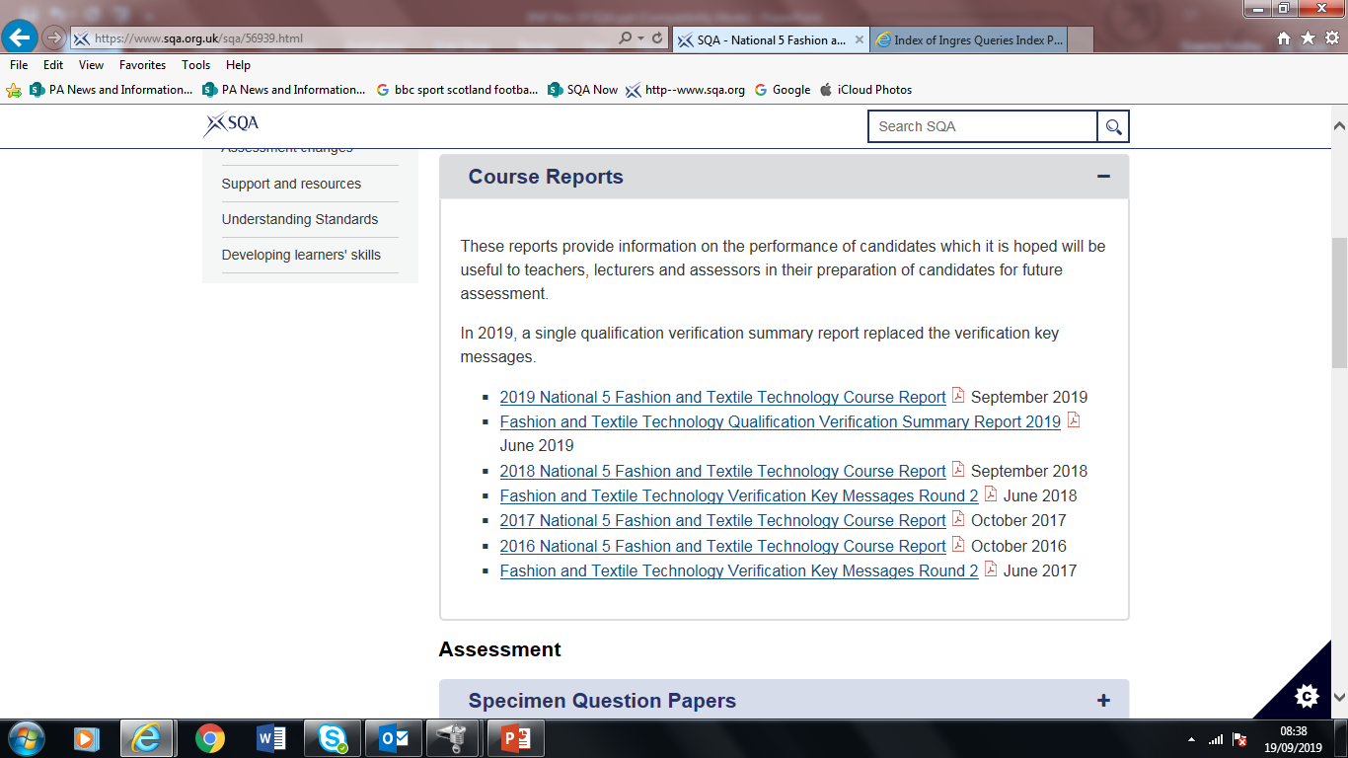
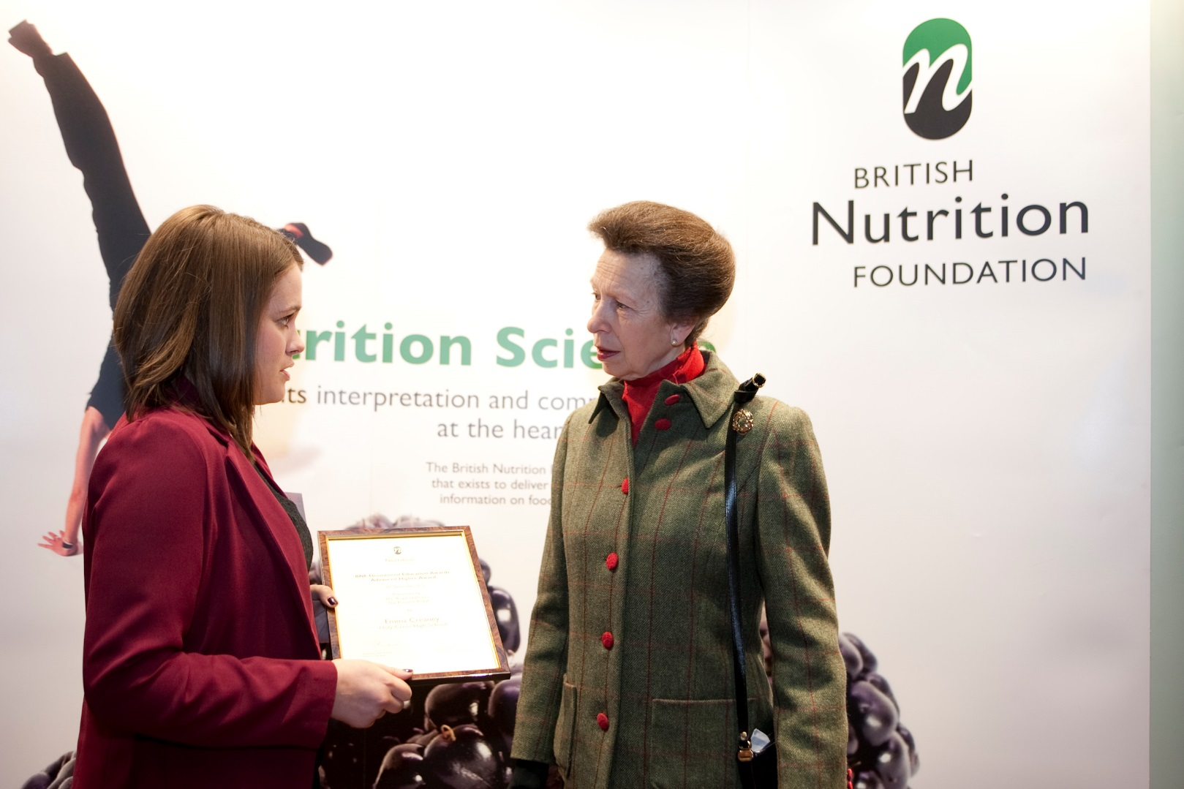

Slide 9

Add in a picture
a picture can add visual interest
keep your layout simple
capture attention

Slide 10
BNF Drummond Education Awards
National 5 Health and Food Technology
Amy Petrie, Ellon Academy
Advanced Higher Health and Food Technology
Jenna Mowat, Brae High School

Slide 11
Revised National Qualifications
Advanced Higher Health and Food Technology
The course will be assessed by a Question Paper and an Assignment.
Question Paper will be worth 50% of the total mark
Assignment will be worth 50% of the total mark
All course materials are now available on the website at
https://www.sqa.org.uk/sqa/48451.html

Slide 12
Removal of ‘Hospitality’ prefix
The new course titles and codes are…
Practical Cake Craft – C876
Practical Cookery – C877
There has been no change to the content of the courses, or the modes of assessment

Slide 13
Coursework briefs
New from this session, the annual coursework briefs for both Fashion and Textile Technology and Health and Food Technology have been posted on the open site.
Please ensure your candidates use this years briefs

Slide 14
Practical Cookery
Recipes will be published by the 31st January 2020
Please ensure candidates follow them
If you have any questions regarding using alternative ingredients, or your candidates require additional support, please contact SQA using the information in the centre guidance document

Slide 15
Candidate workbooks
The following workbooks have been updated:
National 5 Fashion and Textile Technology Assignment and Practical Activity
Higher Fashion and Textile Technology Assignment and Practical Activity
National 5 Health and Food Technology Assignment
Higher Health and Food Technology Assignment
National 5 Practical Cake Craft Assignment and Practical Activity
National 5 Practical Cookery Assignment and Practical Activity
Please ensure your candidates use the updated
workbooks

Slide 16
Health and Food Technology
The following materials have been updated:
National 4 Food for Health assessment support pack
National 5 coursework assignment
Higher specimen question paper and assignment
Advanced Higher course specification
Advanced Higher Food Science, Production and Manufacturing assessment support pack

Slide 17
Verification 2018/19
Subject | Accepted | Accepted* | Not accepted | Total number of centres
Fashion | 9 | 1 | 5 | 15
Health | 10 | 12 | 1 | 23
Cake | 33 | 11 | 6 | 50
Cookery | 82 | 29 | 14 | 125

Slide 18
Verification 2019/20
Subject | Total number of centres involved
Fashion | 45
Health | 46
Cake | 57
Cookery | 118
T

Slide 19
Verification 2019/20
Dates:
Round 1 Event February 2020
Round 1 Visiting 3rd to 28th February 2020
Round 2 Event May 2020
Round 2 Visiting 2nd March to 25th May 2020

Slide 20
Submission dates 2019/20
Externally assessed coursework
National 5 Fashion and Textile Technology 23rd April 2020
National 5 Health and Food Technology 18th March 2020
National 5 Practical Cake Craft 23rd April 2020
National 5 Practical Cookery 23rd April 2020
Higher Fashion and Textile Technology 23rd April 2020 Higher Health and Food Technology 23rd April 2020
Advanced Higher Health and Food Technology 23rd April 2020
Internal assessment mark forms
National 5 Cake, Cookery, Fashion and 1st May 2020
Higher Fashion

Slide 21
Exam dates 2019/20
National 5 and Higher Fashion and Textile 29th May 2020
Technology
National 5, Higher and Advanced Higher 26th May 2020
Health and Food Technology
National 5 Practical Cake Craft 22nd May 2020
National 5 Practical Cookery 2nd June 2020

Slide 22
Removal of fallback
Automatic fallback to National 4 is no longer available.
Learners must be presented for the most appropriate level, based on their needs/ability.
Learners will be certificated for qualifications they have been entered for, please ensure they are aware of the demands.

Slide 23
Events
Webinar
Advanced Higher Health and Food Technology
Understanding Standards
Higher Fashion and Textile Technology
Higher Health and Food Technology
Advanced Higher Health and Food Technology
Practical skills day
Health and Food Technology
All materials from these events can be found on the Understanding Standards website at
https://www.understandingstandards.org.uk/

Slide 24
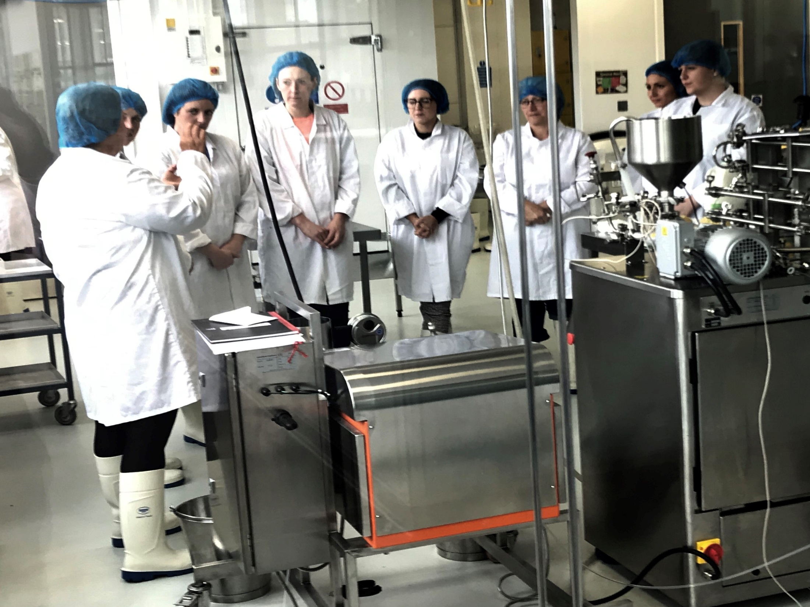
Title with text box and bullets
Keep titles and bullet points short and relevant.
Try to limit the amount of text on each slide:
no more than five lines of text per slide
no more than eight words per line
Too much text is distracting for an audience.
Bold text should be used sparingly.

Slide 25
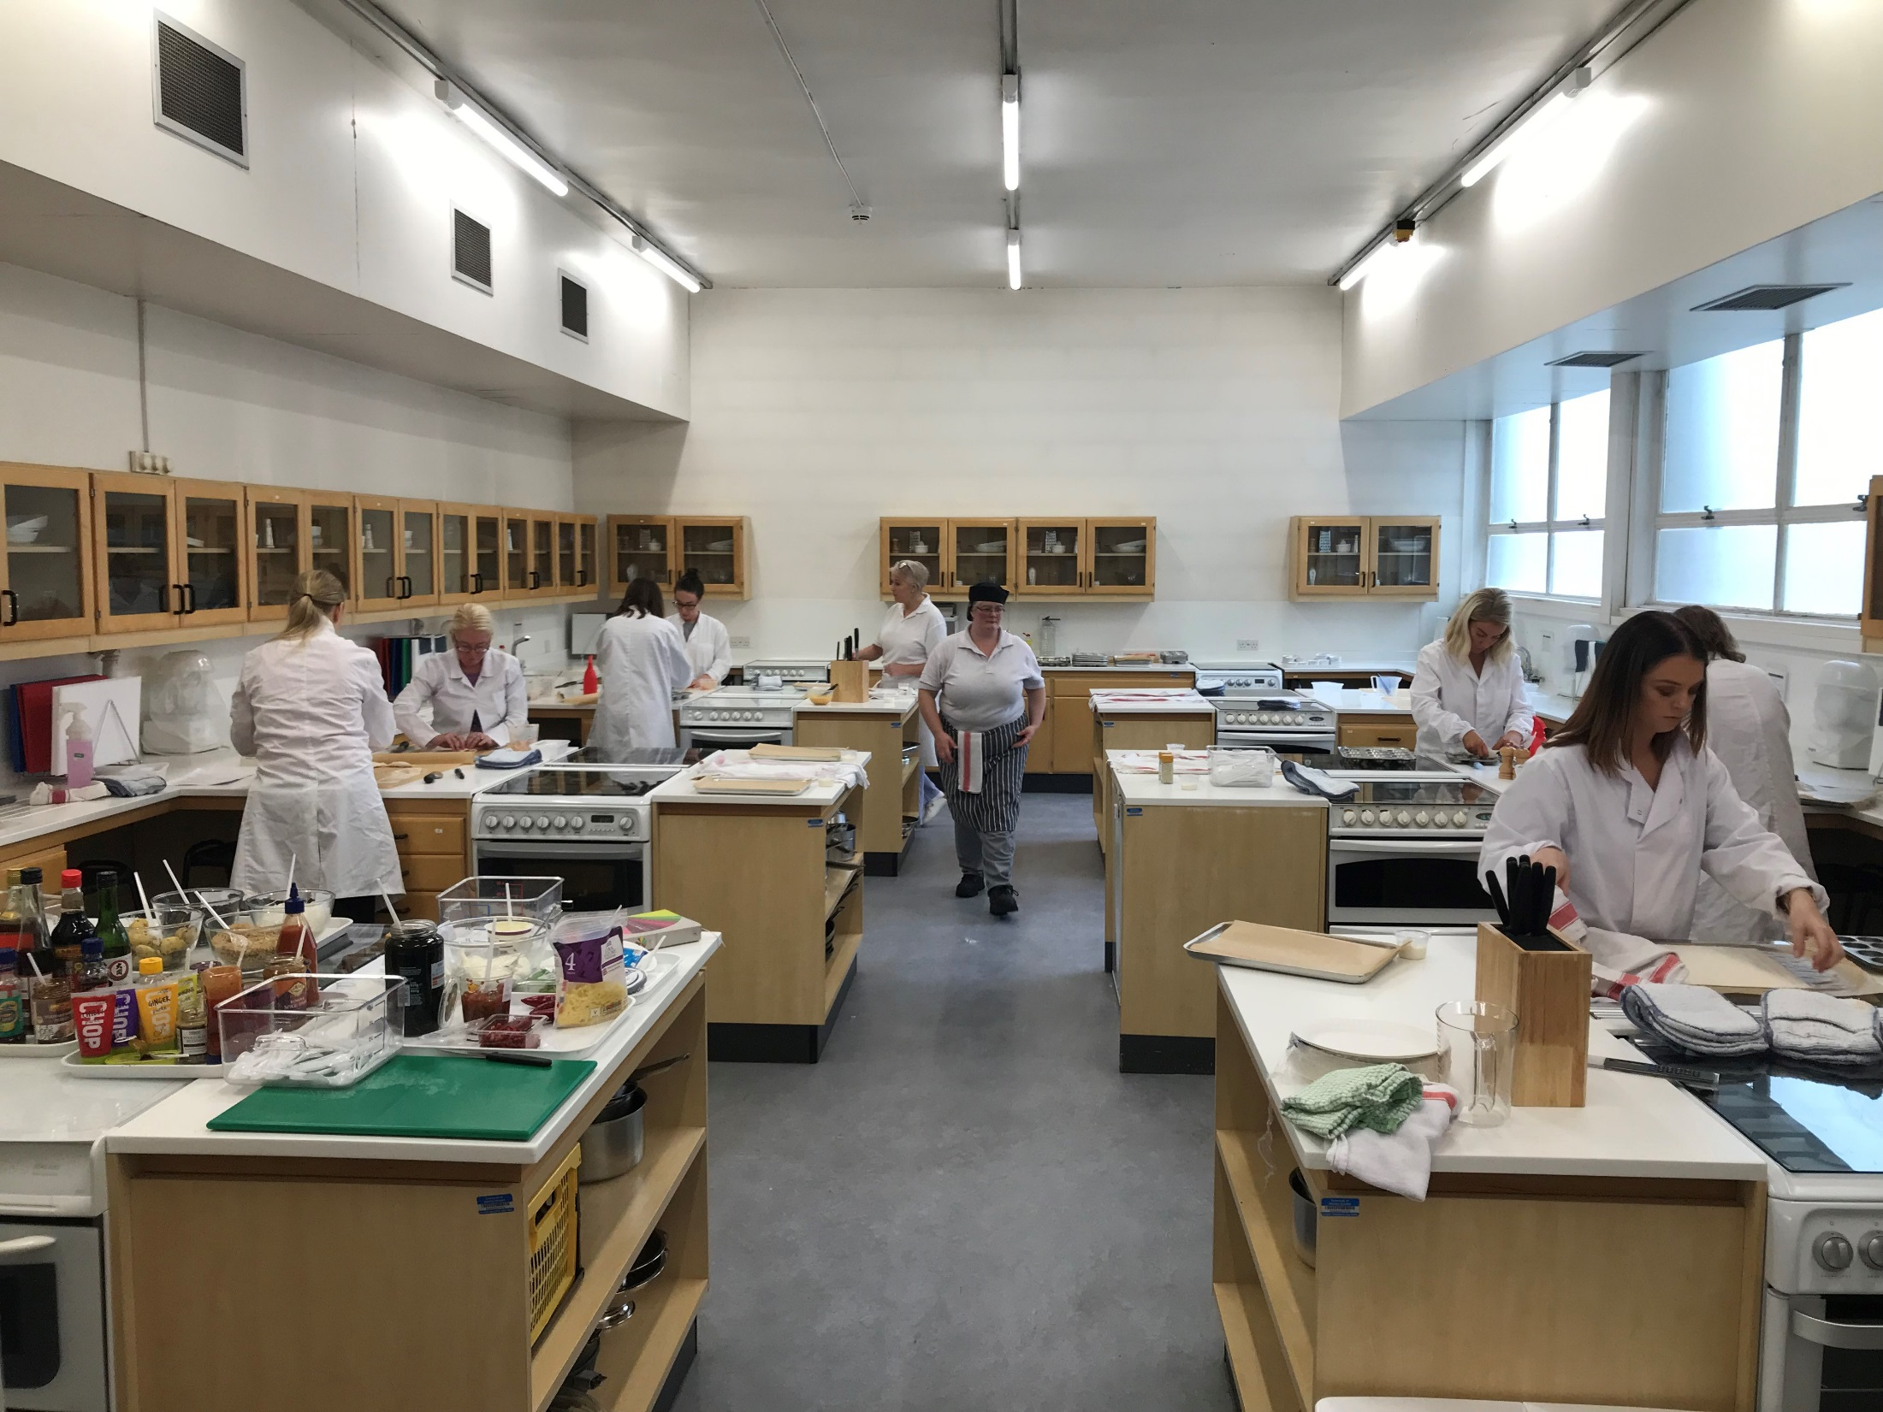
Events
Webinar
Advanced Higher Health and Food Technology
Understanding Standards
Higher Fashion and Textile Technology
Higher Health and Food Technology
Advanced Higher Health and Food Technology
Practical skills day
Health and Food Technology
All materials from these events can be found on the Understanding Standards website at
https://www.understandingstandards.org.uk/

Slide 26
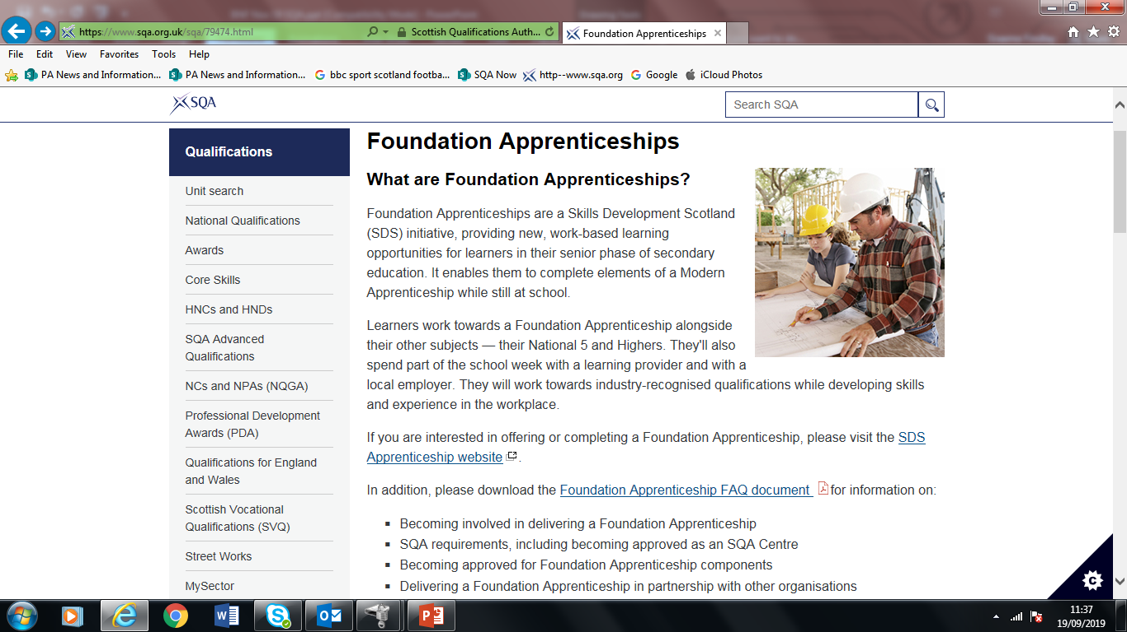
Use me for large images, graphics or tables.

Slide 27


Slide 28


Slide 29
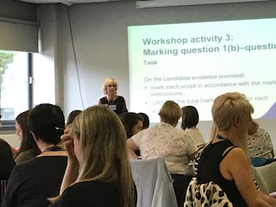
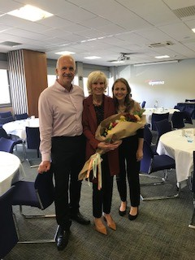
Final farewell…Linda Adam
a picture can add visual interest
keep your layout simple
capture attention

Slide 30
Keep in touch
Subject pages for Cake, Cookery, Fashion and Health http://www.sqa.org.uk/sqa/45625.html
Hospitality Food and Drink blog
http://blogs.sqa.org.uk/hospitalityfoodanddrink
Weekly Centre News
https://mailer.sqa.org.uk/Subscribe/Step1

Slide 31
Keep in touch
Twitter: @sqanews
Facebook: Scottish Qualifications Authority
LinkedIn: Scottish Qualifications Authority
YouTube: SQAonline

Slide 32
Contact details
Manuela De Freitas Qualifications Officer for Fashion and Textiles and Health and Food courses
manuela.de.freitas@sqa.org.uk
0345 213 5480
Suzanne Train Qualifications Officer for Cake and Cookery courses
suzanne.train@sqa.org.uk
0345 213 5206
Graeme Findlay Qualifications Manager
graeme.findlay@sqa.org.uk
0345 213 5492

