Slide 1

Teaching Home Economics
The challenges, the highs and the future
Emma Creaney - Carluke High School

Slide 2

My background
I attended Holy Cross High School where I won the BNF prize for Advanced Higher HFT in 2012.
Undergraduate degree at Abertay university – Food, Nutrition and Health.
PGDE Home Economics at Strathclyde university
Probation until now in Carluke High School.

Slide 3

The challenges… and some? solutions
The main challenges I think we face…
The perception of the subject
Teacher recruitment and teacher retention
Funding
Skills that our students arrive at high school with

Slide 4
The perception of Home Economics
What is the first thing that comes to mind when you hear “Home Economics”?
Home Economics Teachers
Teachers
Cooking
Cooking
Practical
Food
Old fashioned
Old fashioned
Irrelevant
Skills
Easy option
Health
Inclusive
“My wife should have paid more attention in your class”
Essential

Slide 5

What does this mean?
Personally, I was shocked - and angry - at some of the responses.
We are not “just cooking”. We are so much more than that.
We need to champion the subject and prove this.
The perception of our subject is ours to own and ours to change.
Poster adapted from one found online.

Slide 6

Teacher recruitment and retention
“Home Economics teachers are like gold dust!”
There are more courses available now that provide more flexible pathways into the career.
There are roughly 600 Home Economics teachers in Scotland – we are a major support to each other through network meetings, sharing resources and we should be proud of this and welcome new teachers to this community.

Slide 7
Funding
One of the biggest challenges we face – inconsistent and uncertain.
Funding varies across all authorities with some schools collecting money, some authorities provide funding through PEF.
The uncertainty around funding is something we struggle with in my department and unfortunately, it is not something that I can suggest a solution to.
We are a vital part of the curriculum and until we are recognized for this the funding concerns are likely to continue.

Slide 8
Skills they arrive at high school with
Primary schools, despite doing their best, are often not equipped to deliver the second level benchmarks.
This has always been a challenge, however it seems to be more of a challenge as most pupils do not help in kitchen at home anymore.
“Where’s the dishwasher?”
“Who does the dishes?”
“I’m not allowed to cook at home”
How can we solve this problem?

Slide 9

The Highs
Working with external partners
Skills for life, learning and work
The pupils

Slide 10

Working with external partners
The food and hospitality industries are industry leading. Combined they employ approximately over 3 million people in the UK.
We are in a key position to develop the young workforce by equipping our our pupils with essential skills to allow them to thrive in this industry.
This is something we focus on in my department.
We have found that local businesses are keen to support departments and promote careers in the industry.

Slide 11

Our partners – Ramsay of Carluke
Ramsay of Carluke are our local butcher.
Ramsay give us a brief which pupils work from.
S2 learn about the product development process whilst designing a new product using Ramsay’s sausage meat.
Ramsay’s donate the meat used in the challenge.
From each class one dish goes to the final which is judged by Andrew Ramsay and other local business owners/ teachers and a winner is chosen.

Slide 12

Our partners - R&W Scott
We are currently building relationships with R&W Scott.
They are keen to break free from their “jam factory” label and promote the products that they sell. They make mainly coatings and fillings such as the filling inside Malteser bunnies!
The IDL project is going to be for S3 and involve Business, Home Economics, Photography, Graphics and English.
R&W Scott approached us to start this process because they have trouble recruiting food product developers.
S3 pupils are going to work as a business to produce recipes and a promotional leaflet that will be used by R&W Scott.

Slide 13
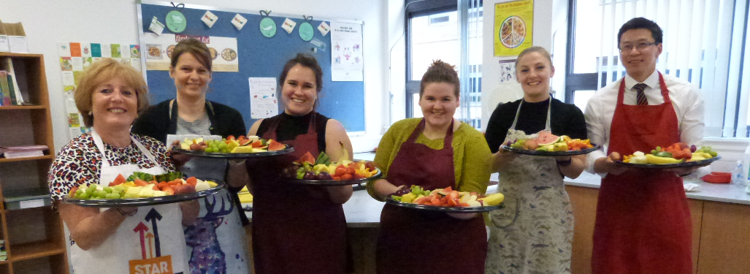

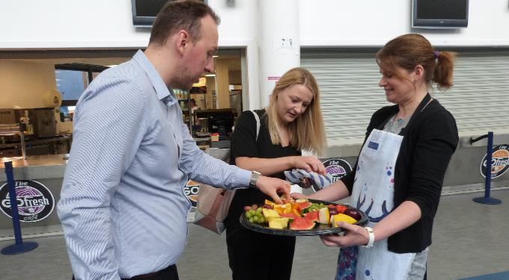
BNF Healthy Eating Week
We used all of the free resources available from the BNF website and followed the plan given as closely as possible.
We managed to get sponsorship from our local Aldi, who donated £30 worth of fruit which we cut up gave out before registration, and W&J Barr who donated bottles of water which were given out to pupils.
S2 completed an IDL project - in Home Economics they completed a food diary, in Math's they worked out how long it would take to burn the excess calories off and in PE they exercised to burn off the calories.

Slide 14
Skills for life, learning and work
Life
Learning
Work
Nutrition
Practical skills
Confidence
Resilience
HWB
Transferable skills
Practical numeracy
Problem solving
National 2 – Advanced Higher
Organisation
Time keeping
Logical thinking
Communication

Slide 15

The pupils
For me, the best and most important part of this wonderful and challenging career is working with the amazing young people we see day in, day out.
“Different”
“Fun”
“life changing”
“Highlight of my week”
“Interesting”
“Exciting”

Slide 16

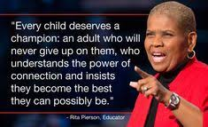

Slide 17
Finally… the future
National recognition of our importance.
National rebranding
New teacher training courses

Slide 18

Thank you

