Slide 1
ICT, numeracy and literacy in food and nutrition lessons

Slide 2

Overview
Opportunities for ICT, literacy and numeracy in food and nutrition lessons.
Developing cross-curricular and interdisciplinary approaches, and experiential learning.
Activity ideas for embedding ICT, literacy and numeracy in food and nutrition lessons.
Links to Food – a fact of life resources.
Suggestions for further reading and sources of information.

Slide 3
Curriculum – what we have to teach
Not ‘computing’ (program/code), but the application of ICT.
Use of search / combine use variety of software to solve problems.
England: They acquire a broad range of subject knowledge and draw on disciplines such as mathematics, science, engineering, computing and art.
Scotland: Literacy, numeracy and health and wellbeing are recognised as being particularly important – these areas are seen as being the ‘responsibility of all’ staff. Interdisciplinary learning is one of the four contexts for learning.
Northern Ireland: Connected learning. Cross-Curricular Skill of Communication / Mathematics. Using digital tools.
Wales: Literacy and numeracy framework. Digital competence framework.

Slide 4
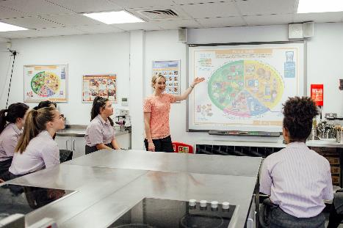

The teacher – being a role model
planning and recording / developing lessons – enrich curriculum;
creating / finding learning resources, e.g. FFL, TES, Countryside Classroom – extend learning;
communicating with others, e.g. forums/groups sharing good practice;
presenting ideas and concepts – learning experiences;
using a variety of multi-media, e.g. PPT, videos, games, templates – new concepts/horizons;
promoting pupil work, e.g. social media;
assessment, e.g. online quiz.

Slide 5
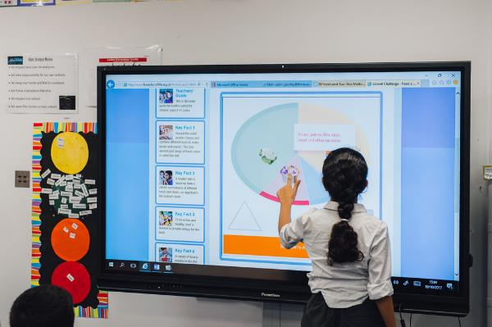
ICT, literacy and numeracy opportunities and inter-relationships
Communication
Presentation
Collaboration
Research, investigation
Data collection and analysis
Modelling – what if?
Photos/video/audio
Activities/games (learning intent)
ICT
Numeracy
Literacy

Slide 6

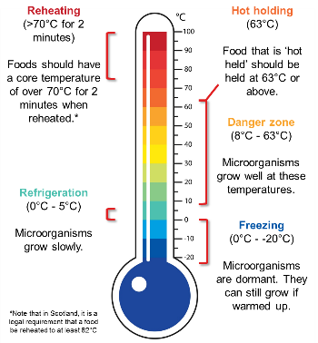
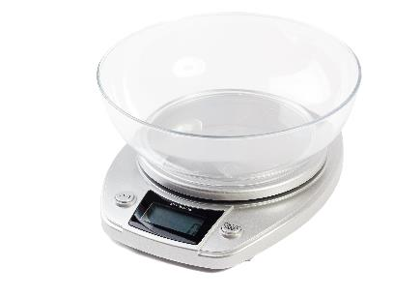
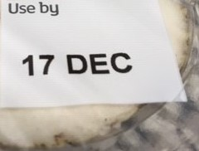
Numeracy
Weighing (weight, portion size)
Measuring (counting, length, volume – ml/cups/portion size, temperature)
Costing (£)
Scaling / Ratios, e.g. recipes
Dates / Timings (hours:mins:sec) and time management
Calculating/modelling energy and nutrients provided
Data analysis …

Slide 7
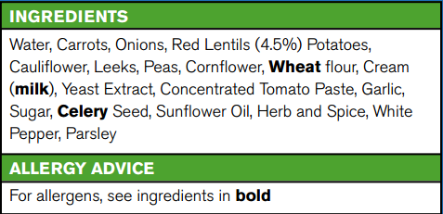
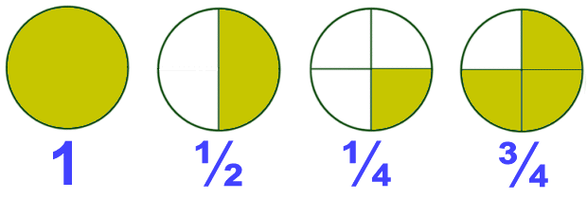

Numeracy
Fractions (cut into two-thirds …)
Decimals (0.1mg)
Percentages (calculating, using)
Sensory evaluation data (rating, ranking, scoring)
Shapes (cut in triangles, circles ...)
Presenting figures in lists and tables

Slide 8
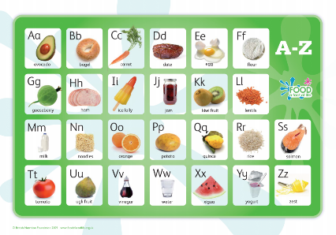

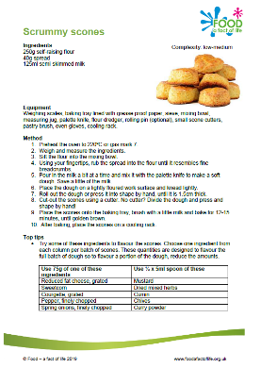
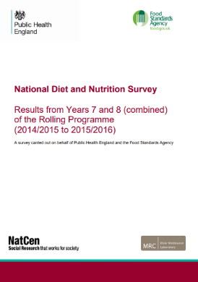
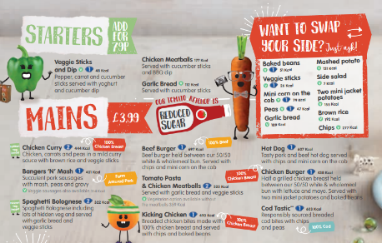
Literacy
Listening and talking … structured talking, arguing/debating, explaining, sharing, describing
Vocabulary development (specialist vocabulary)
Reading … books to introduce topics/themes (fiction/fact), labels, recipes, articles, menus (decision making), research documents/journals
Writing … instructional, surveys, creative (poetry), factual, fiction

Slide 9
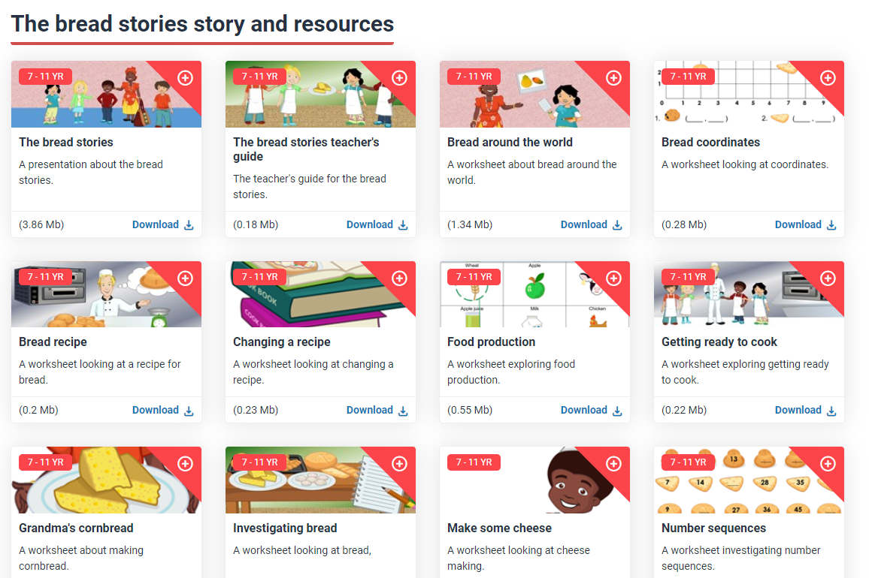
Learn with stories
Seven stories, e.g. 5 A DAY, lunchboxes, bread, fish, dairy farm
Focus on numeracy and literacy
Cross-curricular/inter-disciplinary worksheets
Links to where food comes from, cooking and healthy eating
Many ‘jumping off’ points!
https://www.foodafactoflife.org.uk/7-11-years/activity-packs/learn-with-stories/

Slide 10
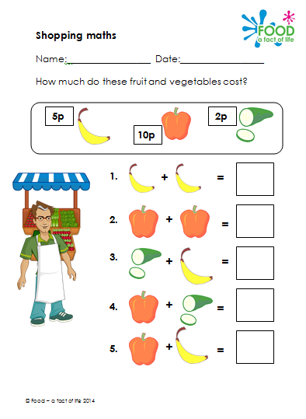
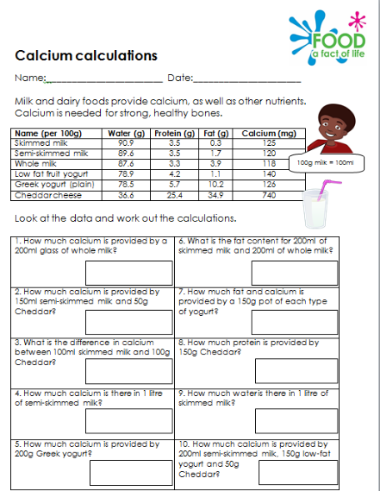
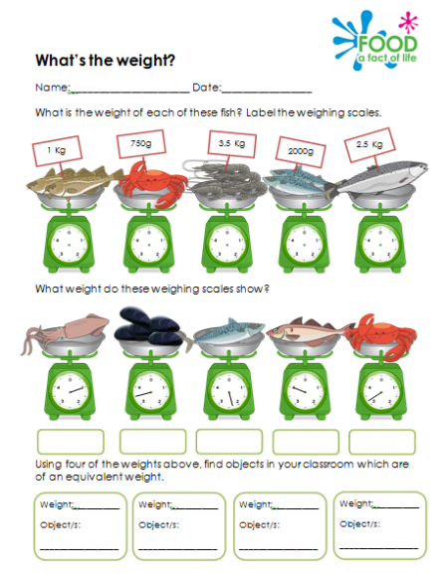
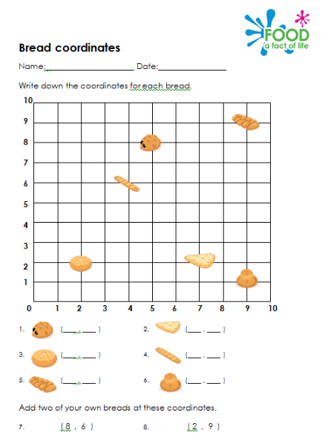
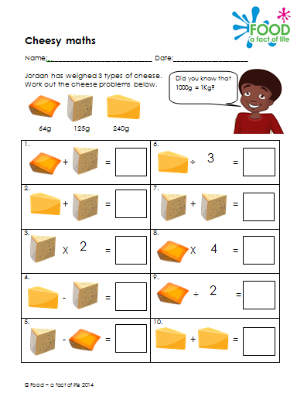
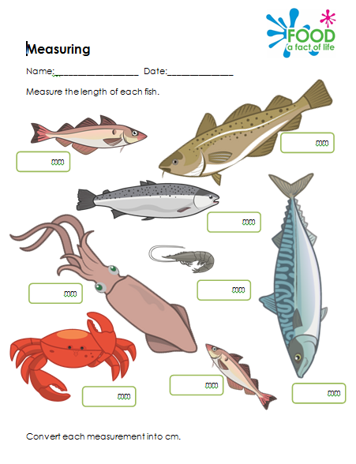
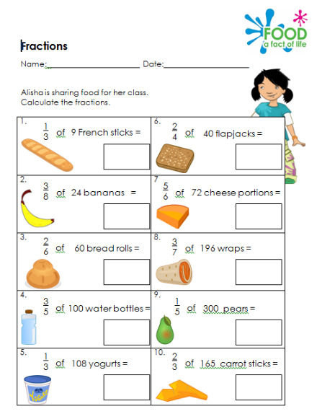
Learn with stories – example resources

Slide 11
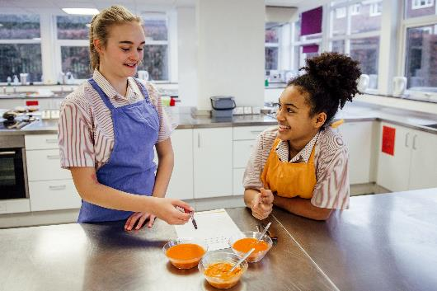
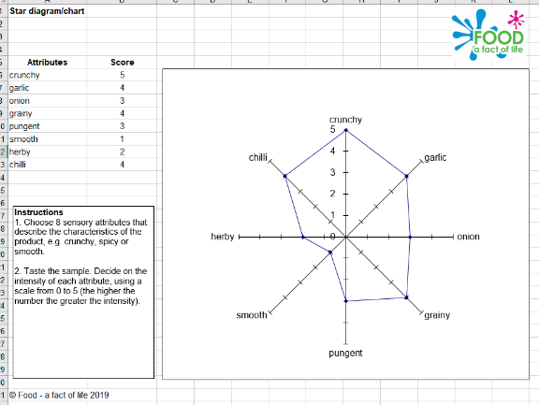
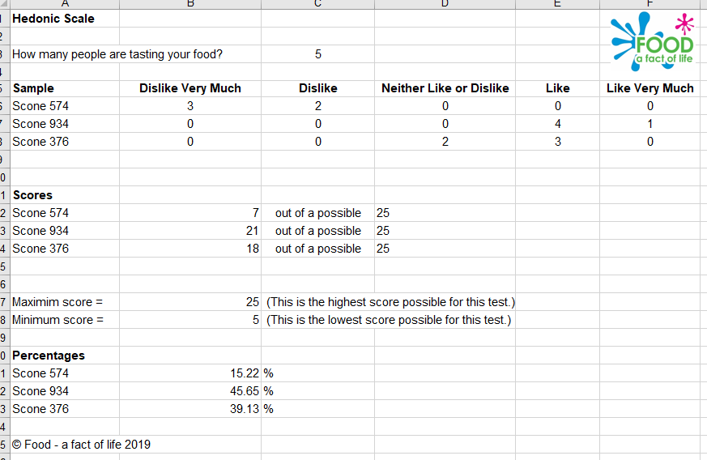
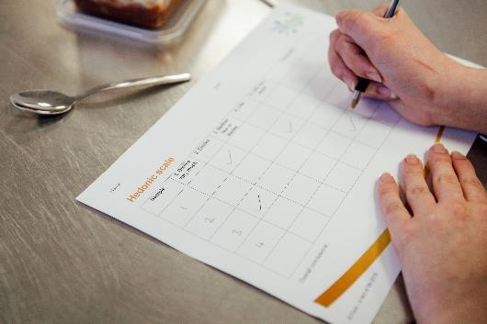
Sensory work
Collating results – using a template
Analysis – typing notes
Presentation – creating charts

Slide 12

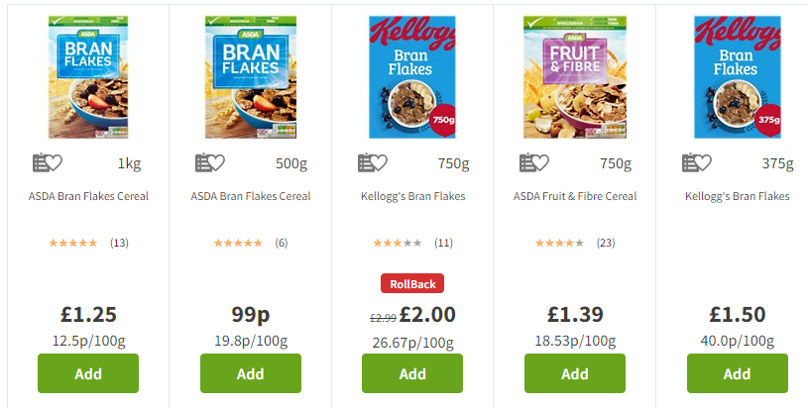
Costing ingredients, recipes, meals …
Compare costs (different brands, economy/luxury, reduced fat …)
Compare costs in different shops
Working to a budget (recipe, occasion, meal …), e.g. £5 to feed 4 people
Calculate cost of recipes (via online shops)
www.asda.com
www.morrisons.co.uk
www.mysupermarket.co.uk
www.ocado.com/
www.sainsburys.co.uk
www.shop.coop.co.uk
www.tesco.com
www.waitrose.com
FFL Resources > https://www.foodafactoflife.org.uk/search-results?q=cost

Slide 13
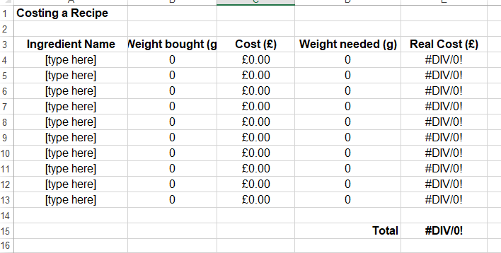
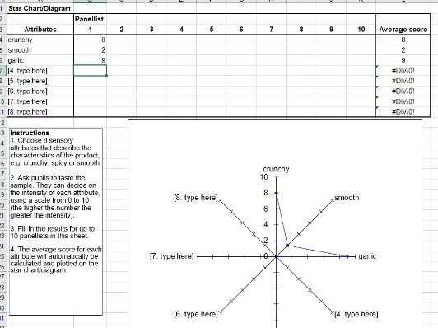
Use of templates
Save time
Help direct and support learning
Support differentiation
Help make sense of data
Communicate their ideas through mathematical modelling and computer-based tools
Test, evaluate and refine ideas
Templates can support:
Writing (writing frames/structure)
Costing (basic, ingredients used, portions)
Analysis of sensory data
Weight to percentage (specifications, labelling)
DRVs (% contribution)
https://www.foodafactoflife.org.uk/resources/?q=sensory https://www.foodafactoflife.org.uk/resources/?q=cost

Slide 14
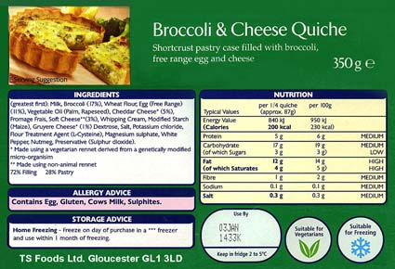
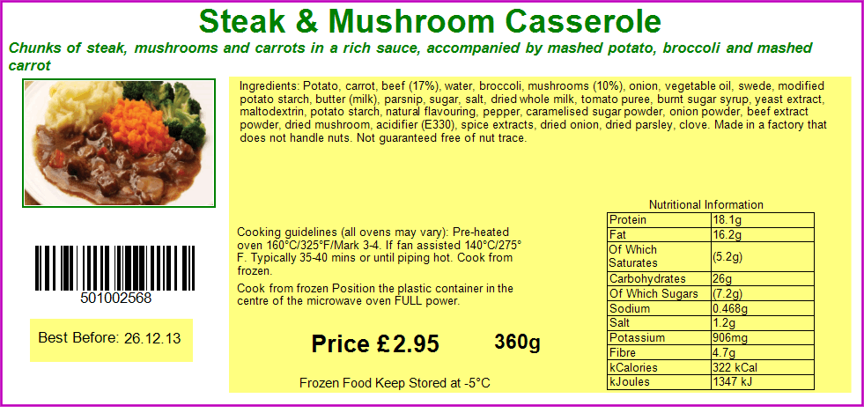
Looking at food labels – numbers and words …
Find the numbers.
Explain their meaning and use.

Slide 15
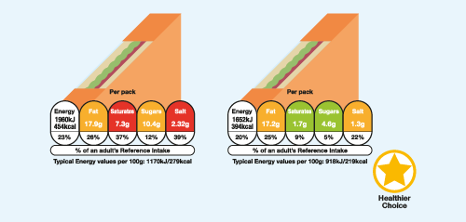
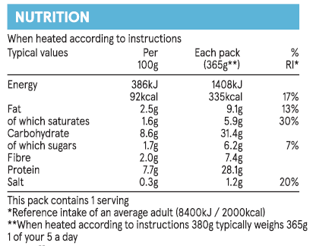
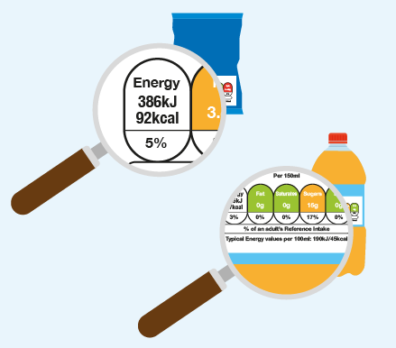
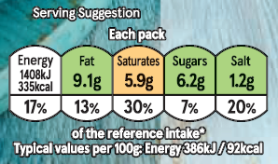
Nutrition food labels
Reading labels and explaining the energy and nutrients provided (per 100g/portion) – front and back of pack
Comparing nutrition labels, e.g. which provides the least salt, most fibre?

Slide 16

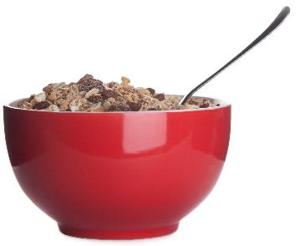
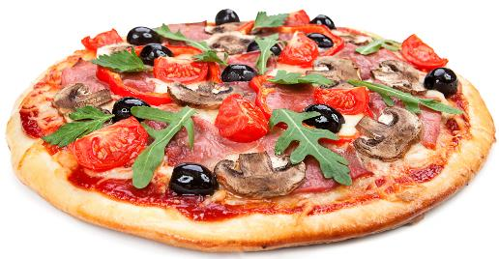
Nutrition food labels
Estimating portions – changes in the amount of energy and nutrients provided, e.g. actual amount of cereal for breakfast (weighed) v recommended on packet, rice/pasta …
Serving size problems, e.g. energy consumed if the whole pizza was eaten, rather than half
https://www.foodafactoflife.org.uk/professional-development/teaching-and-learning/classroom-resources-from-ffl-training/
https://www.foodafactoflife.org.uk/search-results?q=serving+size

Slide 17
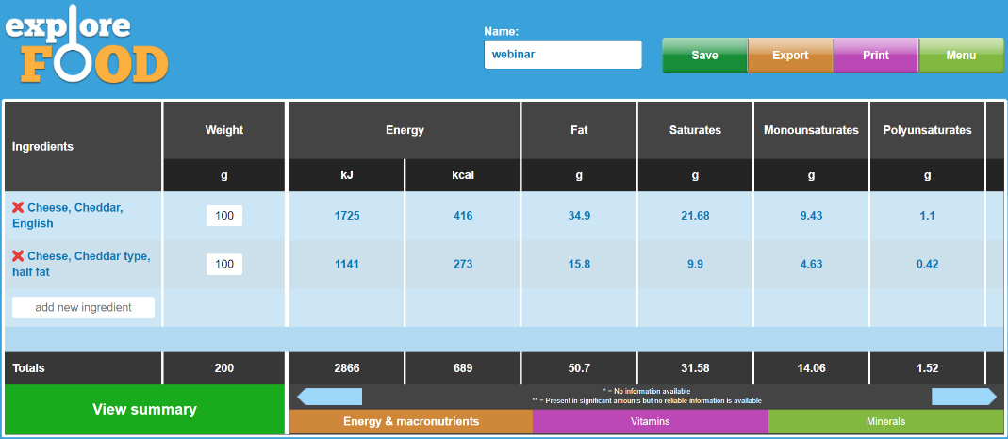
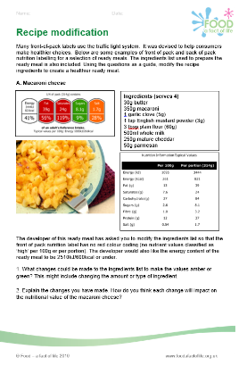
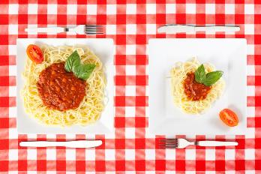
Recipes and nutritional analysis
Energy and nutrients provided by individual ingredients
Energy and nutrients provided by a recipe
Modifying a recipe, based on a need (and checking)
Modelling different portion sizes (assess how the energy and nutrients provided per portion change)
https://www.foodafactoflife.org.uk/11-14-years/nutritional-analysis/

Slide 18
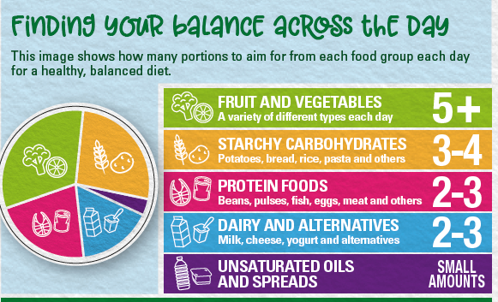
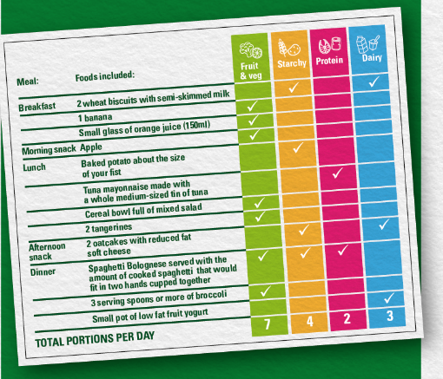
Portions – frequency and size
Review a diet and compare to the ‘number of portions’ of each food group (spot gaps, suggest changes …)
Weigh typical portion sizes, e.g. breakfast cereals (look at differences in weight, nutrition implications …)
Calculate the cost of different portion sizes
Consider food waste and portion size
https://www.foodafactoflife.org.uk/resources/?q=portion
https://www.nutrition.org.uk/healthyliving/find-your-balance/portionwise.html

Slide 19
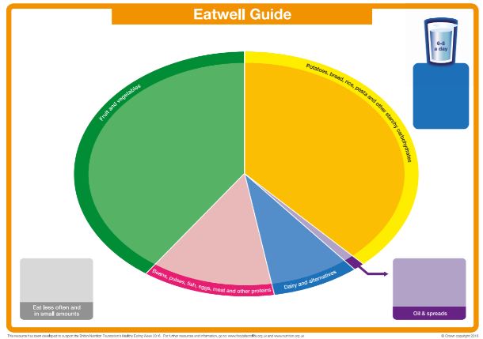
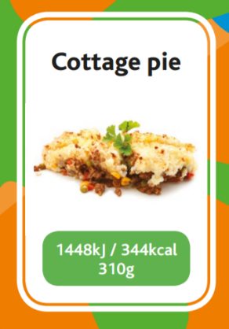
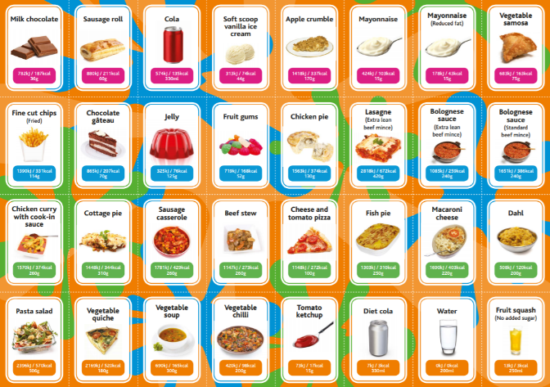
Diet analysis
Sort food cards into food groups
Use food cards to create a diet for the day (considering healthy eating advice, e.g. 5 A DAY)
Calculate energy provided by dishes on food cards – make choices / swaps
https://www.foodafactoflife.org.uk/media/5733/food-cards-with-energy-c-3-16.pdf
https://www.foodafactoflife.org.uk/media/2455/blank-eatwell-guide-ws-711c1.pdf

Slide 20
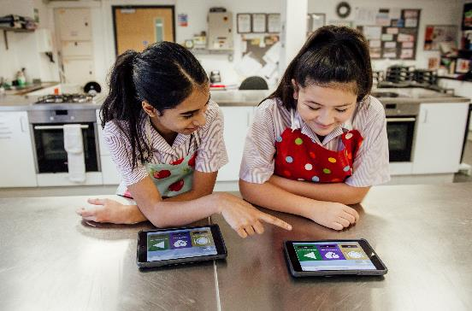
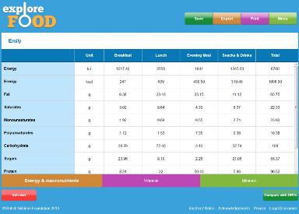
Diet and nutritional analysis
Energy and nutrients provided by diet
Contribution of food/drink at different meal occasions and snacking
Contribution of diet to Dietary Reference Values (DRVs)
Use case studies (dietary needs, preferences …)
https://www.foodafactoflife.org.uk/11-14-years/nutritional-analysis/

Slide 21
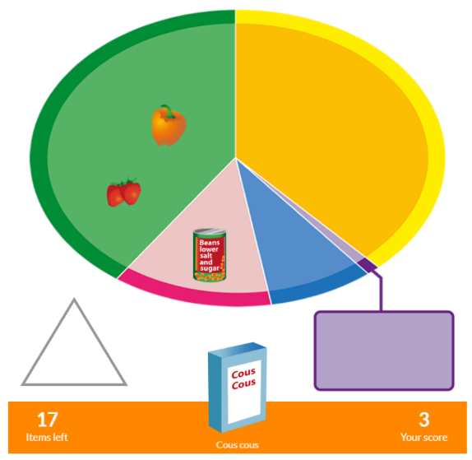
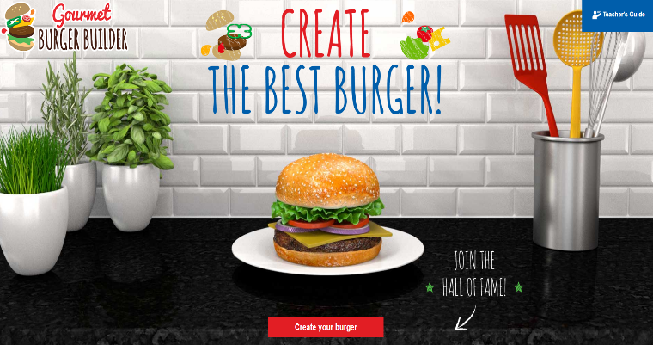
Interactive games/activities – with learning intent
Eatwell Challenge – food groups
Burger Builder – creativity, nutrition, portions, allergens
https://www.foodafactoflife.org.uk/7-11-years/healthy-eating/eat-well/
https://www.foodafactoflife.org.uk/11-14-years/cooking/gourmet-burger-builder/

Slide 22
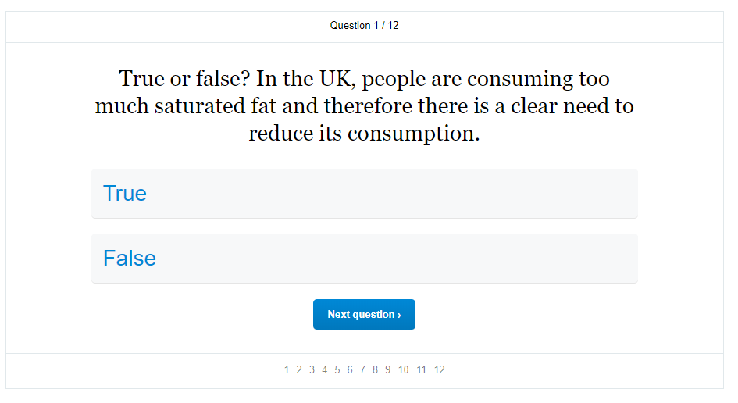
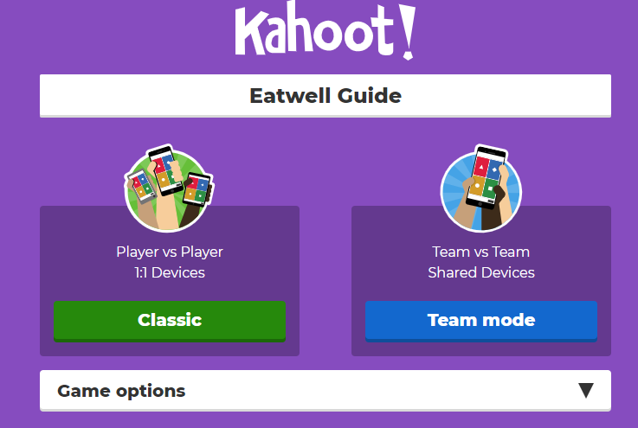

Asssessment
Individual – online multiple-choice (literacy, numeracy, ICT & assessment!)
Class – Kahoot!

Slide 23

Creating presentations, podcasts, movies …
Photos of work and activities in an engaging presentations
Audio podcast of an event or interview
Creating a short movie to promote a theme or topic, show a recipe being made or show an activity

Slide 24


Overview
Ensure opportunities are highlighted in SoW and lesson plans
Inter-connections – ICT, numeracy and literacy
ICT, literacy and numeracy – enriches and expands the curriculum
Celebrate what’s unique … cooking, labels, recipes, nutrition, costing …
Use templates – saves time, helps pupils
Small steps … learn from pupils (and other staff!)

Slide 25

Other sources of information and support
Education Endowment Foundation
STEM
National Numeracy
National Literacy Trust

Slide 26
ICT, literacy and numeracy in food and nutrition lessons
For further information, go to:
www.foodafactoflife.org.uk

