Slide 1
Simple, but fun

Slide 2
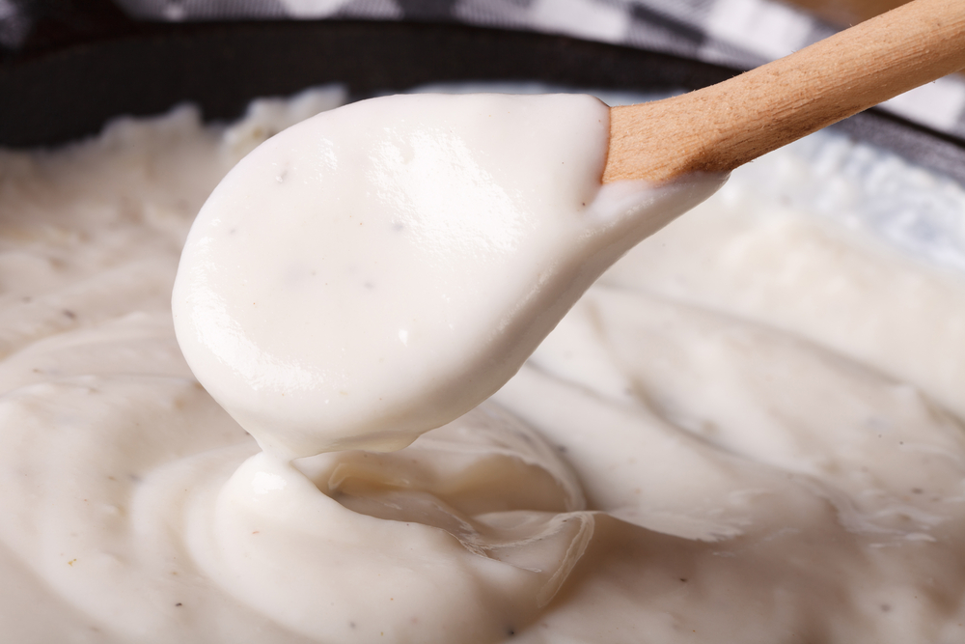
Aims and objectives
Aim
To make recipes that are low cost and can be adapted.
Objectives:
work in pairs;
make a cheese sauce (roux);
use kitchen equipment safely;
make three tasty recipes, which are cheap but cheerful.

Slide 3
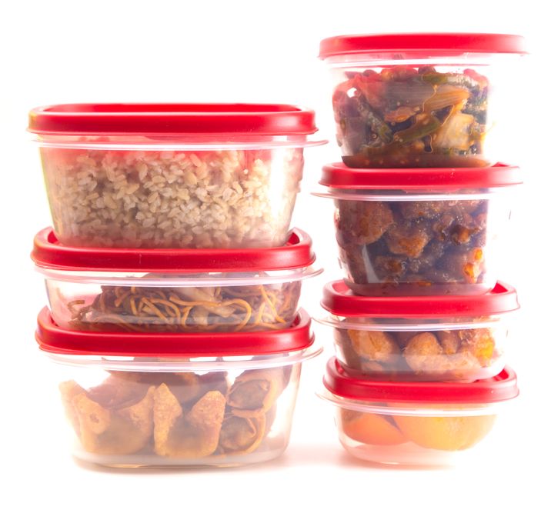
Setting the scene
This module is about making tasty food which is low cost.
Using leftovers saves money and prevents waste.
The sauce can be adapted and used in lots of different recipes in the future.

Slide 4


Food hygiene – getting ready to cook
Tie long hair up.
Remove jewellery and watches.
Remove jumpers and roll-up long sleeves.
Thoroughly wash and dry hands.

Slide 5
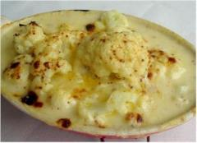
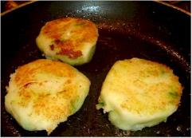
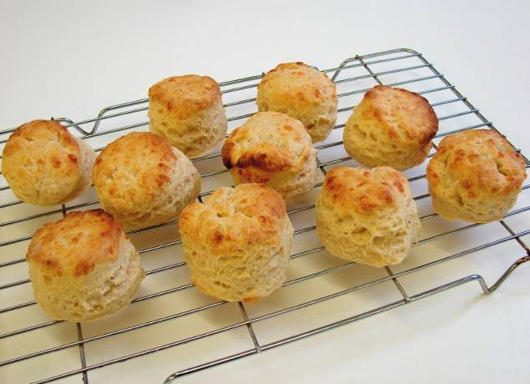
Recipes - you will make:
Cauliflower cheese
Bubble and squeak
Cheesy scones

Slide 6
Food skills and techniques
You will:
chop and slice;
mash;
Combine;
use the hob and oven;
rub-in and roll out;
bake.
Why not download and insert a BNF cooking skill video here?

Slide 7
Shopping list
For 2 people
For 10 people
Cauliflower cheese | Bubble and squeak | Cheesy scones
1 cauliflower 25g reduced fat spread 25g plain flour 250ml semi-skimmed milk 75g reduced fat cheddar cheese 1x5ml spoon mustard | Spray oil 2-3 large potatoes (300g) ½ green cabbage 25g reduced fat spread 1x15ml spoon flour Black pepper | 250g self raising flour 1 x 5ml spoon mustard powder 40g butter or baking fat/block 75g hard cheese 125ml semi-skimmed milk
Cauliflower cheese | Bubble and squeak | Cheesy scones
5 cauliflowers 125g reduced fat spread 125g plain flour 1.25L semi-skimmed milk 375g reduced fat cheddar cheese 5x5ml spoon mustard | Spray oil 10-15 large potatoes 3 green cabbage 125g reduced fat spread 5x15ml spoon flour Black pepper | 2.5kg self raising flour 5 x 5ml spoon mustard powder 400g butter or baking fat/block 750g hard cheese 1250ml semi-skimmed milk

Slide 8
Plan of action
Review recipes to be cooked.
Prepare and cook the potatoes and cabbage.
Make the cheesy scones.
Prepare and cook the cauliflower.
Make the bubble and squeak.
Make the cheese sauce – serve with the cauliflower.
Ensure that you collect your equipment before you start to cook.
Weigh and measure your ingredients accurately.
Keep your work surfaces clean and tidy – wash up as you go.

Slide 9
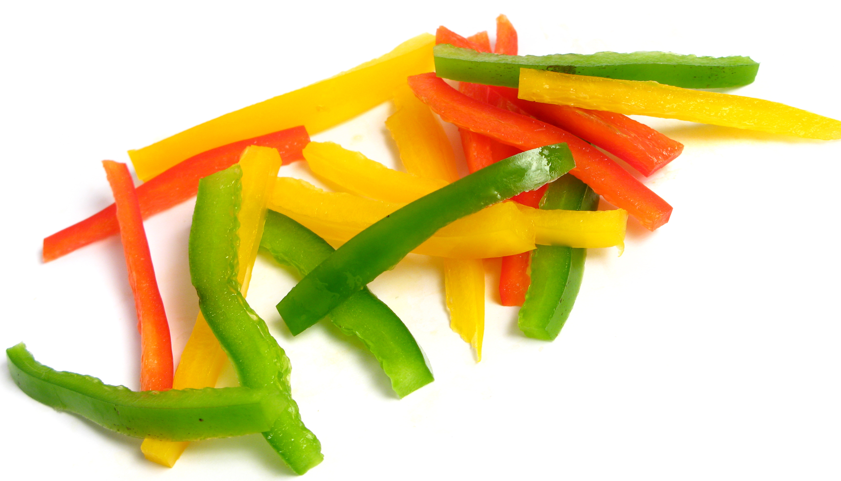
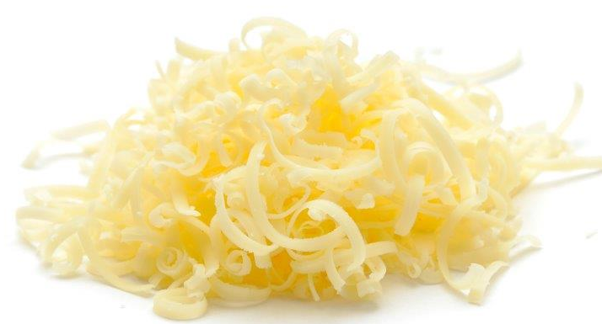
Healthy eating
Use reduced fat cheese in the cauliflower cheese.
Reduce the amount of cheese used.
Add more vegetables to the bubble and squeak, such as peas and peppers.
Keep the skins on the potatoes, providing additional fibre.
Make fruit scones, to increase fruit and vegetable intake.

Slide 10
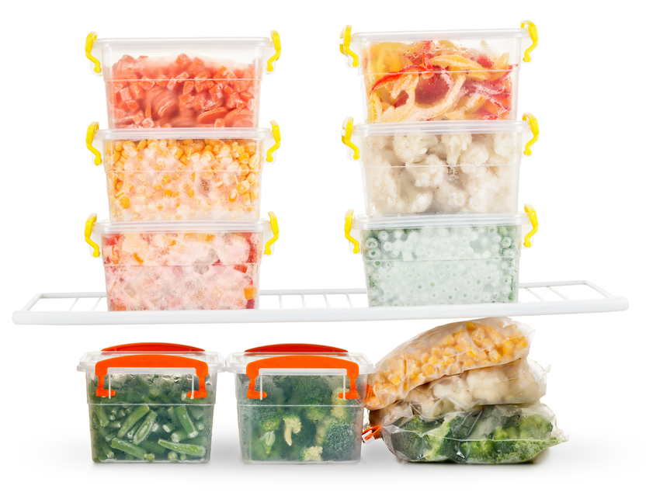
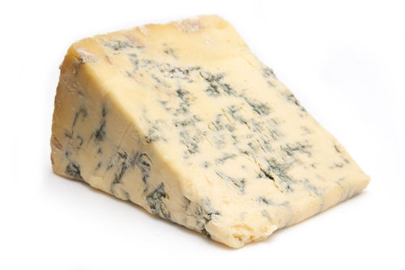
Budgeting
Cut the cauliflower yourself, rather than buying it pre-prepared. You could also use frozen cauliflower.
Use left-over mashed potato, cabbage, Brussel sprouts and other vegetables when you can for the bubble and squeak.
Freeze extra portions of cauliflower cheese and bubble and squeak for another meal.
Buy a large sack of potatoes, and store in a dark cool cupboard.
Use a stronger tasting cheese, e.g. mature cheddar or stilton, as this means you can use less each time.
Frozen vegetables tend to be cheaper than fresh, and can help to cut down on food waste.

Slide 11
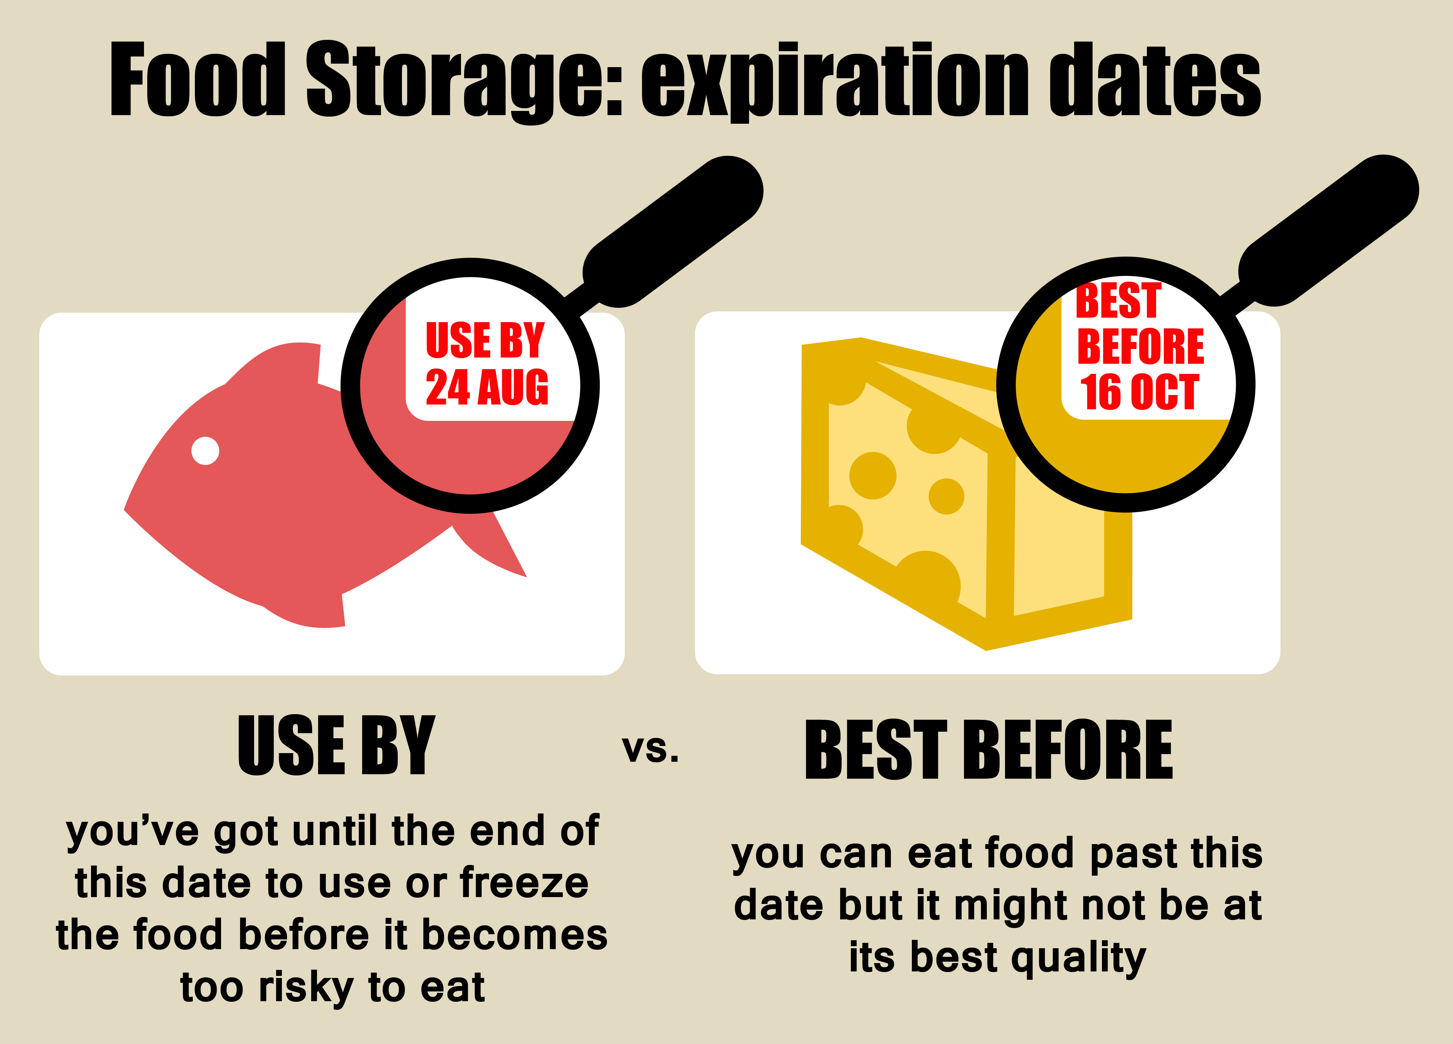
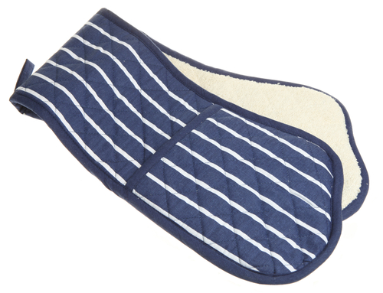
Food safety and hygiene
Wash and dry hands before and during cooking.
Always check date marks, e.g. use-by on the cheese.
Wash fresh fruit and vegetables before use to remove any dirt and bacteria.
Keep pan handles away from the edge of the hob.
Use oven gloves.
Check that any left-overs for the bubble and squeak are only 48 hours old. If older do not use and throw away.

Slide 12
Cooking for the future
Cauliflower cheese
Make up the sauce and pour over fish, pasta or other vegetables.
Replace half of the cauliflower with broccoli.
Try swapping the cauliflower for a range of cooked vegetables such as butternut squash, peppers and onions and sweetcorn for a mixed veggie bake.
Stir the sauce into cooked pasta along with canned tuna, sweetcorn and spring onions for a quick meal.

Slide 13
Cooking for the future
Bubble and squeak
Use left over potatoes and cabbage/Brussel sprouts.
Try adding fresh herbs, chopped onion or cooked leeks.
Cheesy scones
You could experiment with different flavourings by adding herbs or spices.
You could make fruit scones by adding 25g sugar and 75g sultanas before the milk and leave out the cheese.

Slide 14
Back to basics
For further information, go to:
www.foodafactoflife.org.uk

