Slide 1
Wakey Wakey

Slide 2
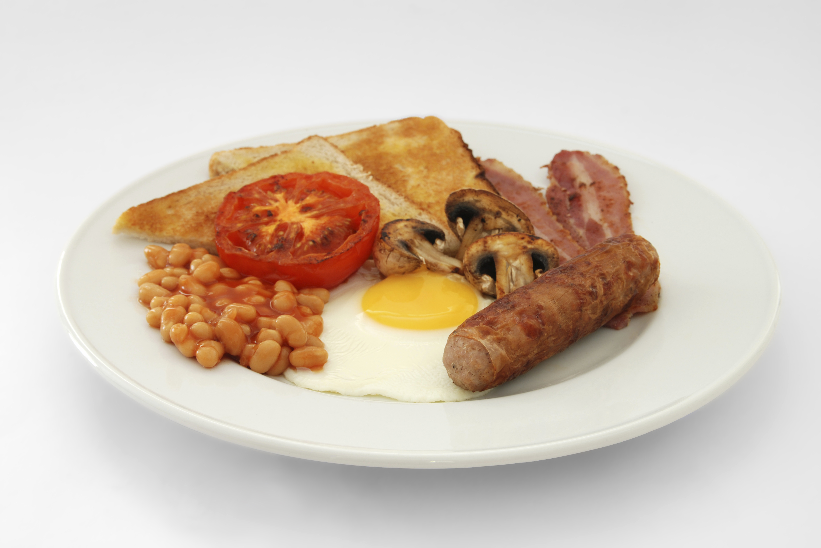
Aims and objectives
Aim
To develop breakfast cookery skills.
Objectives:
work in pairs;
make porridge, pancakes and a healthier cooked breakfast – a ‘grill-up’;
use kitchen equipment safely;
make three tasty recipes for a healthy start to your day.

Slide 3
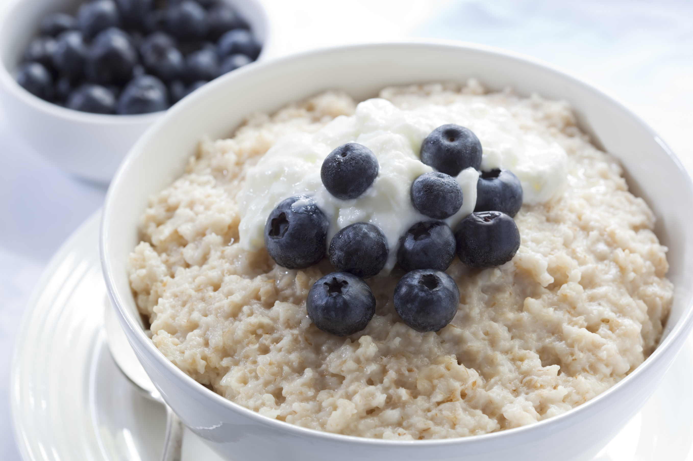
Setting the scene
This module is about making breakfast.
Cooked breakfasts can be made healthier by using different types of cooking methods and thinking about what’s on your plate.
Porridge and smoothies are simple to make and can be adapted to suit your mood and budget.

Slide 4


Food hygiene – getting ready to cook
Tie long hair up.
Remove jewellery and watches.
Remove jumpers and roll-up long sleeves.
Thoroughly wash and dry hands.

Slide 5
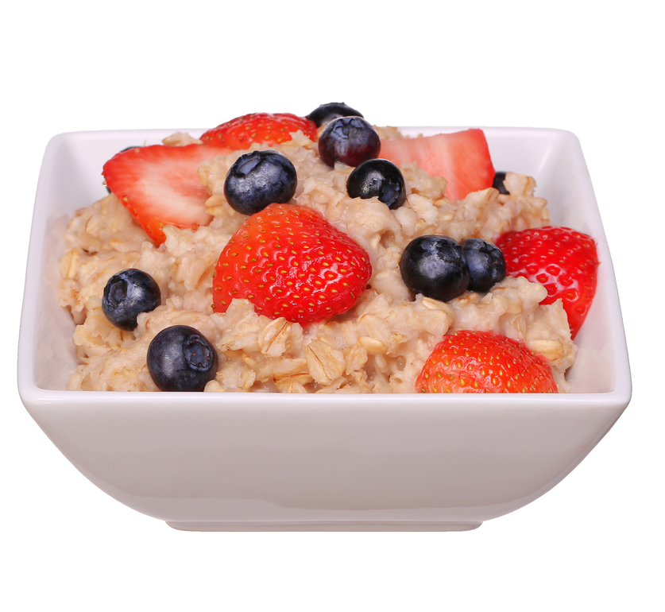
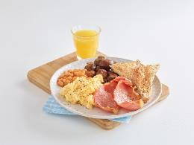
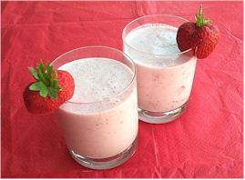
Recipes - you will make:
Porridge
‘Grill-up’
Fruit smoothie

Slide 6
Food skills and techniques
You will:
slice;
use the hob and grill;
use a blender to make a smoothie.
Why not download and insert a BNF cooking skill video here?

Slide 7
Shopping list
For 2 people
For 10 people
Porridge | ‘Grill up’ | Fruit Smoothie
50g oats 200ml semi-skimmed milk 25g blackberries or half a banana or 1 pear ¼ x5ml spoon cinnamon | Spray oil 1 large flat mushroom 1 large tomato 4 rashers lean bacon 1 small can baked beans 1 egg Dash of vinegar | 6 large strawberries 300ml cold semi-skimmed milk 1 small pot of low fat yogurt
Porridge | ‘Grill up’ | Fruit Smoothie
250g oats 1.7L semi-skimmed milk 250g blackberries or 3 bananas or 5 pears Cinnamon | Spray oil 5 large flat mushrooms 5 large tomatoes 10 rashers lean bacon 2-3 large cans baked beans 5 egg Vinegar | 30 large strawberries 1500ml cold semi-skimmed milk 5 small pots of low fat yogurt

Slide 8
Plan of action
Why not invite staff and students along to try out this breakfast menu?
Review recipes to be cooked.
Prepare the smoothie – chill in the fridge.
Make the porridge.
Make the cooked breakfast.
Serve.
Ensure that you collect your equipment before you start to cook.
Weigh and measure your ingredients accurately.
Keep your work surfaces clean and tidy – wash up as you go.

Slide 9
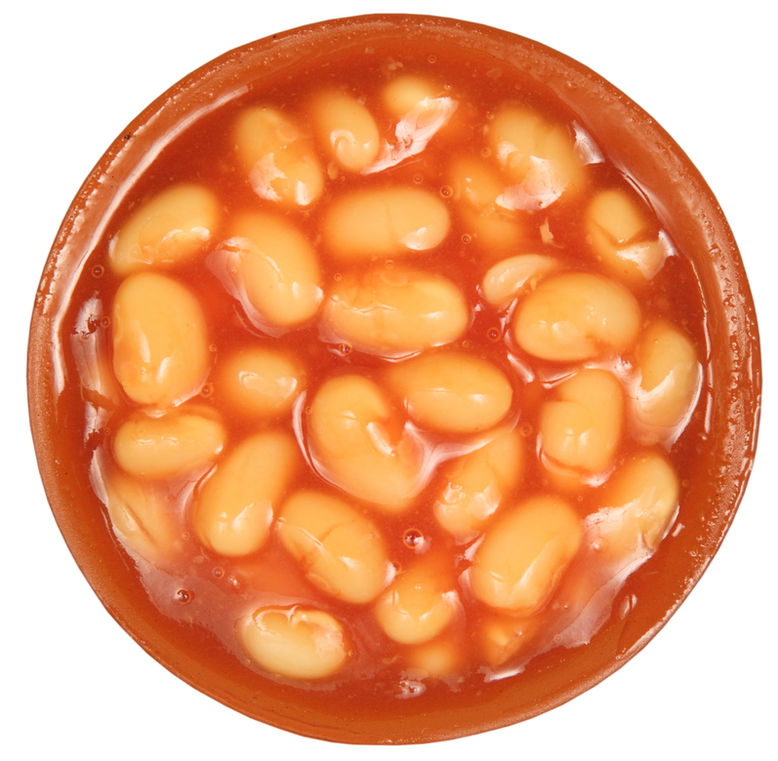
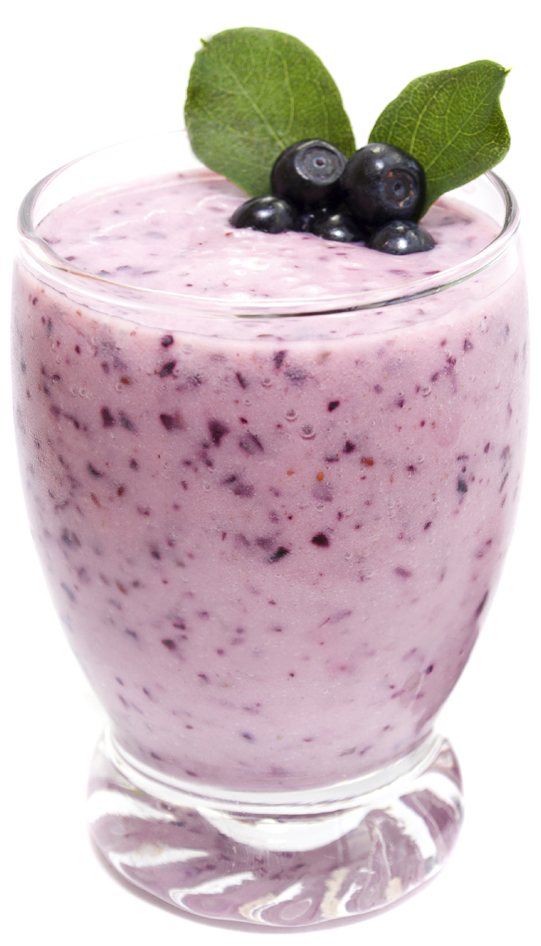
Healthy eating
Use reduced fat sausages and baked beans with no added sugar and salt.
Use back bacon rather than streaky and remove the fat before eating.
Use skimmed or 1% milk in the porridge.
Add additional vegetables to the cooked breakfast, such as tomatoes, mushrooms and beans.
Include a variety of fruit and vegetables in your diet every day - at least 5 portions.
Remember consumption of fruit juice and/or smoothies should be limited to a combined total of no more than 150ml a day.

Slide 10
Budgeting
Freeze sausages individually, so you can use just what you need.
Use frozen berries in porridge.
Make the porridge with water instead of milk.
Oats make a substantial and cheap breakfast, and have a long shelf life if stored correctly.
Large cans of baked beans can be better value than small ones. Share with a friend or store leftovers in a plastic container in the fridge for the next day.
Use canned fruit (in 100% juice) or frozen berries in smoothies.

Slide 11
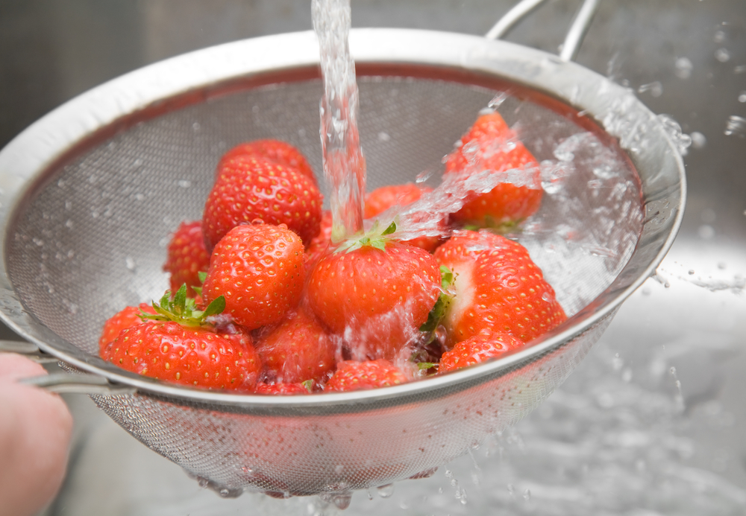

Food safety and hygiene
Ensure eggs are marked with the Lion mark.
Ensure that raw and cooked food is stored and prepared separately.
Use a red board for raw meat if possible.
Use tongs when turning food over under the grill.
If using sausages, check they are cooked thoroughly, i.e. no pink areas remain.
Keep pan handles away from the edge of the oven.
Make sure to wash the fruit.

Slide 12
Cooking for the future
Fruit porridge
If in a hurry, make a microwave porridge sachet (original flavour) and add some fruit e.g. chopped banana, berries, canned peaches or a handful of dried fruit.
Try adding different fruit to the porridge.
Make a bircher
Put the oats in a bowl, pour over the milk and add a small portion of maple syrup and lemon juice.
Mix and put in the fridge overnight.
In the morning add fresh fruit such as raspberries or blackberries.

Slide 13
Cooking for the future
‘Grill-up’
Try including as many fruit and vegetables as possible. This could include a side fruit salad or extra mushrooms or tomatoes.
Smoothies
Try different fruit in a smoothie.
Try making a smoothie using a combination of fruit and vegetables.

Slide 14
Wakey Wakey
For further information, go to:
www.foodafactoflife.org.uk

