Slide 1
A fishy tale

Slide 2
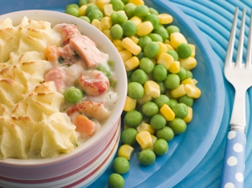
Aims and objectives
Aim
To make a main meal and dessert.
Objectives:
work in pairs;
make a fish pie (or spinach, egg and cashew nut);
use kitchen equipment safely;
make three tasty recipes, for a balanced meal using fish and plenty of vegetables and fruit.

Slide 3
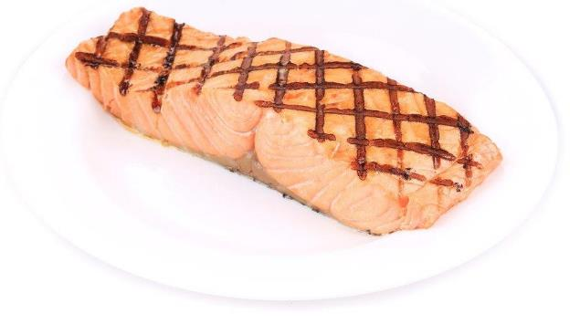
Setting the scene
This module is about making a main meal fish dish with vegetables.
We should have two portions of fish each week, one of which is oily (e.g. salmon, mackerel, sardines). A portion is 140g.
Always have plenty of vegetables – prepare them when you’re ready to cook rather than soaking in water to retain the water soluble vitamins.

Slide 4


Food hygiene – getting ready to cook
Tie long hair up.
Remove jewellery and watches.
Remove jumpers and roll-up long sleeves.
Thoroughly wash and dry hands.

Slide 5
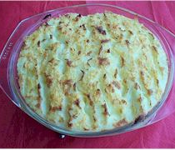
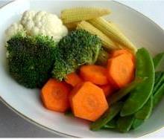
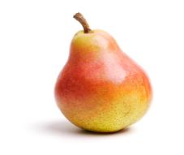
Recipes - you will make:
Fish pie
Mixed vegetables
Poached pear

Slide 6
Food skills and techniques
You will:
peel, chop and slice;
use the hob/oven (boil, poach, bake);
drain;
mash;
layer.
Why not download and insert a BNF cooking skill video here?

Slide 7
Shopping list
For 2 people
For 10 people
Fish pie | Mixed vegetables | Poached pear
3 large potatoes 50g reduced fat spread 350ml semi-skimmed milk Parsley 250g fresh or frozen fish (e.g. cod, haddock, hoki) 2 tomatoes | 2 carrots 1 head broccoli ½ cauliflower 50g baby sweetcorn (optional) 50g mange tout (optional) | 2 pears 2 x15ml spoons ricotta Pinch of cinnamon 300ml apple juice
Fish pie | Mixed vegetables | Poached pear
15 large potatoes 250g reduced fat spread 1.75L semi-skimmed milk Parsley 1.25kg fresh or frozen fish (e.g. cod, haddock, hoki) 10 tomatoes | 10 carrots 5 heads of broccoli 3 cauliflower 250g baby sweetcorn (optional) 250g mange tout (optional) | 10 pears 10x15ml spoons ricotta Pinch of cinnamon 1.5L apple juice

Slide 8
Plan of action
Review recipes to be cooked.
Boil, drain and mash the potatoes for the pie.
Assemble the fish pie and bake.
Poach the pears.
Prepare and cook the vegetables and serve with the pie.
Ensure that you collect your equipment before you start to cook.
Weigh and measure your ingredients accurately.
Keep your work surfaces clean and tidy – wash up as you go.

Slide 9
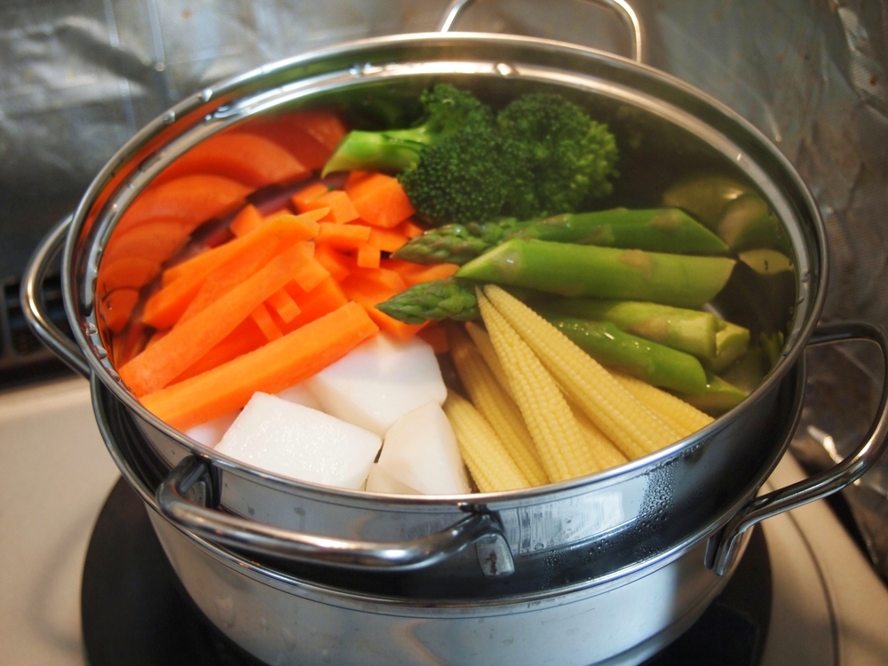
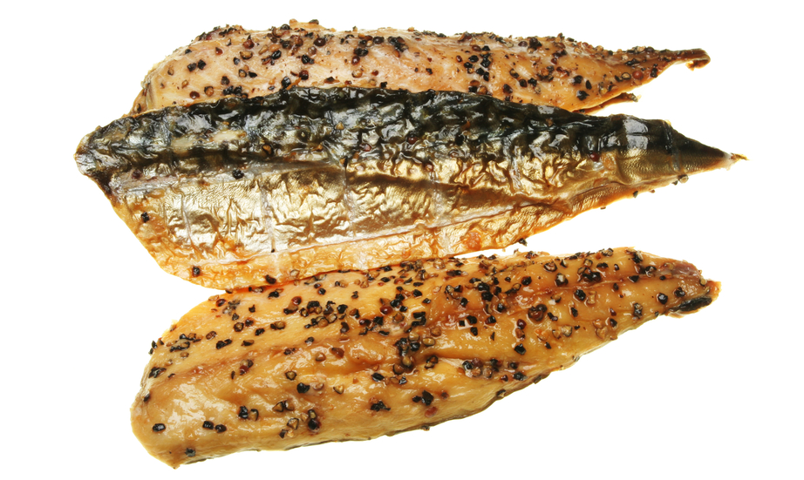
Healthy eating
Include one portion of oily fish (140g) in your diet at least once a week – you could try adding frozen salmon or smoked mackerel to the fish pie.
Steaming or microwaving instead of boiling vegetables helps to retain more of their water soluble vitamins.
Vary the vegetables served with the fish pie – use fresh, frozen or canned.
Keep the skin on your mashed potatoes to increase the amount of fibre provided. Add other vegetables, such as peas, to the mash.

Slide 10
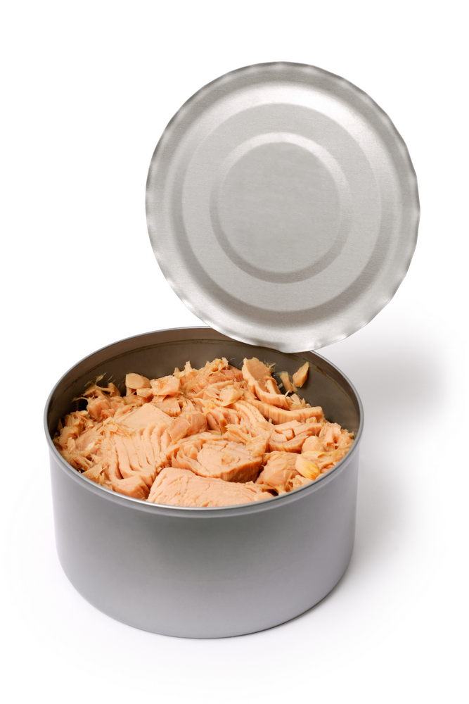
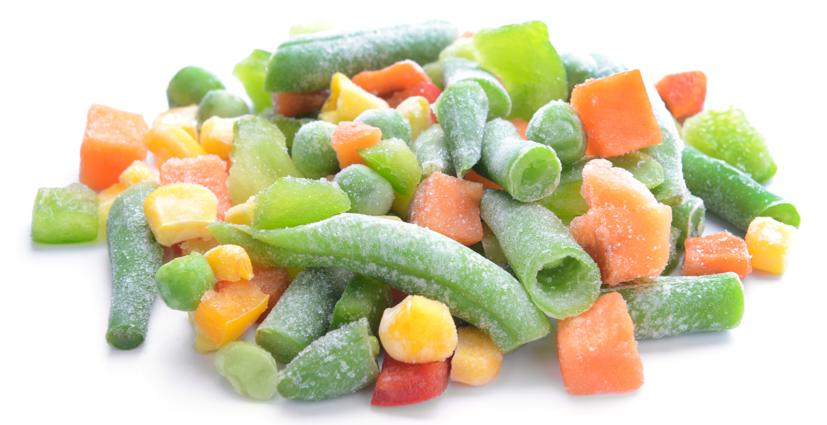
Budgeting
Frozen or canned fish can often be cheaper than fresh.
Supermarkets often reduce prices on fish that it near its sell-by date – freeze the fish as soon as you get home until you’re ready to make the fish pie.
Potatoes are a cheap component of a meal, and have a long shelf life if stored correctly.
Look out for offers on seasonal vegetables in the supermarket or buy frozen vegetables (so you use just what you need).
Instead of using fish, you can use a vegetarian alternative such as boiled egg, spinach and cashew nuts.
Use canned pears (in 100% juice).

Slide 11
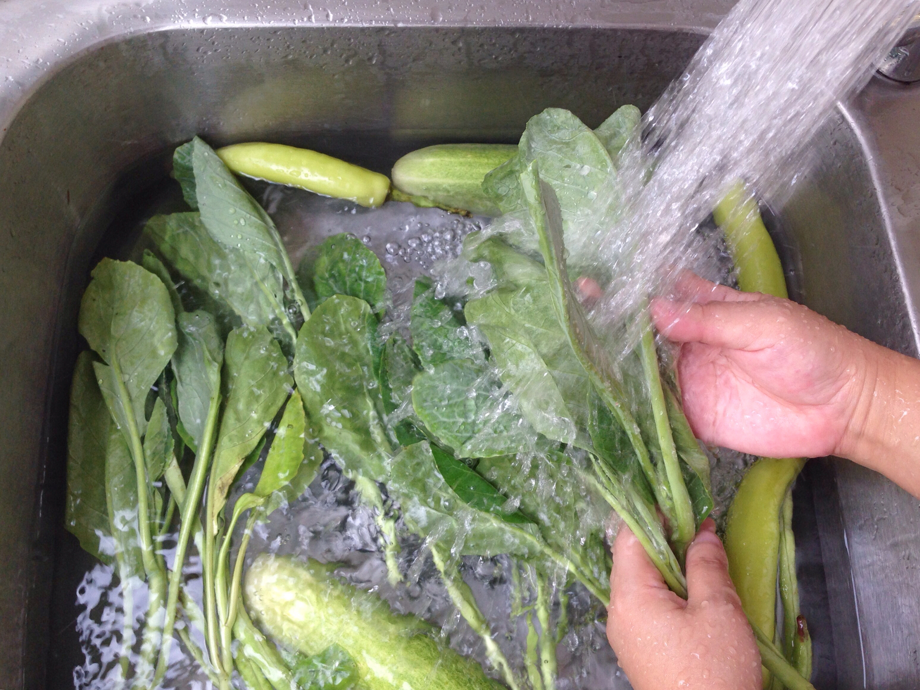
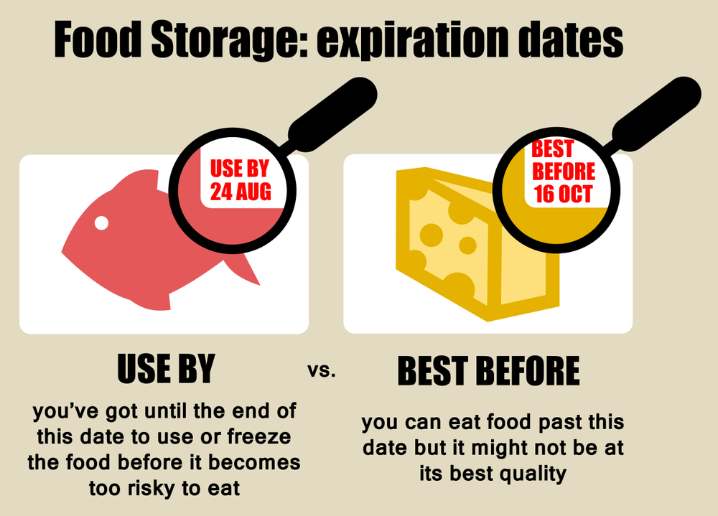
Food safety and hygiene
Wash and dry hands thoroughly before and after cooking.
Ensure that raw and cooked food is stored and prepared separately.
Check date marks.
Wash fresh fruit and vegetables to remove any dirt and bacteria.
Use a separate chopping board for raw fish, ideally a blue one.
Be careful when steaming vegetables.
Use oven gloves.

Slide 12
Cooking for the future
Fish pie
Try adding parsley, reduced fat cheese, peas or mustard to the mashed potato.
Use mixture of different fish, for example tuna, salmon and prawn.
Instead of tomato, try adding wilted spinach, boiled egg, mushrooms or peas.
For a vegetarian option, use a mixture of boiled egg, spinach and cashew nuts.

Slide 13
Cooking for the future
Mixed vegetables
Vary the selection of vegetables depending on what’s in season at the time of year.
Use a mixture of fresh, frozen and canned vegetables.
Poached pears
Try poaching other fruits, such as nectarines or plums.
Try reduced fat Greek yogurt or fat free natural yogurt.

Slide 14
A fishy tale
For further information, go to:
www.foodafactoflife.org.uk

