Slide 1
BBQ frenzy

Slide 2
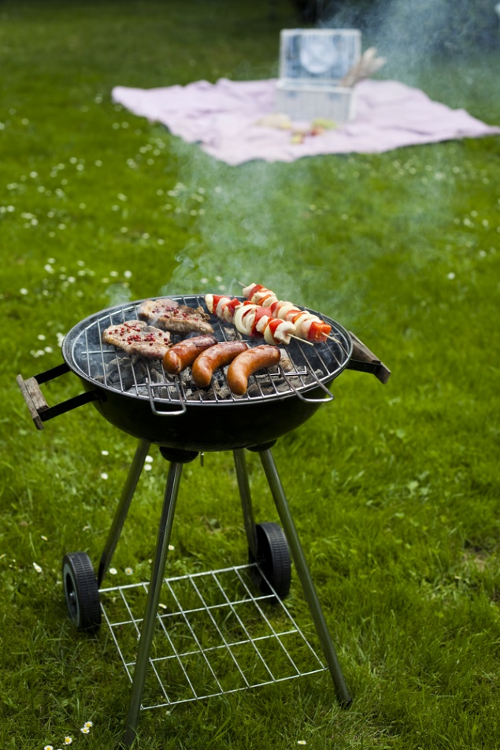
Aims and objectives
Aim
To make great dishes for a summer barbeque.
Objectives:
work in pairs;
make tandoori chicken, kebabs and burgers;
use kitchen equipment safely;
make three barbeque recipes, which can also be cooked inside.

Slide 3
Setting the scene
This module is about creating dishes that could be cooked at a summer barbeque, or in the kitchen all year round.
We all need variety in our diet – barbeques often have the same food, let’s be creative!
Look at ways in which fruit and vegetables can be added. Why not try making a spicy homemade tomato salsa?

Slide 4

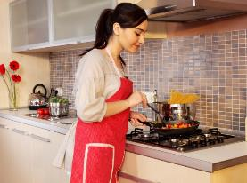
Food hygiene – getting ready to cook
Tie long hair up.
Remove jewellery and watches.
Remove jumpers and roll-up long sleeves.
Thoroughly wash and dry hands.

Slide 5
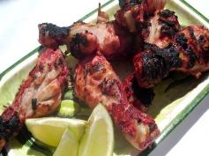
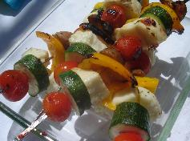
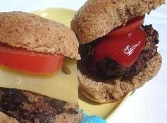
Recipes - you will make:
Tandoori Chicken
Halloumi and vegetable Kebabs
Burgers

Slide 6
Food skills and techniques
You will:
peel, chop and slice;
shape;
thread;
barbeque or grill;
marinade chicken.
Why not download and insert a BNF cooking skill video here?

Slide 7
Shopping list
For 2 people
For 10 people
Tandoori chicken | Halloumi and vegetable kebabs | Burgers
4 chicken drumsticks or 2 chicken legs 1-2 x15ml spoons tandoori paste 4x15ml spoons low fat plain yogurt ½ lemon | Spray oil 1 pack Halloumi 1 courgette 5 mushrooms 1 yellow pepper 8 cherry tomatoes 1 clove of garlic 1x5ml spoon mixed herbs | 200g lean beef mince 1 small red onion Black pepper Flour, for dusting 2 wholemeal bread rolls
Tandoori chicken | Halloumi and vegetable kebabs | Burgers
20 chicken drumsticks or 10 chicken legs 10 x15ml spoons tandoori paste 20x15ml spoons low fat plain yogurt 2 ½ lemon | Spray oil 5 packs Halloumi 5 courgettes 25 mushrooms 5 yellow peppers 40 cherry tomatoes 5 cloves of garlic 5x5ml spoon mixed herbs | 1kg lean beef mince 5 small red onions Black pepper Flour, for dusting 10 wholemeal bread rolls

Slide 8
Plan of action
Review recipes to be cooked.
Prepare Tandoori chicken (1-2 hours in advance) – cover and place in the fridge to chill.
Prepare the kebabs or burgers – cover and place in the fridge to chill.
Start to cook the chicken.
Cook the kebabs and burgers.
Ensure that you collect your equipment before you start to cook.
Weigh and measure your ingredients accurately.
Keep your work surfaces clean and tidy – wash up as you go.

Slide 9


Healthy eating
Removing the skin from the chicken leg will help to reduce the amount of saturated fat and energy in the meal.
Serve with plenty of salads or a range of vegetables, e.g. corn-on-the-cob.
Use brown or wholemeal buns.
Offer reduce salt/sugar tomato ketchup.
Make homemade burgers and kebabs – this means you have control over what goes into them. You could experiment with different herbs and spices or even try adding some dried fruit.

Slide 10
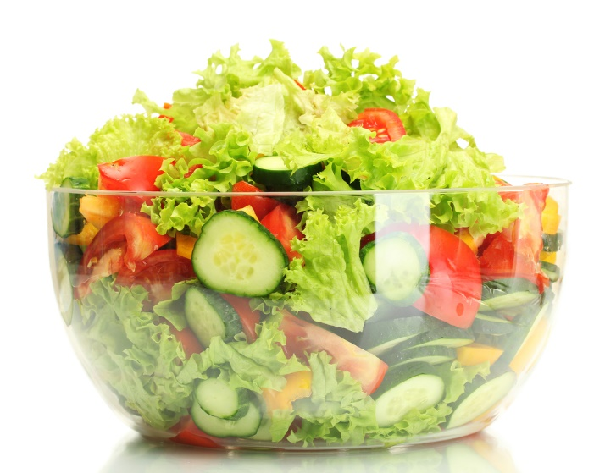
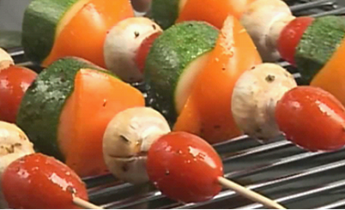
Budgeting
Chicken legs and thighs are cheaper than chicken breast, just remember to remove the skin.
Double the recipe for burgers and freeze half (uncooked) for another time.
Keep pitta bread in the freezer and reheat only what you need.
Bulk out salads with seasonal vegetables, canned sweetcorn or grated carrots.
Replace haloumi with extra vegetables.

Slide 11

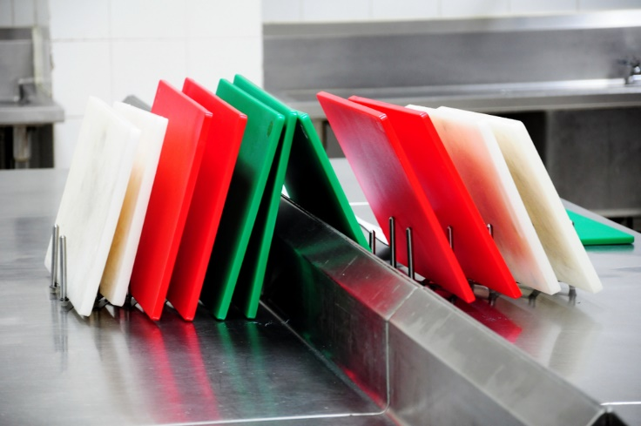
Food safety and hygiene
Wash and dry hands before and during cooking.
Ensure that chicken or beef is cooked all the way through. The juices should run clear with no pink remaining.
Check date marks on all food.
Use a separate chopping board for raw meat, ideally a red one.
Be careful turning food over or removing it from a barbeque or grill.
Keep food covered and only remove from the fridge when ready to cook or serve.

Slide 12
Cooking for the future
Tandoori chicken
Use the paste on other types of meat and fish.
You could try making your own curry paste.
Serve the chicken with boiled brown rice or naan bread and a salad for you and your friends.
Halloumi and vegetable kebabs
Use different vegetables – you could try red onion, aubergine or par-boiled sweet potato.
You could try making your own dipping sauce, such as homemade pesto or spicy tomato salsa.

Slide 13
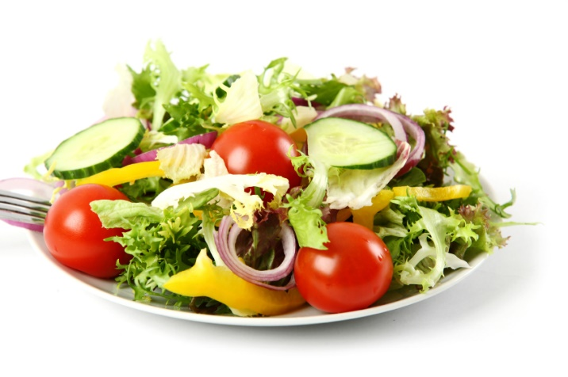
Cooking for the future
Burgers
Add dried fruit, fresh herbs or chilli to the burger mix.
Use lamb, pork or turkey mince for a change.
Instead of serving as a burger, shape into balls and serve with a rich tomato sauce on wholewheat pasta.
Summer salad
Be inventive and vary the ingredients of your salads – try adding a variety of salad leaves, grated vegetables, avocado, walnuts or feta cheese.

Slide 14
BBQ frenzy
For further information, go to:
www.foodafactoflife.org.uk

