Slide 1
Veg out!

Slide 2
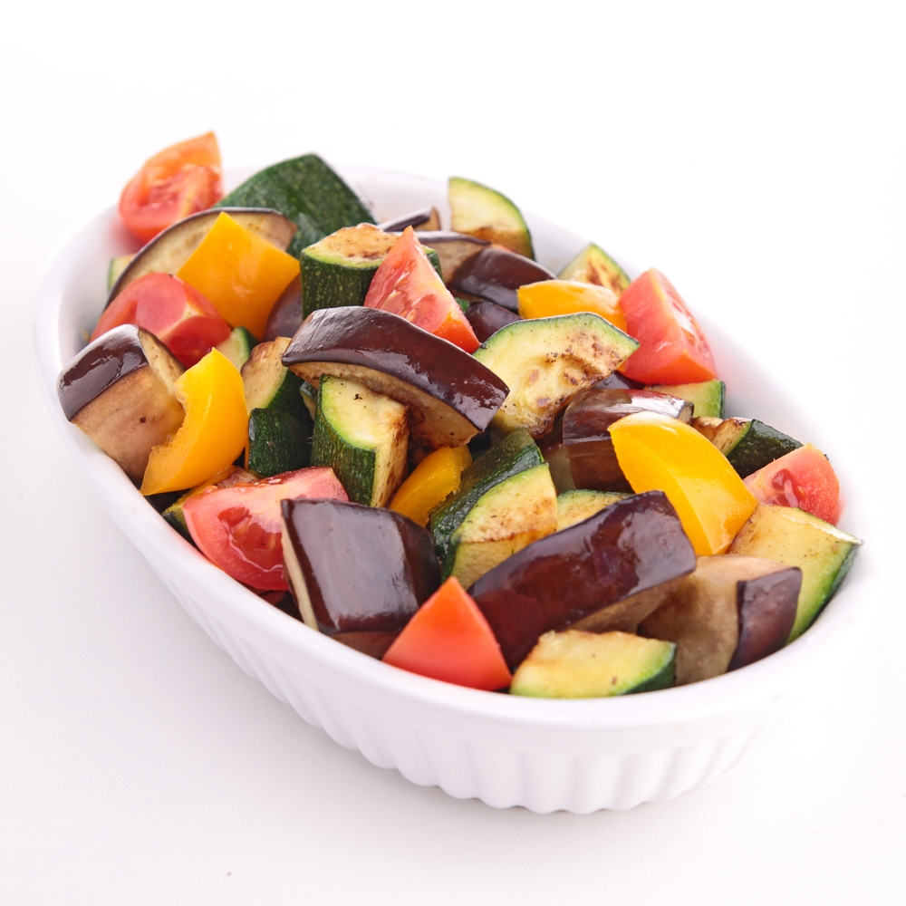
Aims and objectives
Aim
To use a range of vegetables to make versatile dishes.
Objectives:
work in pairs;
make ratatouille, lentil bake and roasted butternut squash risotto;
encourage the use of fruit and vegetables in cooking;
work safely and hygienically.

Slide 3
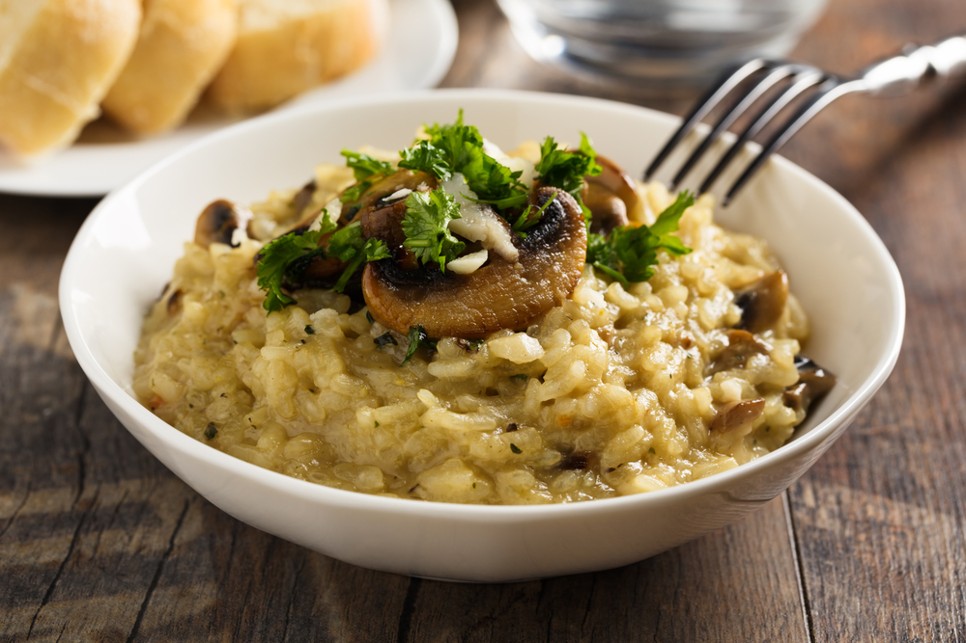
Setting the scene
This module is about including a variety of vegetables in cooking.
The dishes can be prepared in advance, frozen and reheated when required.
We all should eat at least 5 portions of fruit and vegetables everyday.

Slide 4

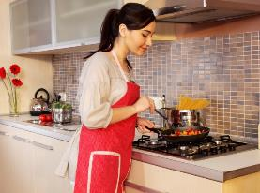
Food hygiene – getting ready to cook
Tie long hair up.
Remove jewellery and watches.
Remove jumpers and roll-up long sleeves.
Thoroughly wash and dry hands.

Slide 5
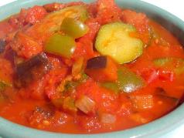
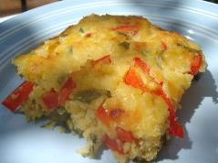
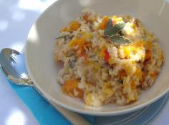
Recipes - you will make:
Ratatouille
Red lentil bake
Roasted butternut squash risotto

Slide 6
Food skills and techniques
You will:
peel, chop and slice;
use the hob and oven (bake, simmer).
Why not download and insert a BNF cooking skill video here?

Slide 7
Shopping list
For 2 people
For 10 people
Ratatouille | Red lentil bake | Roasted butternut squash risotto
Spray oil 1 onion 1 clove of garlic 1 small aubergine 1 green pepper 1-2 courgettes 2 cans tomatoes 1x5ml spoon mixed herbs 1x15ml spoon tomato puree | 200g red lentils 1 red pepper 100g reduced fat cheddar cheese 1 egg 2x15ml spoon low fat plain yogurt Small bunch fresh parsley Black pepper | Spray oil 1 butternut squash ½ red chilli 1 red onion 2 cloves of garlic 250g risotto rice 1x15ml spoon grated parmesan 1x15ml spoon sage
Ratatouille | Red lentil bake | Roasted butternut squash risotto
Spray oil 5 onions 5 cloves of garlic 5 small aubergines 5 green peppers 10 courgettes 10 cans tomatoes 5x5ml spoon mixed herbs 5x15ml spoon tomato puree | 750g red lentils 5 red peppers 500g reduced fat cheddar cheese 5 eggs 10x15ml spoon low fat plain yogurt Small bunch fresh parsley Black pepper | Spray oil 5 butternut squashes 3 red chilli’s 5 red onion 10 cloves of garlic 1.25kg risotto rice 5x15ml spoon grated parmesan 5x15ml spoon sage

Slide 8
Plan of action
Review recipes to be cooked.
Roast the butternut squash.
Prepare and bake the lentil bake.
Prepare and cook the ratatouille.
Cook the risotto and place the butternut squash on top.
Serve the food.
Ensure that you collect your equipment before you start to cook.
Weigh and measure your ingredients accurately.
Keep your work surfaces clean and tidy – wash up as you go.

Slide 9
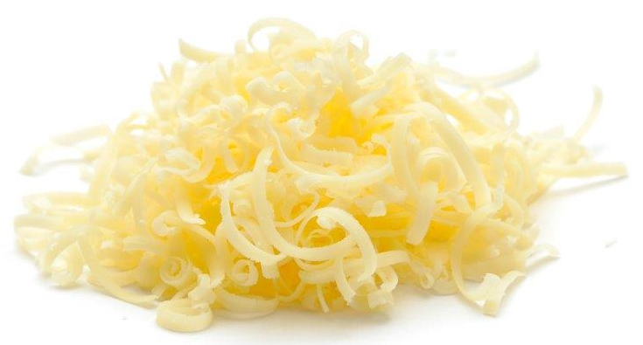
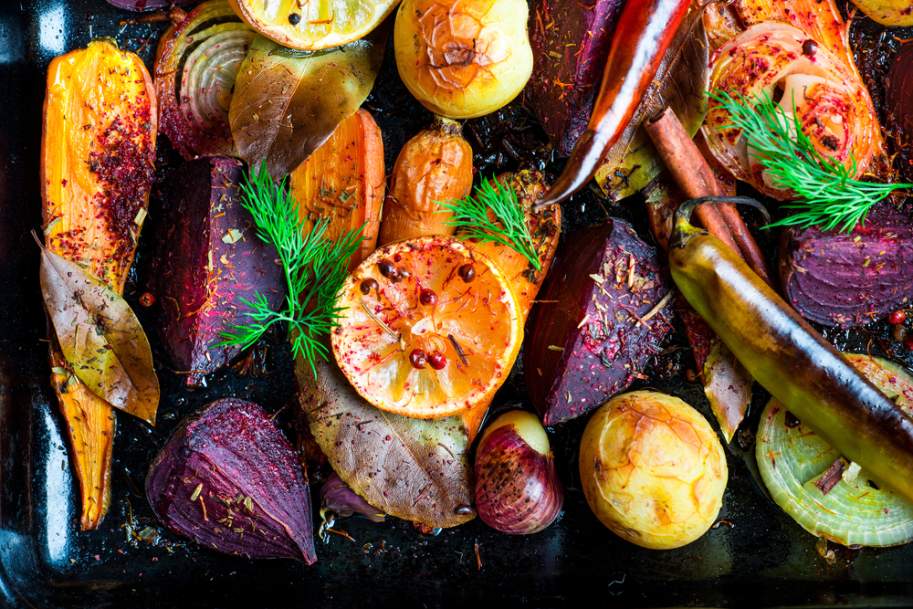
Healthy eating
Add additional vegetables to the risotto.
Instead of roasting the butternut squash, add ‘cooked’ squash to the risotto near the end of cooking.
Use reduced fat Cheddar cheese.
Bulk-up recipes with beans and lentils – it is recommended that we include more of these foods in our diet, and they count towards one of your 5 A DAY. You could add a can of mixed beans to the ratatouille.
Try to add extra vegetables to the dishes to bulk them up and to help you reach your 5 A DAY.

Slide 10
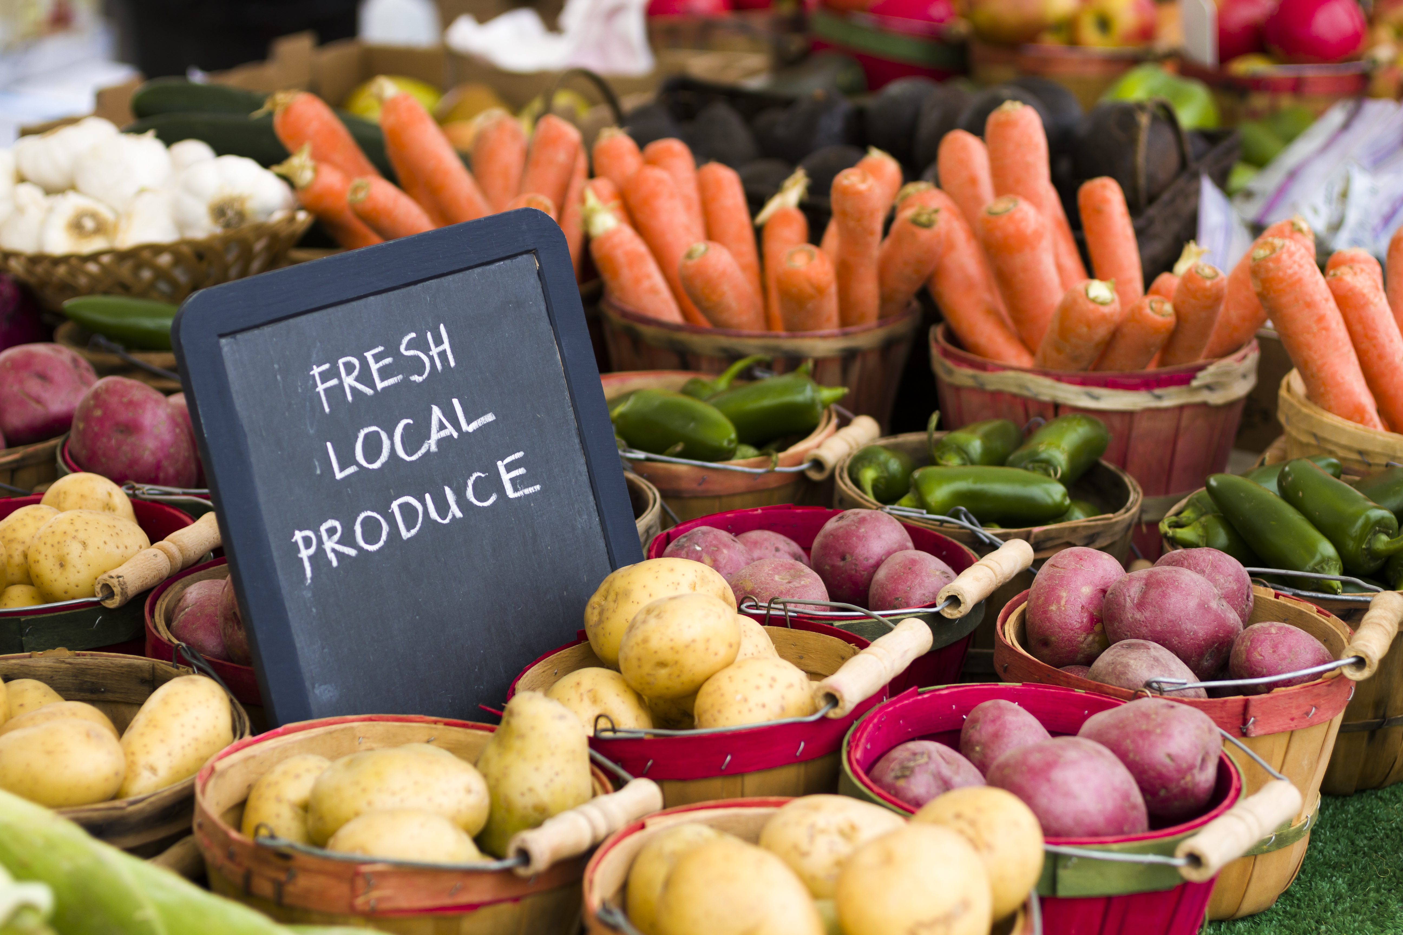
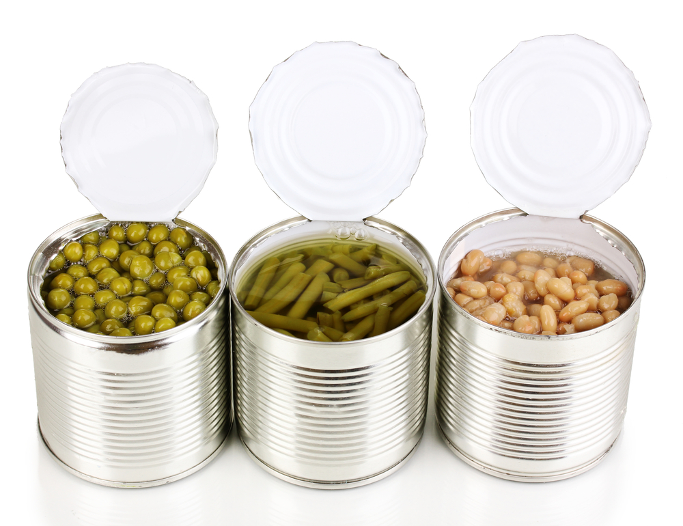
Budgeting
Double the recipe for ratatouille and freeze half – it can be defrosted and used another time, e.g. as a topping on fish.
Instead of butternut squash, mix in frozen vegetables that are in season.
Lentils are cheap, have a long shelf life if stored correctly, and are a source of protein, low in fat and high in fibre. Use left over vegetables in the lentil bake.
Visit local markets for special offers on vegetables.
Frozen vegetables tend to be cheaper than fresh, and can help to cut down on food waste.
You can bulk up your Ratatouille with beans, pulses, wholewheat pasta or brown rice.

Slide 11
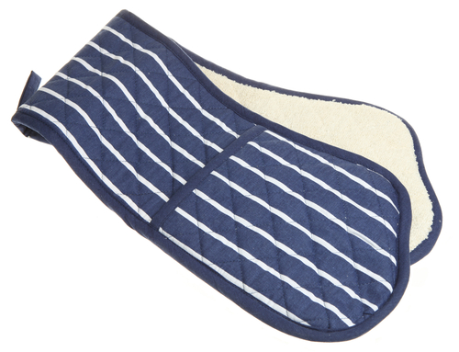
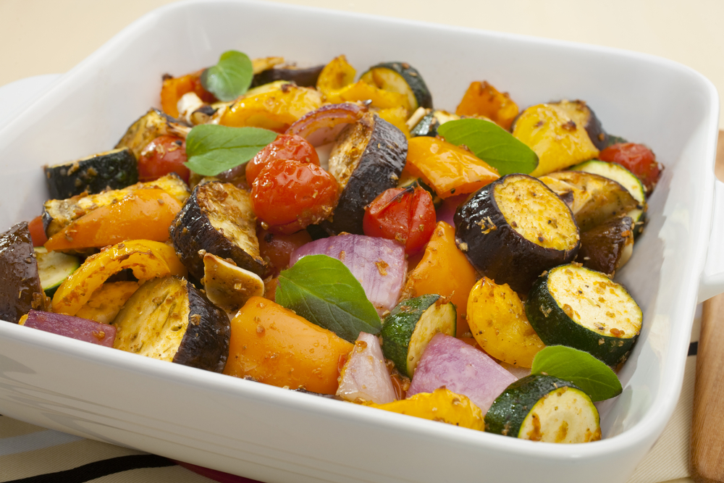
Food safety and hygiene
Wash and dry hands before and during cooking.
Be careful removing the skin from the butternut squash – sometimes it’s easier to roast it in the skin first.
Check date marks.
Wash fresh fruit and vegetables before use to ensure any dirt or bacteria is removed.
If serving with fish, use a separate chopping board when preparing it, ideally a blue one.
Be careful when roasting vegetables.
Use oven gloves.

Slide 12
Cooking for the future
Ratatouille
Ratatouille can be used as a topping or as a side dish.
Pour ratatouille over fish or chicken, sprinkle with cheesy-breadcrumbs and bake.
Experiment with different vegetables, such as celery, olives, carrots, or okra.
Experiment by making a Ratatouille and serving as a main dish with wholewheat pasta or brown rice.

Slide 13
Cooking for the future
Lentil bake
Try swapping the Cheddar for feta or stilton.
Add different herbs, spices or vegetables.
Roasted butternut squash risotto
Make a basic risotto and add leftover vegetables, fish or meat.
After the butternut squash has been roasting for 20 minutes, pour over a can of chopped tomatoes, garlic and a little water – cover and cook for another 20-30 minutes and serve with wholewheat pasta.

Slide 14
Veg out!
For further information, go to:
www.foodafactoflife.org.uk

