Slide 1
Impress

Slide 2
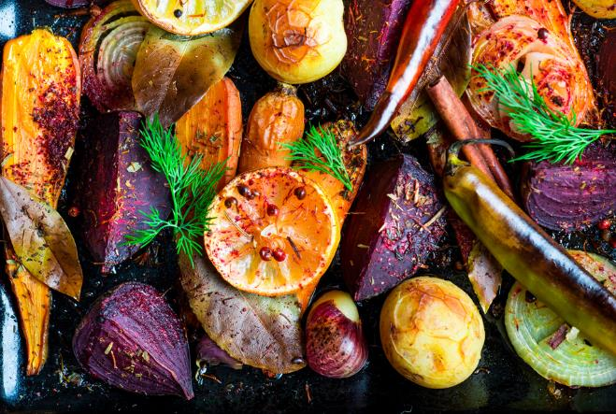
Aims and objectives
Aim
To make a fancy main meal, with vegetables.
Objectives:
work in pairs;
make salmon fish fingers, roasted vegetables and herby mash;
use kitchen equipment safely;
make three tasty recipes, one of which includes oily fish.

Slide 3
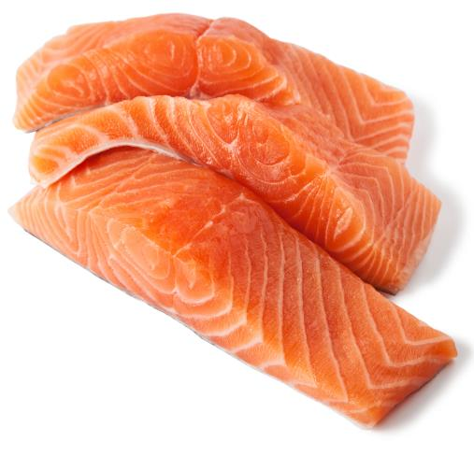
Setting the scene
This module is about making a main meal fish dish that will impress.
It is recommended that we have two portions of fish each week, one portion (140g) of which is oily (e.g. salmon, mackerel and sardines).
Always have plenty of vegetables – prepare them when you’re ready to cook rather than soaking in water to retain the water soluble vitamins.

Slide 4
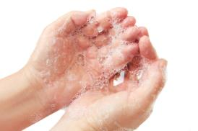
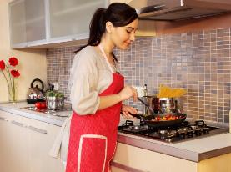
Food hygiene – getting ready to cook
Tie long hair up.
Remove jewellery and watches.
Remove jumpers and roll-up long sleeves.
Thoroughly wash and dry hands.

Slide 5
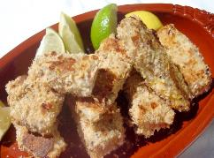
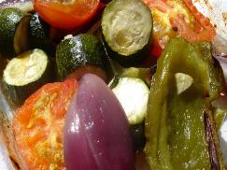
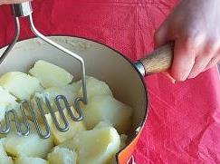
Recipes - you will make:
Salmon fish fingers
Roasted vegetables
Herby mash

Slide 6
Food skills and techniques
You will:
peel and chop;
use the hob and oven;
drain;
mash.
Why not download and insert a BNF cooking skill video here?

Slide 7
Shopping list
For 2 people
For 10 people
Salmon fish fingers | Roasted vegetables | Herby mash
1 salmon fillet 2x15ml spoon plain flour Black pepper ½ lemon 8x15ml spoon wholemeal breadcrumbs 2x15ml spoon low fat plain yogurt | 1 red onion 1 courgette 2 tomatoes 1 pepper 1 clove of garlic | 250g potatoes 50ml semi-skimmed milk Handful of parsley Black pepper
Salmon fish fingers | Roasted vegetables | Herby mash
5 salmon fillets 10x15ml spoon plain flour Black pepper 2 ½ lemon Wholemeal breadcrumbs 10x15ml spoon low fat plain yogurt | 5 red onions 5 courgettes 10 tomatoes 5 peppers 5 cloves of garlic | 1.25kg potatoes 250ml semi-skimmed milk Parsley Black pepper

Slide 8
Plan of action
Review recipes to be cooked.
Prepare the vegetables and roast them.
Boil the potatoes for the mash.
Assemble the salmon fish fingers and start to bake.
Drain and mash potatoes. Flavour the mash.
Serve the meal.
Ensure that you collect your equipment before you start to cook.
Weigh and measure your ingredients accurately.
Keep your work surfaces clean and tidy – wash up as you go.

Slide 9
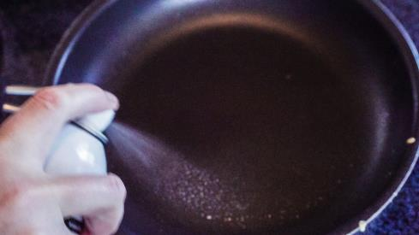
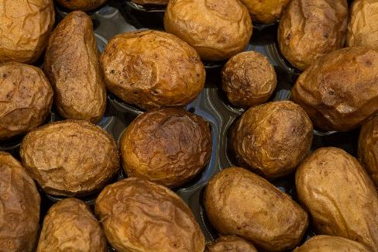
Healthy eating
Include one portion of oily fish (140g) in your diet at least once a week.
Try spraying the vegetables with a cooking spray to reduce the total saturated fat and energy.
When choosing an oil, choose an unsaturated oil as we should be trying to replace foods high in saturated fats with foods rich in unsaturated fat.
Leave the skins on the potatoes as this will increase the fibre content.
Avoid adding fat to the mash – you could use a teaspoon of wholegrain mustard or some vegetables, such as peas, for extra flavour.

Slide 10
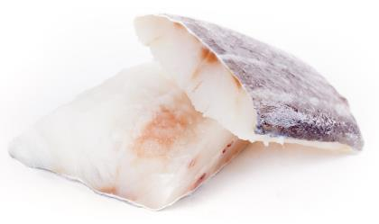
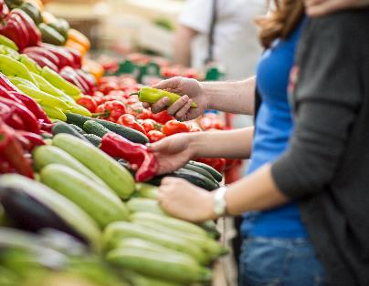
Budgeting
Frozen fish can often be cheaper than fresh fish. The fishmonger at your supermarket may also be able to recommend you a cheaper type of fish.
Make your own breadcrumbs from wholemeal bread. Any spare bread crumbs can be frozen.
Double the recipe for fish fingers and freeze half for another time.
Potatoes are cheap and have a long shelf life if stored correctly so can be bought in bulk.
Buy seasonal vegetables for roasting and look for special offers at local markets.
Frozen vegetables tend to be cheaper than fresh, and can help to cut down on food waste.

Slide 11
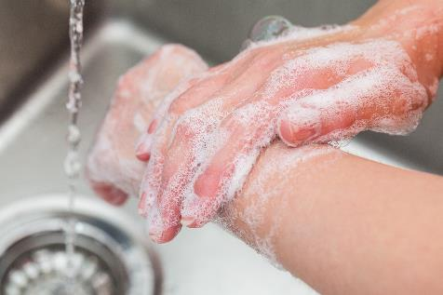
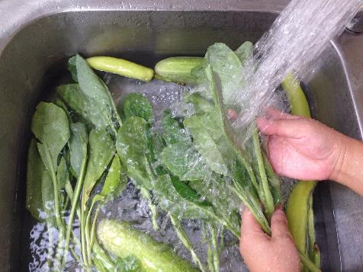
Food safety and hygiene
Wash and dry hands before and during cooking.
Ensure that the fish is cooked thoroughly.
Check date marks.
Wash fresh fruit and vegetables before use to ensure any dirt or bacteria is removed.
Use a separate chopping board for raw fish, ideally blue.
Be careful when roasting vegetables.
Use oven gloves.

Slide 12
Cooking for the future
Salmon fish fingers
Try using different types of fish.
Add extra flavour to the breadcrumbs - try herbs, black pepper, lime zest or chilli.
Roasted vegetables
Choose seasonal vegetables.
Try incorporating roasted vegetables into a couscous salad or a tagine.

Slide 13
Cooking for the future
Herby mash
Experiment with different herbs such as parsley, chives and basil or adding vegetables like cabbage, spring onion or parsnips.
Instead of mashed potato, cook new potatoes and crush with a fork – leaving the skins on will increase the amount of fibre in the meal.

Slide 14
Impress
For further information, go to:
www.foodafactoflife.org.uk

