Slide 1
Budgeting

Slide 2
Save your money by saving your food
FACT: The average family of four can save as much as £70 per month by reducing their food waste.
FACT: UK households we waste 7 million tonnes of it every year, 5 million of which is edible.
Notes:
Source: http://www.lovefoodhatewaste.com/

Slide 3
Plan Ahead
By planning your meals you will be able to cut down on waste and save money!
Making your own food from scratch is much cheaper than buying it ready prepared.
Work out how much you’ve got to spend on food in a week (and be realistic!)
Don’t be tempted to buy special offers if you think it may go to waste and was not already on your shopping list. However, looking for special offers on food that will likely take a while to go off, such as pasta, canned food and cereals may be beneficial.
Plan to buy frozen or canned food such as vegetables. These tend to be cheaper than fresh varieties and you can use them at a later date without them going off, which cuts down on waste.

Slide 4
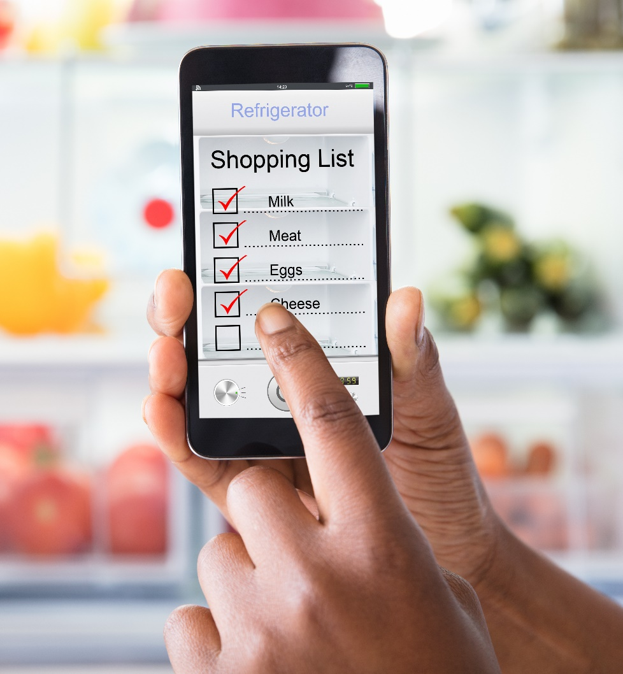
Plan Ahead
Try to buy only what you need – or you might throw food away.
Share the cost of large items with flatmates or friends.
Cooking in larger quantities can help money to go further – make extra and freeze portions for another time.
Plan what you are going to cook before you go to the shops, so you can make a shopping list and only buy what you need.
Why not cook a meal with your friends and share the ingredients?

Slide 5
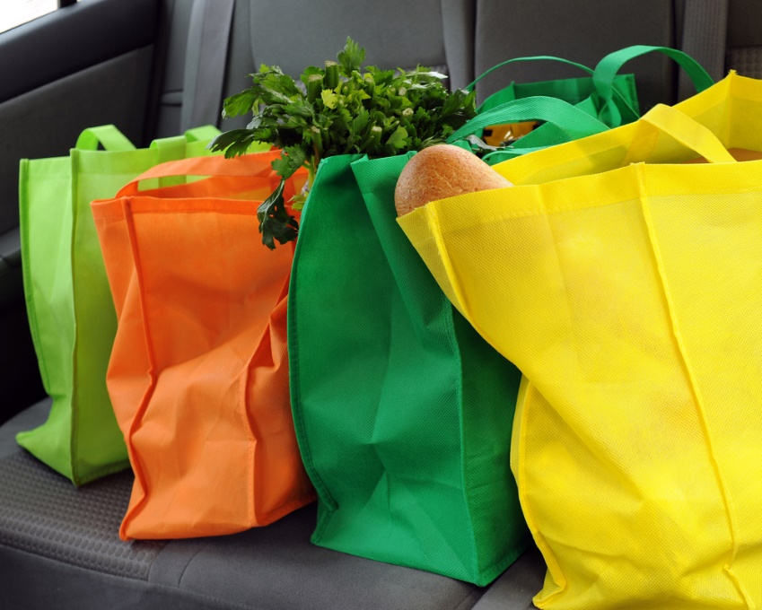
Buy basics and be smart
Look out for foods that have a long shelf-life, like pasta, rice and noodles:
these can form the basis of lots of meals and are cheap to buy;
they can be used to bulk up your meals and make them go further;
these help you to have a balanced diet, plus are good value.
Economy (or own brand) ranges are often great value and the nutritional content is usually very similar to the standard or branded ranges.
Grate cheese to make it go further.
Save leftovers for another meal, either keep it in the fridge for up to 2 days or put a portion in the freezer.

Slide 6
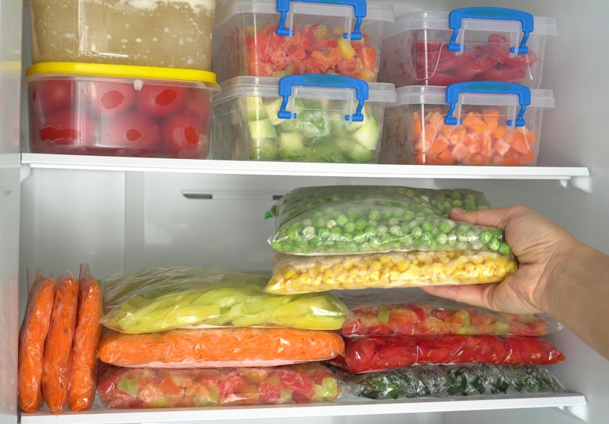
Buy basics and be smart
Keep bread in the freezer for another day.
Go for frozen vegetables – so you can use what you want and freeze the rest.
Long life 100% fruit juice is cheaper than freshly squeezed.
Make recipes go further by adding beans, pulses or seasonal vegetables to your cooking, e.g. Shepherd's pie, spaghetti Bolognese, stir-fry, pie fillings.
Seasonal fruits and vegetables are often cheaper and by shopping seasonally you can also make sure you eat a variety of fruit and vegetables over the course of a year.

Slide 7
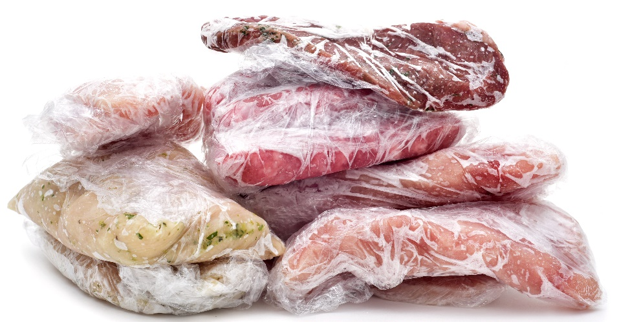
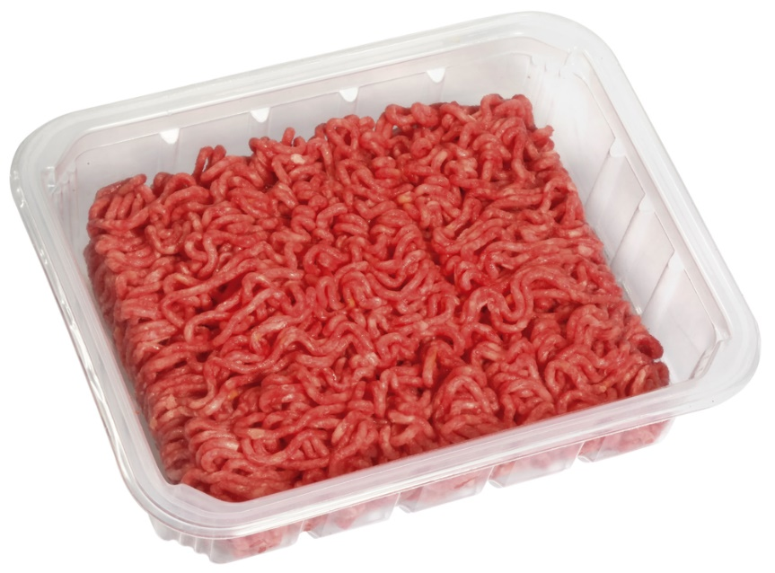
Buy cheaper cuts of meat
Chicken drumsticks and thighs are cheaper than breast.
A whole chicken can also be great value, especially if you use it for more than one meal – why not roast a whole chicken and portion it up into bags for the freezer?
Mince is also versatile and cheaper than other cuts of meat.
Just remember to go for lower fat ranges and/or drain the fat off.
You can also ask your butcher for cheaper cuts of meat such as shins of beef, lamb neck or pork chump.
Keep an eye out for cuts of meat on special offer and buy extra to freeze for another time.

Slide 8
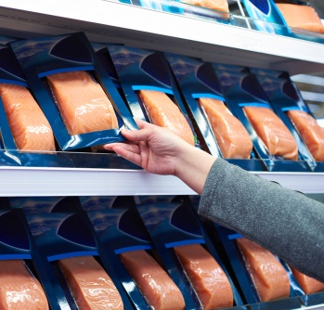
Fish
Canned fish (such as sardines and salmon) can be cheaper than buying fresh fish:
They are easy to prepare and have a long shelf life;
Choose those in spring water to reduce the salt content.
Frozen fish can also be great value
If there are special offers on fresh fish you could take advantage of this and freeze it for when you need it.
Eggs, beans and lentils are all relatively low cost and can be cheaper when bought in bulk. These are all alternative protein sources to meat and fish. Beans and lentils can also be great for bulking-up meals.

Slide 9
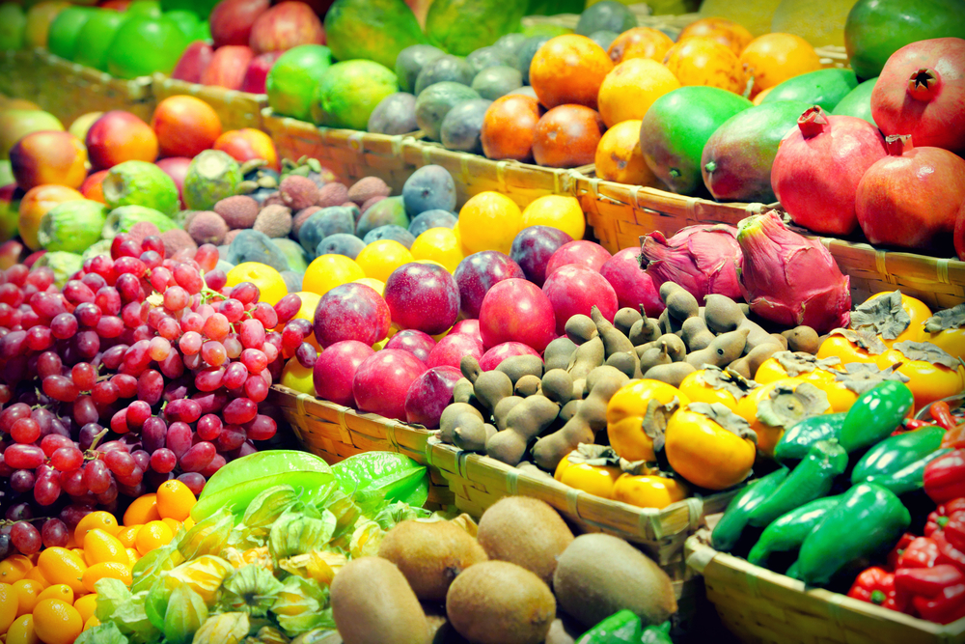
Fruit and vegetables
Frozen vegetables are often cheaper, can be more nutritious than fresh varieties, as freezing preserves the nutrients, and this may also help you cut down on food waste.
It may be cheaper to buy fresh fruit and vegetables from a local market or greengrocer rather than supermarkets.
Loose fruits and vegetables may be cheaper than pre-packaged ones.
Fresh fruit and vegetables are often cheaper when they are in season.

Slide 10

5p off, 50% free!!!
Special offers are great, but don’t buy food just because it’s on offer – you might not use it.
Look out for 3 for 2, money off or x% extra deals. Check that you can store these for when you need them.
Keep your eyes peeled for offers late in the day, often supermarkets reduce their prices.

Slide 11
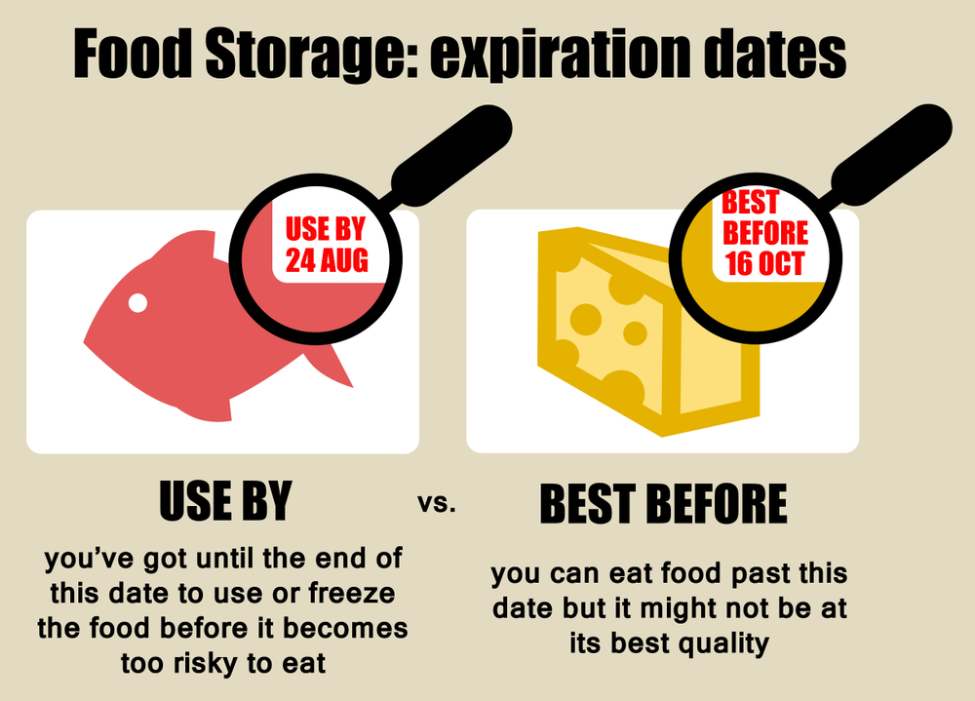
Understanding Food labels
There are two different date marks that appear on food labels:
‘Use-by’ – found on perishable foods such as milk, meat and fish. Foods are not safe to eat after this date.
‘Best before’ – found on a wide range of foods including frozen, dried and canned foods. ‘Best before’ dates are about quality, not safety, are reliant on the food being stored according to the instructions on the label.

Slide 12
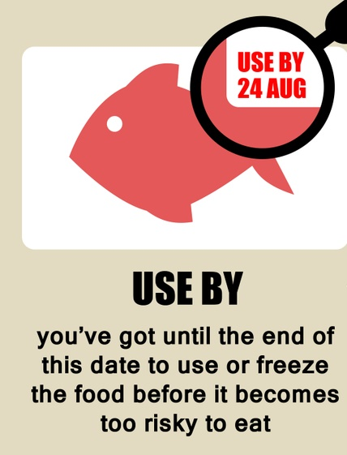
‘Use-by’
Do not consume food or drinks after the ‘use by’ date even if it looks and smells fine.
This is because there is a high risk that foods may lead to food poisoning if used after the use by date.
Unless: you have frozen the food before the ‘use by date’ – freezing extends the ‘use by date’ of the product.
Remember: follow the instructions carefully such as ‘freeze on the day of purchase 'and ‘defrost thoroughly before cooking’.

Slide 13
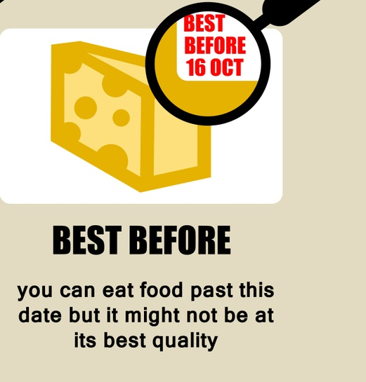
‘Best-before’
The best-before dates are about quality, not safety (i.e. foods are safe to eat after this date but they may not be as crisp or as fresh tasting).
Remember: always store the food as described on the packaging.

Slide 14
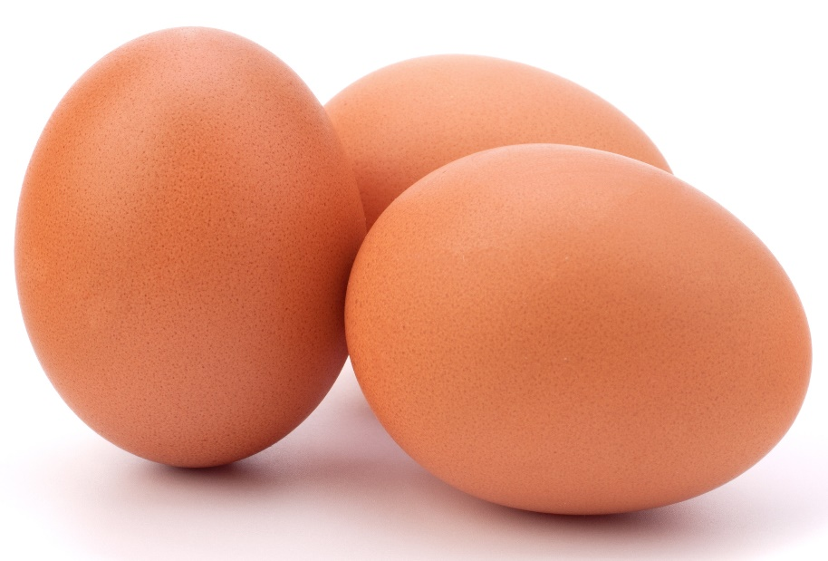
‘Best-before’ - Eggs are an exception!
Eggs display a ‘best before’ date, but should not be consumed after this as there is a risk that they may contain harmful bacteria that can multiply to high levels if the eggs are kept and consumed after this date.
However, new government advice suggests that if the eggs are cooked thoroughly until both yolk and white are solid, they can be eaten a day or two after their ‘best before’ date. This aims to help cut down on food waste.
When choosing eggs, we should be looking at British Lion stamped eggs, especially if planning to eat raw or lightly cooked.
Notes:
http://www.nhs.uk/Livewell/Goodfood/Pages/eggs-nutrition.aspx

Slide 15
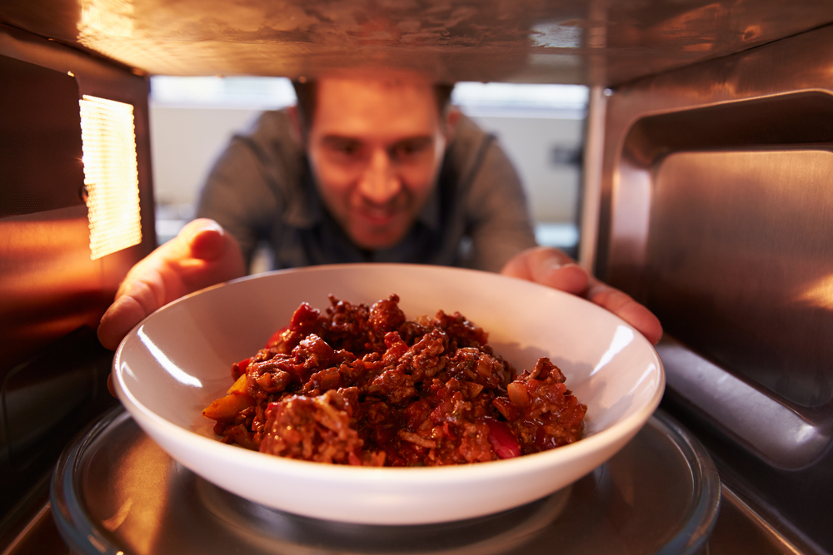
Reduce your waste
Make your own frozen meals - double your normal meals and freeze half. This will be useful for the days you do not have time to cook and will also reduce gas and electricity bills as the meals are not cooked from scratch each time.
Keep an eye on your portion sizes and try not to cook more than you need to reduce waste.
Limit eating out because you will pay extra for convenience and may waste food you have already bought for the week.

Slide 16
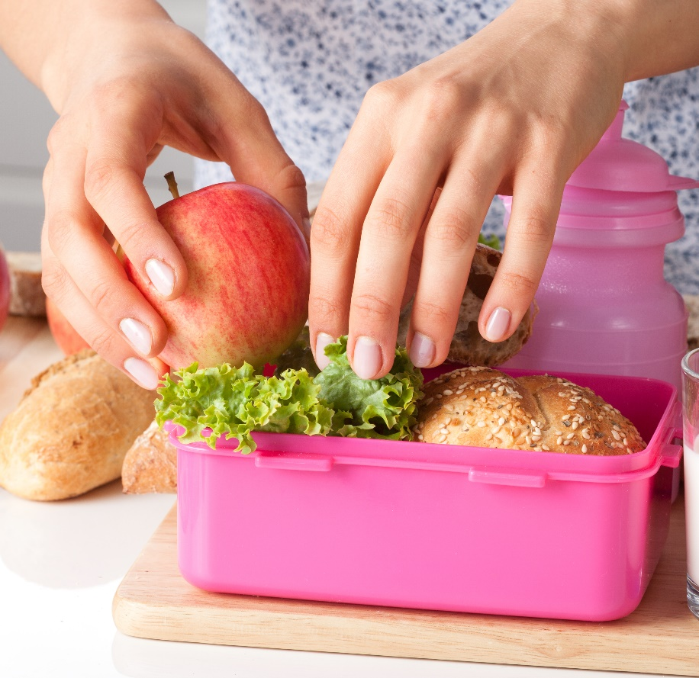
Reduce your waste
Making your own healthy packed lunches can help you save money and use up any leftovers.
Keep a supply of frozen and tinned fruit and vegetables they have a long shelf life and you can use them when you need.
Use cookery websites for recipe ideas based on what you already have in your cupboards.

Slide 17
Frequently Wasted Foods
Food | Use
Vegetables | Make a big batch of vegetable soup – freeze extra portions. Finely chop and add to pasta, couscous or rice. Steam some and have on the side of your main meals. Chop some into ‘sticks’ and have with a dip such as low fat hummus.
Overripe fruits | Add them to milk or yogurt and blend with frozen fruits to make a delicious smoothie. Use them for baking a cake. Add to stews or casseroles to add sweetness to dishes.
Potatoes | Make a potato pie, potato gratin, fish cakes, bubble and squeak, a curry or leek and potato soup. Make mashed potato with chives and serve with your meal – put extra portions in the freezer. Have a baked potato (with the skin) for your meal.
Bread | Make your own breadcrumbs (by grating or whizzing in the blender) to coat fish or chicken or as a crispy topping to pasta bake. If you often waste bread, why not freeze it on the day of purchase and take a few slices out when you need them.

Slide 18
Budgeting
For further information, go to:
www.foodafactoflife.org.uk

