Slide 1
Getting to Grips

Slide 2
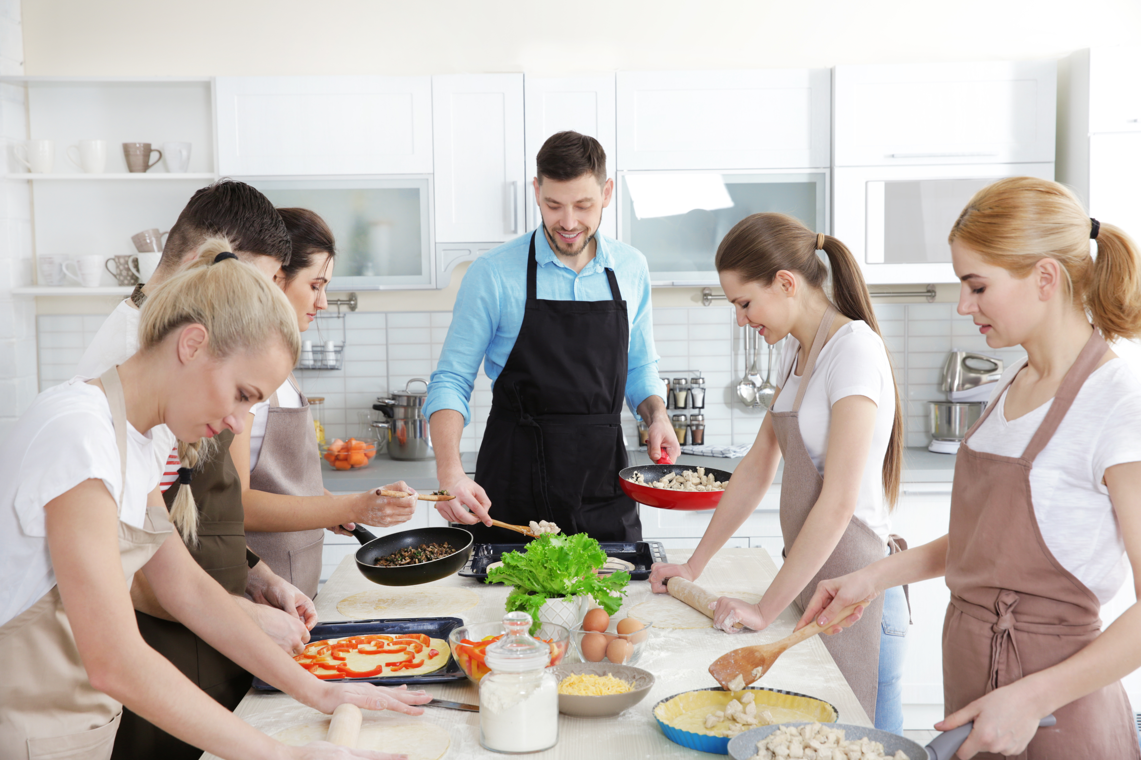
Aims and objectives
Aim:
To become familiar with the kitchen and cooking equipment.
Objectives:
work in pairs;
prepare fruit and vegetables using a range of techniques;
use a knife safely;
make three recipes, using a range of fruit and vegetables.

Slide 3
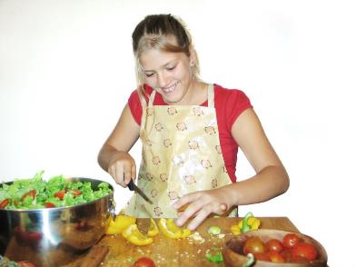
Setting the scene
This module is about getting to grips with the kitchen and cooking equipment.
The recipes will introduce you to some basic skills.
What you make, and learn along the way, will help you to cook in the future.

Slide 4

Food hygiene – getting ready to cook
Tie long hair up.
Remove jewellery and watches.
Remove jumpers and roll-up long sleeves.
Thoroughly wash and dry hands.

Slide 5
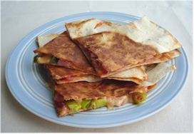
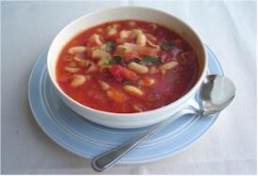
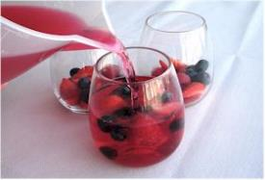
Recipes - you will make:
Tortilla toasties
Tomato and bean soup
Fruit jelly

Slide 6
Food skills and techniques
You will:
use a knife safely;
peel, chop and slice;
spread;
cook on a hob.
Why not download and insert a BNF cooking skill video here?

Slide 7
Shopping list
For 2 People
For 10 People
Tortilla toasties | Tomato and bean soup | Fruit jelly
2 tortillas 1x10ml spoon pasta sauce 25g cheese 1 slice ham 1 spring onion | Spray oil 1 onion 2 celery sticks 1 clove of garlic 2 large cans tomatoes 1 can cannellini beans 1x15ml spoon mixed herbs 50g pasta shells Fresh basil (optional) Parmesan (optional) Black pepper | 1 pack sugar free raspberry jelly Fresh fruit (e.g. berries, bananas, grapes)
Tortilla toasties | Tomato and bean soup | Fruit jelly
10 tortillas 1 jar of tomato pasta sauce 125g cheese 5 slice of ham 5 spring onion | Spray oil 5 onions 1 pack of celery 5 cloves of garlic 10 large cans of tomatoes 5x15ml spoon mixed herbs 5 cans cannellini beans 250g pasta shells Fresh basil (optional) Parmesan (optional) Black pepper | 5 packs of sugar free raspberry jelly Fresh fruit (e.g. berries, bananas, grapes)

Slide 8
Plan of action
Review recipes to be made.
Prepare the jelly – place in the fridge.
Prepare the soup.
Prepare the fillings for the tortilla toastie, cook and serve.
Ensure that you collect your equipment before you start to cook.
Weigh and measure your ingredients accurately.
Keep your work surfaces clean and tidy – wash up as you go.

Slide 9
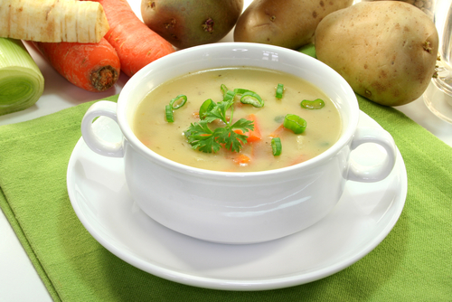
Healthy eating
Experiment with different herbs and spices instead of stock cubes to reduce the salt content of the meal. You could also try using reduced salt stock cubes.
Choose a lower fat cheese for the toastie to reduce the amount of saturated fat and energy in the meal.
Add vegetables, beans and pulses to the soup to increase fibre.
Choose wholewheat pasta to help increase the fibre.
To reduce free sugars, use a sugar-free jelly.

Slide 10
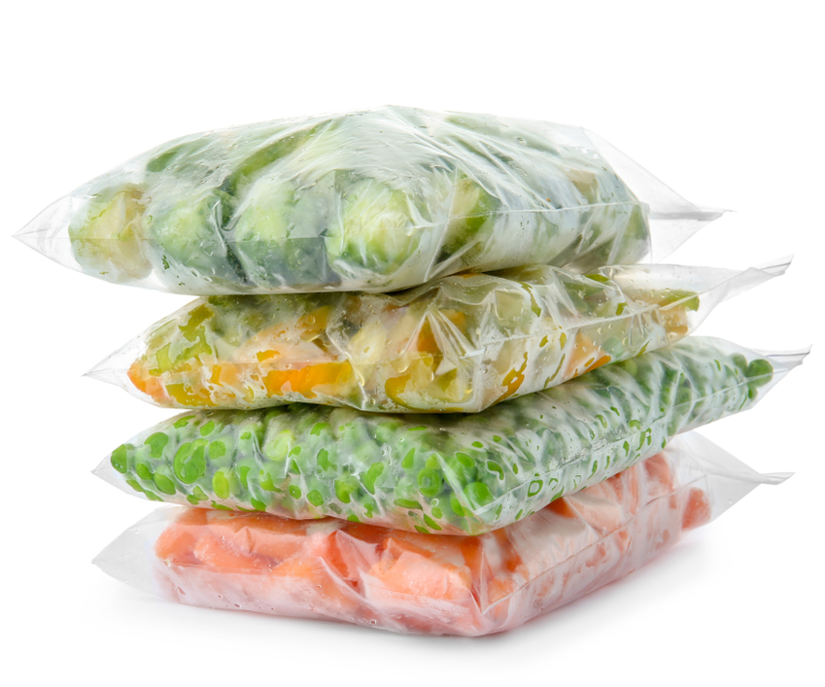
Budgeting
Freeze a pack of tortillas and use only what you need.
Use left overs in your toasties, e.g. ham, tomatoes, onion, mushrooms and spinach.
Soups can be cheap to make and can be a filling main meal. Add plenty of vegetables, beans, pulses, brown rice, wholewheat pasta or lentils to make it go further.
Use canned fruit (in 100% juice), frozen or seasonal fruit in the jelly.
If adding vegetables to the soup, use frozen vegetables (and only use what you need).

Slide 11
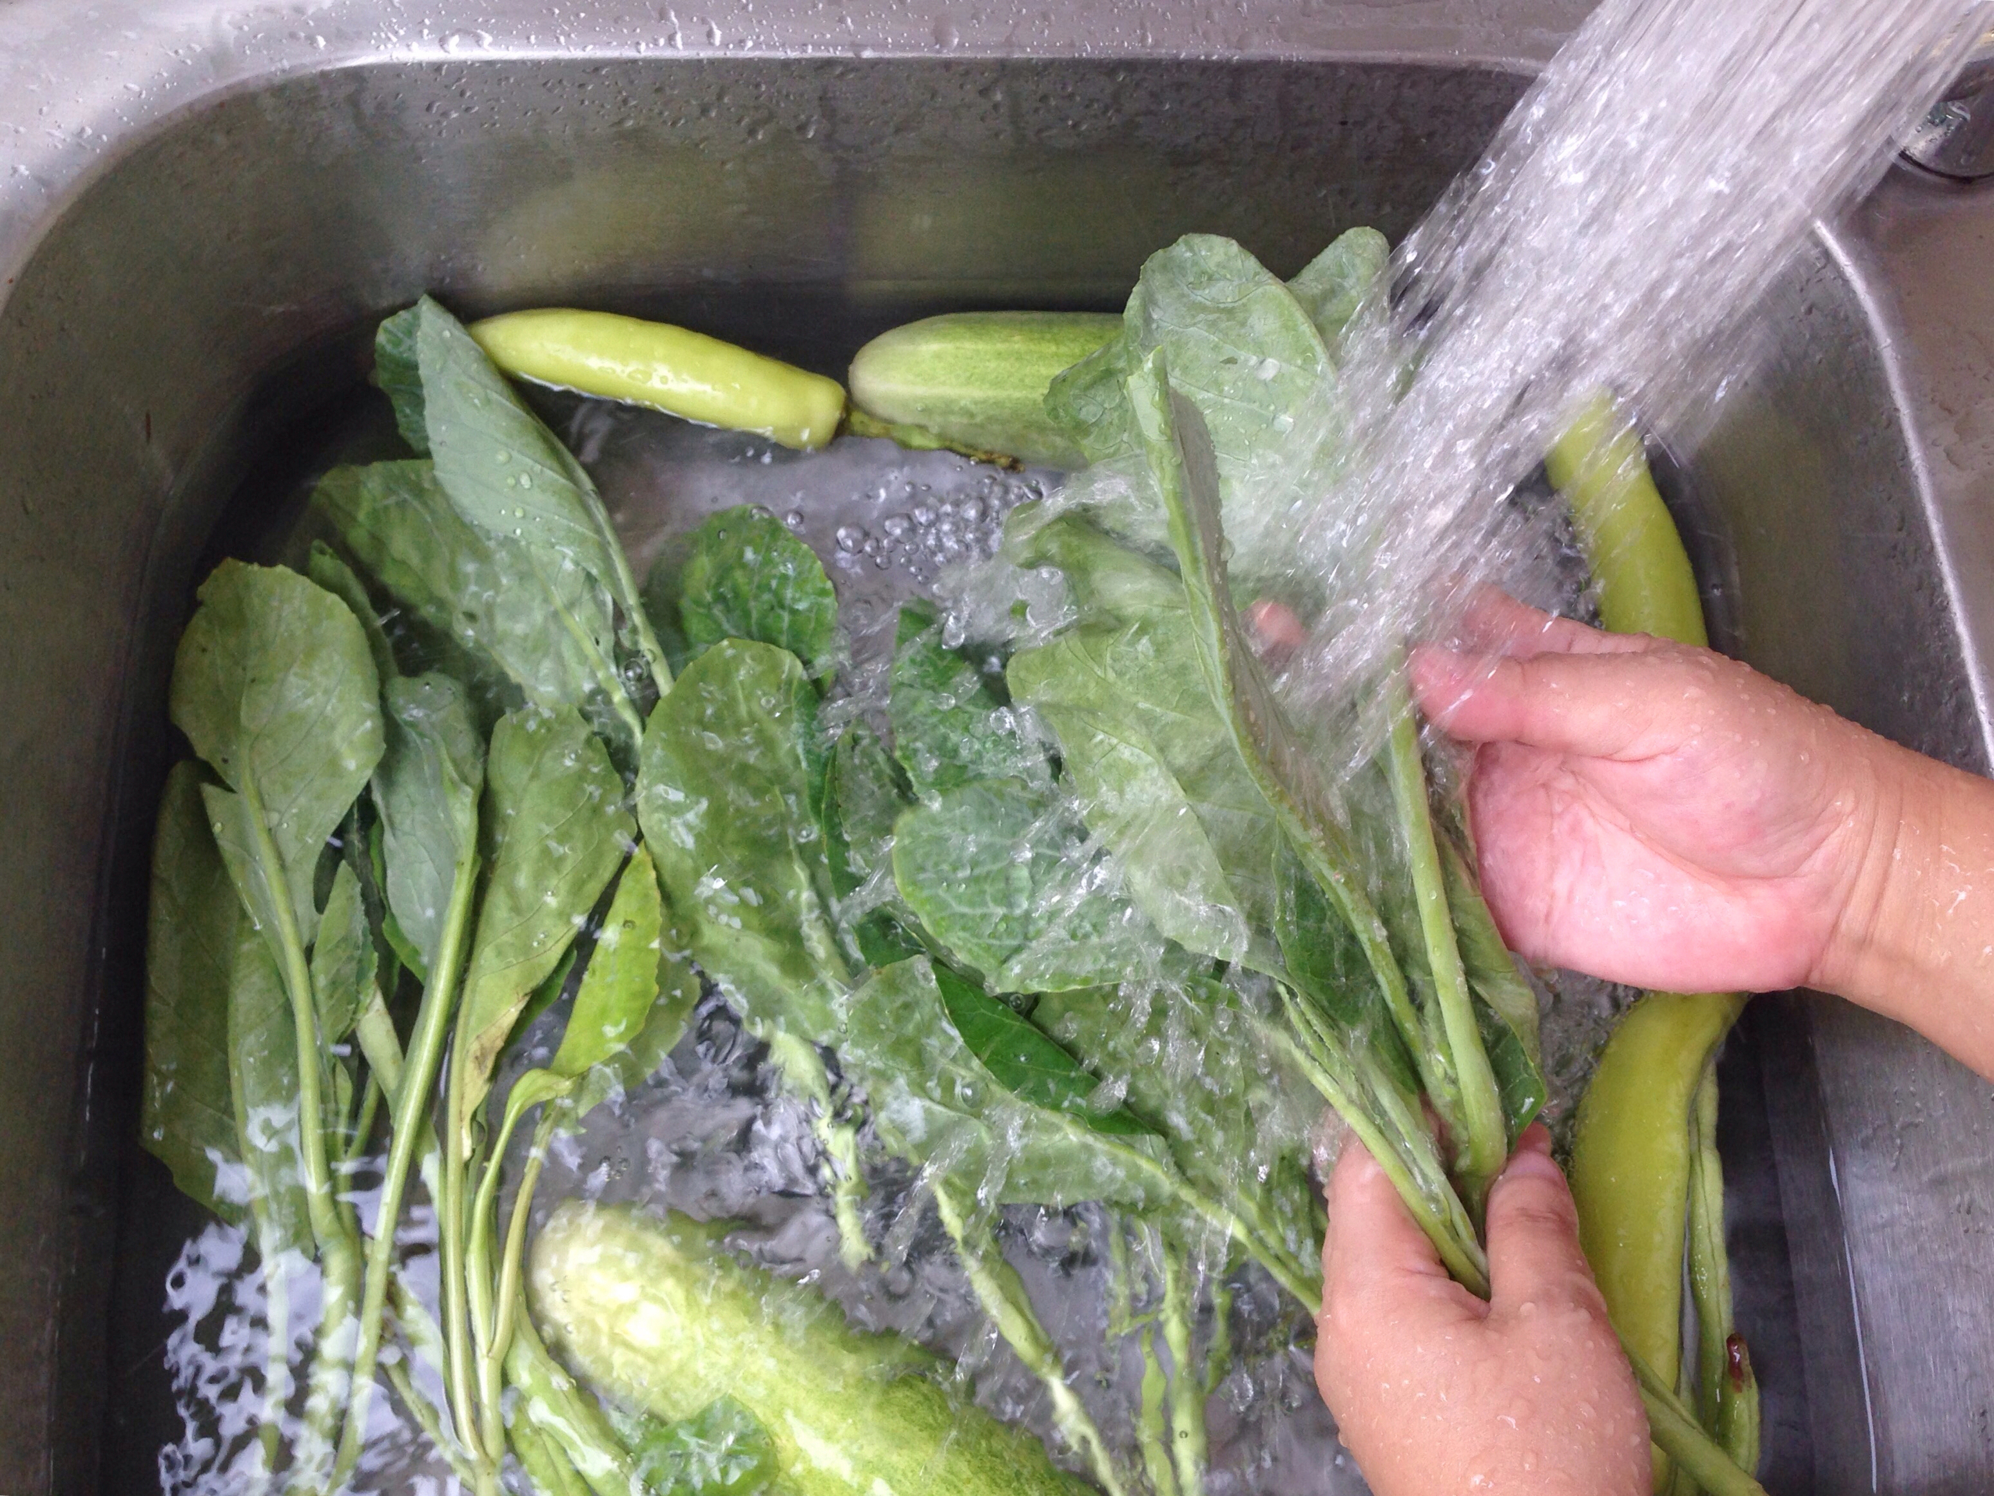
Food safety and hygiene
Wash and dry hands thoroughly before and during cooking.
Chop on a clean, plastic chopping board.
Be careful when turning over the tortilla in the frying pan.
Ensure pan handles do not stick out over the edge of the hob.
Wash fresh fruit and vegetables to remove any dirt and bacteria.
Ensure the soup is cold before storing in the fridge or freezer.

Slide 12
Cooking for the future
Tortilla toastie
Add chilli or garlic for extra flavour.
Go for different fillings – you could try tuna, pesto, mushrooms, tomatoes, red onion, green pepper, courgette, sweetcorn, avocado, kidney beans, chicken. or sliced beef.
Use different varieties of tortilla, e.g. wholemeal, tomato.

Slide 13
Cooking for the future
Soup
Replace the cannellini beans with other types of beans, such as kidney beans or butter beans.
Swap the pasta for brown rice, potatoes with skins, or lentils.

Slide 14
Cooking for the future
Fruit jelly
Use different flavours of sugar free jelly and different fruits.
Use canned fruit (in 100% juice).
Make a layered dessert using different flavoured jelly.

Slide 15
Getting to Grips
For further information, go to:
www.foodafactoflife.org.uk

