Slide 1
Indian Express

Slide 2
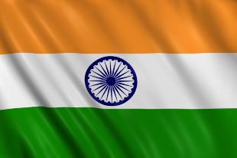
Aims and objectives
Aim:
To develop cooking skills making a selection of Indian recipes.
Objectives:
work in pairs;
make naan bread from scratch, e.g. kneading and baking;
recap on skills from module 1, e.g. use a knife safely;
demonstrate meat handling skills;
try out some simple, but exciting Indian recipes.

Slide 3
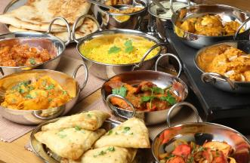
Setting the scene
This module is about developing your cooking skills further.
The recipes will introduce you to making different foods from India.
This will provide you with the skills to cook something tasty and different for your friends.

Slide 4

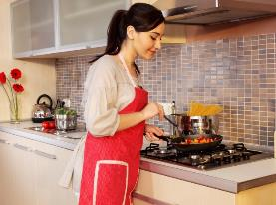
Food hygiene – getting ready to cook
Tie long hair up.
Remove jewellery and watches.
Remove jumpers and roll-up long sleeves.
Thoroughly wash and dry hands.

Slide 5
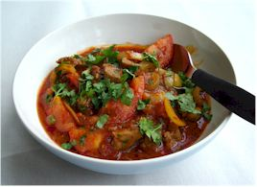
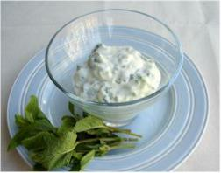

Recipes - you will make:
Lamb Rogan josh
Raita
Naan bread
Serve with a side salad.
If time is short, use ready made naan!

Slide 6
Food skills and techniques
You will:
use a knife safely;
peel, chop and slice;
mix;
grate;
use the hob and the oven;
knead, prove, shape and bake.
Why not download and insert a BNF cooking skill video here?

Slide 7
Shopping list
For 2 people
For 10 people
Lamb Rogan josh | Raita | Naan bread
Spray oil 200g lean lamb leg steaks/neck fillet 2x15ml spoons Rogan Josh curry paste 1 onion 1 clove of garlic 200g can chopped tomatoes 2 tomatoes 1x15ml fresh coriander | 150ml low fat plain yogurt ¼ cucumber 4-5 sprigs of mint | 60ml semi-skimmed milk 1x5ml oil 200g strong flour 1x5ml spoon baking powder ½ sachet instant yeast 1x15ml spoon low fat plain yogurt
Lamb Rogan josh | Raita | Naan bread
Spray oil 1 kg lean lamb leg steaks/neck fillet 1 jar Rogan John curry paste 5 onion 5 cloves of garlic 5x 200g can of chopped tomatoes 10 tomatoes Fresh coriander | 750ml low fat plain yogurt 1-2 cucumbers Bunch of mint | 300ml semi-skimmed milk 50ml oil 1kg strong flour 5x5ml spoon baking powder 3 sachets instant yeast 750ml spoon low fat plain yogurt

Slide 8
Plan of action
Review recipes to be cooked.
Prepare the naan bread – allow to prove.
Prepare the raita – place in the fridge.
Prepare the Rogan Josh.
Cook the bread and serve.
Ensure that you collect your equipment before you start to cook.
Weigh and measure your ingredients accurately.
Keep your work surfaces clean and tidy – wash up as you go.

Slide 9
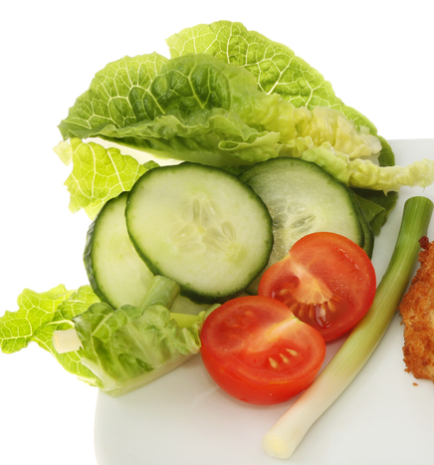
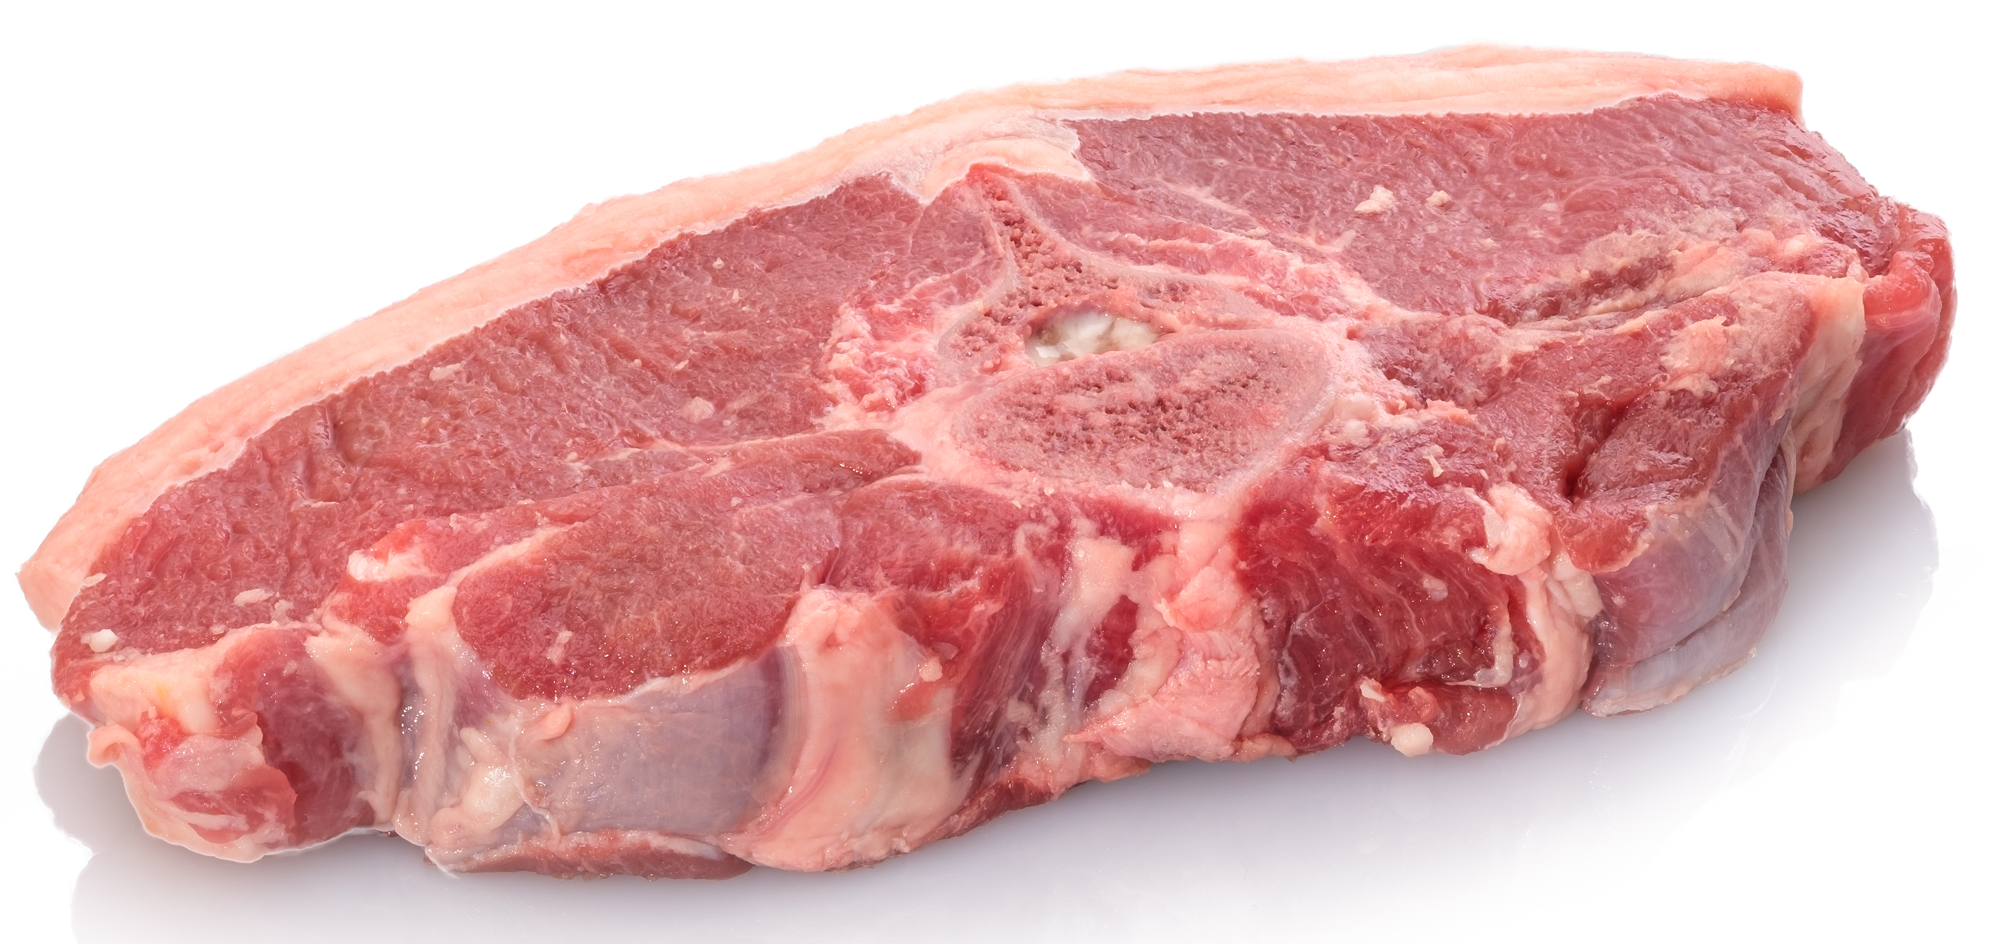
Healthy eating
Removing any visible fat from the lamb will help to reduce the saturated fat content of the meal – this is a good habit to get into when preparing meat. Choose a leaner cut of lamb with less visible fat.
Use low fat plain yogurt for the raita to reduce the amount of saturated fat and energy provided.
Use half wholemeal and half white flour for the naan bread to increase the fibre content.
Add a side-salad.

Slide 10
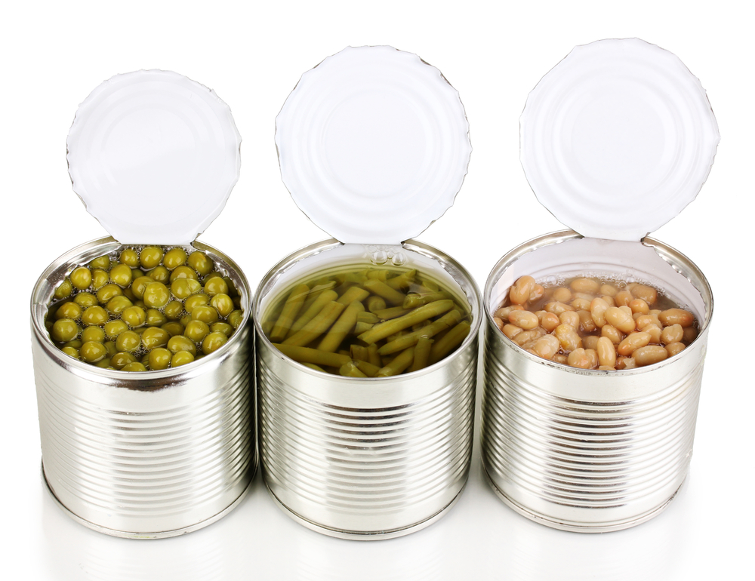
Budgeting
Include a portion of brown rice on the side of the curry.
Add more vegetables, beans and pulses to the curry to bulk it out, this way it will go further.
Double the recipe for the curry and freeze half for another meal.
Frozen or canned vegetables tend to be cheaper than fresh, and can help to cut down on food waste.
Freeze any unused naan bread so you can have it with another meal.

Slide 11
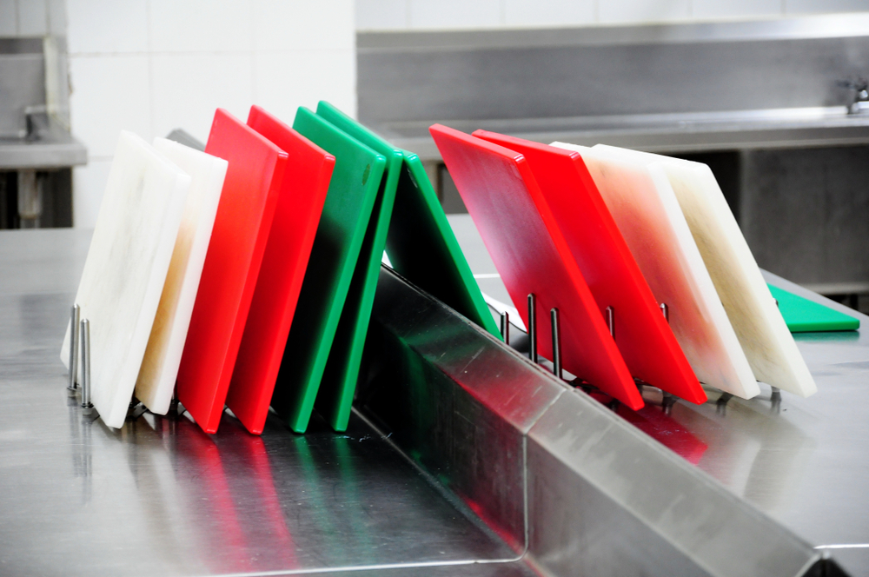
Food safety and hygiene
Wash and dry hands thoroughly before and during cooking.
Use a separate chopping board for raw meat, ideally a red one.
Ensure that the yogurt is within its use-by date.
Wash all fresh fruit and vegetables before use to remove any dirt or bacteria.
Keep the raita in the fridge until needed.
Ensure all work surfaces are clean.
Remember to make sure the dish is no longer hot before storing safely in a fridge within two hours.

Slide 12
Cooking for the future
Quick lamb Rogan josh
Replace the fresh tomatoes with thinly sliced courgettes, peppers or okra.
Batch cook – make double the recipe and freeze portions for another time.
Change the lamb for another protein source, such as beef, chicken, mycroprotein, beans. Alternatively, cook the vegetable based curry and serve with boiled egg.

Slide 13
Cooking for the future
Naan bread
Sprinkle with poppy or sesame seeds before baking.
Add flaked almonds, dried fruit, coconut and spices to the naan mix before baking.
Raita
Try making raita with different herbs for a different flavour.

Slide 14
Indian Express
For further information, go to:
www.foodafactoflife.org.uk

