Slide 1
Pack-a-lunch

Slide 2

Aims and objectives
Aim
To explore a range of foods that can be eaten for lunch.
Objectives:
work in pairs;
make familiar and unfamiliar dishes, e.g. pockets and samosas;
work safely and hygienically;
learn new cooking skills, e.g. grilling, frying.

Slide 3
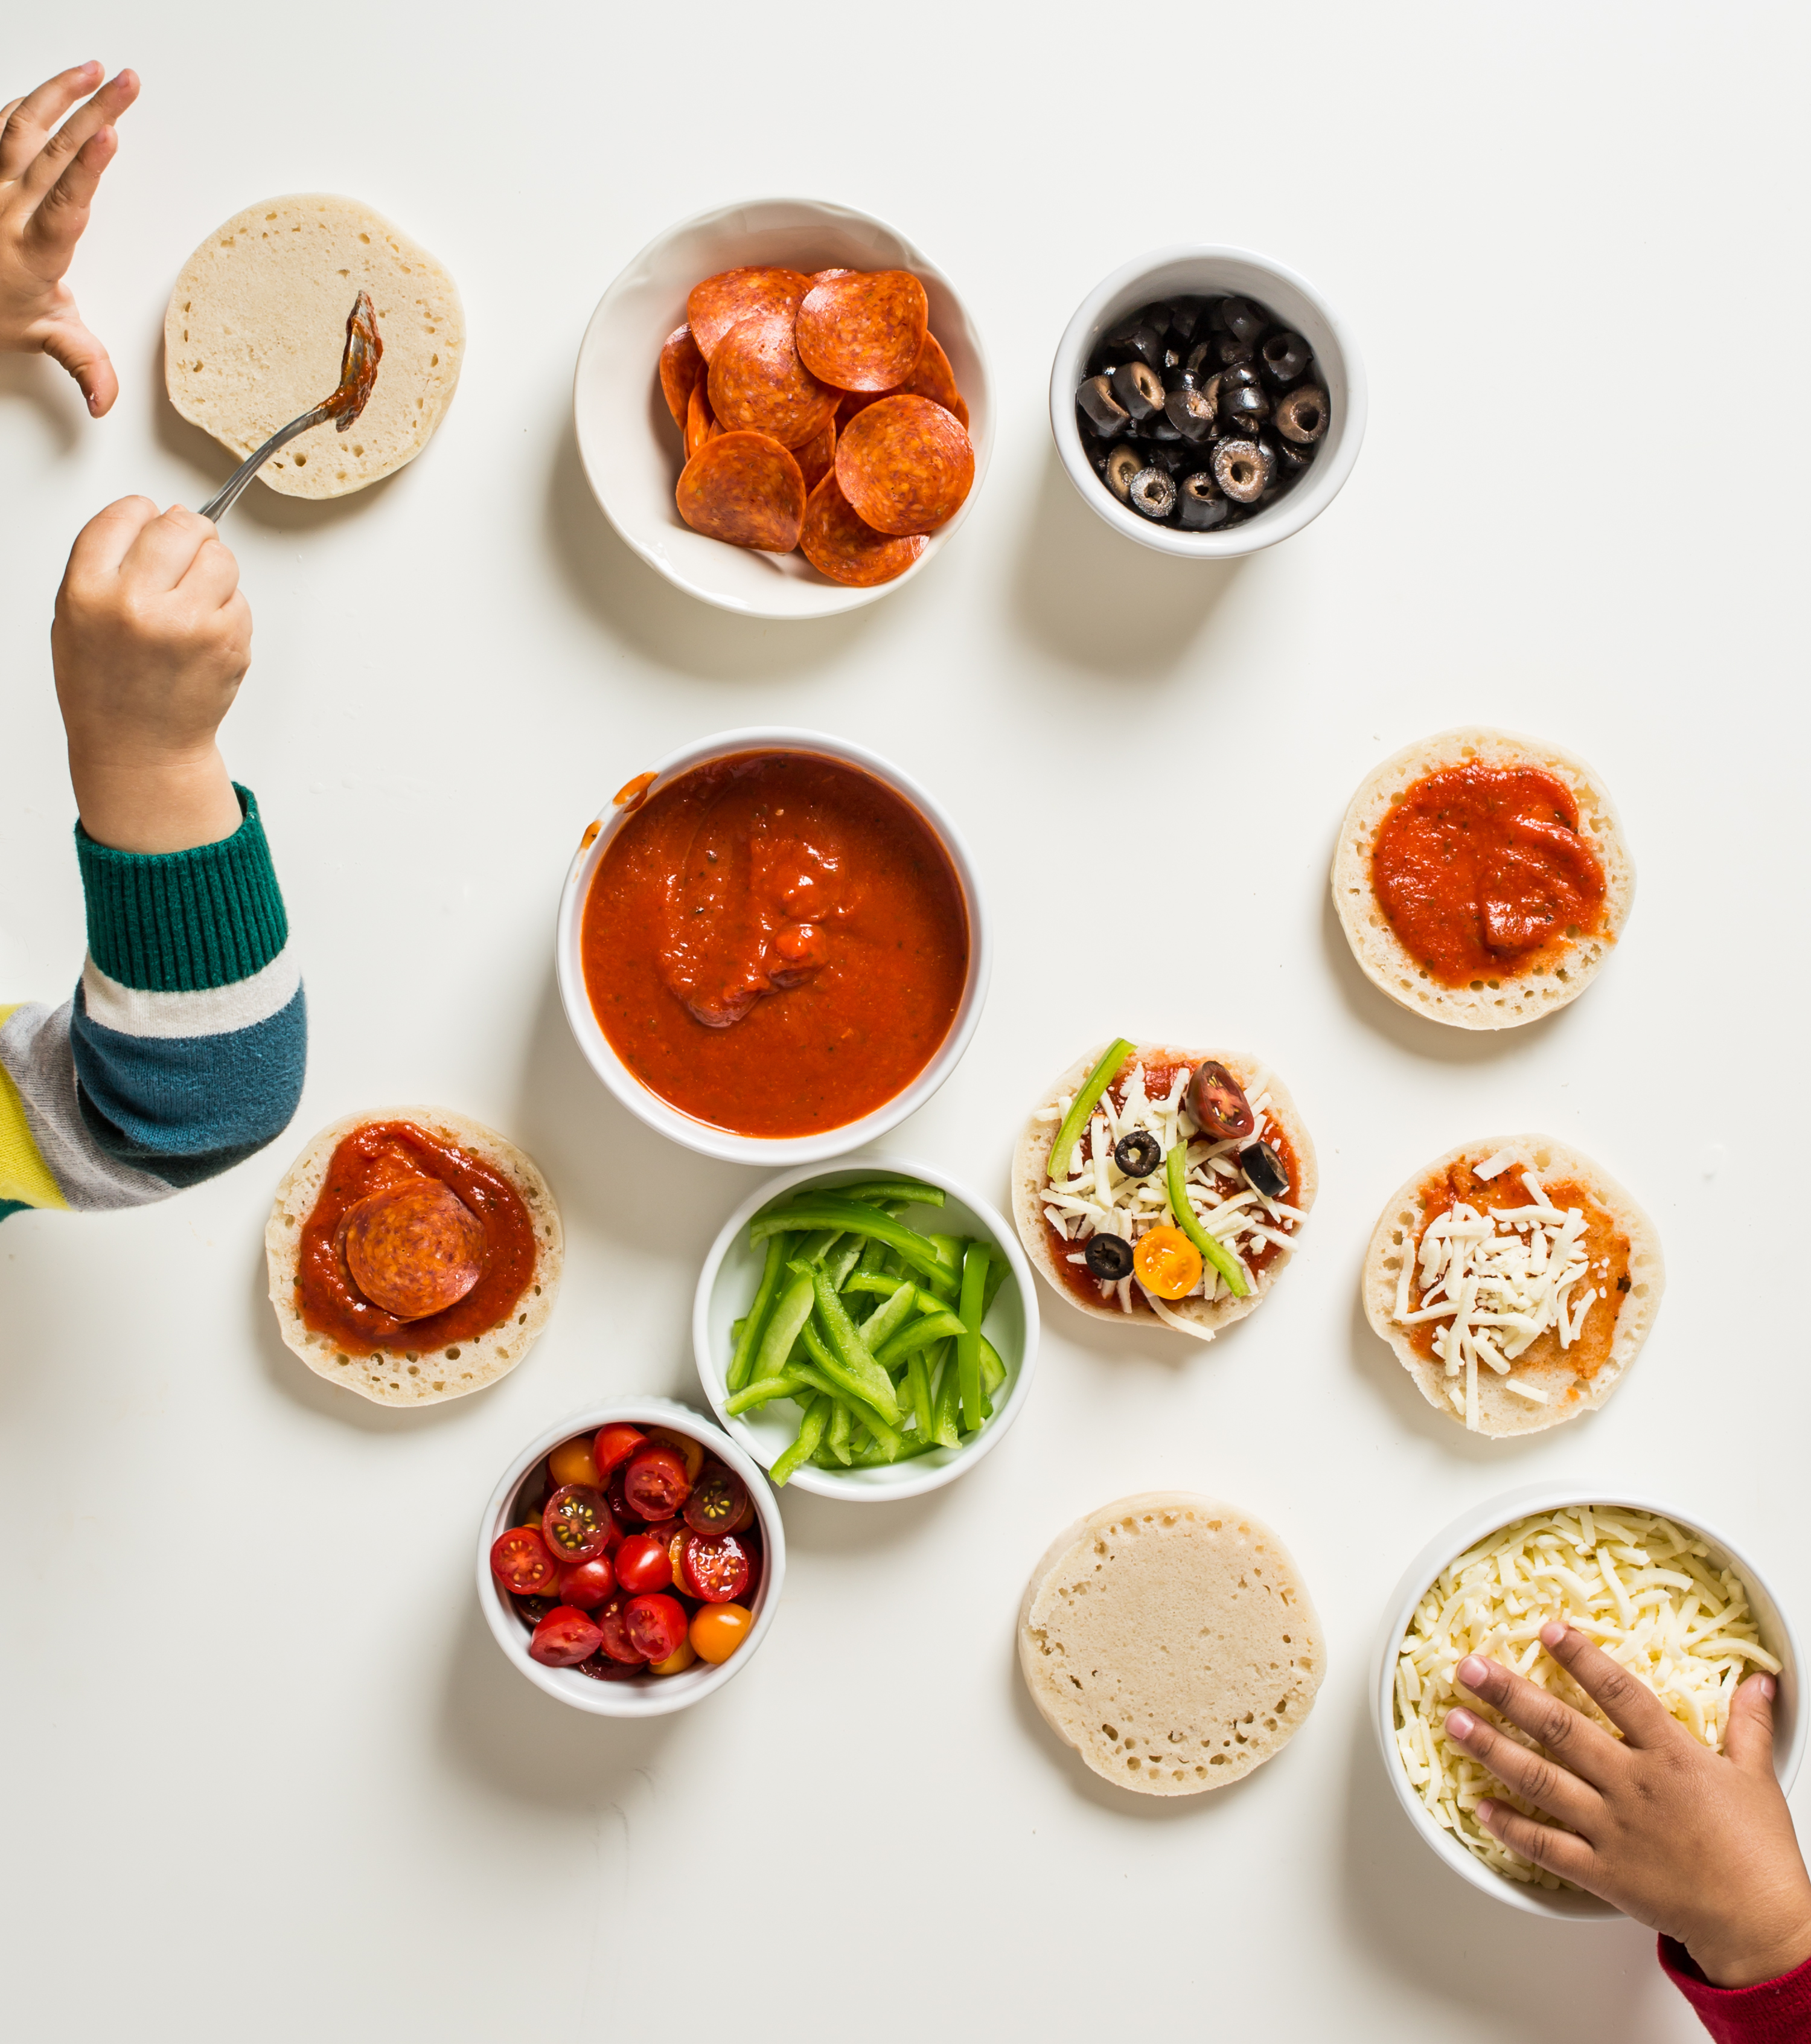
Setting the scene
This module is about making tasty food for lunch or a snack.
The recipes will introduce you to new skills.
You could use the recipes to make fun and interesting dishes in the future.

Slide 4


Food hygiene – getting ready to cook
Tie long hair up.
Remove jewellery and watches.
Remove jumpers and roll-up long sleeves.
Thoroughly wash and dry hands.

Slide 5
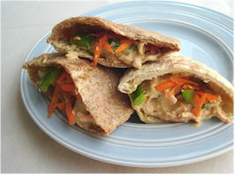
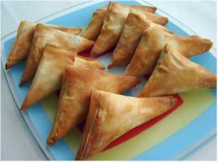
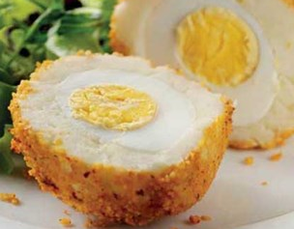
Recipes - you will make:
Hummus, pepper and grated carrot pockets
Veggie samosas
Spicy potato Scotch eggs

Slide 6
Food skills and techniques
You will:
use a knife safely;
grate;
use the grill and the oven;
fry;
make pastry;
boil;
make samosas, i.e. filling, shaping and baking.
Why not download and insert a BNF cooking skill video here?

Slide 7
Shopping list
For 2 people
For 10 people
Hummus, pepper and grated carrot pockets | Vegetable samosas | Spicy potato Scotch eggs
½ red or green pepper 1 ½ carrot 2-3 x 15ml spoons of reduced fat hummus 2 wholemeal pitta bread | Spray oil ½ potato ½ carrot ½ onion ½ red chilli 1x5ml spoon garam masala ½ 5ml spoon turmeric 25g peas (frozen) Fresh coriander 1 pack filo pastry 25g reduced fat spread | 4 eggs 500g mashed potato Freshly ground black pepper 150g packet couscous
Hummus, pepper and grated carrot pockets | Vegetable samosas | Spicy potato Scotch eggs
3 red or green peppers 8 carrots Large tub of reduced fat hummus 10 wholemeal pitta bread | Spray oil 2 ½ potatoes 2 ½ carrots 2 ½ onions 2 ½ red chilli’s 1x 25ml spoon garam masala ½ 25ml spoon turmeric 250g peas Fresh coriander 5 packs filo pastry 125g reduced fat spread | 40 eggs 2.5kg mashed potato Freshly ground black pepper 1.5kg packet couscous

Slide 8
Plan of action
Review recipes to be cooked.
Prepare the samosa filling – allow to chill.
Prepare the veggie pockets – cover and keep in the fridge.
Make and bake the samosas – cool on a cooling rack.
Ensure that you collect your equipment before you start to cook.
Weigh and measure your ingredients accurately.
Keep your work surfaces clean and tidy – wash up as you go.

Slide 9
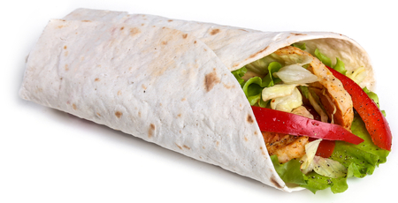
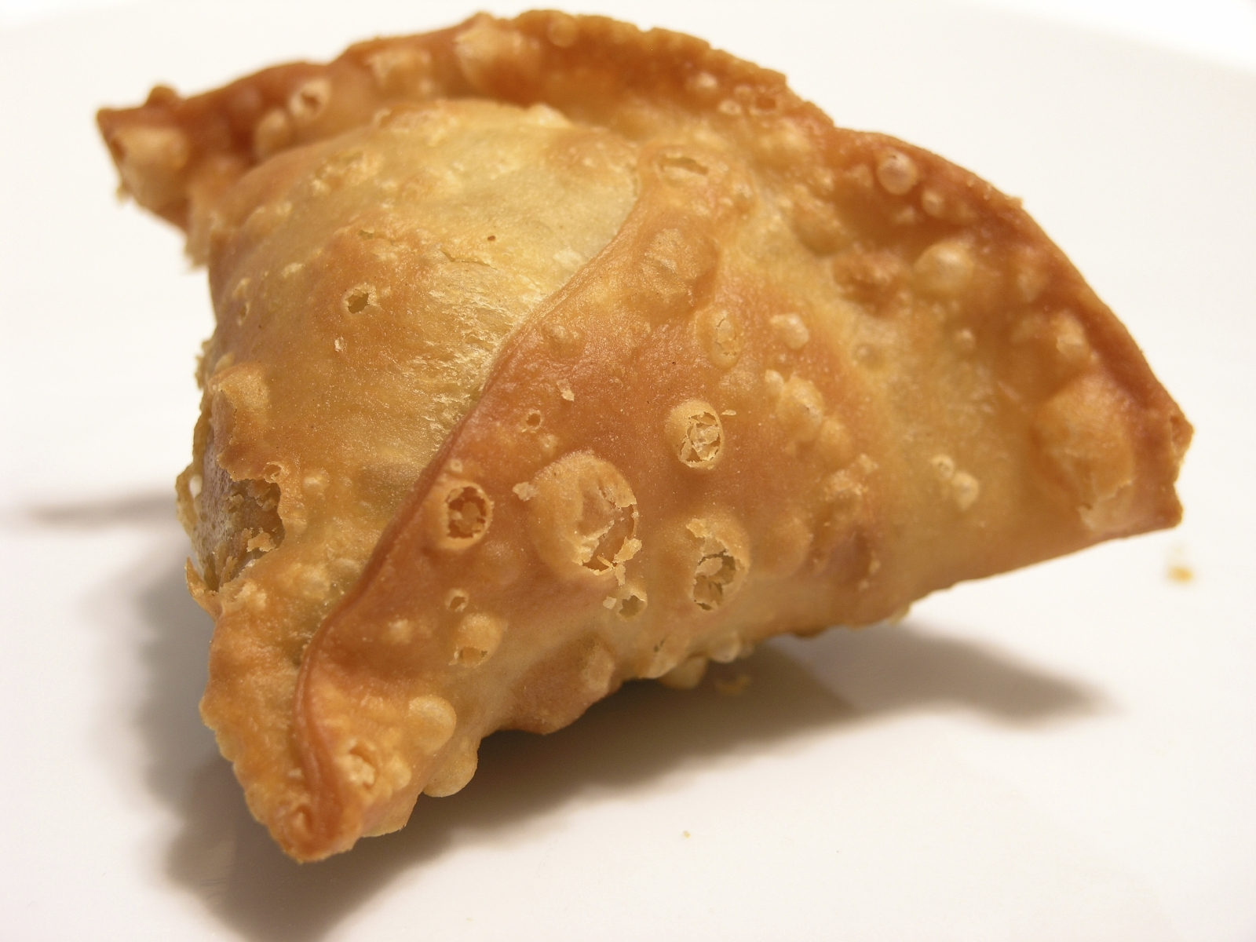
Healthy eating
Regularly choosing lower fat varieties of products, such as hummus, will help to lower the total amount of saturated fat and energy in your diet.
Using wholemeal pitta provides more than twice the amount of fibre than a white pitta.
Add extra vegetables and salad to the wraps.
Making the samosas bigger means that, weight for weight, they contain less pastry.
Bake the samosas rather than fry them to reduce the saturated fat and energy provided.
Add mackerel or salmon to the pitta pockets to increase intake of oily fish.

Slide 10
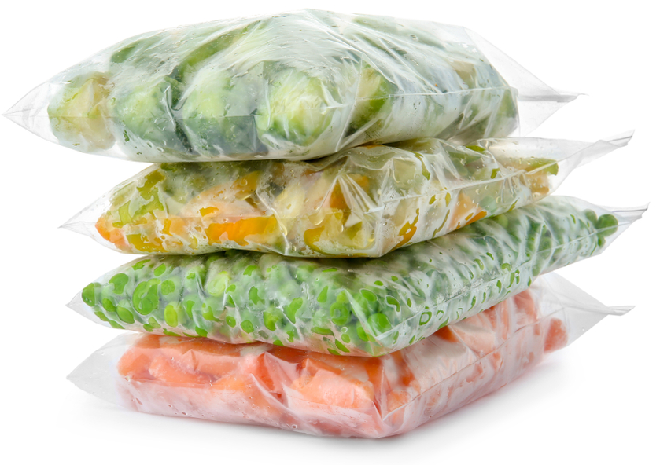
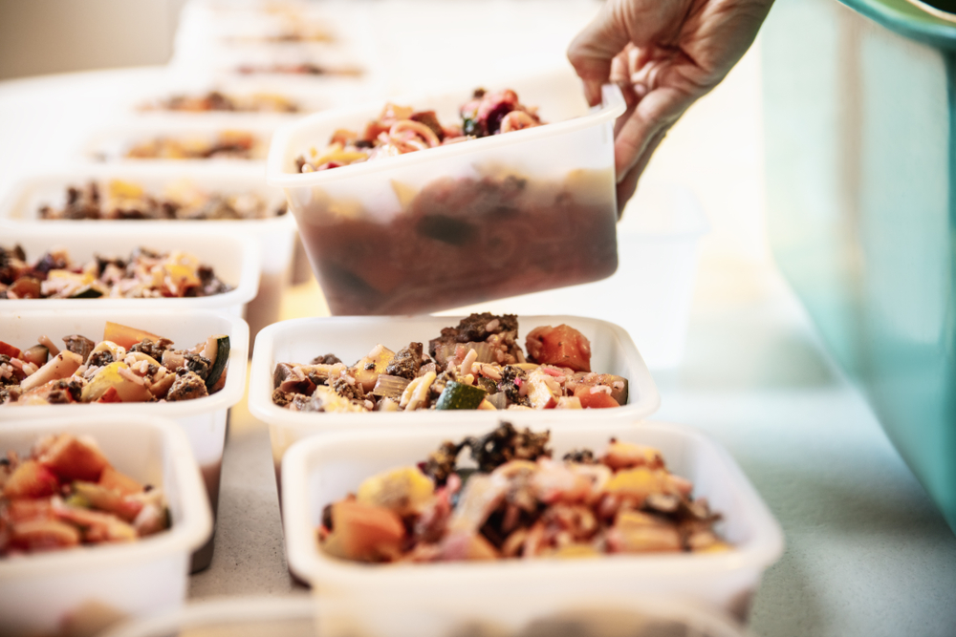
Budgeting
Making your own healthy packed lunch every day can help to save money.
Include fresh fruit and vegetables that are in season – they are often cheaper.
Double the recipe for samosas and freeze some for another time.
Frozen vegetables tend to be cheaper than fresh, and can help to cut down on food waste.
If you do make too much, try freezing or refrigerating and having at another time.

Slide 11
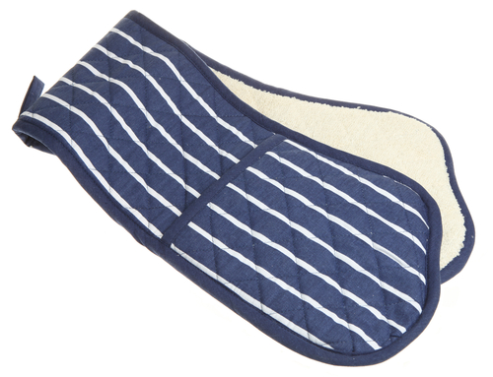

Food safety and hygiene
Wash and dry hands thoroughly before and during cooking.
Wash fresh fruit and vegetables before use to remove any dirt and bacteria.
Chop on a clean, plastic chopping board.
Take care when using the grill and oven – use oven gloves.
If grilling the pitta bread, be careful as these get hot quickly.
Ensure pan handles do not stick over the edge of the hob.

Slide 12
Cooking for the future
Hummus pockets
Use different types of pitta bread, such as wholemeal or seeded.
Vary the crunchy vegetables and fruit in the pockets, e.g. celery, spring onion, grated apple, shredded iceberg lettuce, or sweetcorn.
Replace hummus with a tuna and reduced fat mayo mix, reduced fat grated cheese, cottage cheese, or sliced hard boiled egg.

Slide 13
Cooking for the future
Samosas
Use different vegetables, e.g. okra, sweetcorn, spinach, cauliflower.
Add more chilli or some grated fresh ginger for extra flavour.
Spicy potato Scotch eggs
Blend the potato filling with cooked spinach or chopped tomato – perhaps add chopped herbs?

Slide 14
Pack-a-lunch
For further information, go to:
www.foodafactoflife.org.uk

