Slide 1
Noodle time

Slide 2
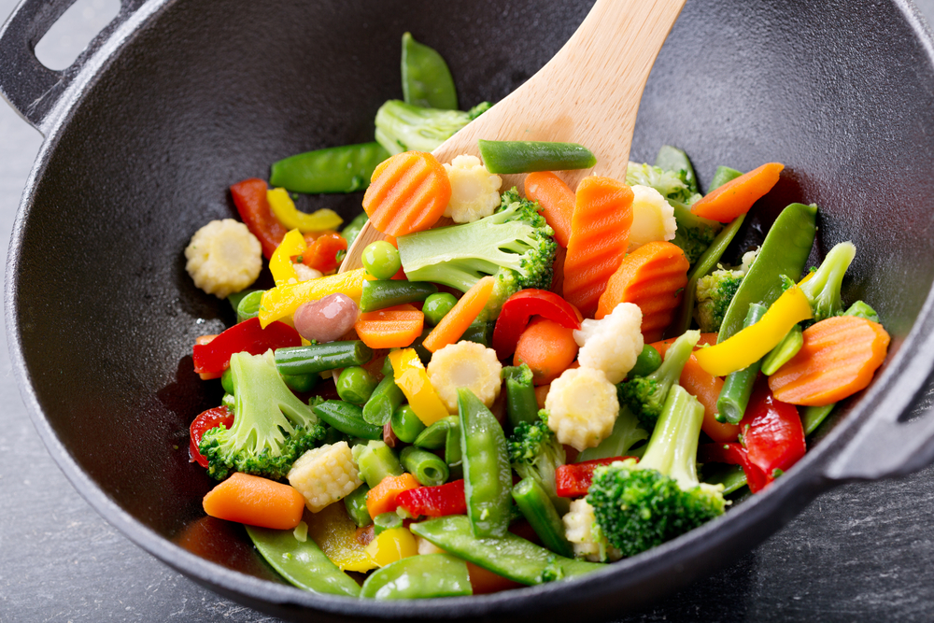
Aims and objectives
Aim
To create a quick, healthy meal using stir-fry cooking methods.
Objectives:
work in pairs;
make a stir-fry meal;
make three tasty recipes, which are quick to make and will impress your friends.

Slide 3
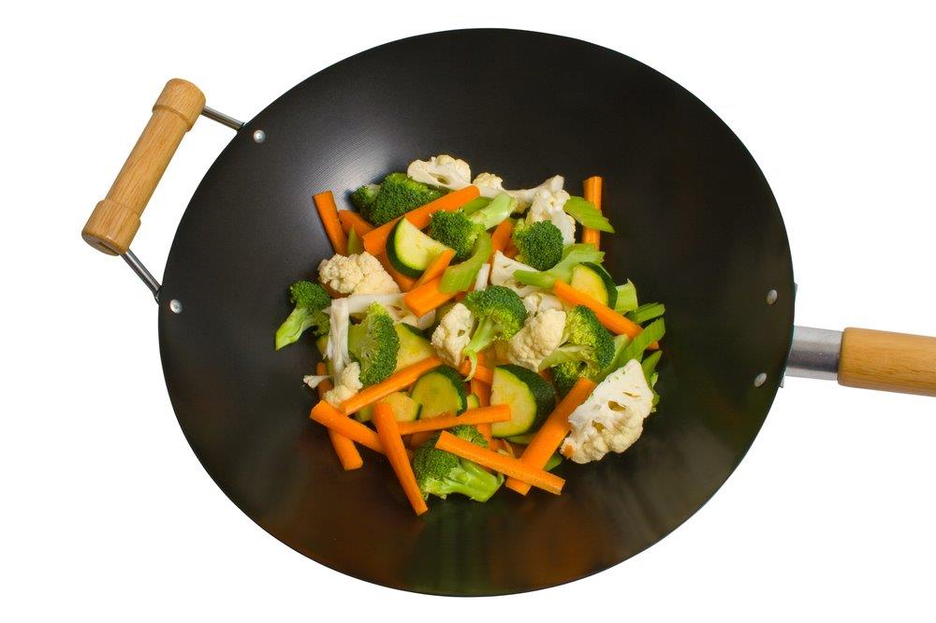
Setting the scene
This module is about trying a new cooking method and exploring new ideas for the future.
The recipes can be changed to suit your own taste quickly and easily.
Stir-fries and noodle dishes can be quick, good value, healthy and tasty – why not experiment?

Slide 4

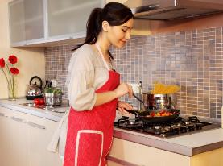
Food hygiene – getting ready to cook
Tie long hair up.
Remove jewellery and watches.
Remove jumpers and roll-up long sleeves.
Thoroughly wash and dry hands.

Slide 5
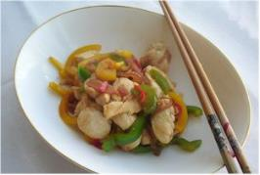
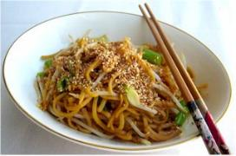
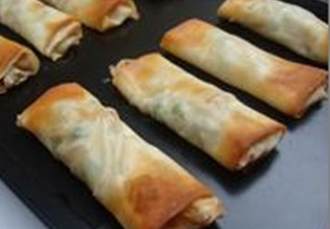
Recipes - you will make:
Chicken (or tofu) stir-fry
Noodles
Simple spring rolls

Slide 6
Food skills and techniques
You will:
peel, chop and slice;
use a blender;
use the hob, e.g. stir-fry and boil;
glaze;
grate;
portion, divide and fold.
Why not download and insert a BNF cooking skill video here?

Slide 7
Shopping list
For 2 people
For 10 people
Chicken (or tofu) stir-fry | Noodles | Simple spring rolls
Spray oil 1x chicken breast (or 3-4 thighs) or 100g of tofu ½ red chilli 1 clove of garlic 1cm fresh ginger ½ red onion 1/3 green pepper 1/3 yellow pepper 2-3 mushrooms 1x10ml spoon reduced salt soy sauce | Spray oil 150g dried noodles 2 spring onions 50g beansprouts 1x15ml spoon reduced salt soy sauce/fish sauce ½ 5ml spoon sesame seeds (optional) | 1x small carrot 2 x spring onions 40g beansprouts 25g frozen peas 1 x 15ml spoon oyster sauce 4 filo pastry sheets Oil
Chicken (or tofu) stir-fry | Noodles | Simple spring rolls
Spray oil 5x chicken breast (or 15-20 thighs) or 500g of tofu 3 red chilli’s 5 cloves of garlic 5cm fresh ginger 3 red onion 2 green pepper 2 yellow pepper 15 mushrooms 5x10ml spoon reduced salt soy sauce | Spray oil 750g dried noodles 10 spring onions 250g beansprouts 5x15ml spoon reduced salt soy sauce/fish sauce Sesame seeds (optional) | 5x small carrot 10x spring onions 200g beansprouts 125g frozen peas 5 x 15ml spoon oyster sauce 20 filo pastry sheets Oil

Slide 8
Plan of action
Review recipes to be cooked.
Make the spring rolls.
Prepare the stir-fry and noodle ingredients.
Make the stir-fry and noodles dishes, and serve.
Ensure that you collect your equipment before you start to cook.
Weigh and measure your ingredients accurately.
Keep your work surfaces clean and tidy – wash up as you go.

Slide 9
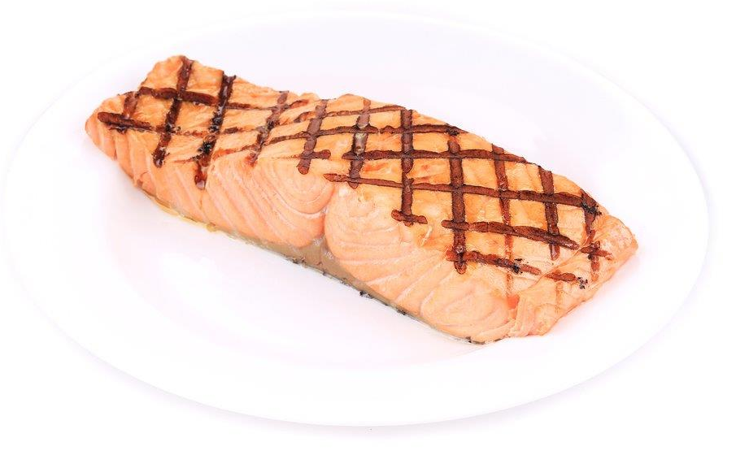
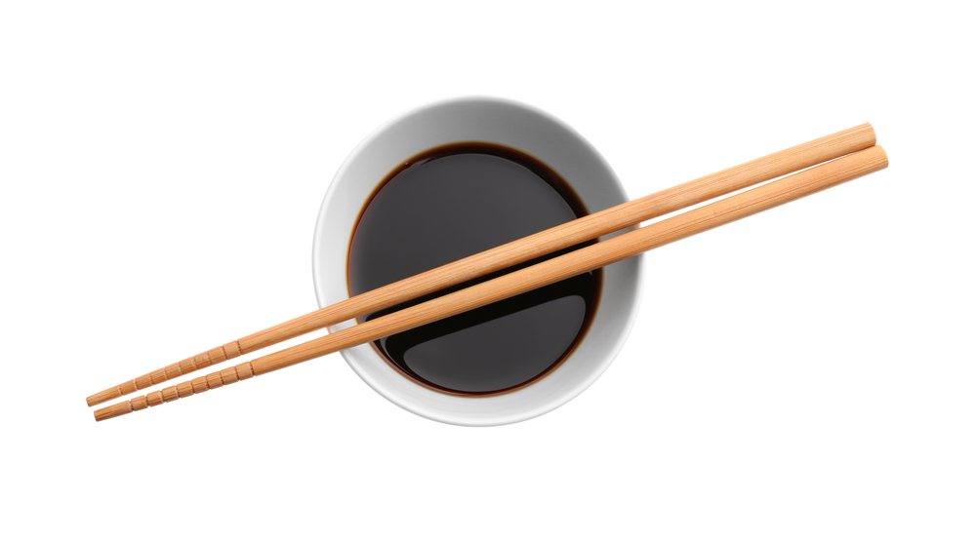
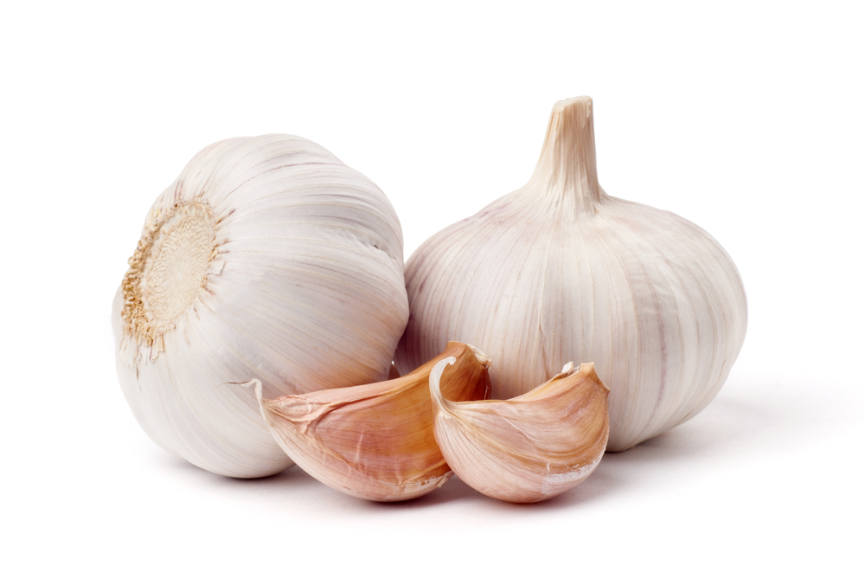
Healthy eating
Remove the skin from chicken to lower the saturated fat provided.
Soy sauce is high in salt, so use reduced salt soy sauce and only in small amounts. Replace soy sauce with other flavours with a lower salt content such as chilli, garlic and ginger.
Choose semi-skimmed milk and low fat yogurt.
Try replacing chicken with cooked salmon or mackerel to increase oily fish intake.
Add more vegetables to the spring rolls such as peas, peppers or finely diced celery.

Slide 10
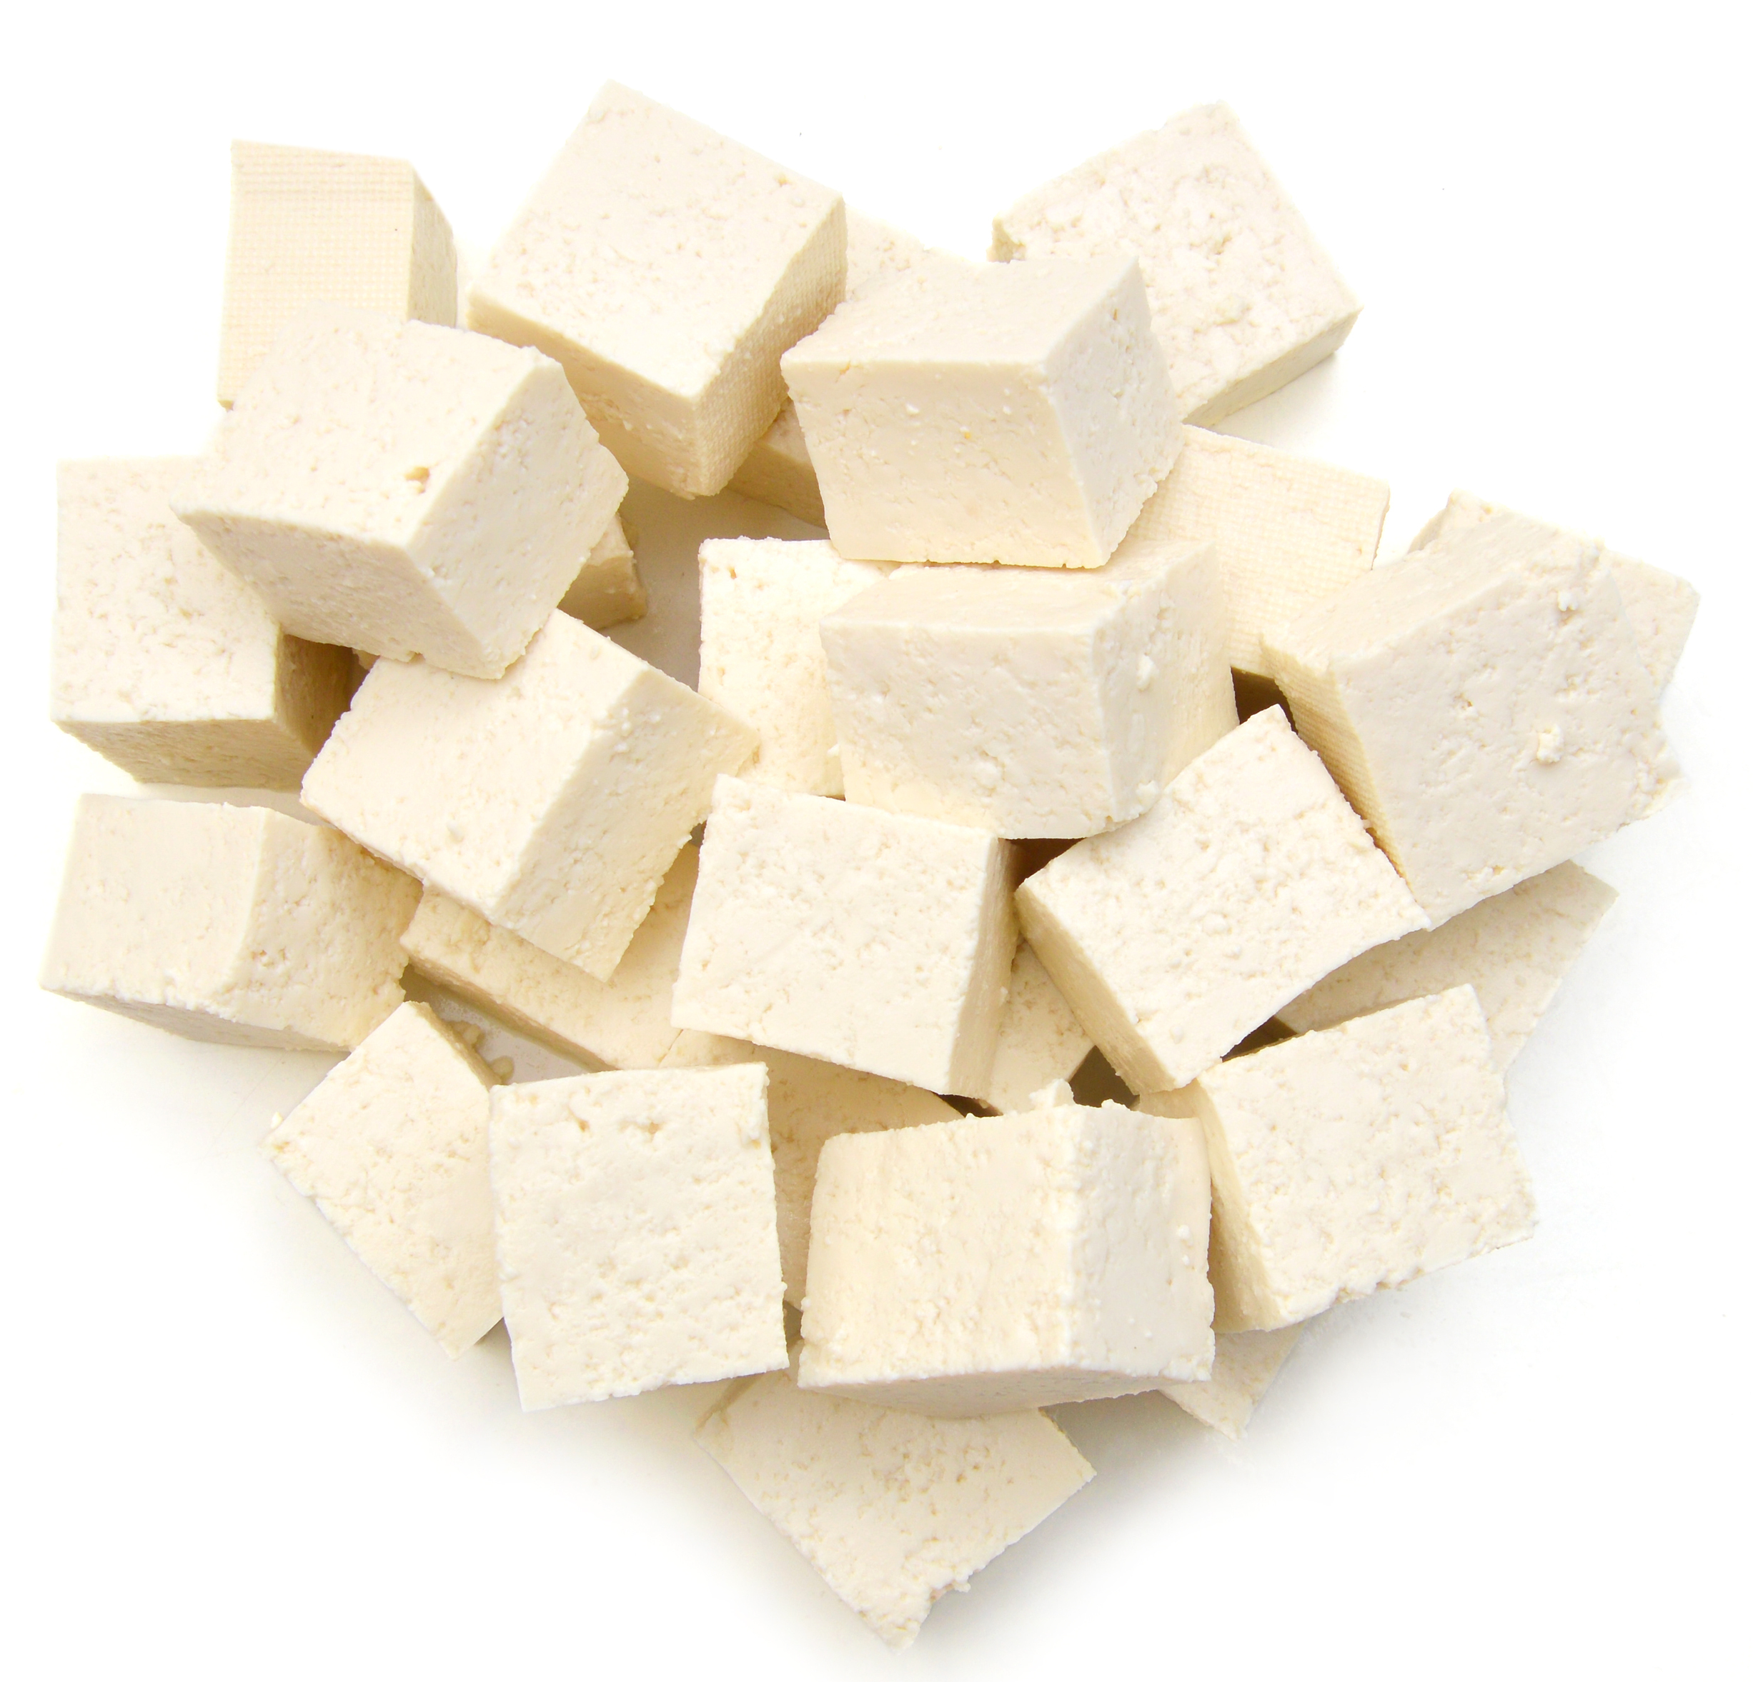
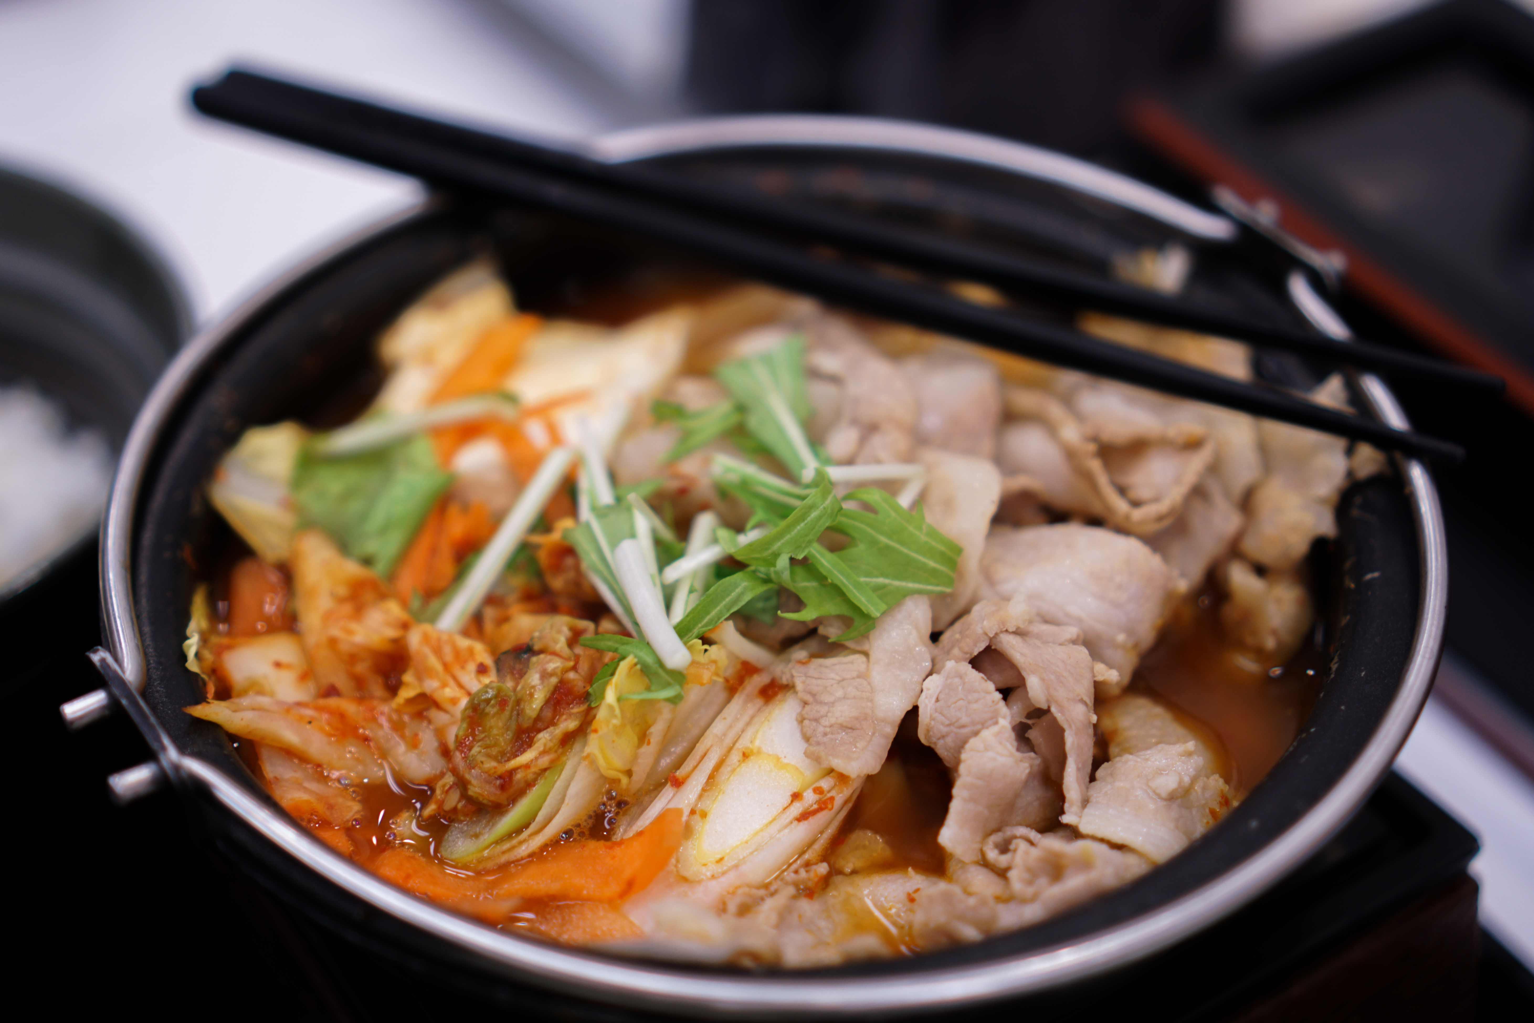
Budgeting
Chicken thighs, or left-overs from a roast chicken, work well in a stir-fry.
Tofu or other meat alternatives may be less expensive than chicken.
Add cooked wholewheat noodles or brown rice to a stir-fry for a main meal.
Dried noodles have a long shelf life if stored correctly.
Use a variety of vegetables in a stir-fry, e.g. beansprouts, broccoli, carrots. These can be fresh, frozen, or canned.
Frozen vegetables tend to be cheaper than fresh, and can help to cut down on food waste.

Slide 11
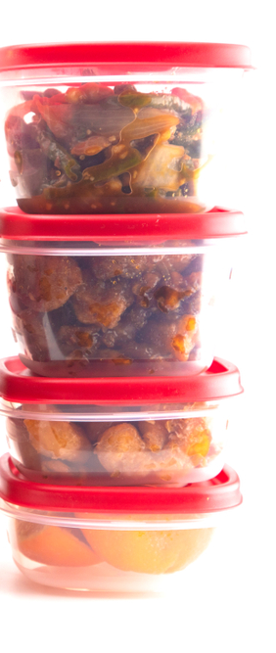
Food safety and hygiene
Wash and dry hands thoroughly before and during cooking.
Keep raw and cooked meat separate. Wash and dry hands thoroughly after touching raw meat.
Wash fresh vegetables and fruit before use to remove any dirt and bacteria.
Chop on a clean chopping board. Use a separate board for raw meat, ideally a red one.
Be careful when using a wok or draining boiling water from a pan.
Check meat is cooked throughout. Juices should run clear and their should be no pink.
If you keep left-overs, store safely in a fridge within two hours. Re-heat only once.

Slide 12
Cooking for the future
Chicken (or tofu) stir-fry
Try using different vegetables, e.g. green beans, courgettes and carrots.
Use other types of meat or fish, e.g. thin strips of beef or prawns.
Add different types of wholewheat noodles or brown rice.
Make your own stir-fry sauce.

Slide 13
Cooking for the future
Noodles
Add extra vegetables to create a noodle main meal, e.g. frozen peas, canned sweetcorn, sliced mushrooms, chopped red pepper.
Simple spring rolls
Try adding some chicken on tofu to the spring rolls.
Try making your own sauce to have with the spring rolls.

Slide 14
Noodle time
For further information, go to:
www.foodafactoflife.org.uk

