Slide 1
Mama Mia!

Slide 2
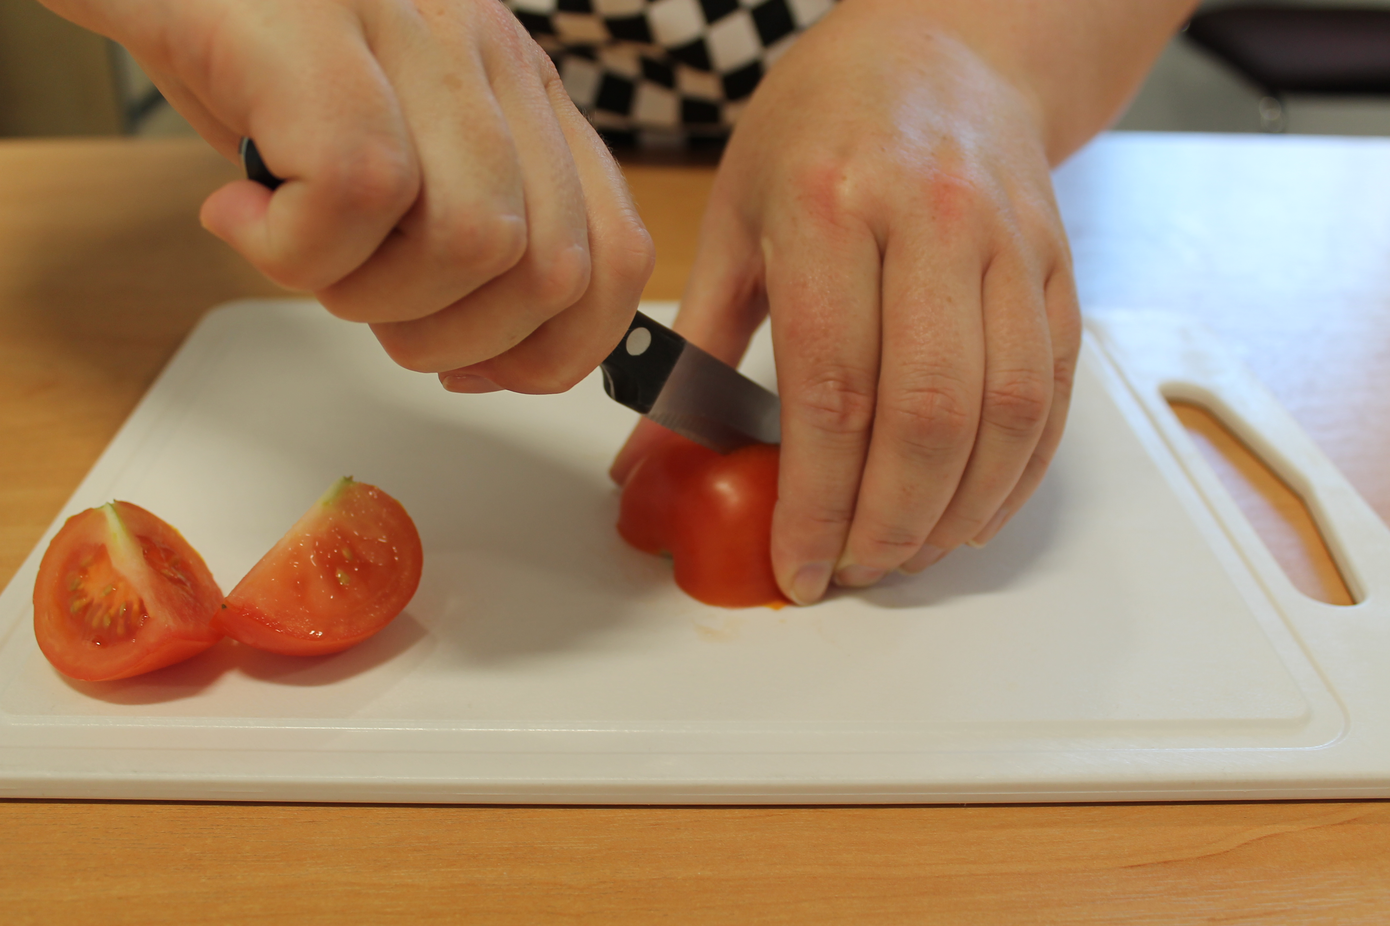
Aims and objectives
Aim
To develop knife and recipe adaptation skills.
Objectives:
work in pairs;
make a basic tomato sauce;
use kitchen equipment safely;
make three tasty recipes.

Slide 3
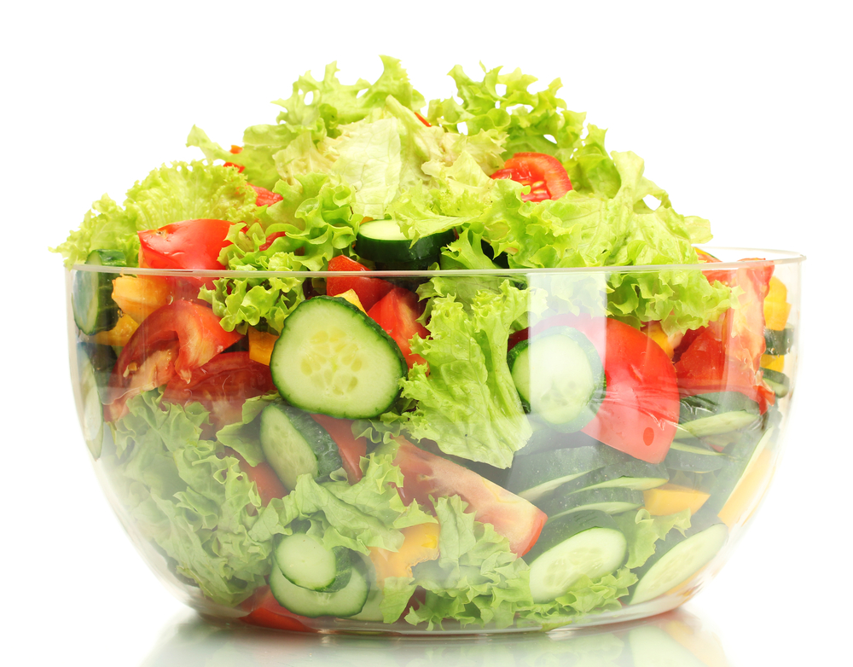
Setting the scene
This module is about preparing simple dishes that can be adapted for a variety of occasions.
The recipes are quick to prepare, and could be a dinner for friends.
Tasty food, made at home, not a jar or packet in sight!

Slide 4

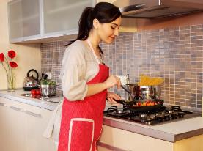
Food hygiene – getting ready to cook
Tie long hair up.
Remove jewellery and watches.
Remove jumpers and roll-up long sleeves.
Thoroughly wash and dry hands.

Slide 5
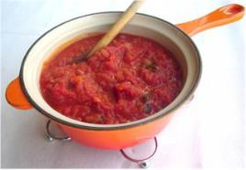
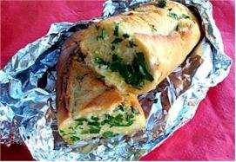
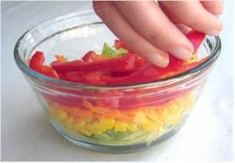
Recipes - you will make:
Basic tomato sauce
Garlic bread
Layered salad

Slide 6
Food skills and techniques
You will:
chop and slice;
grate
layer
drain;
spread;
use a garlic press;
use the hob and oven.
Why not download and insert a BNF cooking skill video here?

Slide 7
Shopping list
For 2 people
For 10 people
Basic tomato sauce | Garlic bread | Layered salad
Spray oil 1 onion 1 clove of garlic 2 large cans tomatoes Handful of fresh basil or 1x15ml spoon dried herbs Black pepper 150g dried wholewheat pasta | 1 small wholemeal baguette 50g reduced fat spread 2 cloves of garlic 15ml spoon chopped parsley | ½ lettuce 1 carrot 1 small can of sweetcorn 1 red pepper
Basic tomato sauce | Garlic bread | Layered salad
Spray oil 5 onions 5 cloves of garlic 10 large cans tomatoes Fresh basil or 5x15ml spoon dried herbs Black pepper 750g dried wholewheat pasta | 2-3 large wholemeal baguettes 250g reduced fat spread 10 cloves of garlic Fresh parsley | 3 lettuce 5 carrots 5 small cans of sweetcorn (or 2-3 large cans) 5 red peppers

Slide 8
Plan of action
Review recipes to be cooked.
Prepare the sauce – allow to simmer.
Prepare the salad – store in the fridge.
Boil the pasta.
Make the garlic bread – bake in foil, and serve.
Ensure that you collect your equipment before you start to cook.
Weigh and measure your ingredients accurately.
Keep your work surfaces clean and tidy – wash up as you go.

Slide 9
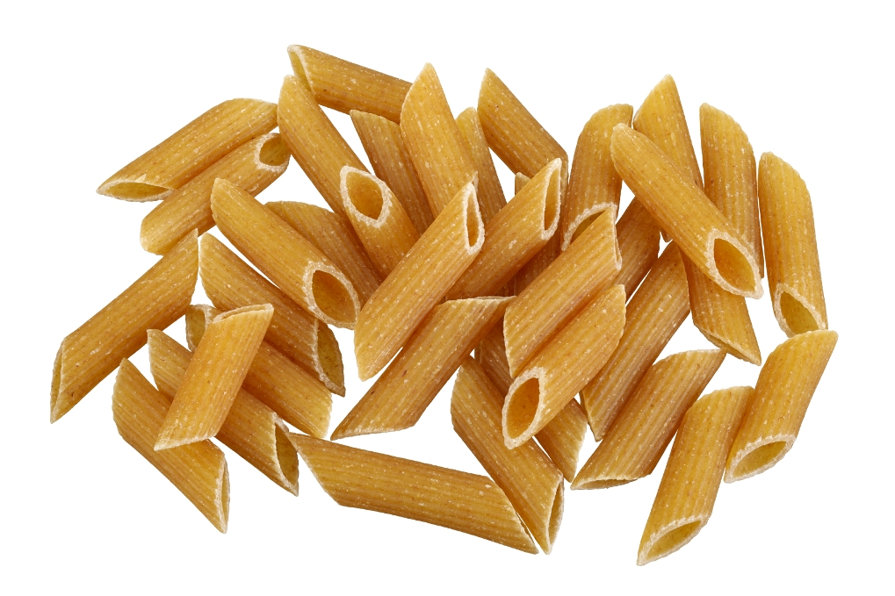
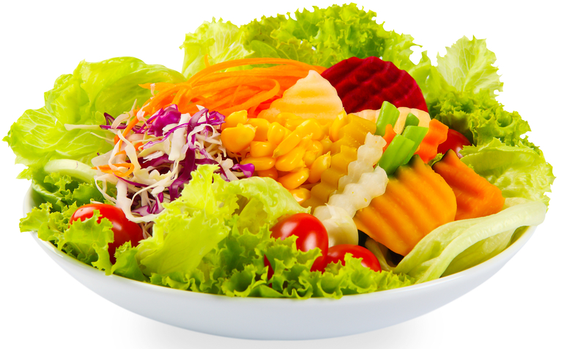
Healthy eating
Use a spread (such as olive or sunflower) for the garlic bread as it is lower in saturated fat than butter and we should be trying to replace food high in saturated fat with food higher in unsaturated fat in the diet.
Choosing wholemeal baguettes will increase the amount of fibre in the meal.
Include a variety of fruit and vegetables in your diet every day – at least 5 portions a day. You could try adding a variety of extra vegetables to your layered salad.
Choose wholewheat pasta instead of white pasta to increase the fibre content of the meal.

Slide 10
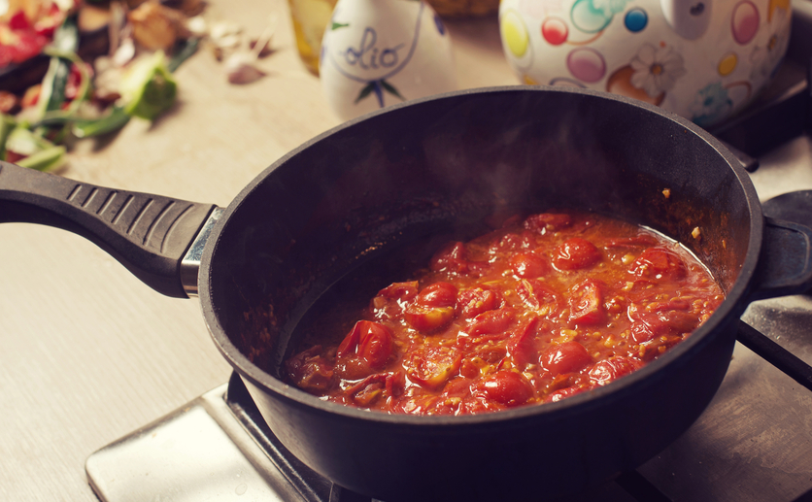
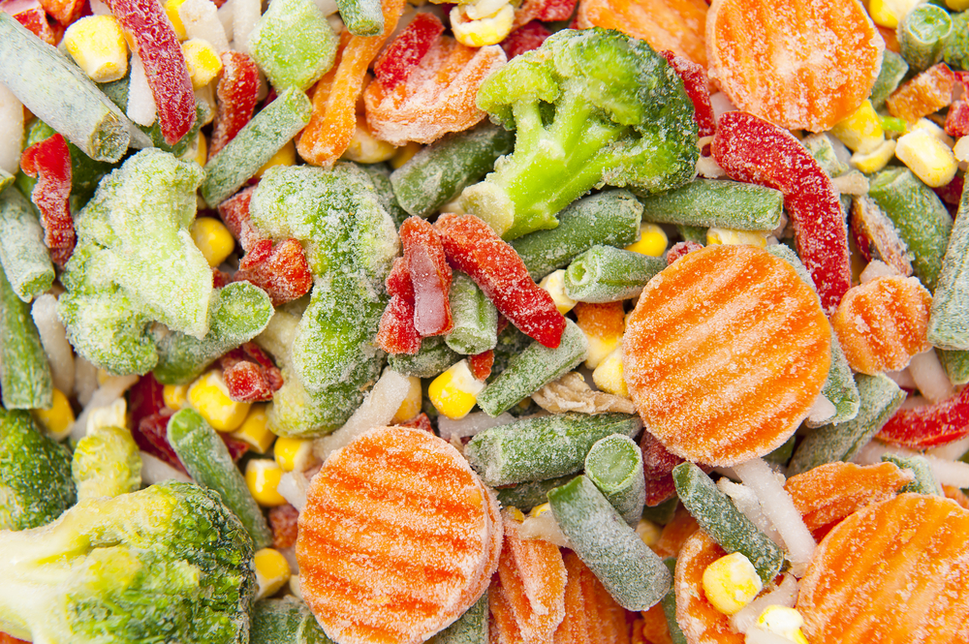
Budgeting
Use own-brand canned tomatoes as these are likely to be cheaper than branded.
Dried pasta has a long shelf life (if stored correctly) so can be bought in bulk to save money.
Bread can be kept in the freezer – use as needed.
Make double the quantity of the tomato sauce and keep half of it in the freezer for a quick meal another time.
Frozen vegetables tend to be cheaper than fresh, and can help to cut down on food waste.

Slide 11
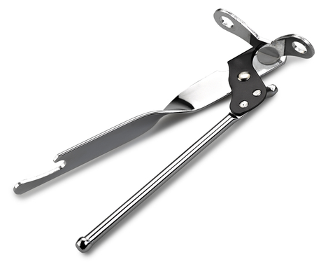
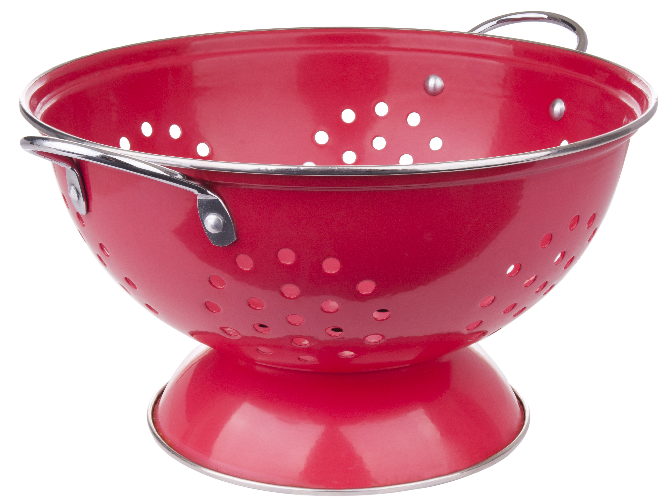
Food safety and hygiene
Wash and dry hands thoroughly before and after cooking.
Chop on a chopping board.
Be careful opening cans – avoid the sharp edges.
Ensure that pan handles do not stick out over the edge of the hob.
Take extra care when draining the pasta over the sink.
Store the salad in the fridge until needed.
If freezing left-over tomato sauce, chill, place in suitable containers and label (keep for up to 1 month).

Slide 12
Cooking for the future
Basic tomato sauce
Add ½ red chilli, for a spicy tomato sauce.
Blend cooked celery, carrots, leeks and peppers into the sauce.
Add minced beef and cook until brown after stage 2 for a simple meat sauce.
Stir-in black olives and canned tuna.
Add chilli powder and red kidney beans – a quick chill!
Pour the basic sauce over white fish, sprinkle with reduced fat cheese and bake for 20 minutes until golden.

Slide 13
Cooking for the future
Layered salad
Use a variety of different fruit and vegetables, such as red cabbage, apple, onion, or beetroot.
Add a layer of boiled egg, canned tuna or grated cheese and brown rice or wholewheat pasta to make a main meal.
Garlic bread
Try using a flatbread rather than a ciabatta to make the garlic bread.

Slide 14
Mama Mia!
For further information, go to:
www.foodafactoflife.org.uk

