Slide 1
Take out? Cook in!

Slide 2
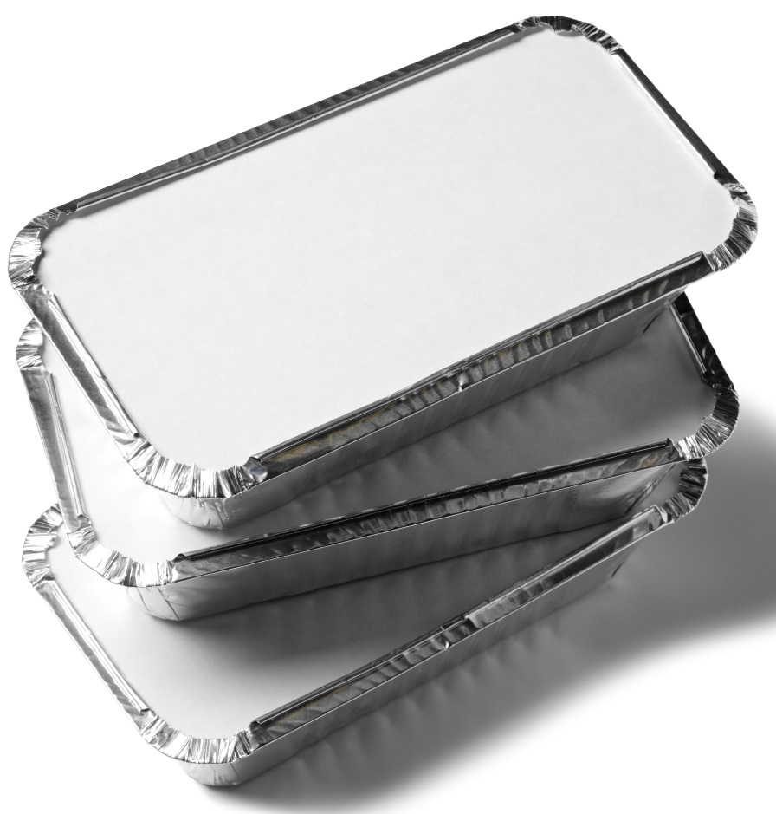
Aims and objectives
Aim
To make foods at home which you might buy from a take-away.
Objectives:
work in pairs;
prepare chicken safely and hygienically;
use kitchen equipment safely;
make three tasty recipes for a treat.

Slide 3
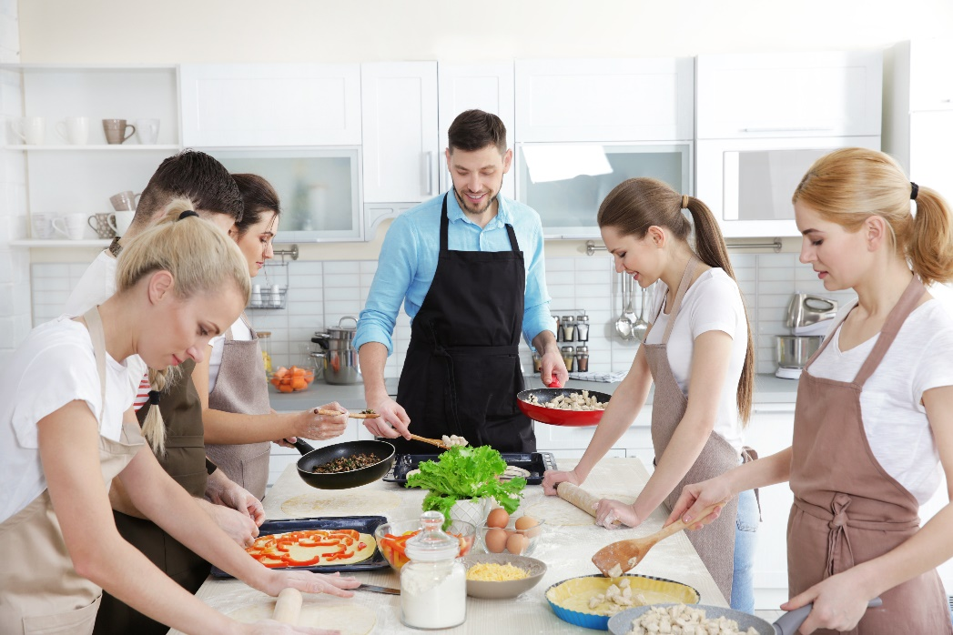
Setting the scene
This module is about cooking tasty food which you might buy from a take-away.
The recipes are quick, simple and fun – they are also good value.
Easy to make with friends as a quick snack or meal.

Slide 4

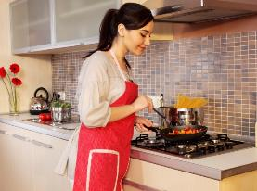
Food hygiene – getting ready to cook
Tie long hair up.
Remove jewellery and watches.
Remove jumpers and roll-up long sleeves.
Thoroughly wash and dry hands.

Slide 5
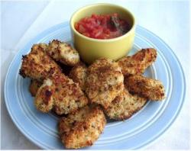
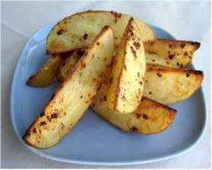
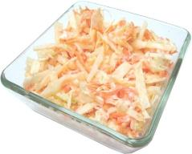
Recipes - you will make:
Parmesan chicken nuggets
Potato wedges
Coleslaw

Slide 6
Food skills and techniques
You will:
chop and slice;
grate;
coat;
use the oven, e.g. bake.
Why not download and insert a BNF cooking skill video here?

Slide 7
Shopping list
For 2 people
For 10 people
Parmesan chicken nuggets | Potato wedges | Coleslaw
50g breadcrumbs 1x5ml spoon mixed herbs 1x15ml spoon grated parmesan 2 chicken breasts or 200g thighs (or myco-protein pieces) 1x15ml spoon plain flour 1 egg | Spray oil 3 large potatoes Chilli flakes Black pepper | ¼ white cabbage 1 medium apple 1 carrot 2x15ml low fat mayonnaise
Parmesan chicken nuggets | Potato wedges | Coleslaw
250g breadcrumbs 5x5ml spoon mixed herbs 5x15ml spoon grated parmesan 10 chicken breasts or 1kg thighs (or myco-protein pieces) 5x15ml spoon plain flour 5 eggs | Spray oil 15 large potatoes Chilli flakes Black pepper | 1¼ white cabbage 5 medium apples 5 carrots 10x15ml low fat mayonnaise

Slide 8
Plan of action
Review recipes to be cooked.
Prepare the wedges – bake in the oven.
Prepare the nuggets – bake in the oven.
Make the coleslaw – cover and place in the fridge.
Serve.
Ensure that you collect your equipment before you start to cook.
Weigh and measure your ingredients accurately.
Keep your work surfaces clean and tidy – wash up as you go.

Slide 9
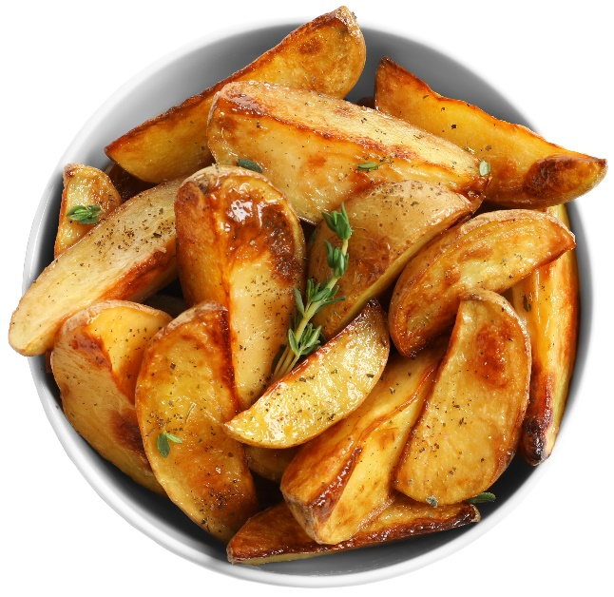
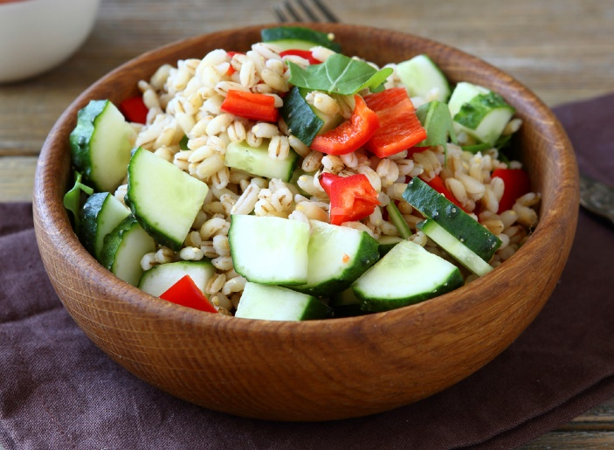
Healthy eating
As these nuggets are oven baked instead of fried, less fat is used during cooking.
Leave the skins on the potato wedges to increase the amount of fibre.
Use half of the quantity of mayonnaise and add low fat plain yogurt to make the coleslaw dressing.
Remove the parmesan cheese to reduce the saturated fat and energy in the meal. Add black pepper, garlic, chilli and/or ginger.
Add a side-salad or cooked vegetables, to increase your 5 A DAY.

Slide 10
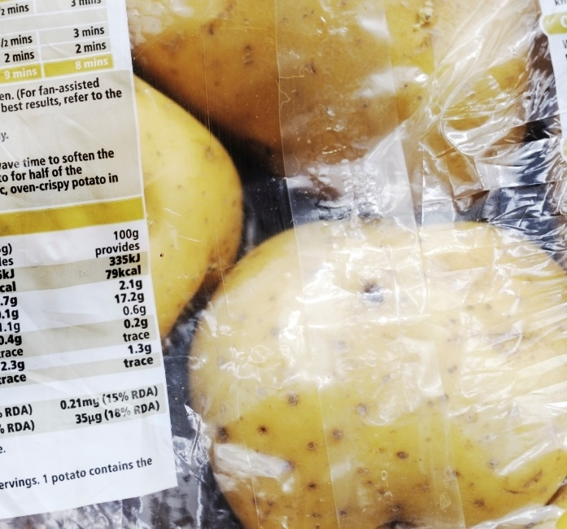
Budgeting
Cooking from scratch is usually a lot cheaper than eating out. Takeaways can be expensive, so making your own can help save money.
Use chicken thighs or try cheaper cuts of fish for the nuggets. Meat alternatives, such as mycoprotein or tofu, or vegetables, such as avocado, may also be cheaper.
Providing they are stored correctly, potatoes can have a long shelf life and so can be bought in bulk.
Make your own breadcrumbs from leftover wholegrain bread and freeze until needed.
Try making the nuggets without the parmesan cheese or try to find cheaper alternatives such as garlic, chilli, fresh herbs or spices.

Slide 11
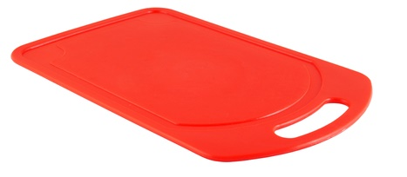
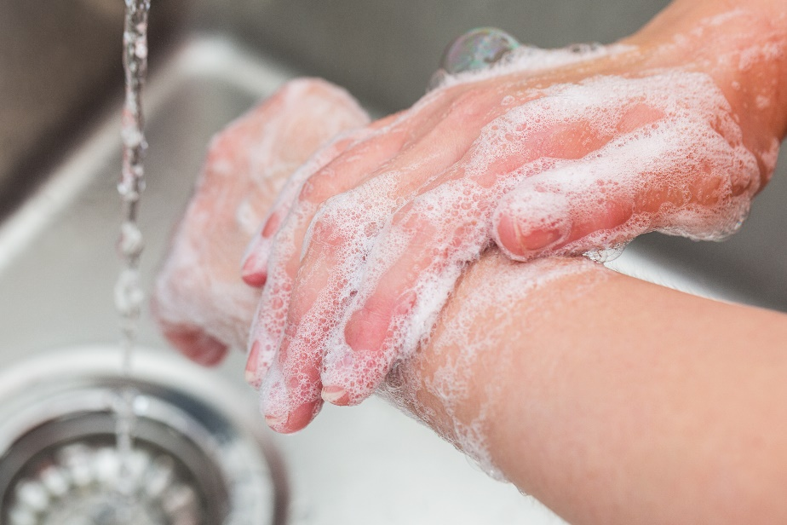
Food safety and hygiene
Wash and dry hands thoroughly before and during cooking.
Keep raw meat separate from cooked meat.
Ensure that the chicken is cooked completely (no pink).
Use a separate chopping board for raw meat, ideally a red one.
Use oven gloves to remove the tray from the oven.
Use lion mark eggs.

Slide 12
Cooking for the future
Parmesan chicken nuggets
Replace the parmesan with garlic, chilli, fresh herbs or spices.
Change the chicken to pieces of fish, such as cod or salmon, or vegetables such as avocado.
Use mycoprotein for veggie nuggets.
Make your own breadcrumbs – either whiz bread in a blender or use a grater. Try different types of bread for variety.

Slide 13
Cooking for the future
Potato wedges
Use different seasonings, e.g. garlic, Italian herbs, spices like paprika.
Use sweet potatoes for a twist.
Homemade coleslaw
Try substituting half of the quantity of mayonnaise with low fat plain yogurt for the coleslaw dressing.
Experiment by adding mustard, spring onion or lemon juice.
Try adding other vegetables such as shredded spinach or celery.

Slide 14
Take out? Cook in!
For further information, go to:
www.foodafactoflife.org.uk

