Slide 1
Back to basics

Slide 2
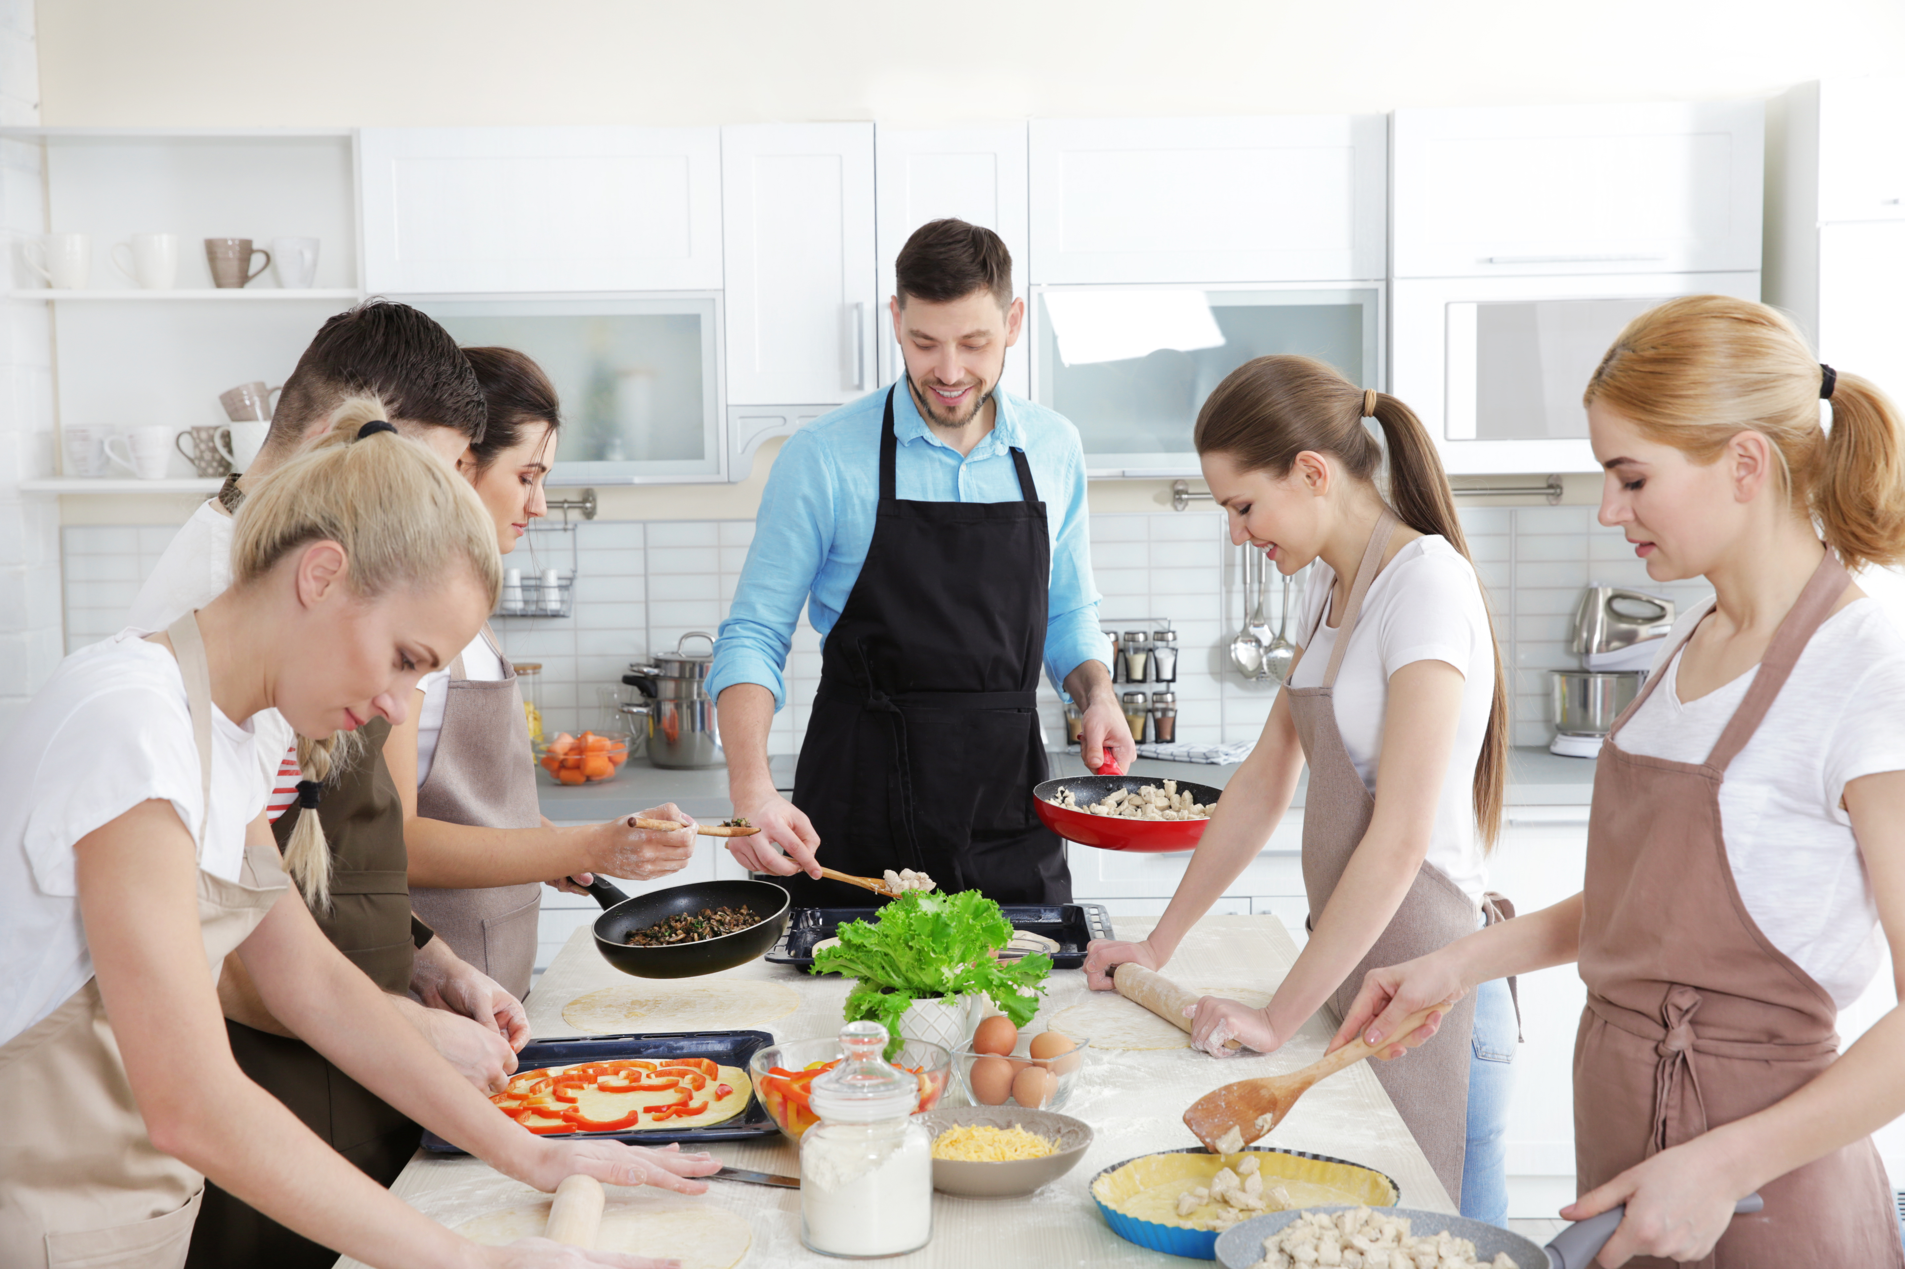
Aims and objectives
Aim
To make three basic recipes to develop baking and knife skills.
Objectives:
work in pairs;
make shortcrust pastry;
use kitchen equipment safely;
make three tasty recipes for a healthy, balanced meal.

Slide 3
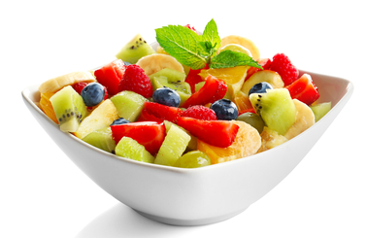
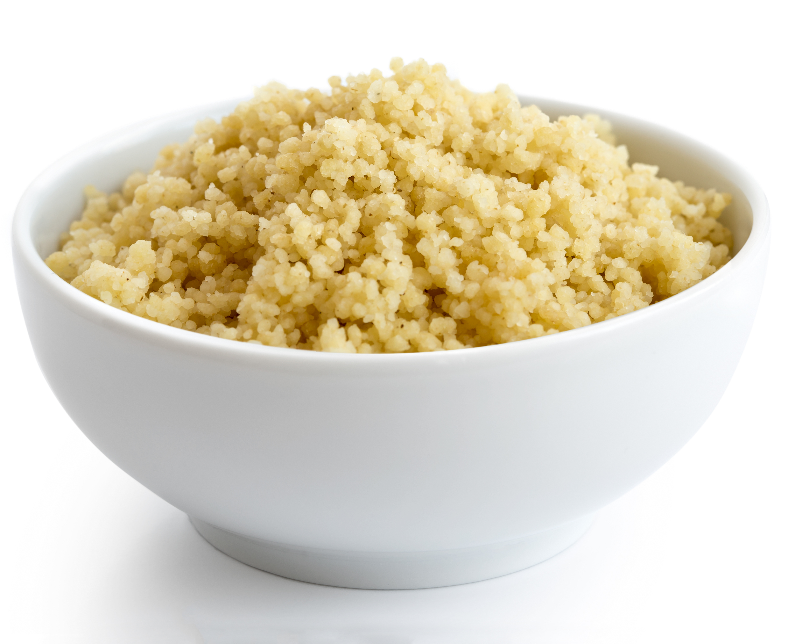
Setting the scene
This module is about making basic recipes which can be adapted in the future.
Couscous is cheap, easy to prepare and a good alternative to rice or pasta.
These are basic dishes that can be prepared in advance and can be adapted easily to suit your mood and taste.

Slide 4

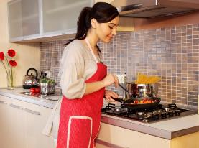
Food hygiene – getting ready to cook
Tie long hair up.
Remove jewellery and watches.
Remove jumpers and roll-up long sleeves.
Thoroughly wash and dry hands.

Slide 5
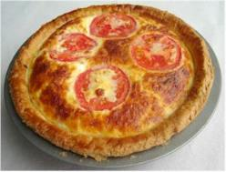
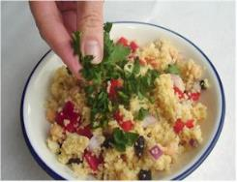
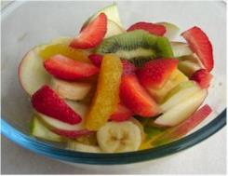
Recipes - you will make:
Quiche
Vegetable couscous
Fruit salad

Slide 6
Food skills and techniques
You will:
peel, chop and slice;
stir, mix and combine;
roll-out;
line a flan tin;
use the the oven;
use a kettle.
Why not download and insert a BNF cooking skill video here?

Slide 7
Shopping list
For 2 people
For 10 people
Quiche | Vegetable couscous | Fruit salad
100g plain flour 50g hard baking vegetable fat 2 large eggs 125ml semi-skimmed milk 50g reduced fat cheddar cheese 1 tomato 2 rashers of bacon (or 3 mushrooms and spray oil) | 1 reduced salt stock cube 200g couscous 1 red onion 1 red pepper 50g almond flakes 50g raisins 100g can chickpeas 2x15ml spoons parsley | 1 banana 1 apple 1 orange 4 strawberries 10 grapes 1 kiwi fruit
Quiche | Vegetable couscous | Fruit salad
500g plain flour 250g hard baking vegetable fat 10 large eggs 625ml semi-skimmed milk 250g reduced fat cheddar cheese 5 tomato 10 rashers of bacon (or 15 mushrooms and spray oil) | 5 reduced salt stock cube 1kg couscous 5 red onion 5 red pepper 250g almond flakes 250g raisins 500g can chickpeas 10x15ml spoons parsley | 5 bananas 5 apples 5 oranges 20 strawberries Bunch of grapes 5 kiwi fruits

Slide 8
Plan of action
Review recipes to be cooked.
Prepare the pastry – place in the fridge.
Make the fruit salad – place in the fridge.
Make the quiche – bake in the oven.
Prepare the couscous and serve.
Ensure that you collect your equipment before you start to cook.
Weigh and measure your ingredients accurately.
Keep your work surfaces clean and tidy – wash up as you go.

Slide 9
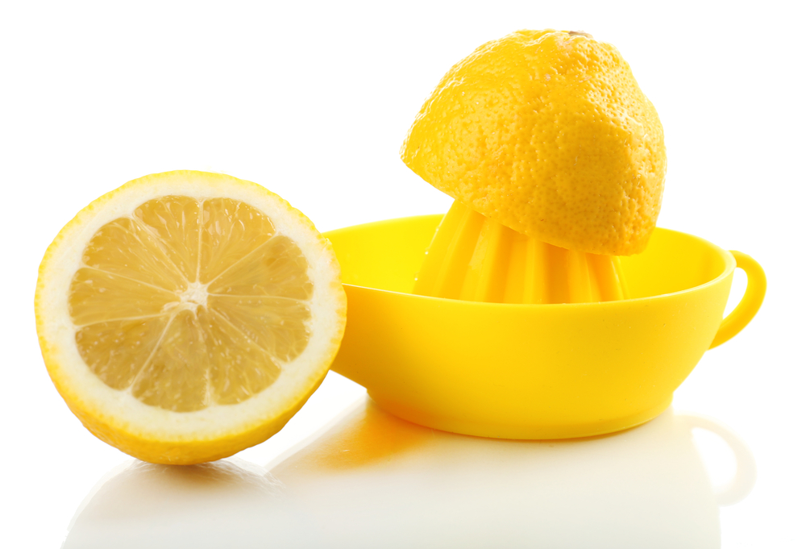
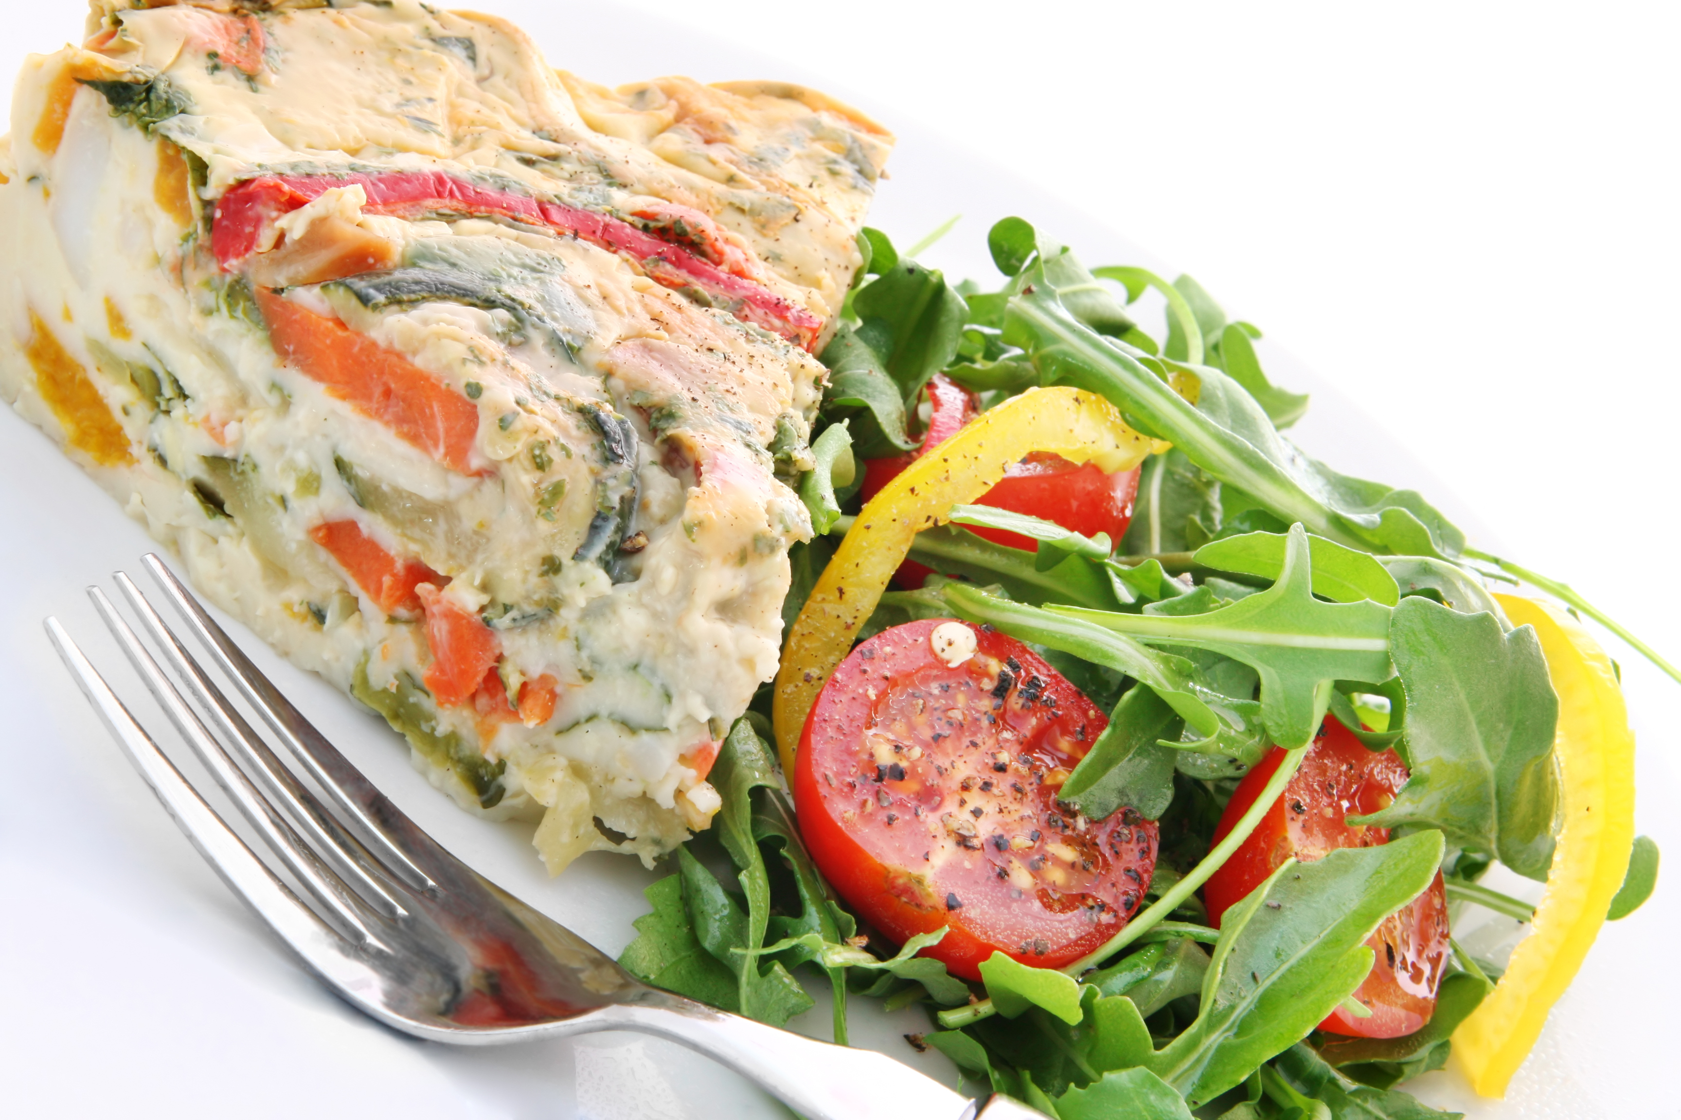
Healthy eating
Choose reduced salt bacon and reduced fat cheese in the quiche and, if using bacon, remove any visible fat.
Use reduced salt stock cubes, using half a cube, or add more herbs or lemon juice for flavour to the cous cous.
Make a crustless quiche! The filling is simply a frittata – pour the egg mixture (and other ingredients) into a greased dish.
Add lemon juice to the fruit salad to stop the fruit turning brown through enzymatic browning.
If using canned fruit opt for those canned in 100% juice rather than syrup and add extra fruit to the fruit salad and veg or salad to the quiche.
Use canned salmon or mackerel in the quiche to increase oily fish intake.

Slide 10
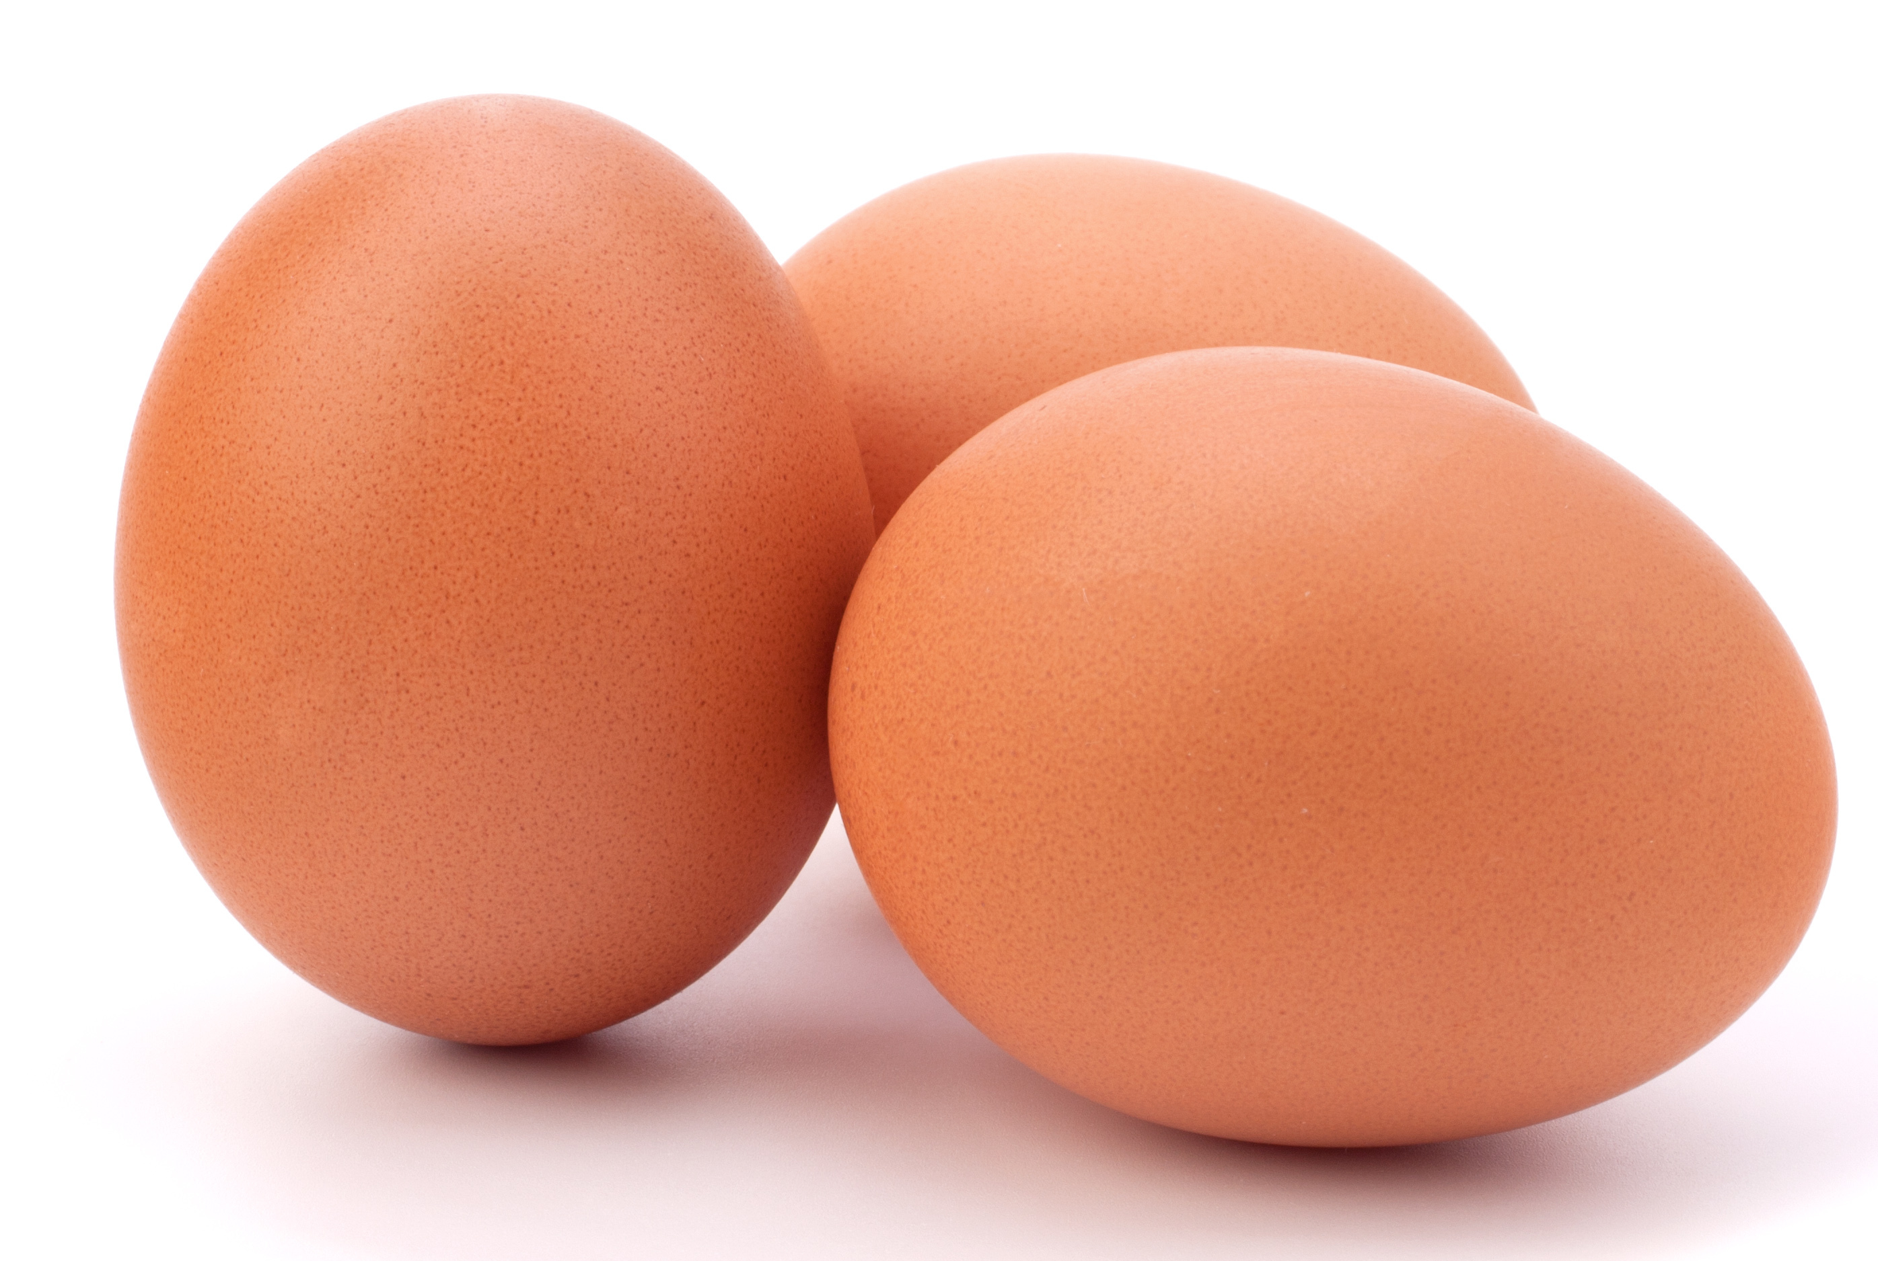
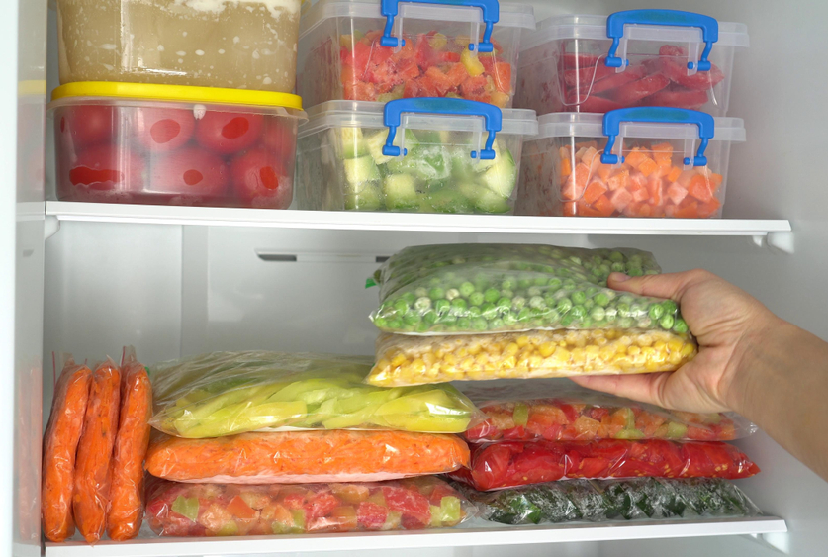
Budgeting
Eggs are relatively cheap and a source of protein.
Couscous has a long shelf life if stored correctly so can be bought in bulk.
Double the recipe and make two quiches – keep one in the freezer for next time.
Use a stronger tasting cheese e.g. mature cheddar or stilton, as this means you can use less each time.
Add canned fruit (in natural juice) to your fruit salad.
Fresh fruit and vegetables can be cheaper from a local market rather than a supermarket. Frozen vegetables also tend to be cheaper than fresh, and can help to cut down on food waste.

Slide 11
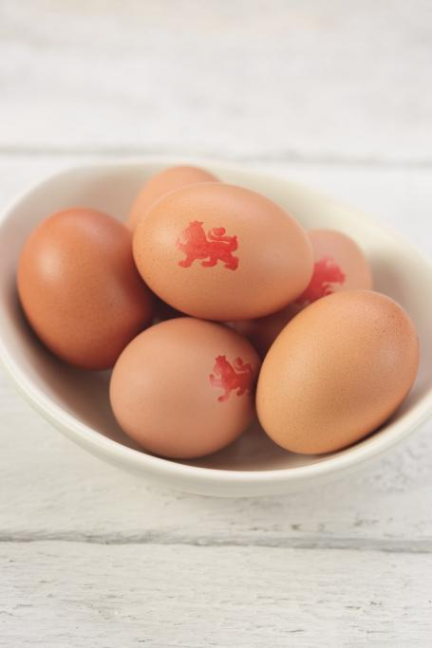
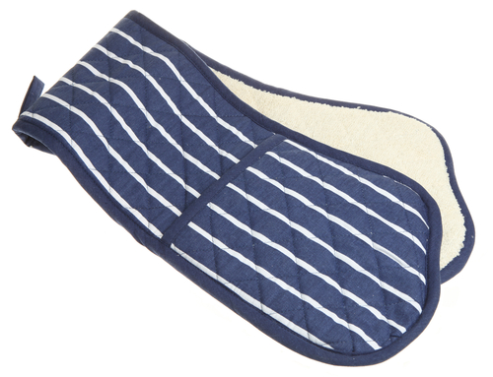
Food safety and hygiene
Wash and dry hands thoroughly before and during cooking.
Keep eggs in the fridge.
Use oven gloves to remove the quiche from the oven.
Use a chopping board.
Wash fresh fruit and vegetables before use to remove any dirt and bacteria.
Use lion mark eggs.
If you keep left-overs, store safely in a fridge within two hours.

Slide 12
Cooking for the future
Quiche
Try adding canned salmon or tuna instead of bacon.
Change the cheddar for other types of cheese – you could try goats cheese, parmesan or ricotta.
Vegetable couscous
Vary the vegetables in the couscous dish, e.g. pomegranate seeds, avocado, grated carrot, celery, spring onion, or olives.
Replace the chickpeas with other pulses such as cannellini beans or kidney beans, or chopped chicken or ham.

Slide 13
Cooking for the future
Fruit salad
Use fresh fruit in season, e.g. strawberries in summer or apples in autumn.
Mix in some canned fruit (in 100% juice), such as pineapple or peaches.
There are no restrictions on the types of fruit you could include in this dish.
Serve with low-fat plain yogurt for breakfast or dessert.

Slide 14
Back to basics
For further information, go to:
www.foodafactoflife.org.uk

