Slide 1

The functional properties of carbohydrates
16 January 2020

Slide 2
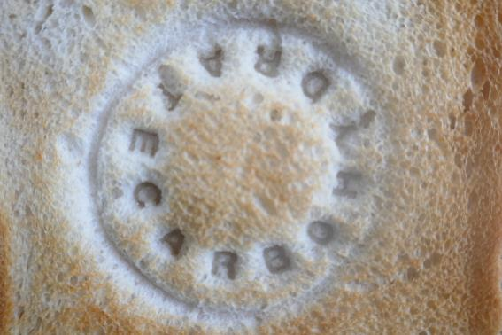
The functional properties of carbohydrates
Barbara Monks B.Ed., M.Ed.

Slide 3
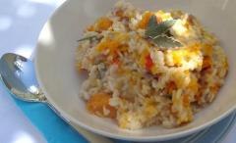
What will be covered?
Why is it important to know about the functions of ingredients?
The functional properties of carbohydrates
Teaching food science through practical activities, focusing on carbohydrates
How to build knowledge and incorporate more functions in practical work
Suggestions for further reading and sources of information
Links to Food – a fact of life resources.
roasted-butternut-squash-risotto

Slide 4
Carbohydrate – an essential in the diet
Carbohydrates are the best way to provide fuel for the body being easy to purchase, readily available all year round It is important to think about types and quality of carbohydrates:
Sugars – mono and di saccharides supply energy but little else and have detrimental effect on teeth.
Starches – composed of amylose an amylopectin provide energy and many micronutrients. Furthermore where less refined wholegrain starches are selected there is enormous benefit to be had from the dietary fibre that they contain
If dietary choices are to be made for healthy active people then starchy carbohydrate in all its forms is a good choice.
Notes:
Carbohydrate

Slide 5
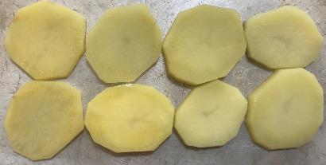
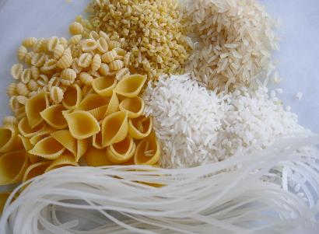
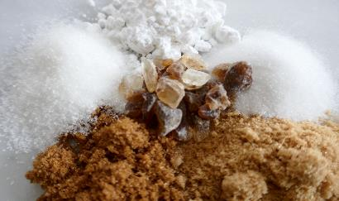
Carbohydrates supply energy
Energy balance can be maintained by:
regulating energy intake through the diet;
adjusting physical activity levels;
a combination of both.
Take a look at the excellent presentation from www.foodafactoflife.org.uk
Notes:
Take a look at the excellent presentation from www.foodafactoflife.org.uk

Slide 6
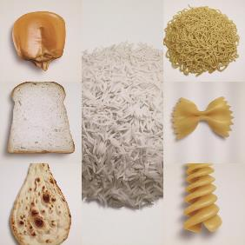
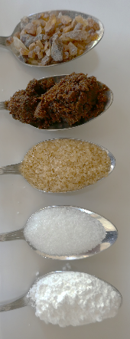
Carbohydrates
Starches
Polysaccharides
Amylose and amylopectin
NSP Dietary fibres
Flour – wheat / corn
Potatoes
Rice
Pasta
Bread
Sugars
Monosaccharides
Disaccharides
Sucrose sugar ingredients:
granulated,
caster, icing,
brown sugars
syrup & treacle
×

Slide 7
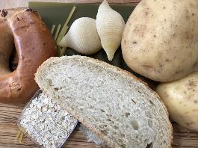
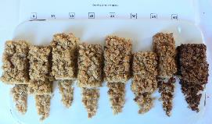
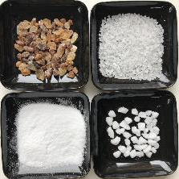
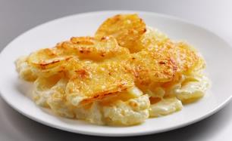
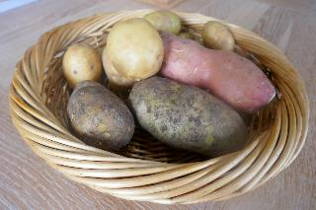
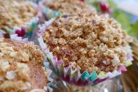
Functions of carbohydrates
Starches
Sugars
Dauphinoise potatoes
Bulk ingredient
Energy
Energy
Browning
Browning
Dextrinisation
Caramelisation
Thickening
Preservation
Gelatinisation
Fermentation
Adding nutrients
Sensory properties
Texture, Colour. Flavour
Appearance
Variety to diet
Dietary fibres – nutritional functionality
https://www.foodafactoflife.org.uk/recipes/cereals/banana-crumble-top-muffins/
https://www.foodafactoflife.org.uk/recipes/

Slide 8
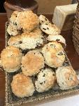
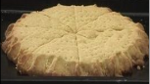
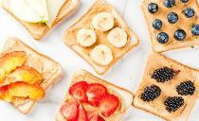
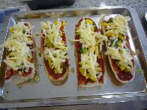
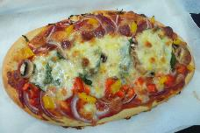
Recipe
Scrummy scones
Baking bread
Grilling toast
Oven baked croutons
Pastry browning
Food science
Examples
Dextrinisation
Recipe
Shortbread
Recipe
Tasty toast
Browning
Surface browning occurs – flavour becomes slightly sweeter
Crispness
(reduced by exposure to air)
Starch
Polysaccharide chain breaks down to shorter chains, known as dextrins due to dry heat
Carbohydrate function
Characteristics
Recipes
11-14 L2C Scone based pizza
Scone based pizza

Slide 9
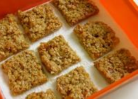
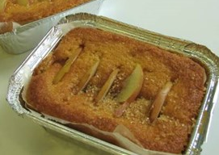
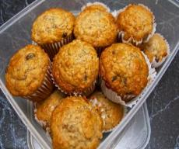
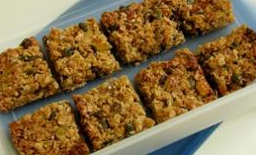

11-14-l2c/fruity-flapjacks/
Heat applied to dry
sugars on Crème brulee
Sugar syrup as in crème caramel sauce
Muffins
Croquembouche
Flapjack
Crumble topping
Parsnips roasted
Onions
Food science
Examples
Caramelisation
Recipe
Banana crumble-top muffins
11-14-l2c/dutch-apple-cake/
Browning
Non enzymic
Sugar is decomposed by high temperature and browns
In syrup the colour changes from clear to darker brown
Flavour become sweeter but then bitter as breakdown leads to carbonisation (burnt)
Used to enhance colour contrast as in puddings above
Contributes to golden hue of baked goods containing sugar
Develop flavour and colour of veg
Carbohydrate function
Characteristics
11-14-l2c/tropical-granola-bars/

Slide 10
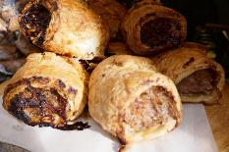
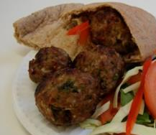
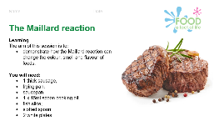
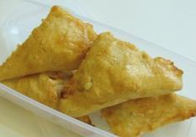
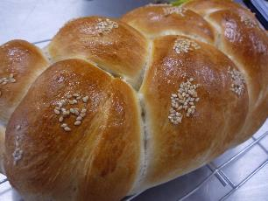
Frying a steak
Sausage rolls
Glazed pastry
Food science
Examples
Maillard reaction
Multi Year
The Maillard reaction
A worksheet looking at the Maillard reaction
Browning
Non enzymic
Enhance colour
Meaty savoury flavour
Flavour
Carbohydrate as reducing sugar reacts with proteins to bring about browning
11-14-l2c/koftas/
Carbohydrate function
Characteristics
11-14-l2c/cheese-and-onion-triangles/

Slide 11
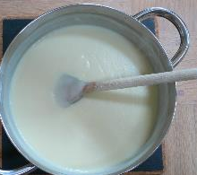
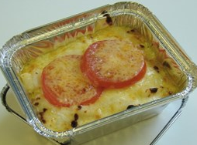
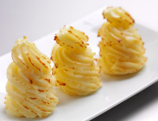

Roux sauce
Milk based sauces
Roux
Bechamel
Soups
Blended sauces:
Custard made with powder
Parsley sauce
Food science
Examples
Gelatinisation
Thickening
14 – 16 Cooking potatoes fact sheet
A fact sheet looking at cooking potatoes
Starches gelatinise when heated in liquids
Uncooked starch is insoluble in water – it is a suspension
Heating and agitation causes amylose in particular to absorb water and thicken the liquid
Liquids become thickened
Viscosity is increased and flow reduced
Manipulation of the thickness enables a sauce to be used for pouring, coating or binding function
Gelation occurs when a gelatinised mix cools
Smooth, lump free
texture
11-14-l2c/macaroni-cheese/
11 – 14 Potato varieties fact sheet
A fact sheet about potato varieties
Carbohydrate function
Characteristics

Slide 12
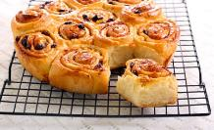
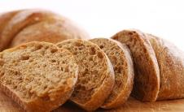
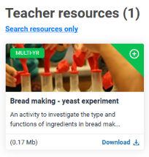
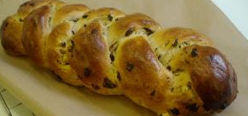
Recipe
Chelsea buns
Food science
Bread rolls
Loaves
Danish pastries
Examples
Teacher resources (1)
Search resources only
multi-yr
Bread making - yeast experiment
Fermentation
Recipe
Brilliant bread
Sugar can be readily used by yeasts to produce the gas carbon dioxide
Fermentation is enabled
Sugars released by action of enzymes in flour during proving feeds yeasts
Dough can be leavened by yeast to give open texture, risen structures.
Carbohydrate function
Characteristics
multi-yr
Finnish fruit plait

Slide 13
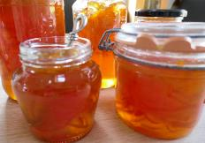
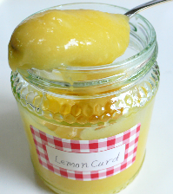
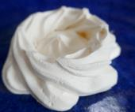
Jams
Hard Meringues
Marmalade
Lemon curd
Conserves
Coulis
Bottled fruits
Food science
Examples
Preservation
Meringues information sheet and recipe
A fact sheet looking at meringues
Sugar used in high enough concentration will reduce the water activity to below that which microbes can grow
Boiling with sugar drives off water making sugar concentration effective
as a preservative
Jam is 63-65% sugar
Sweet products usually with soft consistency
Fruit pectin, acid and sugar work together to form a gel.
Carbohydrate function
Characteristics

Slide 14
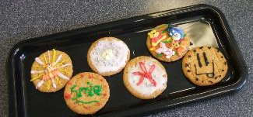
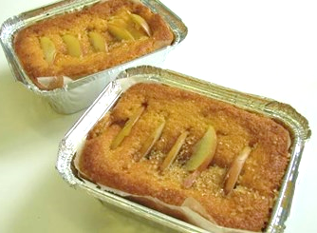
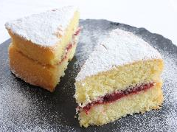

Iced buns
Celebration cakes
Glazed fruit teacakes,
Hot cross buns
Mince pies dusted with icing sugar
Victoria sandwich with caster sugar topping
Nice biscuits
Food Function
Variety to diet
Examples
Sensory properties
Texture, Colour, Flavour,
Appearance
Investigation - sugar in cake
Sugars add colour, texture and flavour and varied appearance
Sugars are used in small amounts in many Asian dishes to compliment flavours of spices
Sugar enables
decoration
Sweeter flavour
Crunchy texture or coating from caramelisation and / or crystals
Colourful, decorative appearance
Traditions
S13 Dutch apple cake
Carbohydrate function
Characteristics

Slide 15
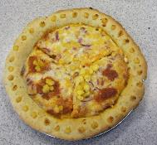
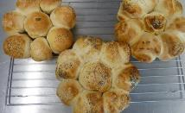
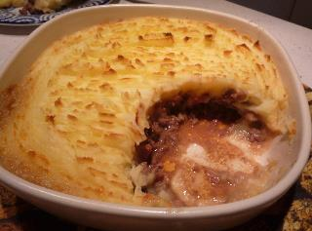
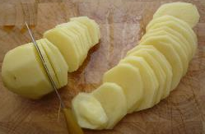
Pastry14 - 16 YR
Investigation - flour in pastry
Couscous
Flatbreads
Cereals – snacks
Rice types
Pasta varieties
Potato types – mash, roast, baked, wedges
Flour types
Variety to diet
Food Function
Adding nutrients
Examples
Recipe
Potato and rosemary bread rolls
Sensory properties
Texture, Colour. Flavour
Appearance
Starchy foods carry micronutrients such as B1 thiamine, iron, niacin
Potatoes deliver vitamin C
Wholegrain starchy foods deliver dietary fibre
Egg pasta enriched protein
Fairly bland – can be enhanced in many ways
Relatively cheap
Soften on cooking – easy to digest
Sometimes pale in colour
Carbohydrate function
Characteristics
Notes:
Starchy foods

Slide 16
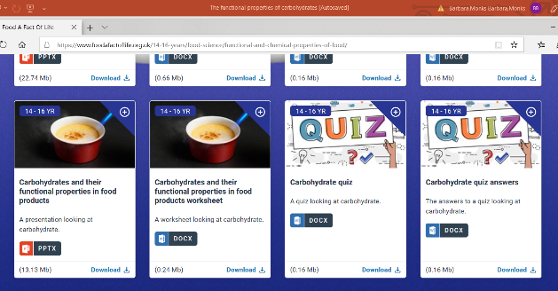
Resources from www.foodafactoflife.org.uk
14 - 16 Years Food science Functional and chemical properties of food
Science of carbohydrate explained
PowerPoint or Word document
Worksheets
Support materials
https://www.foodafactoflife.org.uk/14-16-years/food-science/functional-and-chemical-properties-of-food/
Functional properties of all nutrients
Specific presentation on function of carbohydrates

Slide 17
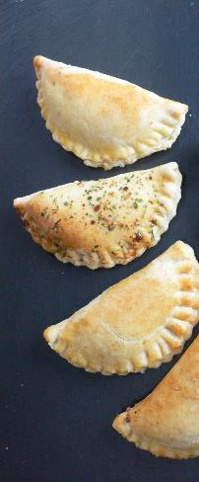
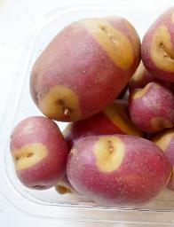
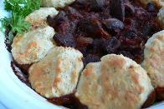
Teaching food functions & extending skills
Top tips
Tag each KS3 recipe with main key food science function and other key points
Notice visual clues indicating function of ingredients in cooked products
Making a dish with a side dish
Making a dish and adding a sauce
Making a dish with skilled garnish – parmesan crisp, pastry crescent, butter pat.

Slide 18
Recipe star
Food preparation skills
. . . . . . . . . . . . . . . . . . . . . . . . . . . . . . . . . . . . . . . . . . . . . . . . . . . . . . . . . . . . . . . . . . . . . . . . . . . . . . . . . . . . . . . . . . . . . . . . . . . . . . . . . . . . . . . . . . . . . . . . . . . . . . .
Eatwell & nutrition link
Food science link
. . . . . . . . . . . . . . . . . . . . . . . . . . . . . . . . . . . . . . . . . . . . . . . . . . . . . . . . . . . . . . . . . . . . . . . . . . . . . . . . . . . . . . . . . . . . . . . . . . . . . . . . . . . . . . . . . . . . . . . . . . .
. . . . . . . . . . . . . . . . . . . . . . . . . . . . . . . . . . . . . . . . . . . . . . . . . . . . . . . . . . . . . . . . . . . . . . . . . . . . . . . . . . . . . . . . . . . . . . . . . . . . . . . . . . . . . . . . . . . . . . . . . . . . . . . . . .
Practical work recipe name
Food Choice / provenance / sustainability link
Food Safety link
. . . . . . . . . . . . . . . . . . . . . . . . . . . . . . . . . . . . . . . . . . . . . . . . . . . . . . . . . . . . . . . . . . . . . . . . . . . . . . . . . . . . . . . . . . . . . . . . . . . . . . . . . . . . . . . . . . . . . . . . . . . . . . . .
. . . . . . . . . . . . . . . . . . . . . . . . . . . . . . . . . . . . . . . . . . . . . . . . . . . . . . . . . . . . . . . . . . . . . . . . . . . . . . . . . . . . . . . . . . . . . . . . . . . . . . . . . . . . . . . . . . . . . . . . . . . . . . . . . . . . . . . . . . . . . . . . . . . . .
Notes:
Some teachers like to use the 5 star method page I’ve mentioned previously when I’ve been talking to teachers - 5 star points pick up the key information that could be tagged to the recipe

Slide 19
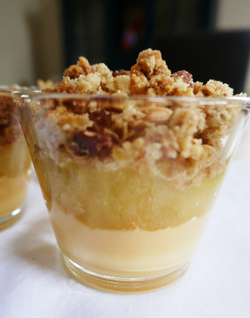
Teaching food functions
Top tips
Tag each KS3 recipe with main key food science function and other key points
Notice visual clues indicating function of ingredients in cooked products
Making a dish with a side dish
Making a dish and adding a sauce
Making a dish with skilled garnish – parmesan crisp, pastry crescent, butter pat.

Slide 20

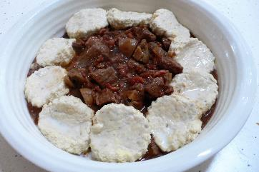

Thank you for taking part
Discussion of the functions of ingredients
The functional properties of carbohydrates
Teaching food science through practical activities, focusing on carbohydrates
Building knowledge and incorporate more functions in practical work
Suggestions for using Food – a fact of life resources.
Notes:
Thanks so much for being here with me tonight, i

Slide 21

Other sources of information and support
www.thecookeryteacher.com
Every recipe has
‘Cooks Know How’
www.epicurious.com
www.foodafactoflife.org.uk
IFST – Love Food Love Science resources
www.sciencelearn.org
Books: Use the range of textbooks and revision guides

Slide 22
The functional properties of carbohydrates
For further information, go to:
www.foodafactoflife.org.uk

