Slide 1
Diet & Health: Can you trust the headlines?
Sara Stanner
February 2020
Education Conference

Slide 2
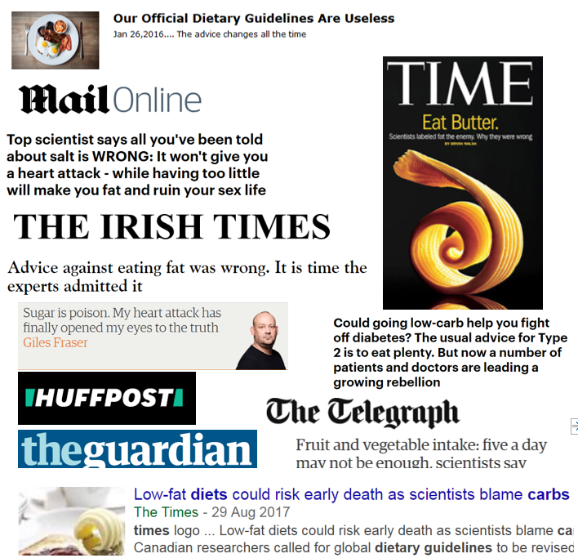
Conflicting soundbites & headlines
The media is massively increasing the quantity of information we have access to
If you get confused after reading stories in the media about which foods, supplements and eating behaviours are good/bad for you, you are not alone!
Mixed messages are confusing, may lead to apathy and can undermine evidence-based health advice
Many young people place more trust in health advice from lifestyle influencers than qualified experts

Slide 3
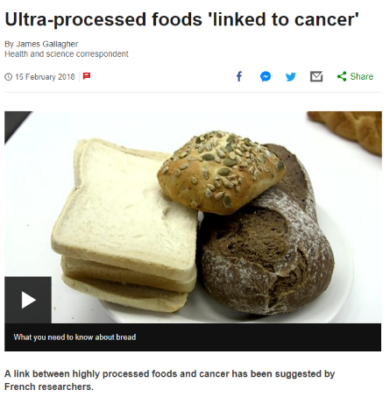
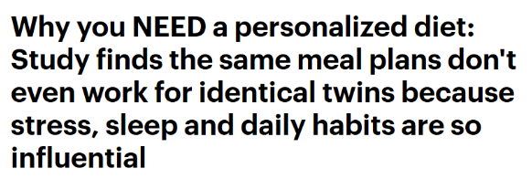
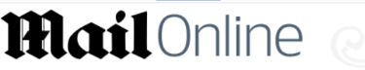

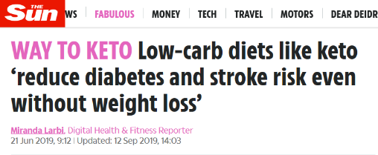
A few recent examples…
Ultra-processed foods – are they as harmful as the headlines suggest?
Diet trends – from fad diets to low carb and plant based diets….
Personalised nutrition – are population guidelines ineffective?

Slide 4


Ultra-processed foods and health What are the facts behind the headlines?
Heart disease?
IBS?
Early death?
Depression?
Weight gain?
High blood pressure?
Cancers?

Slide 5
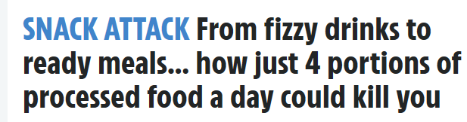
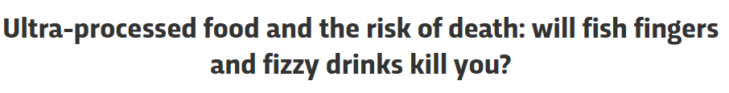
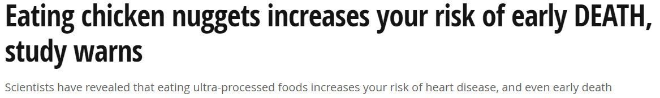

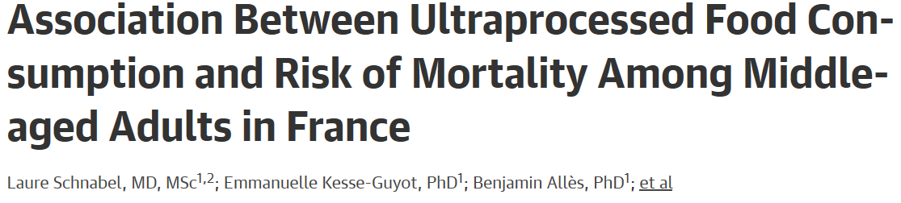

Risk of death
Are the findings as alarming as the headlines suggest?

Slide 6
Definition: the NOVA classification
1. Unprocessed or minimally processed foods | Natural products which may have been processed in some way (e.g. drying, roasting, pasteurization, fermentation, freezing) No sugar, salts, fats or oils added (e.g. fruits/veg, grains, meat, milk)
2. Processed culinary ingredients | Ingredients derived from Group 1 foods or from nature by certain processes (e.g. salt, sugar, honey, veg oil, butter) Usually used in combination with foods from Group 1
3. Processed foods | ‘Relatively simple’ products made by adding ingredients from Group 2 to Group 1 – usually 2-3 ingredients (e.g. veg in brine, fruits in syrup, cheese, cured meats & bacon, freshly made bread, salted/sugared nuts or seeds)
4. Ultra-processed food and drink products | Described as ‘industrial formulations’ with 5 or more ingredients This also includes foods from Group 3 which have had ‘cosmetic/sensory additives’ added (e.g. mass produced bread, breakfast cereals, sweets, fizzy drinks, fish fingers, chicken nuggets, instant soups, ready meals)

Slide 7
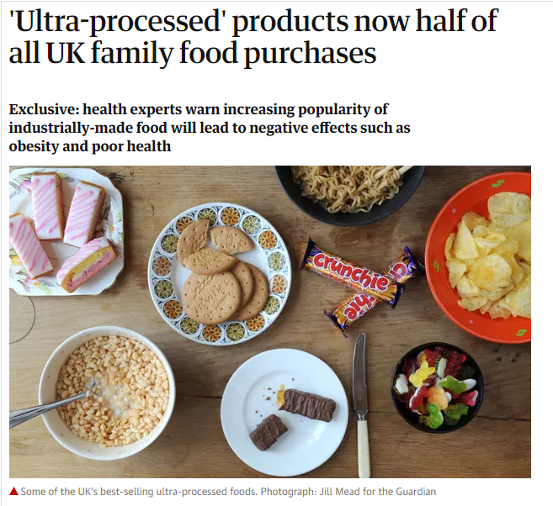
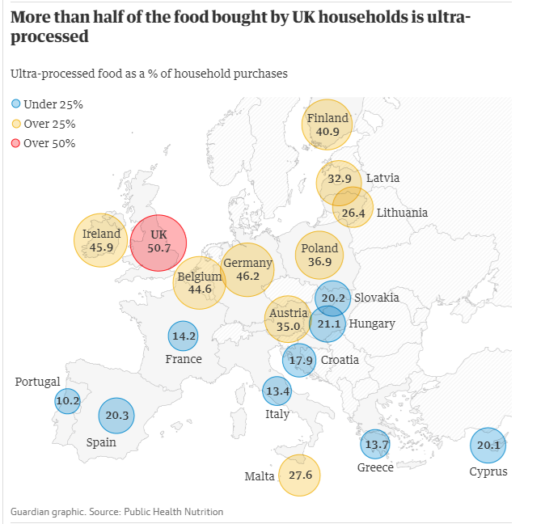

Slide 8
Early death - study findings
SUN prospective cohort study
~20,000 participants aged 20-91 years
>4 servings of ultra-processed foods a day associated with +62% risk all-cause mortality over the next 10 years
+18% risk with each additional serving
Sample not representative of general population
What is a serving? Different for different foods
NutriNet-Santé Study
~45,000 adults aged 45+ years
+10% in ultra-processed food consumption linked to +14% risk of mortality (mostly cancers and CVD)
French don’t eat much ultra-processed foods vs. other countries – around 14% diet
Participants could choose the 24-hr they recorded info

Slide 9
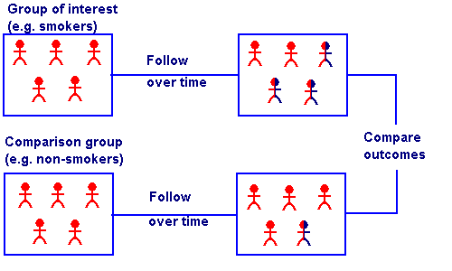
Cohort studies can’t show causal associations
Confounding?
Smoking
Carrying a lighter
Lung cancer
Both studies found people who ate lots of UPFs had healthier lifestyles…

Slide 10
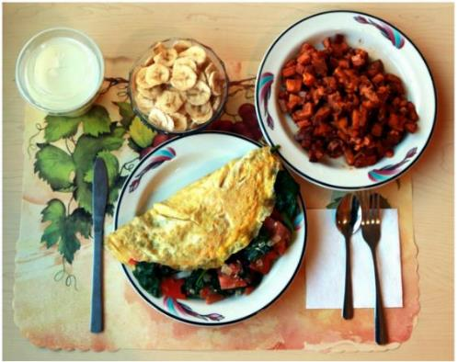
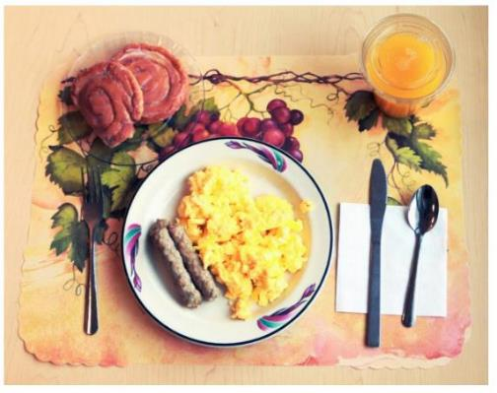
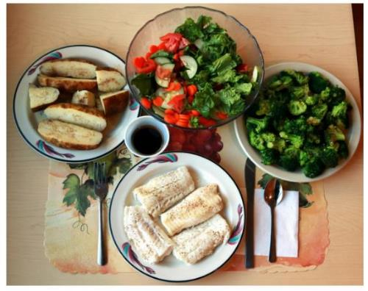
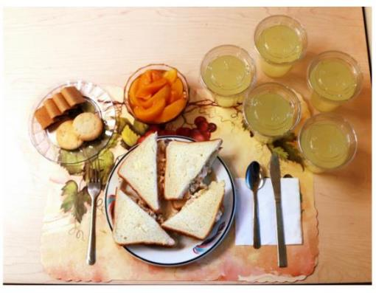
Unprocessed vs. ultra-processed diets
Unprocessed breakfast
Ultra-processed breakfast
But why?
If not nutritional differences,
what’s the mechanism?
Unprocessed dinner
Ultra-processed dinner

Slide 11
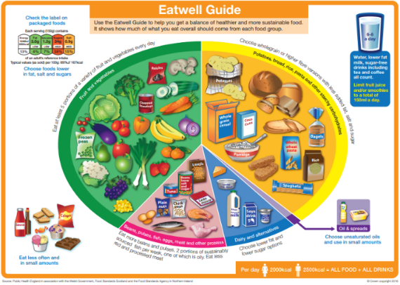
Are the findings as alarming as they seem? The BNF view
Study of potential health effects of high ultra-processed food consumption very much in infancy – epidemiological evidence scarce & limited
Many ultra-processed foods are HFSS foods and drinks or processed meats that there already is advice to reduce intake of
Consumer messaging around reducing ultra-processed foods could be difficult – what comes to mind when asked?
Dietary advice based on diet quality rather than on the degree of processing may be more helpful
The term ‘processed foods’ often viewed negatively but probably perceived as a limited range of foods and not all processing is bad!
Processed foods are difficult to avoid entirely – about identifying healthier options
Media stories often lack detail & context – associations don’t prove causality!

Slide 12
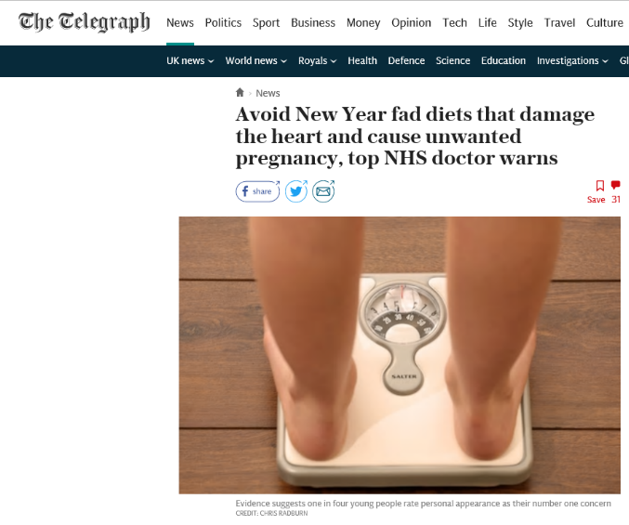
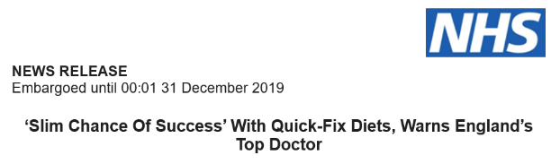
Dietary approaches to health and weight loss: facts behind the headlines
New year headlines discouraged fad diets!
Restrictive diets with few foods and products claiming to help people lose weight quickly can have damaging side effects including diarrhoea, heart problems and even lead to unplanned pregnancies by interfering with oral contraception
Most people get fed-up, start eating more, choose less healthy foods and pile the pounds back on!

Slide 13
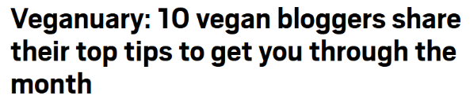
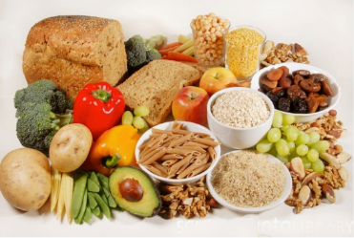
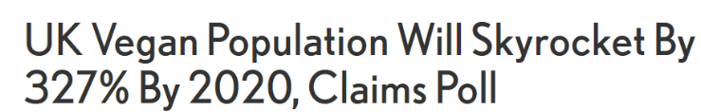
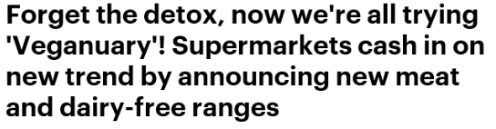
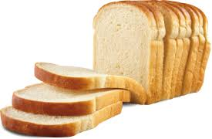
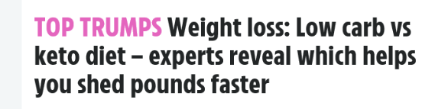
Vegan, plant-based or low carb?
Are starchy foods good or bad? Should we avoid meat?
‘Veganuary’ 2019: Quarter of million people tried a vegan diet
According to Vegan Society, number of vegans has risen 360% over past 10 years, with 42% aged between 15 and 34
7% of British people have gone plant-based
But at same time, low-carb diets have gained wider recognition in the media and within healthcare
?

Slide 14
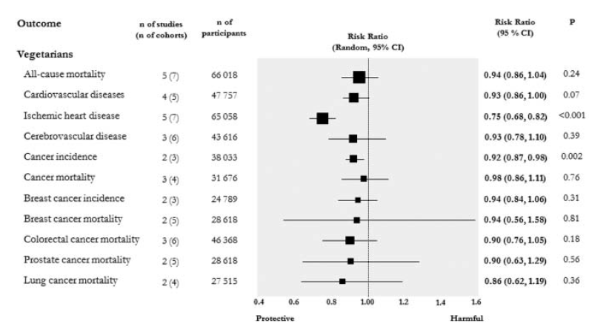
Plant-based diets
Promoted in dietary guidelines around the world for health & sustainability
Observational studies have found associations between plant based dietary patterns & reduced risk of disease as well as risk factors (e.g. total/LDL cholesterol, inflammatory markers)
RCTs have shown them to lower total/LDL cholesterol & improve blood pressure, inflammatory & endothelial markers
Meta-analysis of cohort studies: vegetarian vs non vegetarians
25% reduction of IHD incidence and/or mortality
Dinu et al. 2017

Slide 15
Plant-based diets
Flexitarian approach: prudent plant-based dietary patterns with small intakes of red meat, fish & dairy products have demonstrated significant improvements in health (although optimal intake unknown)
And not all plant based diets are the same
Plant foods | Coronary Heart Disease Comparing extreme deciles
All | HR 0.92; 95% CI 0.83 - 1.01
Healthy | HR 0.75; 95% CI 0.68 - 0.83
Less Healthy | HR 1.32; 95% CI 1.20 - 1.46
Healthy: wholegrains, fruits/veg, nuts/legumes, oils
Less healthy: juices/sweetened beverages, refined grains, crisps/fries, sweets
Using data from HPS (43,259 men) and NHS 1&2 (166,039 women)
Satija et al. 2017

Slide 16
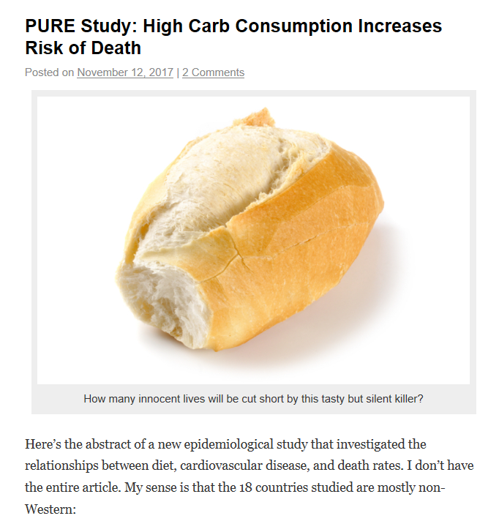
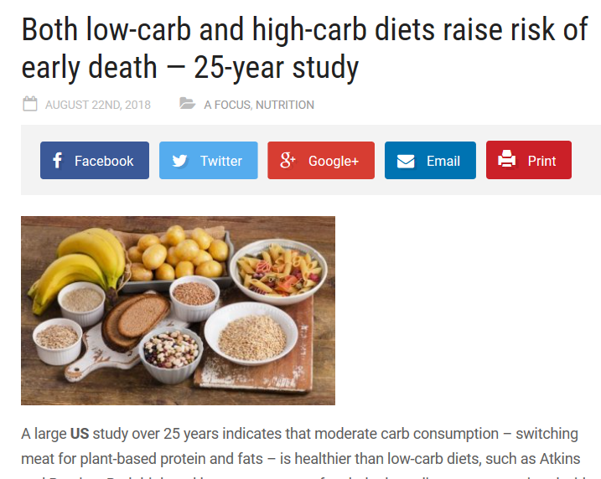
Low carb diets - conflicting headlines
Headlines suggest low carb diets could reduce life expectancy by five years
PURE STUDY ARIC STUDY
Headlines suggest low carb diet is the answer to a healthy life…

Slide 17
Main findings of these two studies
But were the results as different as the headlines suggest?
Prospective Urban Rural Epidemiology (PURE) Study
>135,000 participants aged 30-70 years from 18 countries followed for 7 years to look at diet and mortality and CVD events
The 20% of people with the lowest carbohydrate intake had a 28% lower risk of death
Higher fat intake was associated with a 23% lower risk of death
Authors suggested global dietary guidelines should be revised
Atherosclerosis Risk in Communities (ARIC)
~15,000 adults aged 45-64 years from 4 US communities followed for average of 25 years
Combined ARIC data with data from 7 other studies from North America, Europe and Asia
Low or high carbohydrate diets were associated with (~20%) increased mortality risk
Dehagan et al. Lancet 2017
Seidelmann et al. Lancet 2018

Slide 18
PURE findings: definition of ‘low carb’
‘High’ >60% total energy, ‘Low’ <46% energy
Those in the lowest carb category (with lower mortality rates) still got 46% of their calories from carbs
52% consumed an average of at least 60% of energy from carbs, especially in the low- and middle-income countries
Macronutrient analysis didn’t qualify type of carbohydrate (by fibre content or glycaemic index)
 | Quintile 1 | Quintile 2 | Quintile 3 | Quintile 4 | Quintile 5
% carbohydrate | 46 | 55 | 61 | 68 | 77

Slide 19
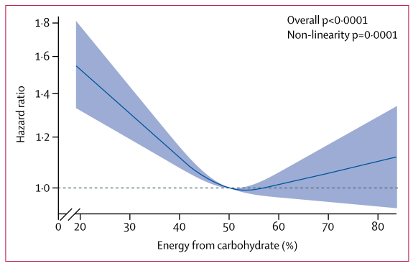
ARIC findings: definition of ‘low carb’ & type of carb
‘High’ >70% energy, ‘low’ <40%
‘U’ shaped association, lowest risk at 50-55% energy from carbs
Low carb and high carb conferred higher risk but dependent on substitution and pattern (animal fat/protein increased risk but plant based lowered risk)
Mean = 48.9%
“Contradictory” studies actually had similar results! Around half of energy from carbs associated with the lowest risk of dying early
For low carbohydrate diets risk dependent on source of fat and protein:
Animal-derived = increased risk (HR = 1.18 [1.09-1.29])
Plant-derived = decreased risk (HR = 0.82 [0.78-0.87])

Slide 20
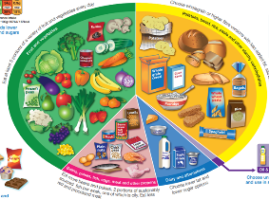
Healthier dietary patterns: BNF view
U-shaped association of carbohydrate intake and life expectancy cautions against long-term use of low and high carbohydrate diets
Replacement of carbohydrates with animal-derived fat and protein should be discouraged
But substitution for plant-derived sources may promote healthy-ageing
Findings support previous reports of the benefits of a plant-based dietary patterns
Studies support the current UK guidelines & Eatwell Guide
The devil is in the detail! Incomplete stories can undermine expert advice.

Slide 21

Is personalised nutrition the model of the future?
Public health advice focusses on populations or specific groups
Personalised nutrition uses information on individual characteristics to develop tailored diets which compliment a person’s lifestyle, biological measurements, unique genetic profile and/or microbiome
In the early 2000s, the human genome was mapped, and scientists could study the subtle individual genomic differences
Recognition of the role of gut microbiota in health and individual variability (gut bacteria ‘fingerprint’)

Slide 22
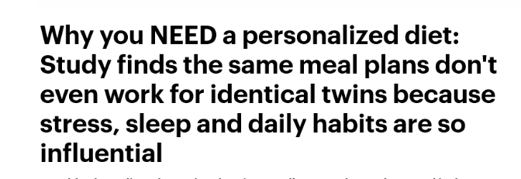
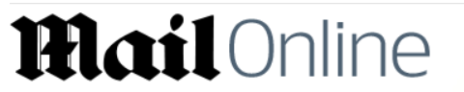
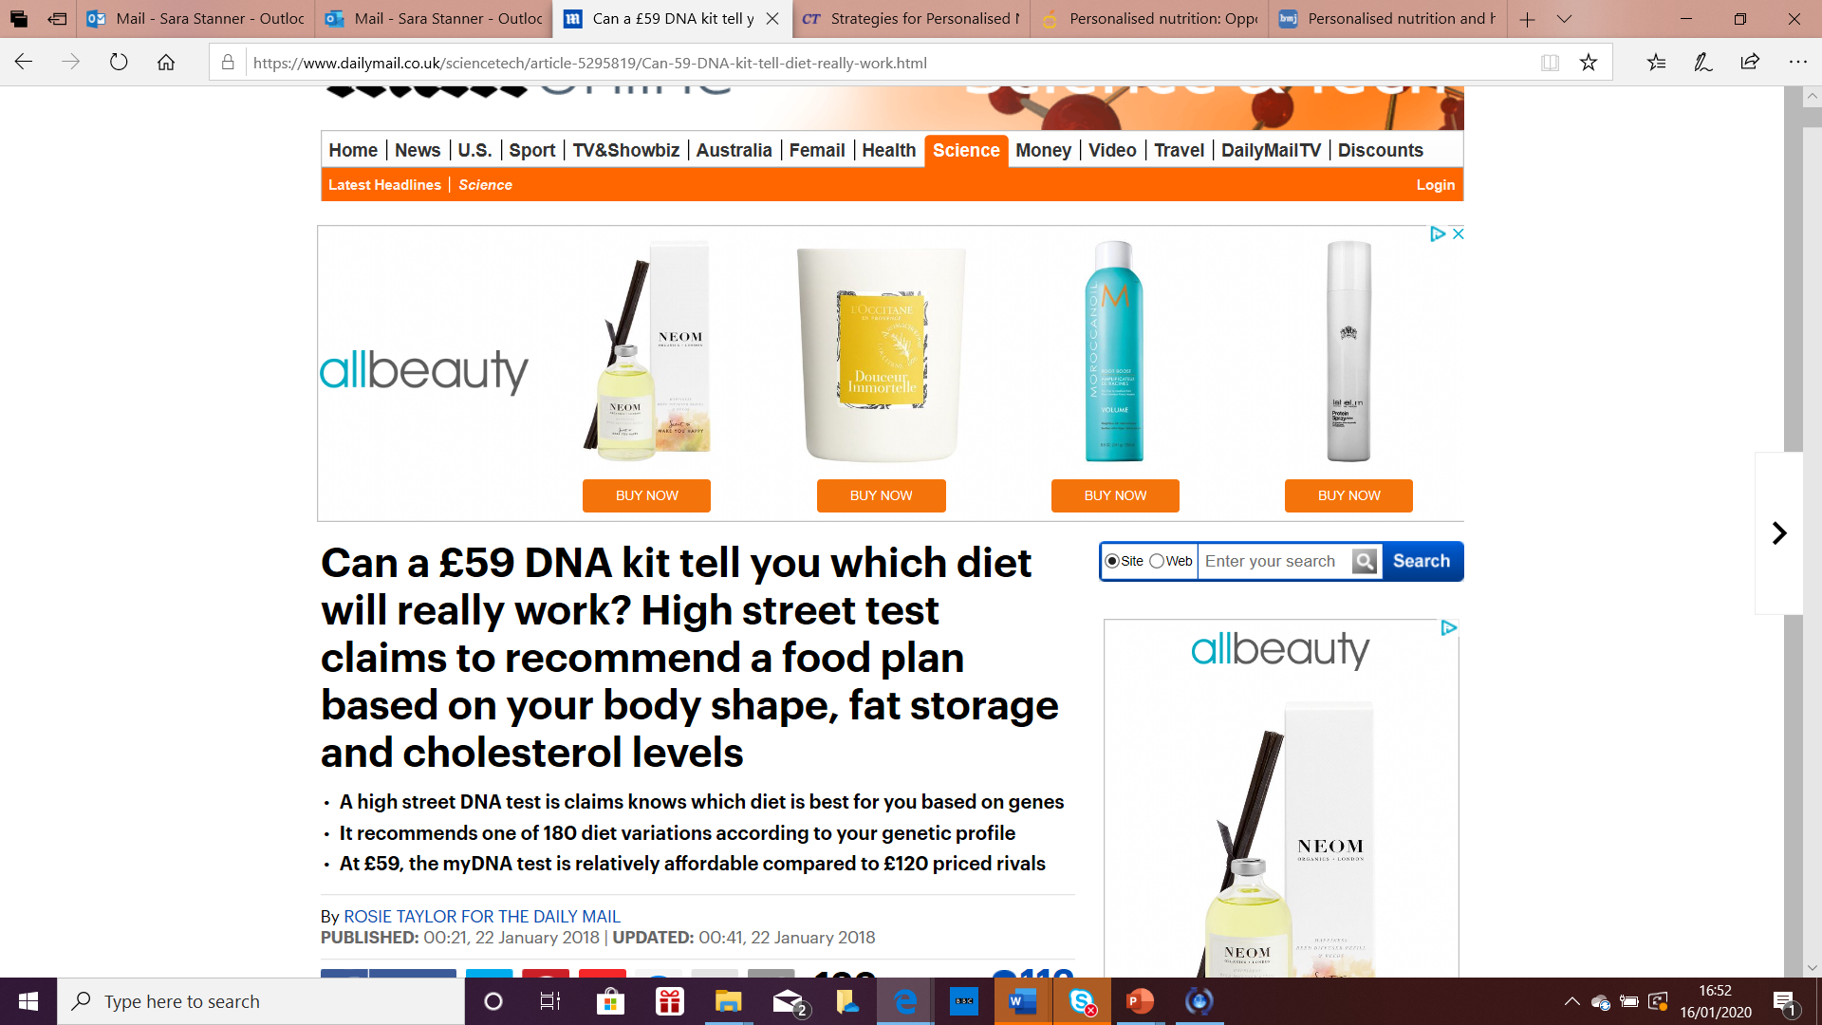
What’s the evidence?
Are promises surpassing the evidence?
We know that we respond to dietary intake uniquely – even if identical twins. Although mechanisms that define these are still unclear
Impact of this approach on dietary behaviour change or health unclear
Few robust studies have tested personalised nutrition approaches but strong methodology was Food4Me…..

Slide 23
Food4Me
Trial of adults in 7 European countries randomised to various internet-delivered interventions
Level 0 = Control (non-personalised) intervention
versus
Level 1 = Personalised Nutrition (PN) based on diet only
Level 2 = PN based on diet and phenotype
Level 3 = PN based on diet, phenotype and genotype
Celis-Morales et al. (2015) Genes & Nutr. 10:450

Slide 24
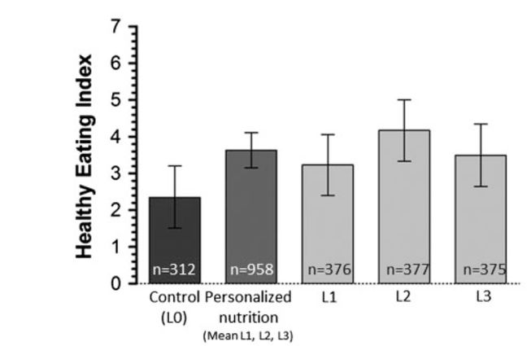

Personalised nutrition improved dietary behaviour
Change after 6 months
Included genotype
Personalised nutrition works but no added advantage of phenotypic or genetic information
Celis-Morales C et al. (2017) Int. J. Epidemiol. 46, 578-588

Slide 25
Role of personalised nutrition: BNF view
‘One size fits all’ dietary advice may not be most effective technique for improving public health
Tailoring advice to diet & lifestyle is likely to be more successful in changing dietary behaviour
Digital age supports delivery of personalised advice, but there are concerns about management of data/individual privacy
Wearable technologies (fitness trackers, mobile apps) to collect information continuously on physical activity, sleep, heart rate, stress, blood pressure etc may help motivation but whether they maintain sustained behaviour change is unknown
The complex interactions between our personal gut microbiomes, our own genomes and the food we eat may well be key to future advice, but there is little evidence of additional benefit from more sophisticated & expensive approaches at present
Headlines often jump ahead of the evidence base. Often
science needs to catch up with the hype!

Slide 26
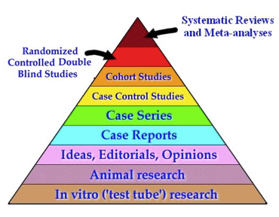
How BNF appraises the evidence
Study design
Population size
Inclusion/exclusion criteria
Recruitment & losses to follow-up
Intervention – timing, dose, blinding
Choice of control group
Measurement of exposure and outcome – reliable, reproducible
Statistical analysis
Size and precision of effect/relationship
Risk of bias and confounding
Financial support/affiliation

Slide 27
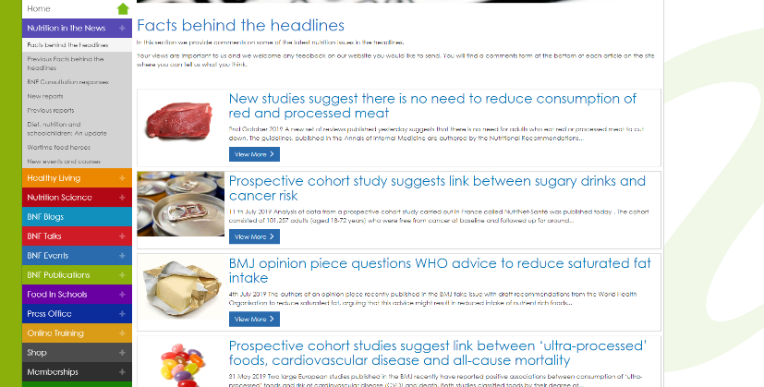
How can we help people navigate the media?
Support/encourage journalists to get their facts straight
Signpost evidence based responses – e.g. BNF, Sense about Science, NHS Choices
Encourage and support young people to be critical & think beyond the headline…
‘Facts behind the headlines’
https://www.nutrition.org.uk/nutritioninthenews/headlines.html

Slide 28
Fact or fiction?
Is the evidence provided testimonials or personal opinion?
Does it sound too good to be true? Is it suggesting a simple fix?
Is the source of the information, such as a book author or blogger, trying to sell an unbalanced diet plan or a product like dietary supplements?
Do they give an opinion from a general trusted source – e.g. charity/health organisation, government, educational organisation – who aren’t promoting or selling any products
Does it suggest conflict with status quo? If so, does it also present opposite view?
Look out for the word ‘new’ (this can mean the information is preliminary in nature)
Ignore the headline - as you read the details of an article, you often find a different story emerges. The real story is usually at the end!

Slide 29
Further information
BNF Resources (www.nutrition.org.uk)
Webinars:
Personalised nutrition - is it all in the gut?
Plant-based diets - it's not just fruit and veg
Facts Behind the headlines
Regular updates on the evidence behind recent media stories
Website factsheets
Plant-based diets
Healthy eating for vegans and vegetarians
Blogs
Should we all be going meat free?
Websites
British Nutrition Foundation (BNF)
Sense about Science
NHS – Behind the Headlines

Slide 30
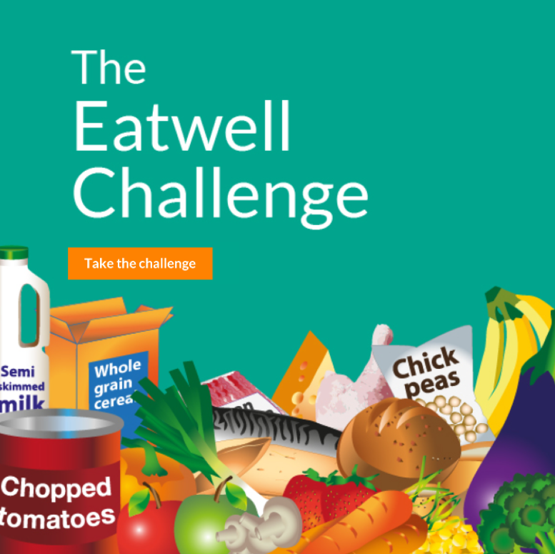
Food – a fact of life resources
5-7 Healthy eating
7-11 Heathy eating
11-14 Healthy eating
14-16 Healthy eating
The Eatwell Guide
Factors affecting food choice
11-14 Food route journals to engage pupils
14-16 Food route journals to engage pupils
Healthy eating and nutrition FFL webinar recordings
www.foodafactoflife.org.uk
Interactive Eatwell Challenge

