Slide 1
Your Daily Bread – Turning Wheat into Flour & Much More (Primary) National Food and Nutrition Education Conference 2020 Duncan Monroe

Slide 2

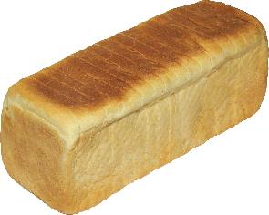
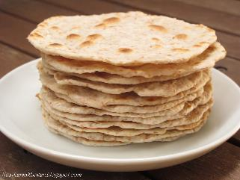
“Give us this day our daily bread”
A
C

Slide 3
Agenda
Wheat
Milling
Baking
The Size of the Industry
References

Slide 4
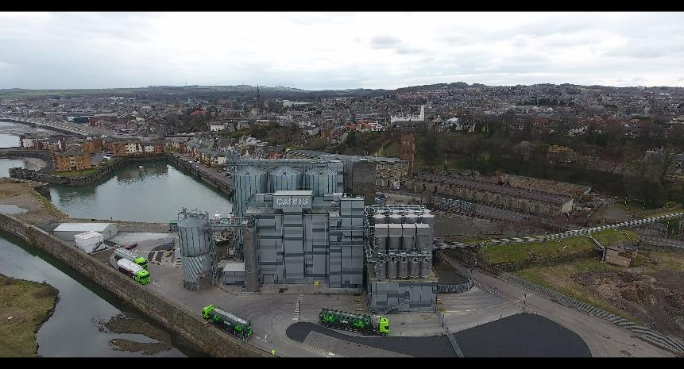
Flour Mill, Kirkcaldy

Slide 5
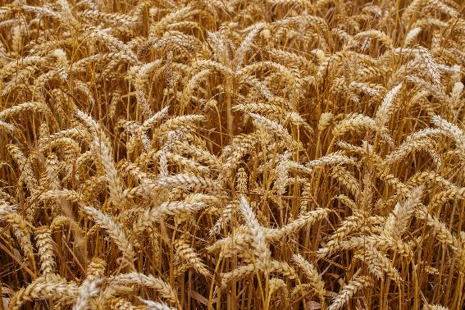
Wheat

Slide 6
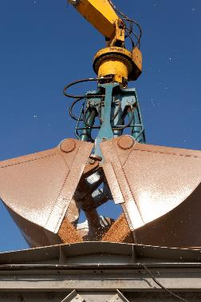
Wheat is Hardy & Versatile
Very durable
Grown across the globe, excluding tropical and sub-tropical regions
Winter Wheat & Spring Wheat
Easy to handle and transport
Easy to store

Slide 7
Many Uses - Energy
Human Food – bread, biscuits, starch
Animal Food
Ethanol
Alcohol
Seed

Slide 8
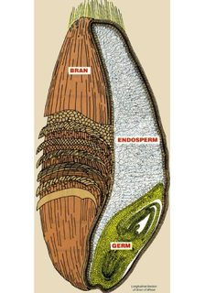
Wheat Grain
This

Slide 9
What Makes Wheat Different
It has a crease
It contains gluten

Slide 10
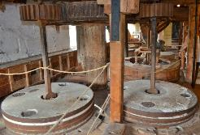
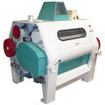
The Milling Process
Traditional Milling - Stoneground
Modern Milling – Roller Mills, Gradual Reduction

Slide 11
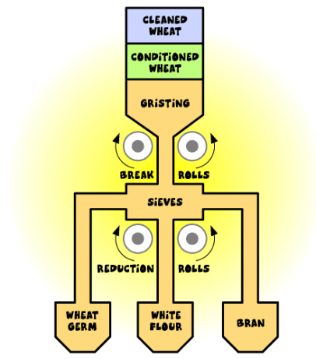
Milling diagram

Slide 12
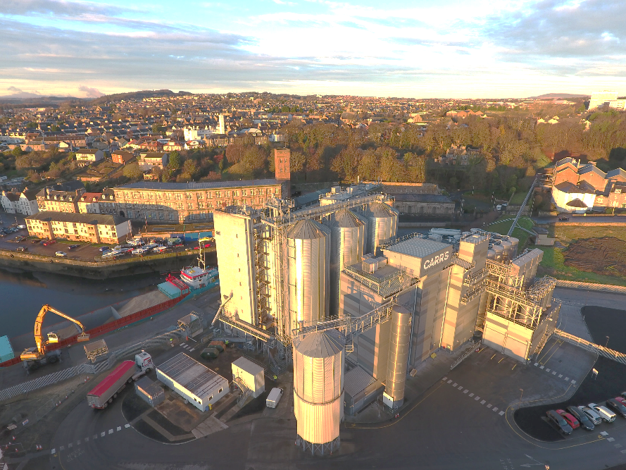

Slide 13
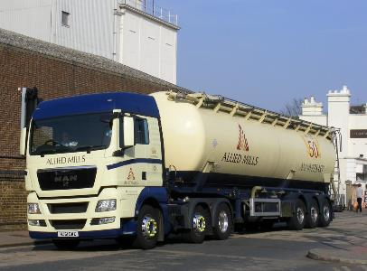
A Typical Large Mill Supplies
100 tankers per week
28 tonnes per tanker
60,000 loaves
140,000 packets biscuits
CC BY-NC-ND

Slide 14
UK Millers Supply
Bread Bakers
Plant Bread
Artisan
Biscuit Manufacturers
Food Manufacturers
Pies
Cakes
Soups/Sauces
In-Store Bakeries
Home-Bakers

Slide 15
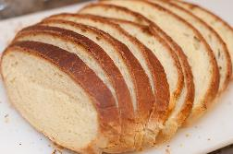
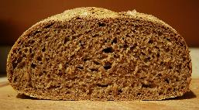


Types of Flour
Strength
Bran Content
CC BY-SA
C BY-NC-ND

Slide 16
UK Millers Supply – Each Day
14,000 tonnes of flour
12 million loaves
5 million packets of biscuits
4 million cakes and buns
2 million pizzas
Source: nabim Flour Milling in the UK

Slide 17
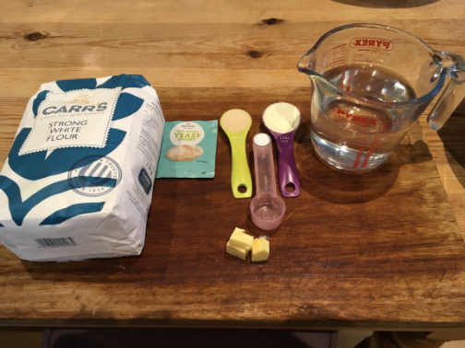
Bread Baking - Ingredients

Slide 18
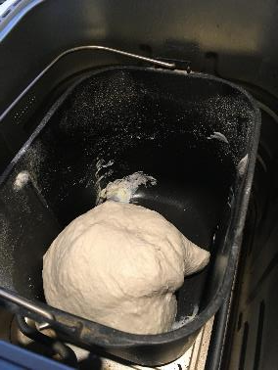
Bread Baking - Mixing

Slide 19
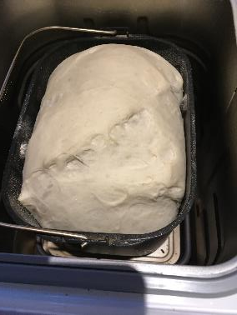
Bread Baking - Proving

Slide 20
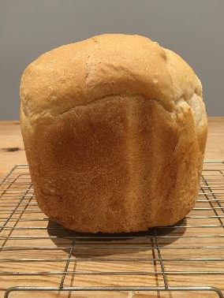
Bread Baking – A Loaf

Slide 21
Teaching Resources
www.foodafactoflife.org.uk
New Fibre February resources
www.nabim.org.uk
fabflour.co.uk

Slide 22
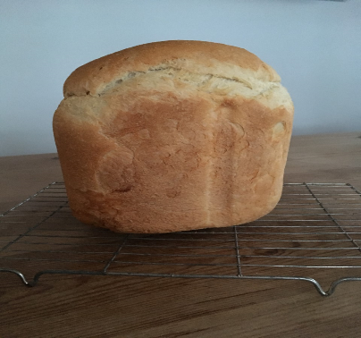
Thank You

