Slide 1
Your Daily Bread – Turning Wheat into Flour & Much More (Secondary)
National Food and Nutrition Education Conference 2020
Duncan Monroe

Slide 2

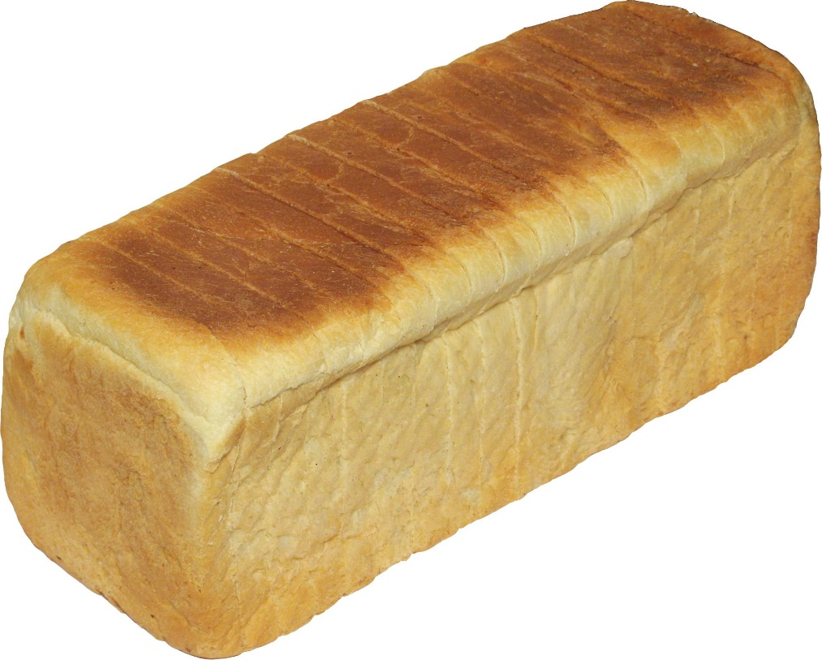
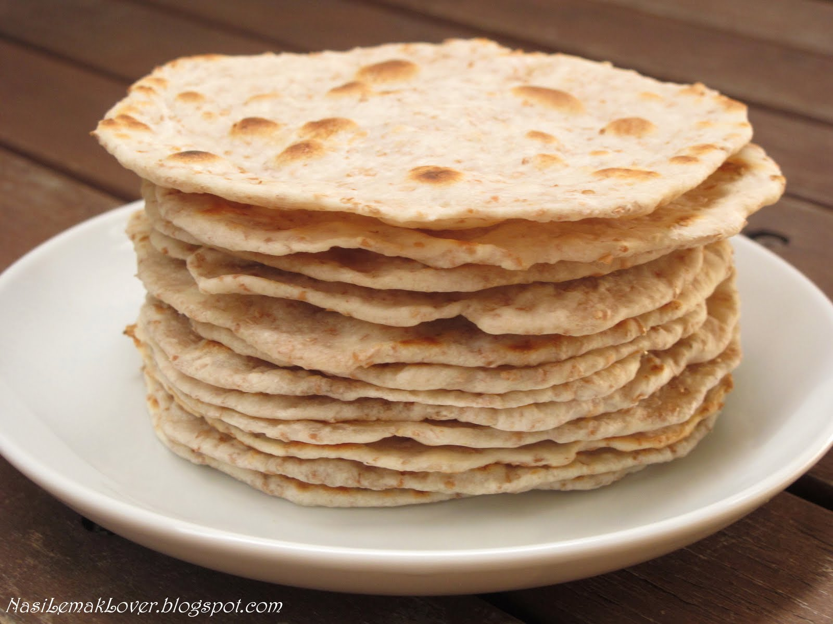
“Give us this day our daily bread”
A
C

Slide 3
Agenda
Wheat
Milling
Baking
The Size of the Industry
References

Slide 4
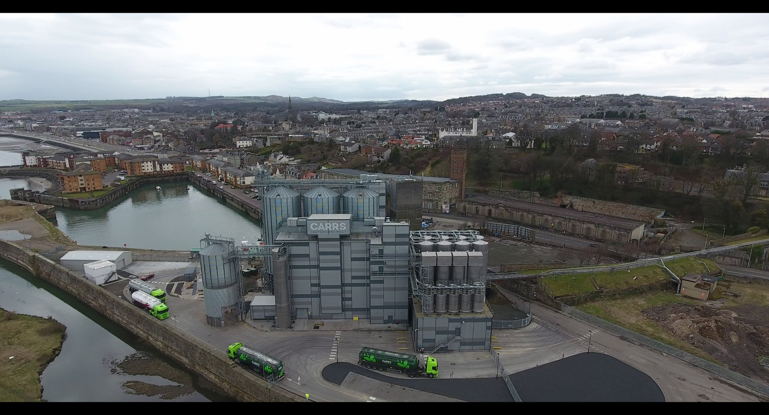
Flour Mill, Kirkcaldy

Slide 5
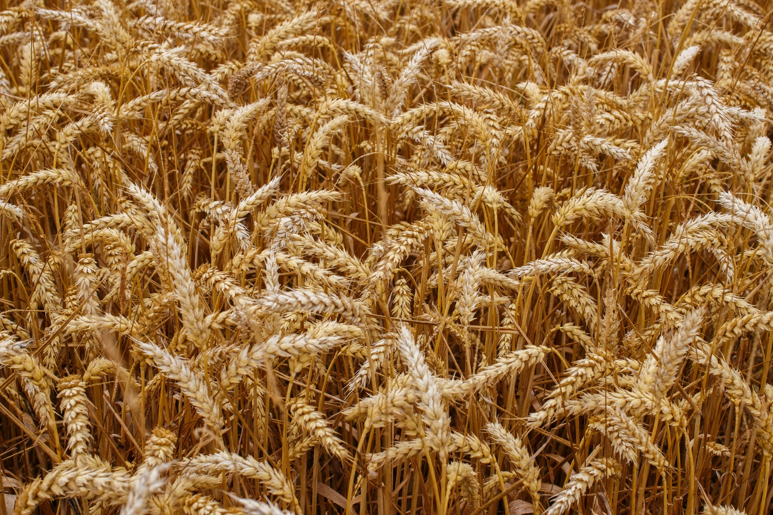
Wheat

Slide 6
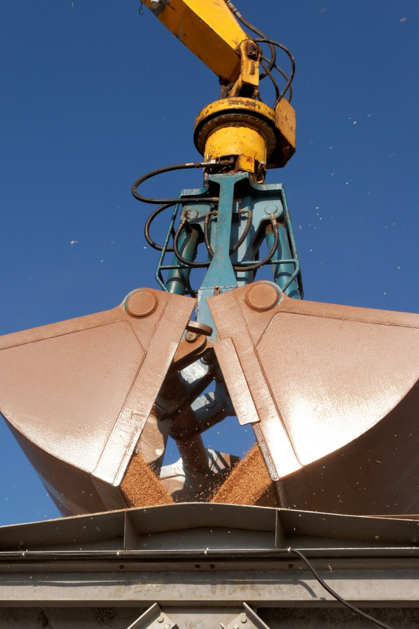
Wheat is Hardy & Versatile
Very durable
Grown across the globe, excluding tropical and sub-tropical regions
Winter Wheat & Spring Wheat
Easy to handle and transport
Easy to store

Slide 7
Many Uses - Energy
Human Food – bread, biscuits, starch
Animal Food
Ethanol
Alcohol
Seed

Slide 8
GLOBAL WHEAT PRODUCTION 2018/19 est.
China | 131 million tonnes
India | 113 million tonnes
Russia | 72 million tonnes
USA | 51 million tonnes
France | 34 million tonnes
Canada | 32 million tonnes
UK | 16 million tonnes
Total | 733 million tonnes
Source: International Grain Council

Slide 9
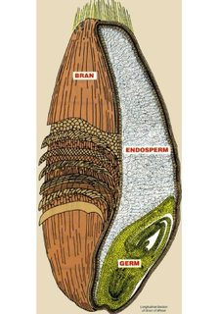
Wheat Grain
This

Slide 10
What Makes Wheat Different
It has a crease
It contains gluten

Slide 11
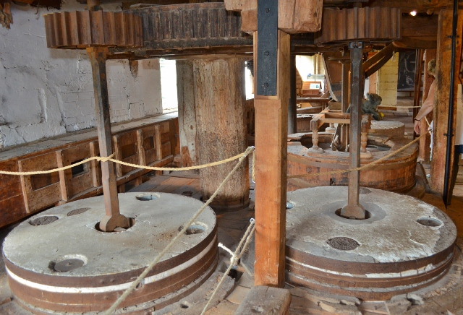
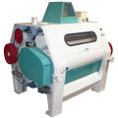
The Milling Process
Traditional Milling - Stoneground
Modern Milling – Roller Mills, Gradual Reduction

Slide 12
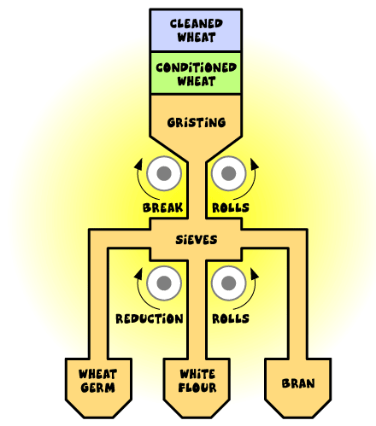
Milling diagram

Slide 13
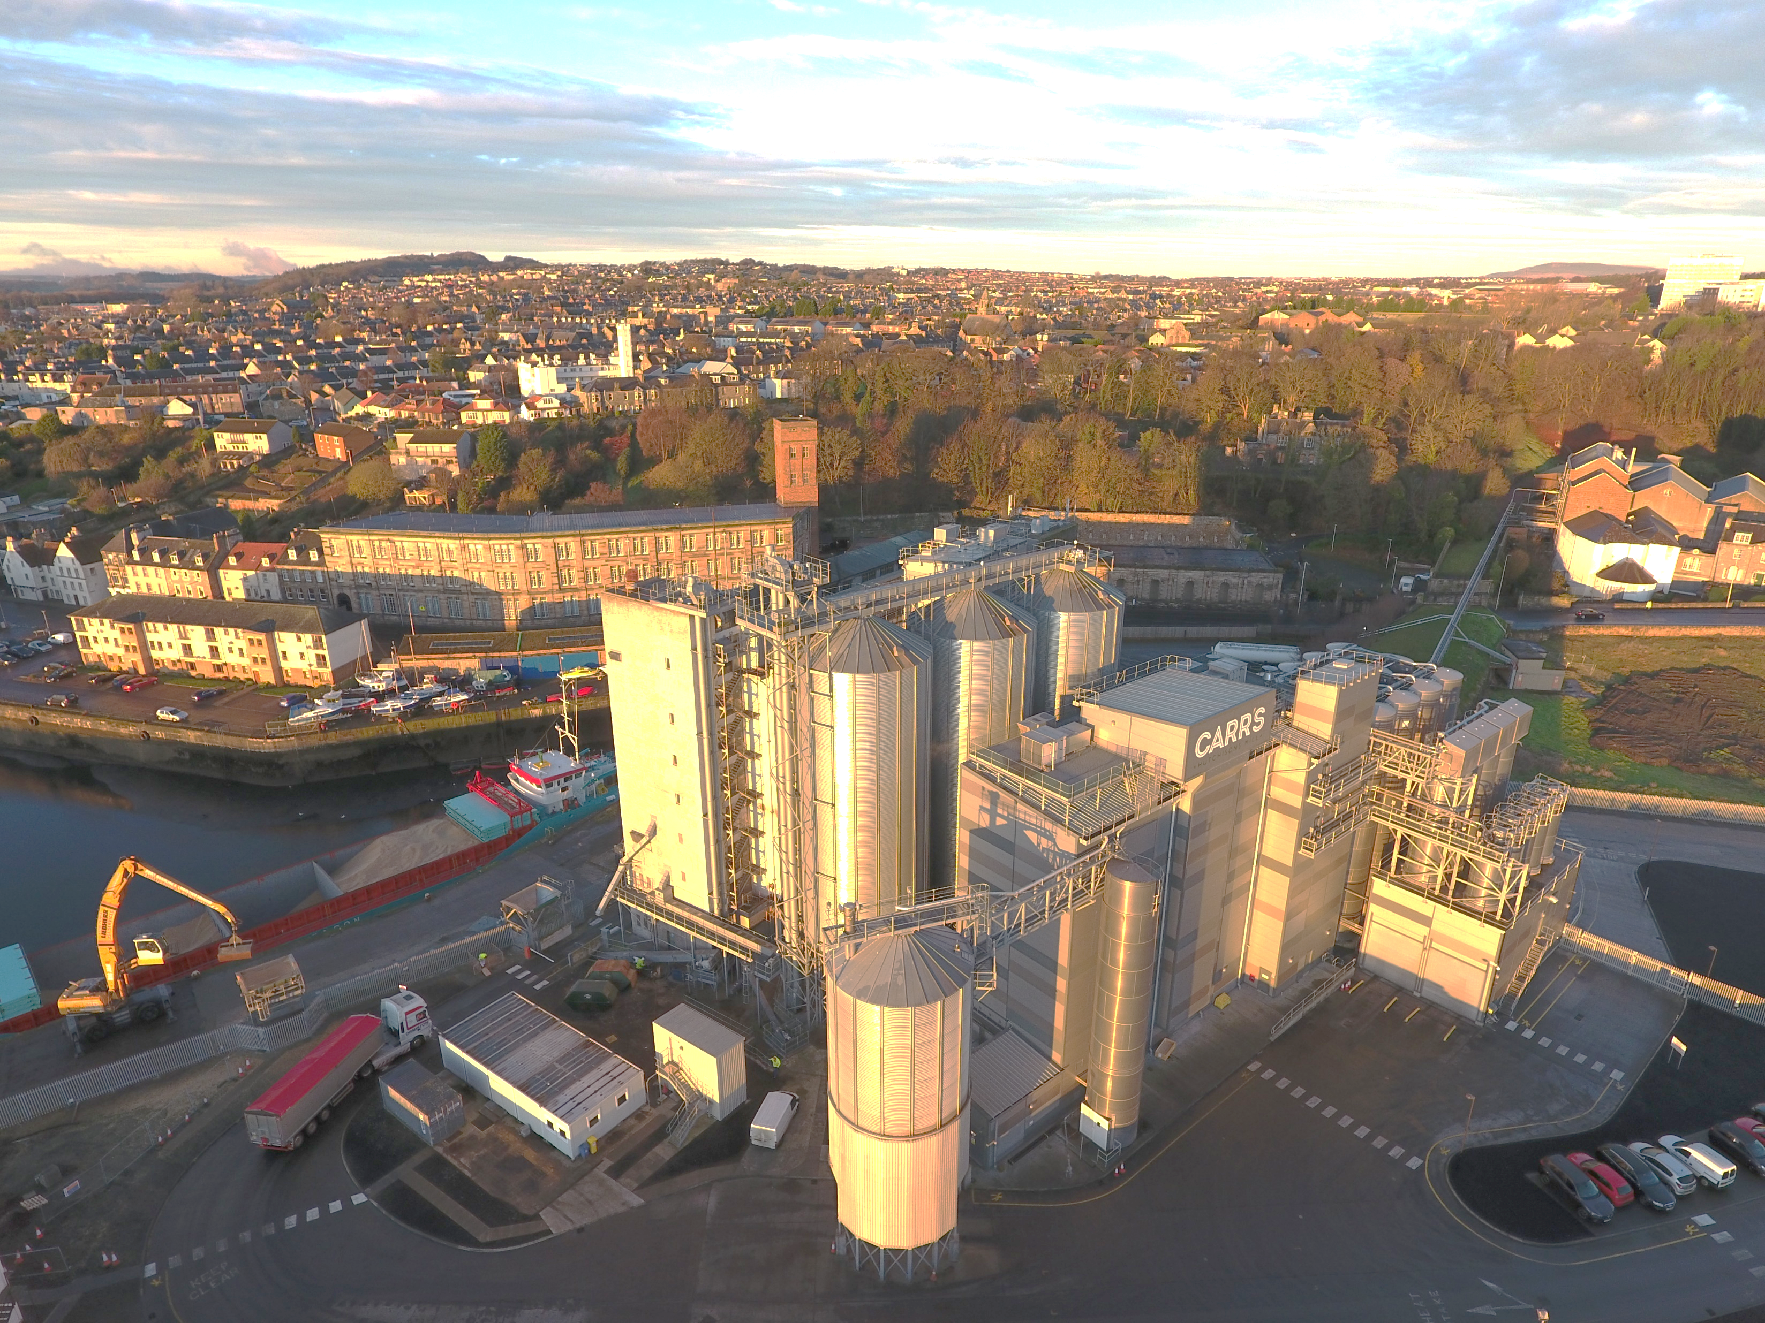

Slide 14
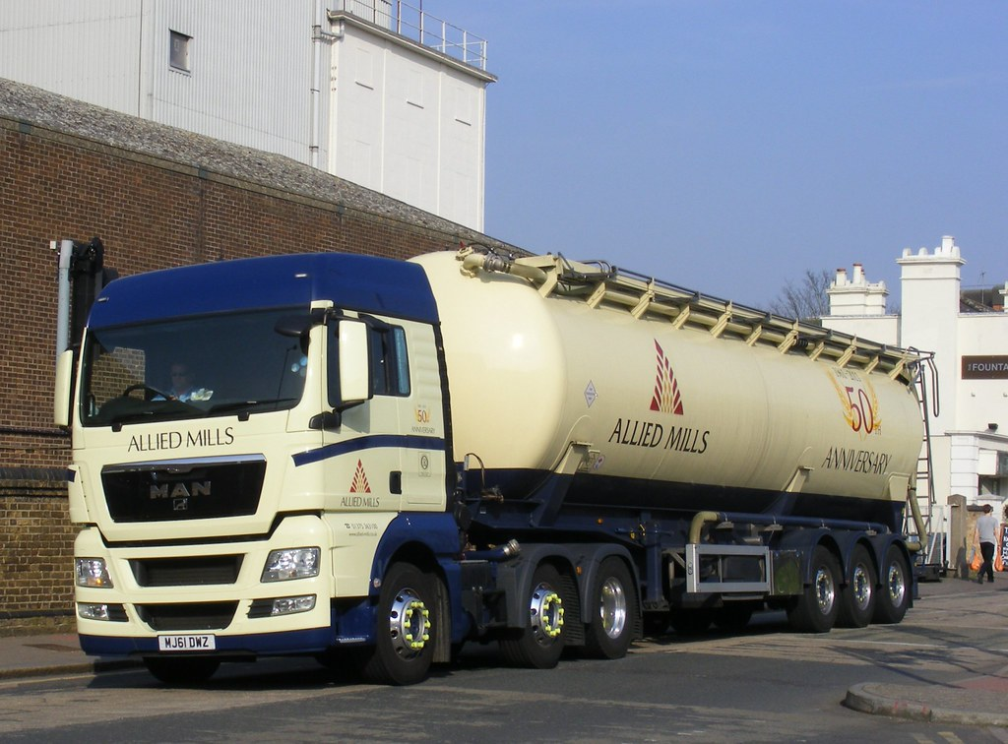
A Typical Large Mill Supplies
100 tankers per week
28 tonnes per tanker
60,000 loaves
140,000 packets biscuits
CC BY-NC-ND

Slide 15
UK Millers Supply
Bread Bakers
  Plant Bread
  Artisan
Biscuit Manufacturers
Food Manufacturers
  Pies
  Cakes
  Soups/Sauces
In-Store Bakeries
Home-Bakers

Slide 16
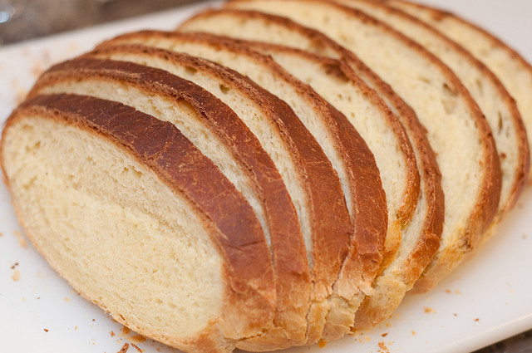
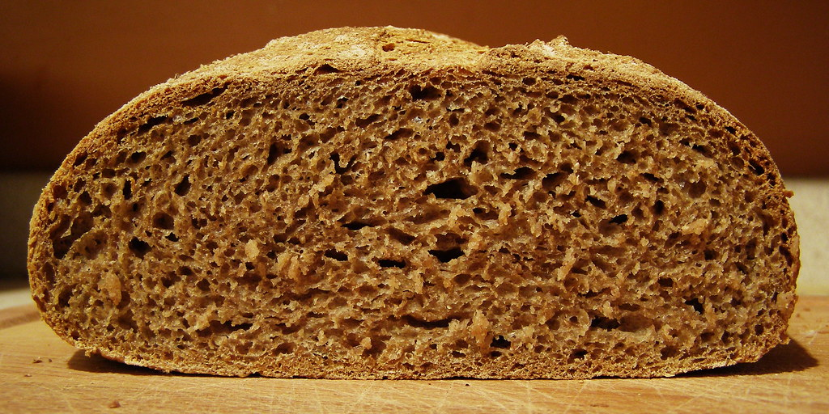


Types of Flour
Strength
Bran Content
CC BY-SA
C BY-NC-ND

Slide 17
UK Millers Supply – Each Day
14,000 tonnes of flour
12 million loaves
5 million packets of biscuits
4 million cakes and buns
2 million pizzas
Source: nabim Flour Milling in the UK

Slide 18
Feeding the Nation
99.8% of households purchase bread
30% of supermarket SKUs contain flour
Flour provides carbohydrate, protein and
  35% of adult daily fibre intake
  33% of adult daily calcium intake
  30% of adult daily iron intake
Source: nabim Flour Milling in the UK

Slide 19
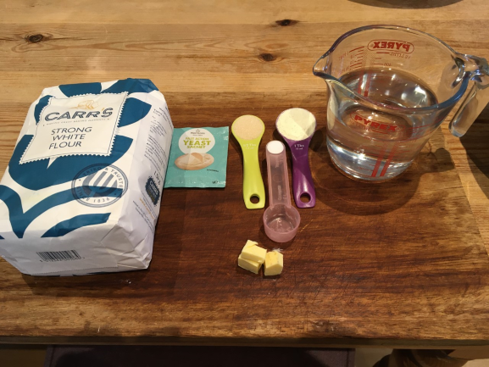
Bread Baking - Ingredients

Slide 20
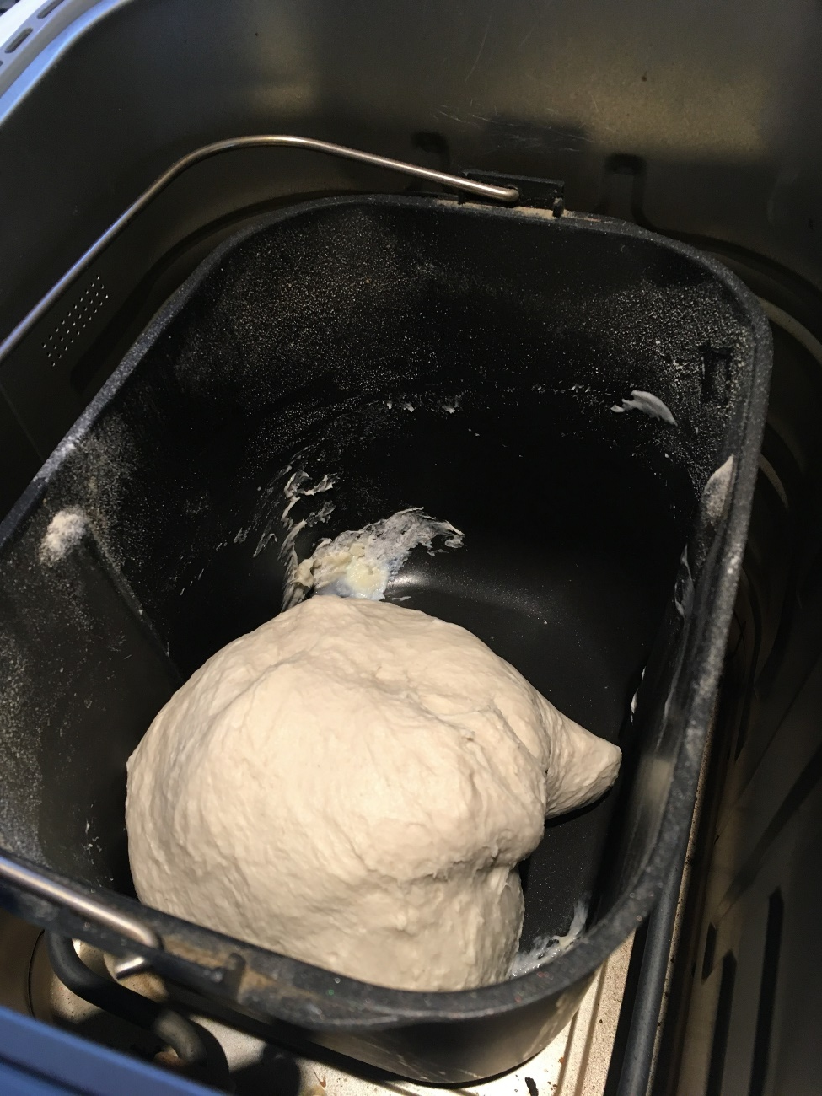
Bread Baking - Mixing

Slide 21
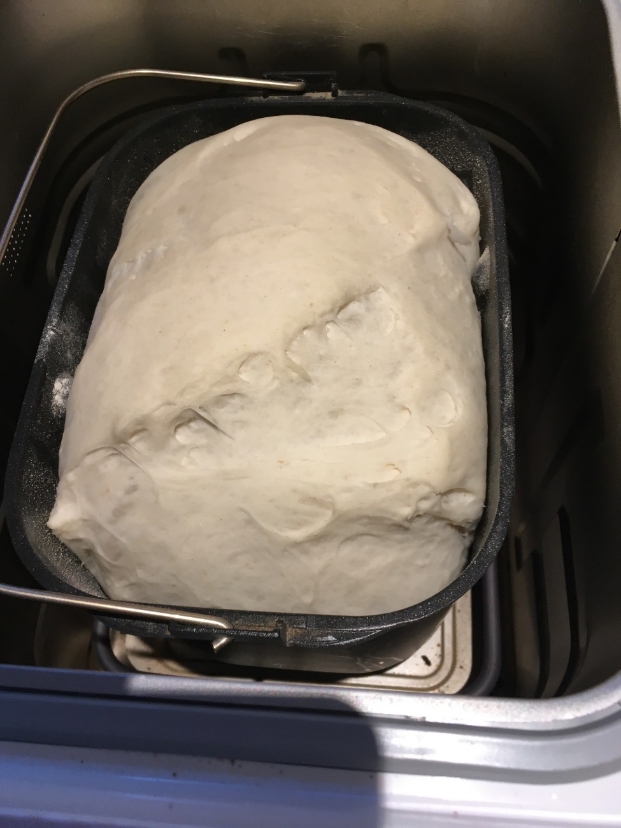
Bread Baking - Proving

Slide 22
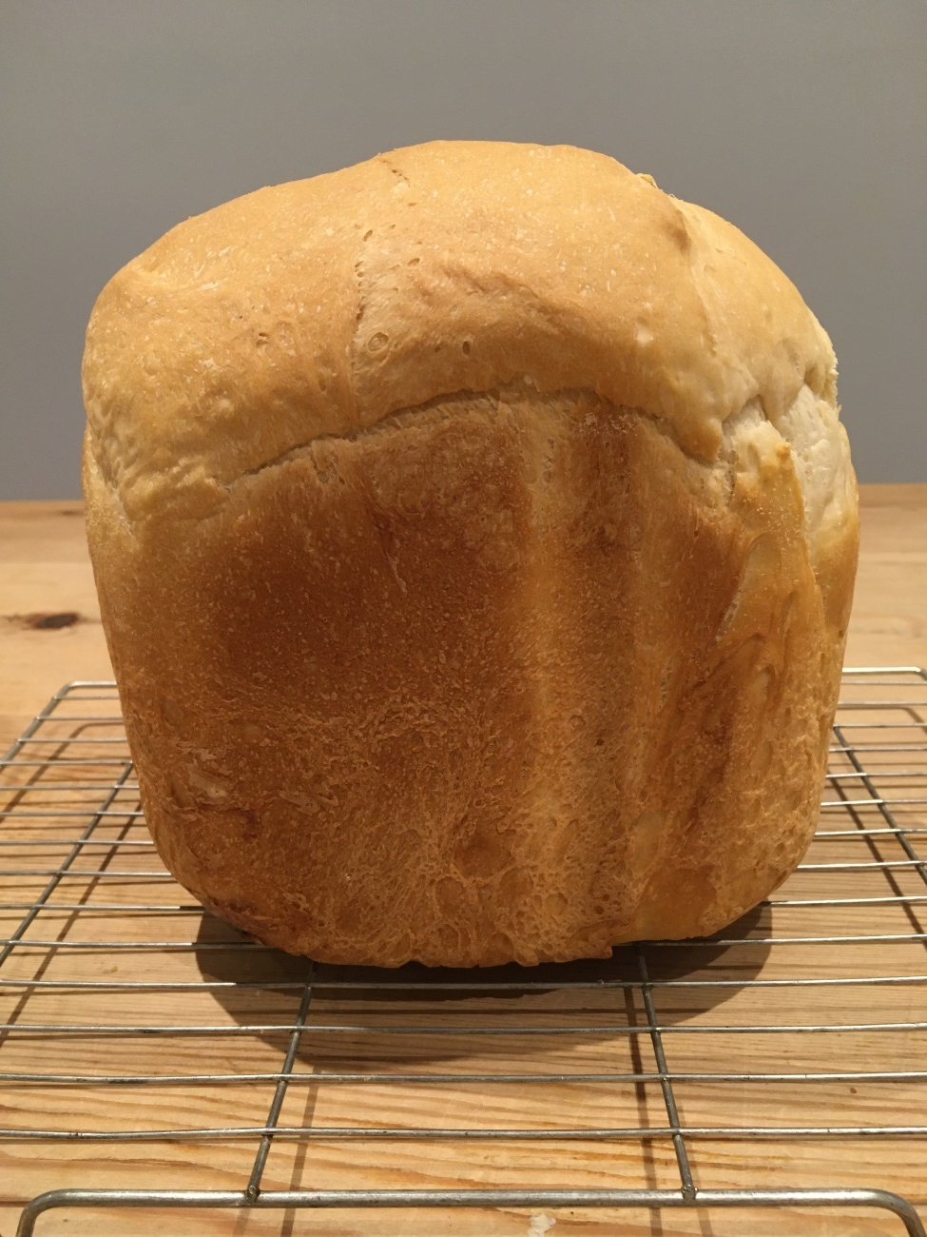
Bread Baking – A Loaf

Slide 23
Speciality Flour
Heat Treated Flour
Cakes
Soups & Sauces

Slide 24
Durum Wheat
Milled into Semolina (semi-milled)
For Pasta

Slide 25
Teaching Resources
www.foodafactoflife.org.uk
  New Fibre February resources
www.nabim.org.uk
www.fabflour.co.uk

Slide 26
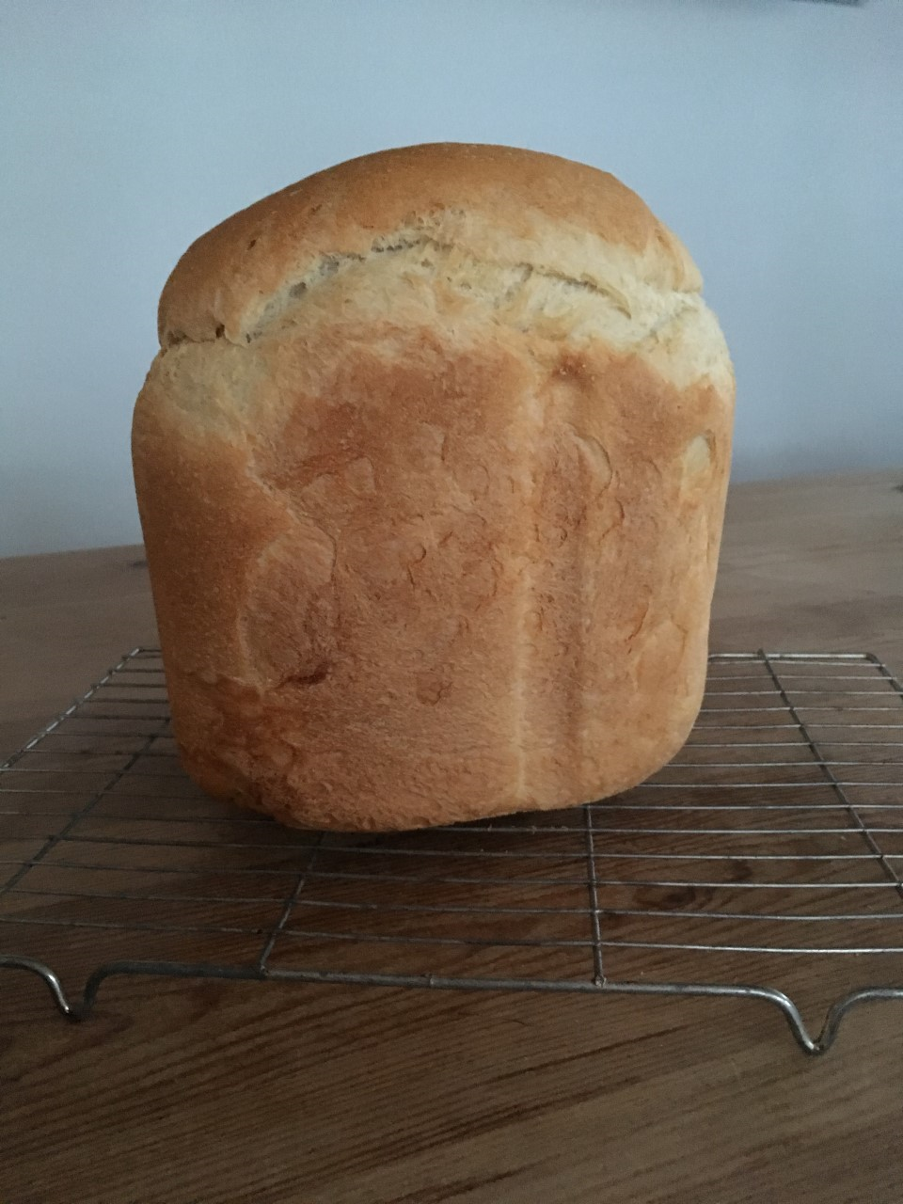
Thank You

