Slide 1
The nutrition of wheat and dairy
Alex White
British Nutrition Foundation

Slide 2
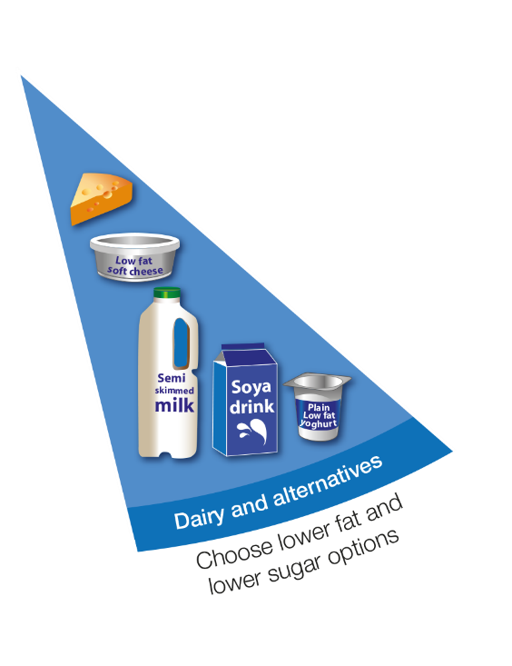
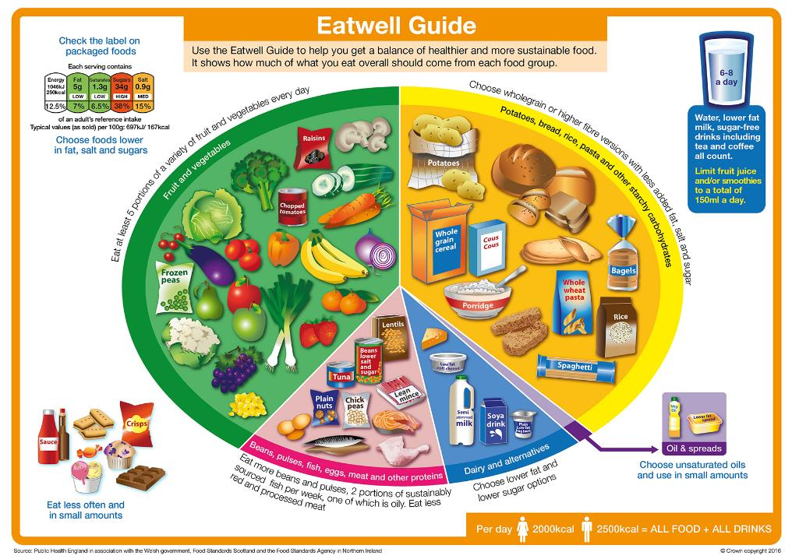
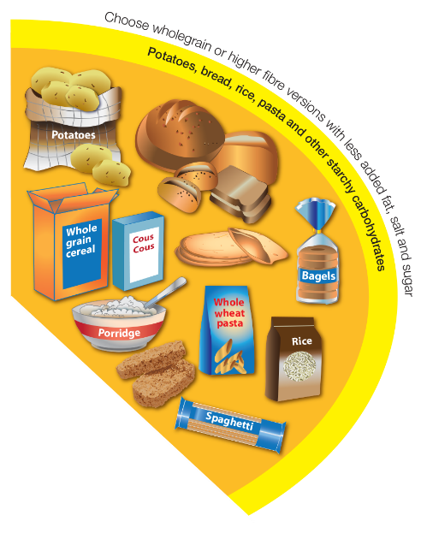
The Eatwell Guide

Slide 3

Wheat – what food is included?
There are many different foods containing wheat in this group of the Eatwell Guide.
Some foods, including rice and potatoes are included in this group, but do not contain wheat.
Wheat is one of the world's most commonly consumed cereal grains and forms a staple part of the UK diet.
Foods that contain wheat include: breads, breakfast cereals, biscuits, crackers, crumpets, scones, pancakes, cakes, pizza, pasta, pastries and Yorkshire puddings.

Slide 4

Myth or fact?
“White bread does not have any vitamins and minerals.”
Myth
White and brown flour in the UK is fortified with iron, calcium, niacin and thiamin. Products made from these types of flour can be a source of these micronutrients, as well as providing protein and fibre.

Slide 5
Nutrient composition of bread
“White bread does not have any vitamins and minerals.”
Average values per 100g | White bread | Brown bread | Wholemeal bread
Iron (mg) | 1.5 | 2.2 | 2.4
Calcium (mg) | 155 | 186 | 106
Niacin (mg) | 1.60 | 2.80 | 3.80
Thiamin (mg) | 0.22 | 0.22 | 0.25

Slide 6
Nutrients in starchy food
Starchy foods can provide:
Fibre – helps to maintain normal bowel function.
B Vitamins – for example thiamin, which helps the body use the energy from the carbohydrates we eat.
Iron – required by red blood cells which transport oxygen around the body.
Calcium – to help develop and maintain healthy bones and teeth.
Folate – needed for the formation of healthy red blood cells and for the nervous system.
It is important when we are choosing starchy carbohydrates that we try to choose wholegrain or higher fibre varieties.

Slide 7
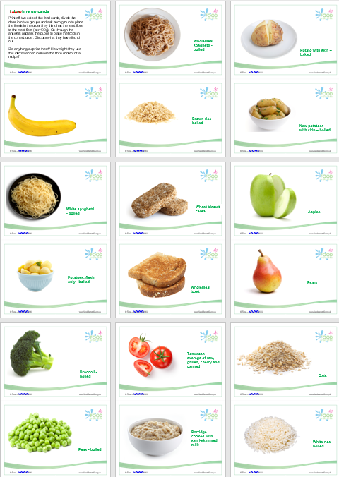
Fibre
Age group (years) | Dietary recommendation (g/day) | Mean intake (g/day)
1.5-3 | 15 | 10.3▼
4-10 | 20 | 14.0▼
11-18 | 25 | 15.3▼
19-64 | 30 | 19.0▼
65+ | 30 | 17.5▼
75+ | 30 | 16.5▼
Adults are recommended to eat 30g of fibre per day.
Current adult intake is around 19g per day on average.
Diets high in fibre are associated with a reduced risk of heart disease, type 2 diabetes and colorectal cancer.
It is also important for digestive health and may increase fullness.
We can consume more fibre by increasing our consumption of wholegrains, choosing a high fibre breakfast cereal and including plenty of fruit and vegetables and pulses, nuts and seeds within our diet.
18% adults & 15% children
have no wholegrain consumption
NDNS
31% adults & 8% teens meet 5 A DAY
The Fibre line up

Slide 8



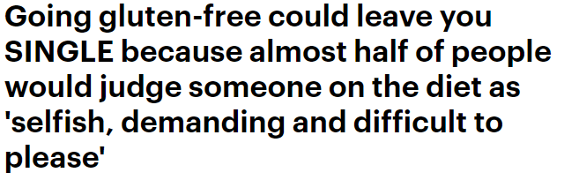
Wheat, gluten and excluding foods
Only around 1% of the population have coeliac disease.
However, a recent survey found that 8% of participants avoid gluten as ‘part of a healthy lifestyle’.
Although some media reporting has indicated benefits to cutting out gluten, there is no reason to do so in the absence of a gluten related disorder.
Mintel 2018

Slide 9

Wheat, gluten and excluding foods
Cutting out gluten without reason may result in poorer nutrition (such as reduced intake of wholegrains, micronutrients and fibre).
Coeliac disease is also more difficult to clinically diagnose if a person has eliminated gluten from their diet.
People who think they suffer from a food allergy or other food intolerance should seek professional advice from their GP.
Wheat intolerance and coeliac disease

Slide 10



Dairy and alternatives – what food is included?
Milk
Cheese
Yogurt
Fromage frais
Cream cheese
Quark
Dairy calcium-fortified alternatives to these foods, such as soya drinks, soya yogurts, and oat, nut and rice milks.
Butters, creams and dairy ice-creams are not included in this group as they are high in saturated fat, and so are included in ‘foods to eat less often and in small amounts’.

Slide 11

Dairy and alternatives
Dairy and alternatives are good sources of protein and some vitamins.
They are an important source of calcium and also iodine.
The calcium in dairy foods is particularly good for us because our bodies absorb it easily.
We should be using lower sugar and lower fat versions of dairy foods and drinks where possible, as some options can be high in saturated fat and sugar.

Slide 12
Nutrients in dairy
Calcium – for the development and maintenance of strong, healthy bones.
Protein – for growth and repair function.
Iodine – important for healthy nerve and brain function, and healthy skin.
Vitamin B12 - for healthy red blood cells and nerve function.
Vitamin B2 (riboflavin) – to help release energy from carbohydrate and protein.

Slide 13
How much does dairy contribute to nutrient intakes?
 | 1.5-3 | 4-10 | 11-18 | 19-64 | 65-74 | 75+
Protein | 31 | 20 | 13 | 13 | 15 | 18
Riboflavin | 53 | 40 | 29 | 27 | 31 | 35
Vitamin D | 25 | 14 | 7 | 5 | 5 | 5
Calcium | 57 | 44 | 34 | 34 | 40 | 45
Iodine | 62 | 51 | 40 | 34 | 37 | 40
Zinc | 34 | 22 | 15 | 14 | 17 | 19
Percentage contribution to nutrient intakes from milk and milk products.
National Diet and Nutrition Survey 2018

Slide 14


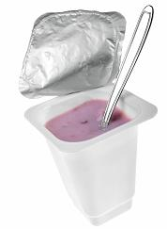
Myth or fact?
Myth
“Reduced fat dairy products contain less calcium than standard varieties.”
Calcium is not removed with the fat when milk is skimmed and therefore skimmed milk actually has slightly more calcium than whole milk.

Slide 15
Choosing lower fat and sugar options
Some dairy products can be high in saturated fat and sugar.
Having a high fat diet can make it easier to consume too many calories and, over time, gain weight.
You can use food labels to help make better choices when choosing dairy products.
Full-fat cheeses and dairy products are recommended up to the age of 2.
Average values per 100ml | Whole milk | Semi-skimmed milk | Skimmed milk
Energy (kcal) | 63 | 46 | 34
Protein (g) | 3.4 | 3.5 | 3.5
Fat (g) | 3.6 | 1.7 | 0.3
of which saturates (g) | 2.3 | 1.1 | 0.1
McCance and Widdowson’s
Notes:
Positive studies for dairy and CVD
Advice to opt for low fat dairy if overweight

Slide 16
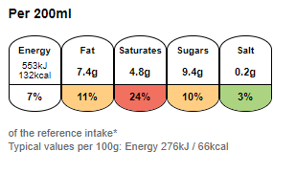
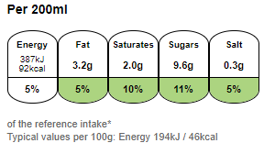
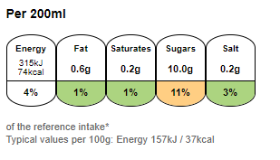
Choosing lower fat and sugar options
Whole milk
Semi-skimmed milk
Skimmed milk

Slide 17
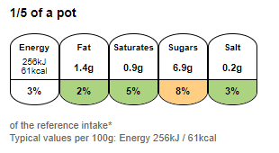
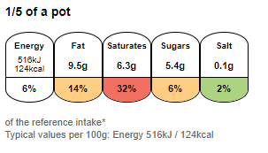
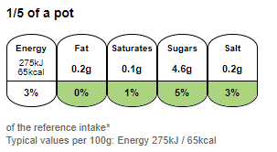
Choosing lower fat and sugar options
Low fat natural yogurt
Greek Style Yogurt
0% Fat Greek Yogurt

Slide 18
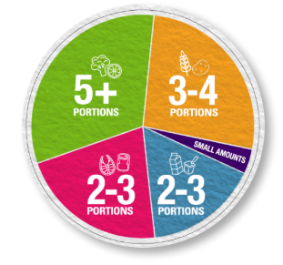

Healthy, varied and balanced diet
A healthy, varied and balanced diet includes:
eating plenty of fruit and vegetables and wholegrains;
trying to cut back on foods high in free sugars and salt;
swapping foods with a high proportion of saturated fats for those rich in unsaturated fats;
following the basic healthy eating principles as depicted in the Eatwell Guide.
Find your balance - get portion wise!

Slide 19
Further information
Reading
Public Health England (PHE)
British Nutrition Foundation (BNF)
Scientific Advisory Committee on Nutrition (SACN)
Resources
The Eatwell Challenge
Eatwell Guide videos
Eatwell Guide Kahoot quizzes
Eatwell Guide posters
Fibre line up
Dairy posters

Slide 20
The nutrition of wheat and dairy
For further information, go to:
www.foodafactoflife.org.uk

