Slide 1
Cooking in schools – why?
Roy Ballam
1 February 2020

Slide 2
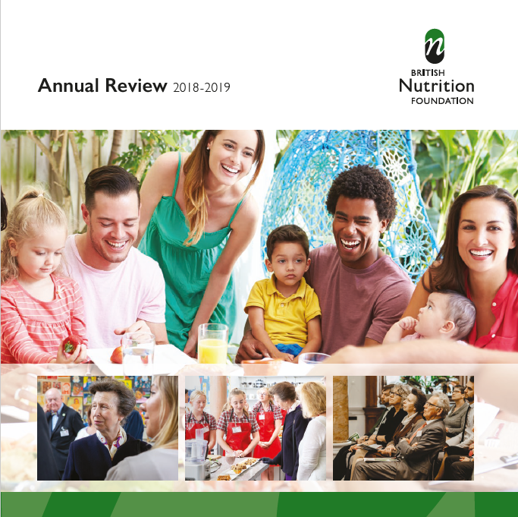
The British Nutrition Foundation
Independent charity
Established in 1967
Vision: Everyone can access healthy, sustainable diets
Work realised through websites; media engagement; Nutrition Bulletin; conferences and events; publications; training; work with schools; projects and collaborations; wider stakeholder engagement; awards
Patron HRH The Princess Royal
www.nutrition.org.uk
https://www.nutrition.org.uk/aboutbnf/whoweare/annualreports.html

Slide 3
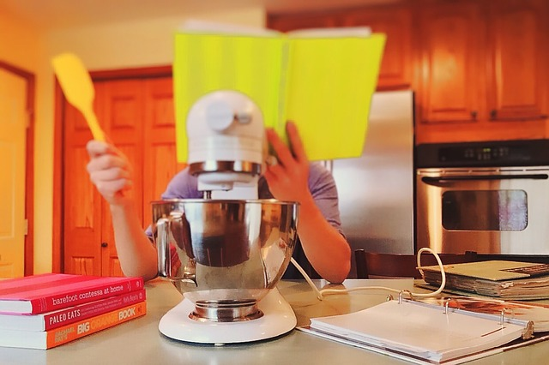
Today
Overview
What’s happening in our society?
Let’s face up to how we live
What do we want for the future?
Barriers, research and opportunities

Slide 4
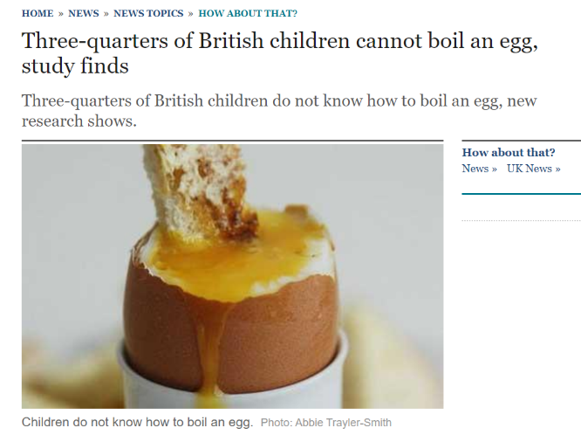
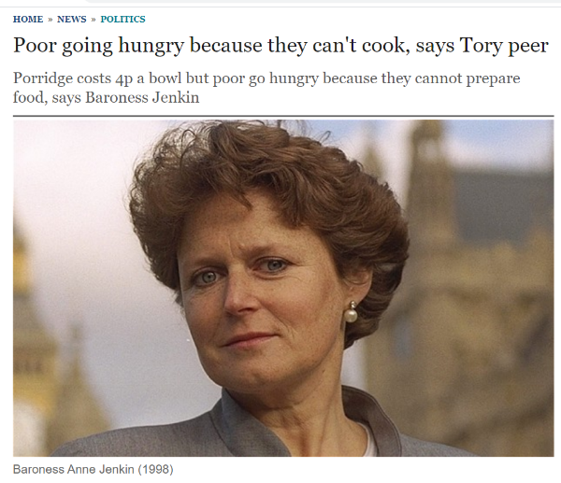
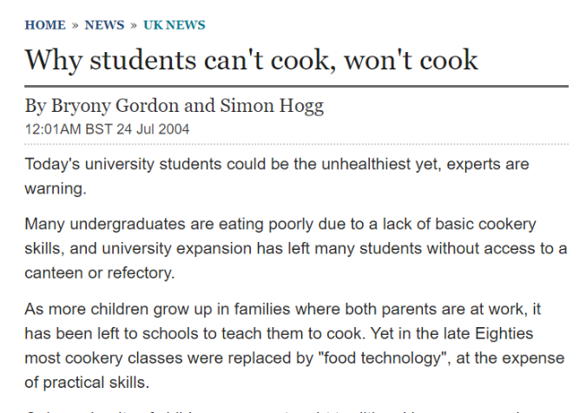
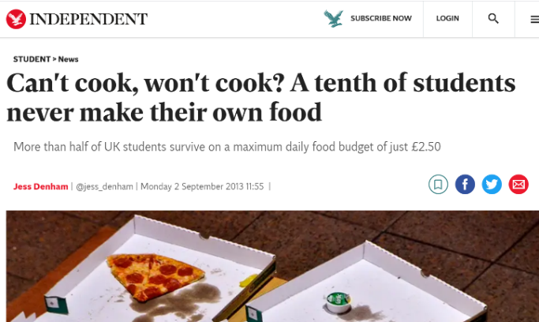
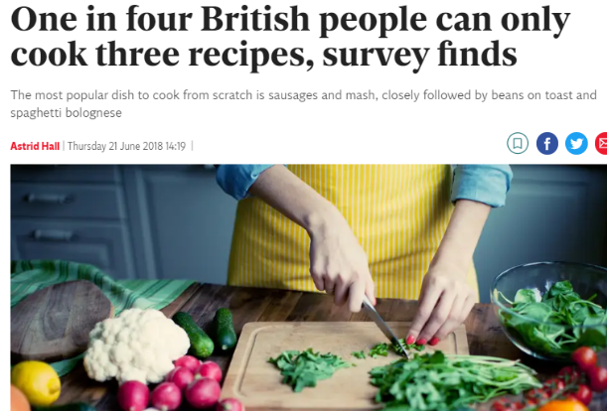
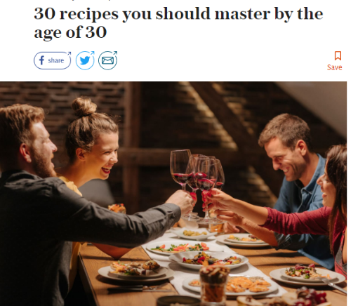
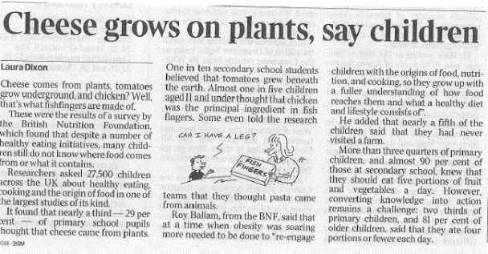
Overview

Slide 5
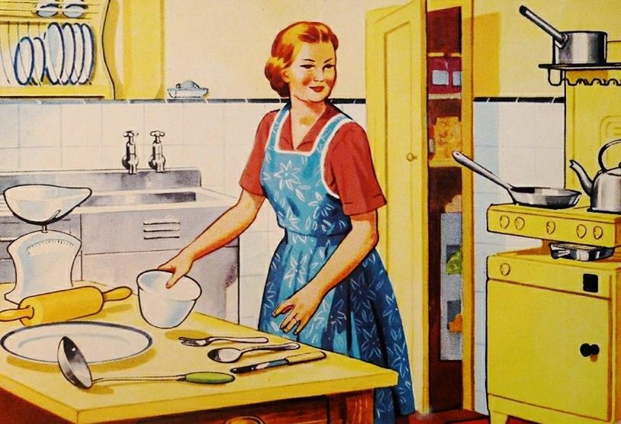
What’s happening in society?

Slide 6
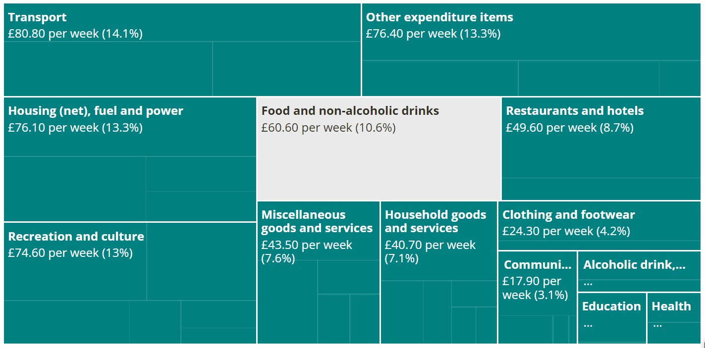
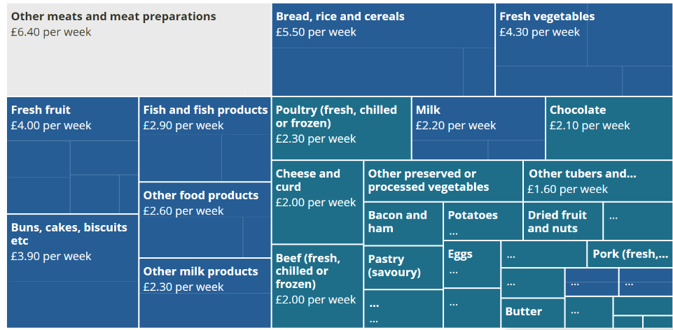
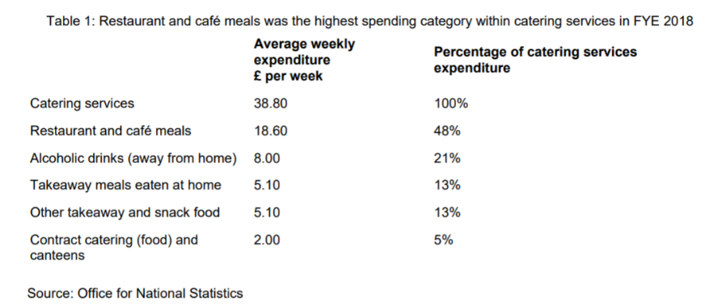
Spending on food
Family spending in the UK
Food at home £55.70
Restaurants £38.80
https://www.ons.gov.uk/peoplepopulationandcommunity/personalandhouseholdfinances/expenditure/bulletins/familyspendingintheuk/financialyearending2018
Notes:
Comparing spending across the different income groups, households in the two lowest equivalised disposable income deciles spent proportionally more on takeaway meals eaten at home, with the poorest 10% of households spending 19% and the second-poorest spending 22% of their overall catering services expenditure on takeaways.
Percentage (eating out) – 2001 it was: 2.7%, in 2017 it was 3.4%

Slide 7
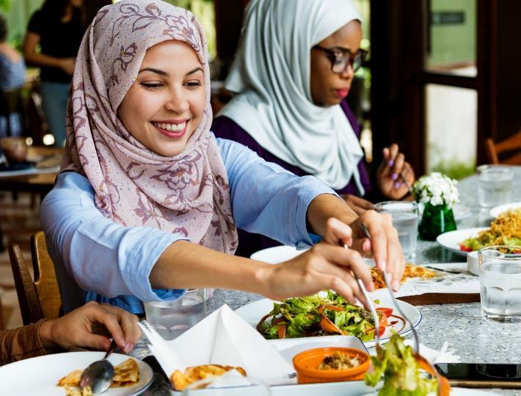
Attitudes towards cooking
60% 16-34s like experimenting with new cooking trends and ingredients, compared to 51% of UK consumers overall.
While they show a passion for experimental cooking, they appear to struggle to master the basics.
Although the majority of young consumers love to cook, it is deemed too difficult by almost half (46%).
Why? Cooking from scratch produces too much washing up; preparing raw ingredients is a hassle, for example peeling and chopping.
https://www.mintel.com/press-centre/food-and-drink/60-of-uk-16-34-year-olds-who-cook-like-experimenting-with-new-cooking-trends-but-many-fail-to-master-the-basics (2016)

Slide 8

I intend to cook, but …
Those saying they intend to increase the number of meals they cook from scratch at home is almost half of consumers (AHDB/YouGov, March 2019).
Younger consumers are driving the increase in scratch cooking, with 58% of 25–34-year-olds saying they intend to cook more meals from scratch.
Why? Price. Enjoyment. Health.
Despite a desire to cook more, some consumers were deterred by barriers such as lack of time, knowledge and confidence in the kitchen.
https://ahdb.org.uk/news/consumer-insight-falling-consumer-confidence-feeds-scratch-cooking-increase
Notes:
Price
Price is the number one factor for shoppers buying meat and dairy (see AHDB meat shopper journey report) and, with increased economic uncertainty, consumers who check the price of products before buying them has risen to 80% (AHDB/YouGov). As the convenience offered by pre-prepared foods often comes with a large price tag, 26% of consumers said they would rely less on pre-prepared foods if money was tight (Kantar Worldpanel Plus | April 2018).
Eating for enjoyment
For many, cooking is a hobby. Most consumers said they enjoyed cooking and 58% like to experiment. Consumers who claim they would rather do other things than waste time cooking are at the lowest level since the start of AHDB’s consumer survey in 2015 (AHDB/YouGov).
Nearly 9 out of 10 consumers believe that knowing how to cook affects what you can eat (AHDB/YouGov). Cooking ability empowers consumers to eat foods they enjoy and adds variety to meals. Taste has always been the primary reason for food choice but even more so now – there has been a rise of 5% since 2014 of meals eaten due to taste (Kantar Worldpanel | Total food| 52 w/e 7 Dec 14 vs 52 w/e 2 Dec 18).
Channels such as YouTube and Instagram provide easy-to-follow tutorials and recipe inspiration, with consumers opting to follow a variety of social media ‘influencers’ depending on their interests. Bloggers such as Joe Wicks for those interested in fitness, or Deliciously Ella for plant-based, for example.
Health
The increase in scratch cooking could be influenced by consumers who want to eat less processed and more natural foods. More information is available to consumers relating to health, with many turning to diet and fitness apps to track calories, nutrition and more. Pre-processed foods can be viewed by consumers as unhealthy, as they can have high levels of salt and sugar. Cooking from scratch enables consumers to have greater control over what they eat.

Slide 9
Attitudes to cooking
Level of cooking skill
40% - I enjoy cooking and I'm confident cooking a wide variety of dishes
32% - I enjoy cooking but have a limited repertoire of things I feel confident cooking
18% - I cook because I have to but don't particularly enjoy it
8% - I can cook very basic things and often use ready meals
2% - I can't cook at all and so don't really bother to try
47% would cook more if knew more simple dishes using a few key ingredients
28% would rather do other things than waste time cooking
23% don’t need to cook these days as there are so many options that you can buy to get great tasting food
https://ahdb.org.uk/news/consumer-insight-attitudes-to-cooking (Oct-Nov, 2019)

Slide 10
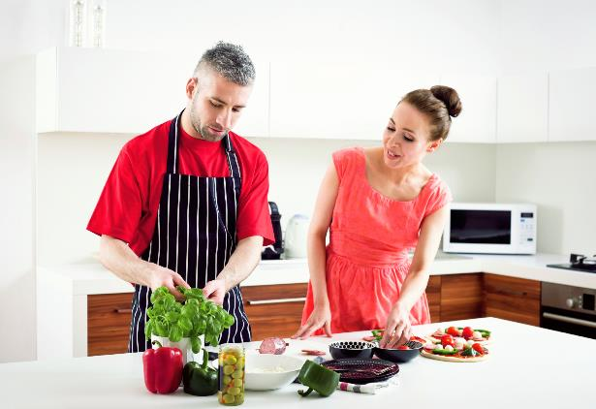
Cooking from scratch
AHDB’s tracker findings show that 78% of people say they cook from scratch once a week or more, with little variation by age.
41% intend to increase the number of meals they cook from scratch at home.
76% always check the price of food before buying it
Mintel ask respondents about dishes created completely from scratch (defined as using uncooked ingredients)
around a third of 16—24 year-olds say how they mostly prepare evening meals is by cooking completely from scratch, compared with over 50% of those aged 55 or over.
Ease of preparation is another key factor in meal choice and, for this reason, ready-to-cook shortcuts and component meals that remove the need to cook from scratch have a broad appeal.
AHDB definition ‘scratch cooking’: to prepare and cook a home-made meal with a recipe that uses fresh, raw and store cupboard ingredients.

Slide 11
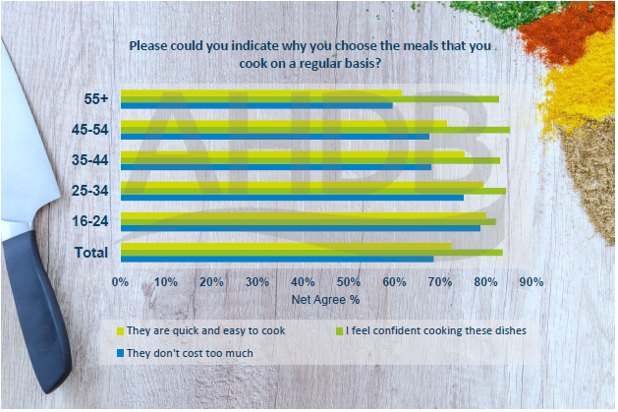
Cooking confidence
Cooking confidence is a key factor in choice of meal to cook across all age groups
There’s a willingness to learn …
33% want to learn to cook more recipes
34% want to learn how to cook something new
How we live is changing …
1990, 21% of 2034 year olds lived with parents – in 2017 it was 26%
Those aged 16-24 years more likely to sit and eat alone than any other age group
Recipe inspiration is online/social media – increasingly important to many
https://ahdb.org.uk/news/consumer-insight-attitudes-to-cooking (Aug, 2018)

Slide 12
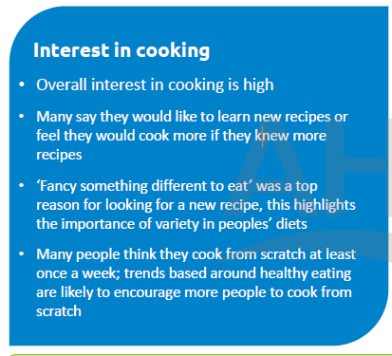
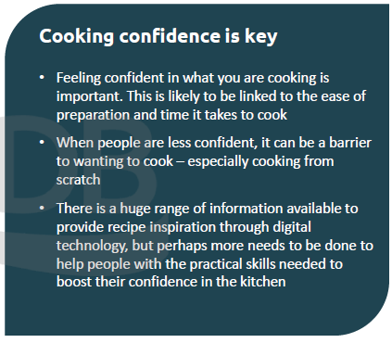
Summary
https://ahdb.org.uk/news/consumer-insight-attitudes-to-cooking (Aug, 2018)

Slide 13
Where do we learn?
Source of learning
Sources of new recipe inspiration (Oct/Nov-19)
Aug 2019
Oct/Nov 2019
Parents
Cookery books
Food websites
Come up with them myself
Other family members
62%
66%
50%
51%
Food websites 48% of Females vs 38% for Males
37%
39%
Cookery books 35% of 16-44s vs 44% for over 45s
37%
35%
Social Media 21% of Females vs 13% amongst Males
29%
29%
-2 WoW
Base: All respondents who can cook at all (Oct/Nov-19: 4249)
EQ31: Please select where you learnt to cook the dishes you cook regularly?
EQ32: Please select where you go for inspiration for new recipes?

Slide 14
Is it important to know how to cook?
Interest in cooking (agreement):
+2 YoY
+3 YoY
Base: All respondents (Oct/Nov-19: 4341)
EQ35_5/10. To what extent do you agree or disagree with these statements? I would rather do other things than waste time cooking/ am intending to increase the number of meals I cook from scratch at home
EQ35a_1 – I think it’s important to know how to cook as it affects what you eat

Slide 15

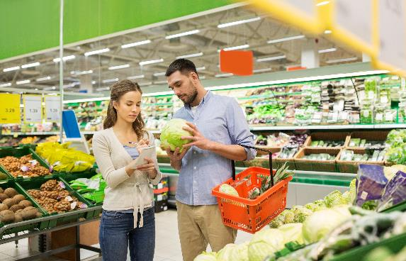
Let’s face up to how we live …

Slide 16
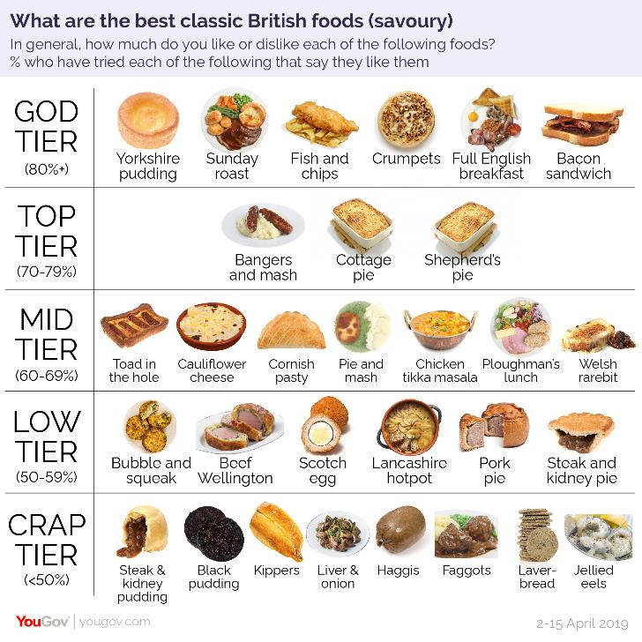
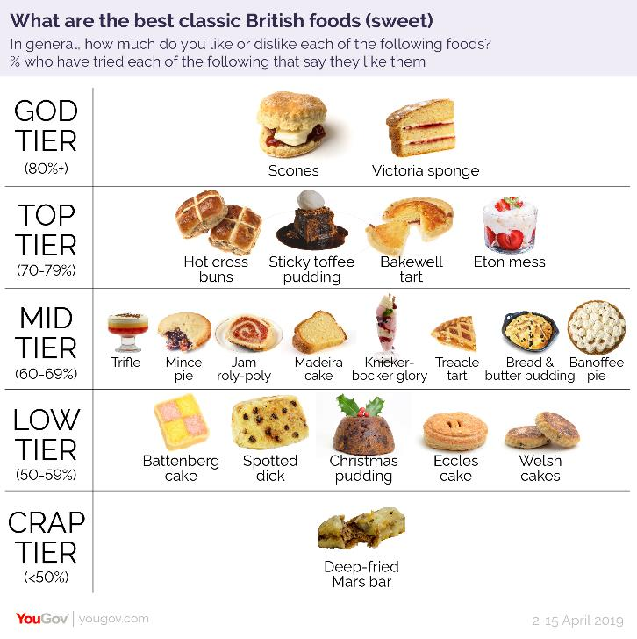
If we do cook, what do we make/like?
Nation’s favourite home-cooked recipes
Curry – 11.11%
Spaghetti bolognaise – 10.27%
Roast dinner – 10.20%
Lasagne – 6.75%
Chilli – 6.31%
Casserole – 3.56%
Stir fry – 3.36%
Shepherds pie – 3.15%
Cottage pie – 2.98%
Soup – 2.44%
1. Sausages and mash
2. Beans on toast
3. Spaghetti bolognaise
4. Boiled egg and soldiers
5. English breakfast
6. Roast dinner with vegetables and gravy
7. Omelette
8. Stir fry
9. Porridge
10. Tuna mayonnaise jacket potato
11. Soup
12. Shepherd's/Cottage pie
13. Pie and mash
14. Pancakes
15. Chilli Con Carne
16. Lasagne
17. Baked salmon with vegetables
18. Spaghetti and meatballs
19. Toad in the hole
20. Macaroni and cheese
2,000 people - "stuck in a rut" due to their lack of culinary skills
Seven out of 10 admitted they rely on shortcuts such as pre-chopped veg, crushed garlic and ready-to-eat rice to ensure dinner is a success
https://www.independent.co.uk/extras/lifestyle/british-people-cooking-recipes-kitchen-skills-food-dishes-survey-a8409586.html
https://ubamarket.com/uks-favourite-recipe-curry/
https://yougov.co.uk/topics/food/articles-reports/2019/06/11/classic-british-cuisine-ranked-britons
Notes:
recent YouGov survey found that 91% of Britons enjoy their own national cuisine.

Slide 17
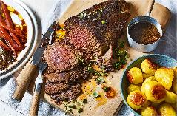
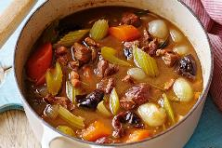
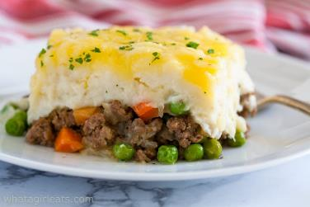
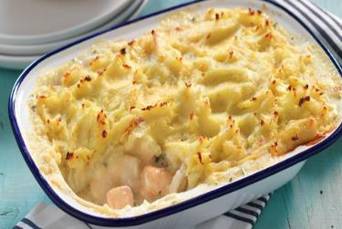
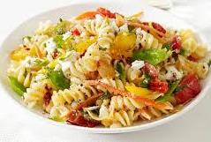
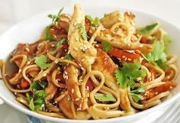
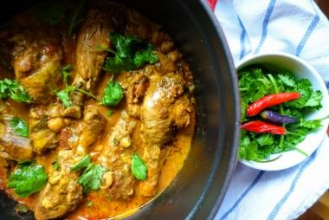
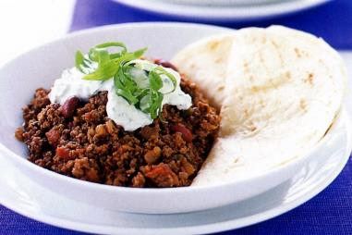
What's the trends?
Traditional meals are declining in favour of world cuisines over the last 4 years
Roast Dinners -8%
Casserole -22%
Shepherds pie -7%
Fish pie -16%
Italian Food +14%
Oriental Food +12%
Indian food -3%
Mexican +2%
Source: AHDB/Kantar Worldpanel Usage
Total Foods | Top Dishes | 52 w/e September 2019 vs 2015
17

Slide 18
What influences what we cook?
What take into account:
Food influences (Oct/Nov-19)
Income (59%)
Living arrangements (34%)
Cultural background (15%)
News stories (7%)
Social Media (7%)
Religious background (3%)
Lifestyle (60%)
-2 WoW
-5 WoW
-4 WoW
+2 WoW
Source: YouGov UK Profiles question
Base: All respondents (Oct/Nov-19: 4696/ 4341)
YouGov UK Profiles ‘cooking_concern’: Which, if any, of the following do you take into consideration when deciding what to eat, whether at home or out of home?
YGq12_wave13: Which of the following, if anything, influences what you eat?

Slide 19
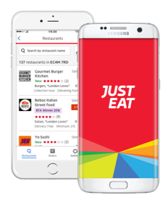
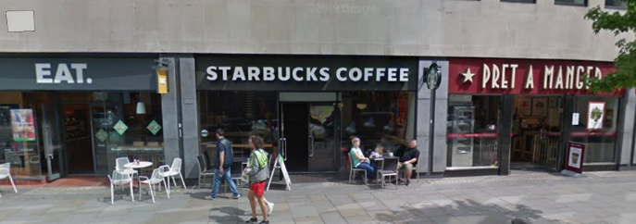


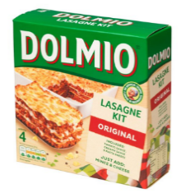
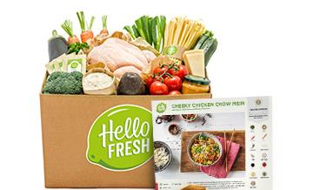
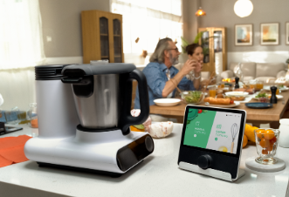
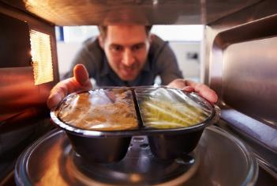
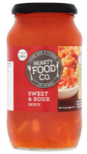
How we shop … how we eat …
Eating out
Take away and delivery
Shopping
Assemble/Warm-up
Meal kits
Technology/Devices
Notes:
Take away/delivery – quick service food, as well as traditional restaurants

Slide 20
So, do we need to cook?
Location
Food skills and confidence
Take-away
Money
Knowledge / food and recipe repertoire
Delivery
Occasion
Kitchen (storage/equipment)
BUT – IS THIS WHAT WE REALLY WANT FOR OUR SOCIETY AND FUTURE?
Alone, family, friends
Cook v assemble

Slide 21
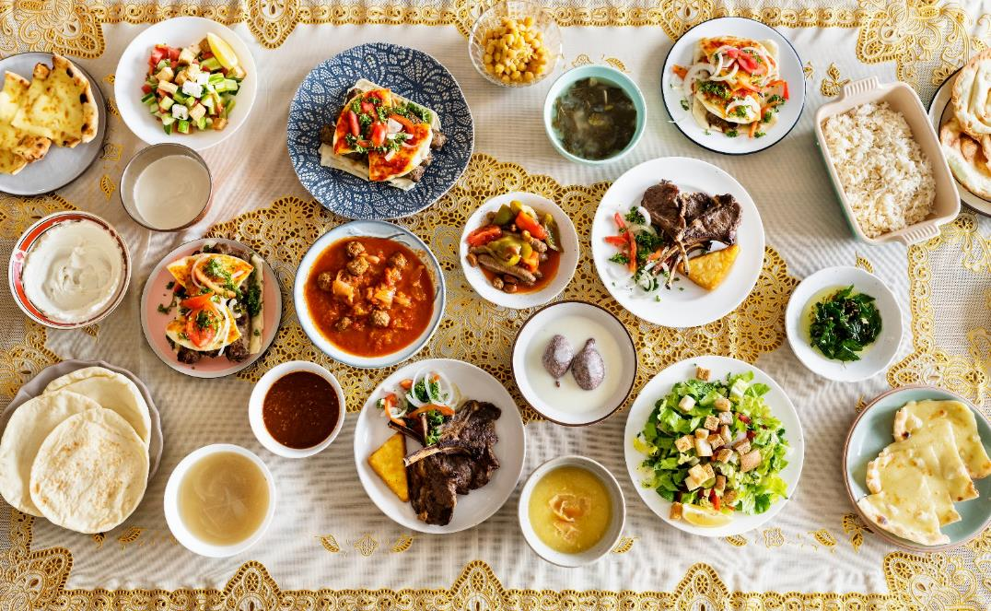
Food …
it’s a fact of life
Society
Culture
Religion
History
Tradition
Provenance
Where we live
Shared experiences
Who we are
Who we are with
Pleasure

Slide 22


So, what do we want for the future?

Slide 23
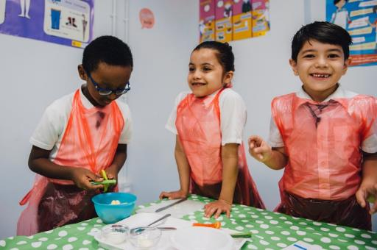
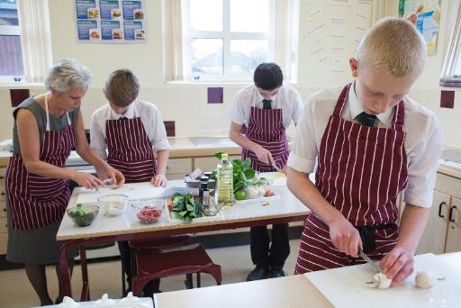
OK, why ‘cook’ at school?
Curriculum – unique element of food education
Food literacy skills – developed over time
Cross curricular – embrace other learning (make it real)
Part of a comprehensive ‘food education’ package
Culture – reflect background, passion and personality
Social – reduce isolation, work with others
Health – apply healthy eating in meaningful ways
Technology – where and how our food is produced and processed
Life skill – a skill for ‘life’
Enjoyment – you might just have fun!

Slide 24
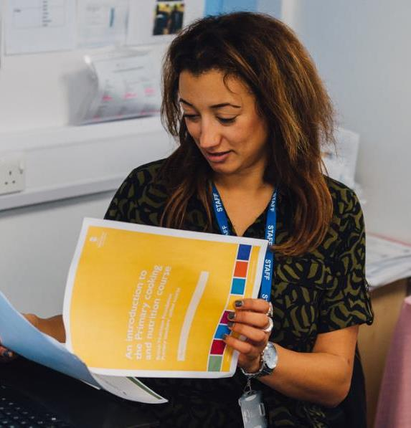
Barriers – the reality
Just over 50% primary schools have less than 10 hours of food education a year (14% secondary schools).
Lack of time (timetabling), budget and facilities and resources are seen as barriers to teaching the content of the curriculum.
Staff training and experience is challenging, especially for secondary schools.
Design & Technology Association reports that during the primary training year, a trainee might receive around three hours of D&T study (with food just being one part).
Low level entering the profession at secondary level (35 ‘food’ specific places in 2017/18 in England).
Food Education Learning Landscape (2017) For more information on the findings, and to read the full review, the report and appendices can be accessed at: http://bit.ly/2hRBhwC
Initial teacher training number census 2017 to 18, DfE 2017 https://www.gov.uk/government/statistics/initial-teacher-training-trainee-number-census-2017-to-2018

Slide 25

What does research say?

Slide 26

Research
… some evidence for an association between teaching cooking skills and improved nutrition knowledge, changing food preferences, increased confidence in cooking skills and healthier eating habits. (Caraher 2010)
… School based kitchen garden - increases in children’s reported willingness to try new foods. (Gibbs 2013)
Is cooking dead? Many school administrators, non-home economics teachers and some parents do not value Home Economics Food and Nutrition education; Home Economics Food and Nutrition education is seen as less valuable than math and science for future career planning; outdated curriculum and teaching infrastructure; reduced numbers of new home economics teachers; decreasing student food knowledge and skills; and changing social norms regarding food and eating (increased use of convenience foods across population groups, a youth ‘fast food culture’ and fewer family meals). (Slater 2013)

Slide 27
Research
Impact of cooking classes (systematic review 2003-2014): Findings suggest that cooking programs may positively influence children’s food-related preferences, attitudes, and behaviors. Further research is needed to fill knowledge gaps on ideal program length, long-term effects, and usefulness of parent engagement, tasting lessons, and other intervention components. (Hersch 2014)
Perceptions of cooking education: Eleven focus groups (71 total participants). Students who had taken cooking classes displayed cooking confidence, developed additional non-cooking-related skills, and valued the courses. Students believed cooking is a life skill, would like to learn more skills and about cultural cuisines, and thought cooking classes should be offered, but not required for all high school students. (Hansen 2019)
Education policy: The authors conclude that food education should form part of the curriculum, but rather than a piecemeal approach, they recommend it be taught, by specialist teachers, in an integrated, sequential and developmentally appropriate manner through an established subject, such as Home Economics. (McCloat/Caraher, 2019)

Slide 28


What’s the opportunities?

Slide 29

Opportunities
SMT/SLT and governors ‘on board’
Healthy Schools / Healthy rating scheme (whole school)
Curriculum, including the new RSE and Health Education (all schools) “the principles of planning and preparing a range of healthy meals”
Modern, culturally appropriate recipes which promote The Eatwell Guide (considering cost)
Food literacy approach - not just cooking …
Teacher CPD – planned, undertake and implemented
Feedback from pupils and parents/carers – do they believe it is important?
Establishing minimum standards for food education in schools, e.g. 18/24 hours/year
Minimum standards (FELL, 2017)
Allocate a ring‐fenced budget for food education (￡/per pupil)
Follow Cooking and nutrition, as set out in the National Curriculum (England)
Set a curriculum which supports progression in teaching and learning from one year group to the next, as set out in the government's ‘Core Competences for Children and Young People aged 5–16 years’ (PHE 2016)
Nominate a Food Education Lead, who co‐ordinates, monitors and reports on food education activities throughout the school to Senior Leadership Team, ensuring tie‐in to whole school food policy
Ensure that all teachers that teach food are trained to (or working through) the government's ‘Food teaching in primary/secondary schools: knowledge and skills framework’ (PHE 2015a,b)
Have a whole school food policy/plan which is implemented, monitored and reported on

Slide 30
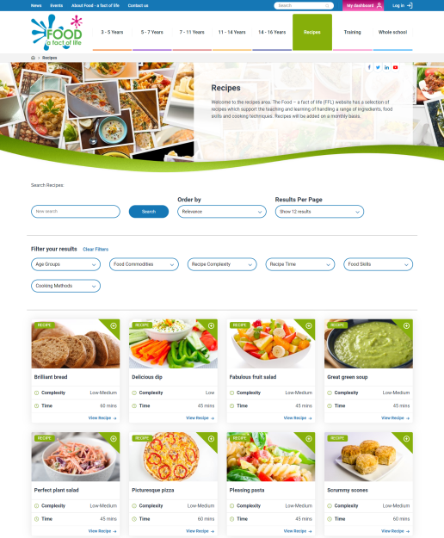
How can FFL help?
Resources
Recipes
Management
Training
www.foodafactoflife.org.uk

Slide 31

Take home messages
Cooking, as part of food education, can play a role in child development and wellbeing
There’s a need to listen to what current consumers want … helping them and future generations
Food education needs to be compulsory for all, with standards for time, resource and teacher support
Let’s work together – enjoy your food, and share your passion

Slide 32
Reading list
https://ahdb.org.uk/news/consumer-insight-falling-consumer-confidence-feeds-scratch-cooking-increase
https://www.foodnavigator.com/Article/2019/09/13/Future-Thinking-How-are-UK-consumers-shopping-and-eating-in-2019
https://www.mintel.com/press-centre/food-and-drink/60-of-uk-16-34-year-olds-who-cook-like-experimenting-with-new-cooking-trends-but-many-fail-to-master-the-basics
https://www.foodspark.com/Trends-People/7-consumer-attitudes-towards-scratch-cooking
https://www.foodnavigator.com/Article/2019/08/19/Consumers-want-both-convenience-and-the-chance-to-cook-from-scratch-HelloFresh-celebrates-its-first-profitable-quarter
https://www.telegraph.co.uk/women/life/rise-diy-meal-kit-fad-future/
https://openaccess.city.ac.uk/id/eprint/7878/
https://www.researchgate.net/publication/235703470_Expanding_Children's_Food_Experiences_The_Impact_of_a_School-Based_Kitchen_Garden_Program
https://www.ncbi.nlm.nih.gov/pmc/articles/PMC4222785/
https://onlinelibrary.wiley.com/doi/abs/10.1111/fcsr.12305
https://onlinelibrary.wiley.com/doi/abs/10.1111/ijcs.12042
https://onlinelibrary.wiley.com/doi/10.1111/nbu.12303
https://drive.google.com/drive/folders/0B6vmekGX5OPfTm9xMzc5VkpCUTg
http://www.gov.uk/government/publications/food-teaching-in-primary-schools-knowledge-and-skills-framework
http://www.gov.uk/government/publications/food-teaching-in-secondary-schools-knowledge-and-skills-framework
http://www.nutrition.org.uk/foodinschools/competences/competences.html

Slide 33
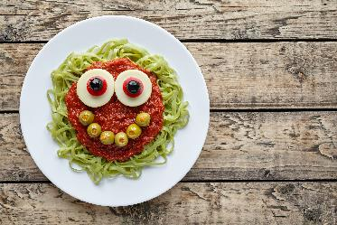
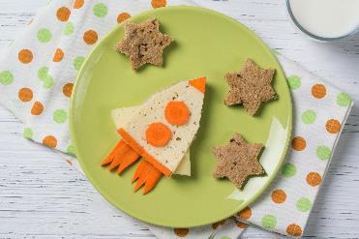
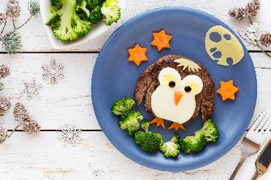

Thanks for listening and enjoy your food!
For further information, go to: www.nutrition.org.uk or www.foodafactoflife.org.uk

