Slide 1
Sports and nutrition – what is the connection?

Slide 2

Sport and nutrition
Ensuring people who are active get the right nutrition is vitally important for many aspects of training and performance. This can include:
maximising performance in a chosen sport or exercise;
reducing the risk of injury and illness;
ensuring the best recovery after exercise or a training programme.
However, whilst there is lots of media attention around nutrition for very active people, how does this translate for the general population?

Slide 3


The context of energy and exercise
Notes:
The requirements for energy are higher in those that are very active.

Slide 4



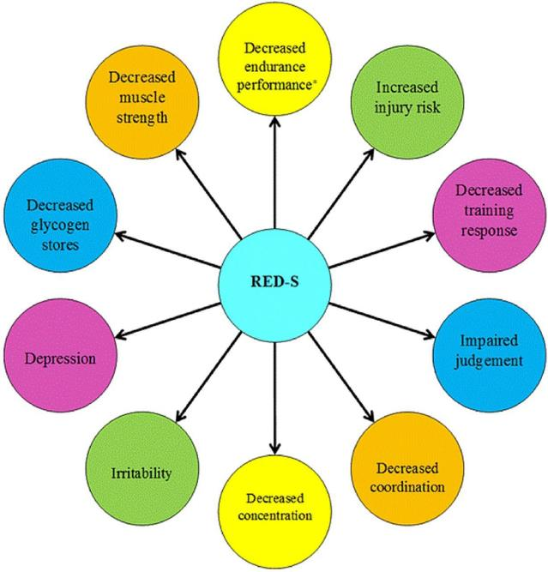
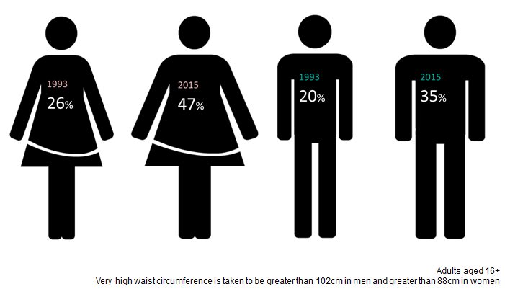
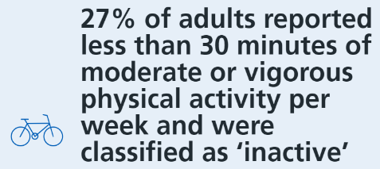
The context of energy and exercise
Relative energy deficiency in sport
63%
1 in 5 children starts school overweight or obese.
By the time children leave primary school, 1 in 3 are overweight or obese.
Health Survey England 2018
Statuta et al.

Slide 5

Supplementation
Supplements can include: micronutrients, macronutrients or other substances that may incur a performance benefit (e.g. creatine).
A high proportion of athletes take supplements, estimated at around 64% of athletes.
18% of the supplements used were rated as having a ‘low level of scientific evidence’.
65% of all UK adults reported having taken some form of vitamin or supplement in the past year.
In 2016, the global supplement market was estimated to be worth $132.8 billion in 2016.
Baltazar-Martins et al. 2019
Mintel – ‘Vitamins and Supplements’ report, 2016
Zion Market Research

Slide 6

Why are people taking supplements?
The main reasons people are taking supplements are:
to correct or prevent nutrient deficiencies that may impair health or performance;
for convenient energy and nutrient intake around an exercise session;
to achieve a performance benefit.
But supplements can be expensive and ineffective and we should be taking a ‘food first’ approach.
Maughan et al. 2018

Slide 7
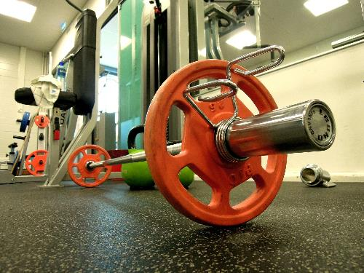

Protein supplements
The main role of protein in the body is for growth, repair and maintenance of body cells and tissues, such as muscle.
15-25g of high quality protein, has been shown to be enough for optimum muscle protein synthesis following any exercise or training session for most people.
Any excess protein that is ingested will be used for energy.
The recommendations for daily protein intake are set equally for both endurance training and resistance training athletes.
American College of Sports Medicine (ACSM)
Notes:
Add current protein intakes

Slide 8
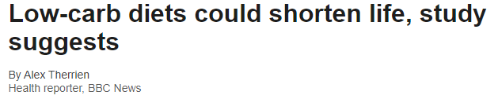
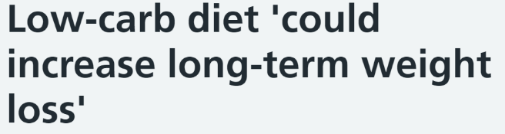


Low carbohydrate diets
There has been an increase in the interest around low carbohydrate diets, for weight loss or sport performance in particular.
There is some evidence that low carbohydrate diets can be effective for weight loss in the short term.
In the long term, it doesn’t seem that low carbohydrate diets are better than other approaches (such as low fat diets) for weight control.
It’s important to remember, different diets work for different people so it is important to find a diet you can stick to.

Slide 9
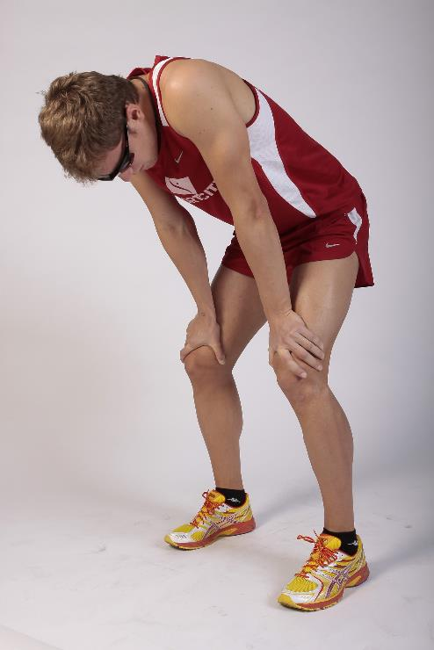
Carbohydrate and sport
The main role of carbohydrate is to provide energy and therefore it is important in exercise.
When they are digested, carbohydrates are broken down into glucose to provide readily available energy for the body to use quickly and effectively.
The body can store carbohydrates in the muscles and liver as glycogen, and use these stores as a source of fuel for the brain and muscles during physical activity.
These glycogen stores are limited, so it is important to be fully fuelled at the start of any exercise and to refuel post exercise.

Slide 10
General health and the importance of fibre
Age group (years) | Dietary recommendation (g/day) | Mean intake (g/day)
1.5-3 | 15 | 10.3▼
4-10 | 20 | 14.0▼
11-18 | 25 | 15.3▼
19-64 | 30 | 19.0▼
65+ | 30 | 17.5▼
75+ | 30 | 16.5▼
Adults are recommended to eat 30g of fibre per day.
Current adult intake is around 19g per day on average.
Diets high in fibre are associated with a reduced risk of heart disease, type 2 diabetes and colorectal cancer.
It is also important for digestive health and may increase fullness.
We can consume more fibre by increasing our consumption of wholegrains, choosing a high fibre breakfast cereal and including plenty of fruit and vegetables and pulses, nuts and seeds within our diet.
18% adults & 15% children
have no wholegrain consumption
NDNS
31% adults & 8% teens meet 5 A DAY

Slide 11
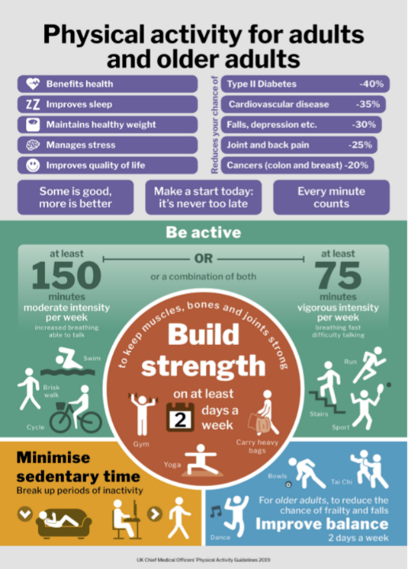
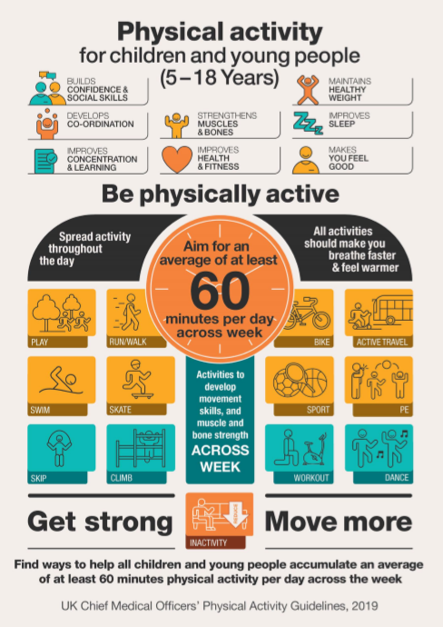
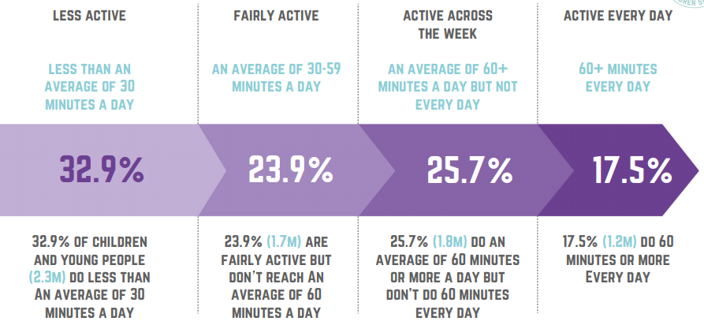
We should all be getting active!
Health Survey England 2018
Active lives children and young people survey 2017/18
CMO Physical activity guidelines

Slide 12
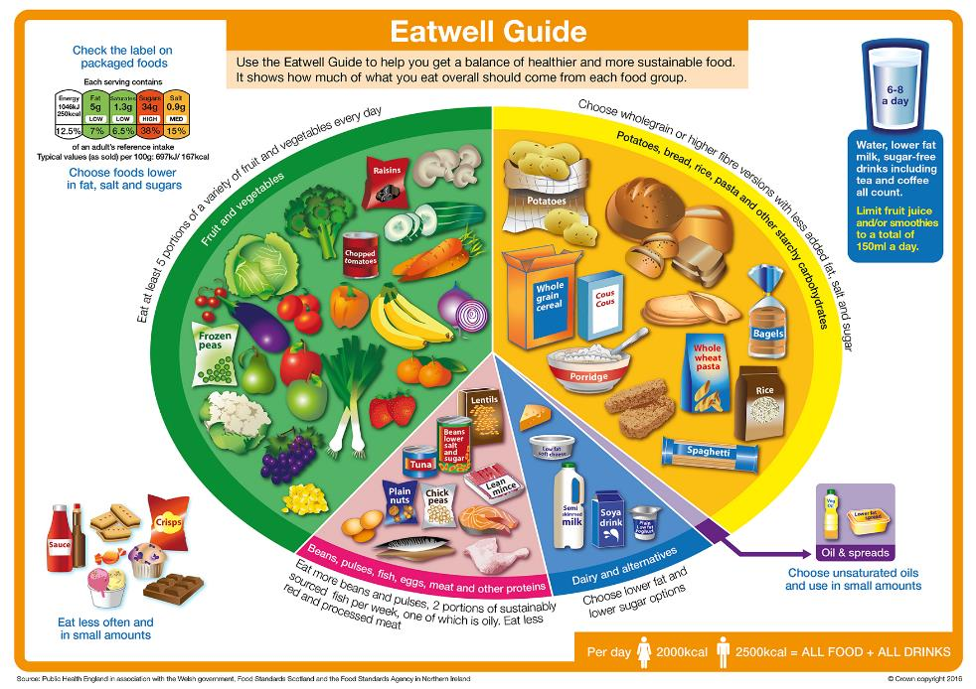
And following healthy, varied and balanced diets

Slide 13
Sports and nutrition – what is the connection
For further information, go to:
www.foodafactoflife.org.uk

