Slide 1
Nutrition and health claims regulation

Slide 2
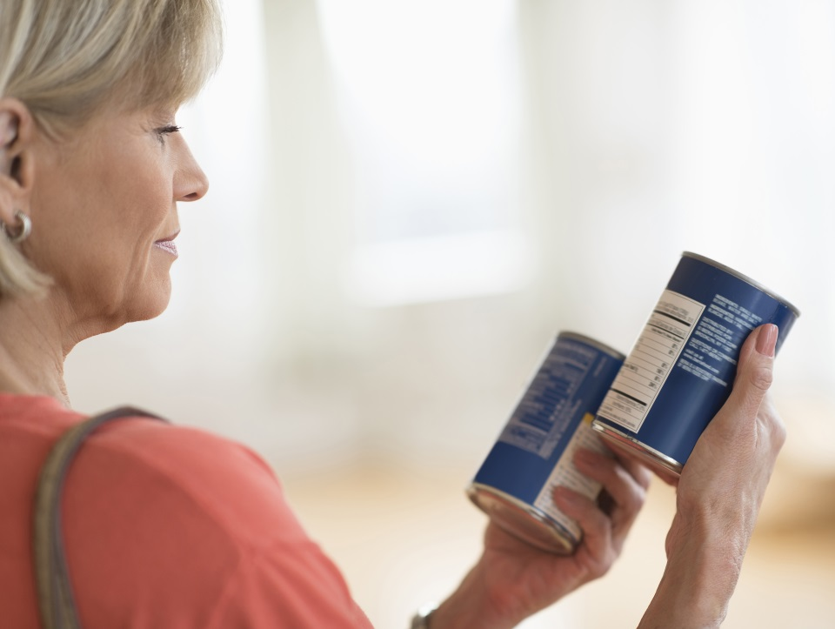
Food labels
Food labels provide information which helps people to know when to eat food, and how to store it safely.
Historically, food label legislation has been dictated by the European Union and this is still the case. However, food label legislation may change after January 2021.
For more information about this, click here.

Slide 3
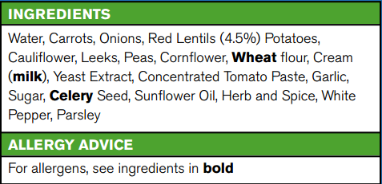
Food labels
The following eight pieces of information must appear by law on food labels:
name of food or drink;
list of ingredients (including additives and allergens – allergens are highlighted in bold);
weight or volume;
date mark;
storage and preparation conditions;
name and address of the manufacturer, packer or seller;
country of origin and place of provenance;
nutrition information.

Slide 4

Nutrition and health claims
Nutrition and health claims on food are also controlled by European regulations.
If you see a nutrition or health claim on a food or drink, it should have been authorised and listed on the European register of claims and will have met certain conditions. Nutrition claims include foods that say ‘source of fibre’ must contain at least 3g of fibre per 100g. Health claims include ‘Calcium is important for normal growth and development of bones in children’.
The aim of the regulation is to make sure that claims made on food are not misleading, and are based on science, as well as encouraging food companies to develop healthier products.

Slide 5
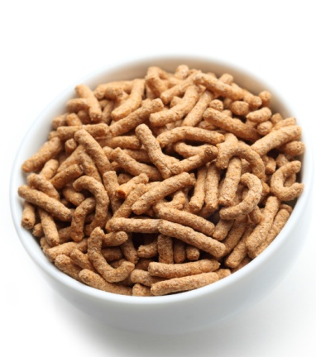
Nutrition claims
A nutrition claim describes what a food contains (or does not contain) or contains in reduced or increased amounts. Examples include:
Low fat (less than 3g of fat per 100g of food);
High fibre (at least 6g of fibre per 100g of food);
Source of vitamin C (at least 15% of the nutrient reference value for vitamin C per 100g of food).
The full list of permitted Nutrition Claims can be found on the European Commission website. https://ec.europa.eu/food/safety/labelling_nutrition/claims/nutrition_claims_en

Slide 6
Nutrition claims
'Nutrition claim' means any claim which states, suggests or implies that a food has particular beneficial nutritional properties due to:
The energy it:
provides
provides at a reduced or increased rate or
does not provide
The nutrients or other substances it:
contains
contains in reduced or increased proportions or
does not contain

Slide 7
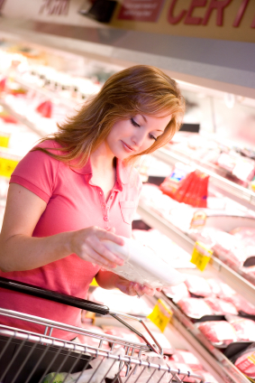
Health claims
A health claim may be featured on the packaging if a food or one of its ingredients has been agreed by experts to provide health benefits. A health claim states or suggests there is a relationship between a product and health.
A list of permitted and rejected health claims was published in November 2011 by the European Commission and is updated on a regular basis. This is now available on the online register at http://ec.europa.eu/nuhclaims/
In order to make a claim, the amount present of the nutrient, substance or food must fulfil the specific conditions of use of the claim.

Slide 8
Types of health claims
'Function Health Claims’ (or Article 13 claims) -
relating to the growth, development and functions of the body, OR;
Referring to psychological and behavioural functions, OR;
On slimming or weight-control.
'Risk Reduction Claims' (or Article 14(1)(a) claims) - on reducing a risk factor in the development of a disease. For example: "Plant stanol esters have been shown to reduce blood cholesterol. Blood cholesterol is a risk factor in the development of coronary heart disease"
Health 'Claims referring to children's development' (Article 14(1)(b) claims). For example: "Vitamin D is needed for the normal growth and development of bone in children"

Slide 9

Health claims
Health claims on food labels are not allowed to state that the food can prevent, treat or cure any disease or medical condition, neither are they allowed to make reference to a rate or amount of weight loss.
If a claim is not already on EC’s register of accepted claims, a claim must be put to the European Food Safety Authority.
Before a company can make a health claim, the evidence to support the proposed claim is reviewed by a panel of experts (the European Food Safety Authority’s NDA panel) who assess whether the claim is supported by all the available scientific evidence. The European Commission (EC) then decide whether to authorise the claim and how it should be worded.

Slide 10
This diagram shows the process that the EC goes through when deciding if a claim is justified.
Making a claim on food
Nutrition Claim
Health Claim
Is the claim about:
- Disease risk reduction?
- Child development and health?
Must be listed in EC nutrition claims annex
NO
Article 13 claim
YES
Article 14 claim
Is the claim based on...?
EC
Health Claims Authorisation process
Generally accepted scientific evidence
New evidence
Member state list of article 13 health claims
EC list of permitted health claims

Slide 11
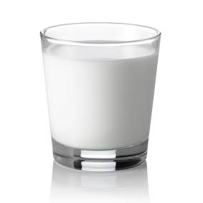
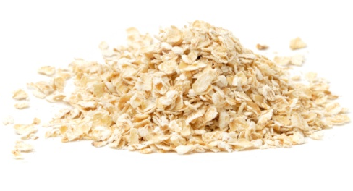
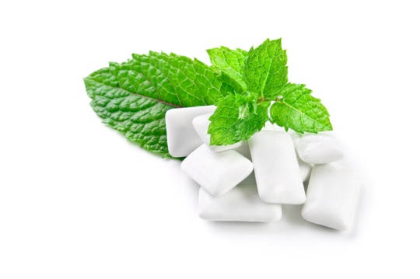
Examples of health claims
Function claims
Folate contributes to maternal tissue growth during pregnancy.
Calcium is important for normal growth and development of bones in children.
Sugar-free chewing gum contributes to the maintenance of tooth mineralisation.
Risk Reduction Claims*
Oat beta-glucans have been shown to lower/reduce blood cholesterol. High cholesterol is a risk factor in the development of coronary heart disease.
*For risk reduction claims, there are always two sentences, both of which should be used.

Slide 12
What does the regulation cover?
All food, drinks and dietary supplements
All ‘commercial communications’ (e.g. adverts, websites, on pack)

Slide 13
What is not permitted?
Medicinal claims, about preventing, treating or curing a disease.
Claims on alcoholic beverages (more than 1.2% alcohol), other than low/reduced alcohol or energy.
Claims that suggest health could be affected by not consuming the food.
Claims that make reference to a rate or amount of weight loss.
Claims that make reference to recommendations of individual doctors and health professionals.
Currently decisions are made be EFSA but this may change in the future

Slide 14
Key questions EFSA’s NDA Panel considers in the scientific evaluation of health claims.
Is the food/constituent sufficiently defined and characterised ?
No
Yes
Is the claimed effect sufficiently defined, and is it a beneficial physiological effect?
No
Yes
Have pertinent human studies been presented to substantiate the claim?
No
No
Yes
The NDA Panel weighs the evidence from all pertinent studies
The application is not considered further

Slide 15
Summary
Nutrition and health claim legislation are controlled by EFSA, but this may change in the future.
A nutrition or health claim on a food or drink, should have been authorised and listed on the European register of claims and will have met certain conditions.
There are different types of nutrition and health claims, but all claims need to be authorised.

Slide 16
Nutrition and health claims regulation
For further information, go to:
www.foodafactoflife.org.uk

