Slide 1
The history of bread making

Slide 2
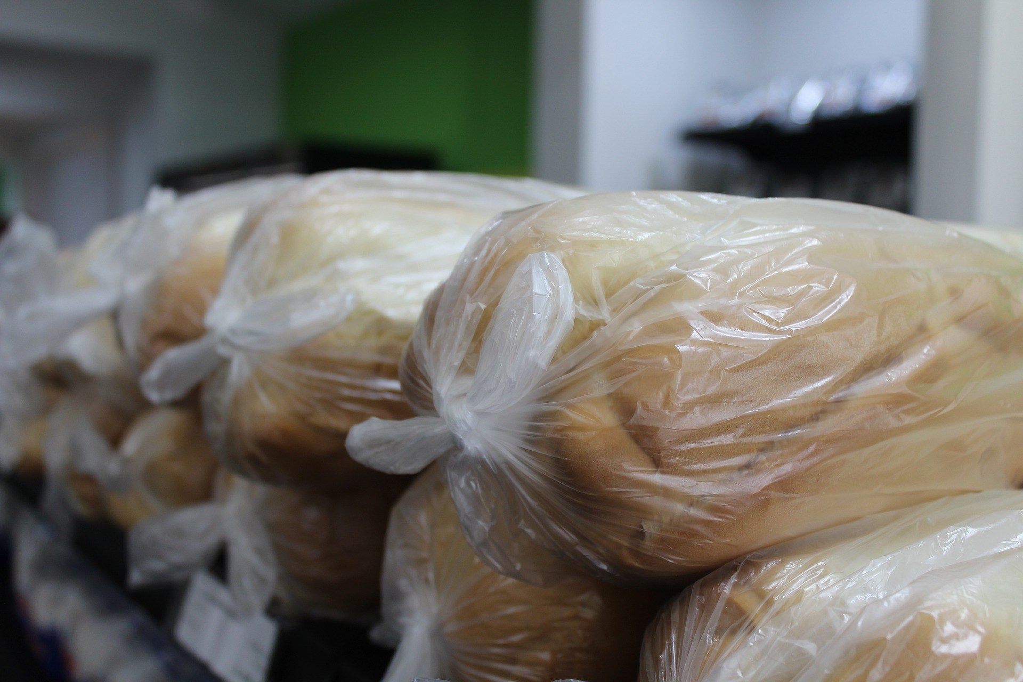
The history of bread making
Bread is one of the most highly consumed foods in the UK with nearly 11 million loaves sold each day.
However, bread has not always been available in the way in which it is now and there are a number of key steps, and people, that are important in helping produce bread from the raw ingredients.
Flour & Bread Consumption, Nabim

Slide 3
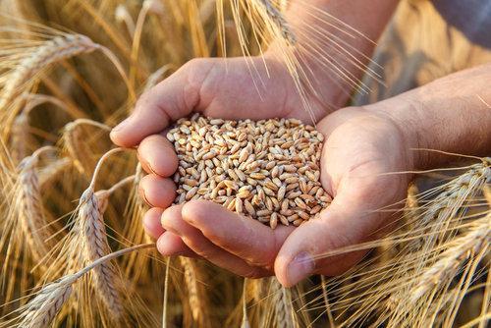
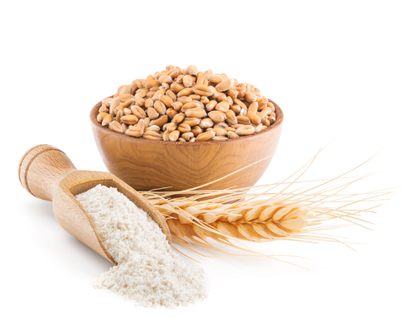
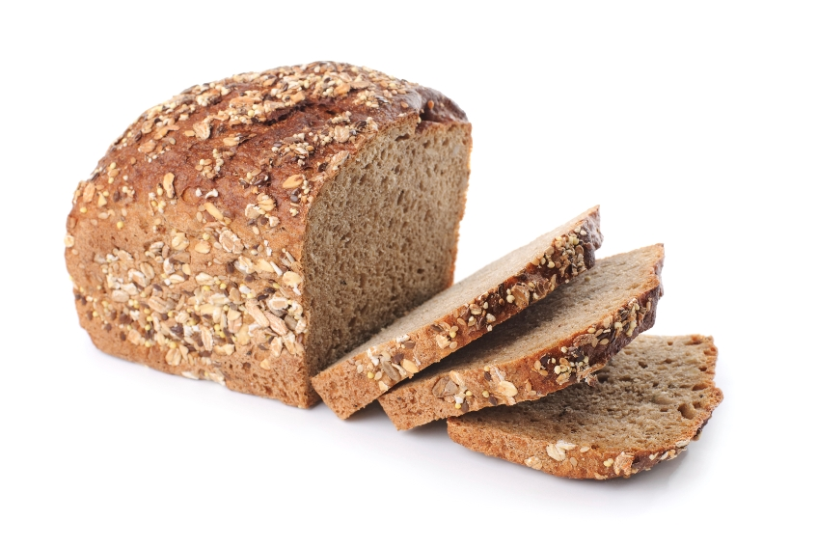
The history of bread making
It is estimated that bread has been around for tens of thousands of years and has been an important food to a number of civilisations.
However, the bread from this time was very different to how it is now.
The next slides show some of the progression of bread.
A Brief History of Bread

Slide 4
Prehistoric bread
Although mixtures of water and grains were eaten in prehistoric times, it was the idea to start cooking this mixture that formed the early versions of bread.
Although there is some argument as to when exactly this was, there is certainly evidence of bread that is thousands of years old.
A Brief History of Bread

Slide 5
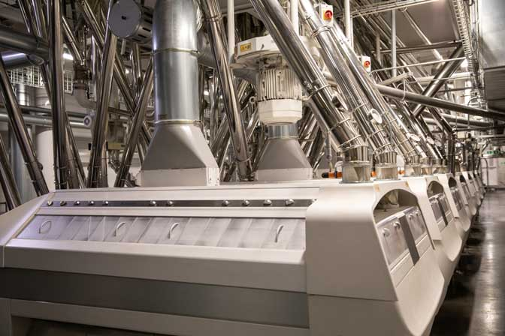
Milling
In modern day bread making, milling wheat to make flour is an important part of the bread making process.
The basic principles of milling were incorporated around three thousand years ago, when two flat, circular stones were stacked on top of one another and used to grind the grain.
A Brief History of Bread

Slide 6
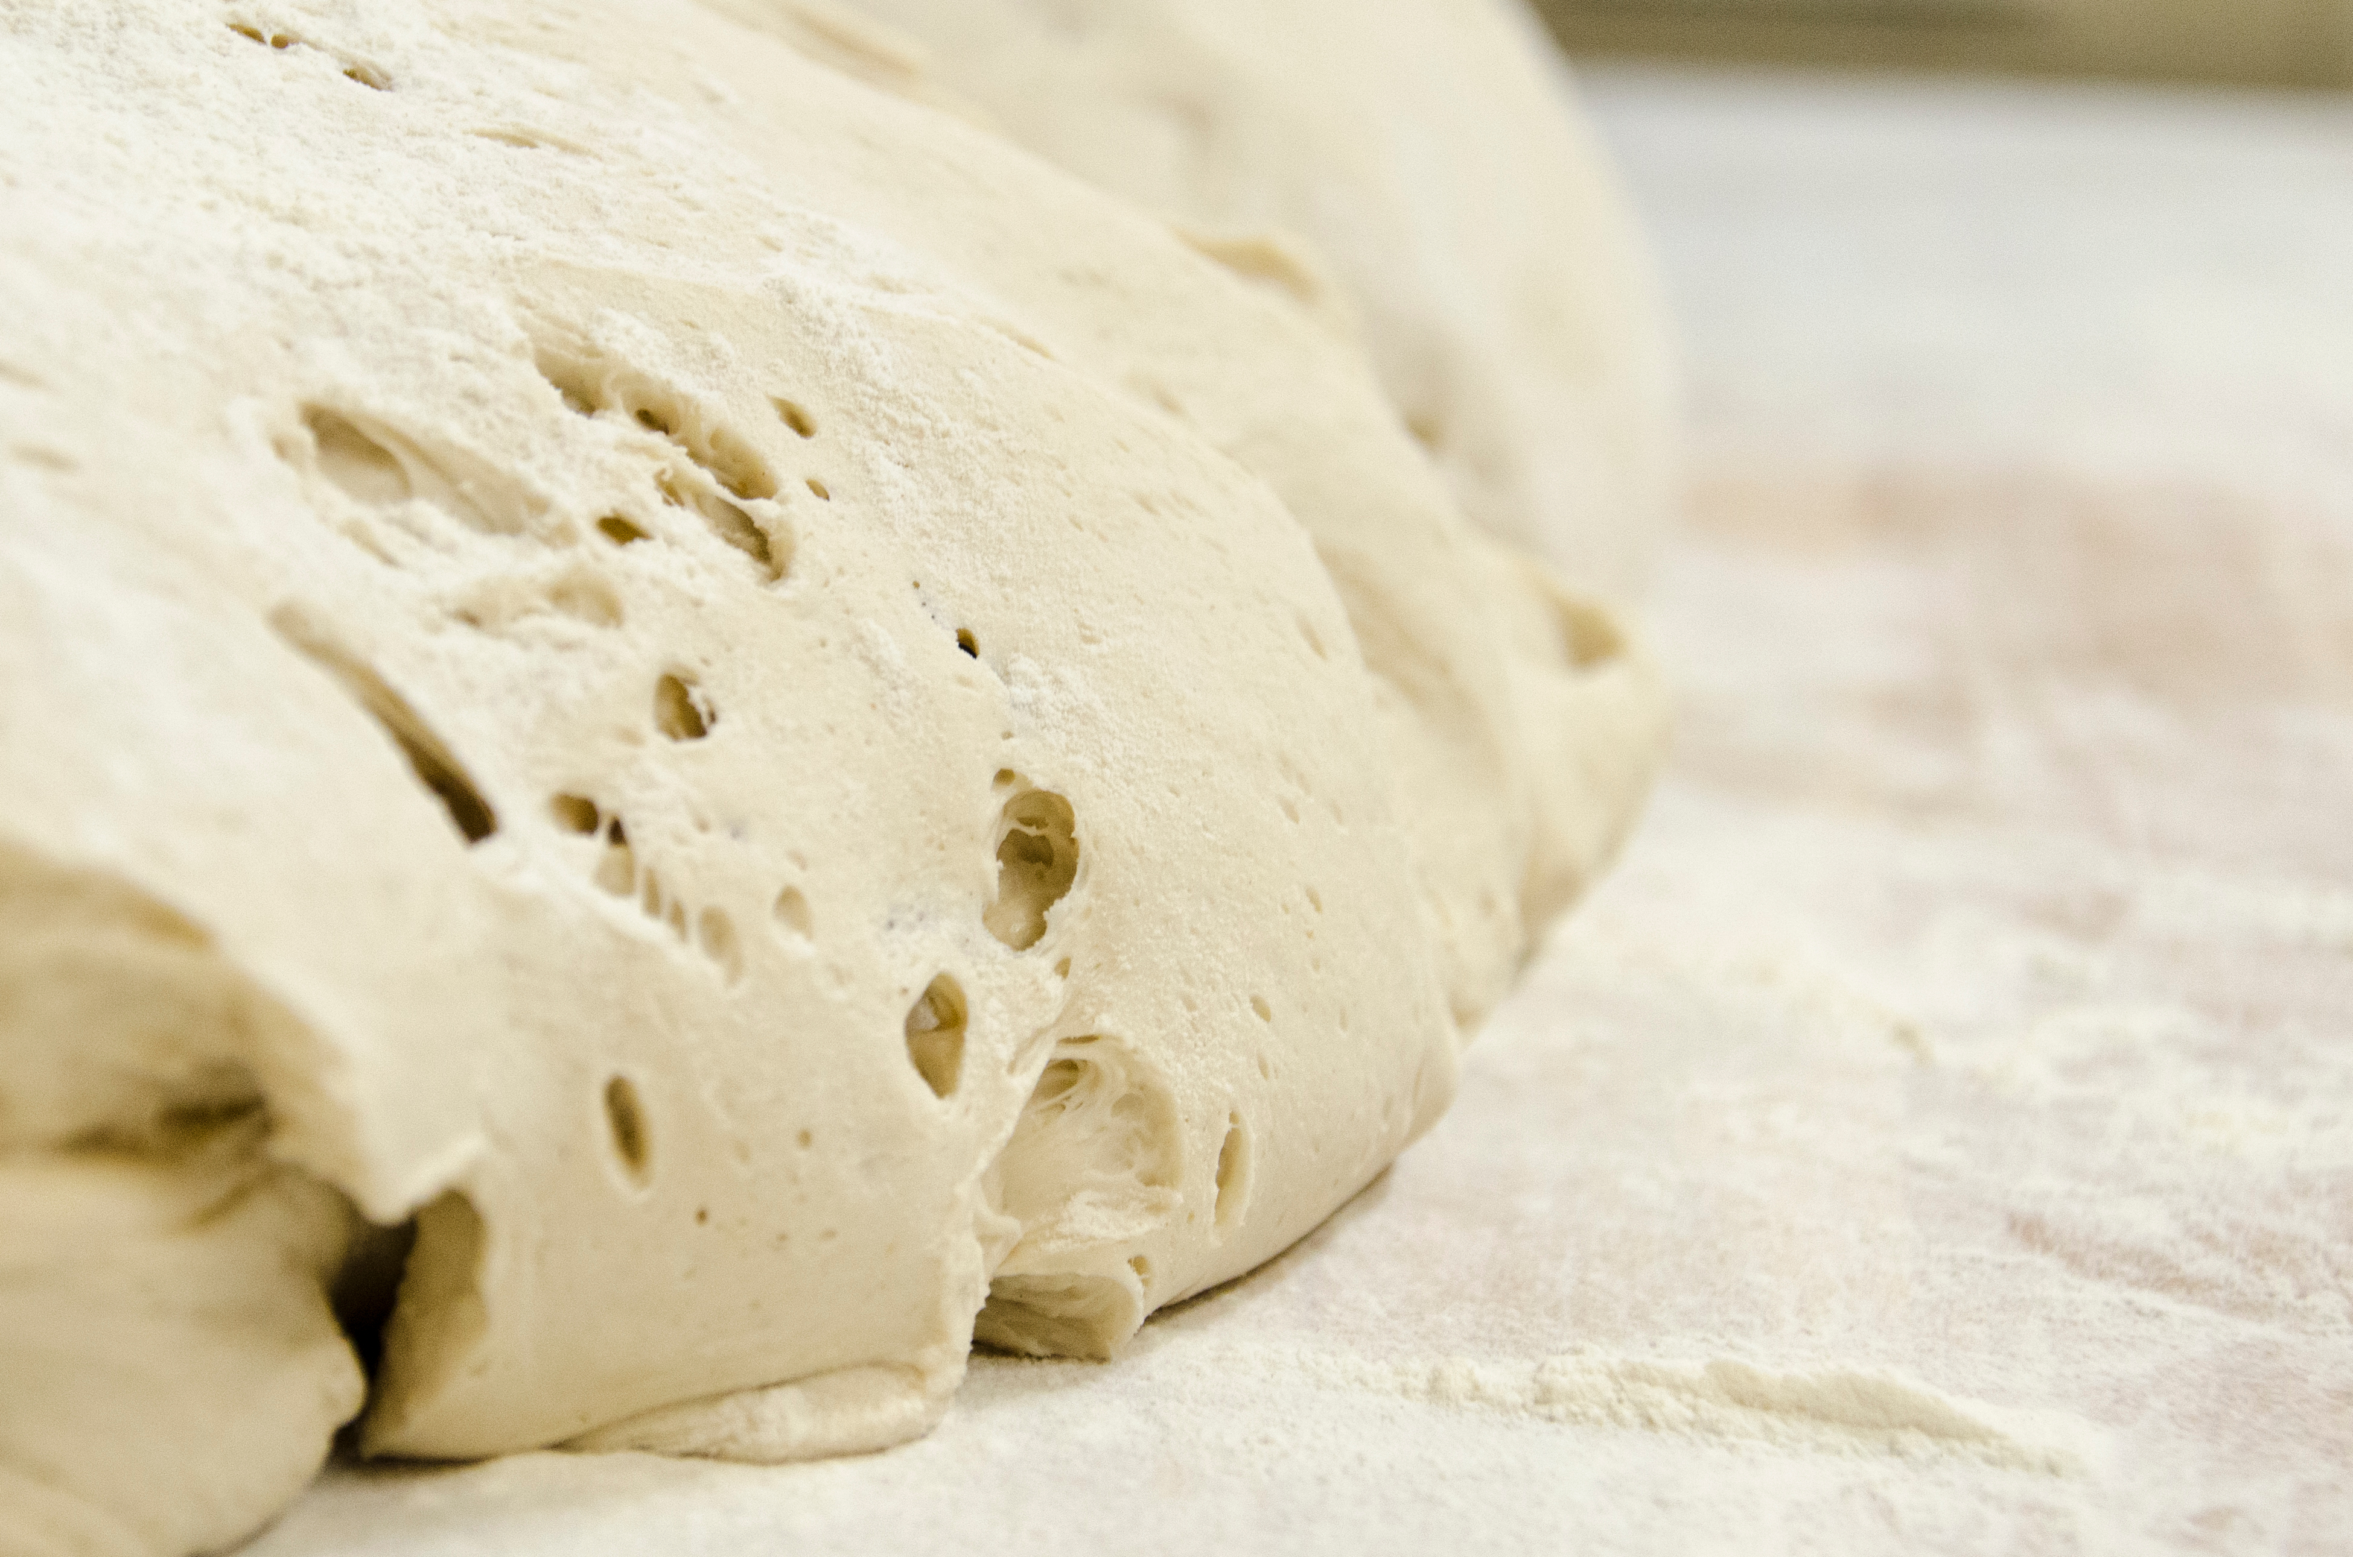
Using yeast
One of the defining characteristics of modern bread is the use of yeast to help it rise.
However, whilst this method may seem modern, there is evidence of making bread using yeast that dates back to the ancient Egyptians in around 300BC.
A Brief History of Bread

Slide 7
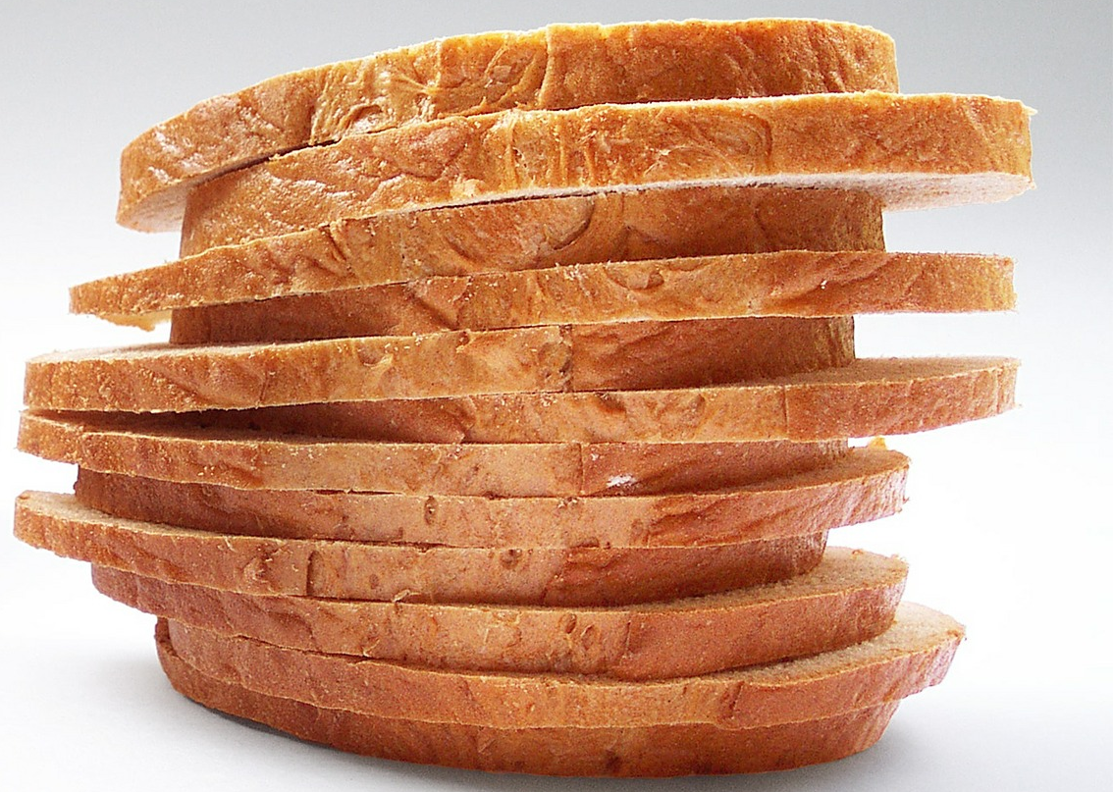
The best thing since sliced bread
When you buy a loaf of bread in the supermarket, it is usually sliced. However, this has not always been the case.
The first bread slicing machine was created in 1928 in America although, sliced bread was not sold in the UK until 1930. During the second world war, bread was again not sliced to save money.
It was then reintroduced in 1950.

Slide 8
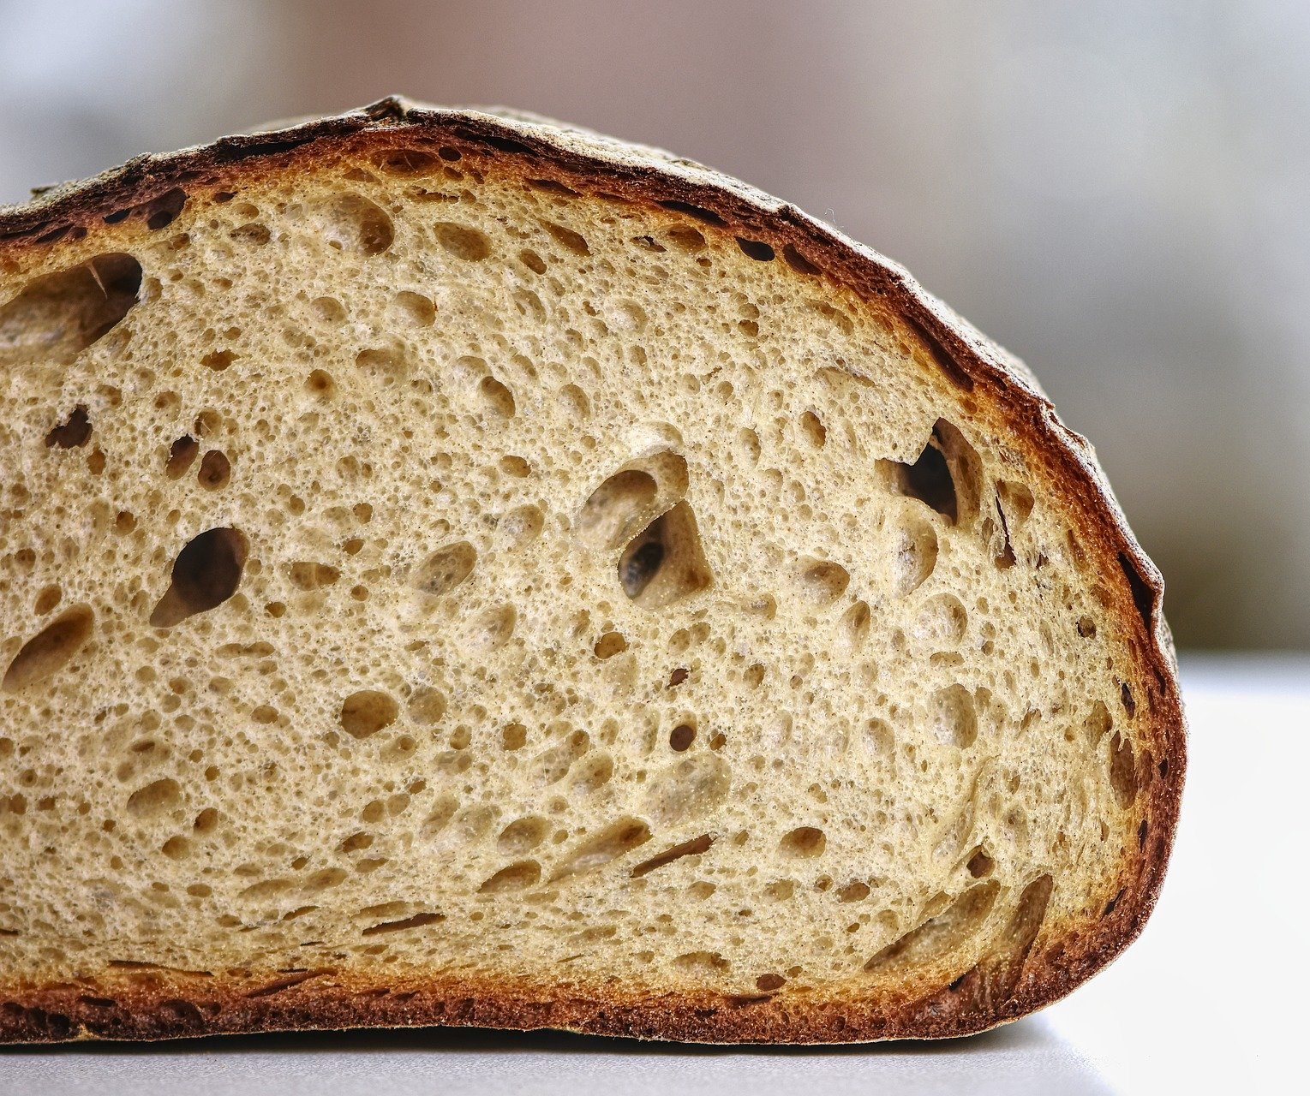
The national loaf
In 1942, the ‘national loaf’ was introduced into the UK. This was a government regulated loaf of bread that was made from brown flour, using about 85% of the grain. For reference, Wholemeal uses 100% and white flour about 78% of each grain.
It was similar to a brown loaf and was introduced to make the best use of scarce grain in the second world war.
The national loaf was abolished in 1956.

Slide 9
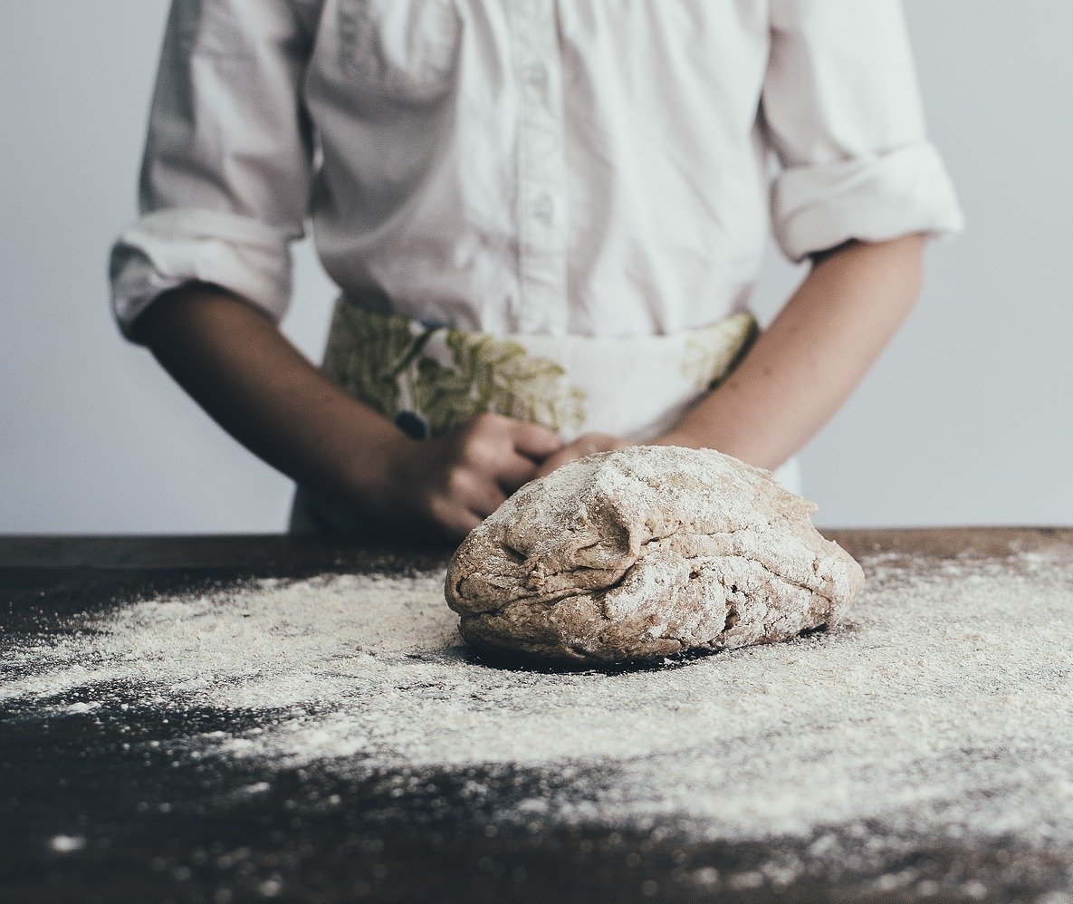
Traditional bread making
Even the way bread is made has not always been the same.
In the traditional process, although the same basic ingredients are used, there was a longer and slower fermentation process.
This meant that traditional bread making was a slow process that required bakers to work long hours and would not be able to keep up with the modern demand for bread.

Slide 10
The Chorleywood Bread Process
Arguably the largest change to the bread making process was the invention of the Chorleywood bread process, which was developed in 1961.
This process differed from previous processes in the speed it took to complete. Changes in the mixing speed meant that the fermentation process could be reduced to just one hour and the overall process was less than four hours.
This meant that larger scale bread production was possible and there was a reduced cost of production. It also meant that bread could be produced with a longer shelf life.

Slide 11
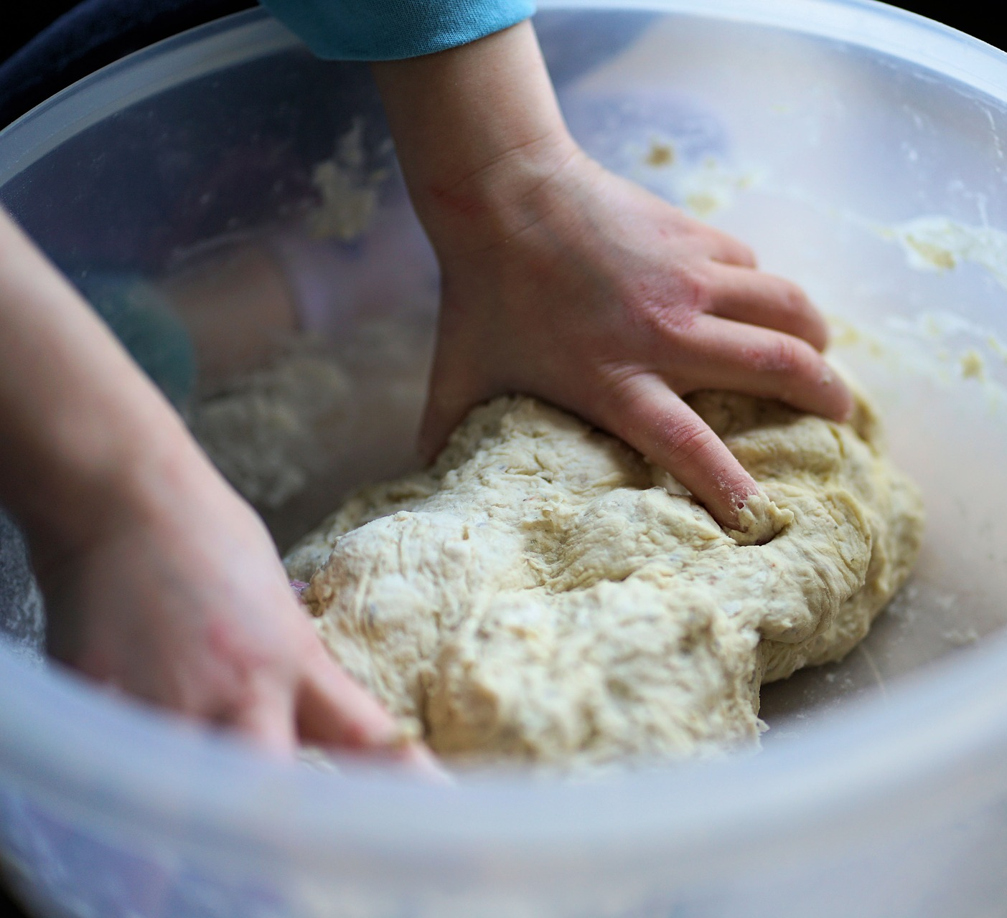
Bread and Flour regulations
As bread is such a staple food in the UK, vitamins and minerals are added to flour to try and increase our intakes.
White flour was first fortified with calcium in the UK in 1941 to prevent rickets. Now, the Bread and Flour regulations state that some micronutrients must be added to all white and brown flour.
These micronutrients are calcium, iron, thiamine (vitamin B1) and niacin (vitamin B3).

Slide 12
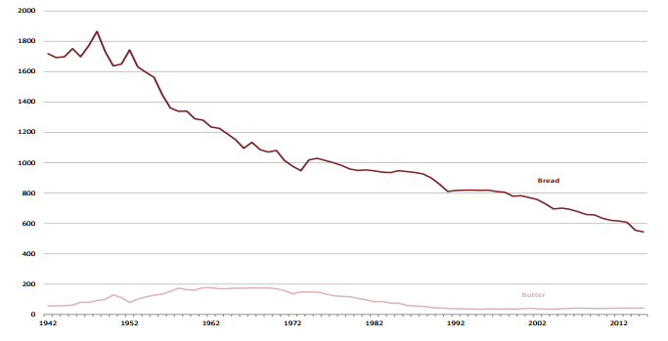
The decline of bread purchasing
There has been a decline in purchasing of bread in the UK. In 1945, 30% of household energy intake was from bread.
However, as there has been a rise in a number of convenient alternatives and due to changing buying patterns, this reduced to 11% in 2014.
The graph on the right shows the reduction in the amount of bread people are buying.
Discuss some reasons why you think this might be happening.
UK purchases of bread and butter, 1942 – 2015 (grams per person per week)
Family Food survey 2015

Slide 13
The history of bread making
For further information, go to:
www.foodafactoflife.org.uk

