Slide 1
Bread production

Slide 2
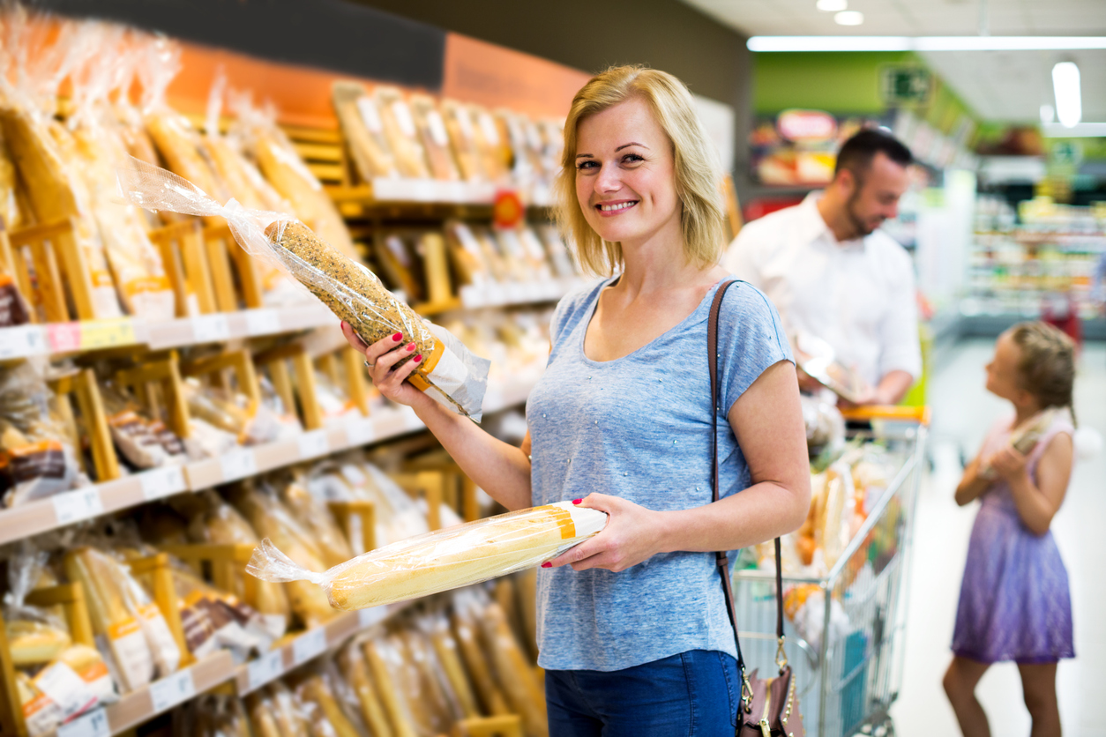
Our daily bread
Bread is bought by 99.8% of British households, and the equivalent of nearly 11 million loaves are sold each day.
Approximately 60-70% of the bread we eat is white and sandwiches are thought to account for 50% of overall bread consumption.
Average bread purchases are the equivalent of 60.3 loaves per person per year.

Slide 3
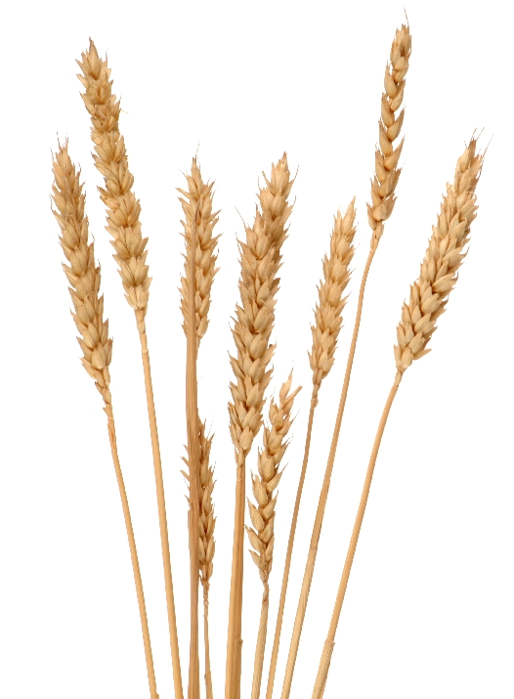
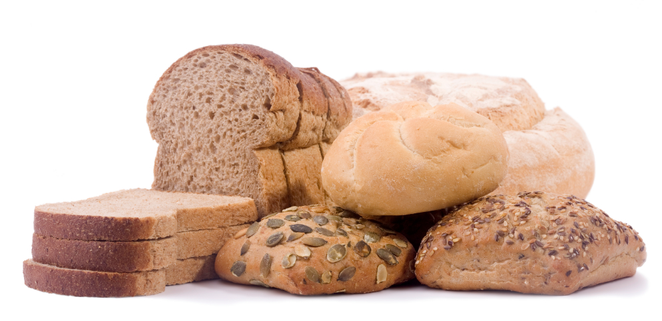
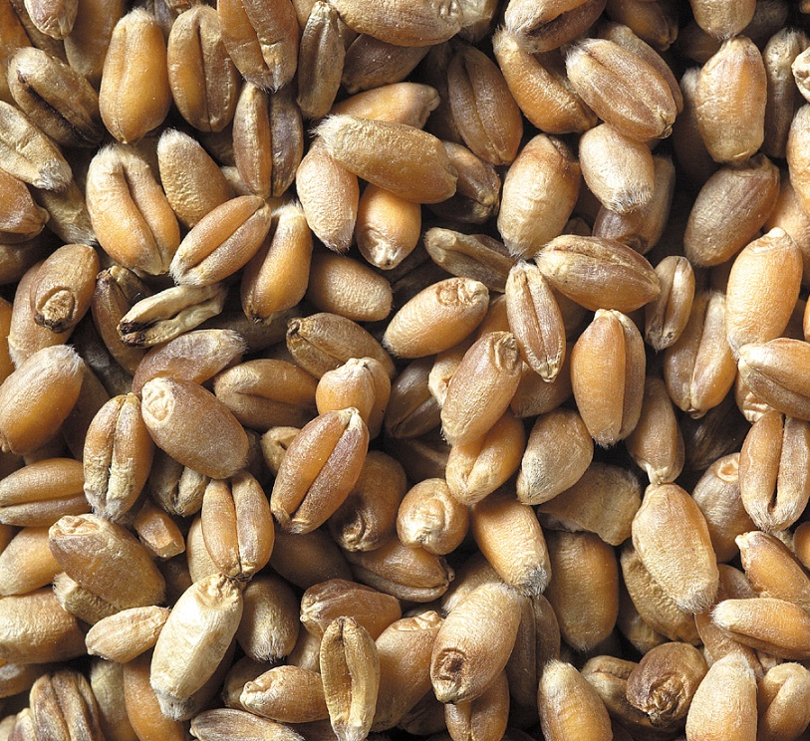
Milling
Bread is made from flour so, the important first step of producing bread is to make the flour.
The person who does this is called the miller.
Their job is to grind wheat grain in a mill to make flour.

Slide 4
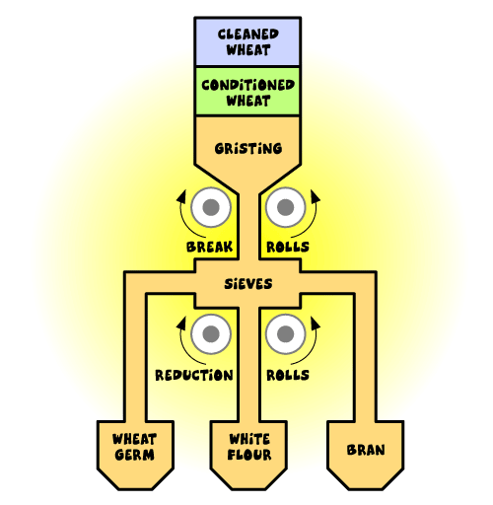
The milling process
The milling process involves putting the wheat into a mill. The wheat is then pulled apart as it passes through two steel rollers which run at different paces.
The broken down wheat grain then passes through a sieve which sorts the particles into: white flour, wheat germ, wheat feed and bran. This flour can then be used for making bread.
It is estimated than around 60% of flour produced by UK millers is used for bread making.
The Milling Process, Nabim

Slide 5
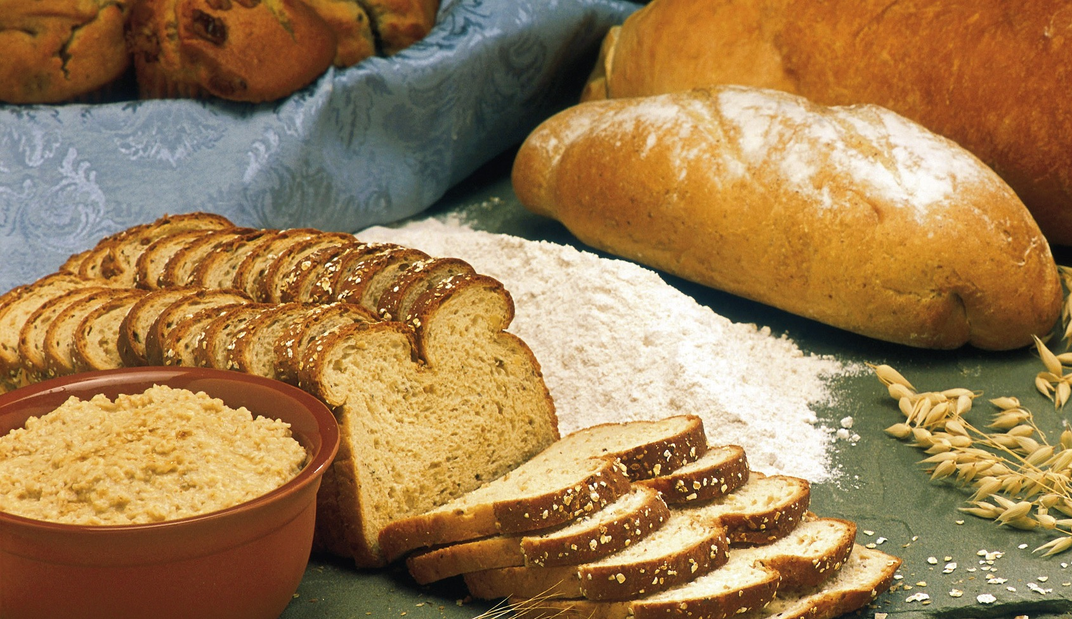
Making bread from flour
The three main types of flour produced are:
white flour;
brown flour;
wholemeal flour.
The Bread and Flour regulations state that calcium, iron, thiamine (vitamin B1) and niacin (vitamin B3) must be added to all white and brown flour.

Slide 6
The Chorleywood Bread Process
The process that is now used for making most bread is the Chorleywood bread process which was developed in 1961.
This process differs from previous processes in the speed it takes to complete. Changes in the mixing speed means that the fermentation process could be reduced to just one hour and the overall process to less than four hours.
This means that larger scale bread production is possible and the cost of production is reduced. It also means that bread could be produced with a longer shelf life.
Chorleywood Bread Process, Nabim

Slide 7
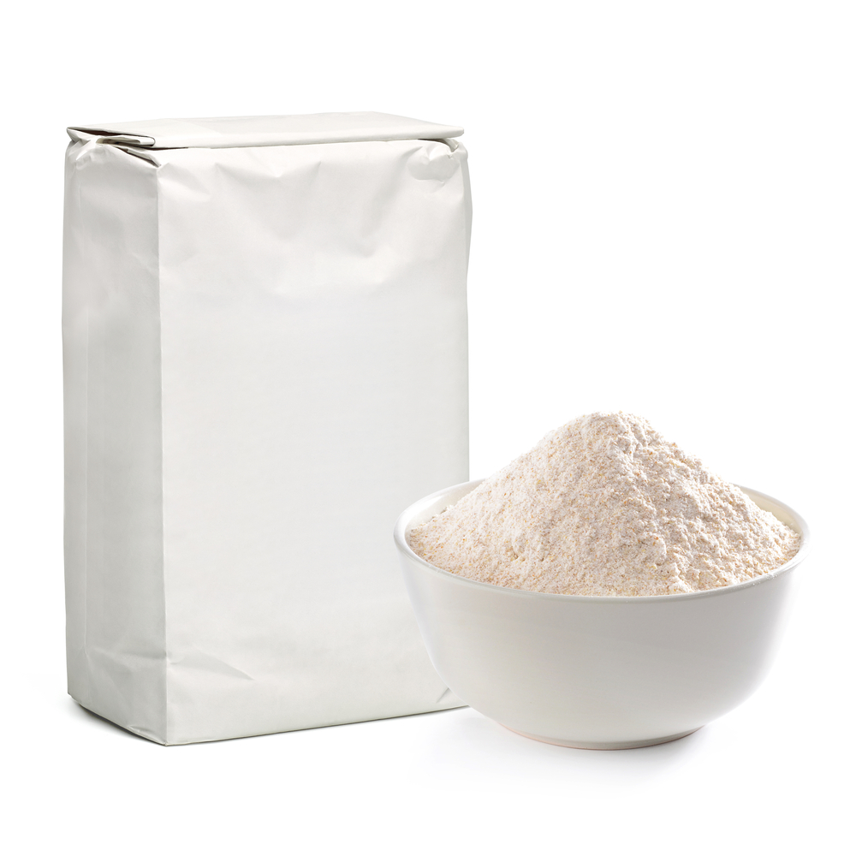
Ingredients
The main ingredients to make a basic loaf of bread are flour, water, yeast and salt.
Either fat or emulsifiers, and vitamin C are also often added to the bread to help to stabilise the bubbles in the dough.
These are the key ingredients used in the Chorleywood bread process.
Chorleywood Bread Process, Nabim

Slide 8
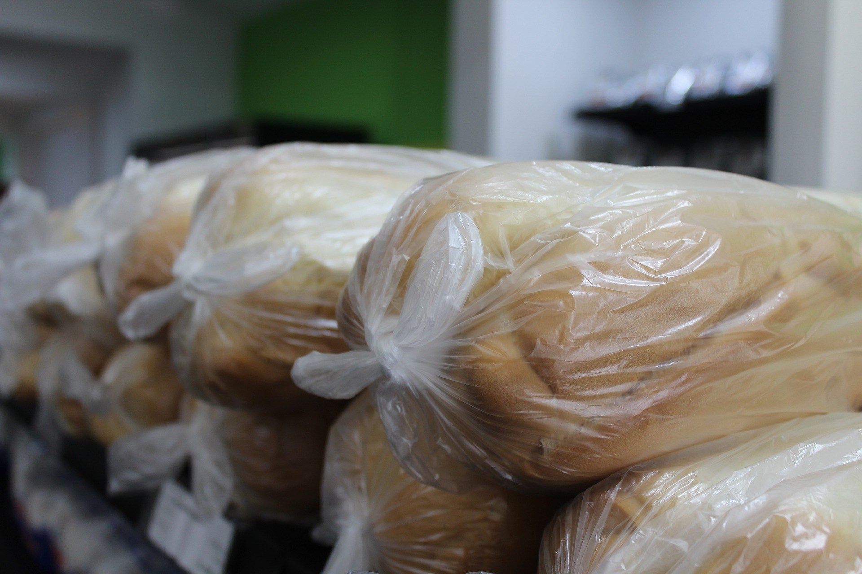
The process
Bread making consists of four main stages:
Mixing
Proving/Fermenting
Baking
Cooling
The total time to complete all of these steps is around 3 hours 45 minutes as the mixing stage is much faster in the Chorleywood process than in traditional means.
Chorleywood Bread Process, Nabim

Slide 9
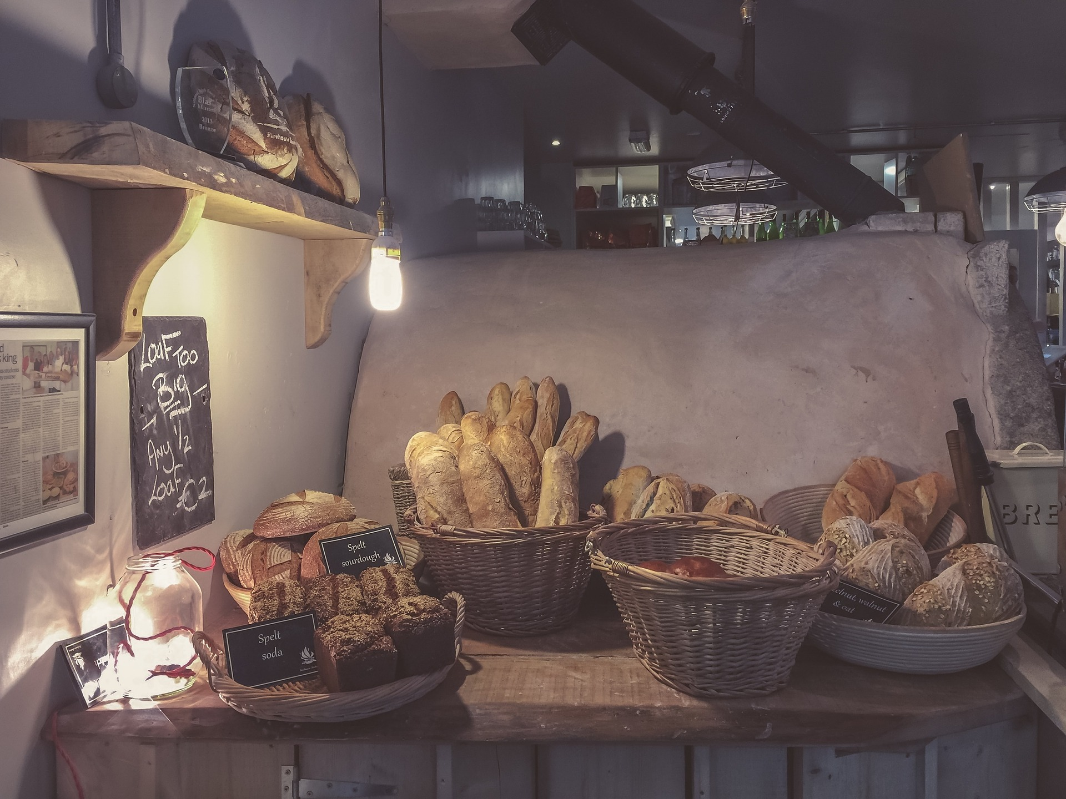
Mass production and artisan
Although there are still traditional bakers producing artisan bread, the majority of bread bought in the UK is mass produced bread.
This mass produced bread is made using the Chorleywood bread process.
Instead of using this modern system, traditional bakers will knead the bread by hand and use traditional processing techniques. Traditionally made breads tend to have a longer fermentation time and therefore take longer to make.

Slide 10
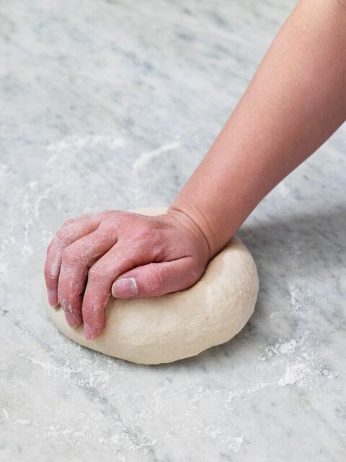
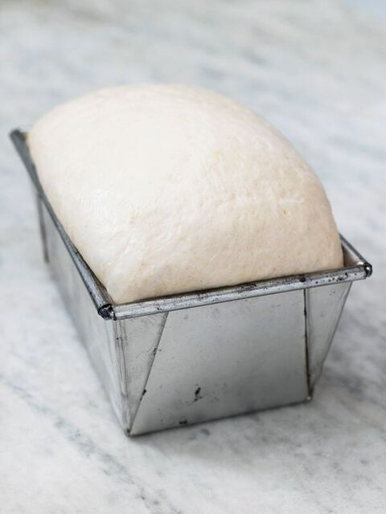
Home-made bread
Even the bread people make at home follows the same processes and ingredients. The main ingredients to make bread at home are flour, salt, water and yeast.
Lots of people make their own bread at home.

Slide 11
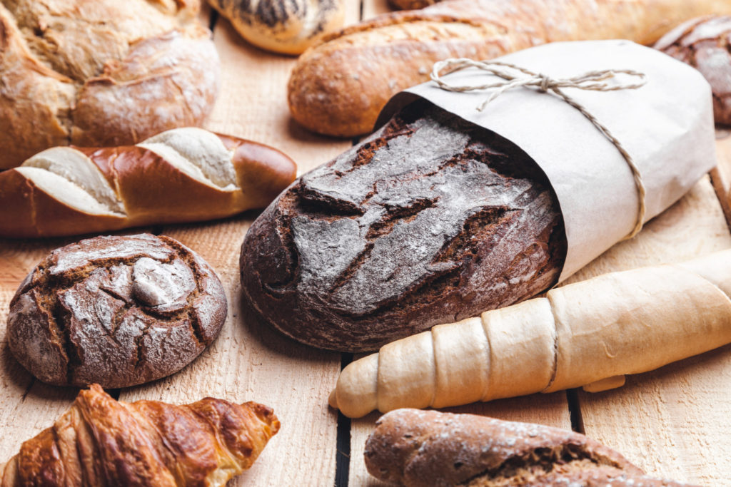
Bread facts
Over 200 different kinds of bread are produced in the UK – from butter rich brioche and crisp baguettes to farmhouse loaves and focaccia, soft ciabatta and crumpets to chapattis and flaky croissants. This diversity is only possible because of the vast range and quality of British flour available.
Sandwiches account for 50% of bread consumption; whether bought or made-at-home.
Despite being a staple food in the UK for centuries, bread consumption has fallen steadily over the last few decades. Average consumption per person now equates to only around 2-3 slices of bread a day.

Slide 12
Bread production
For further information, go to:
www.foodafactoflife.org.uk

